Slide 1
Movie Plot
3 Act

Slide 2
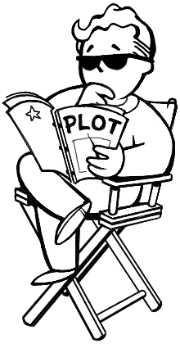
What is PLOT?
What happens

Slide 3
What is a Plot Point?
Important parts of the plot

Slide 4
Act 1: Exposition
Introduction
Who is in the movie?
Where are they?
What are they doing?
Act 1 ends when the first plot point (something happens or changes)

Slide 5
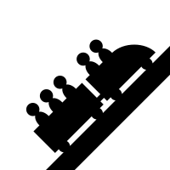
Act 2: Rising Action
The movie gets more exciting
The good guy and bad guy get closer together

Slide 6
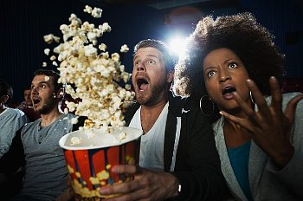
Act 3: Climax
The most exciting part
The big fight
Good guy meets bad guy
Resolution

Slide 7
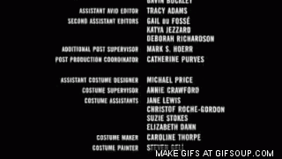
Credits
Opening Credits
Closing Credits

Slide 8
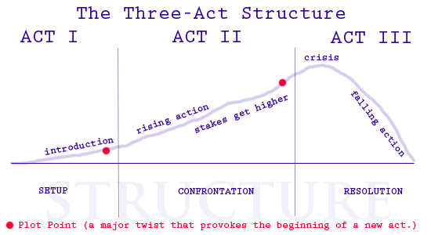

Slide 9
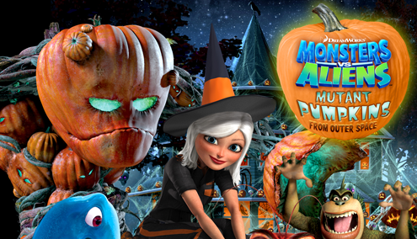

Slide 10
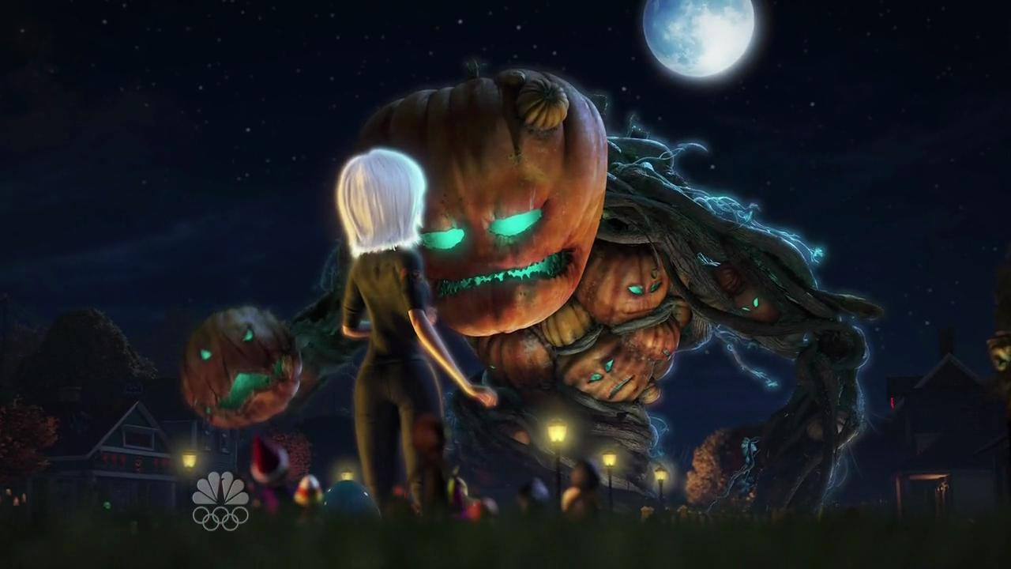
Mutant Pumpkins from Outer Space
Put the plot points into the correct Act.

Slide 11
Act 1: What Happened?
Aliens flush toilets onto pumpkins
The “Monsters” must go to Modesto, California

Slide 12
Act 2: What Happened?
The Monsters are looking for the alien pumpkins
The pumpkins become alive
The monsters and pumpkins start fighting
They give candy to the pumpkins
The pumpkins become one big pumpkin monster

Slide 13
Act 3: What Happened?
The giant pumpkin monster explodes
She punches the head off of the pumpkin giant.
The monsters play with the children

Slide 14
Storyboard
Let’s make our own movie storyboard.

Slide 15
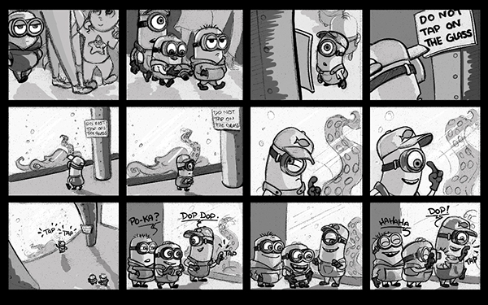
Storyboard
First, we need “Exposition”:
Who is in the movie?
Where are they?
What are they doing?

Slide 16
Storyboard
Now write plot points on the cards
We will draw them to see what happens in our movie.

