Slide 1
Predator vs Prey

Slide 2
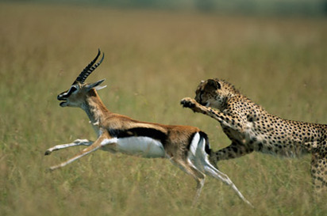
What is a Predator?
It eats other animals.

Slide 3
What is a Prey?
It is eaten by other animals.

Slide 4
________ eats ________.

Slide 5
Predator and Prey
Which is predator?
Which is prey?

Slide 6
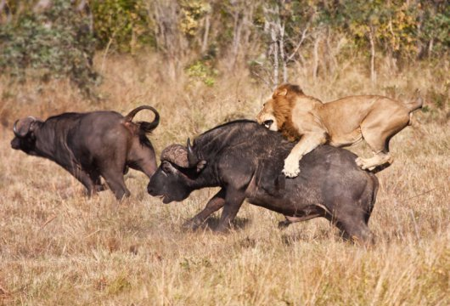

Slide 7
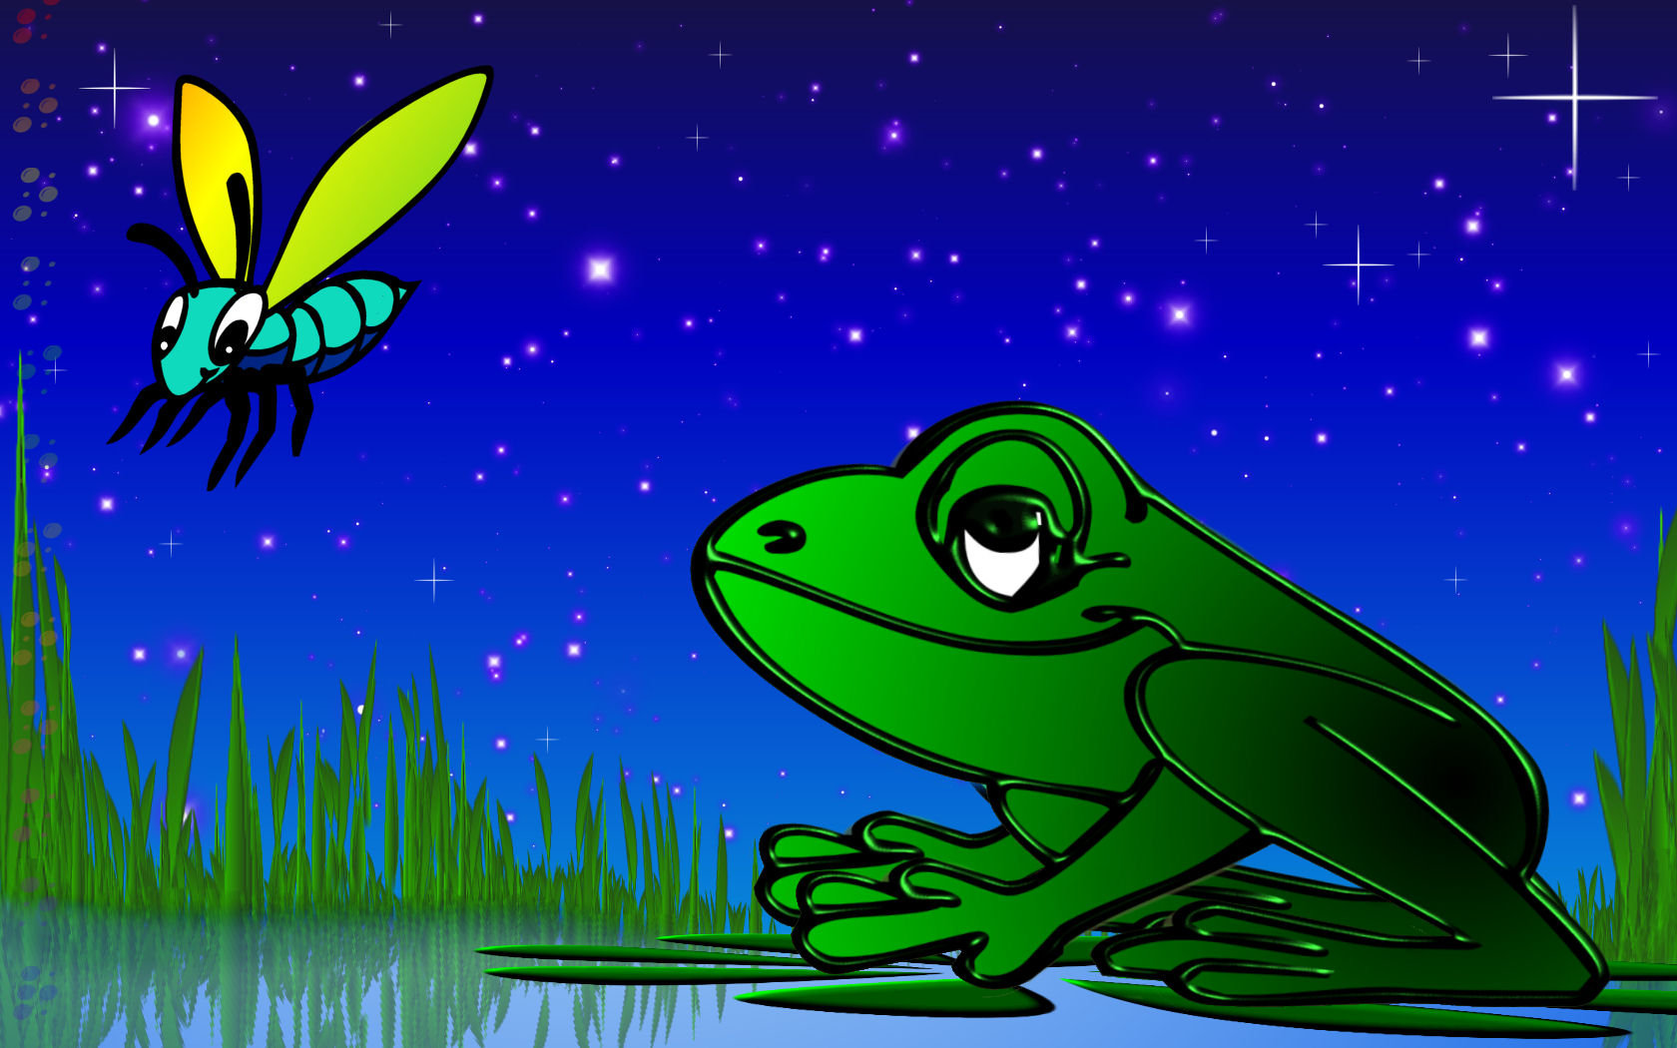

Slide 8
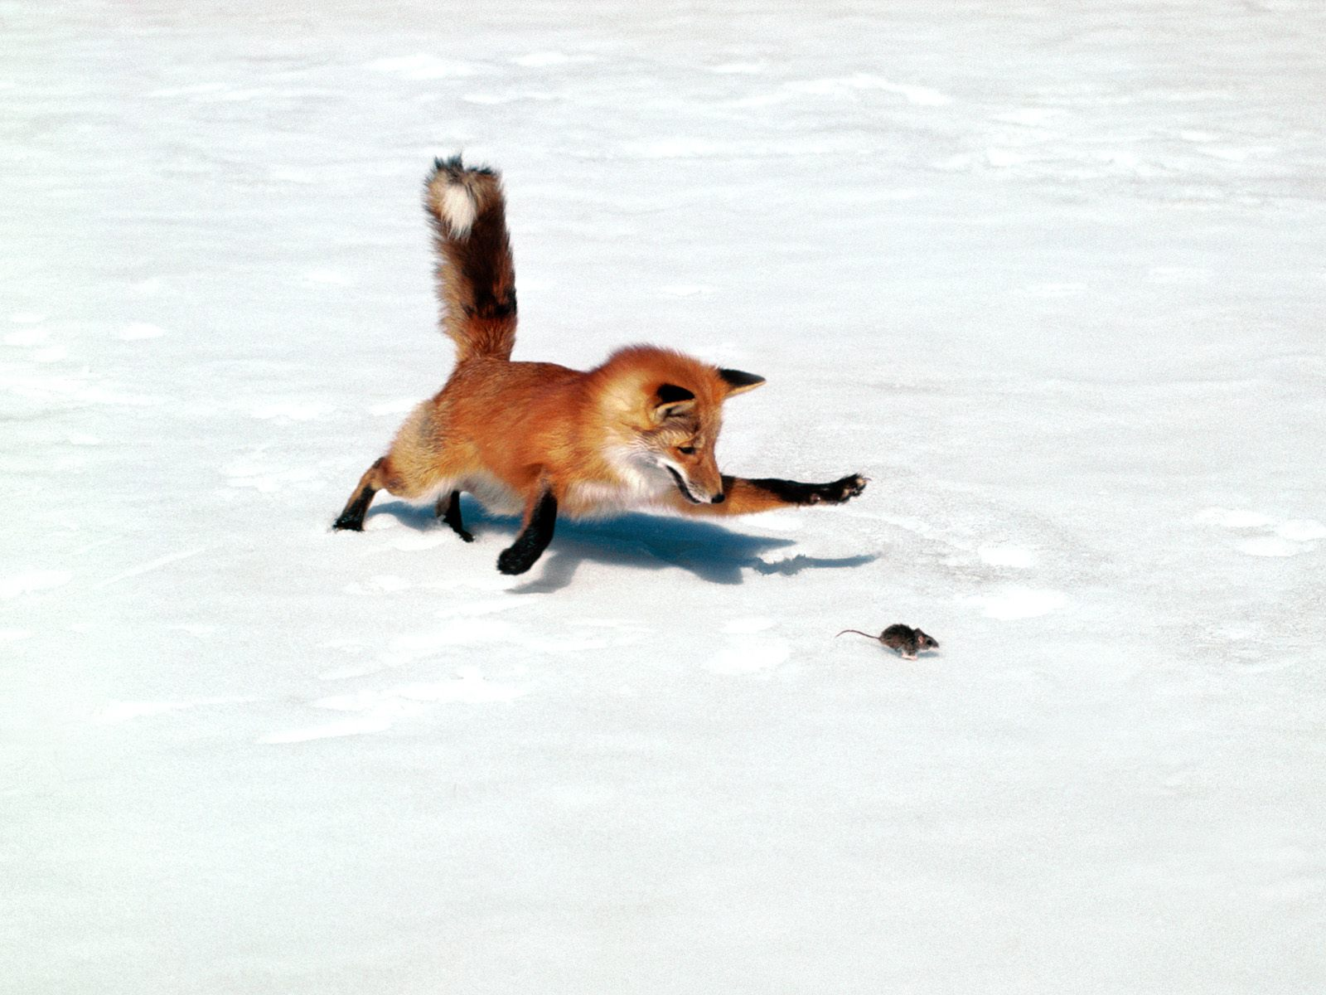

Slide 9
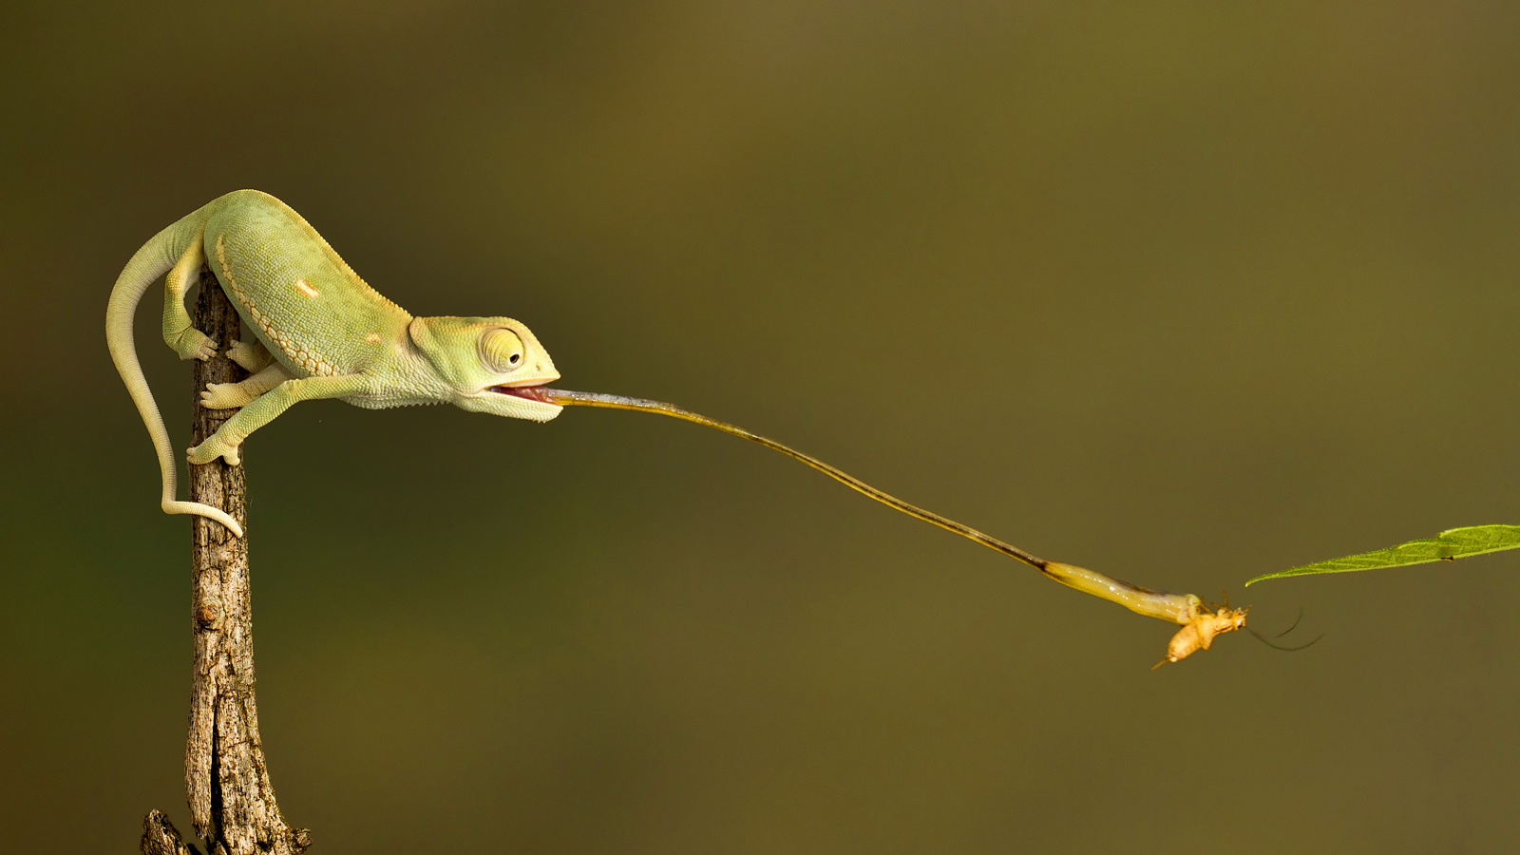

Slide 10
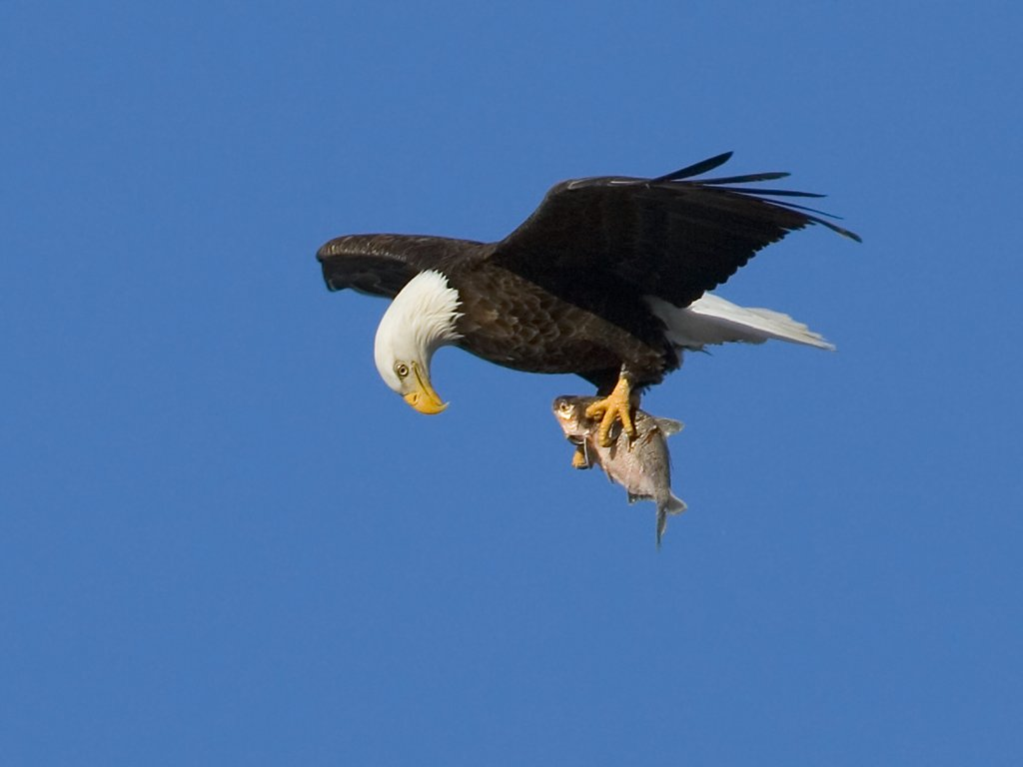

Slide 11
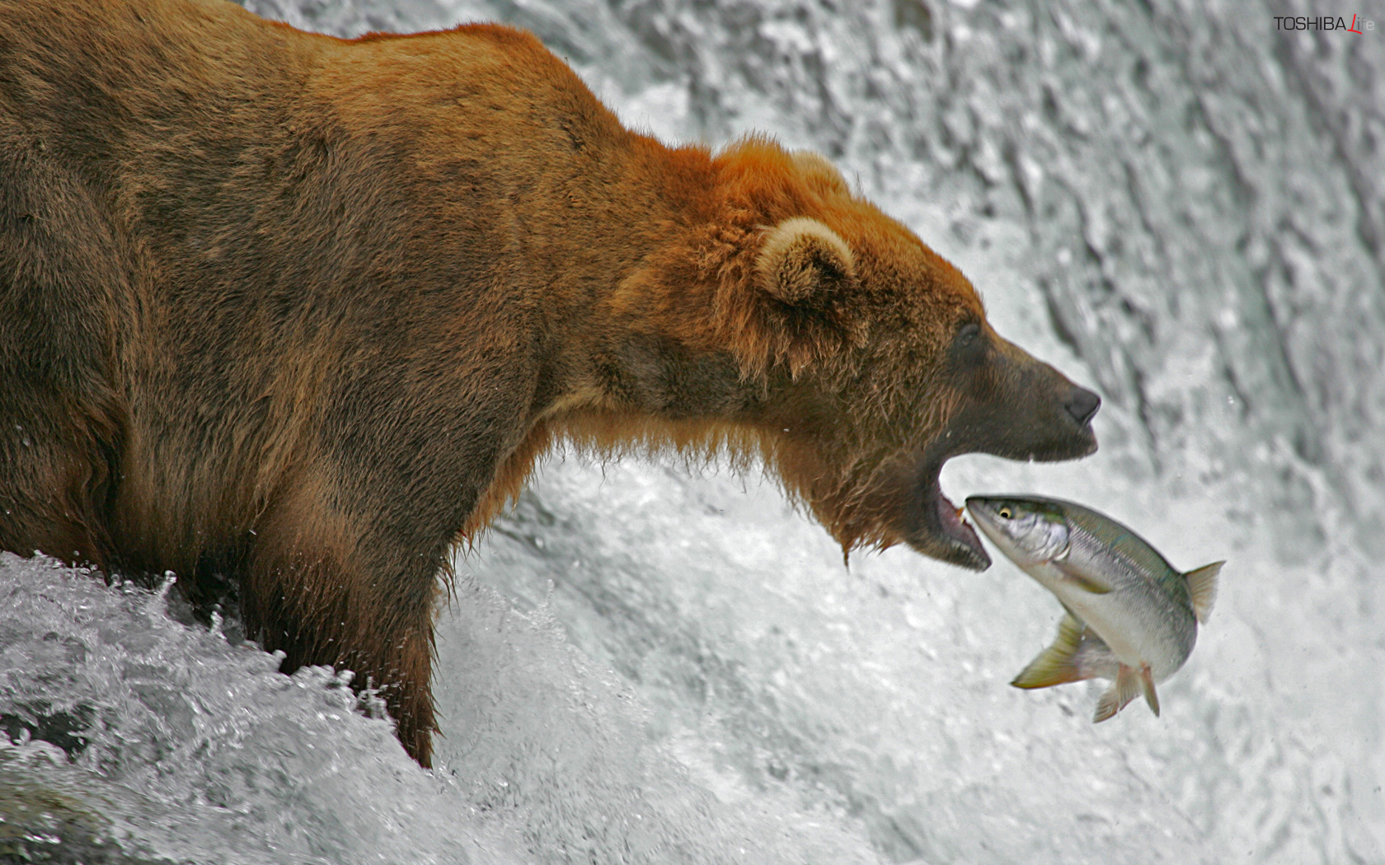

Slide 12
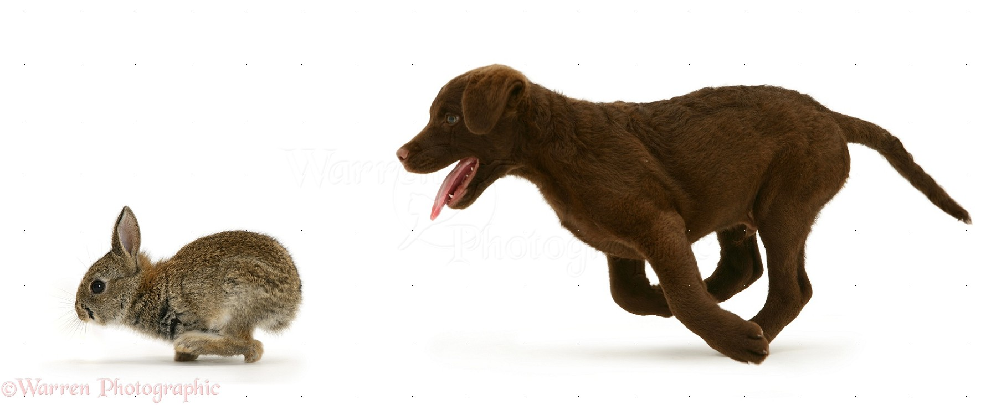

Slide 13
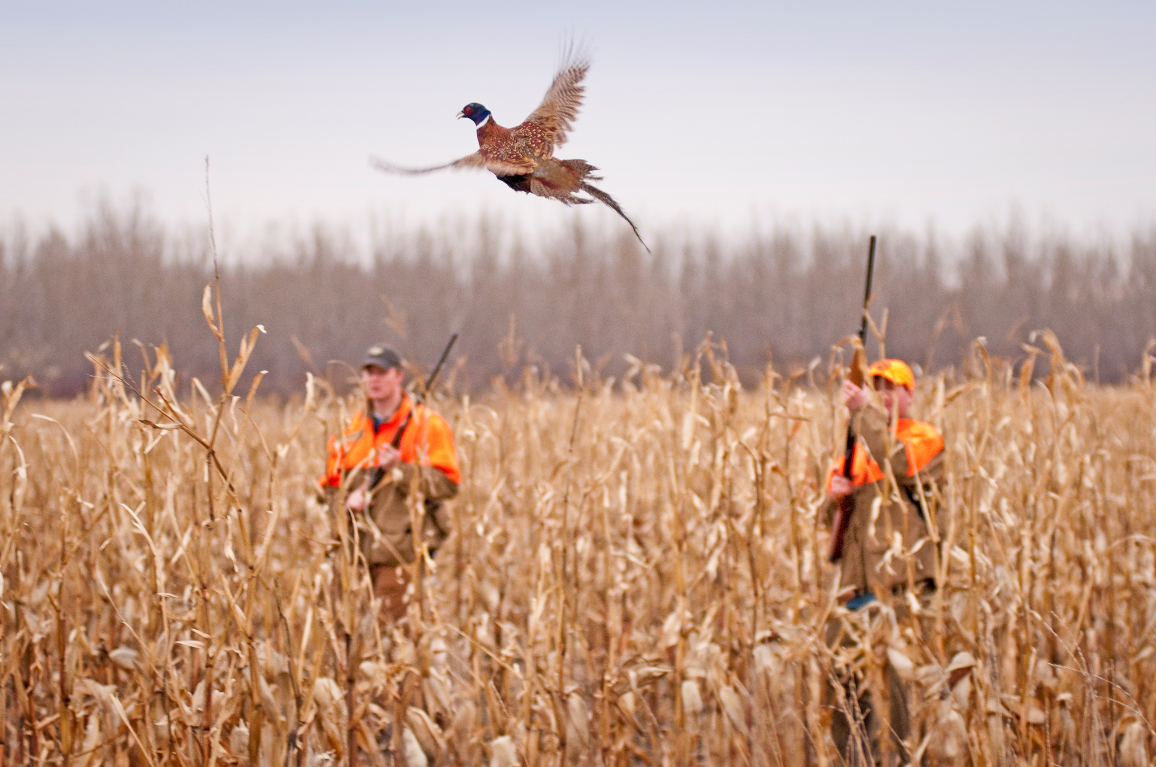

Slide 14
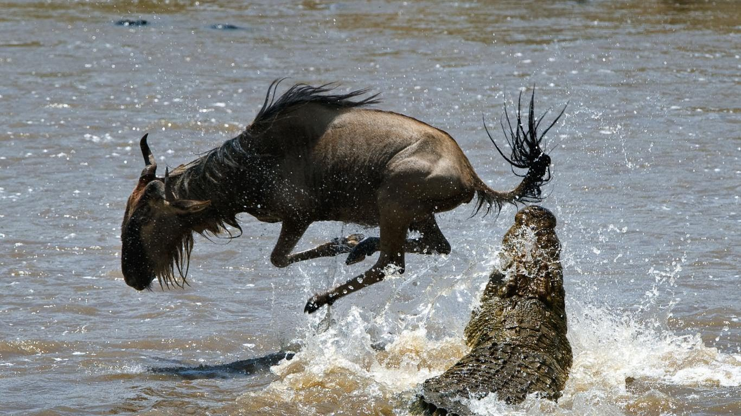

Slide 15
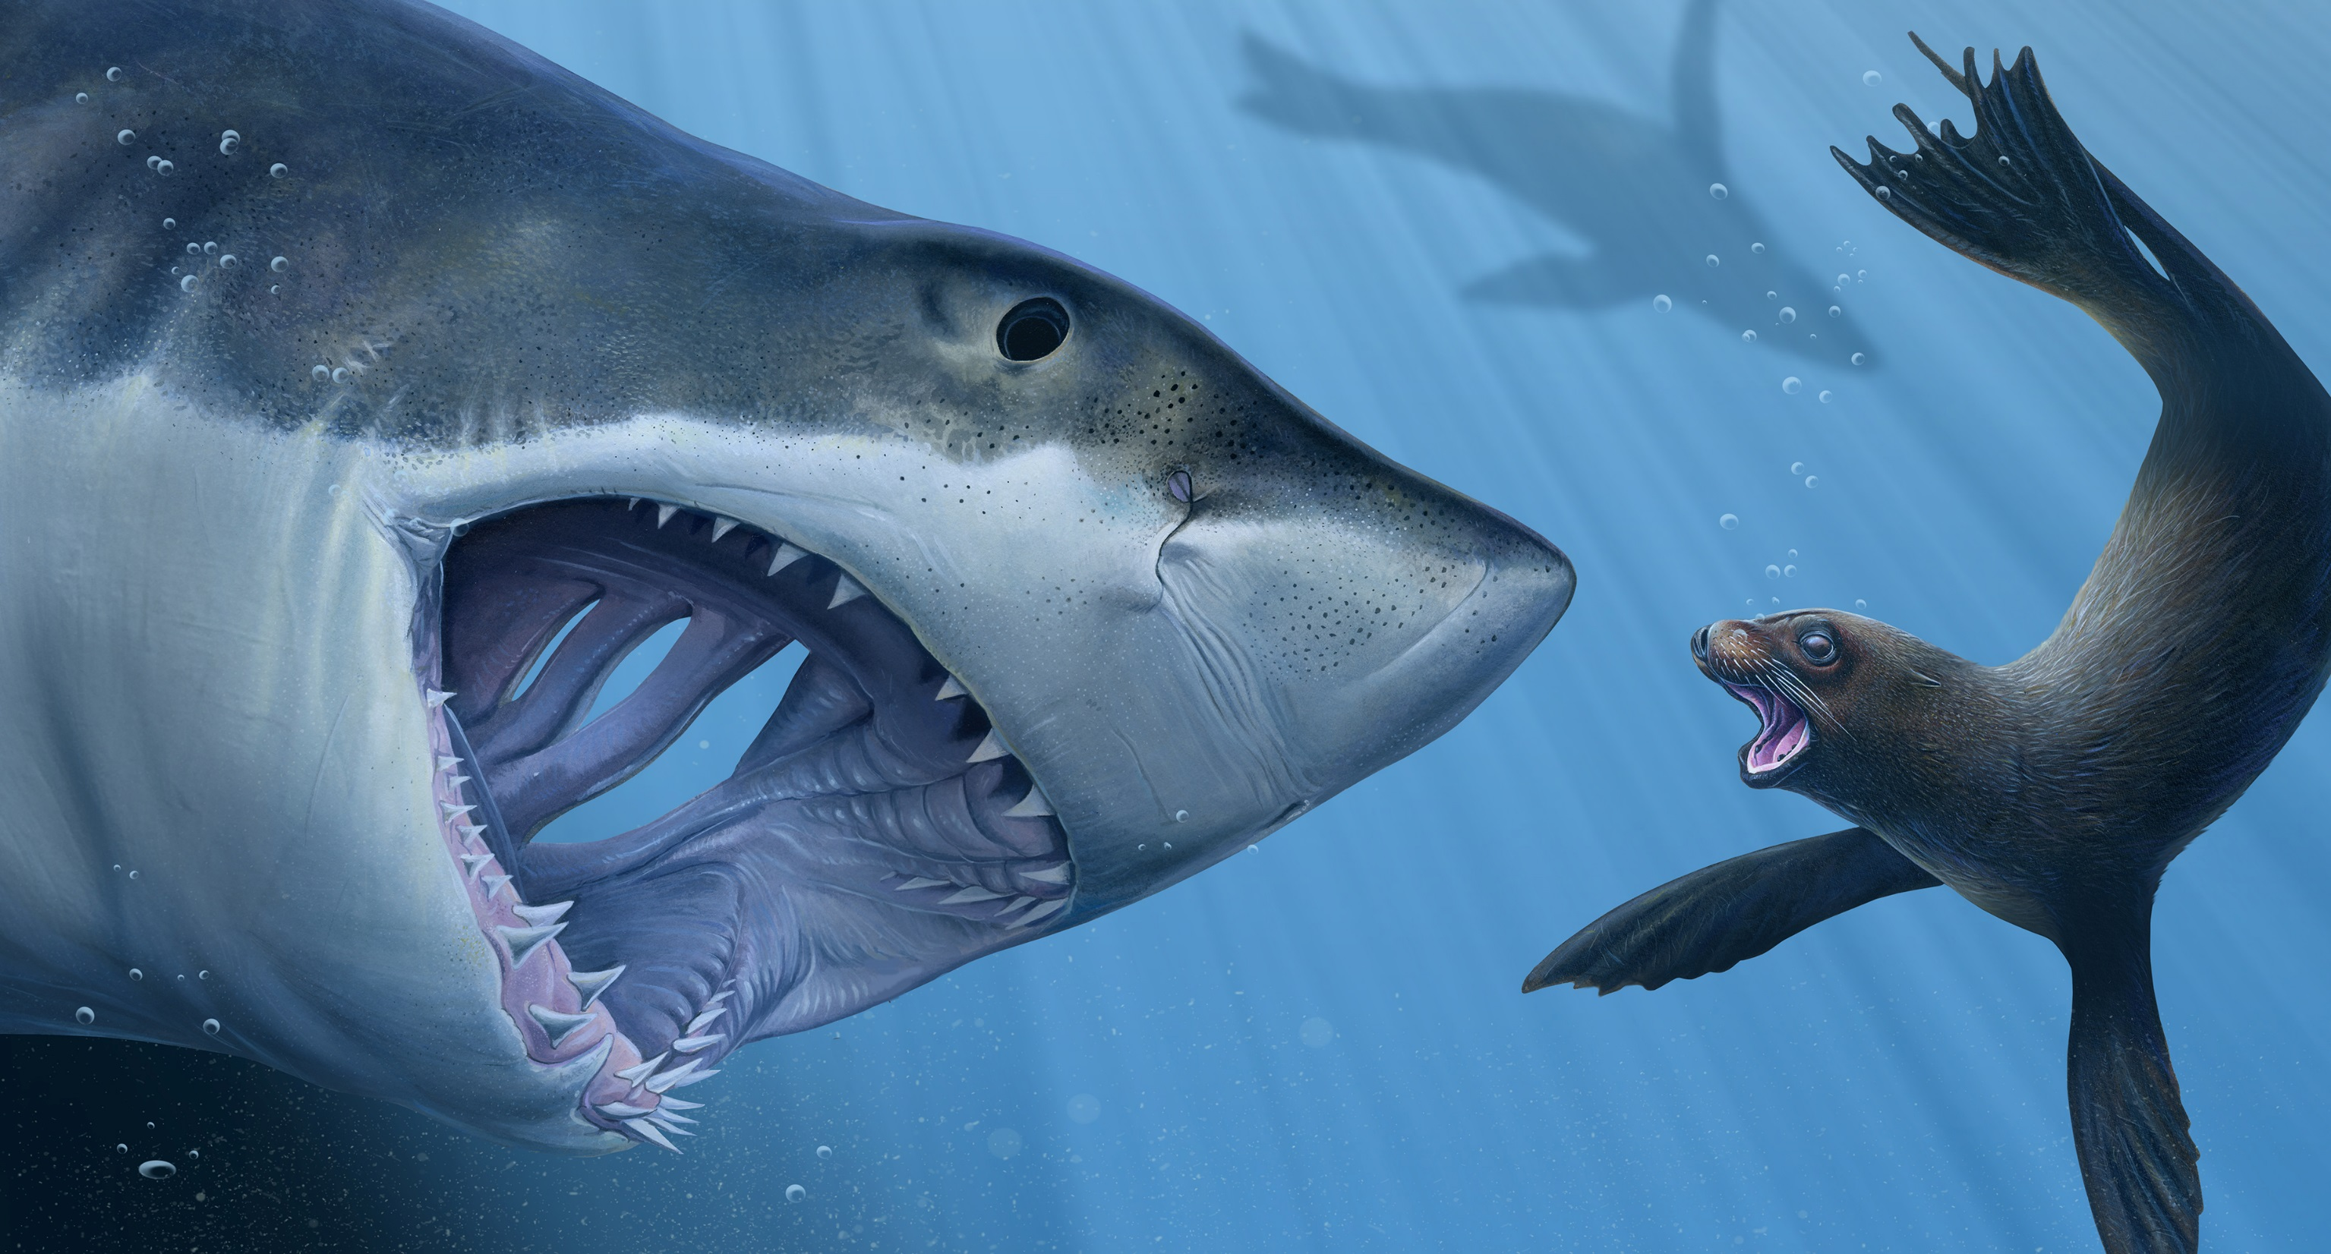
Watch the Video
Answer the Questions
https://www.youtube.com/watch?v=pgYmY6--DjI&t=320s

Slide 16
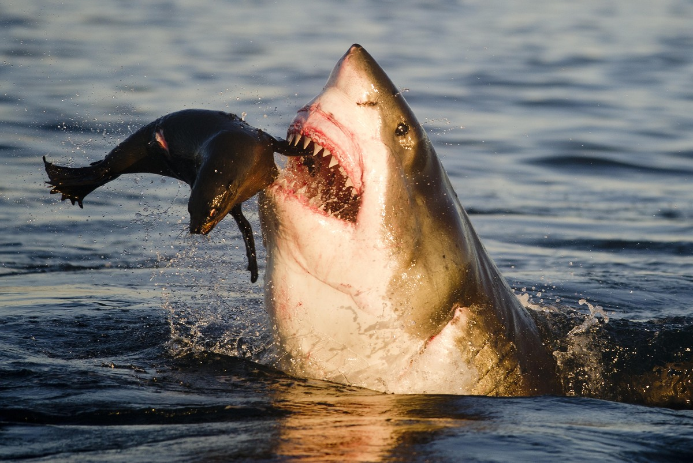
Who is the predator?
Shark

Slide 17
Who is the Prey?
Seal

Slide 18
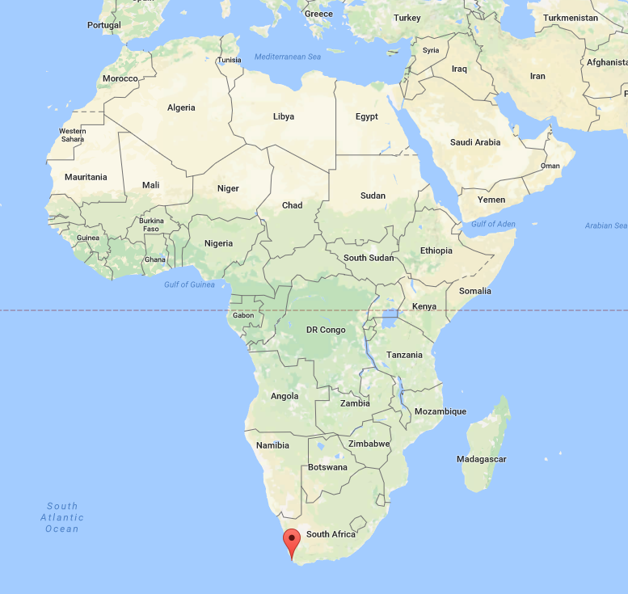
Where is it?
Seal Island

Slide 19
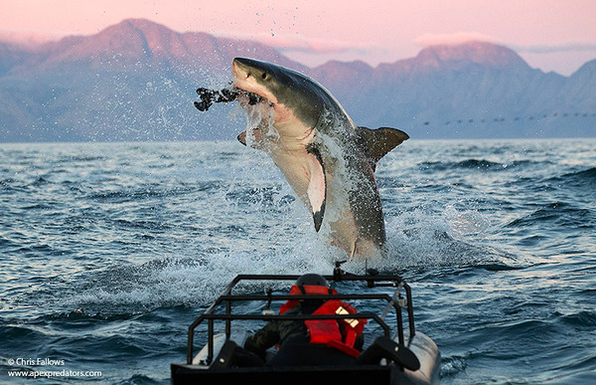
What is the Shark’s name?
Colossus

Slide 20
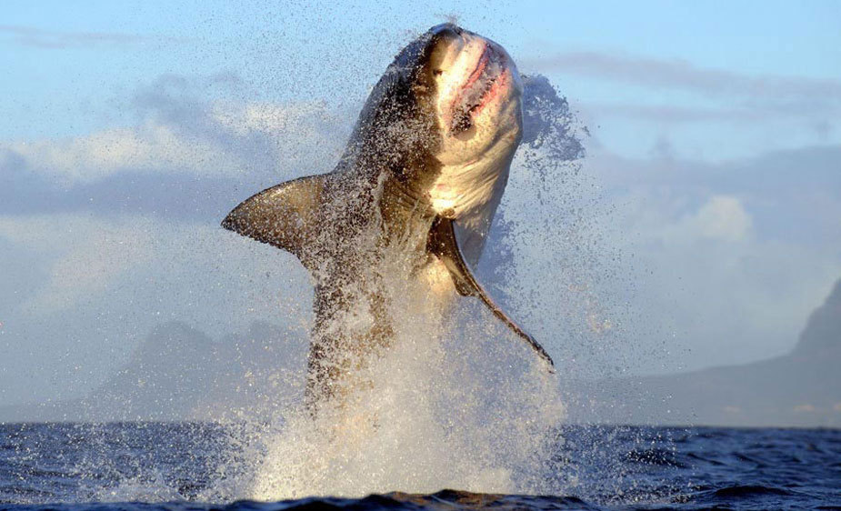
Jumping out of the water:
Breaching

Slide 21
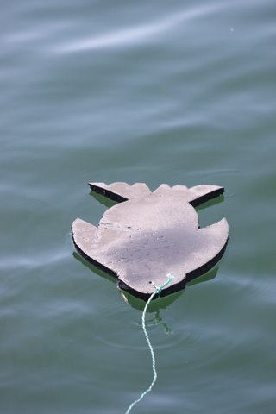
It’s not a real seal:
Decoy

