Slide 1
The Fisherman and His Wife
https://www.youtube.com/watch?v=A310NZlOYqA

Slide 2
Has, Have, Had

Slide 3
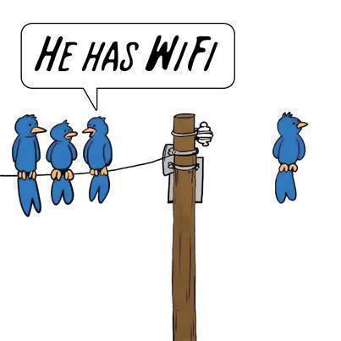
Has / Have
I
You
He / she
It
They
We
Have
Have
Has
Has
Have
Have

Slide 4
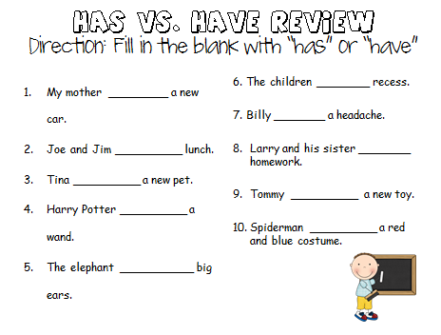

Slide 5
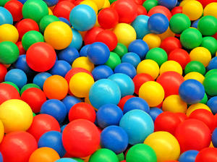
Has / had
Now, she ________ a yellow ball.
Yesterday, she _________ a blue ball

Slide 6
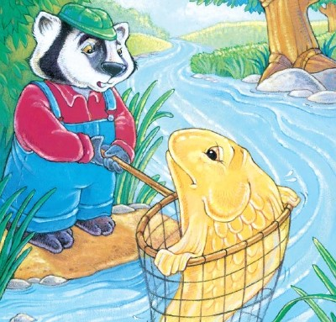
Look at the Picture and Make a Sentence:
He _______ a fish.

Slide 7
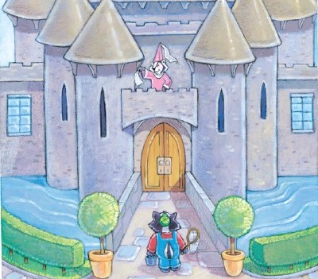
Look at the Picture and Make a Sentence:
She _______ a hut.
She _______ a castle.

Slide 8
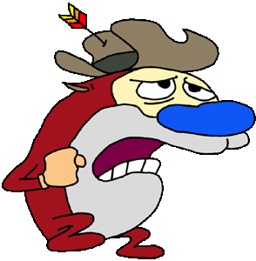
Making a Question:
He has a blue nose.
Does he have a blue nose?

Slide 9
Making a Question:
He has a blue nose.
Does he have a blue nose?

Slide 10
Does she have a red dress?
Yes, she has a red dress.

Slide 11
Does Mr. S have a hat?
Yes, he has a hat.

Slide 12
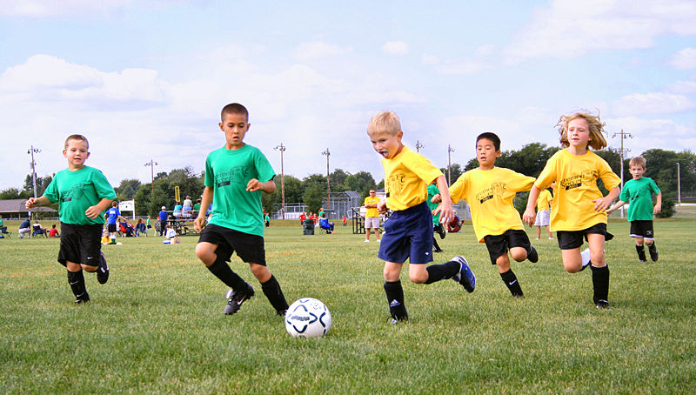
Do they have a soccer ball?
Yes, they have a soccer ball.

Slide 13
Do I have green shoes?
No, you don’t have green shoes.

Slide 14
Do you have a pencil?

Slide 15
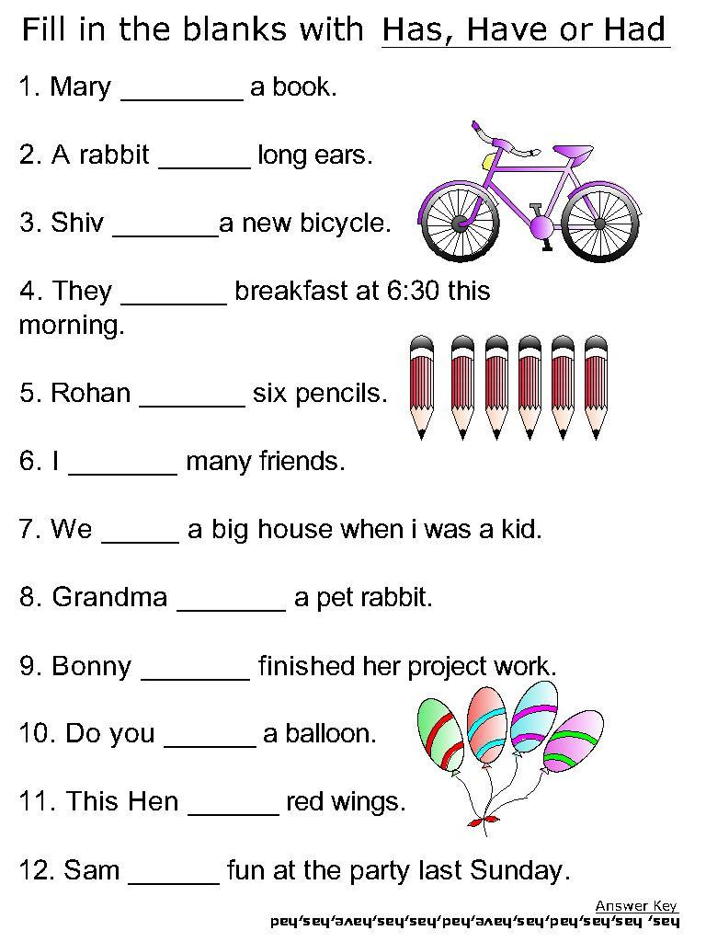
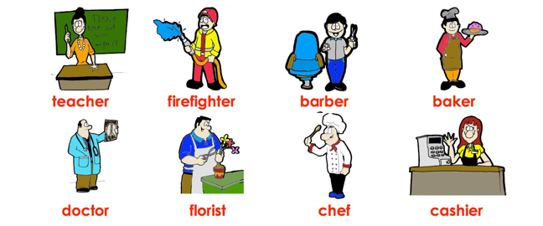
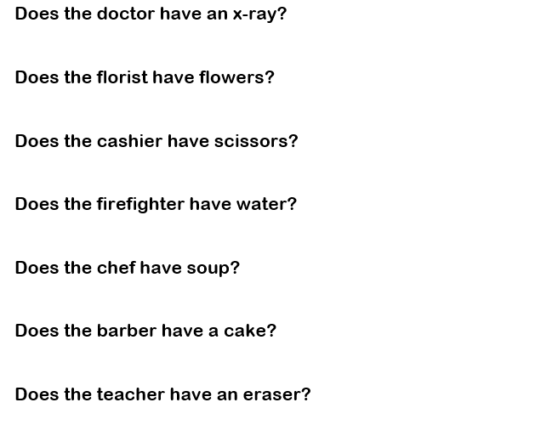

Slide 16
Go Fish Game

Slide 17
Rules:
“_(name)_, do you have _(color)_ _(number)_ fish?”
“Yes, I do.”
“No, go fish”

Slide 18
Web page games:
https://www.earlymoments.com/upload/EarlyMoments/FunActivities/one-fish-activity4.pdf
https://www.earlymoments.com/upload/EarlyMoments/FunActivities/one-fish-activity1.pdf
https://www.earlymoments.com/upload/EarlyMoments/FunActivities/one-fish-activity7.pdf

