Slide 1
Food Chain

Slide 2
___________ eats __________
Predator prey

Slide 3
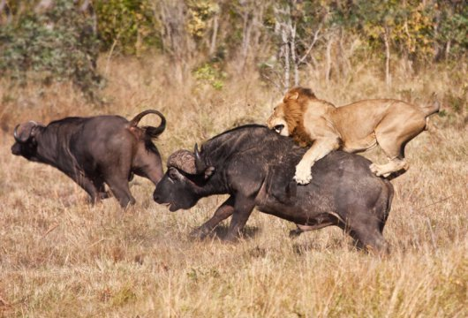
Predator vs Prey

Slide 4
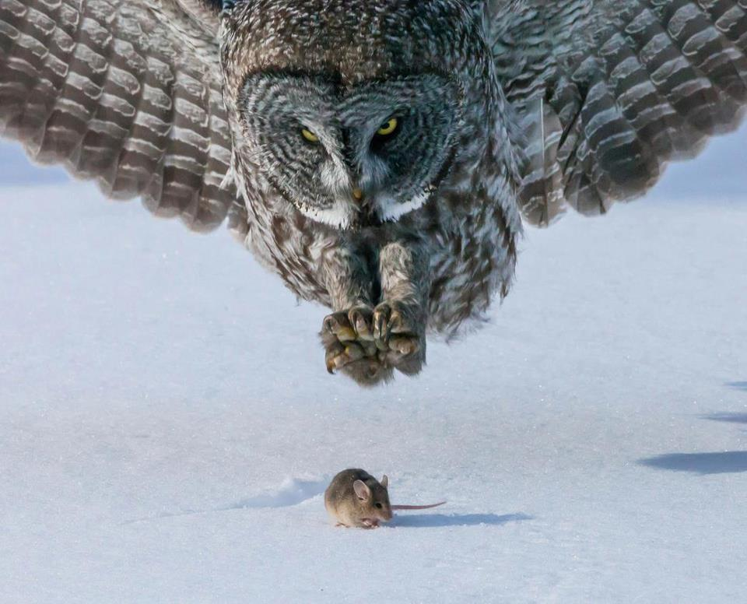
Predator vs Prey

Slide 5
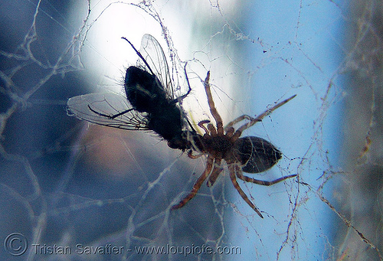
Predator vs Prey

Slide 6
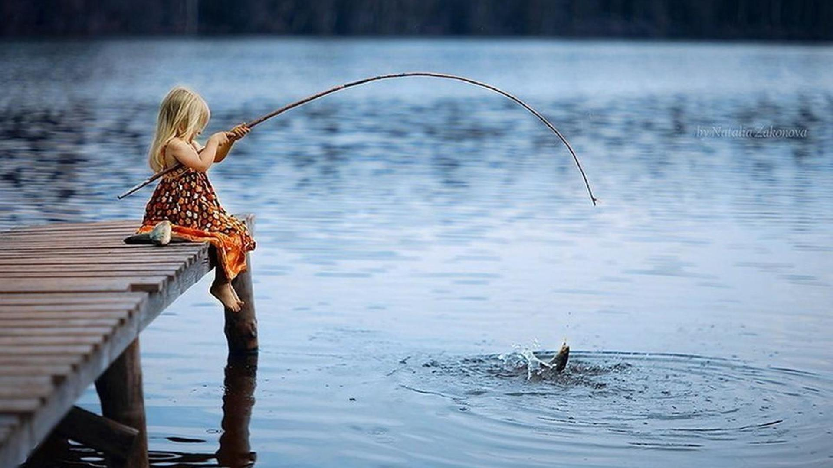
Predator vs Prey

Slide 7
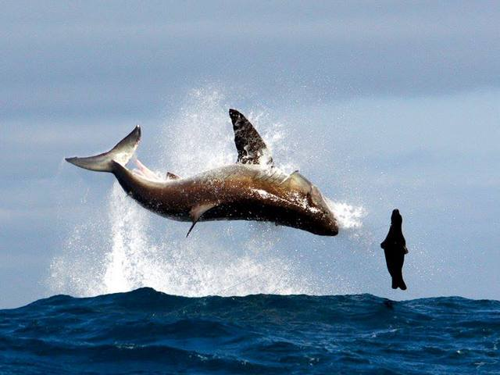
Predator vs Prey

Slide 8
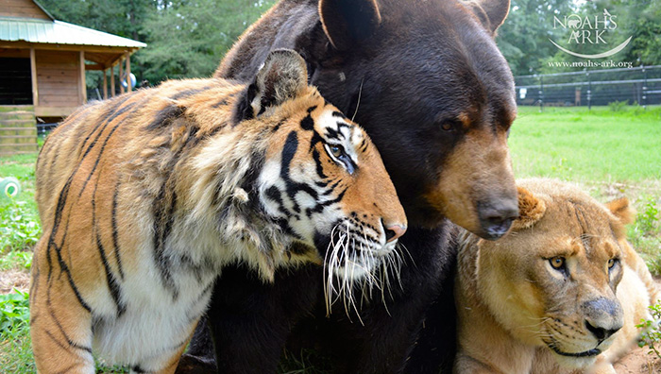
Apex Predator
Nothing eats it.

Slide 9
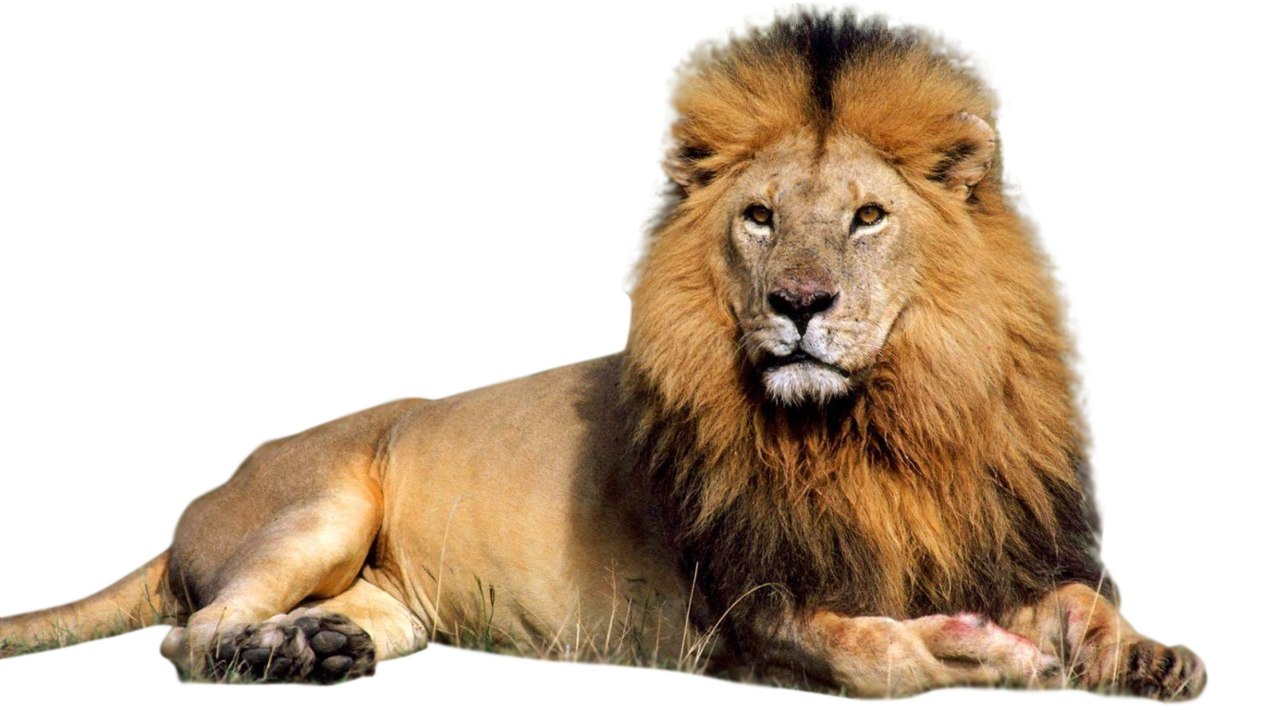
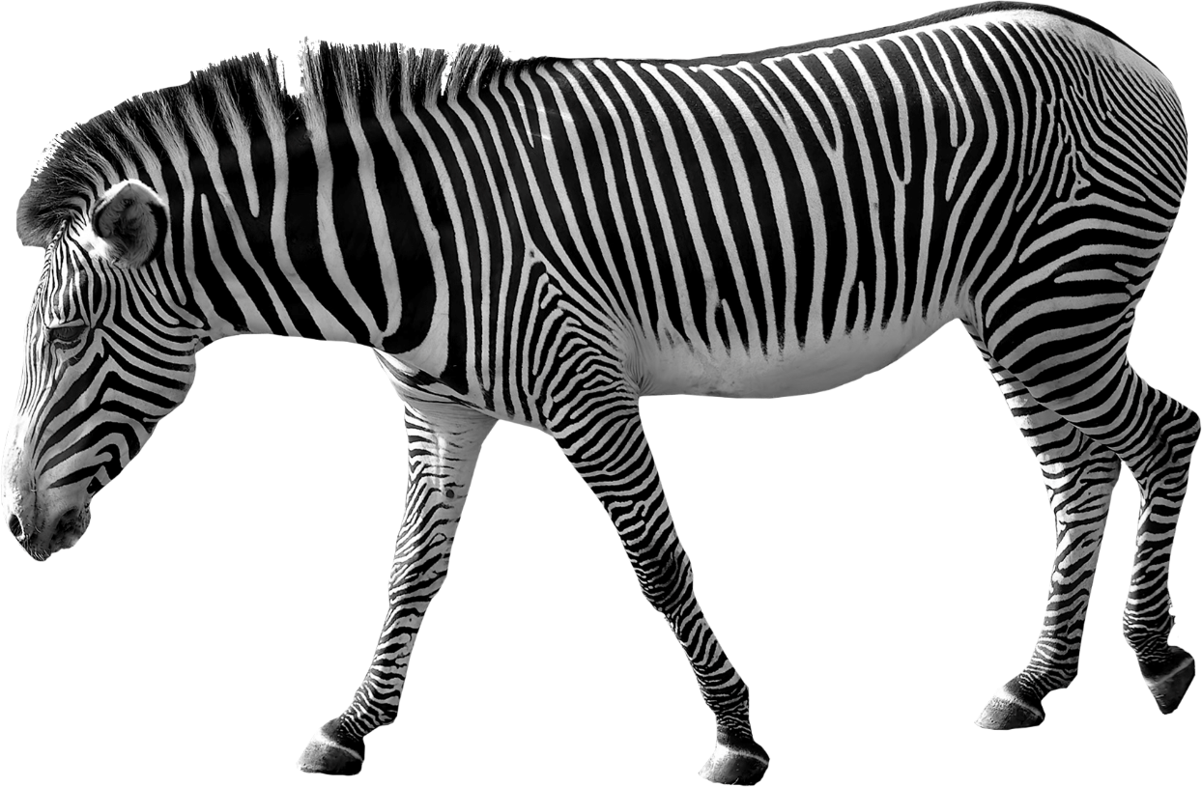
Who’s the apex predator?

Slide 10
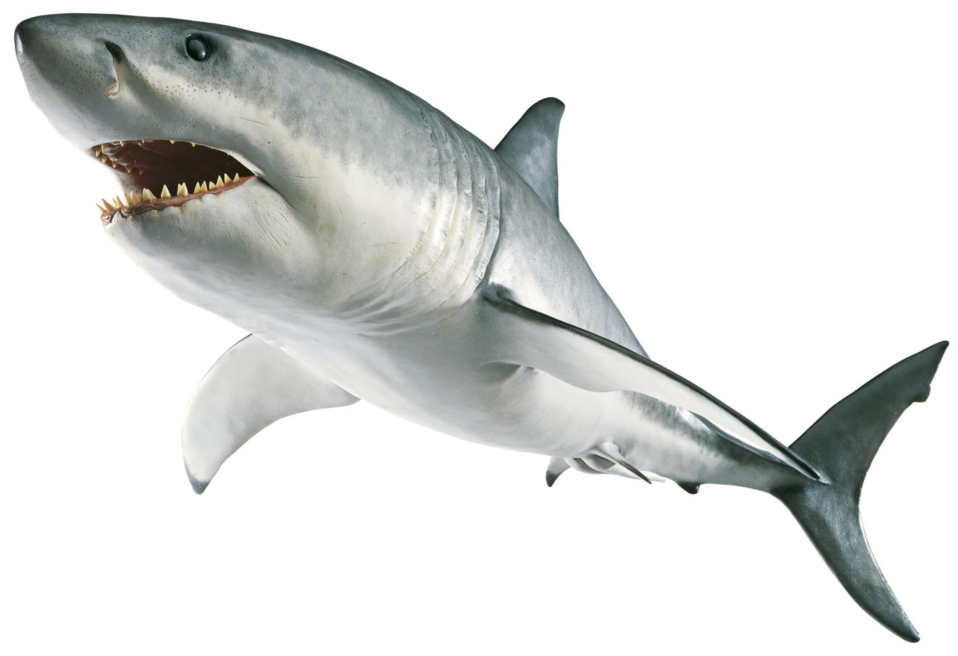
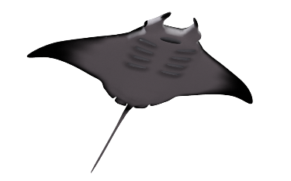
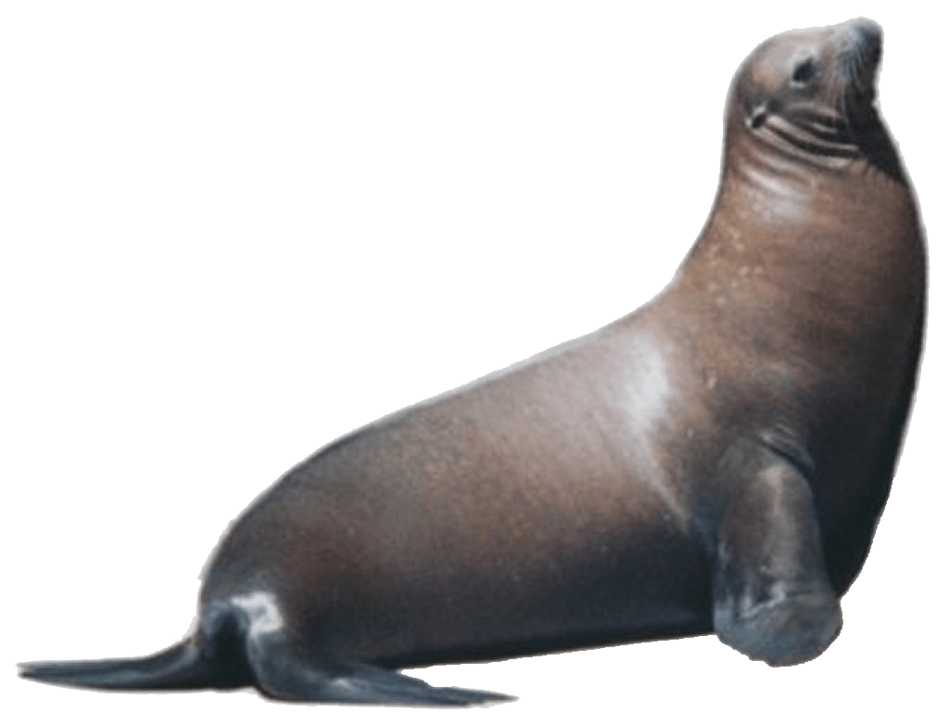
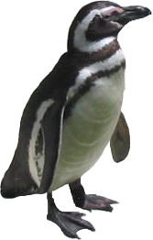
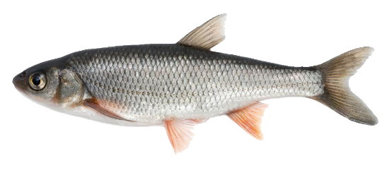
Who’s the apex predator?

Slide 11
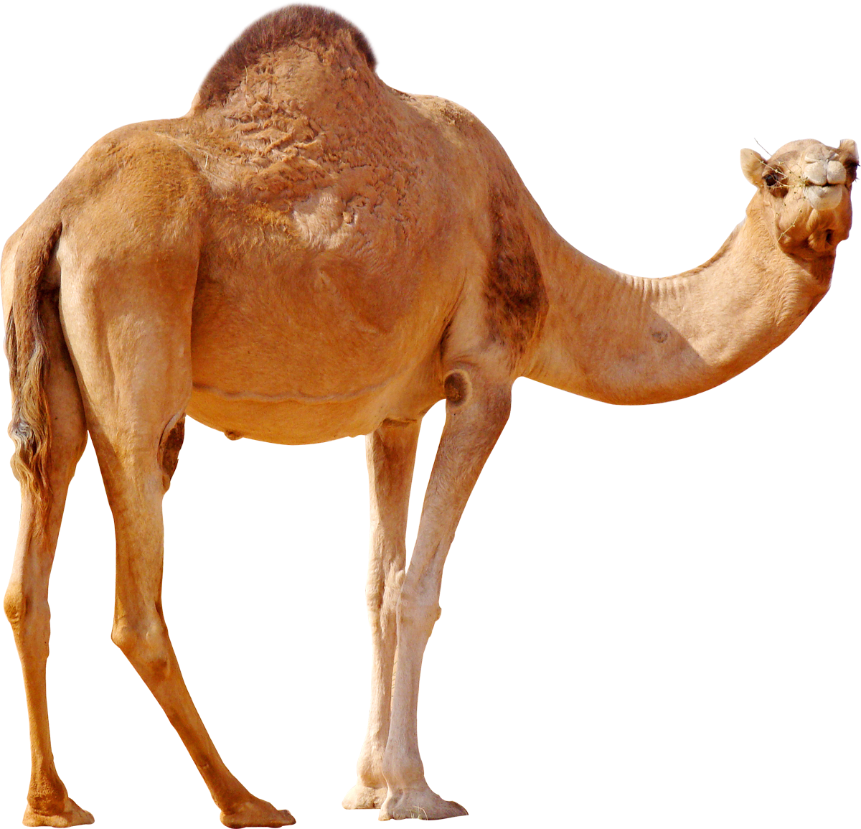
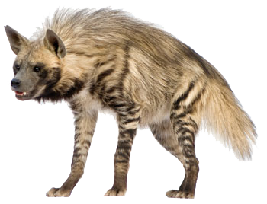
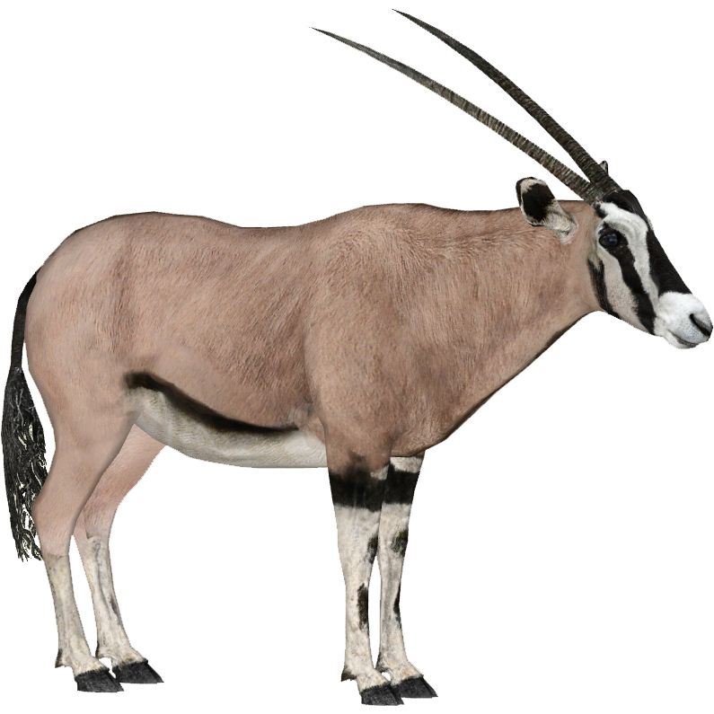
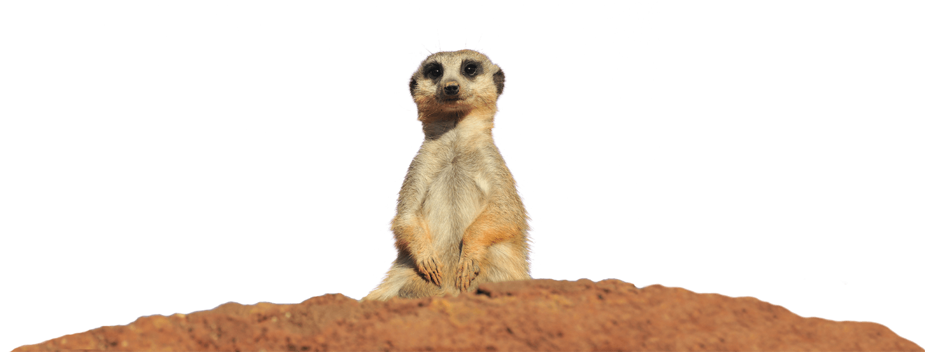
Who’s the apex predator?

Slide 12
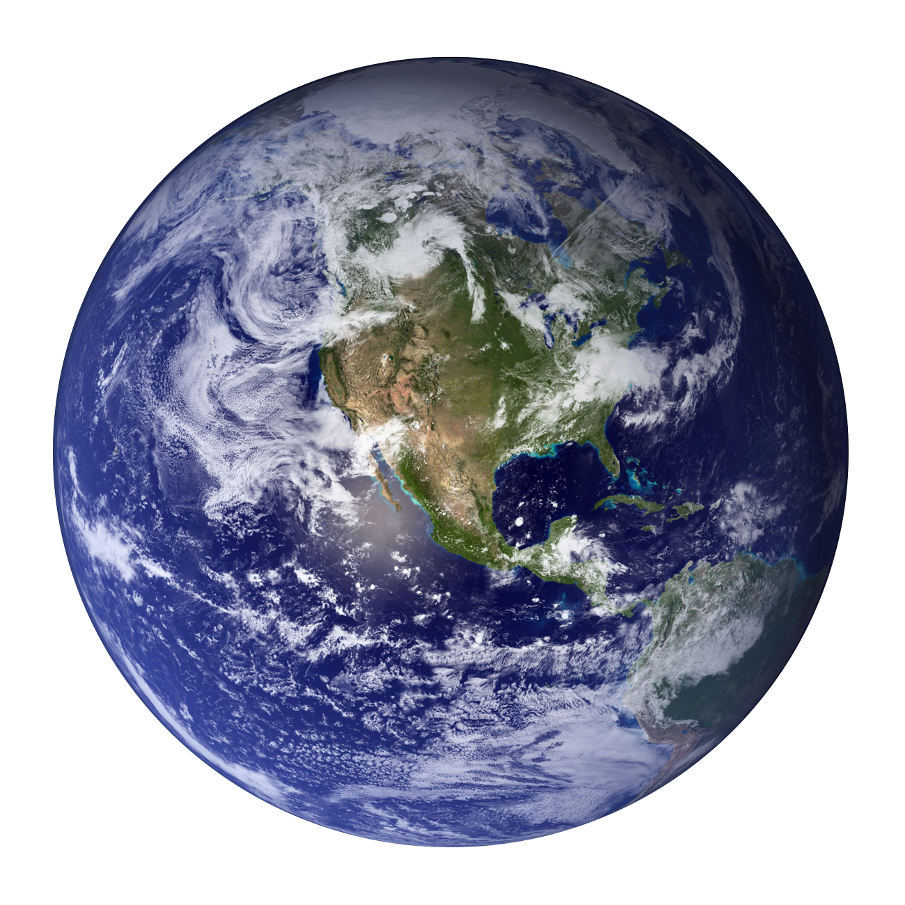
Who’s the apex predator?

Slide 13
Let’s Compare
Humans and Animals

Slide 14
44
KPH
48
KPH
63.5
KPH
69
KPH
88
KPH
98
KPH

Slide 15
266 KG
300 KG

Slide 16
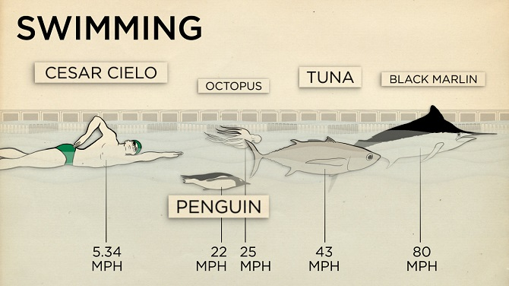
3.8
KPH
35.4
KPH
40
KPH
69
KPH
129
KPH

Slide 17
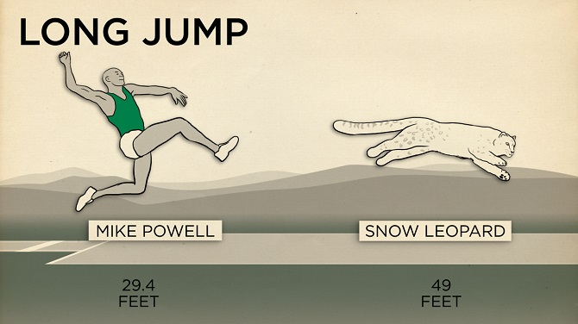
9m
15m

Slide 18
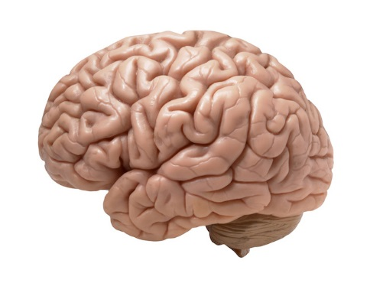
So, why are humans the apex predator of the world?

Slide 19
The Food Chain

Slide 20
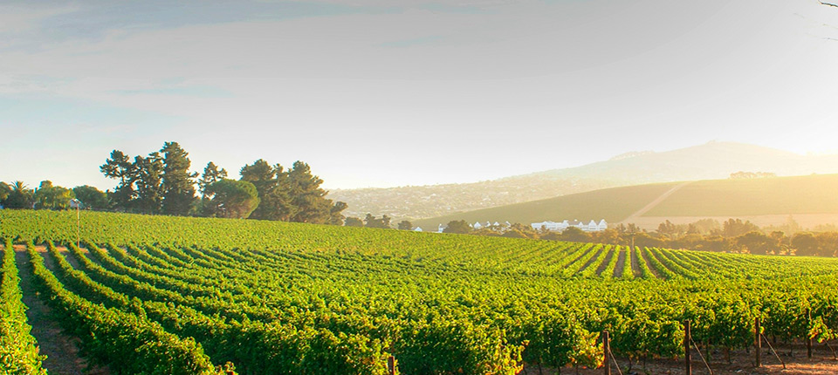
Producers

Slide 21
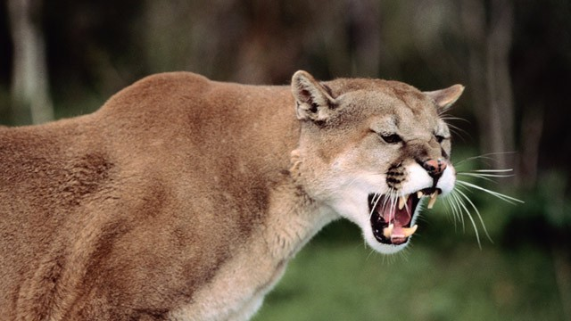
Consumers

Slide 22
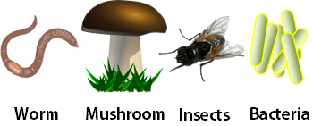
Decomposers

Slide 24
Africa Food Chain
Cut and paste the animals.

Slide 25
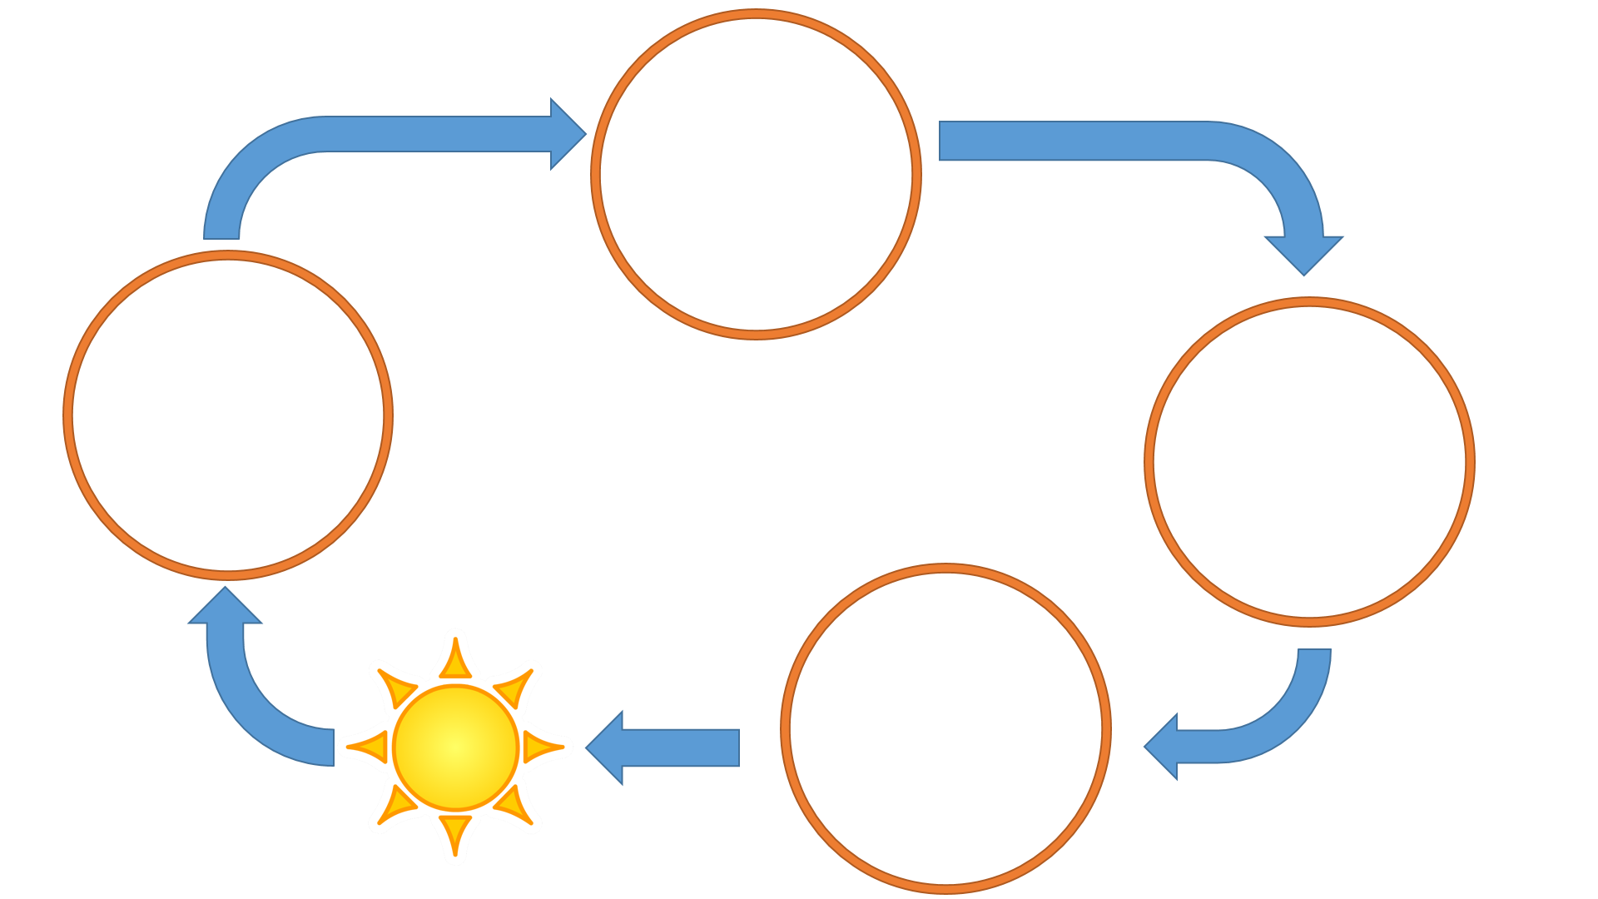
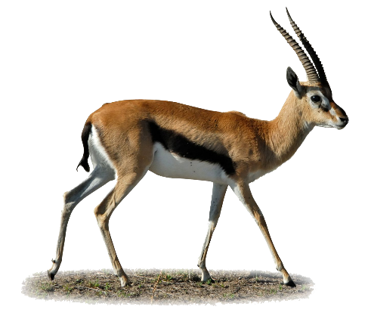
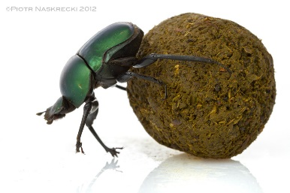
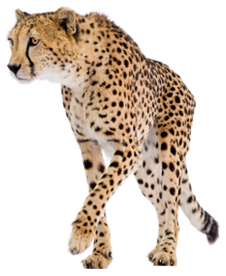

Slide 26
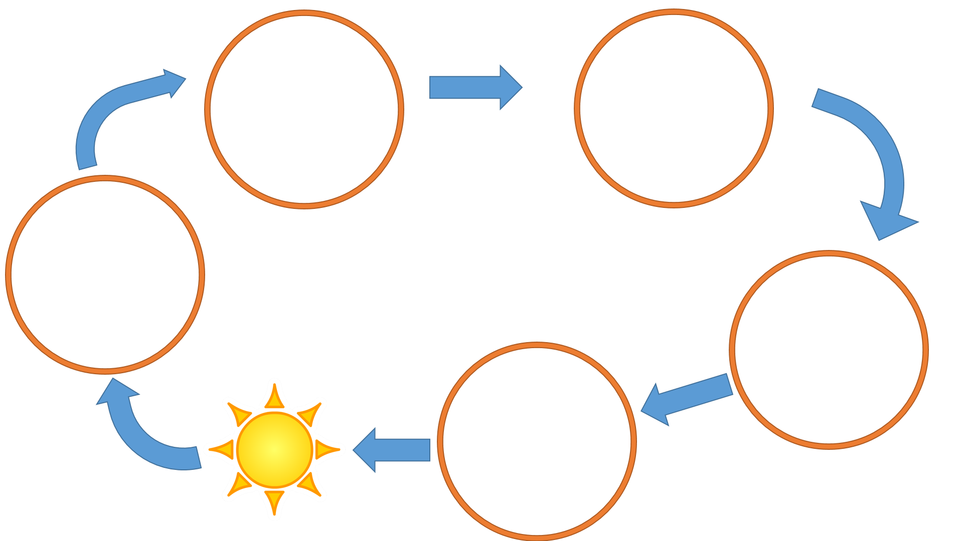
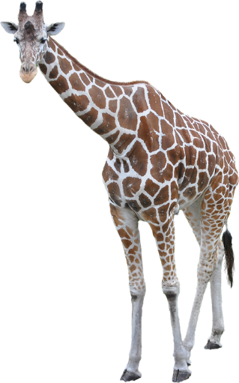
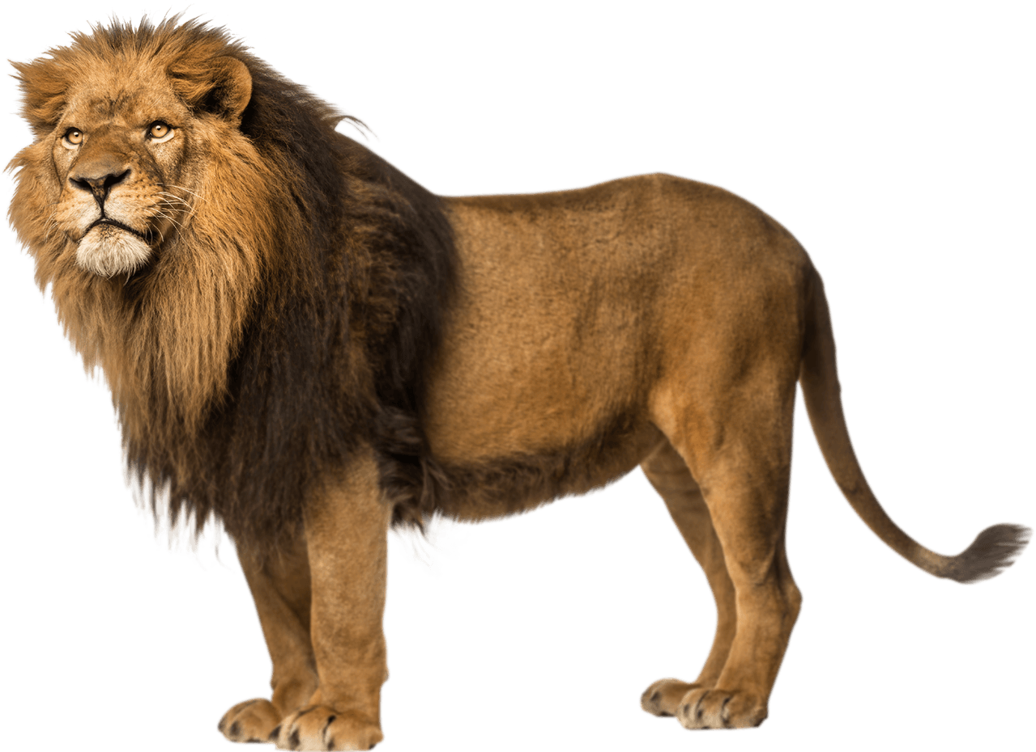
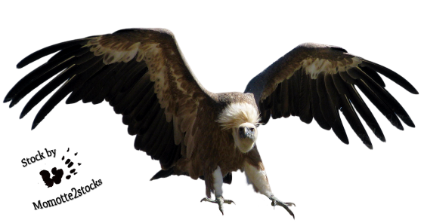
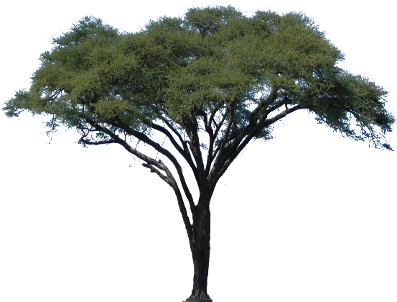
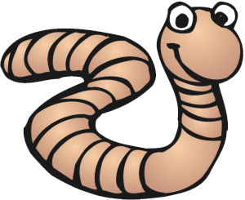

Slide 27
What happens when the food chain breaks?

Slide 28
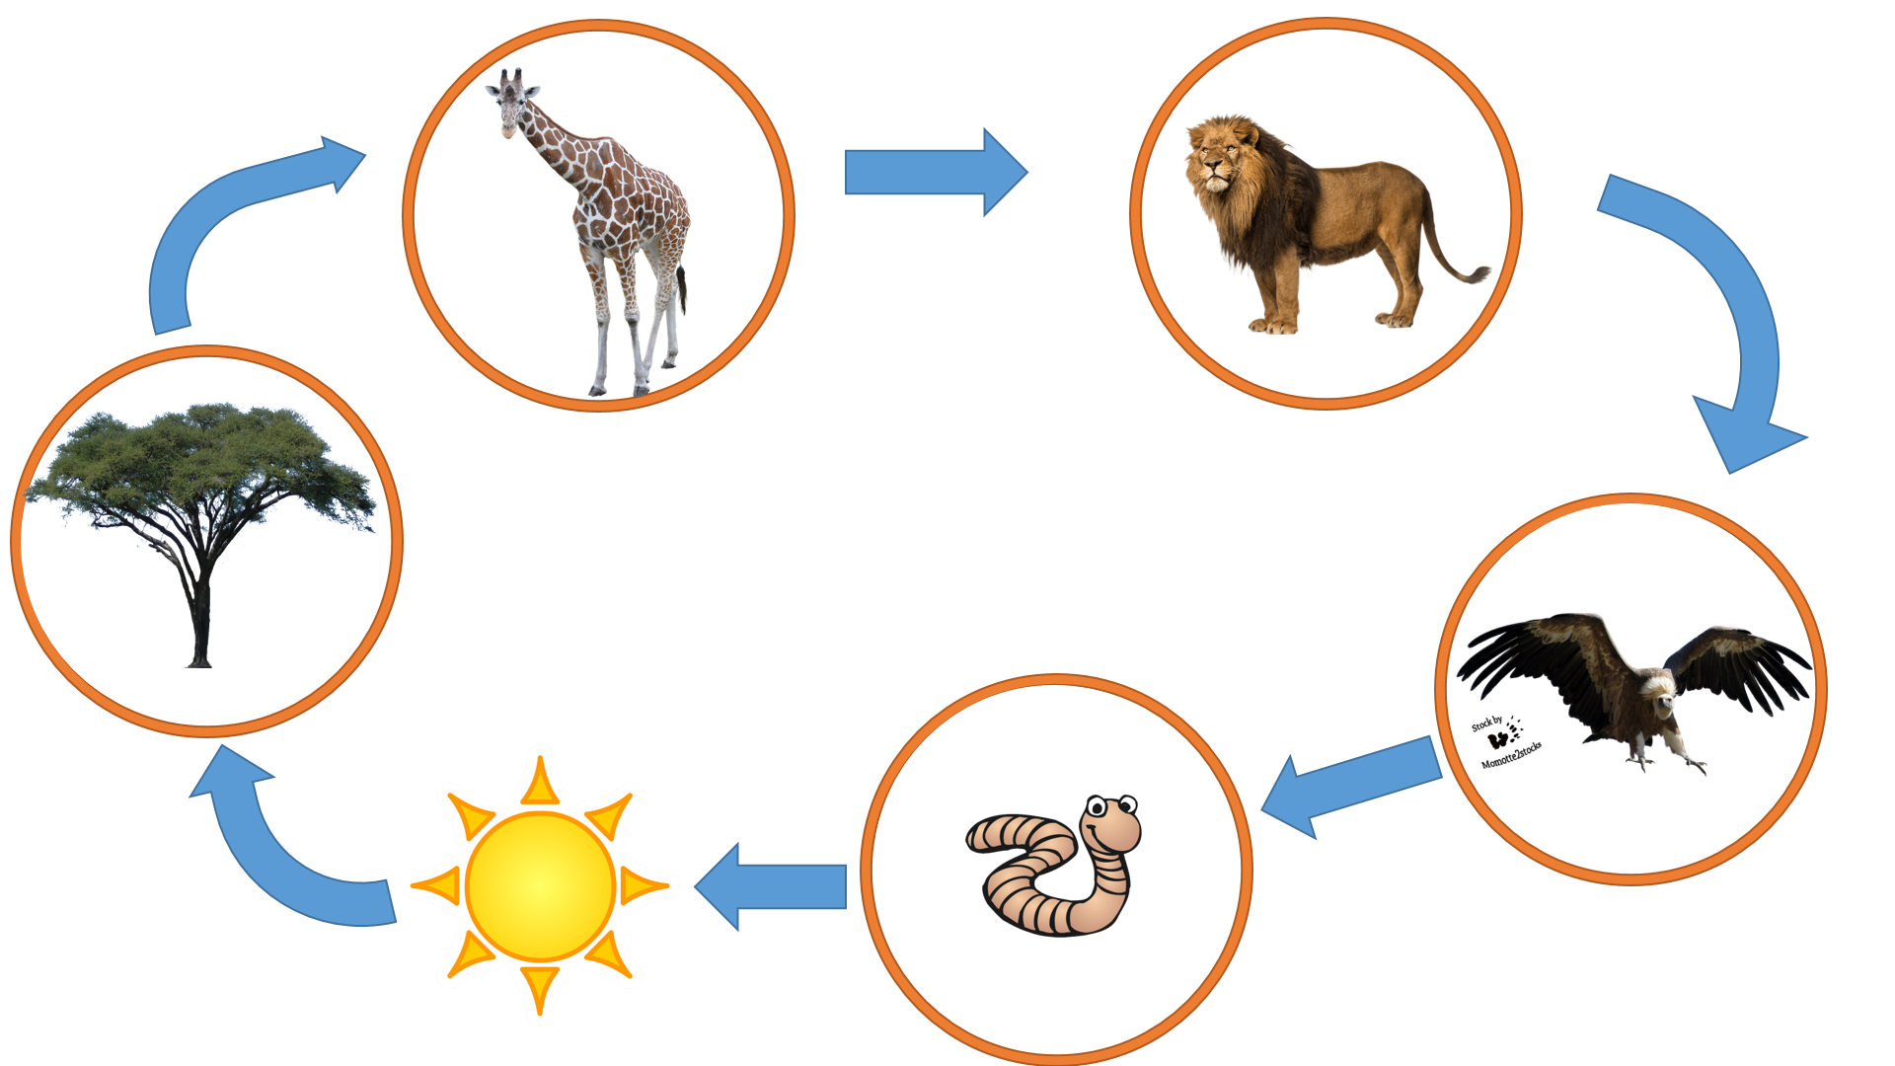
What happens when the food chain breaks?

Slide 29
What happens when the food chain breaks?

Slide 30
Grass / Rabbits / Foxes
http://cashmancuneo.net/flash/fc44/foodchain.swf

