Slide 1
Red Fish Blue Fish

Slide 2
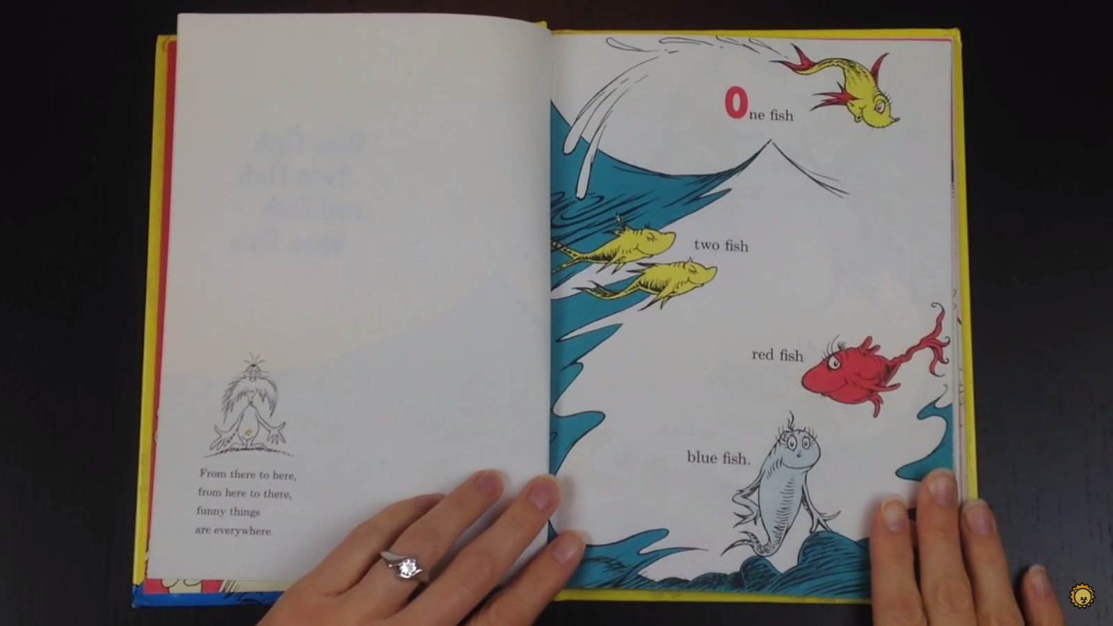

Slide 3
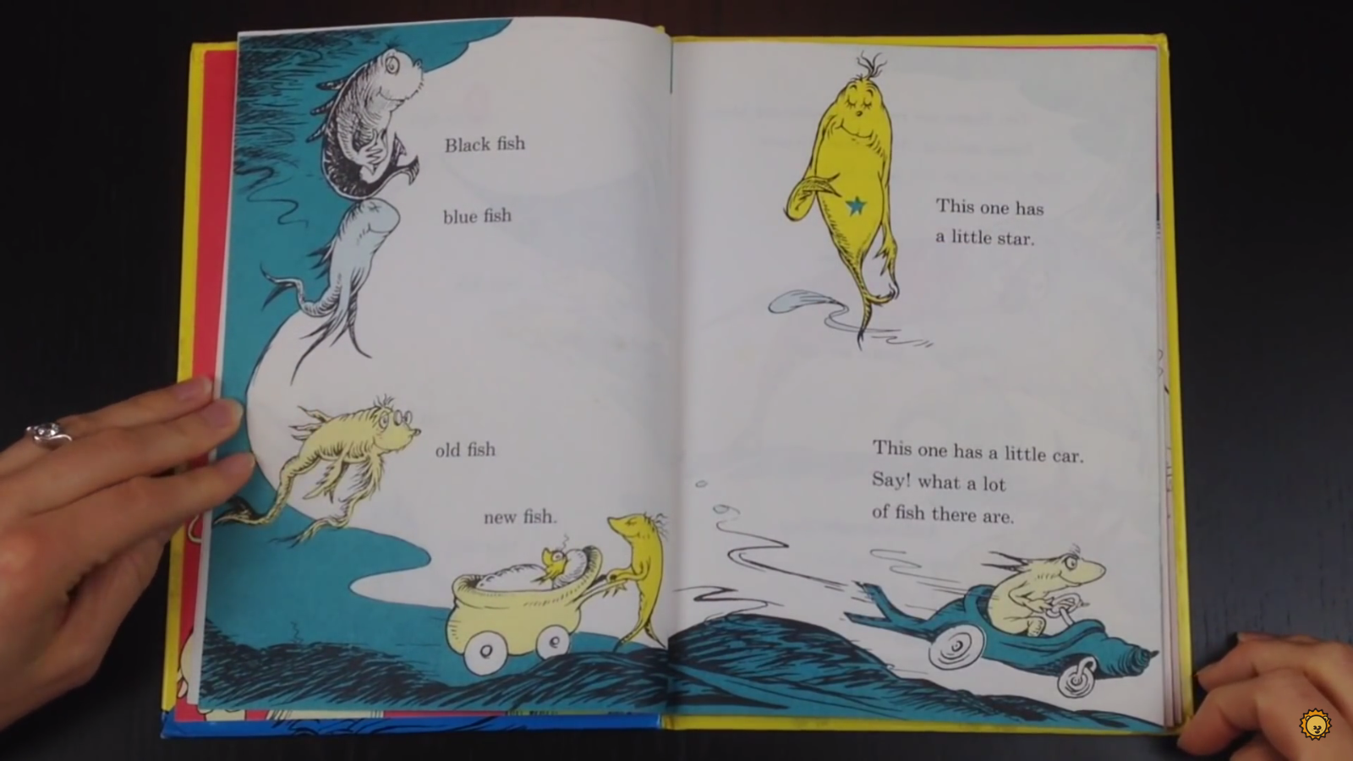

Slide 4
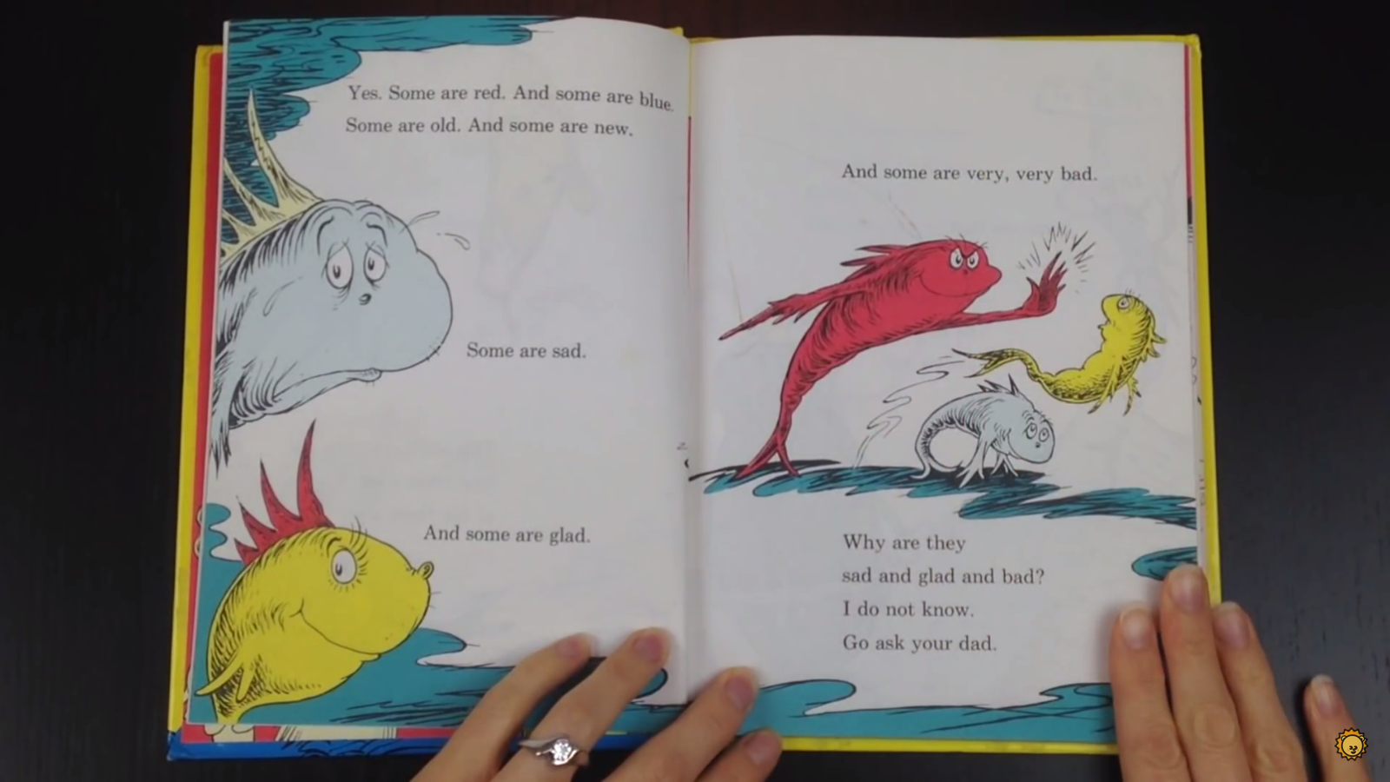

Slide 5
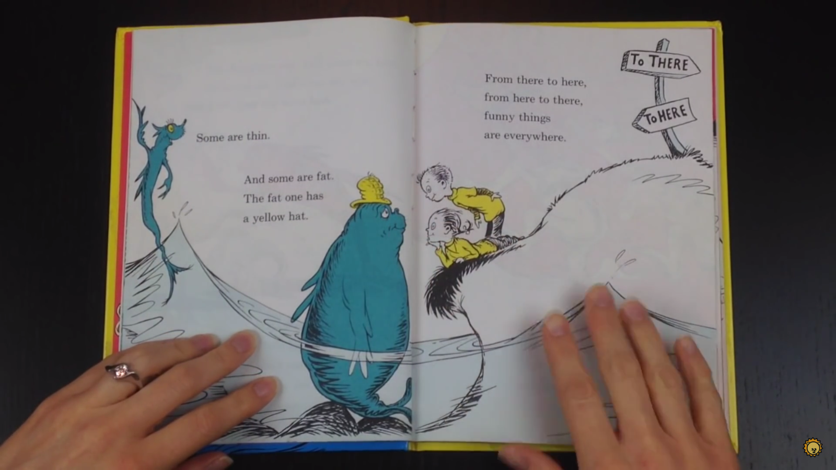

Slide 6
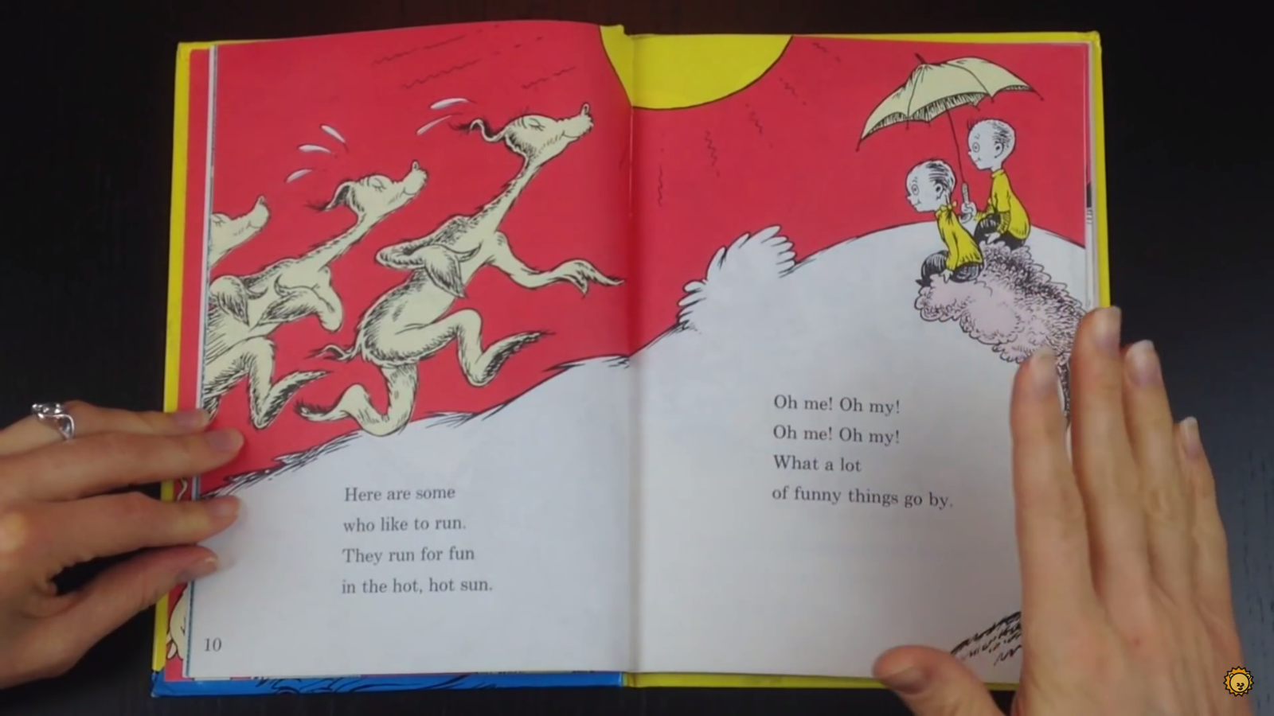

Slide 7
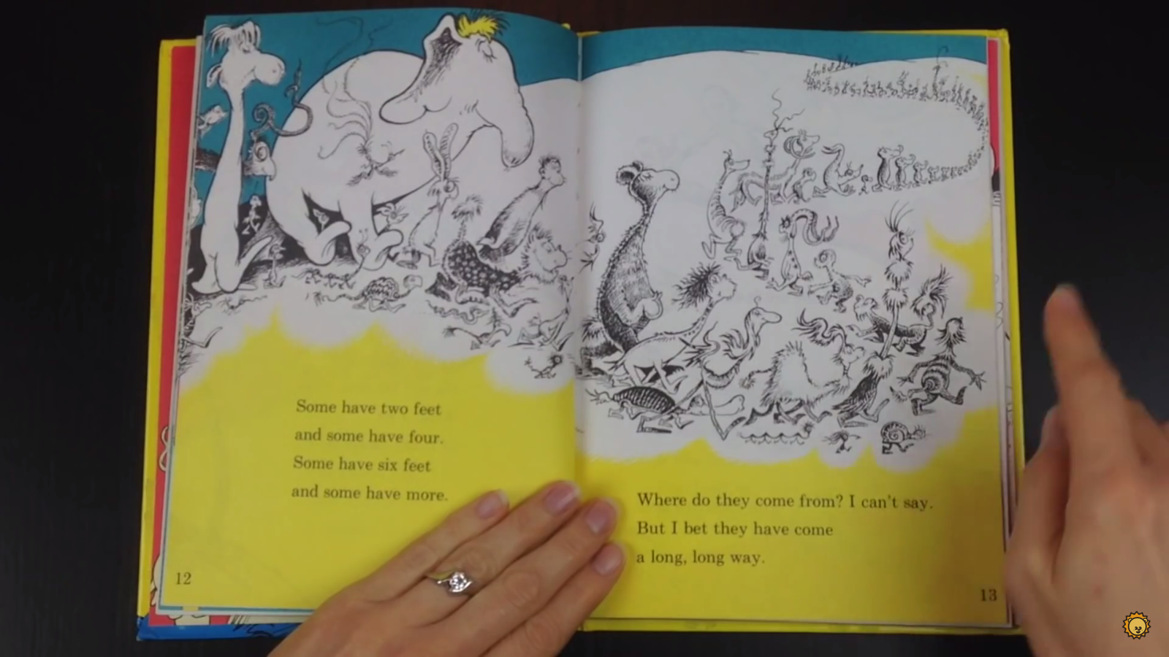

Slide 8
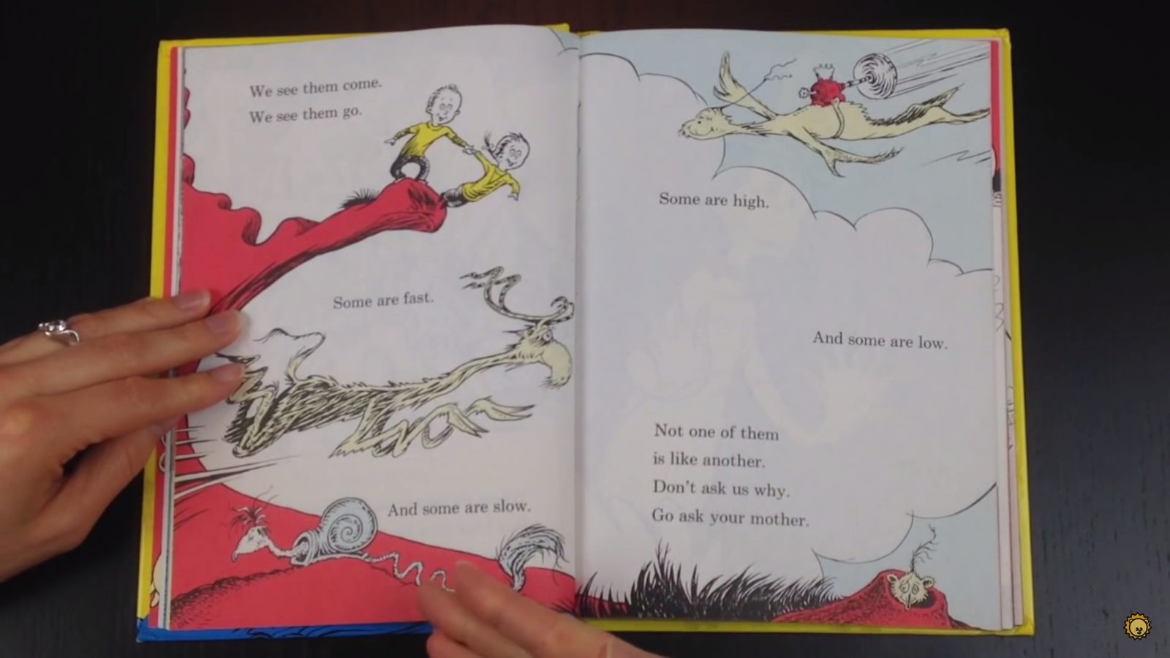

Slide 9
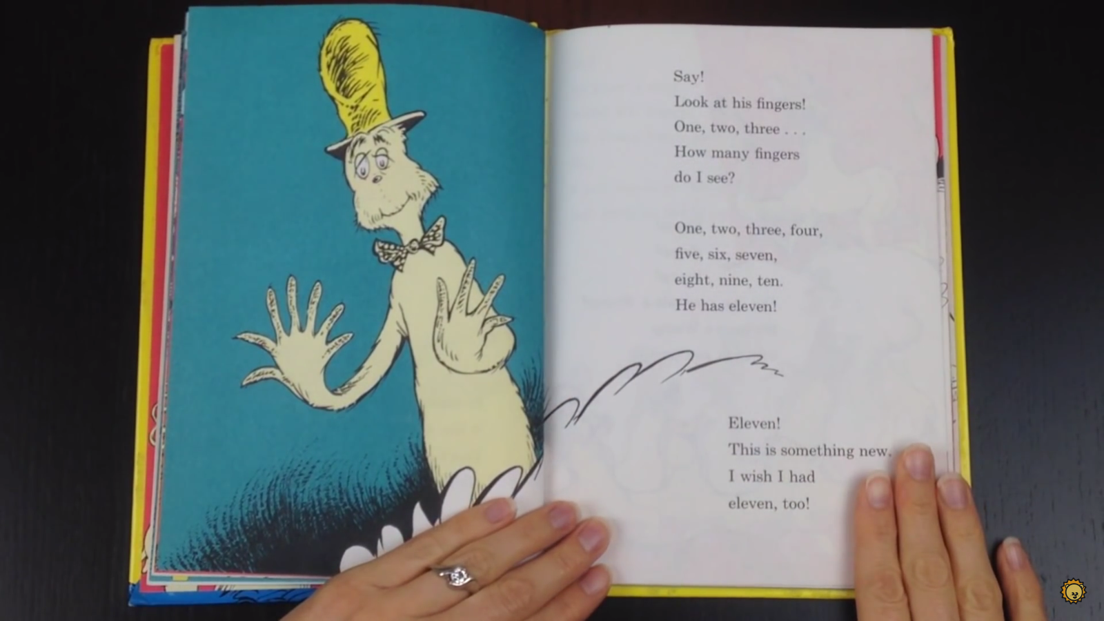

Slide 10
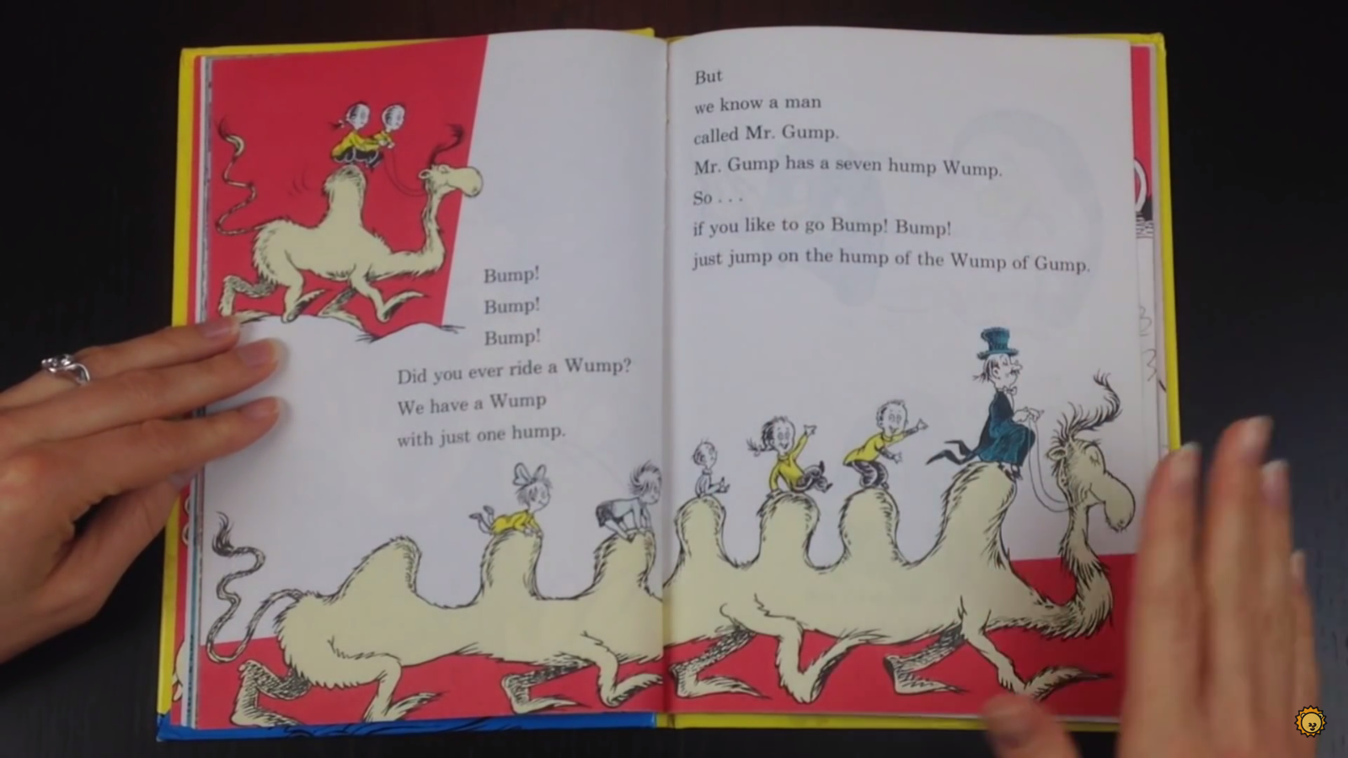

Slide 11
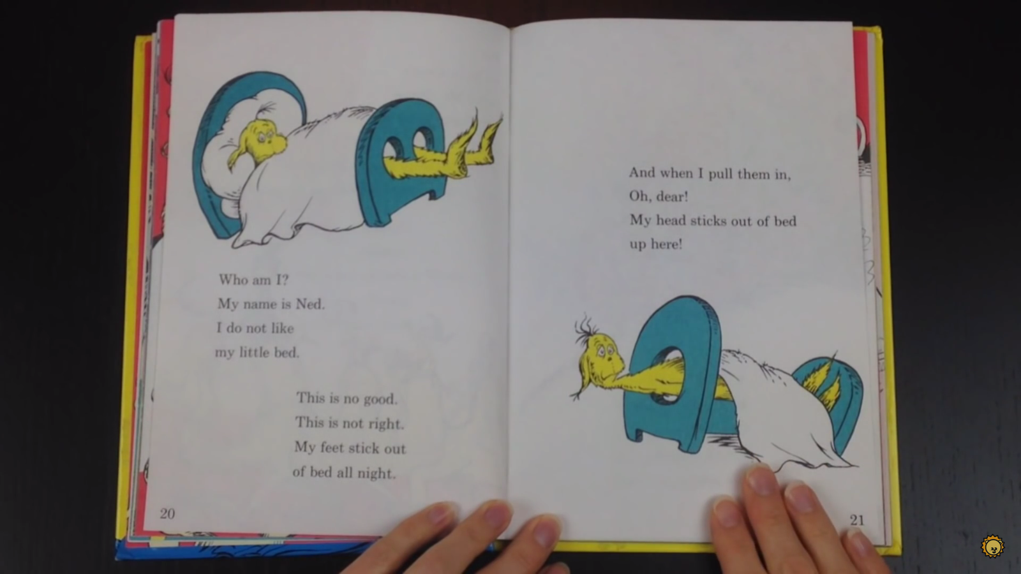

Slide 12
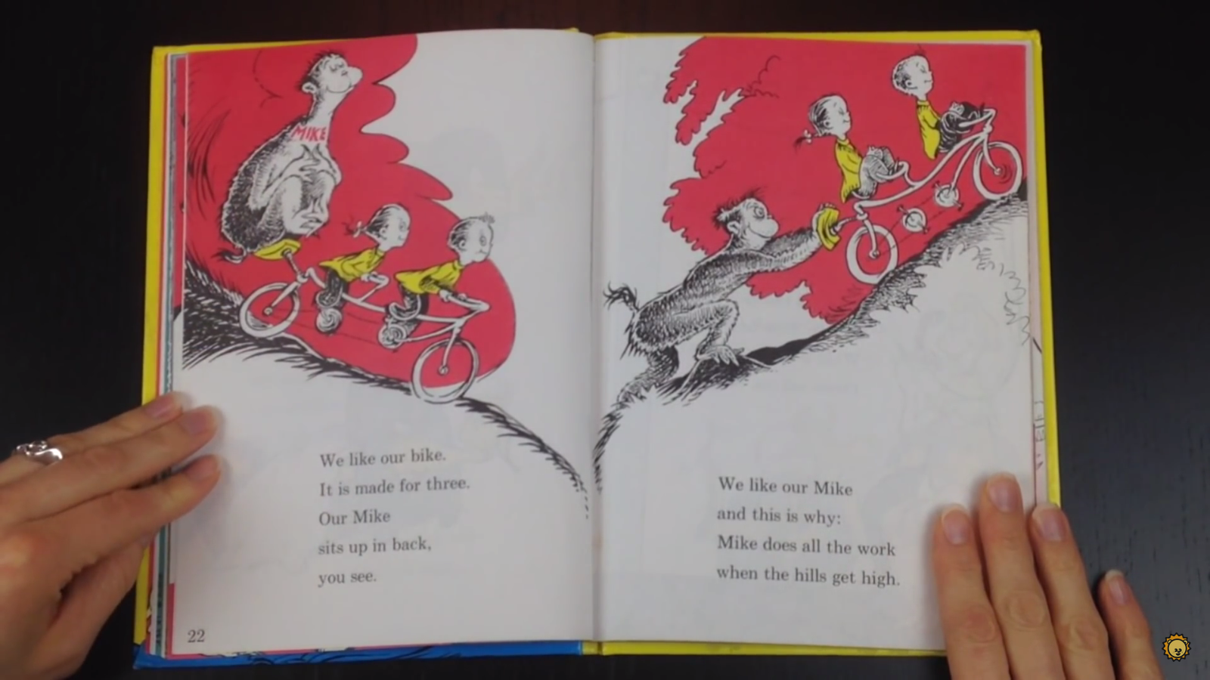

Slide 13
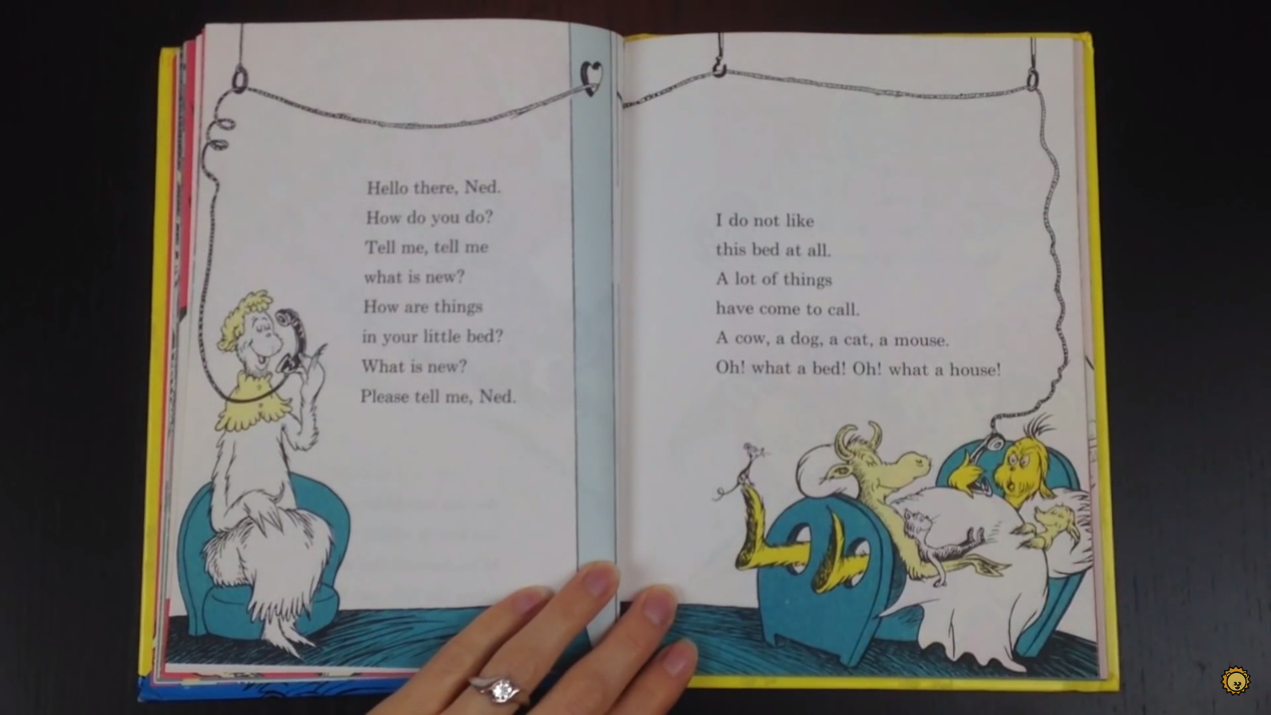

Slide 14
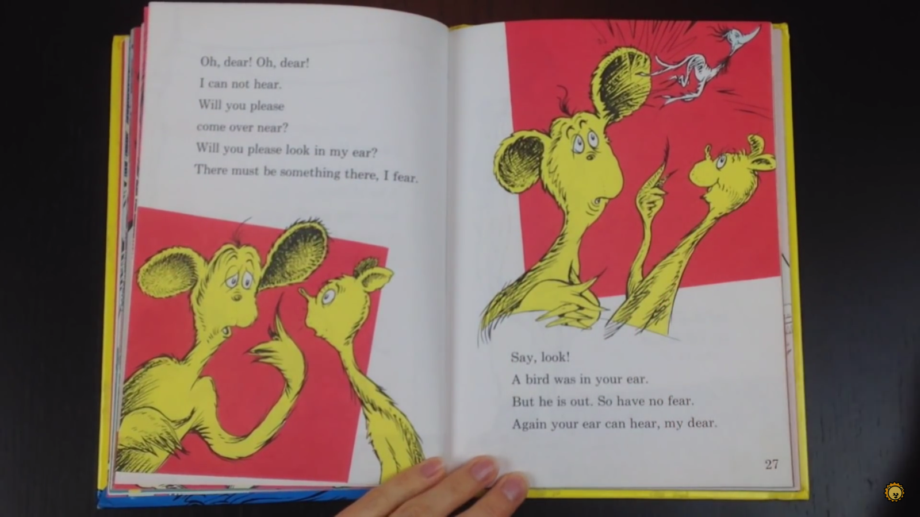

Slide 15
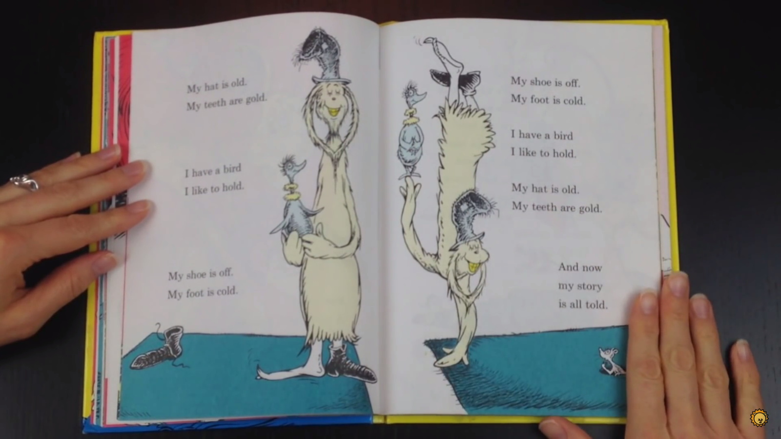

Slide 16
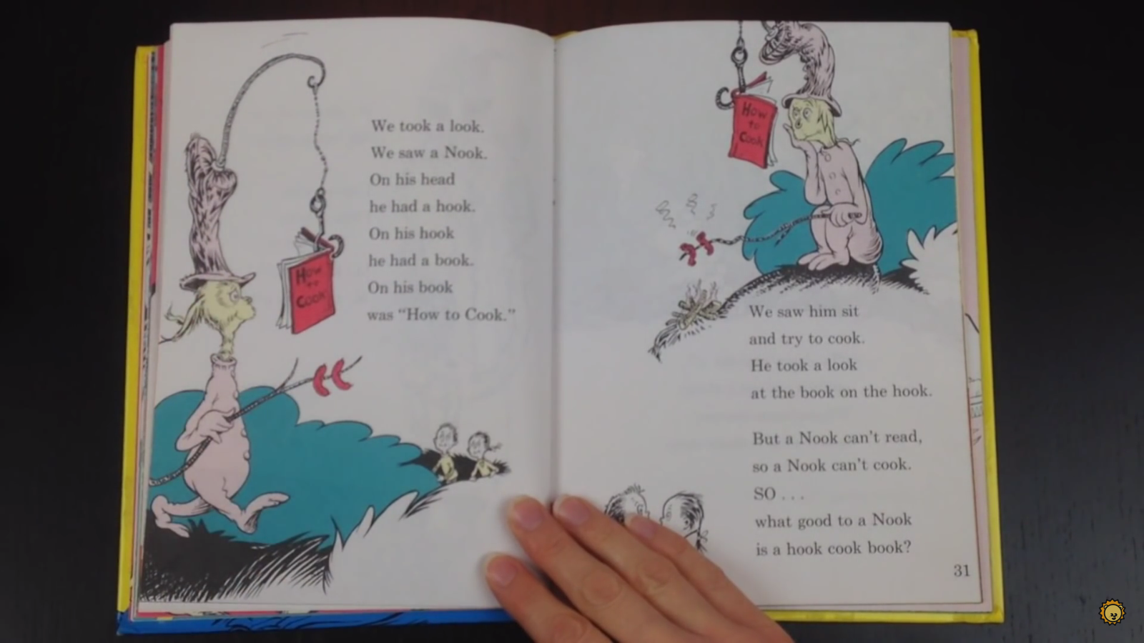

Slide 17
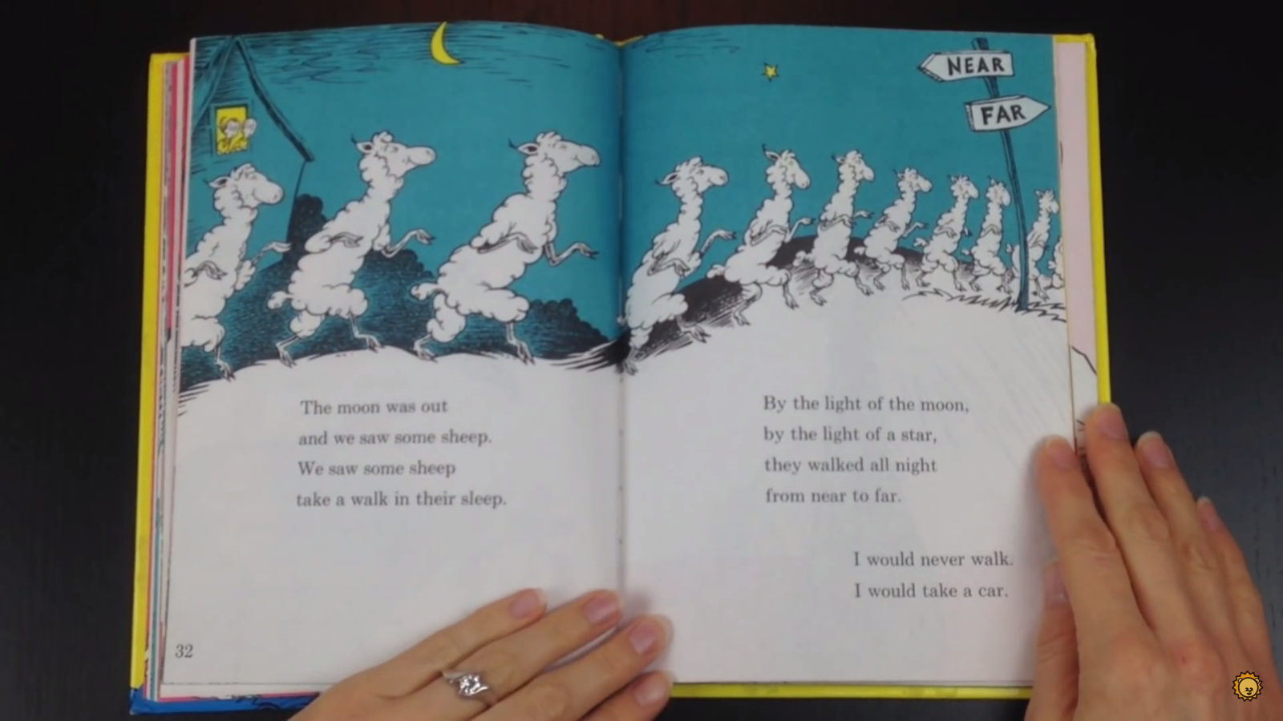

Slide 18
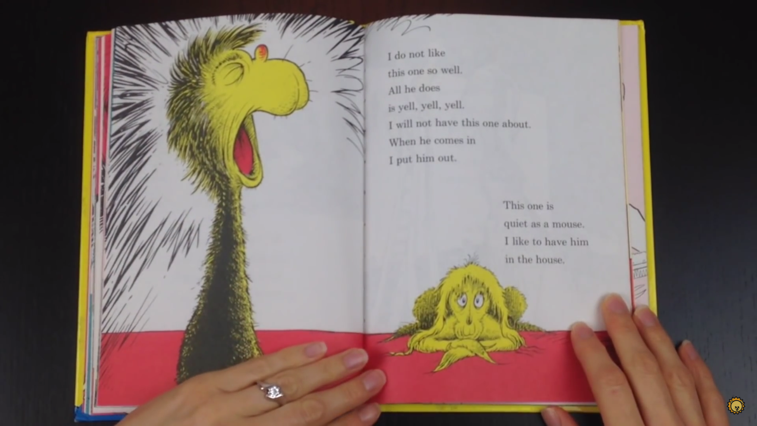

Slide 19
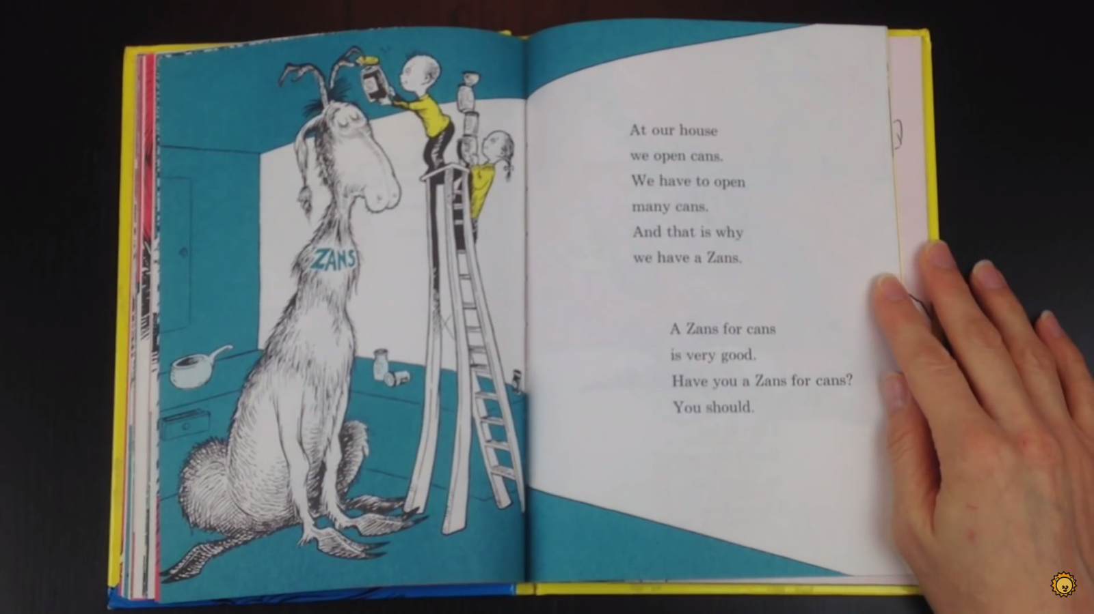

Slide 20
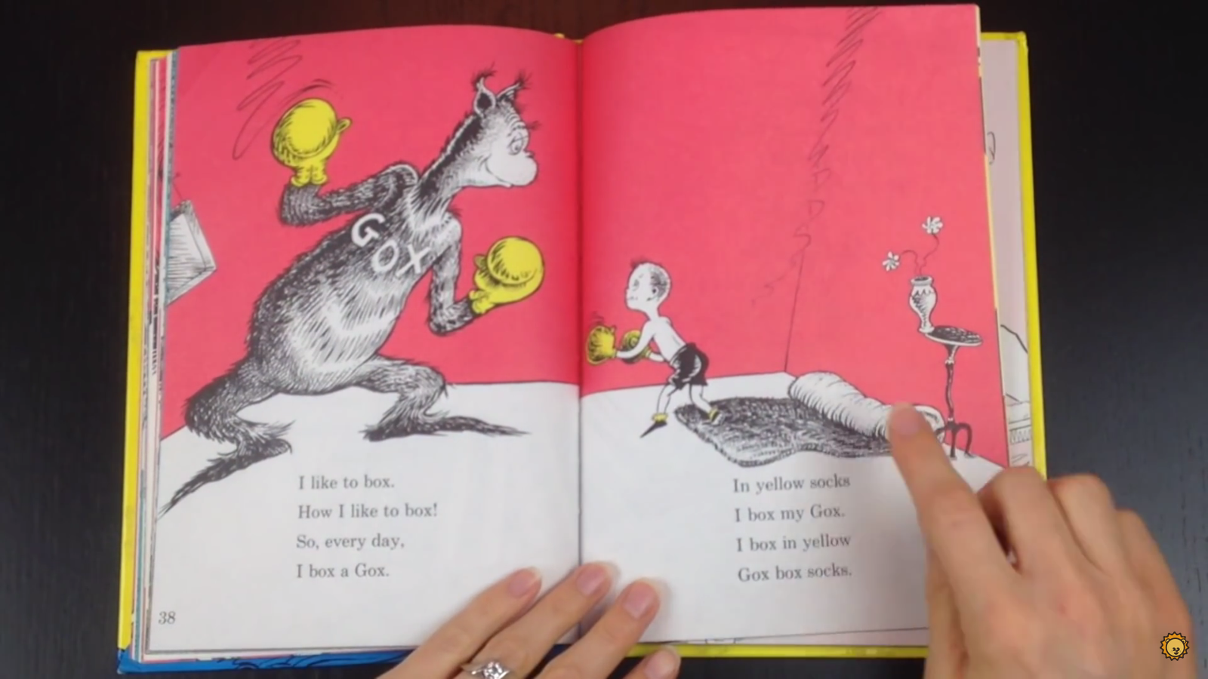

Slide 21
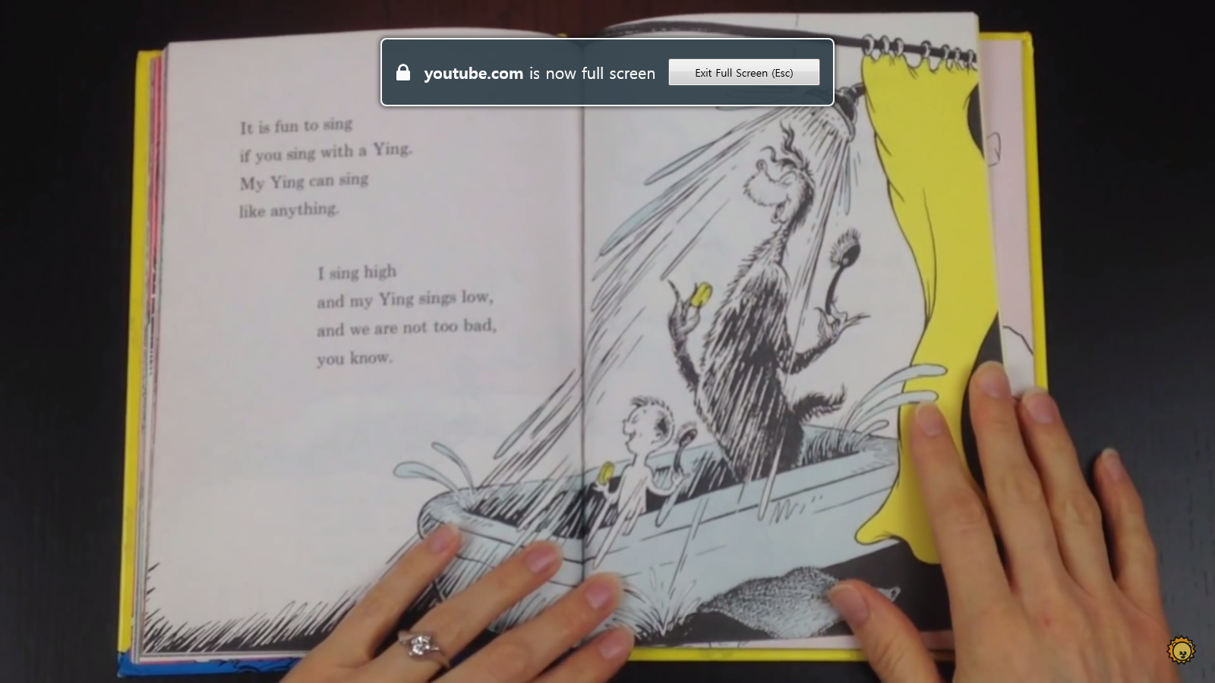

Slide 22
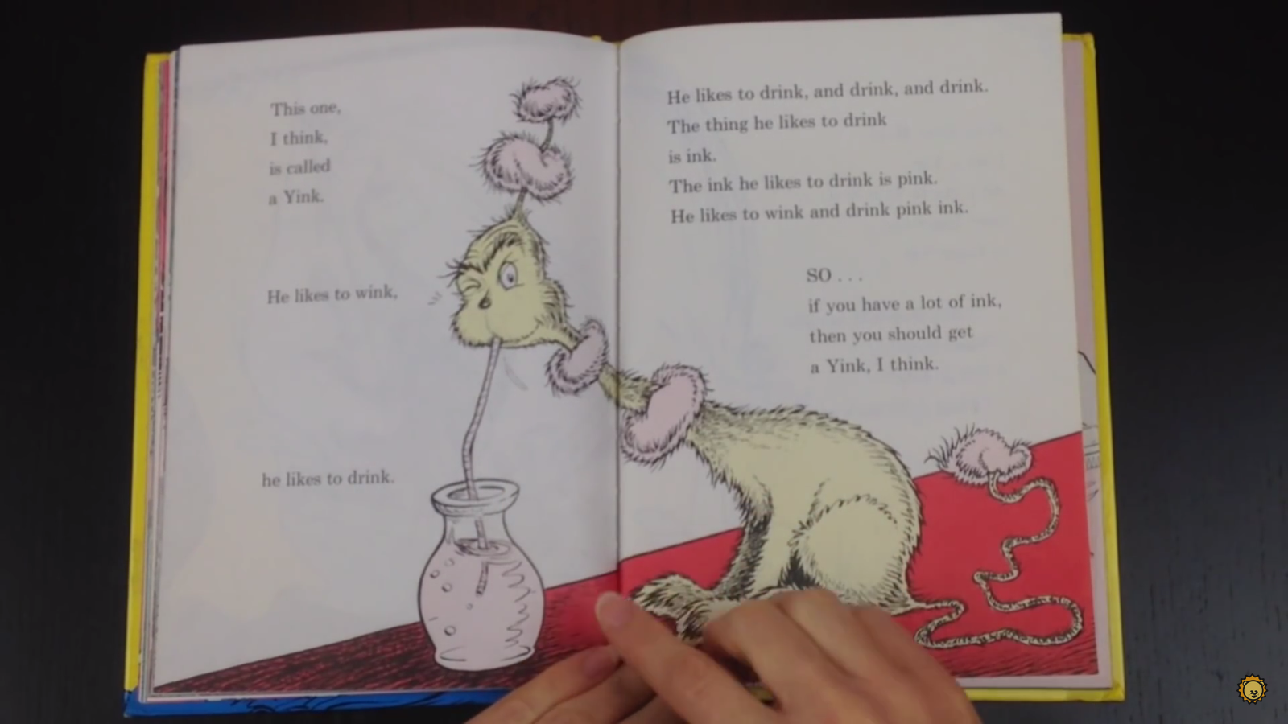

Slide 23
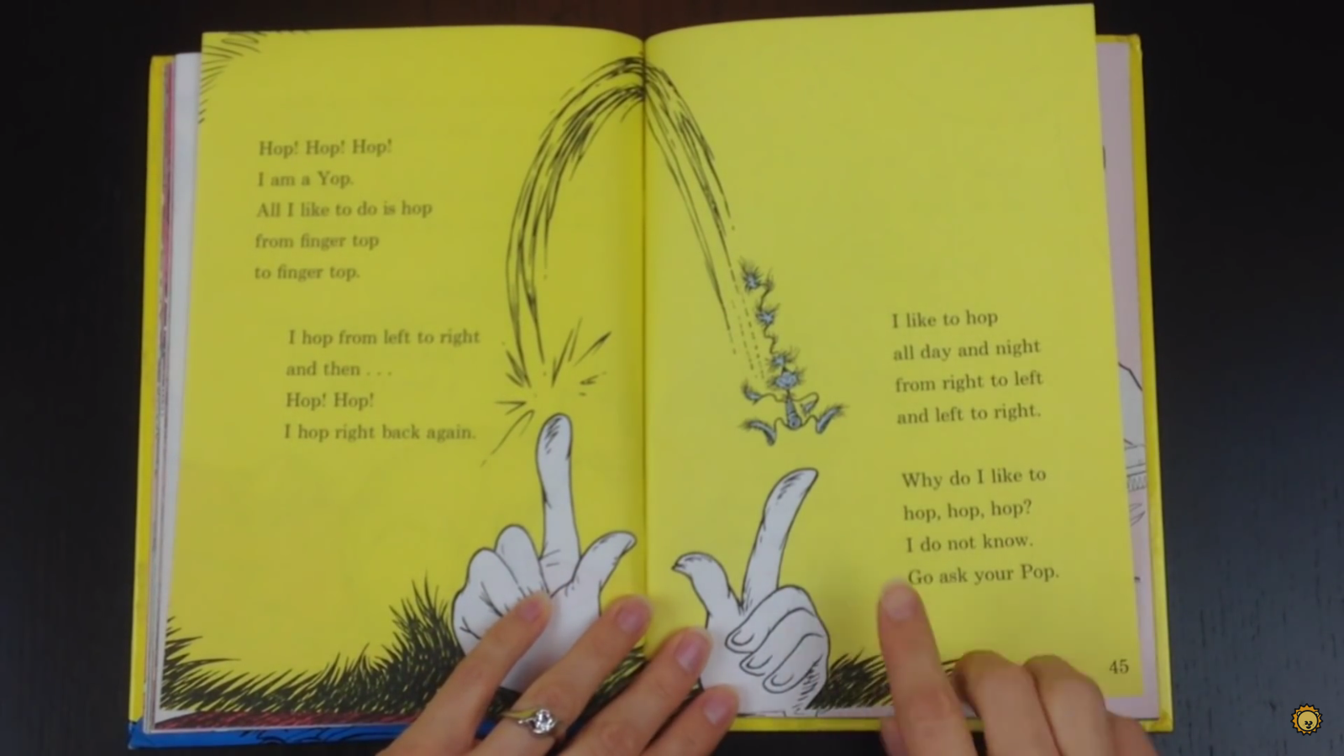

Slide 24
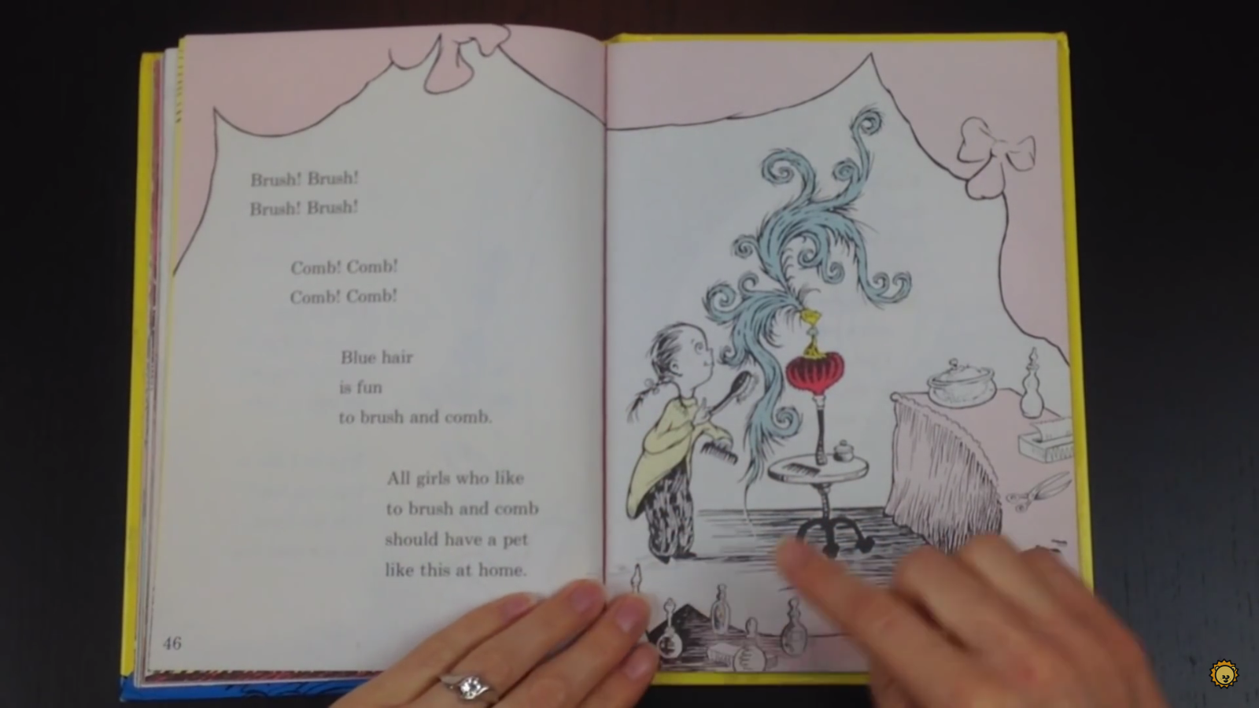

Slide 25
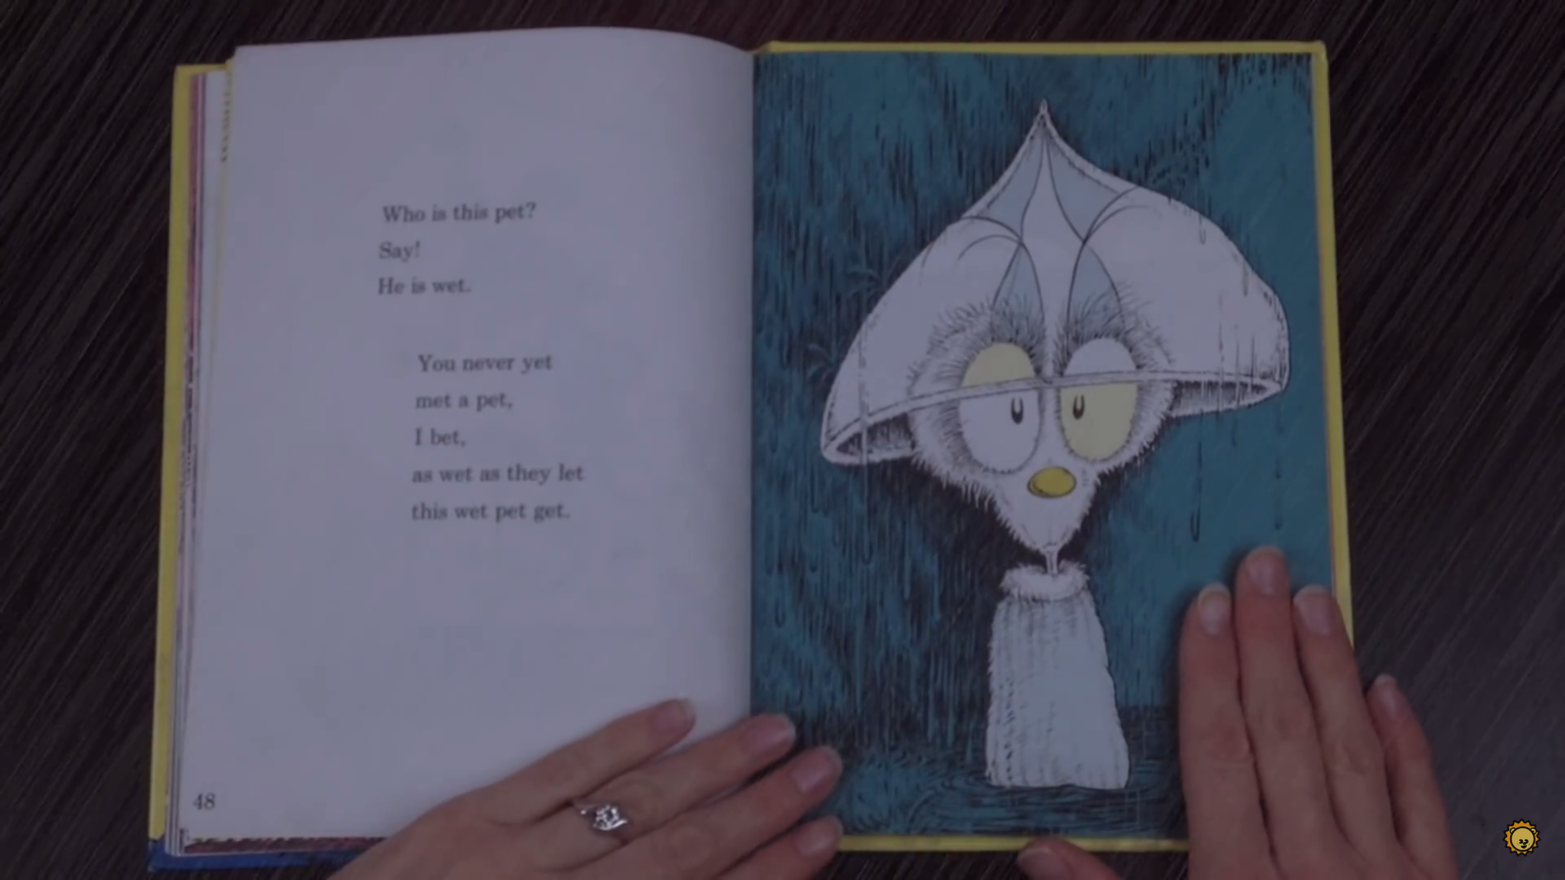

Slide 26
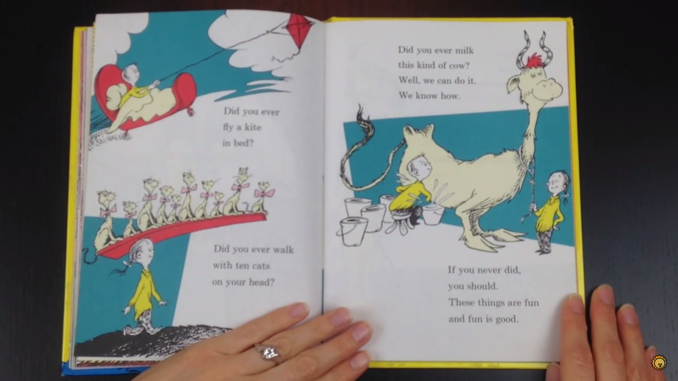

Slide 27
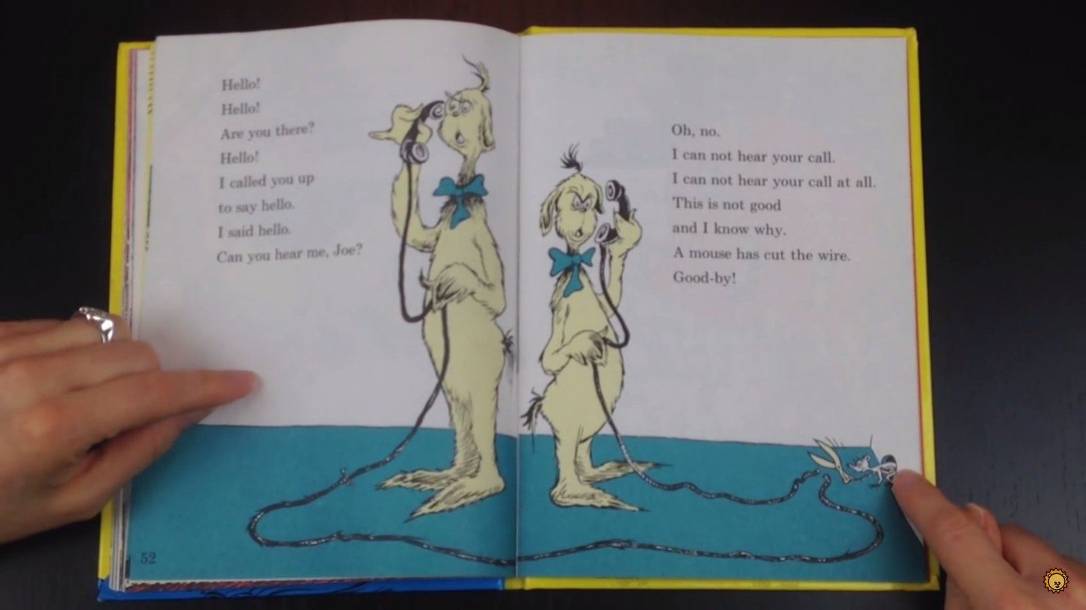

Slide 28
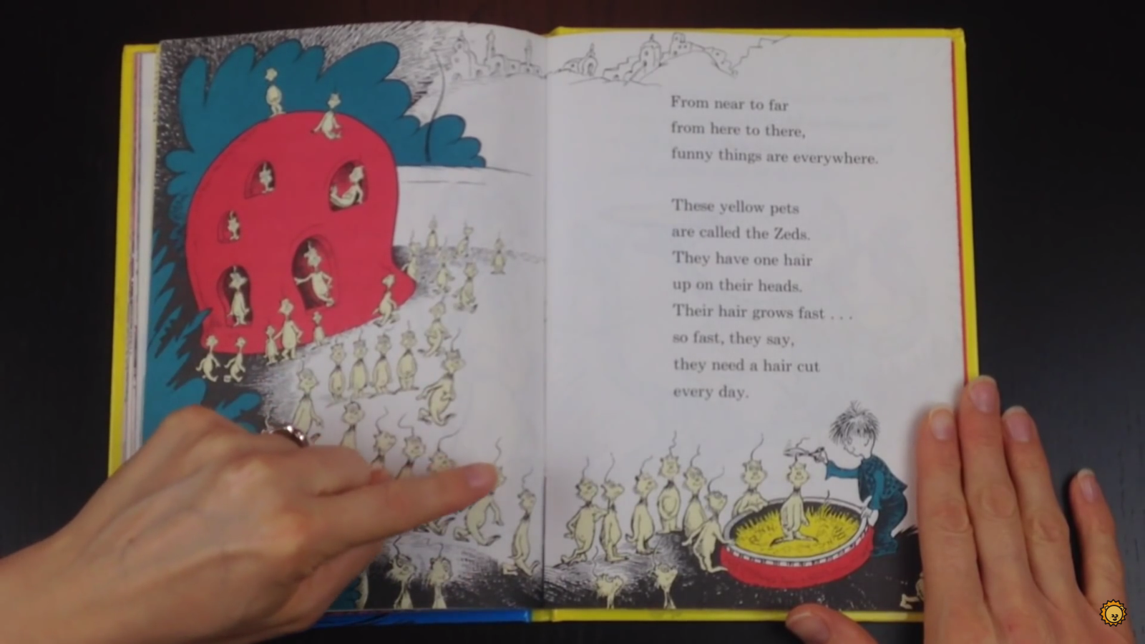

Slide 29
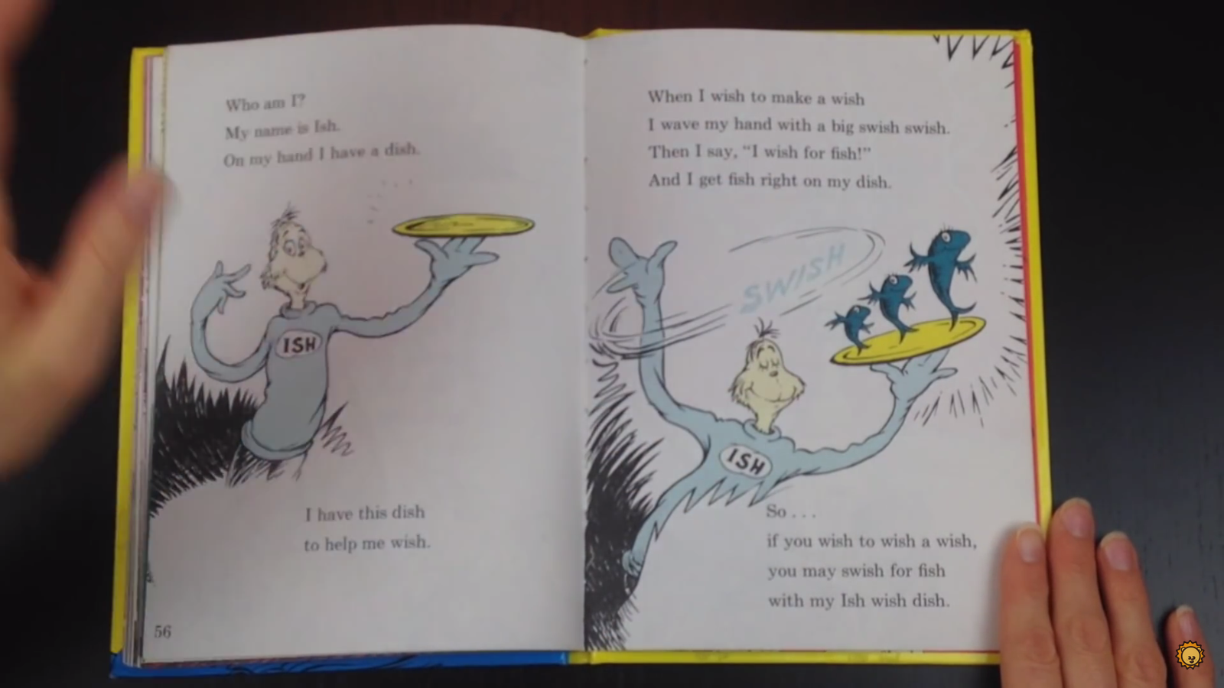

Slide 30
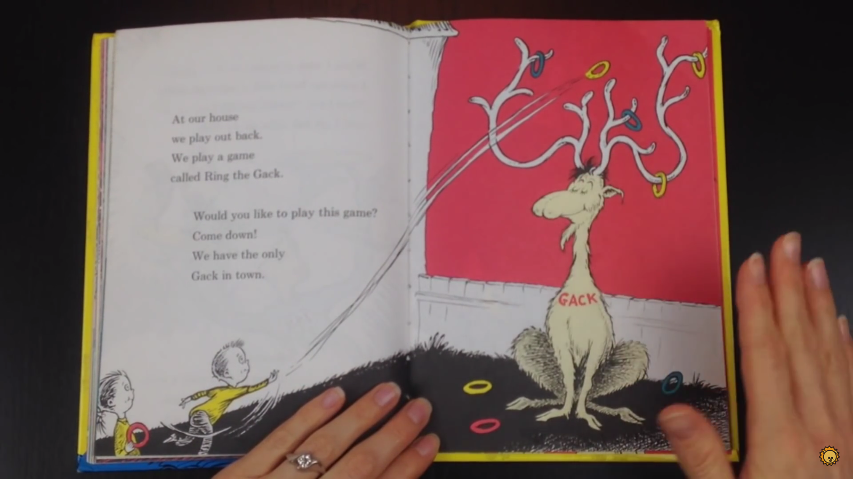

Slide 31
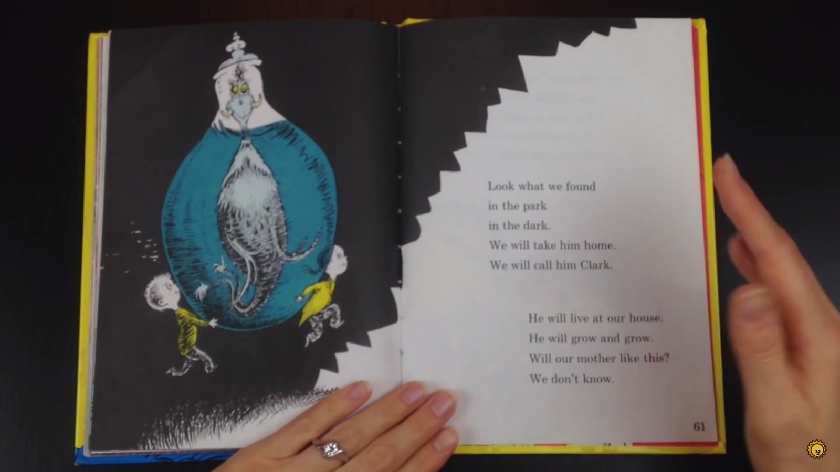

Slide 32
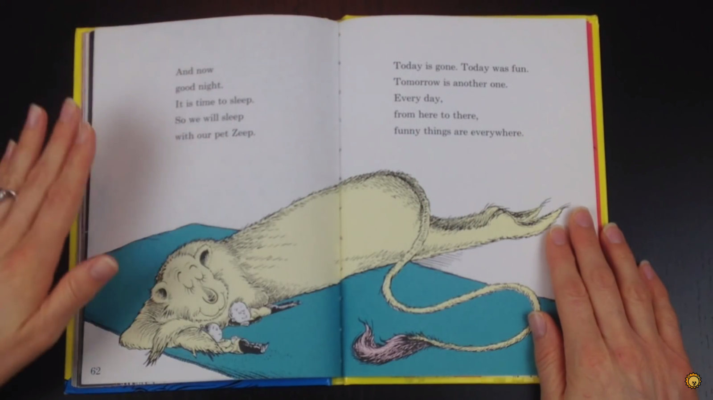

Slide 33
What does it mean?
Glad
Hump
Yell
Hop
Comb
Wet
Happy
Big back
Talking loud
Small jump
For hair
With water

Slide 34
Crazy animals in the Book
Describe them

Slide 35
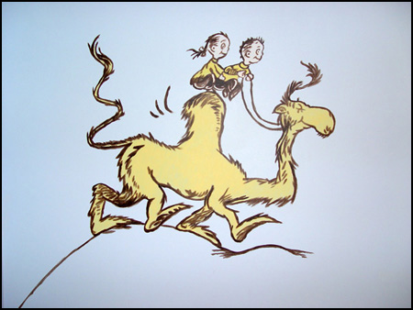
Wump

Slide 36
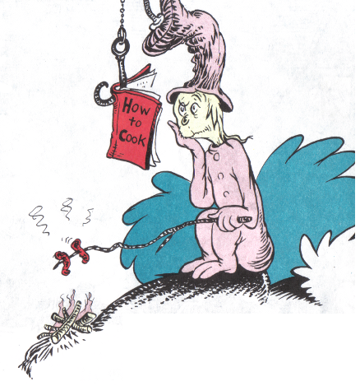
Nook

Slide 37
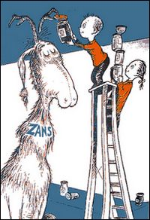
Zans

Slide 38
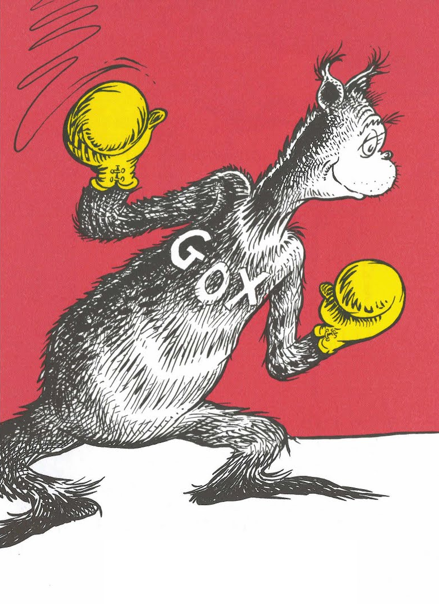
Gox

Slide 39
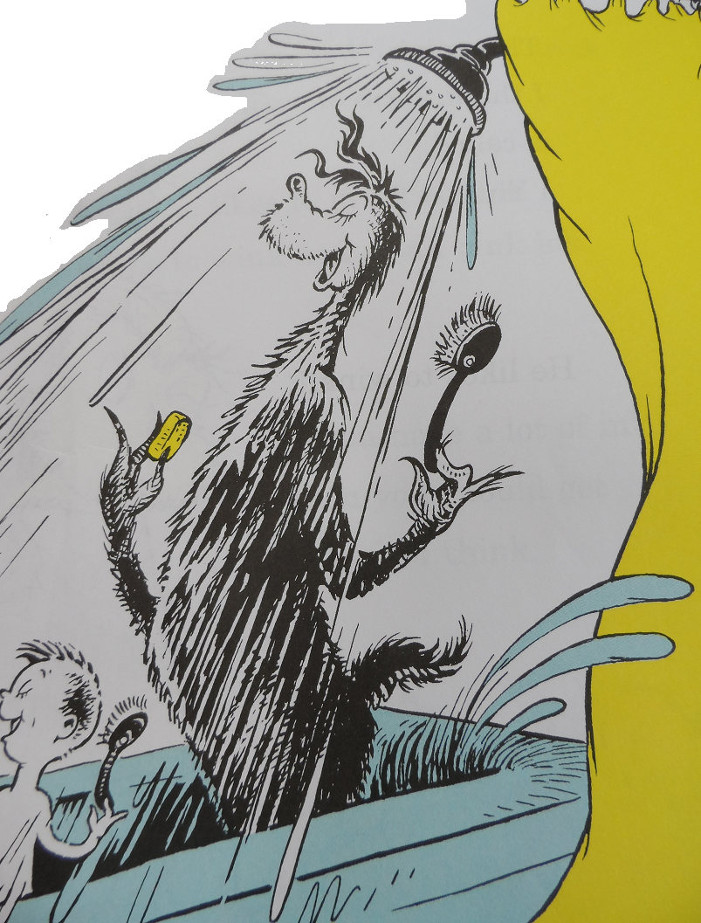
Ying

Slide 40
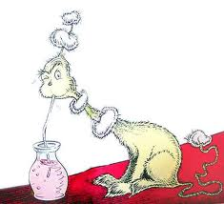
Yink

Slide 41
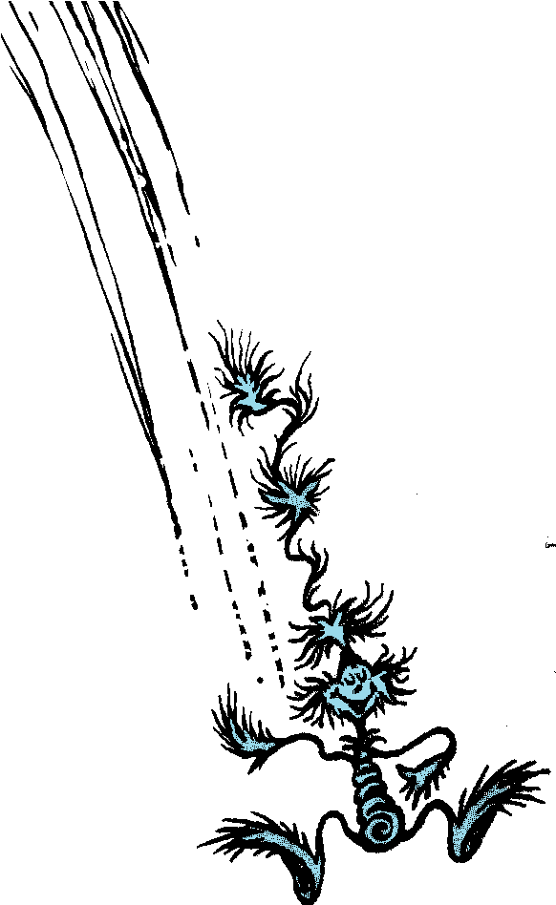
Yop

Slide 42
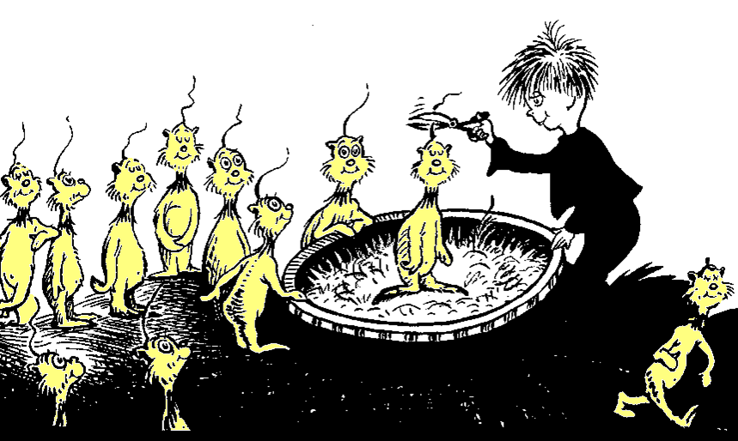
Zeds

Slide 43
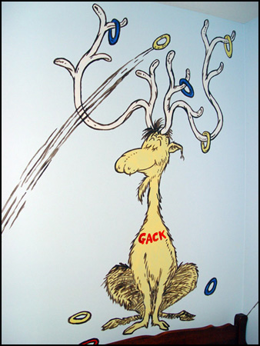
Gack

Slide 44
One Fish, Two Fish…
https://www.youtube.com/watch?v=0waeG_x2eow

Slide 45
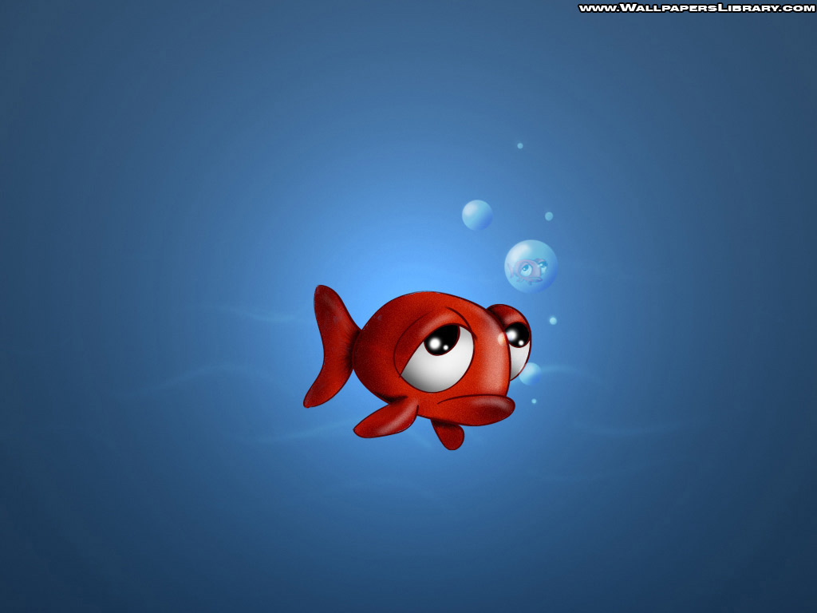
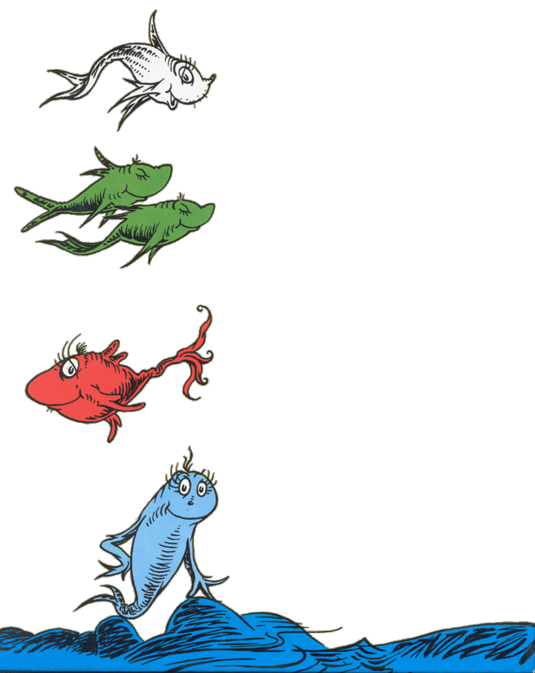
The Wump has ________.
Humps

Slide 46
Can a Nook cook?
No

Slide 47
What does a Zans do?
It opens cans.

Slide 48
What sport does the Gox like?
Boxing

Slide 49
Yings like to ______.
Sing

Slide 50
What does a Yink drink?
Pink Ink

Slide 51
What does a Yop do?
It hops.

Slide 52
What is special about Zeds?
Their hair grows very fast

Slide 53
How do you play Ring the Gack.
Throw a ring on Gack’s antlers.

Slide 54
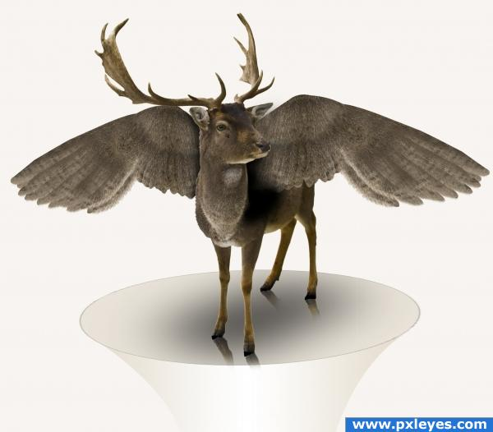
Make your own Animal:
Draw it
Describe it
Adjectives
What does it like?
It likes _______ and _____.
Where does it live?

Slide 55
Make your own animal
http://switchzoo.com/zoo.htm

