Slide 1
Deep Sea Creatures
https://www.youtube.com/watch?v=6N4xmNGeCVU

Slide 2
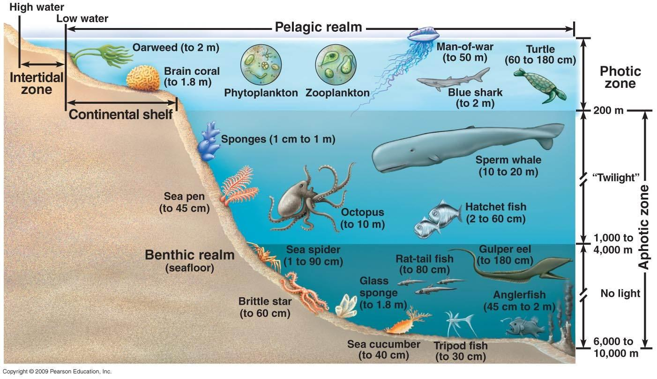

Slide 3
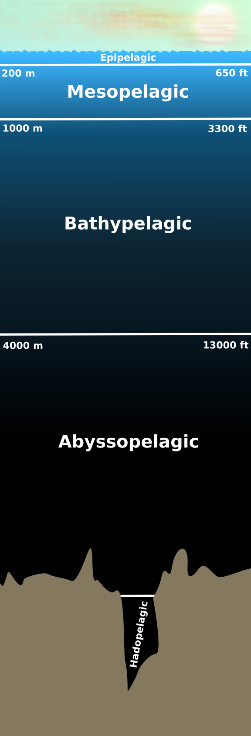
Put the sea creatures in the correct zone

Slide 4
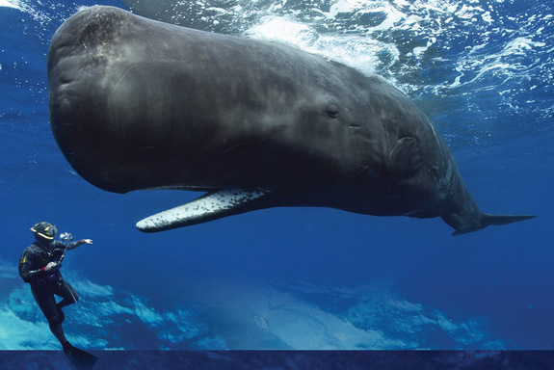
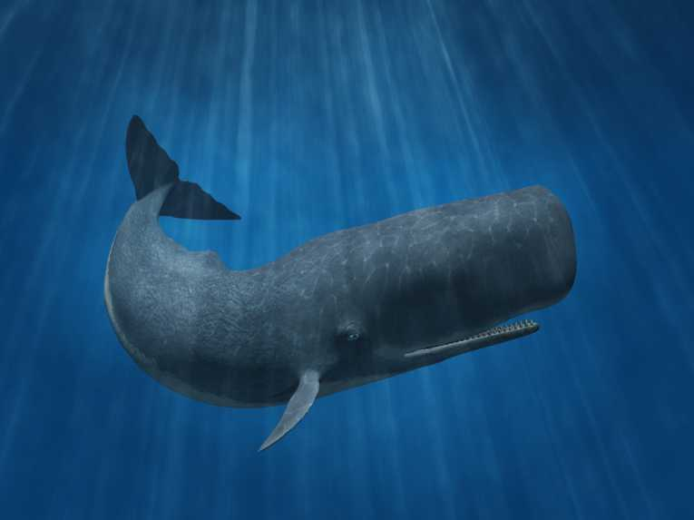
Sperm Whale
0 to 2,250m

Slide 5
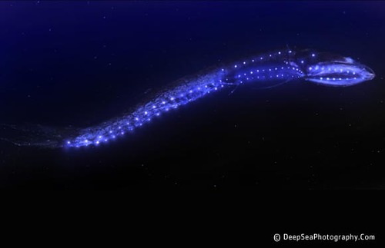
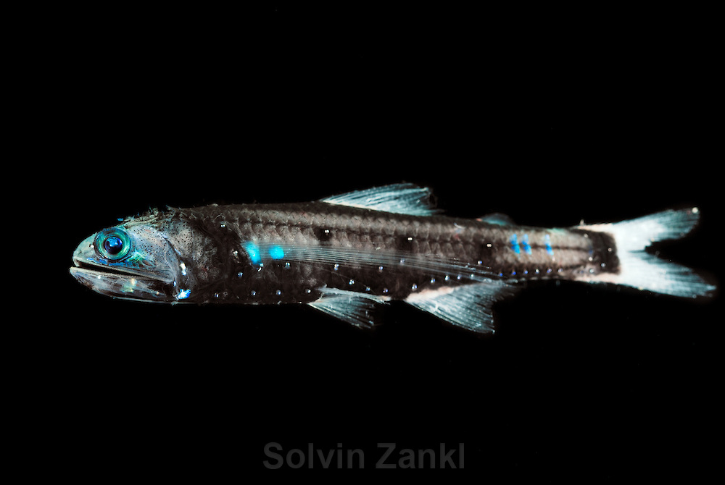
Lanternfish
100m to 1,500m

Slide 6
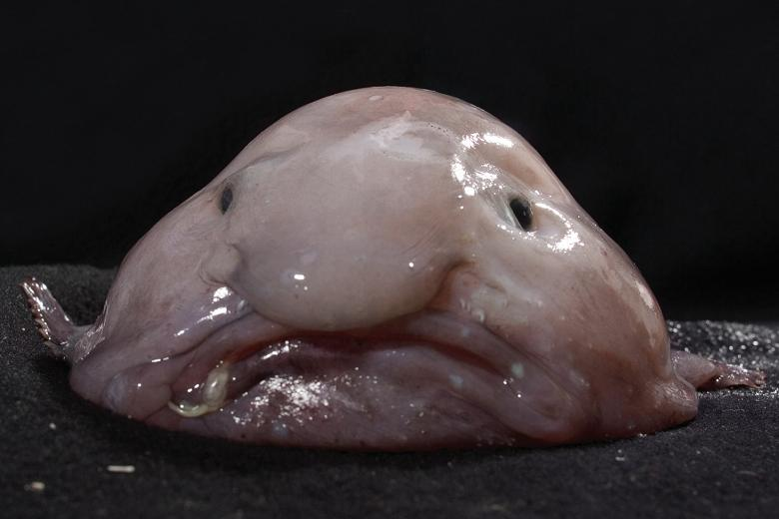
Blobfish
600m to 1,200m

Slide 7
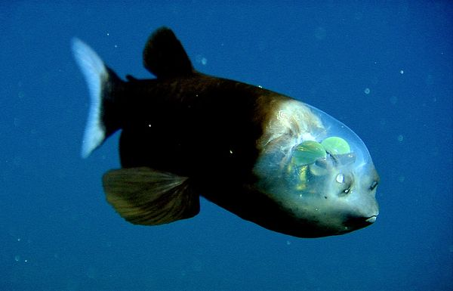
Barreleye fish
400m to 2,500m

Slide 8
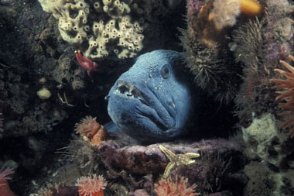
Atlantic Wolffish
600m

Slide 9
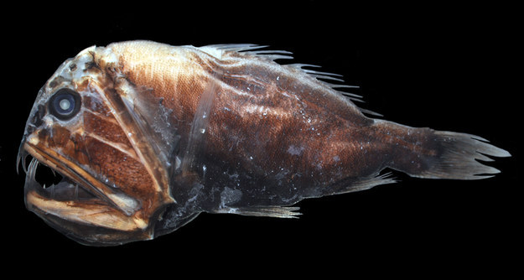
Fangtooth
1,000m to 5,000m

Slide 10
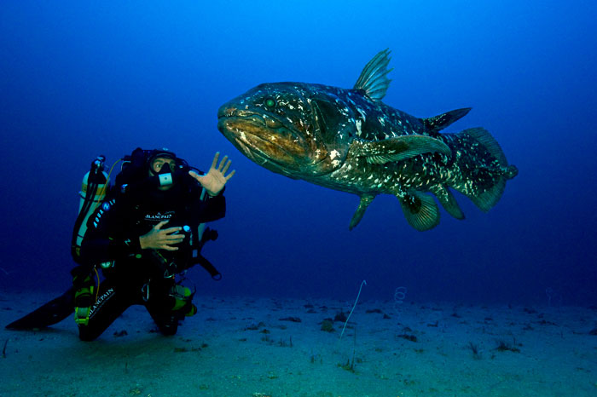
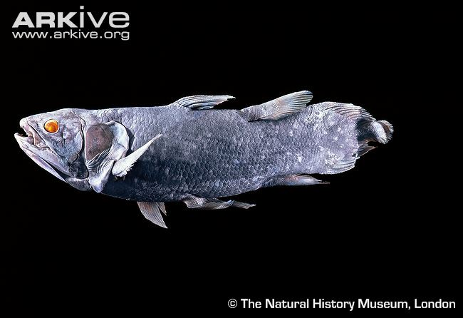
Coelacanth
100m to 500m

Slide 11
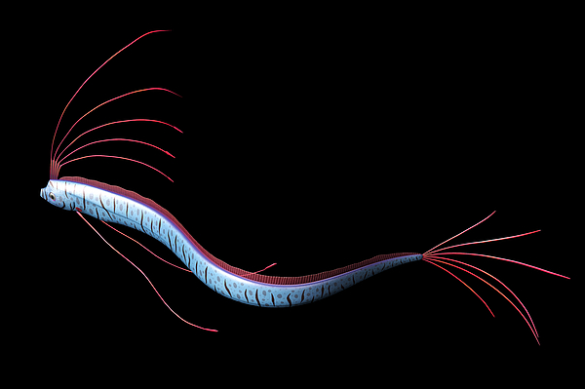
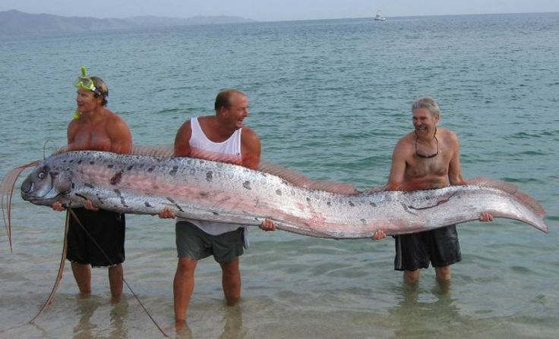
Oarfish
1,000m

Slide 12
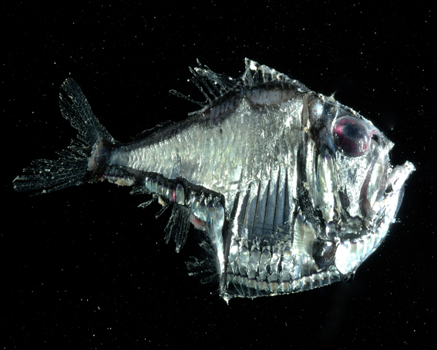
Hatchetfish
50m to 1,500m

Slide 13
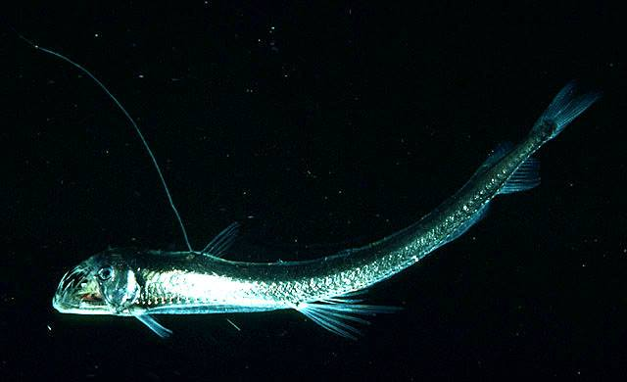
Pacific Viperfish
1,000m to 4,000m

Slide 14
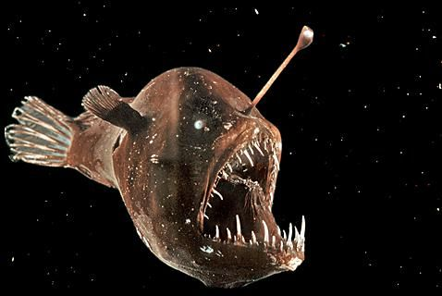
Anglerfish
1,000m to 2,000m

Slide 15
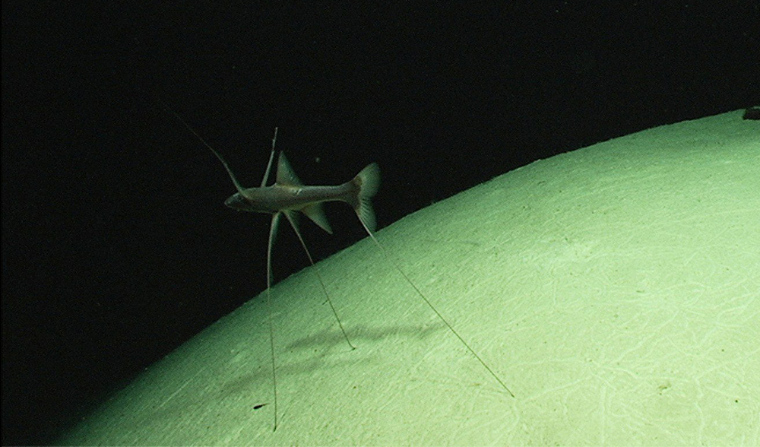
Tripod Fish
900m to 5,000m

Slide 16
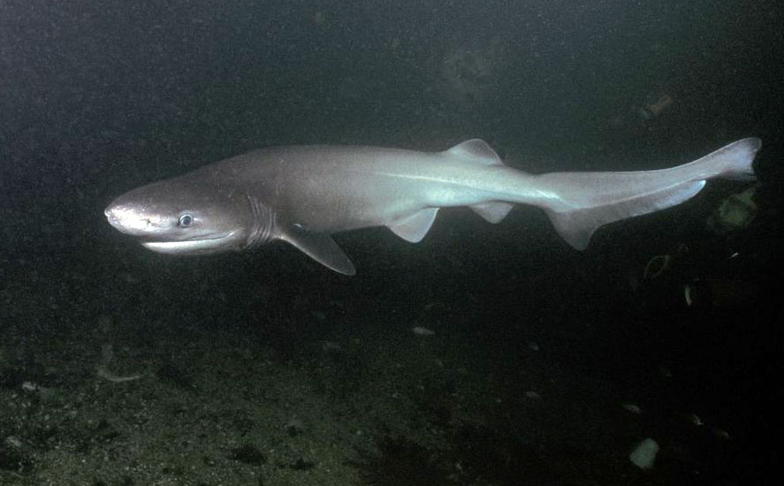
6 Gilled Shark
500m to 1,000m

Slide 17
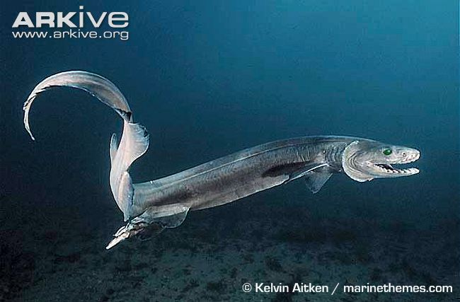
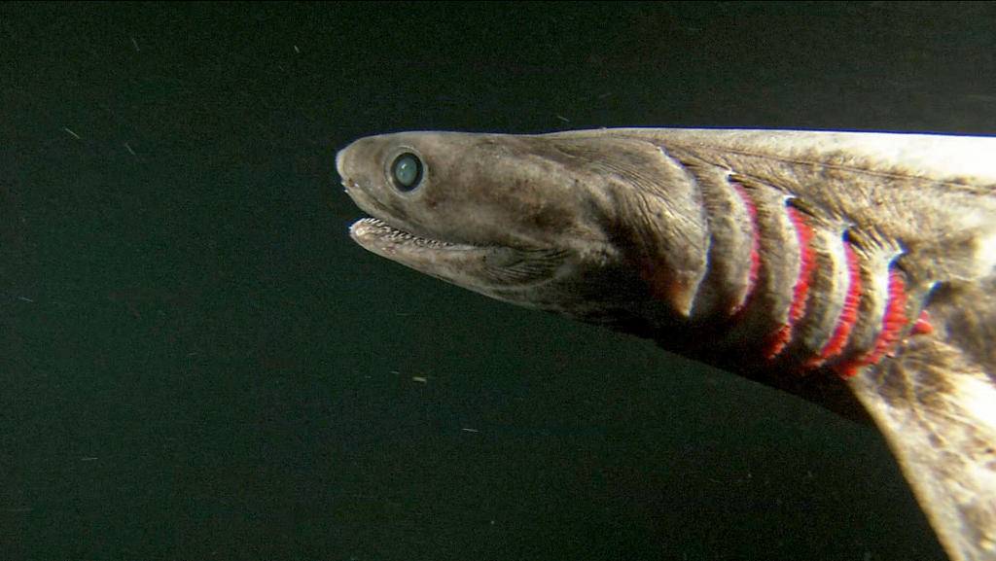
Frilled Shark
50m to 1,500m

Slide 18
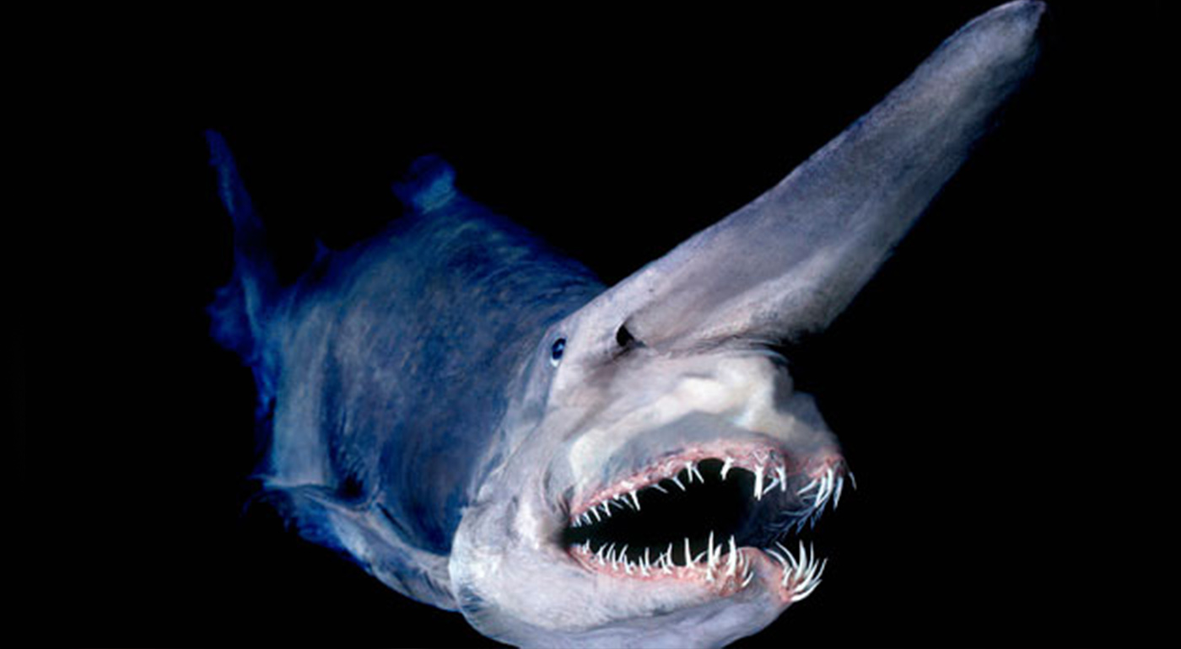
Goblin Shark
200m to 1,300m

Slide 19
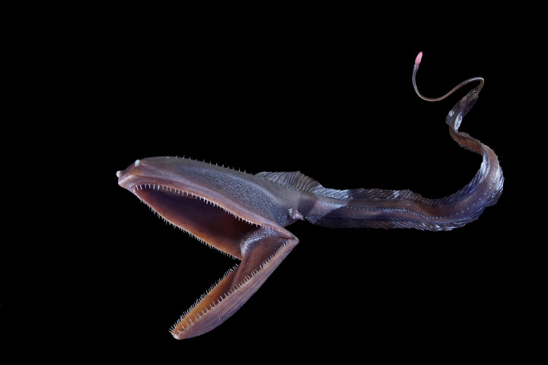
Gulper Eel (Pelican Eel)
2,000m to 3,000m

Slide 20
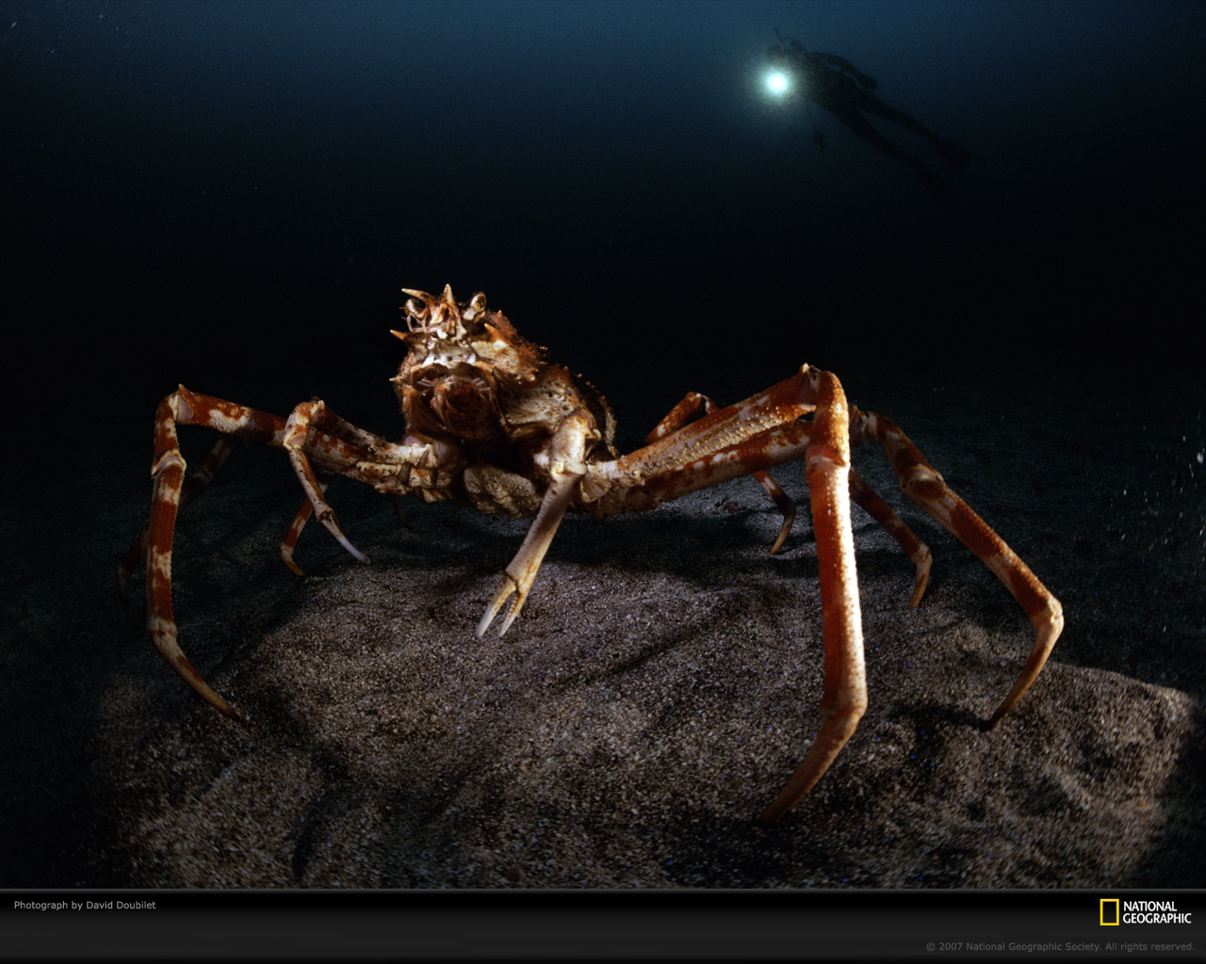
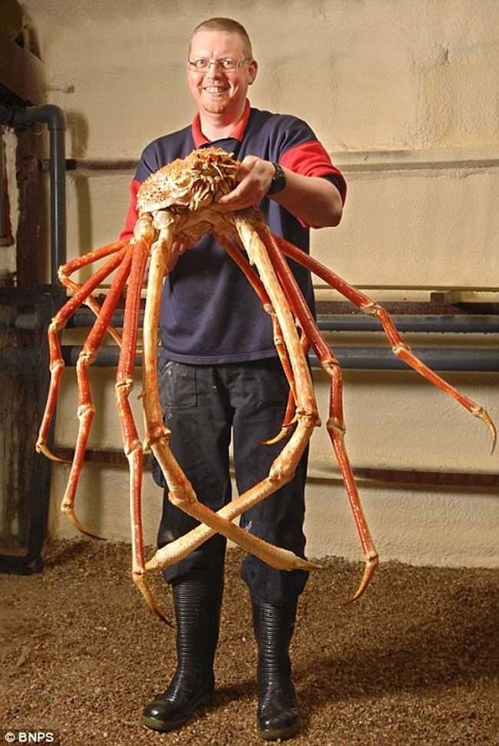
Giant Spider Crab
50m to 600m

Slide 21
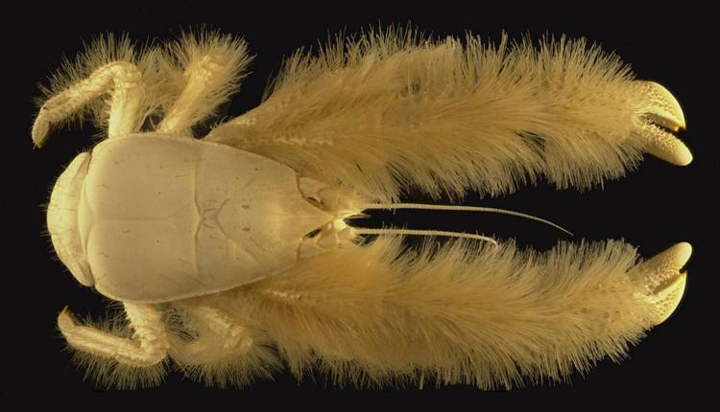
Yeti Crab
2,000m to 3,000m

Slide 22
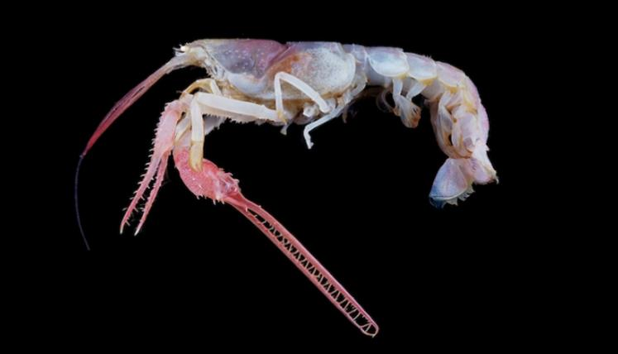
Terrible Claw (Blind) Lobster
250m

Slide 23
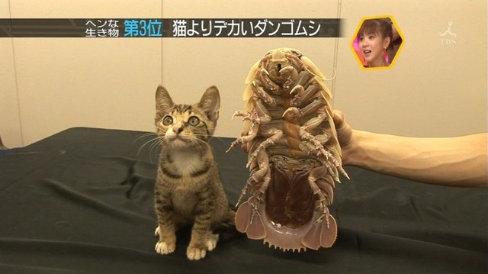
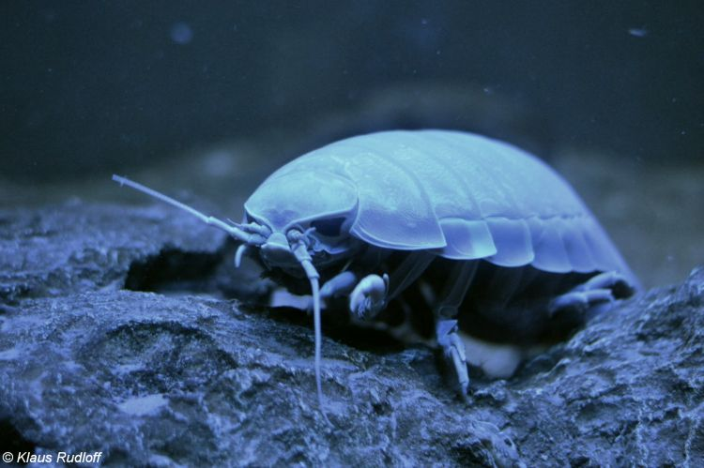
Giant Isopod
170m to 2,200m

Slide 24
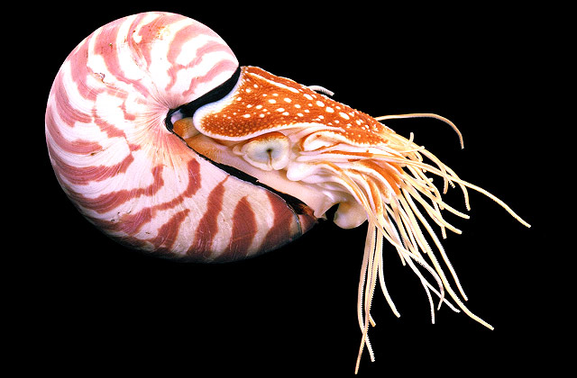
Nautilus
5m to 800m

Slide 25
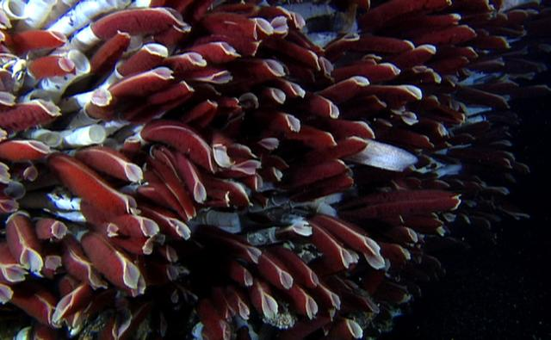
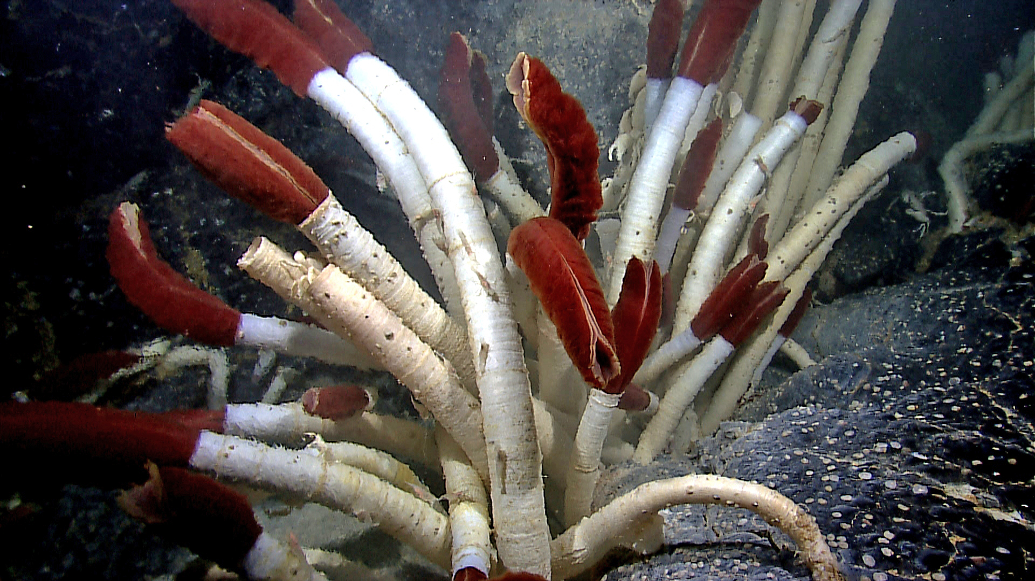
Giant Tube Worms
1,500m

Slide 26
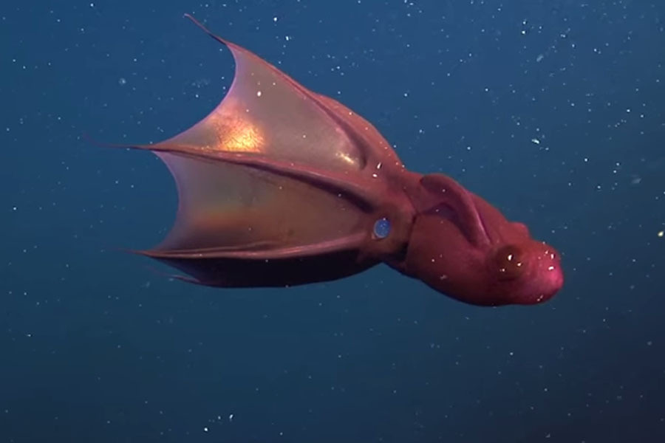
Vampire Squid
600m to 900m

Slide 27
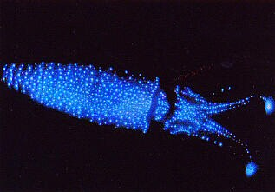
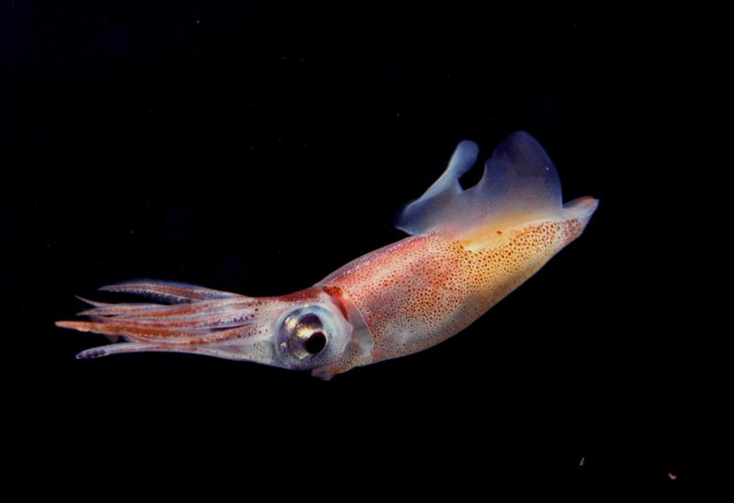
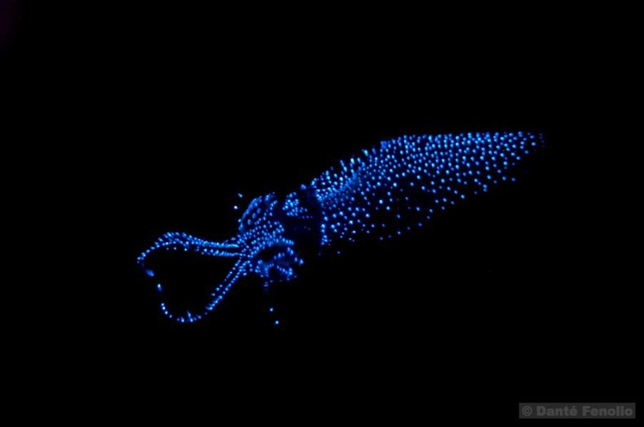
Firefly Squid
180m to 370m

Slide 28
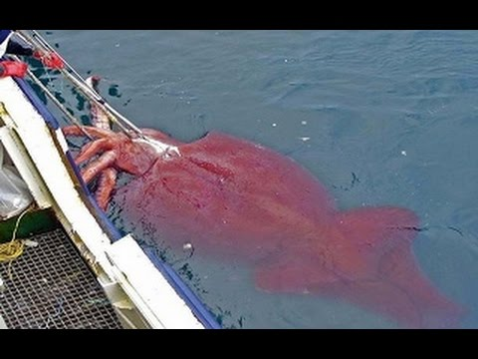
Giant Squid
300m to 1,000m

Slide 29
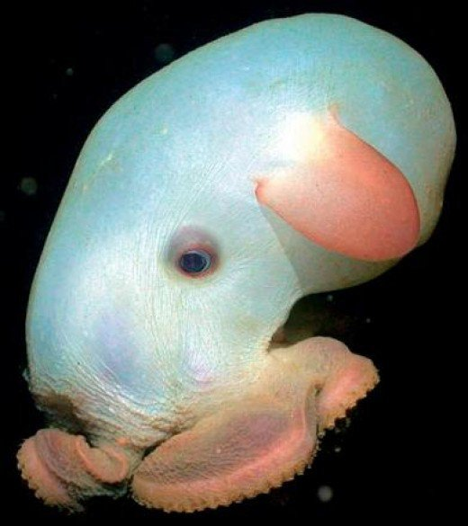
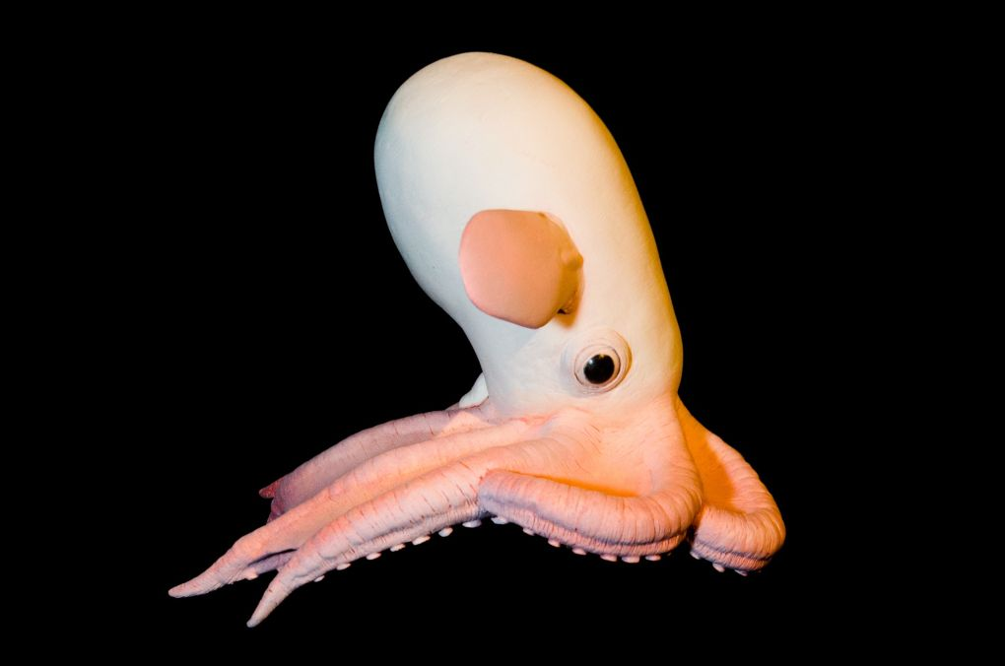
Dumbo Octopus
3,000m to 7,000m

Slide 30
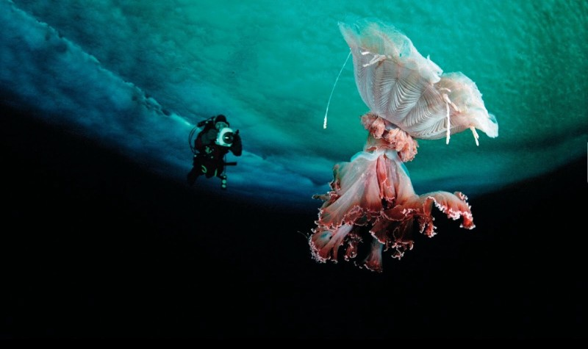
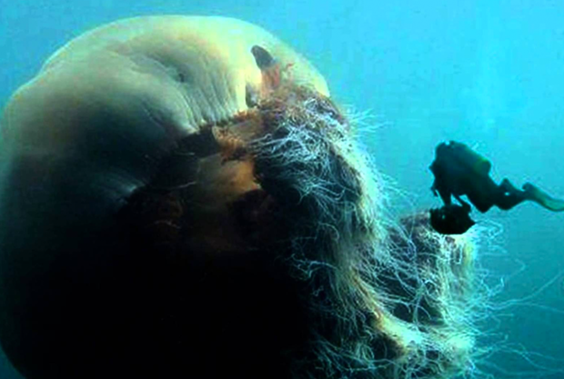
Jellyfish
0 to 9,000m

Slide 31
Identify the Sea Creatures
http://www.seasky.org/deep-sea/deep-sea-menu.html

Slide 32
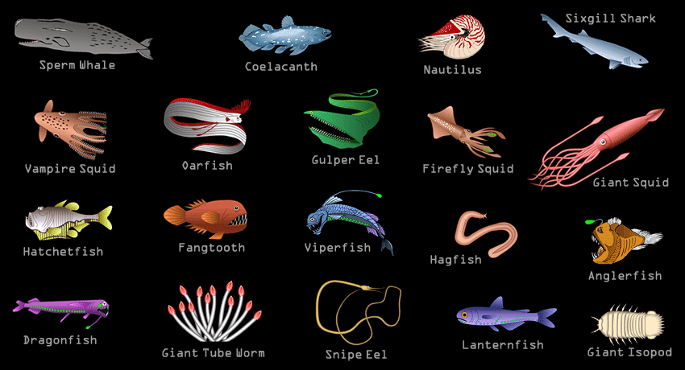

Slide 33
Nemo
https://www.youtube.com/watch?v=y9ZgTXDJb0U

Slide 34
Some Deep Sea Creatures
https://www.youtube.com/watch?v=KEjU6RhoSGU

