Slide 1
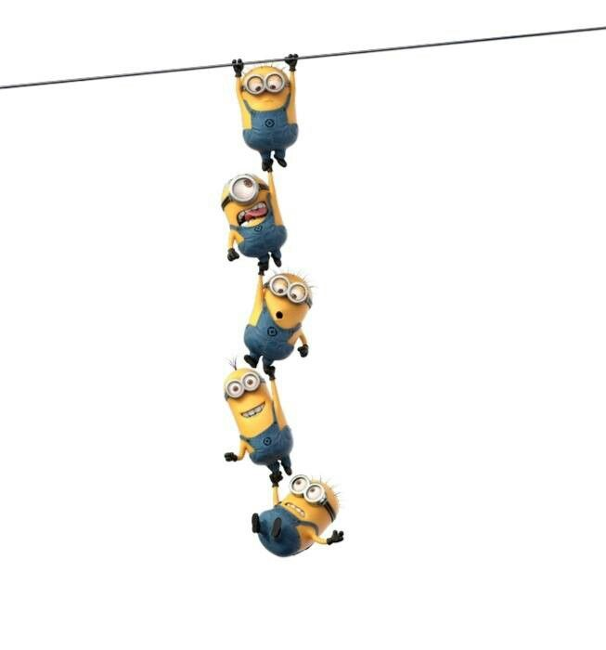
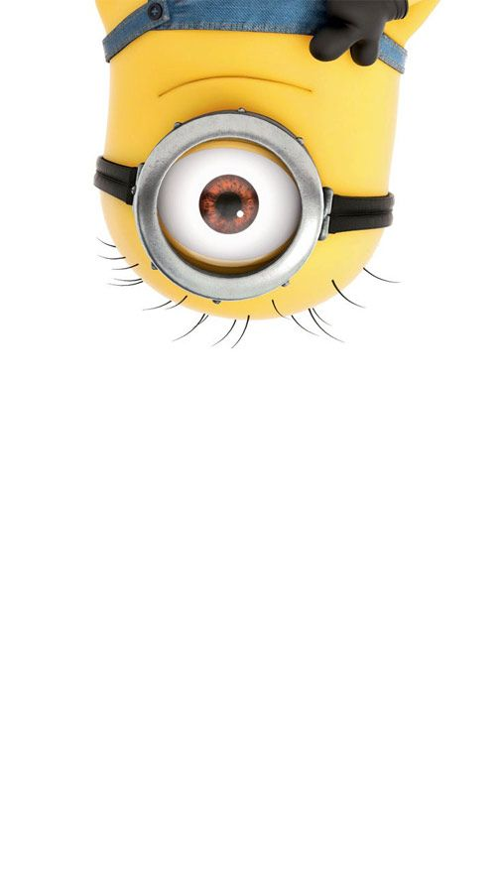
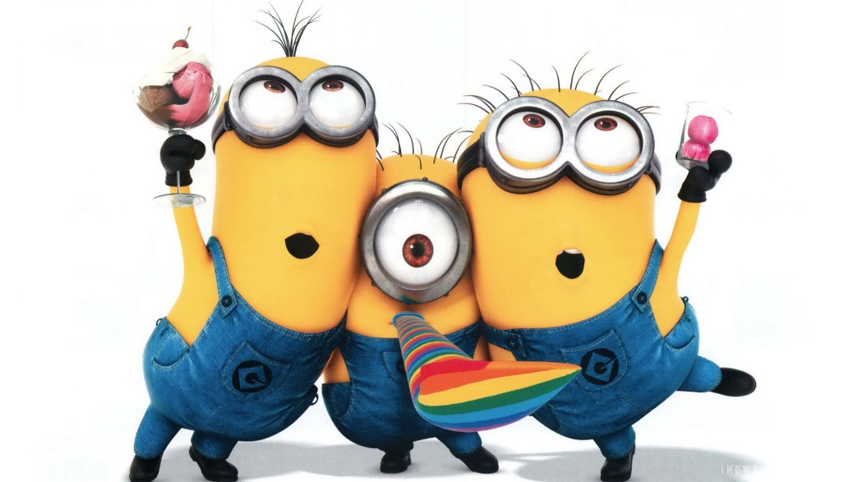
Minion Party
http://www.game37.net/play-games/minions-hidden-alphabets

Slide 2
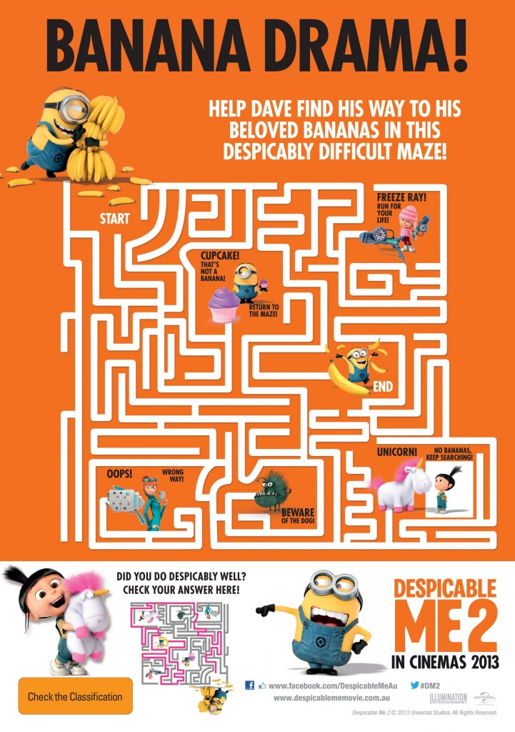
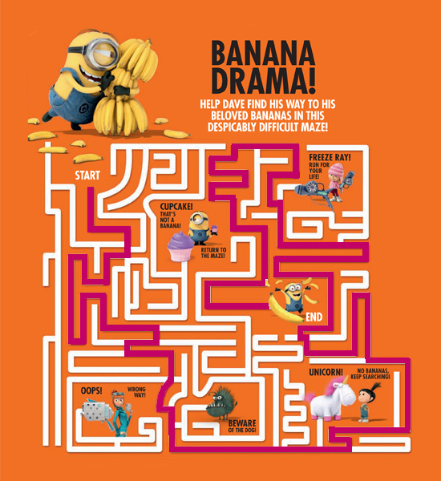

Slide 3
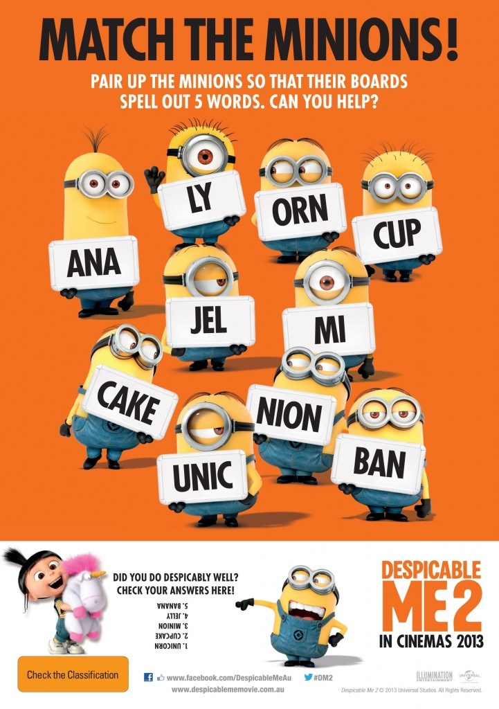

Slide 4
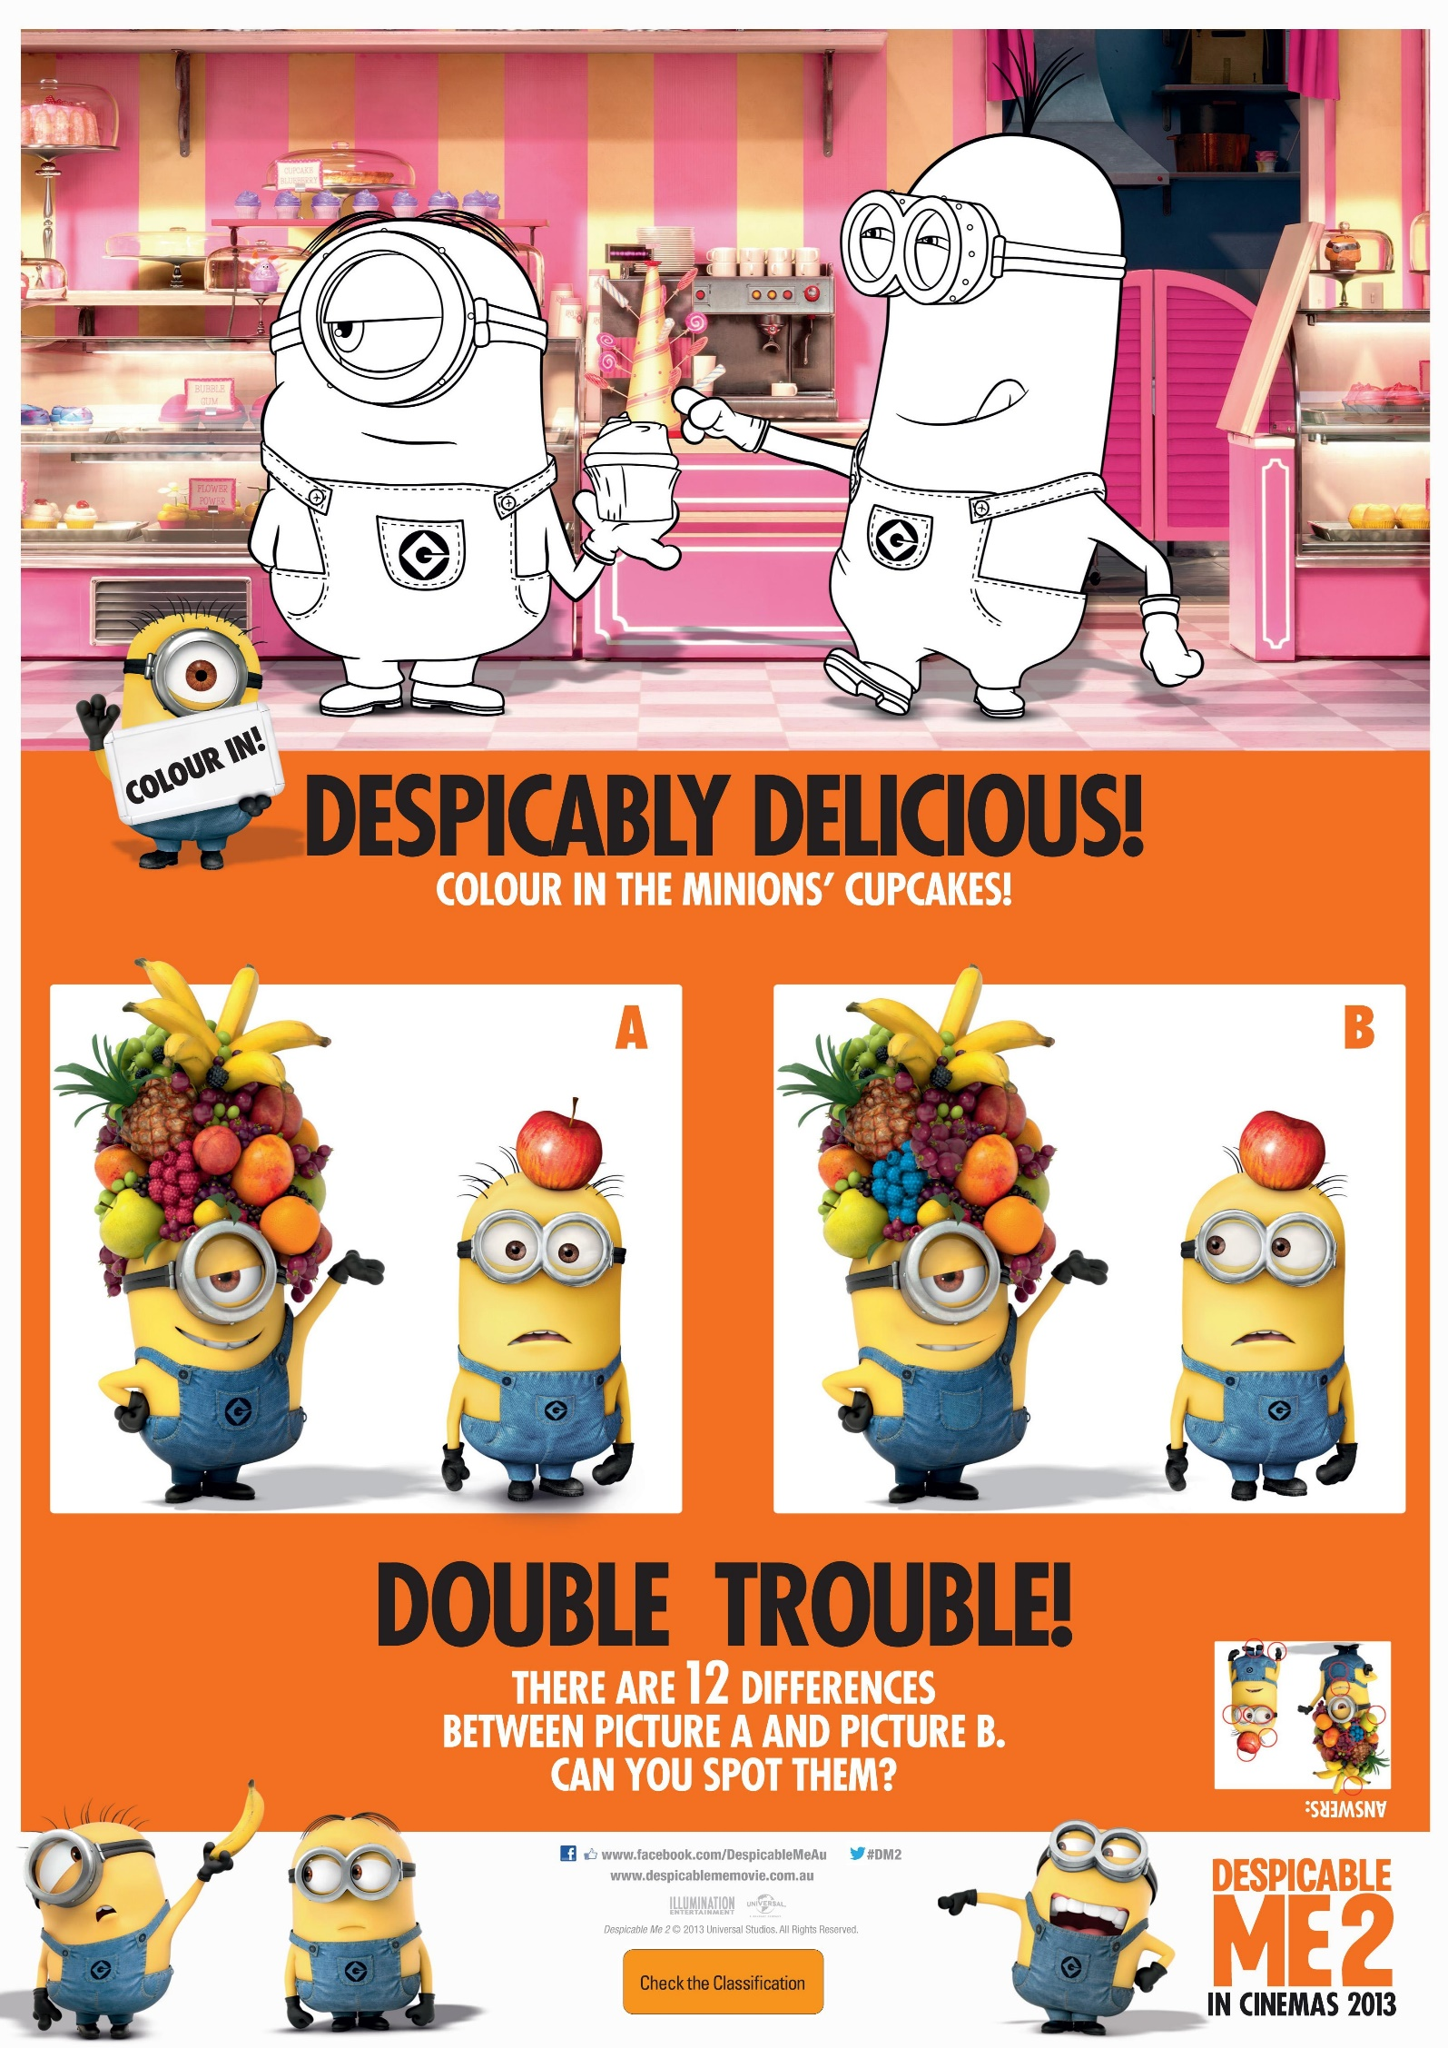

Slide 5
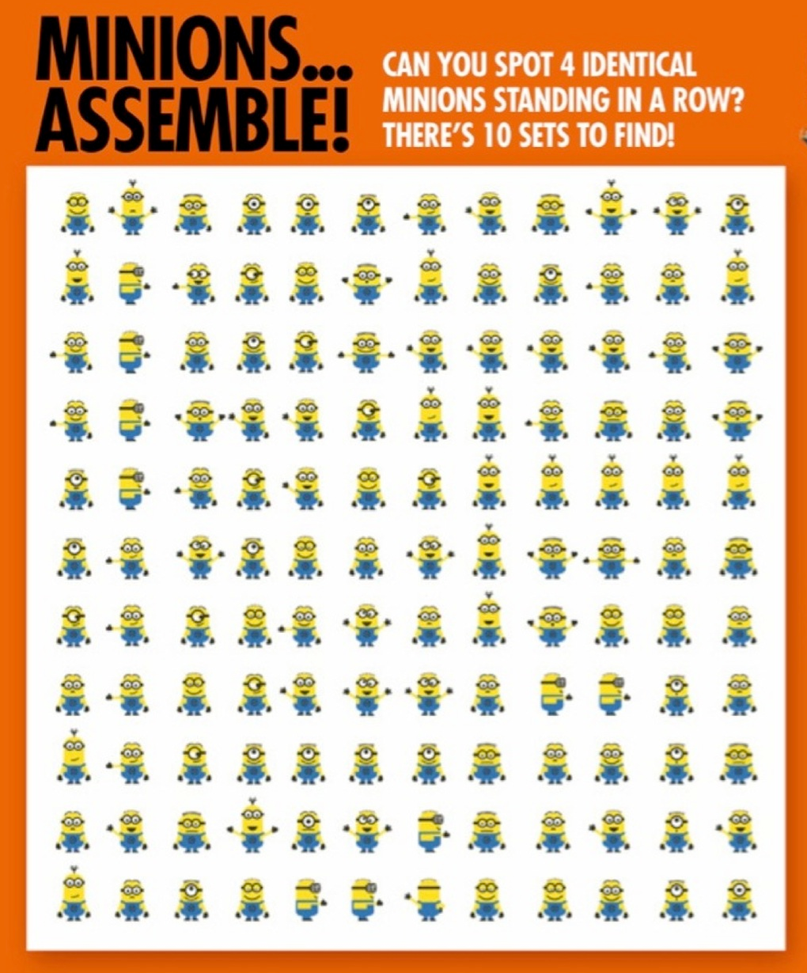

Slide 6
School Test
http://minion-games.net/minion-games/minion-schol-test

Slide 7
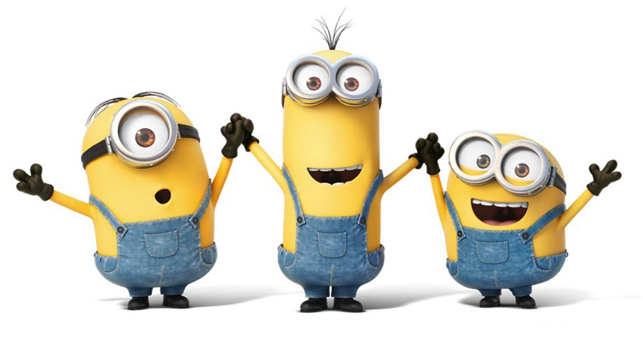
UNSRAMBLE THE WORDS
VIADD -
KIME -
LINHA -
NEB -
RUSMEM -
MARHA -
TREES -
DJYU -
NUJYI -
HOWNOJA -
HOTNANY -
VESTEN -

Slide 8
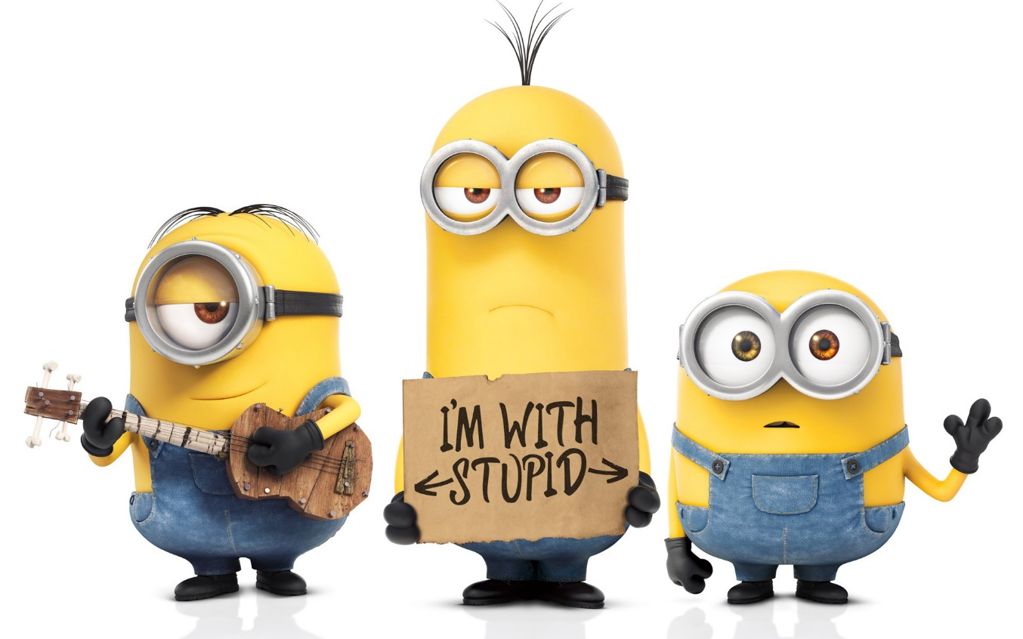
Scramble the Word Game

Slide 9
House Makeover
http://www.game37.net/play-games/minions-house-makeover

Slide 10
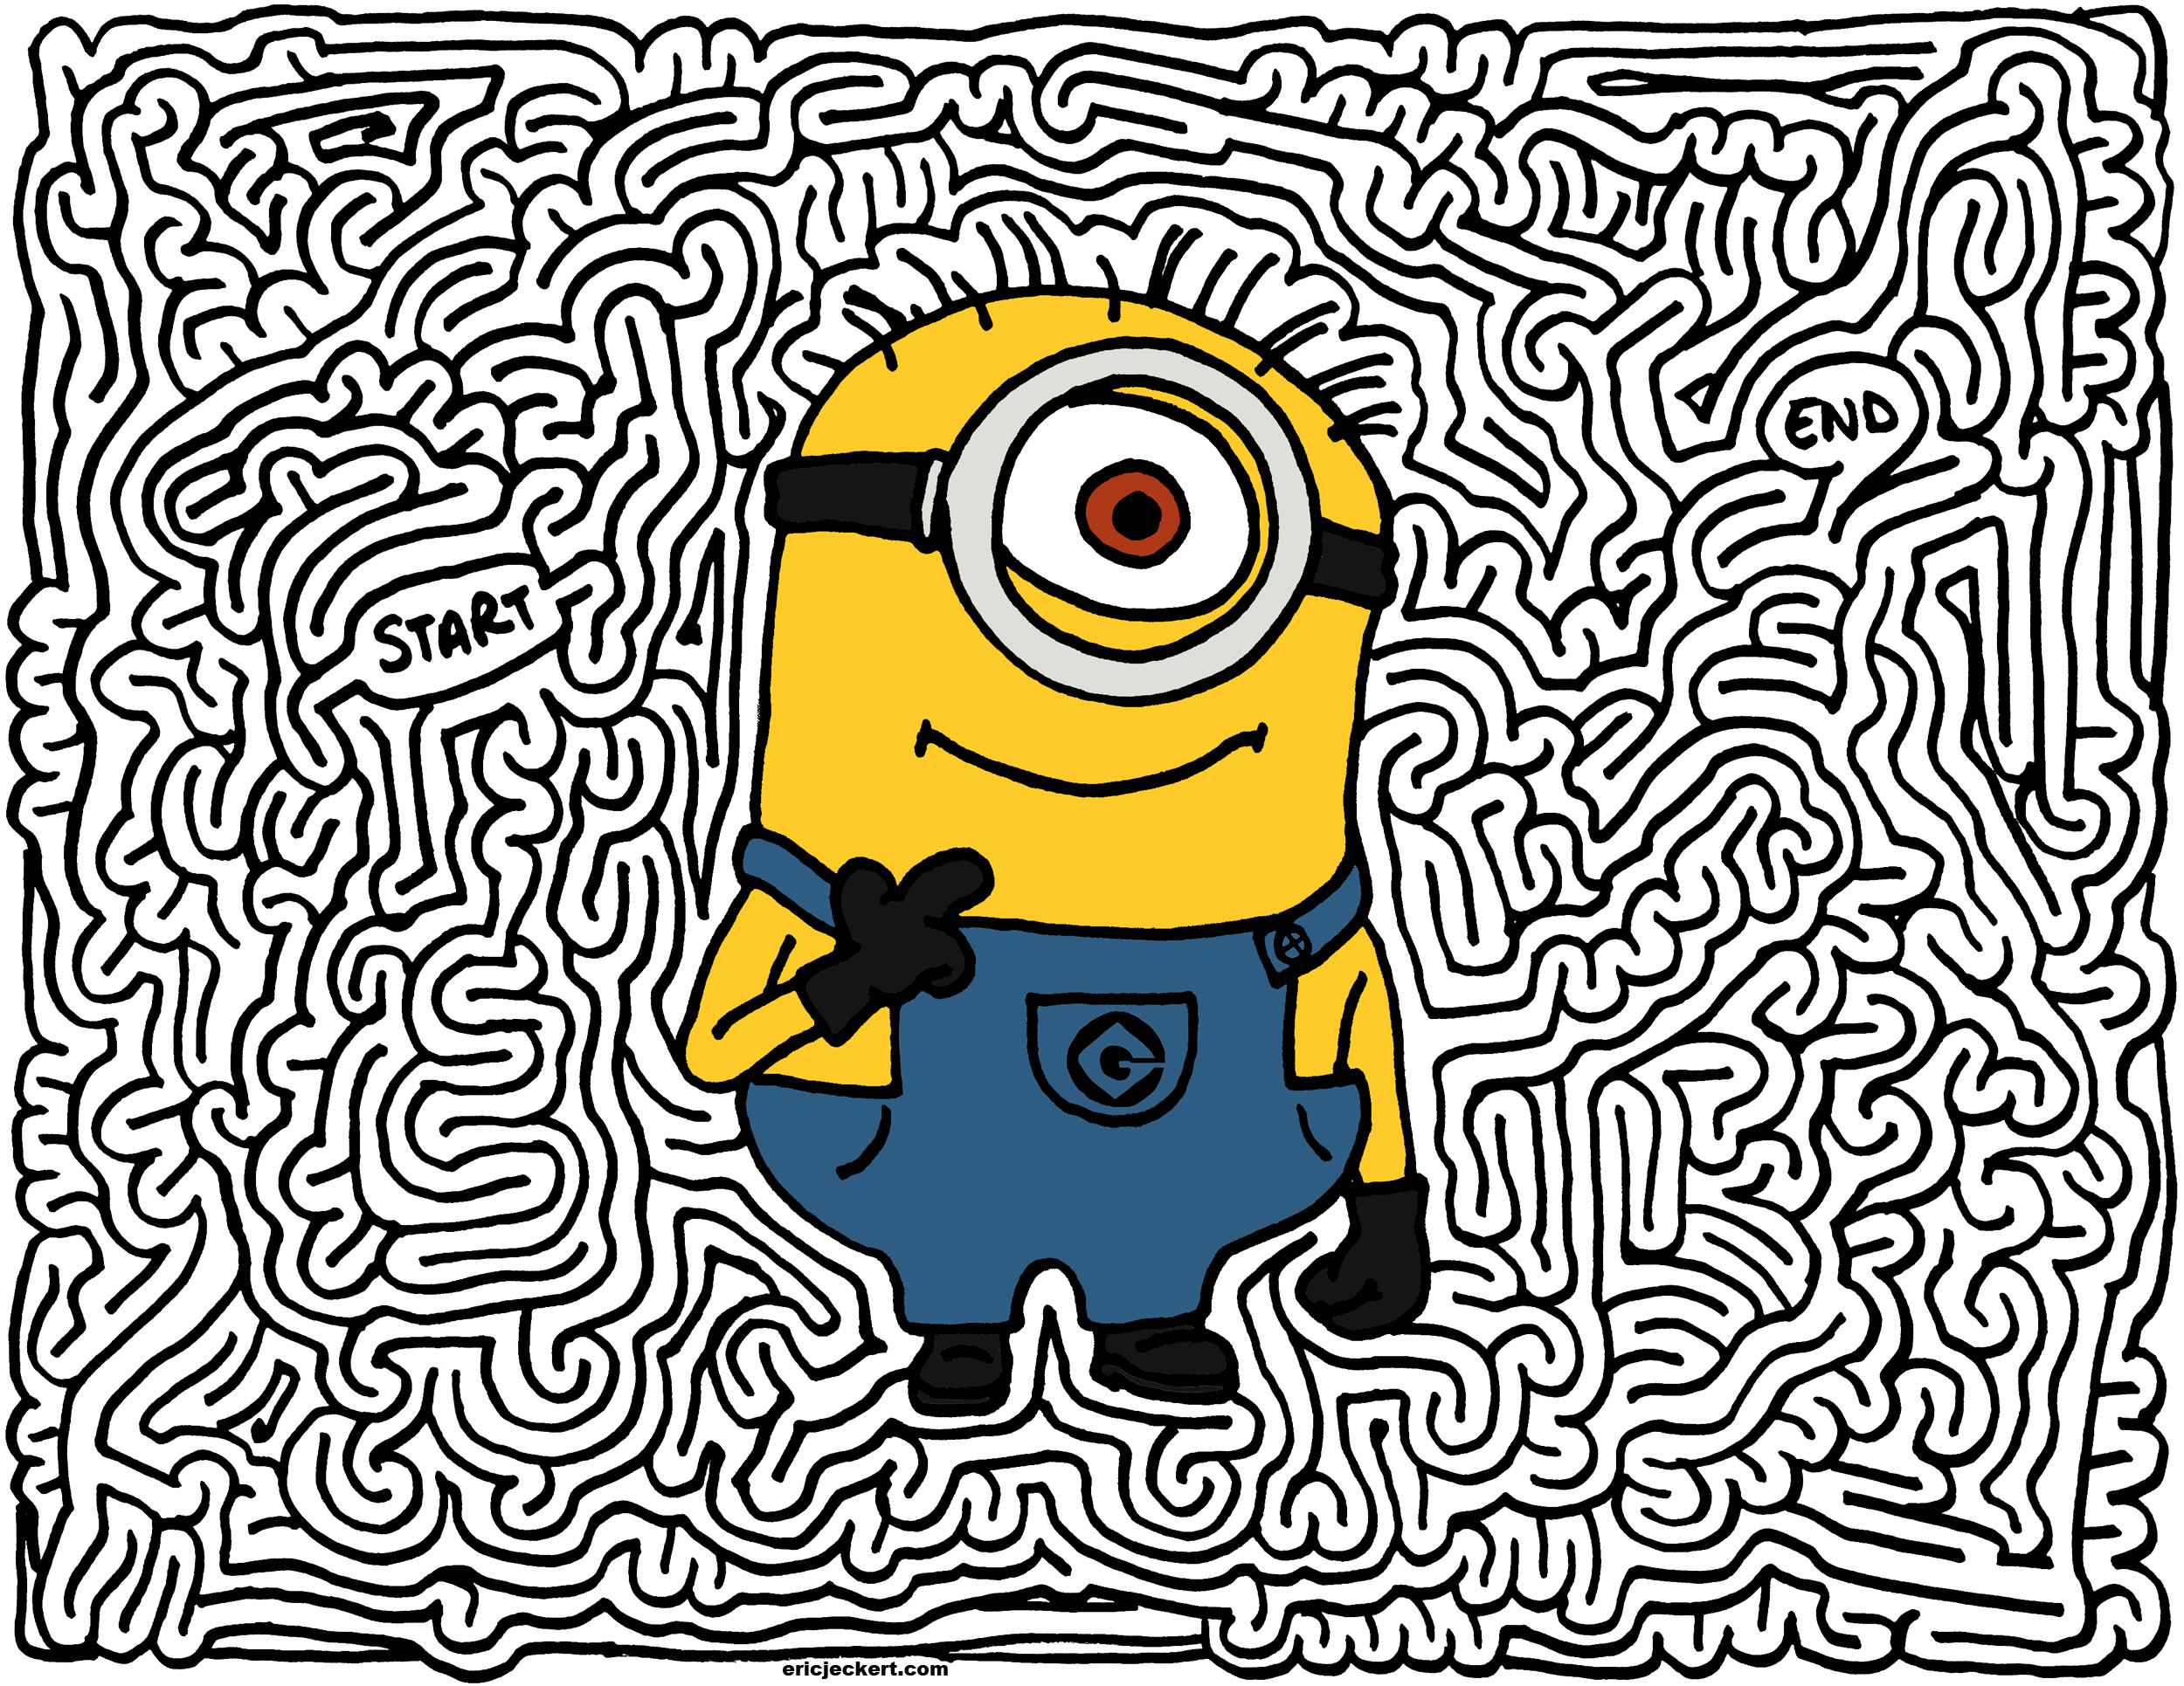

Slide 11
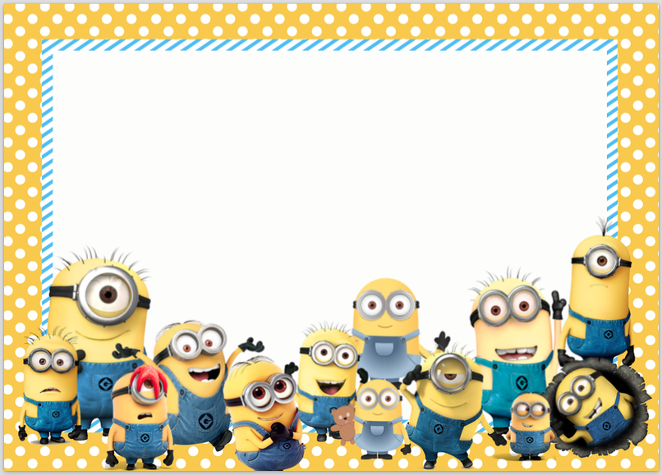
Face Paint
http://www.game37.net/play-games/minion-face-paint

Slide 12
Speed Game
http://www.game37.net/play-games/minion-fast

Slide 13
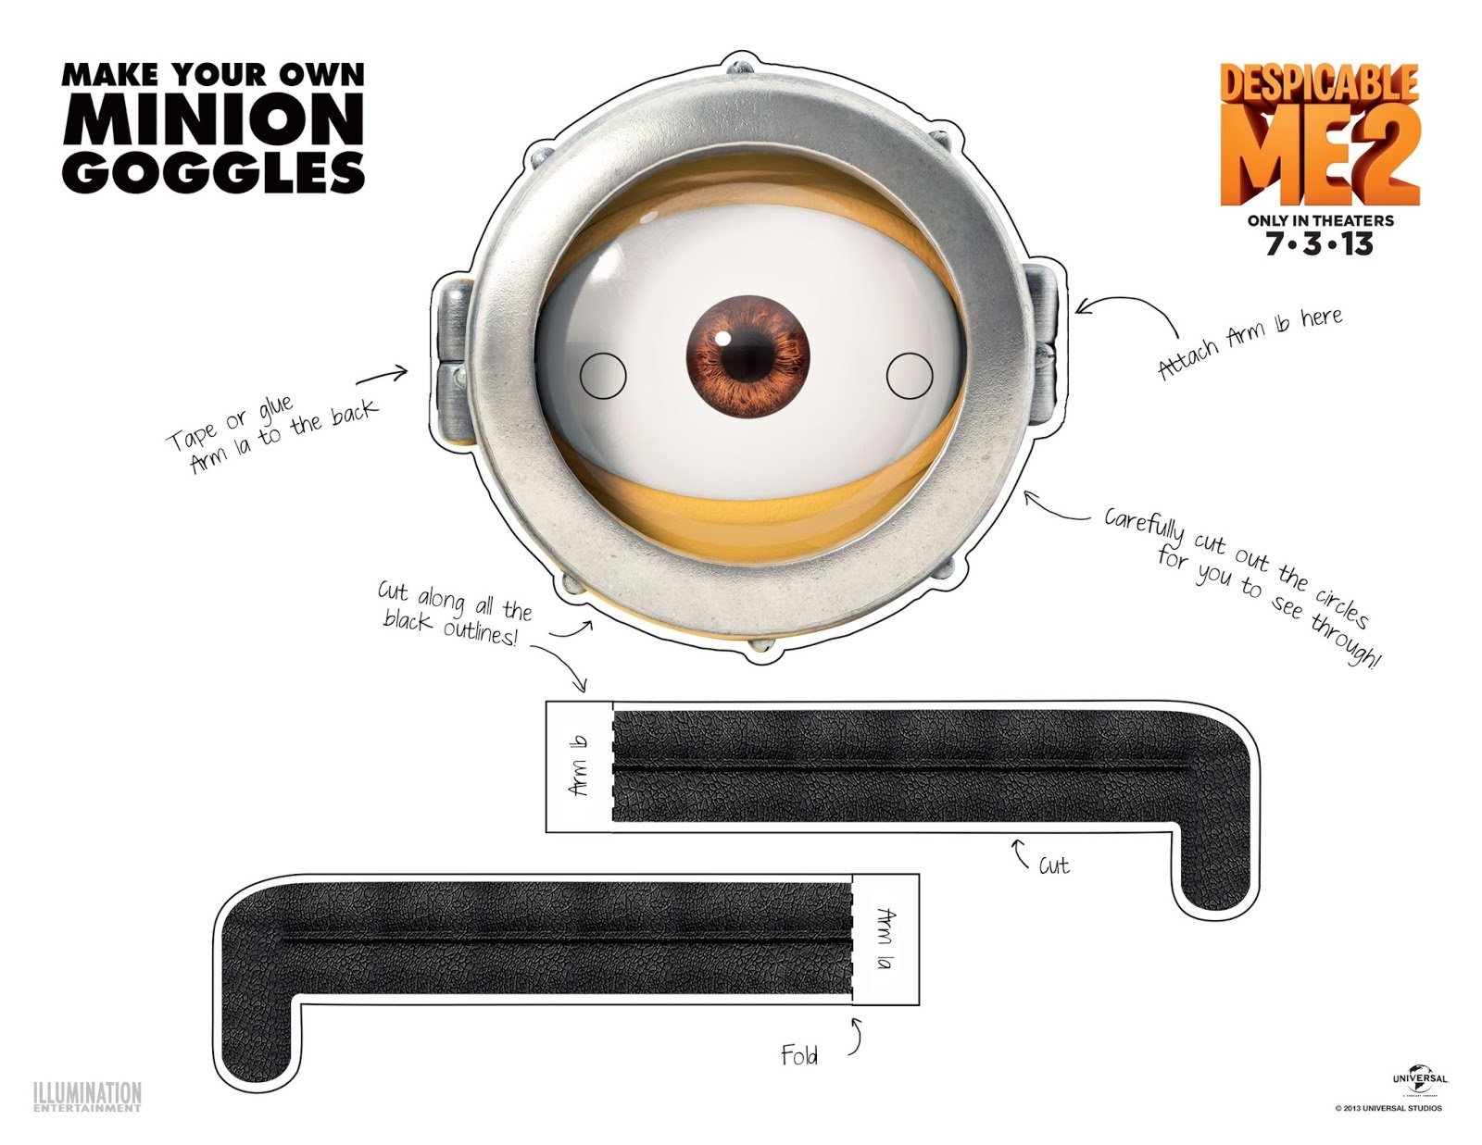

Slide 15
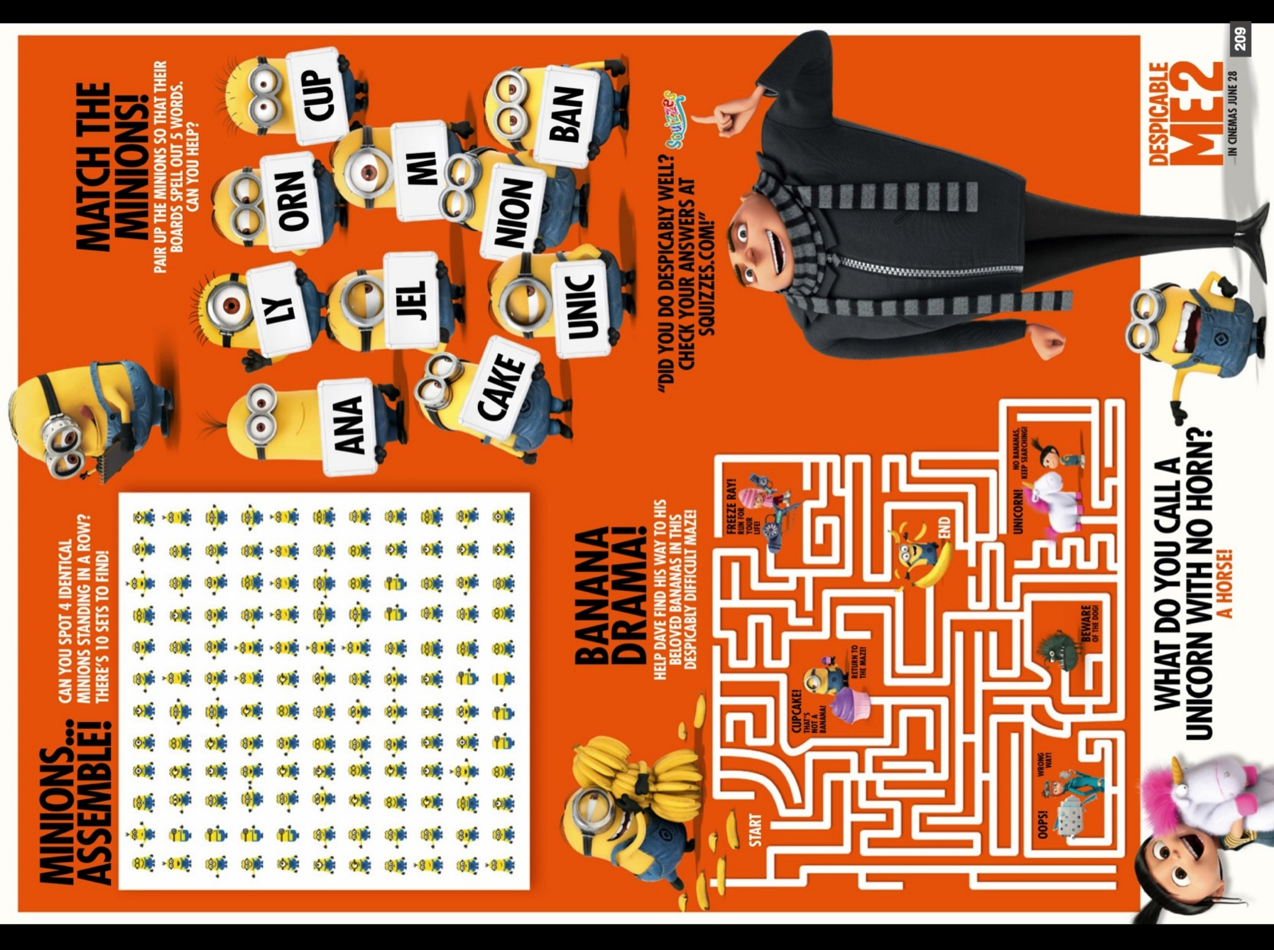

Slide 16
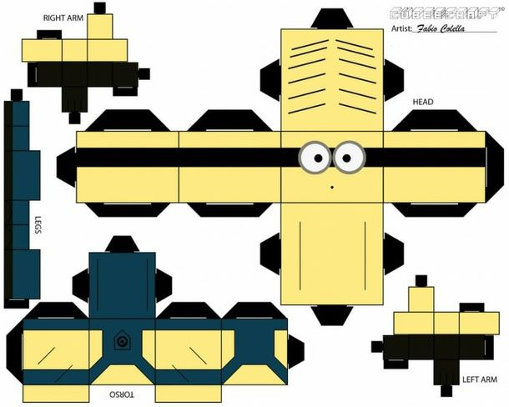

Slide 17
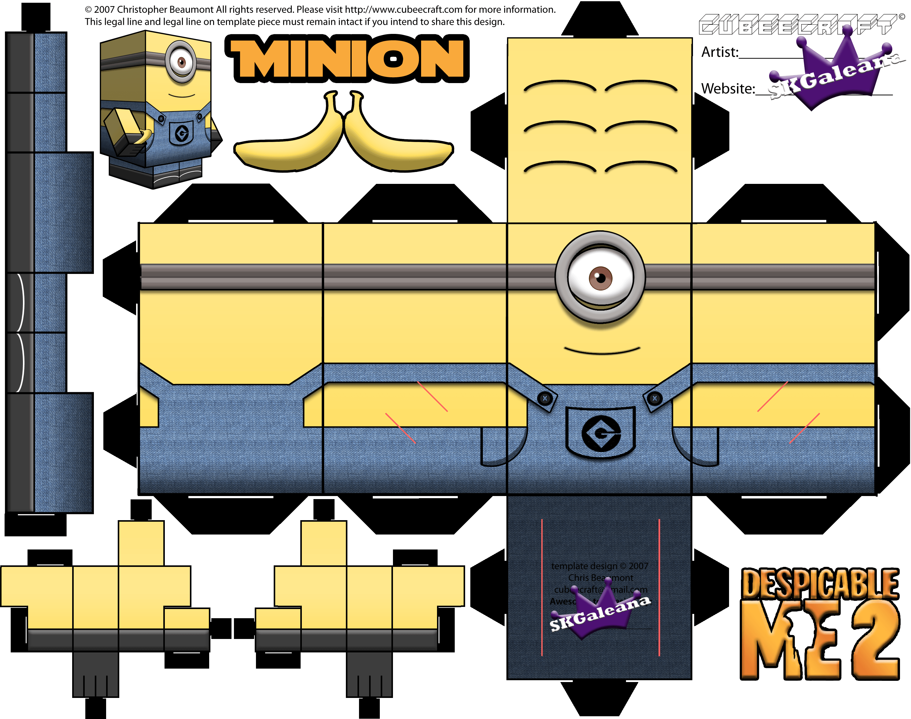

Slide 18
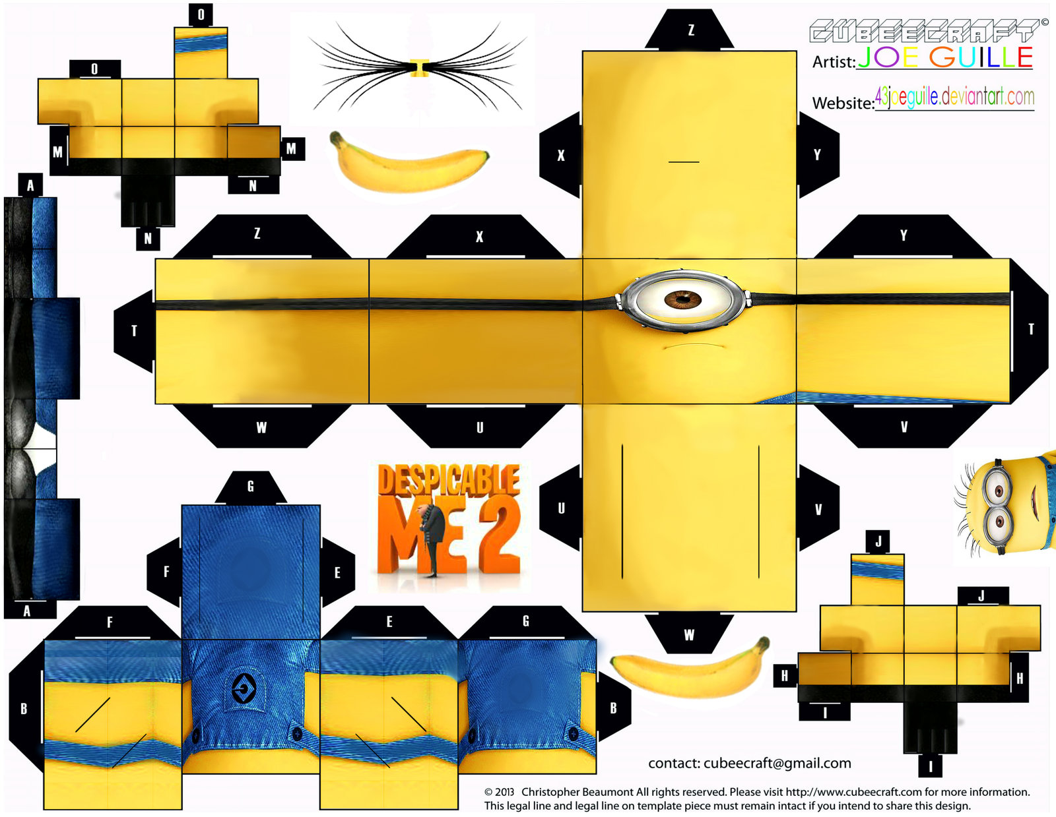

Slide 19
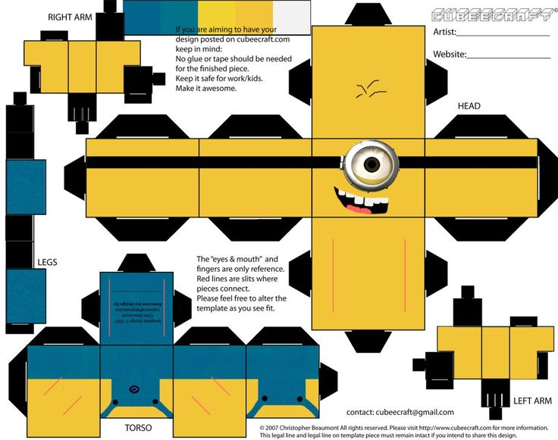

Slide 20
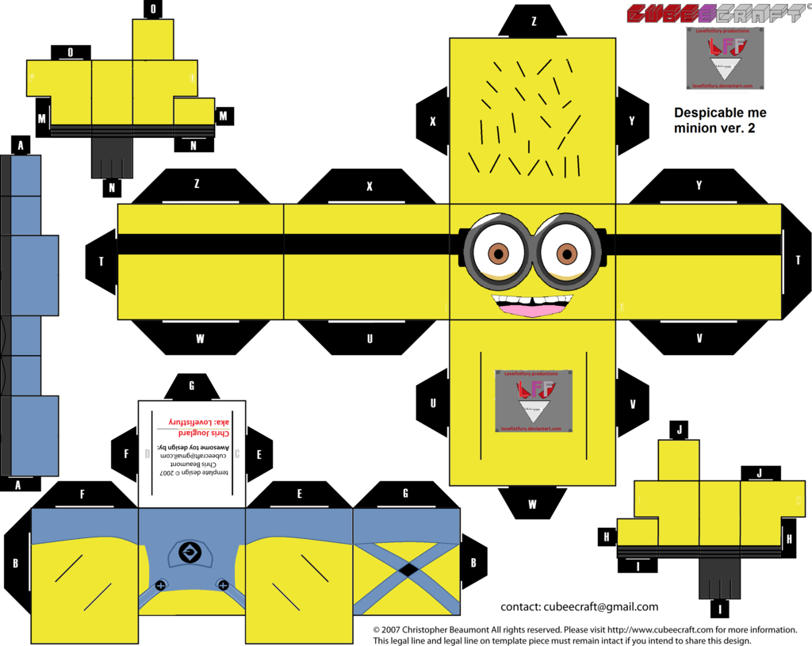

Slide 21
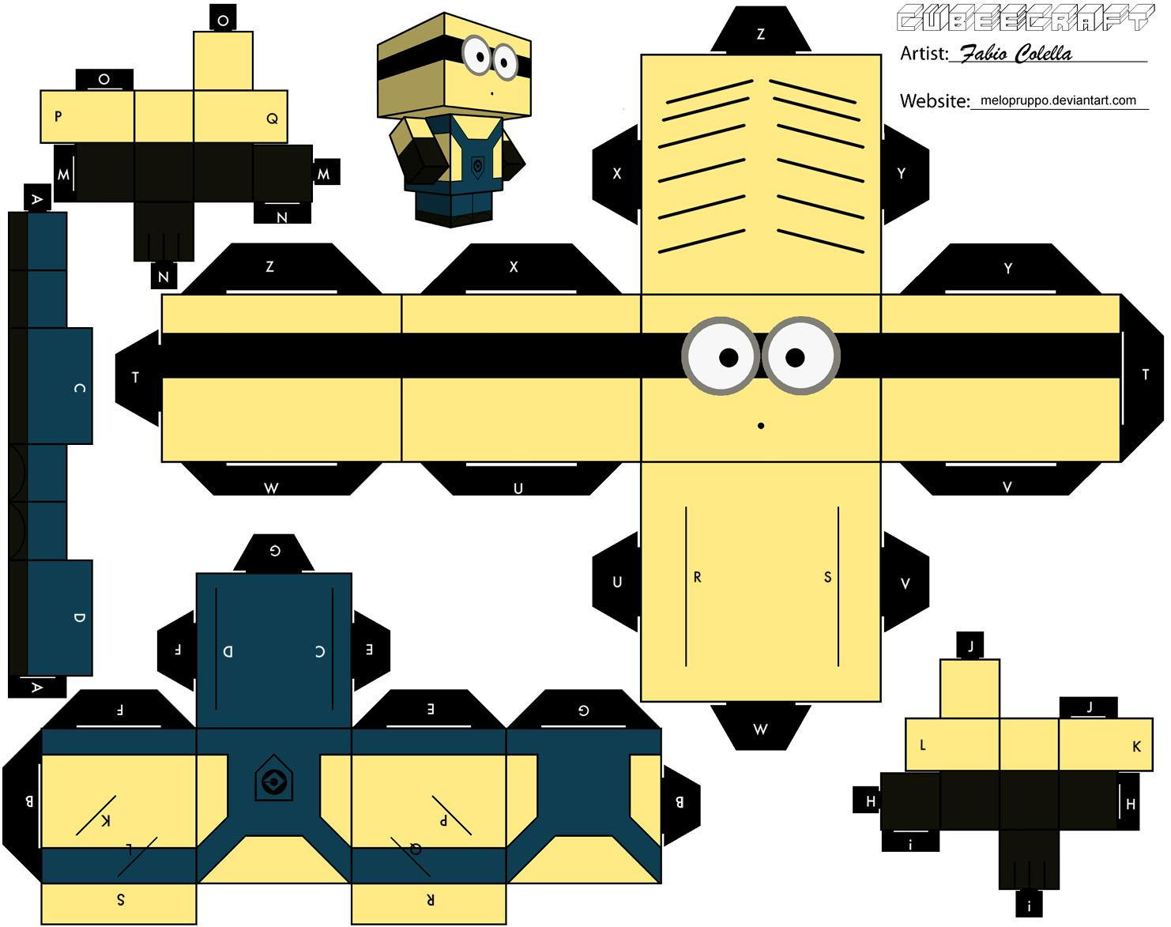

Slide 22
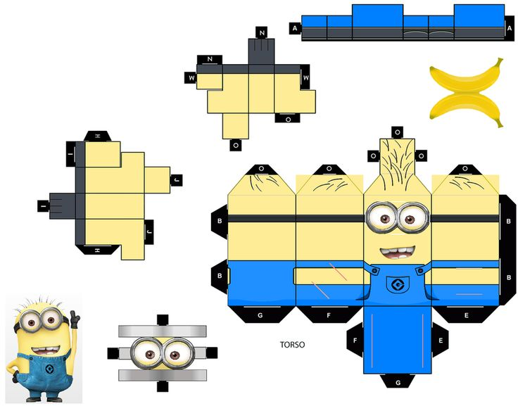

Slide 23
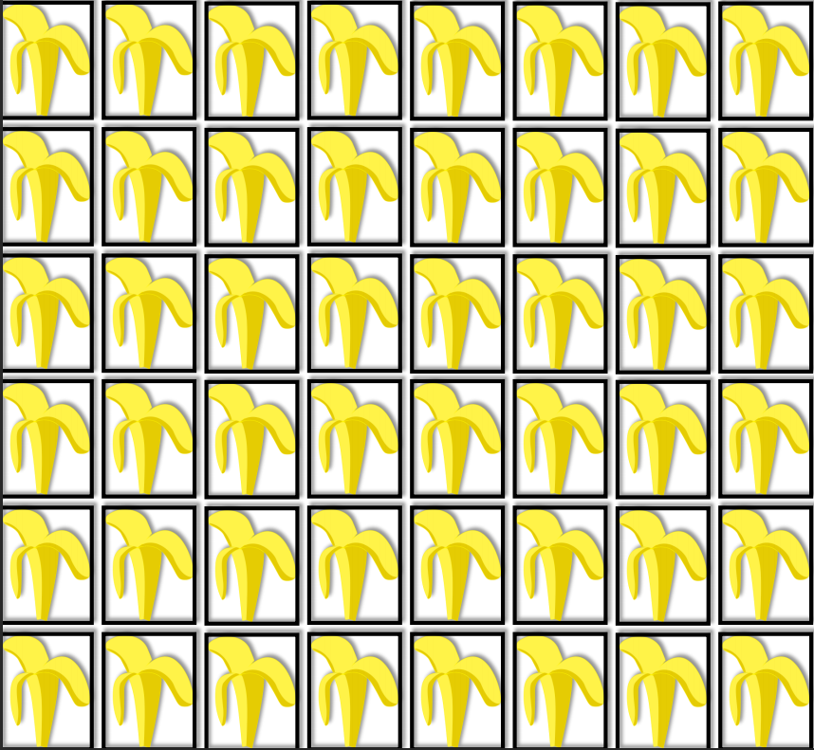

Slide 24
http://www.game37.net/play-games/minions-hidden-alphabets
http://www.game37.net/play-games/minions-house-makeover
http://minion-games.net/minion-games/minion-schol-test
http://www.game37.net/play-games/minion-fast
http://www.game37.net/play-games/minion-face-paint
Hide the banana Lots around the room.
Scrambled names (Use white board to make a scrambled word, students guess, then make their own word)
Yellow balloons
Buy googly eyes for printing minions

