Slide 1
EBS

Slide 2
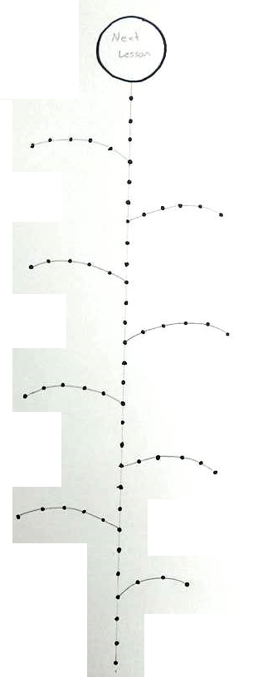
Sticker Board
You can win stickers
Put the stickers on the flower.

Slide 3
Sticker Board
When you finish a leaf, you can win a prize

Slide 4
Sticker Board
If you finish all the way to the top, you can choose the next lesson
Lesson Topic (dinosaurs, sports, hobbies)
Lesson Type (math, puzzle solving, music)
Game

Slide 5
Folders
Put your name on your folder.

Slide 6
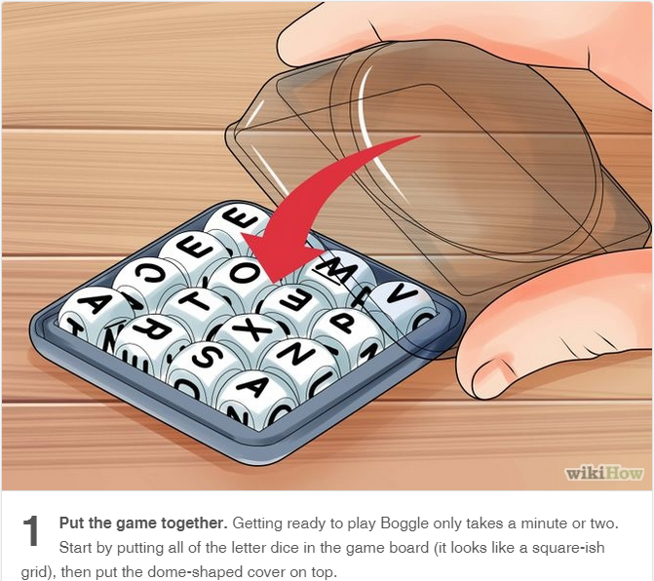

Slide 7
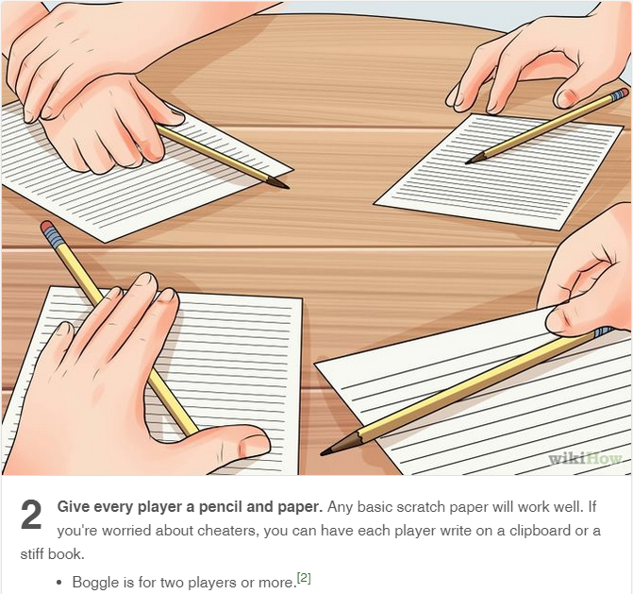

Slide 8
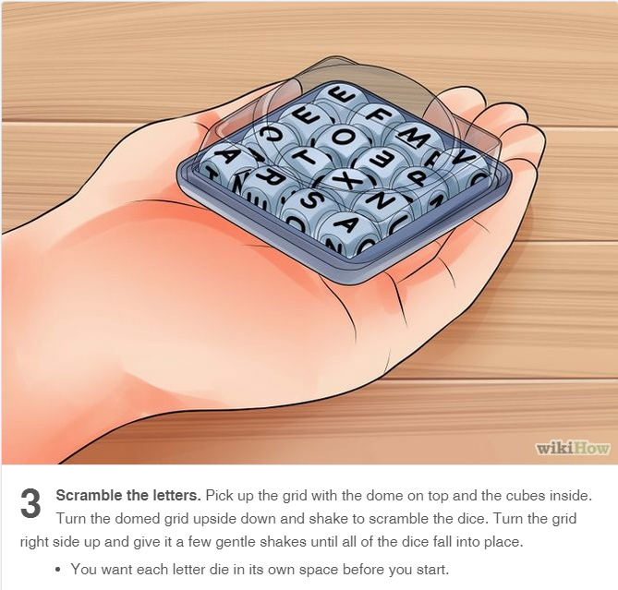

Slide 9
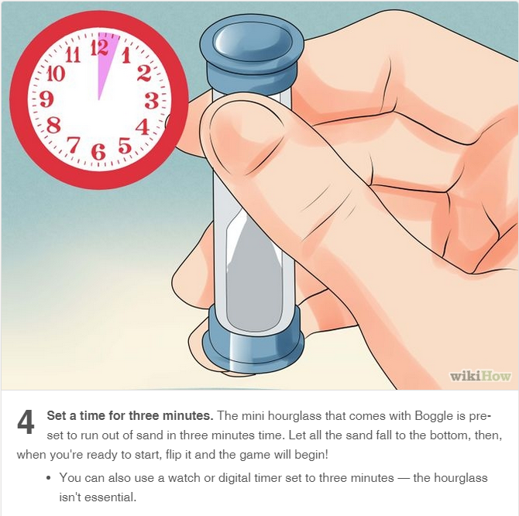

Slide 10
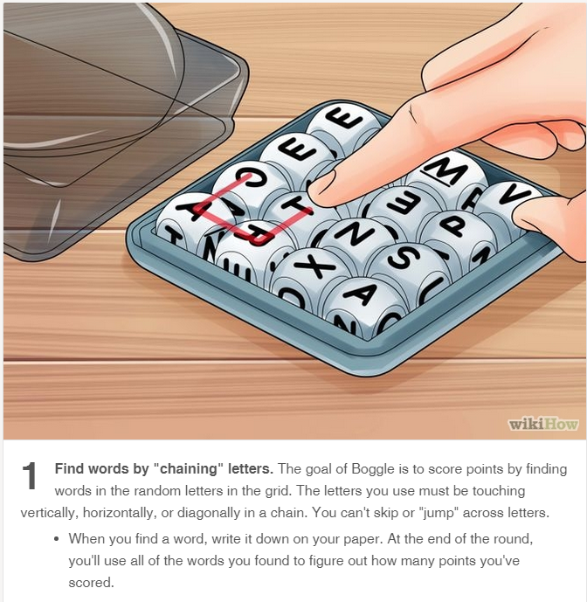

Slide 12
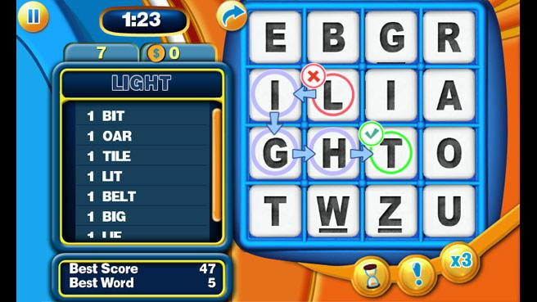

Slide 13
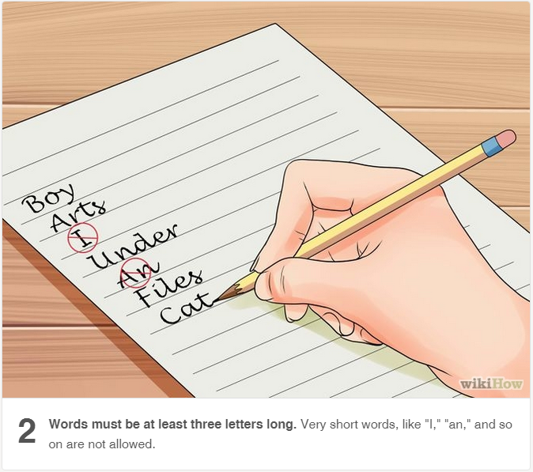

Slide 14
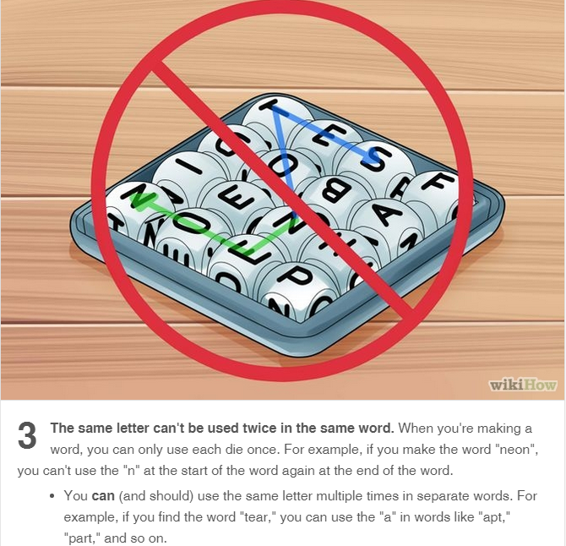

Slide 16
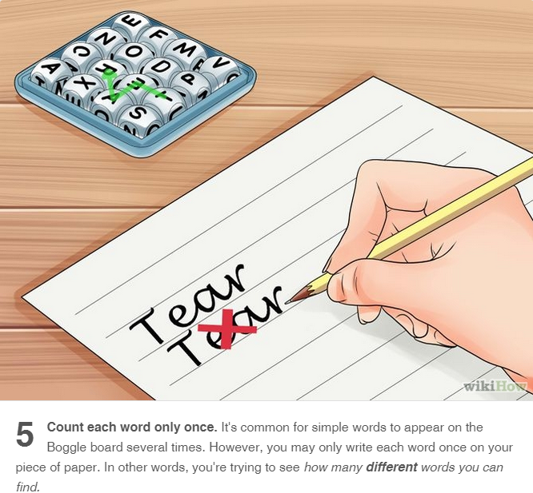

Slide 17
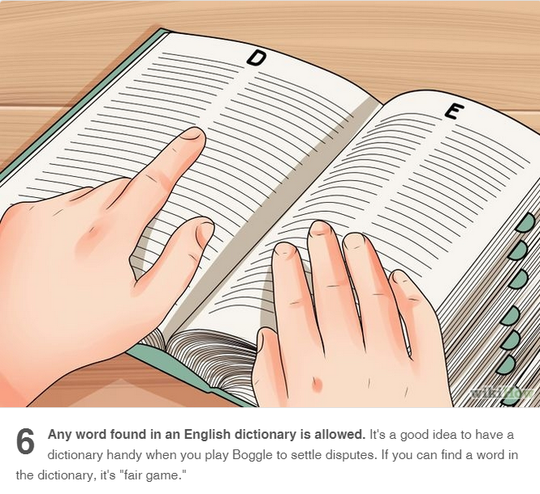

Slide 18
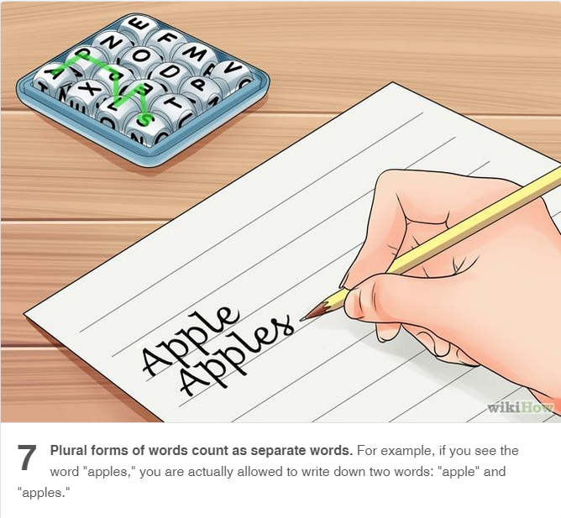

Slide 19
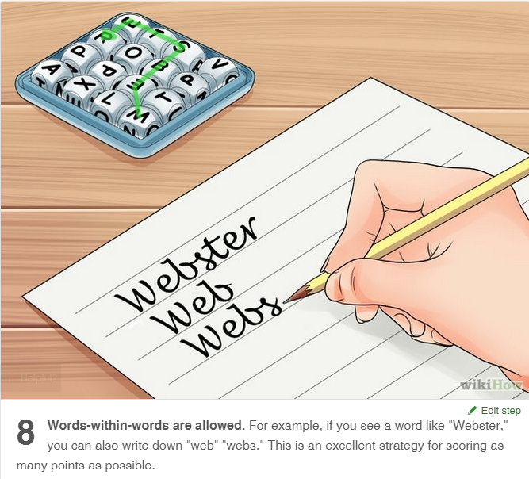

Slide 20
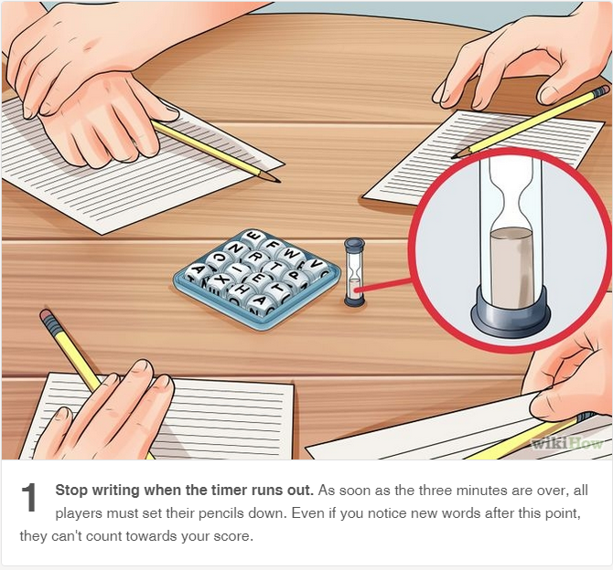

Slide 21
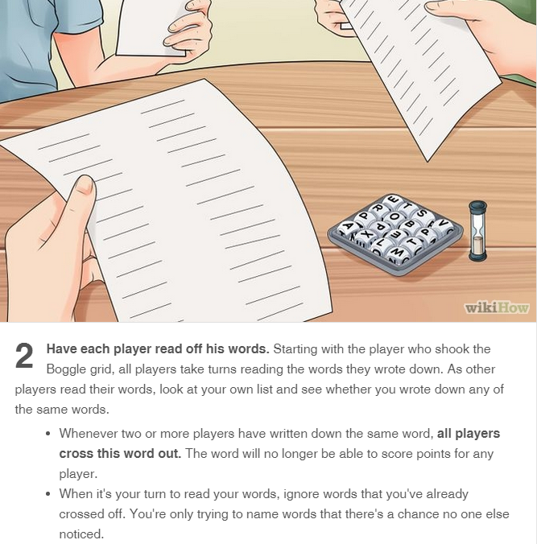

Slide 22
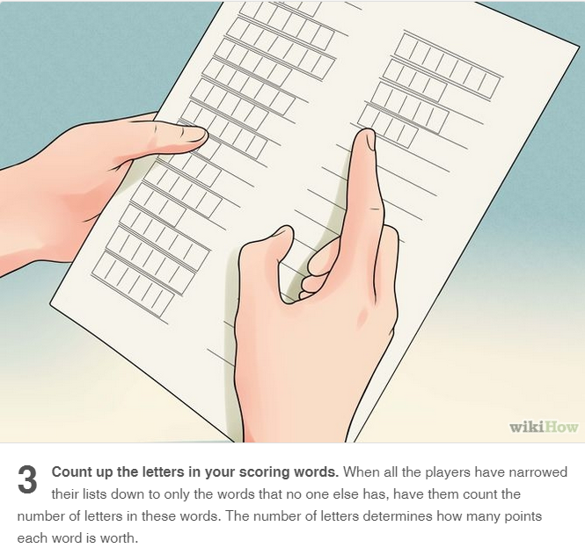

Slide 23
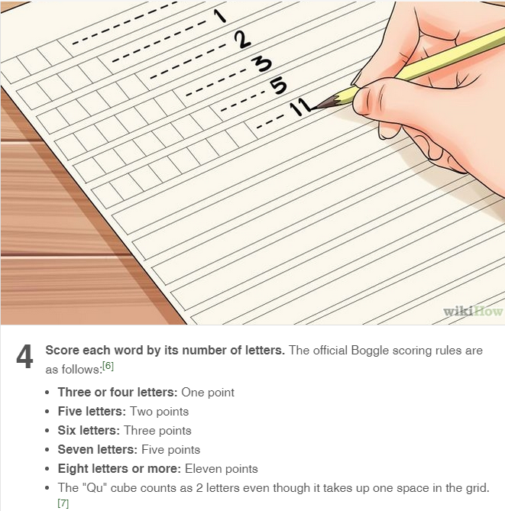

Slide 24
