Slide 1
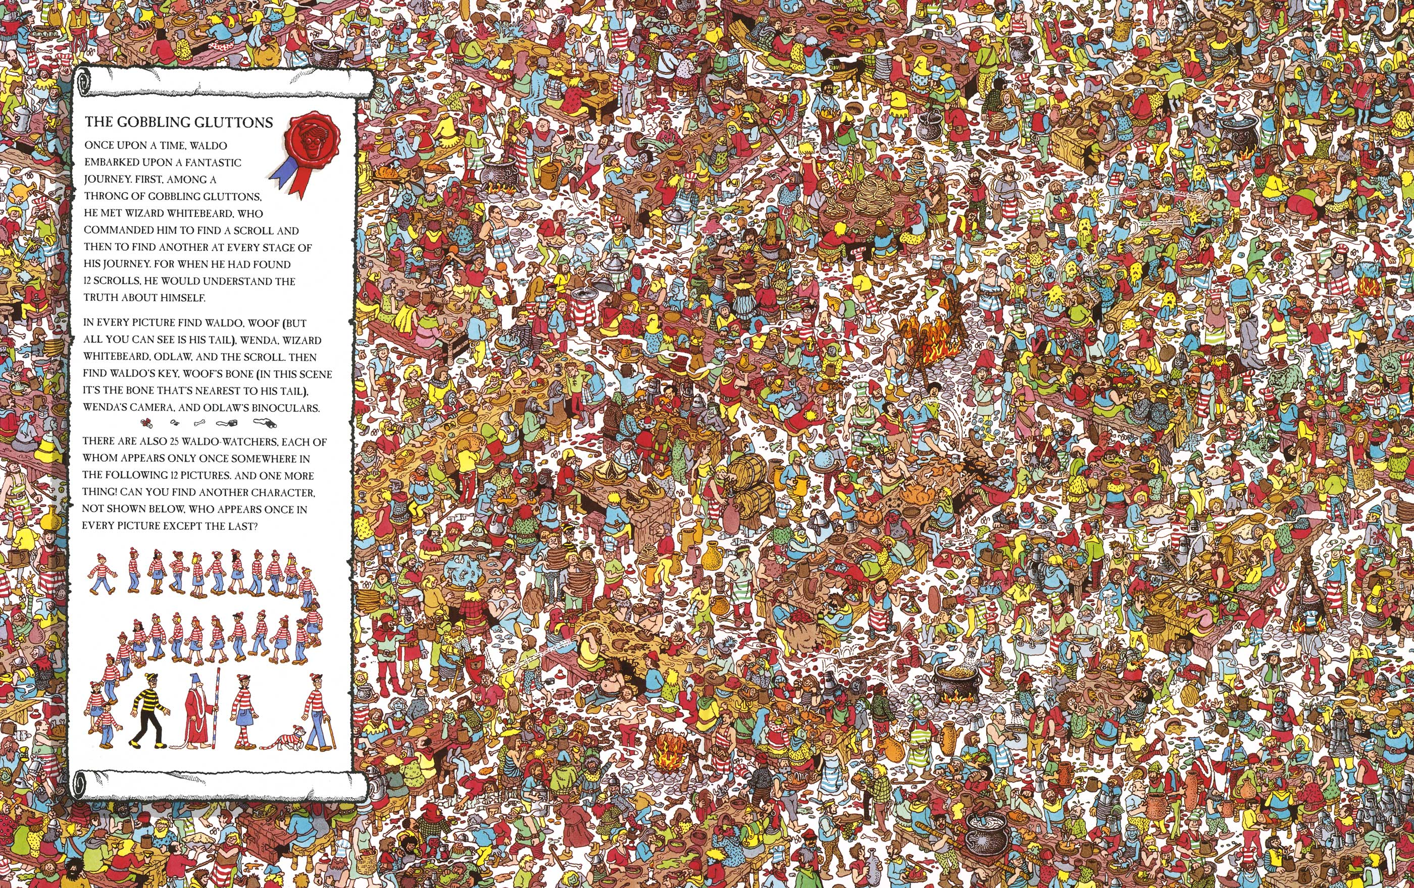

Slide 2
Lesson 1 - Whoonu

Slide 3
Introduction:
What is your favorite …
Animal
Color
Number
Character
Subject (class)
City

Slide 4
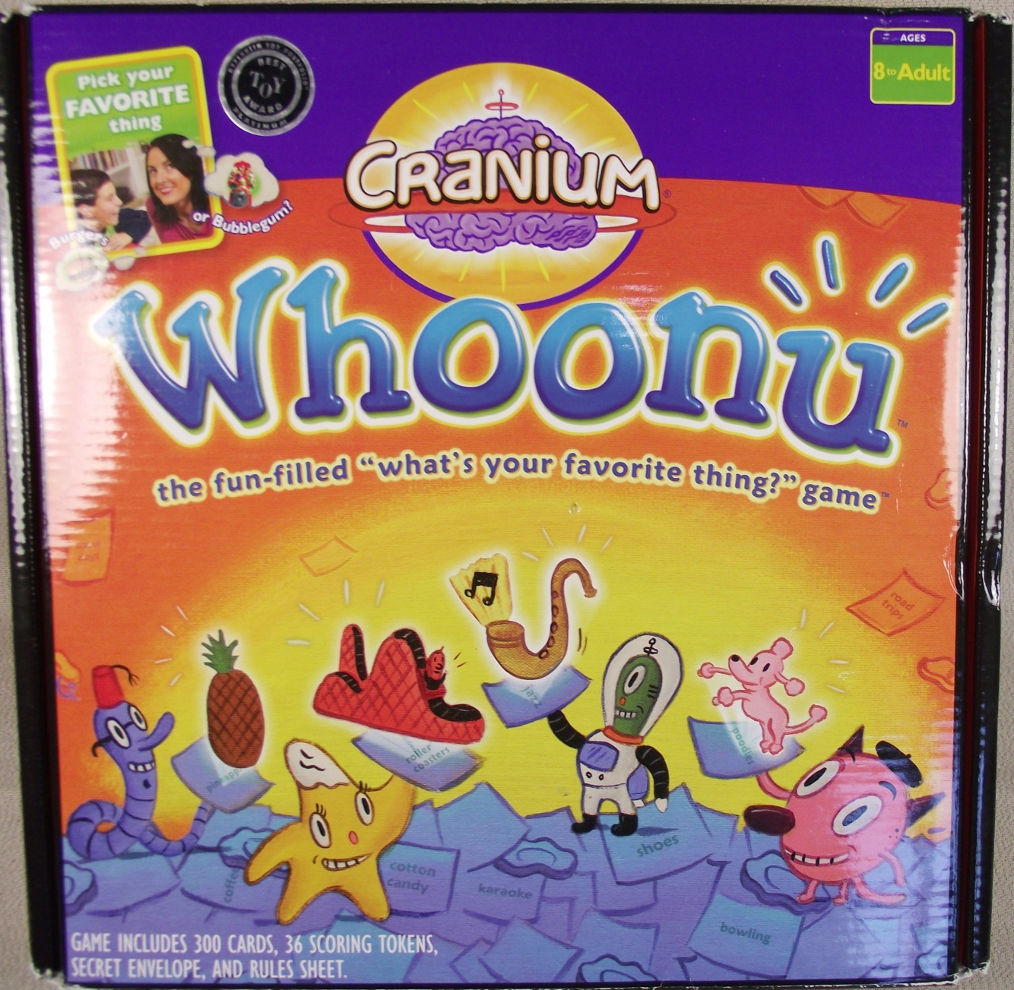

Slide 5
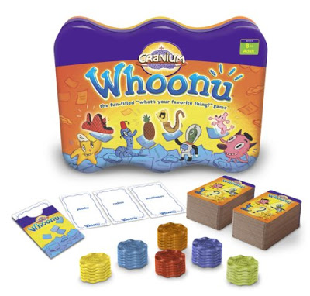

Slide 6
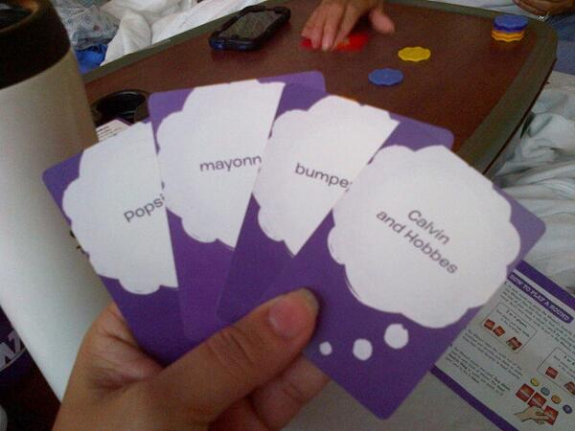

Slide 8
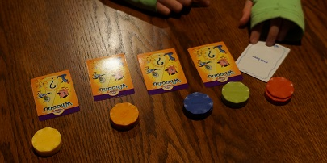

Slide 9
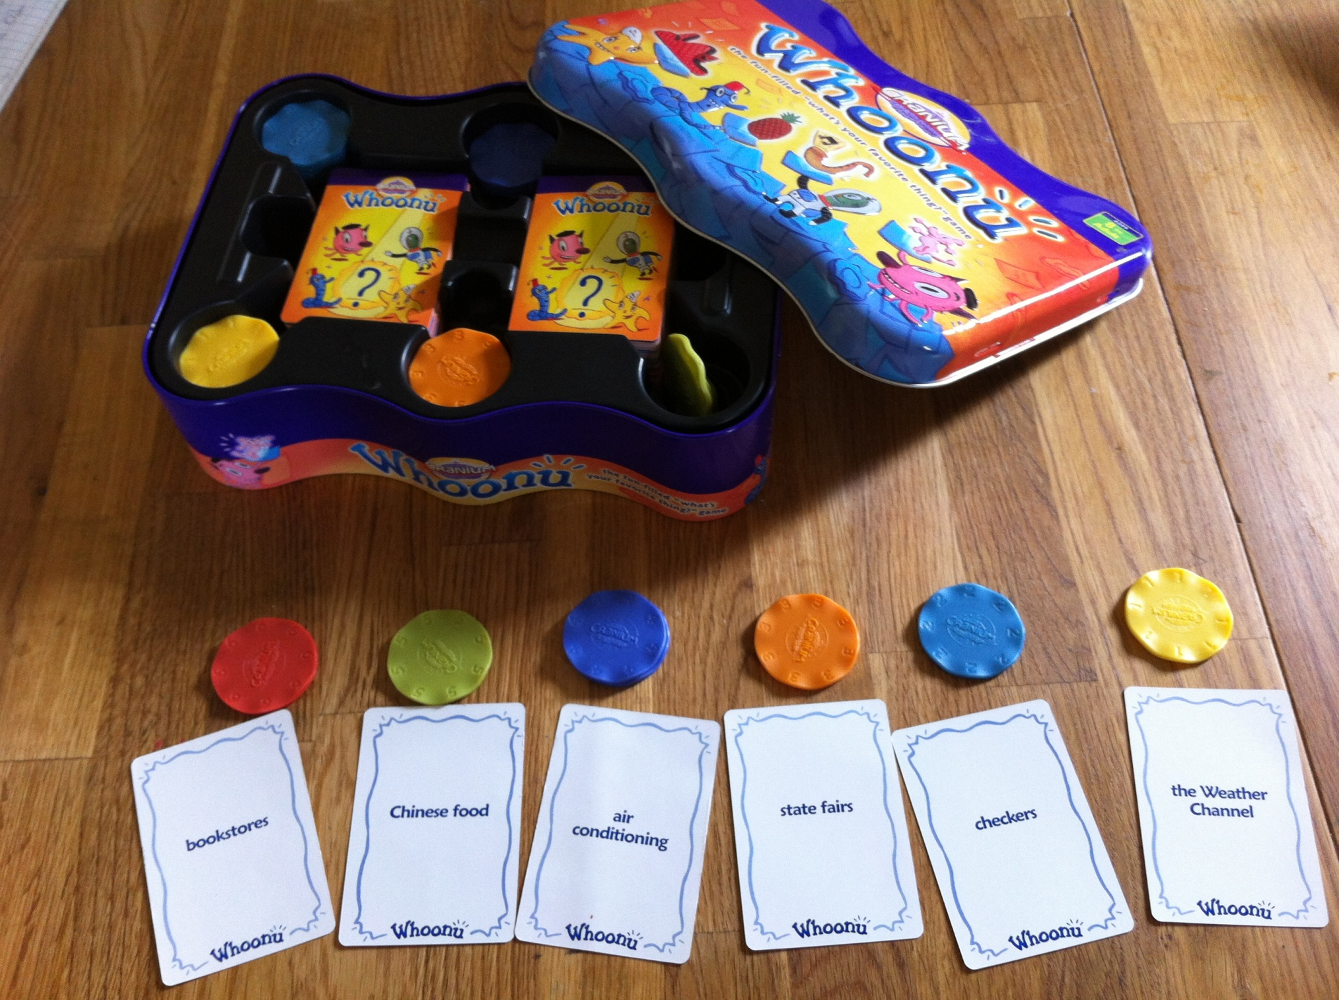

Slide 10
6
6
6
6
6
5
5
5
5
5
4
4
4
4
4
3
3
3
3
3

Slide 11
6
6
6
6
6
5
5
5
5
5
4
4
4
4
4
3
3
3
3
3

Slide 12
2
2
2
2
2
1
1
1
1
1
2
2
2
2
2
1
1
1
1
1

