Slide 1
Adjectives for People

Slide 2
Name some adjectives you can use for people?
Tall
Short
Thin
Heavy
Colors (hair, eyes, skin)

Slide 3
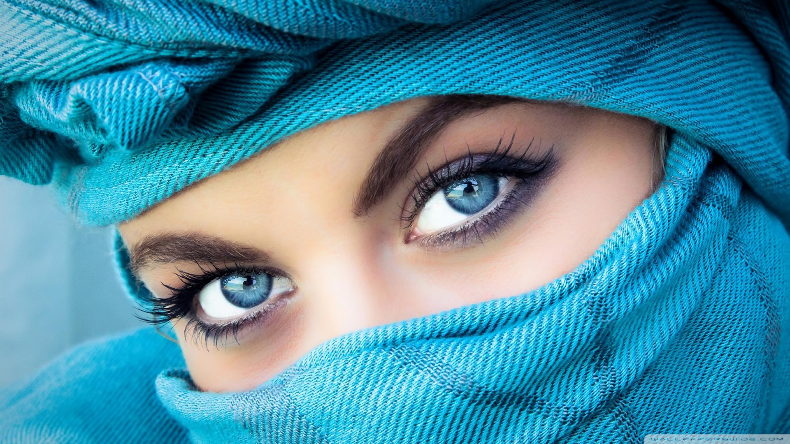
He / She has _______ _______.

Slide 5
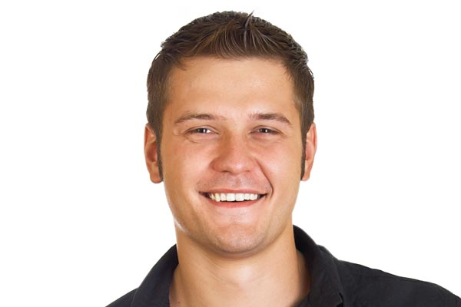

Slide 6
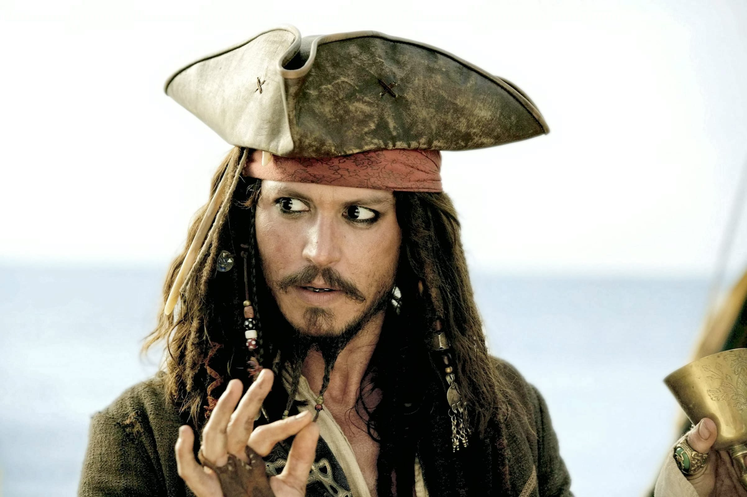

Slide 7
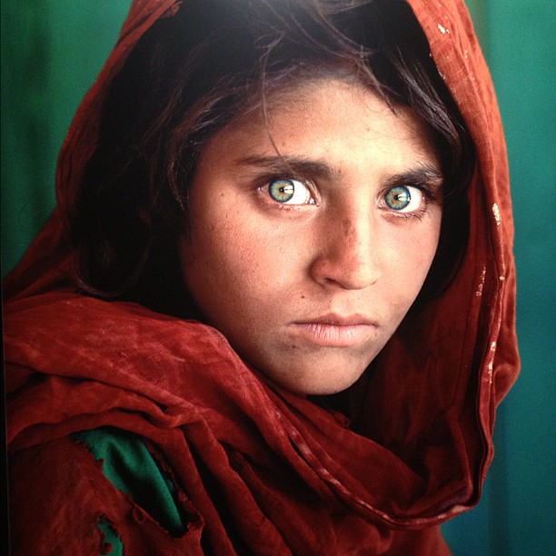

Slide 8
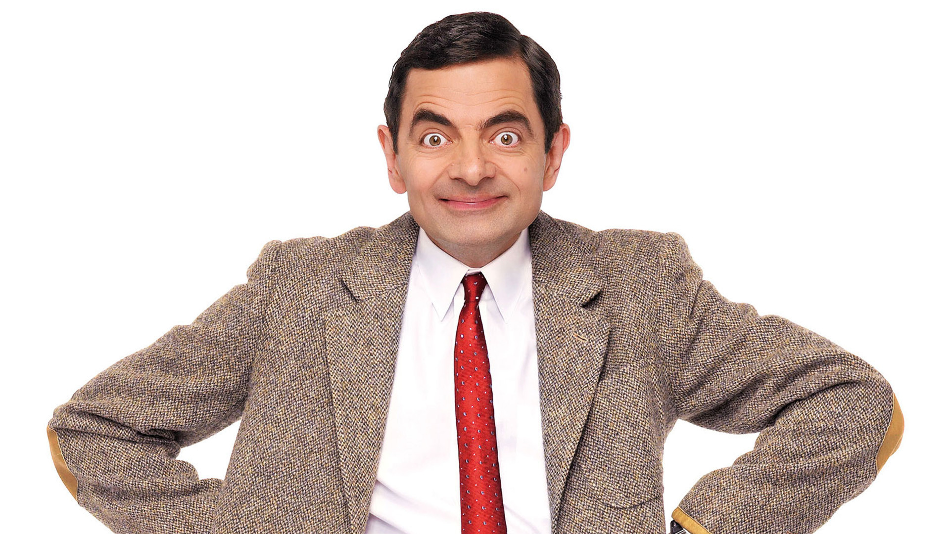

Slide 9
Does he / she have ______ ______?

Slide 10
