Slide 1
Lesson 12 – “-er”
+ jobs

Slide 2
Suffix
At the end of a word
  er

Slide 3
How to Use: “er”
“more”
Person or thing
What does it do?
  Job

Slide 4
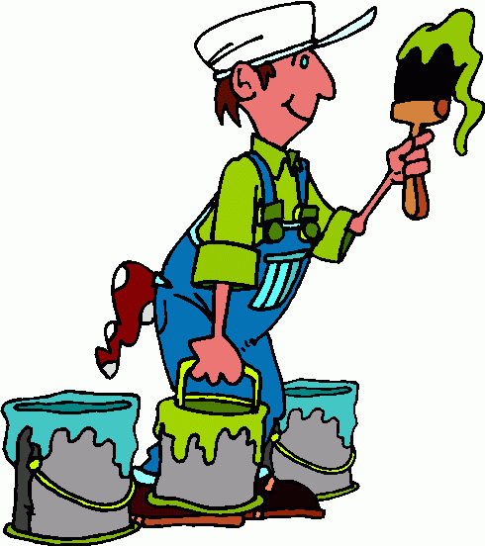
People

Slide 5
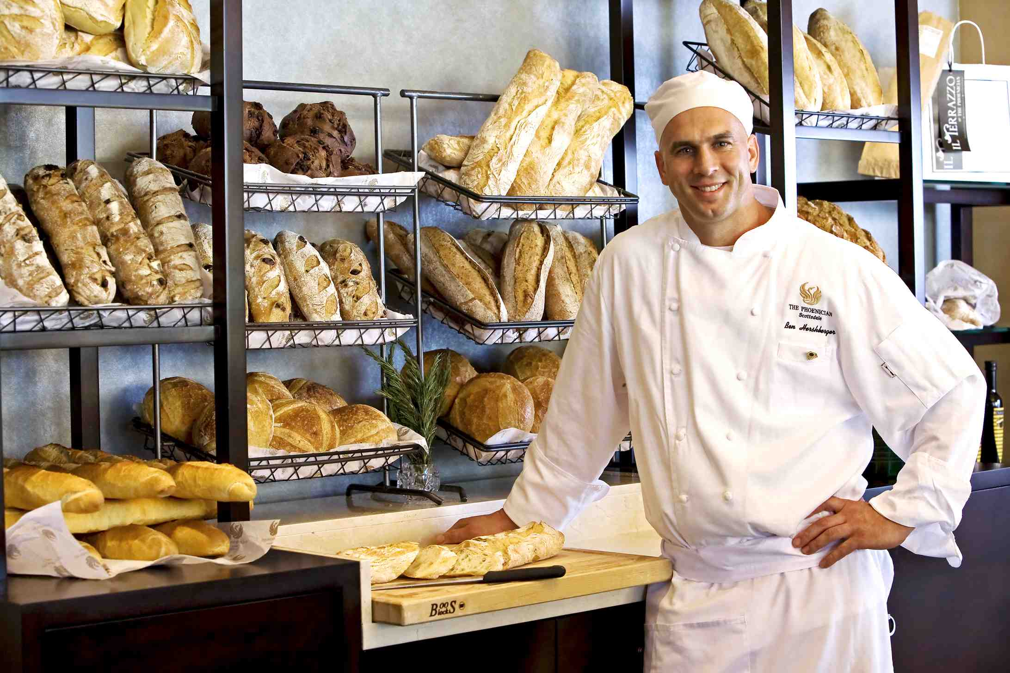

Slide 6


Slide 7


Slide 8


Slide 9


Slide 10
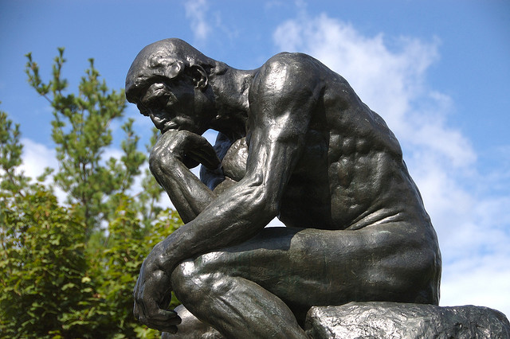

Slide 11

There are many other jobs.

Slide 12
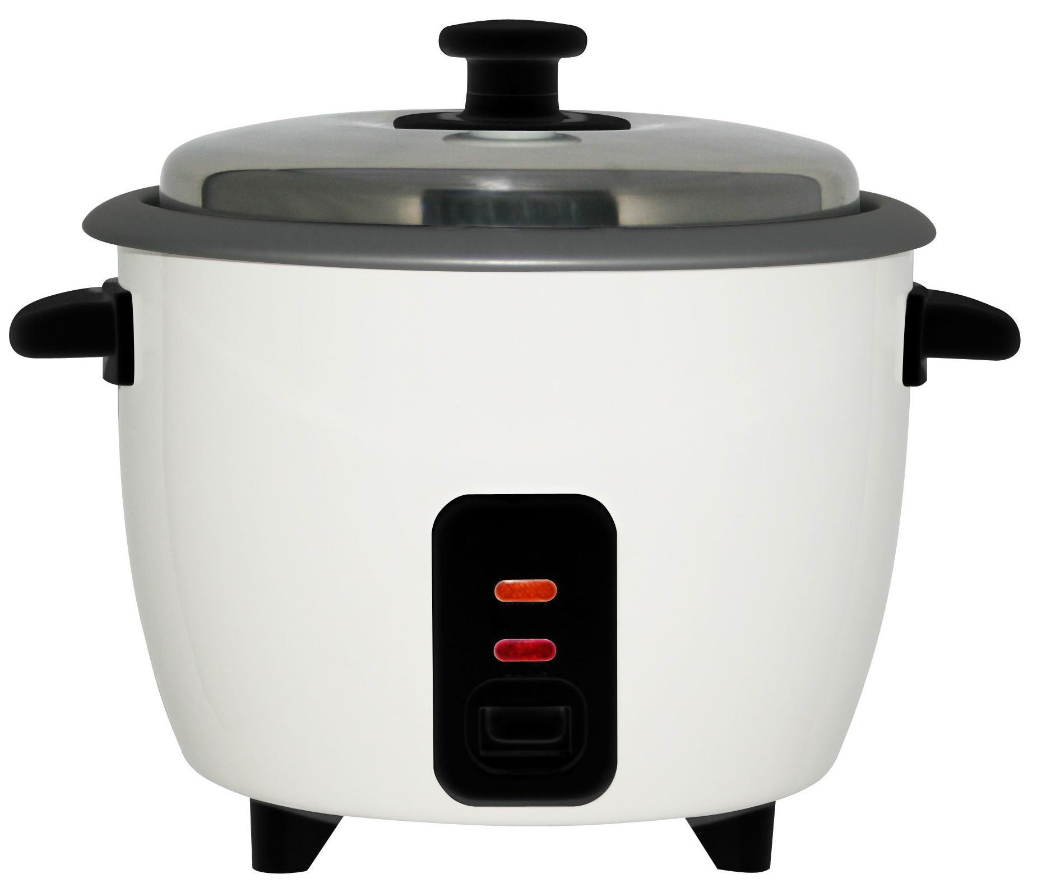
Things

Slide 13
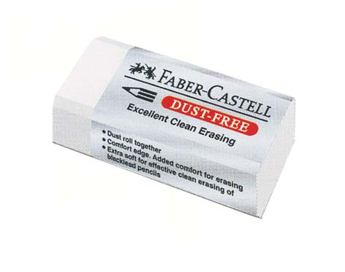

Slide 14


Slide 15
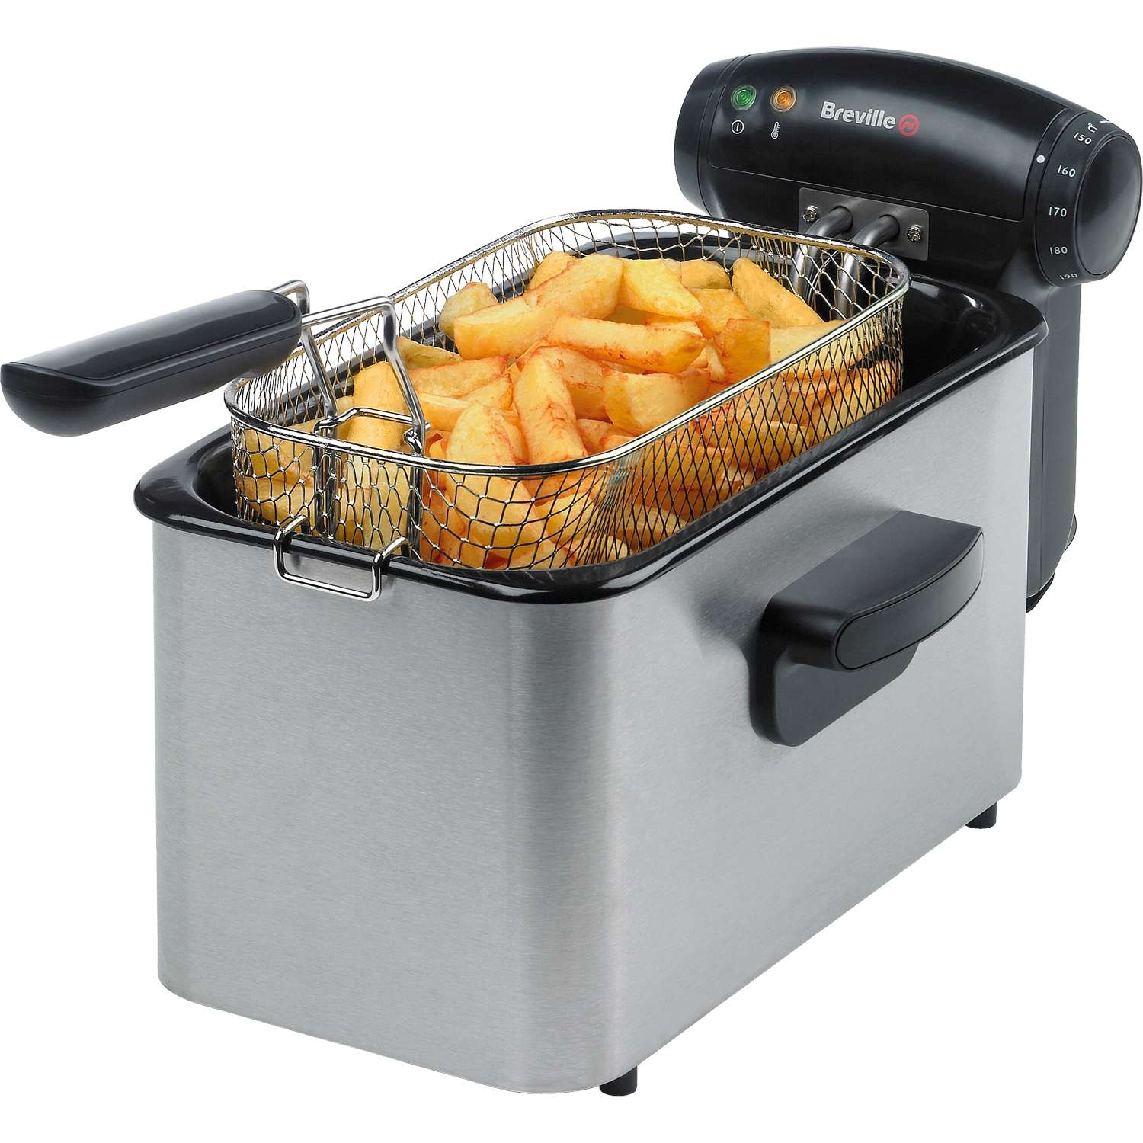

Slide 16


Slide 17


