Slide 1
Lesson 15 – Identifying Relationships

Slide 4
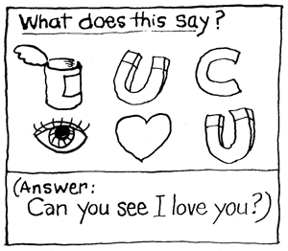
Rebus Puzzles

Slide 5
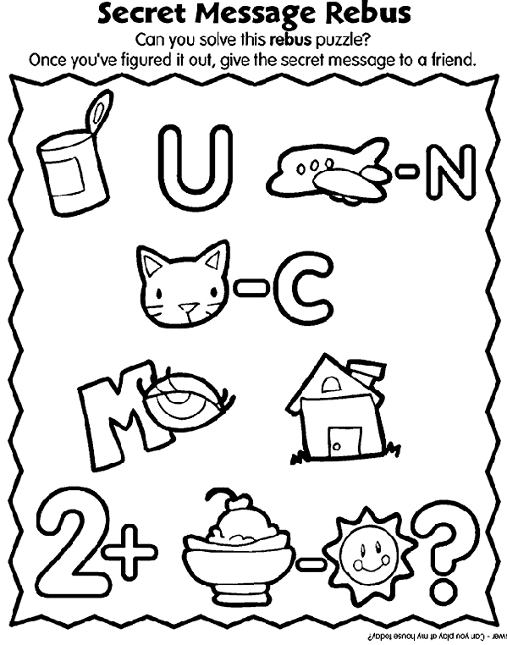

Slide 6
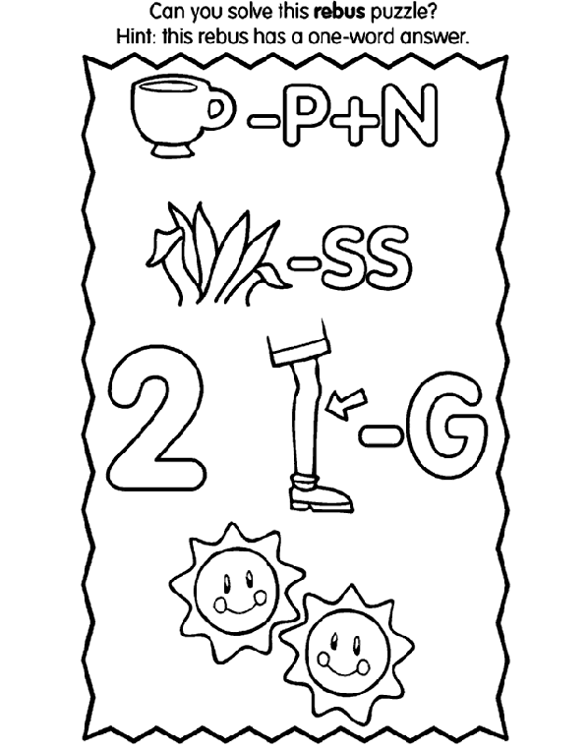

Slide 7
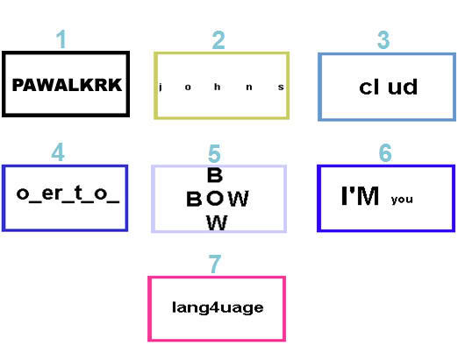

Slide 8
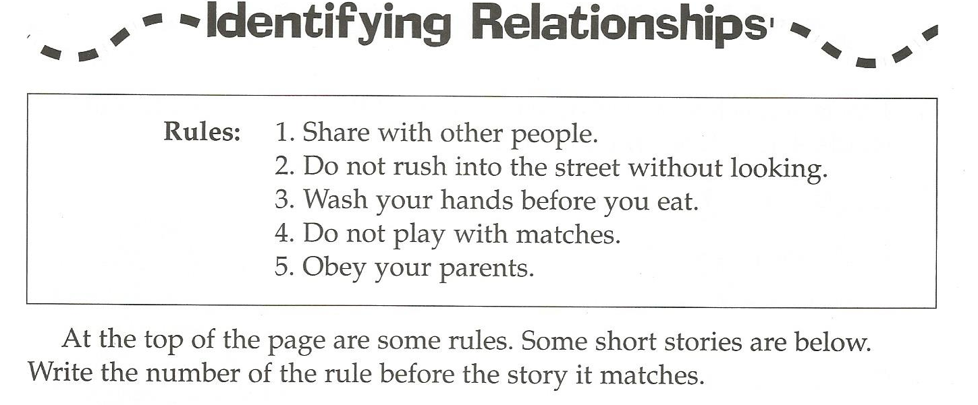

Slide 14
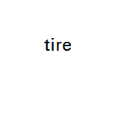
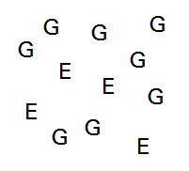
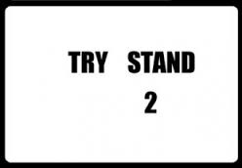
PWALKARK
MEREPEAT
GIVE GET
GIVE GET
GIVE GET
GIVE GET
NOONT
S
E
M I T
Ever
Ever
Ever
Ever
T
O
W
N
TI
ME

