Slide 1
Unit 2 Assessment Test

Slide 2
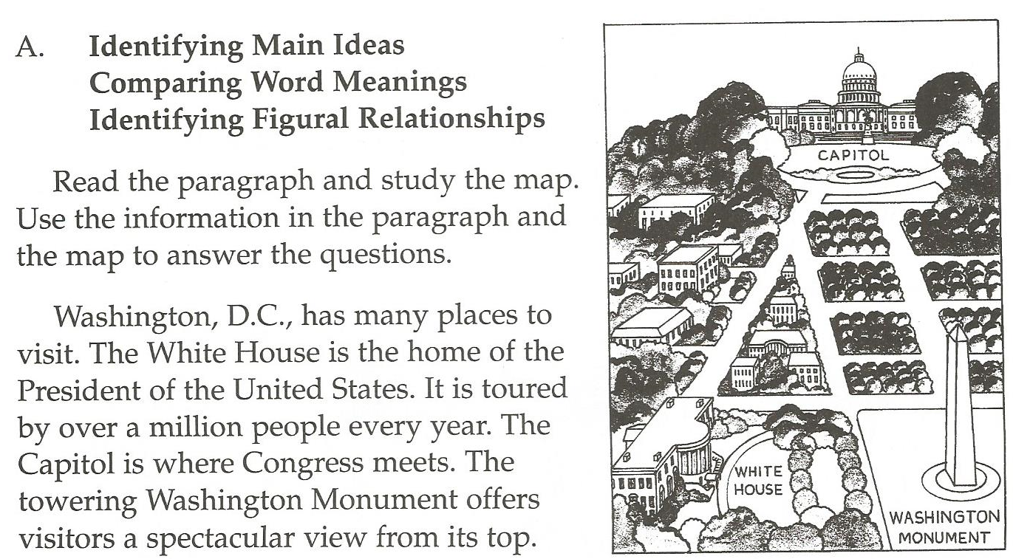
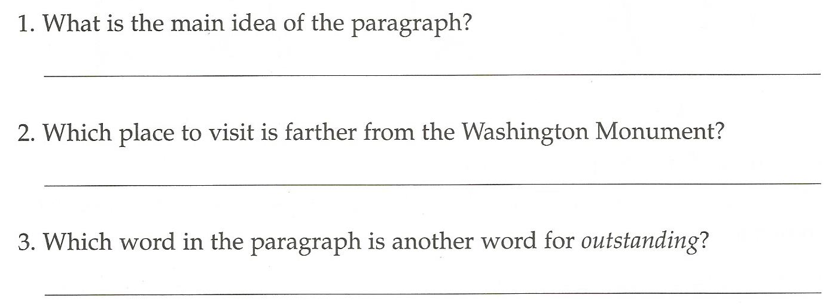

Slide 4
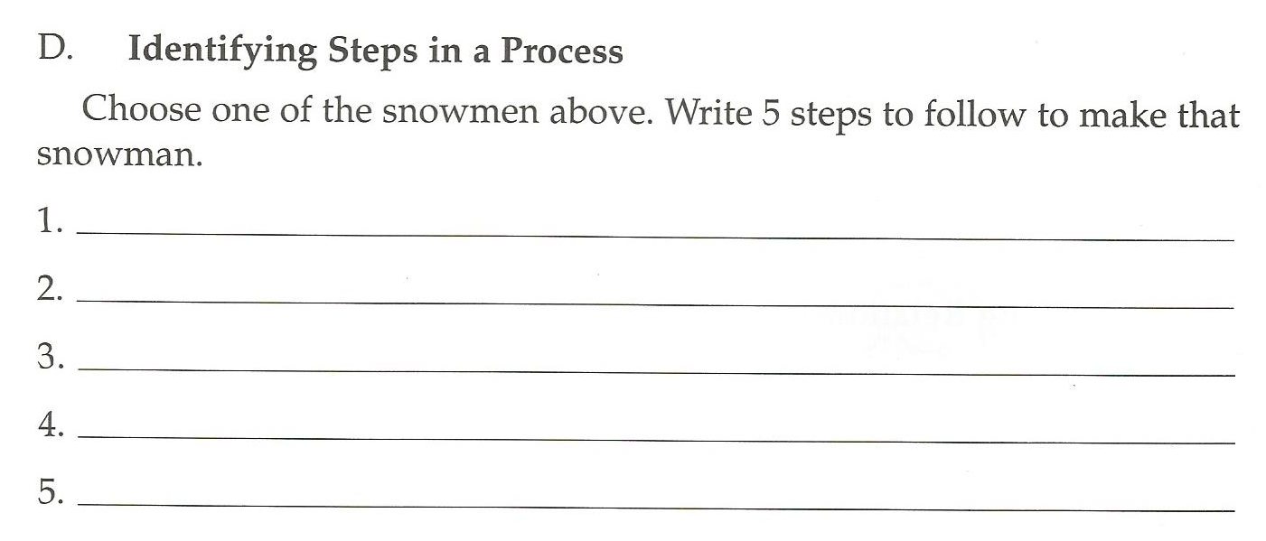
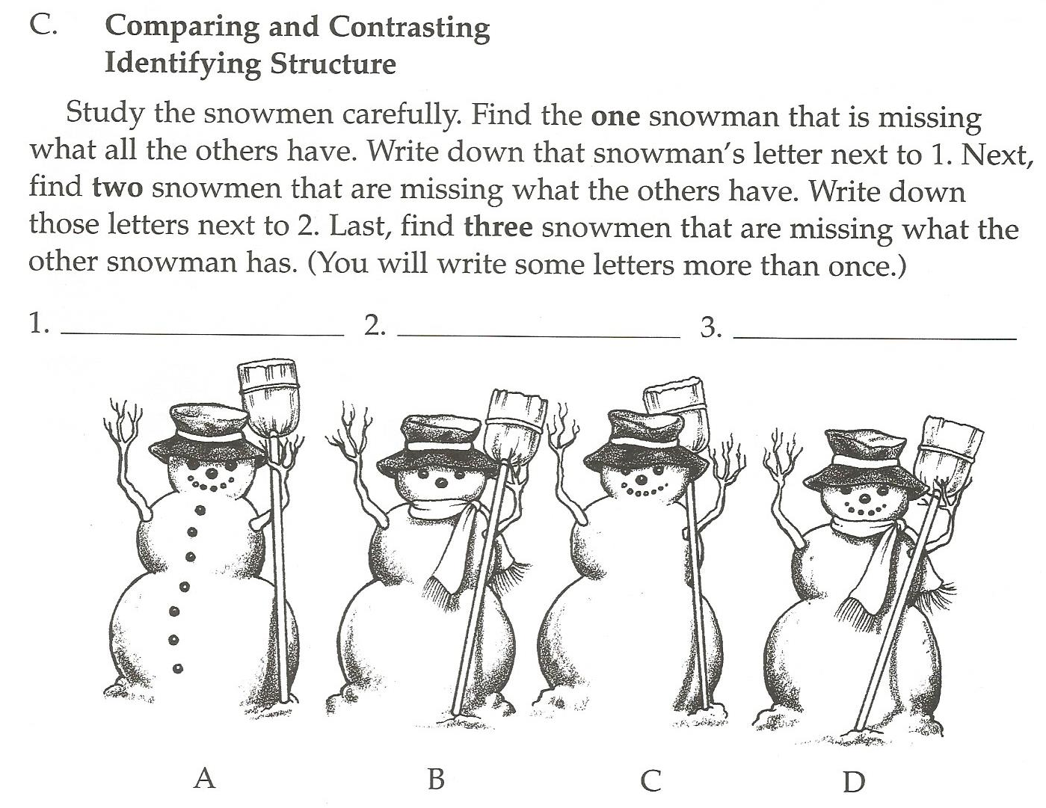

Slide 5
Board Games
Whoonu
Apples to Oranges
Pictureka
Madlibs

