Slide 1
https://www.youtube.com/watch?v=RLeoreilVp0#t=94

Slide 2
Lesson 17 – Ripley’s Believe it or Not

Slide 3
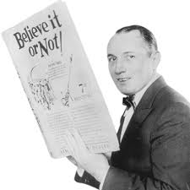
Believe it or Not!
Robert Ripley was a cartoonist. He was famous for making cartoons about interesting people and things. He travelled around the world discovering many things. A lot of people enjoyed his work and he became famous. Eventually
he created a TV show and
museums to show the interesting
things in this world.

Slide 4
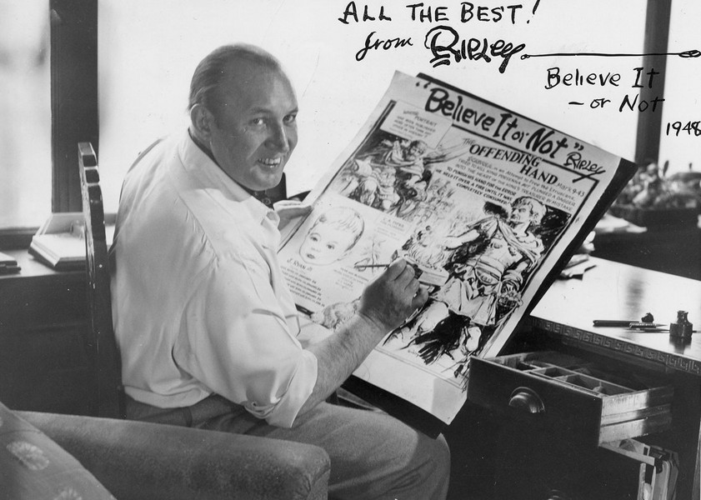

Slide 5
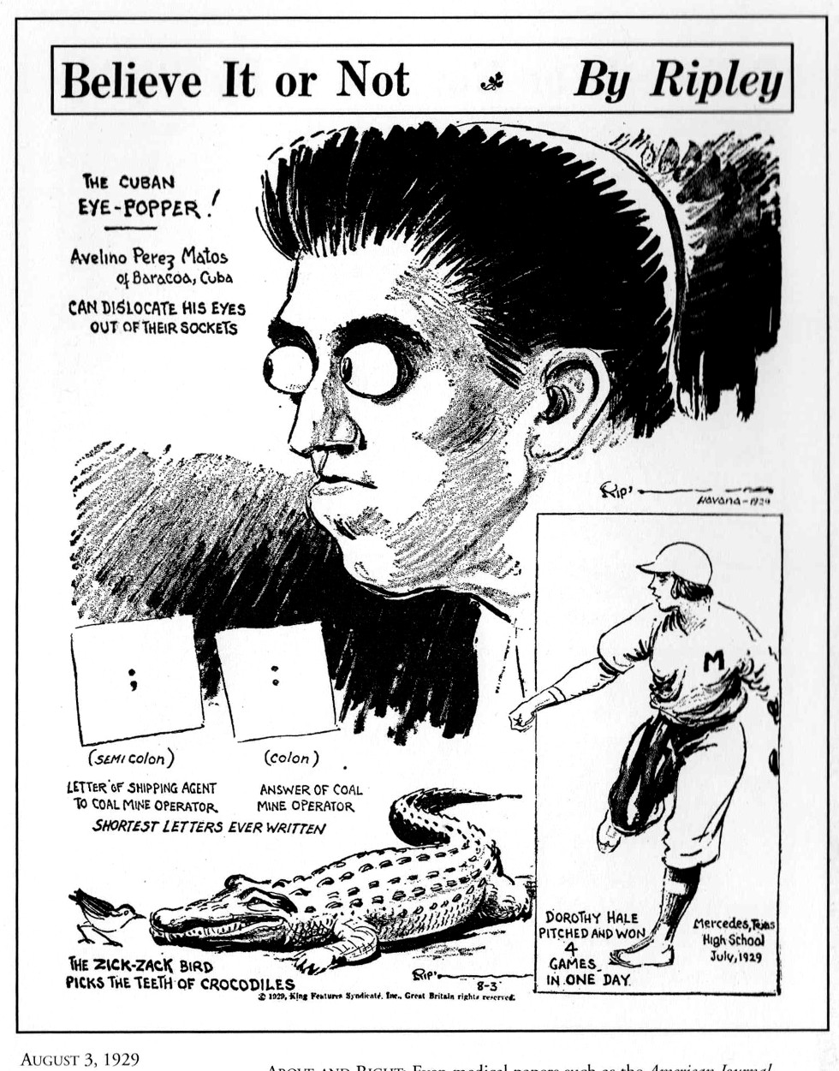
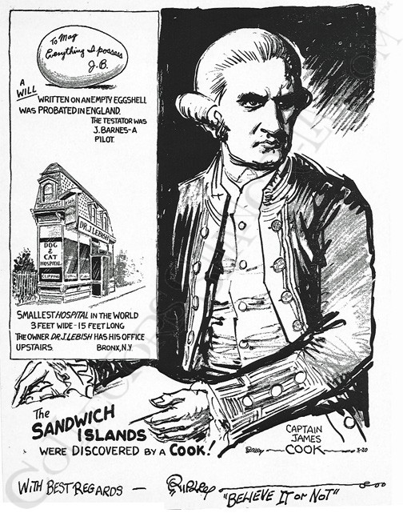

Slide 6
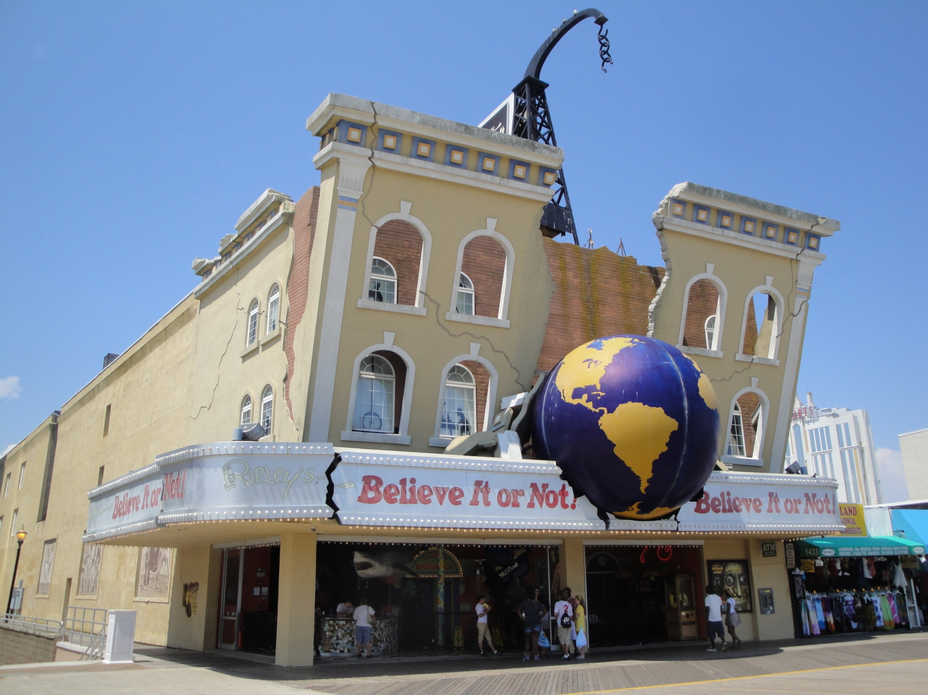
Ripley’s Museums

Slide 8
Animals:

Slide 9
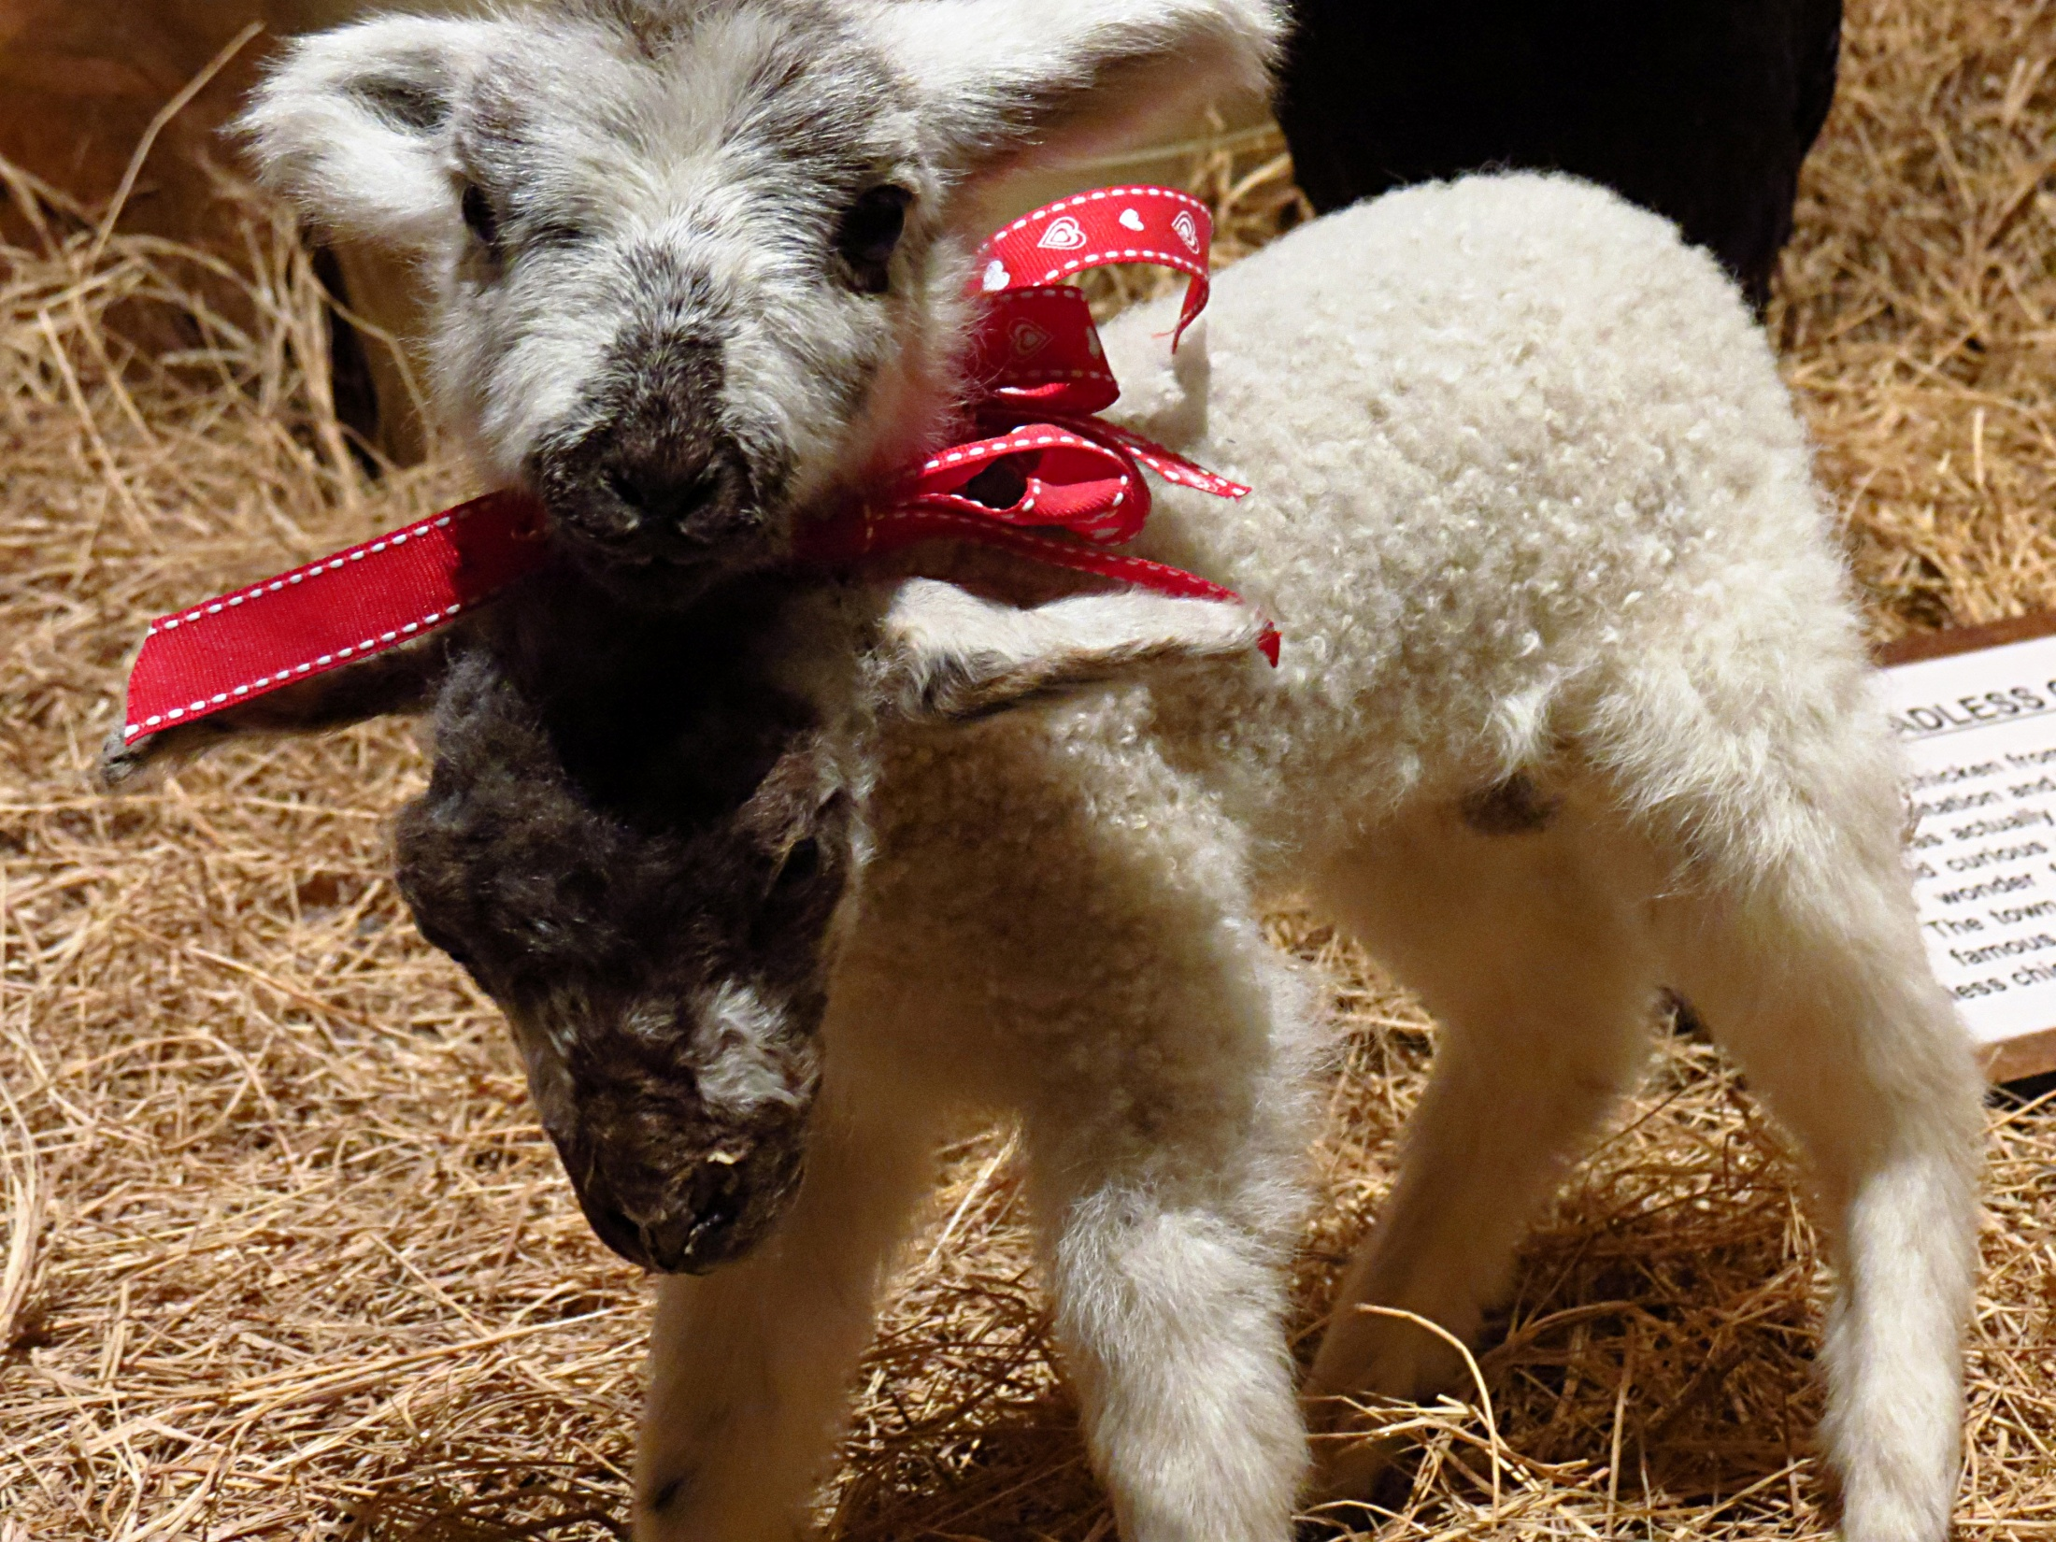
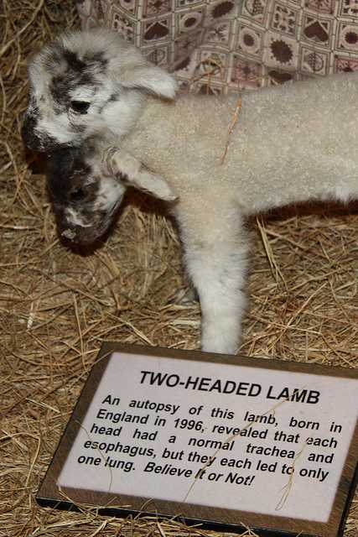

Slide 10
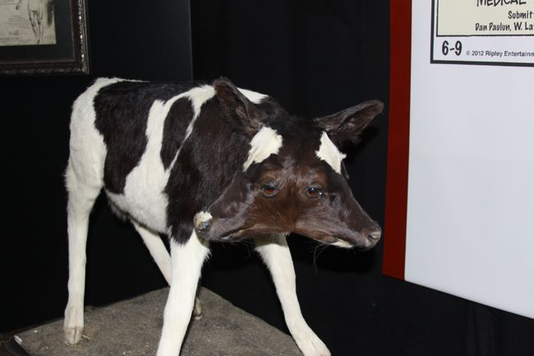

Slide 11
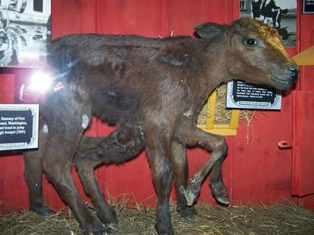

Slide 12
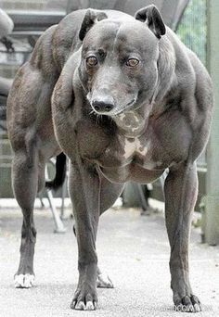
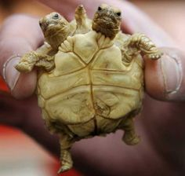
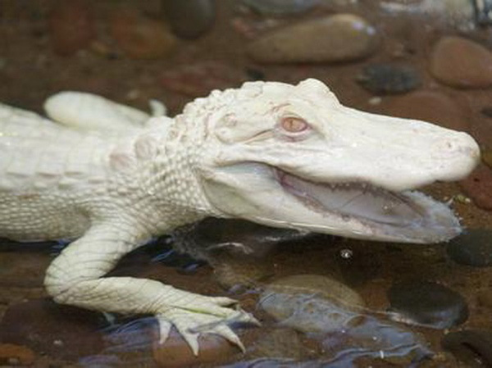
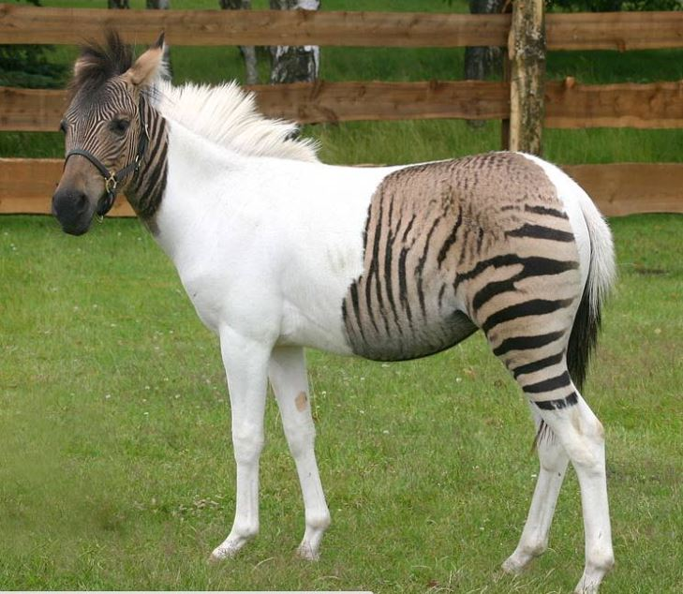
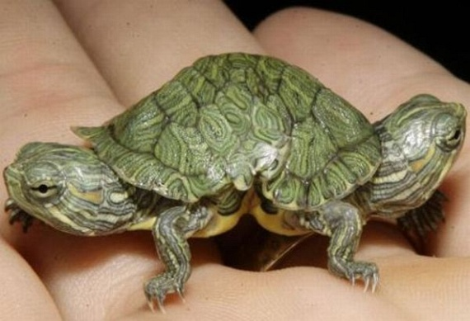

Slide 13
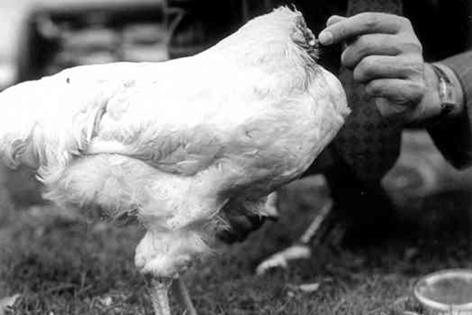
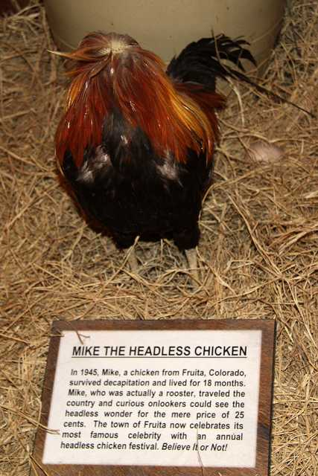

Slide 14
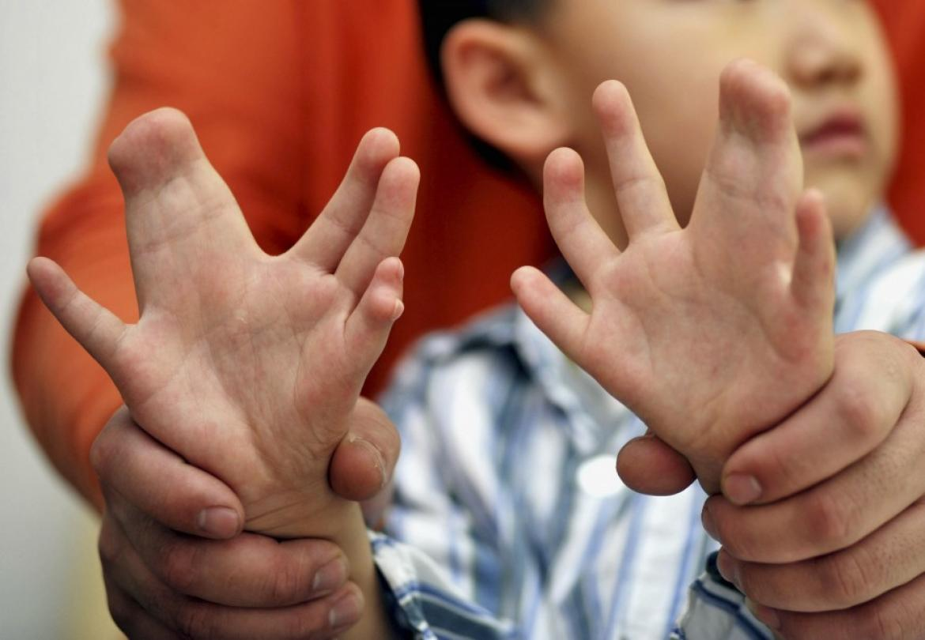
Mutated Humans

Slide 17
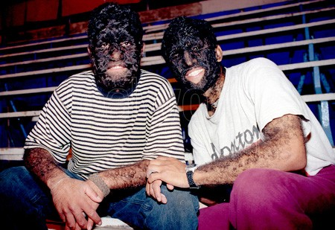

Slide 18
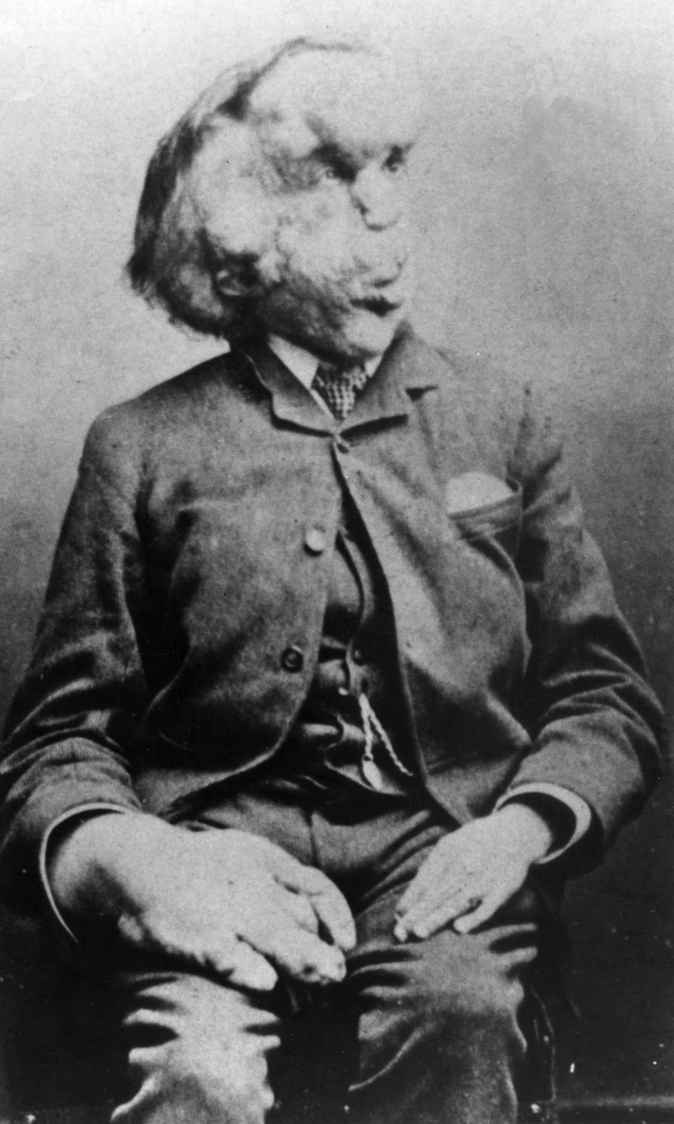
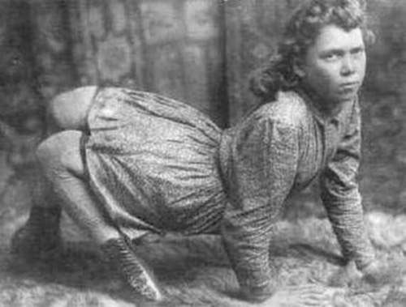
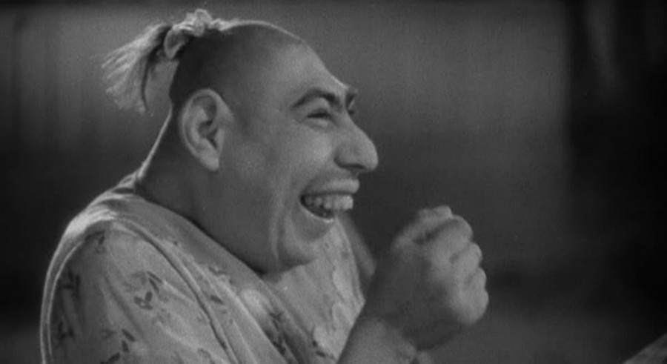

Slide 19
Conjoined Twins

Slide 20
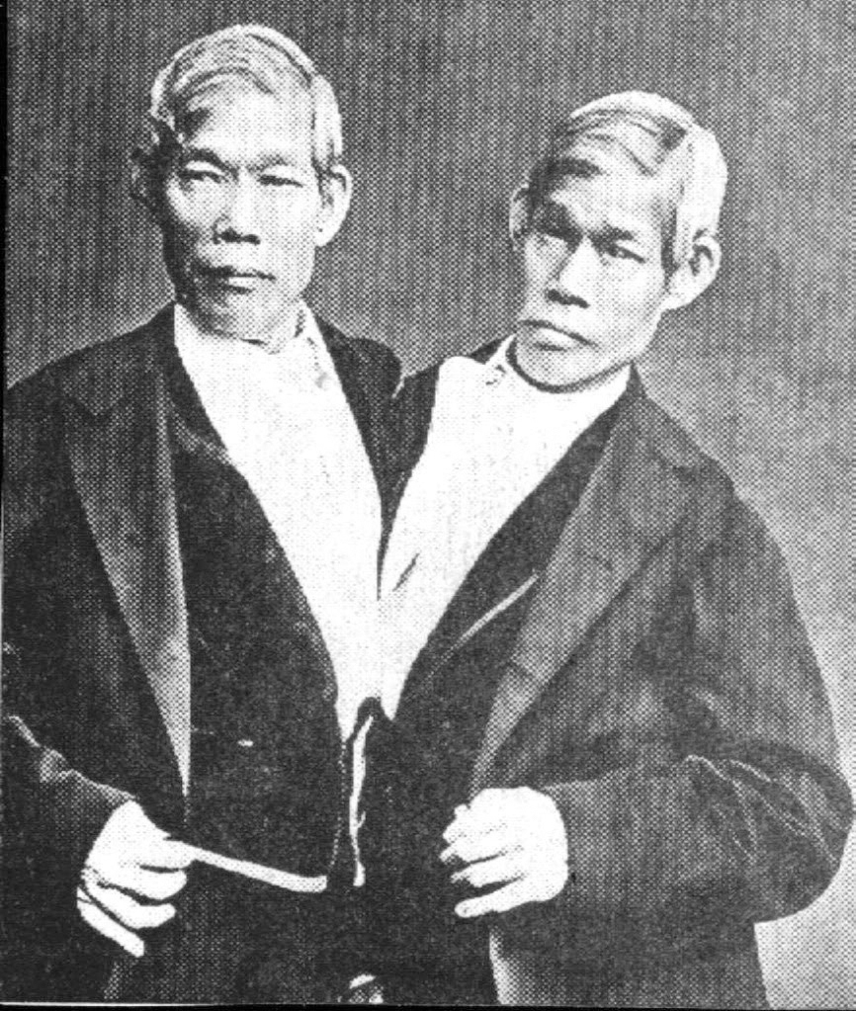
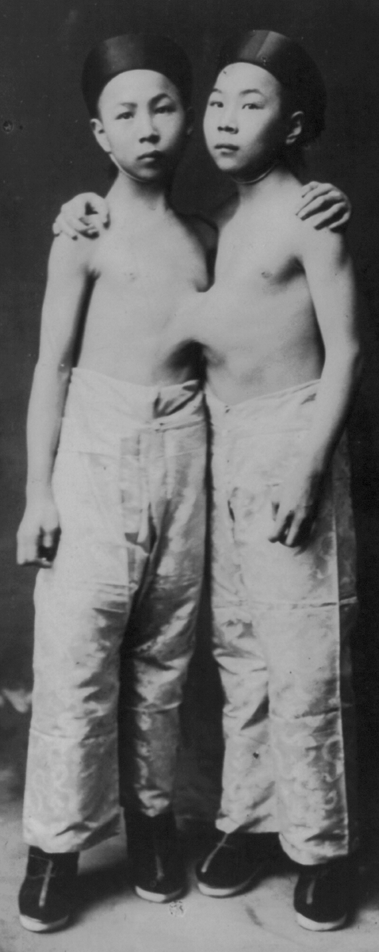

Slide 23
The Amazing

Slide 24
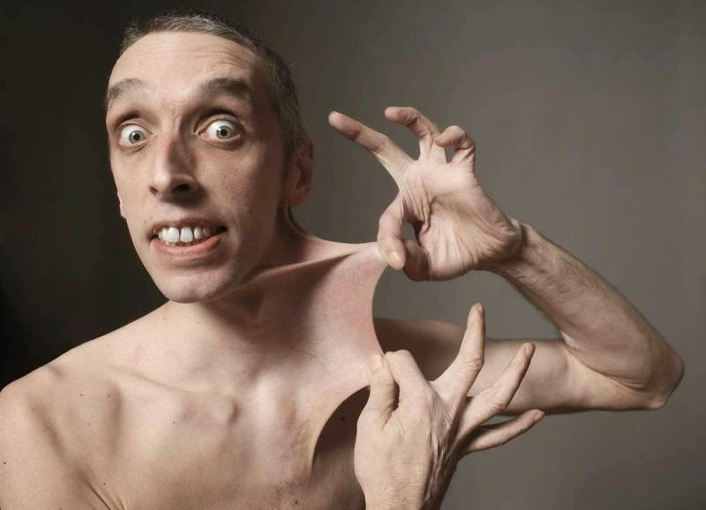

Slide 25
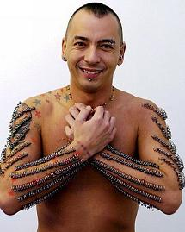
In just under 8 hours Kam Ma broke the world record for most piercings in a single session when he had 1,015 metal rings inserted all over his body.

Slide 26
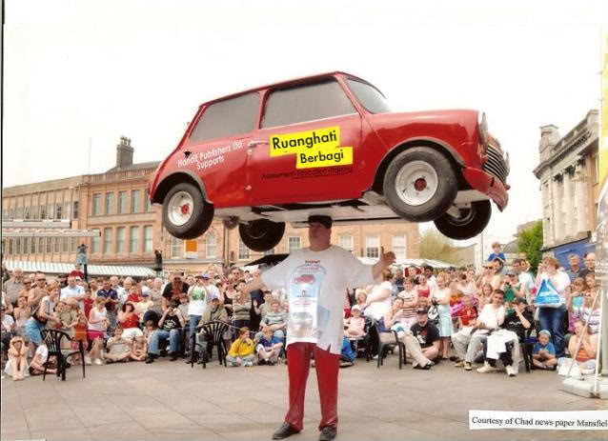
John Evans, who goes by the title of “professional head balancer”, was able to balance a 159-kilogram (352-pound) mini cooper on his head for 33 seconds without the use of hands.

Slide 27
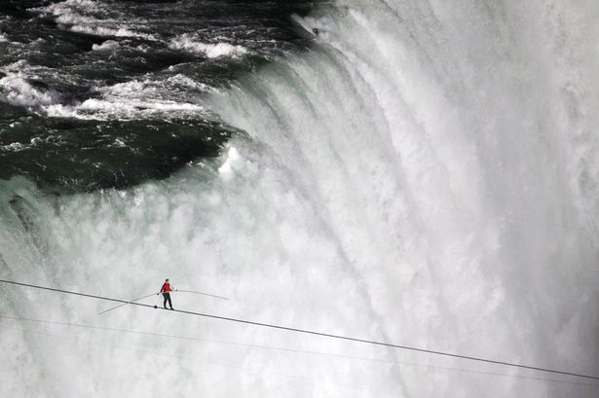
Nikolas “Nik” Wallenda walked across Niagara Falls on a tight rope!

Slide 28
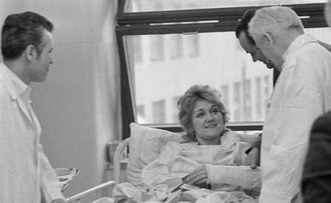
Vesna Vulovic is a former flight attendant who currently holds the world record for surviving the highest fall without a parachute.
On 26 January 1972 during a flight over Czechoslovakia a bomb planted by Croatian terrorists exploded in the baggage section of the aircraft causing the plane to break into pieces. The plane fell approximately 10,000m before hitting the ground. Vesna was the sole survivor

Slide 29
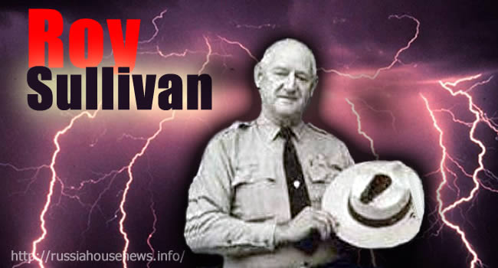
Between the ages of 30 and 65, Roy Cleveland Sullivan was struck by lightning seven times - and survived them all.

Slide 30
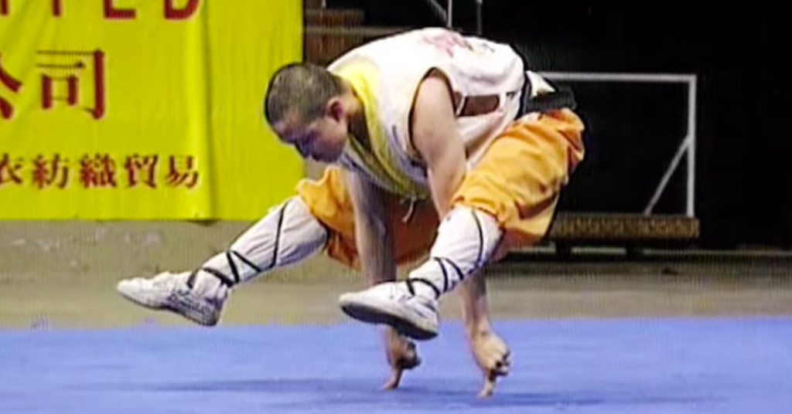
People are amazing video

Slide 31
Do you know someone amazing?
What can they do?
Can you do something awesome?
What would you like to do?

Slide 32
The Guinness Book of World Records

Slide 33
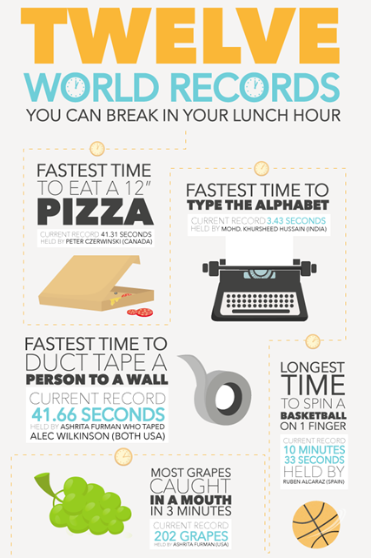
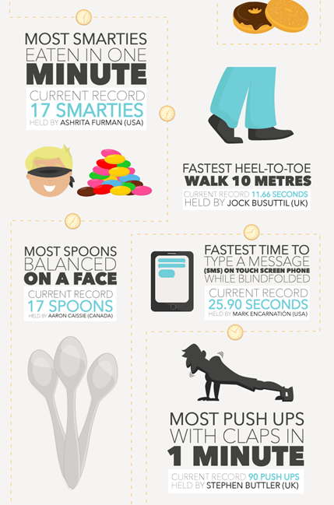

Slide 34
Most triangles drawn in 30 seconds:
90
https://recordsetter.com/world-record/triangles-drawn-30-seconds/37267?autoplay=true

Slide 35
Longest time balancing a pencil on your nose:
4:41
https://www.youtube.com/watch?v=xwcTzxzM5Y0

Slide 36
Most spins in 1 minute
112
http://challengers.guinnessworldrecords.com/challenges/166-most-kathak-spins-in-1-minute

Slide 37
Most times a paper is folded in half
12
http://pomonahistorical.org/12times.htm

