Slide 1
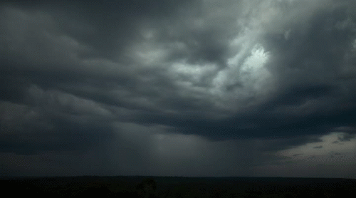

Lesson 18 – A Thunderstorm

Slide 2
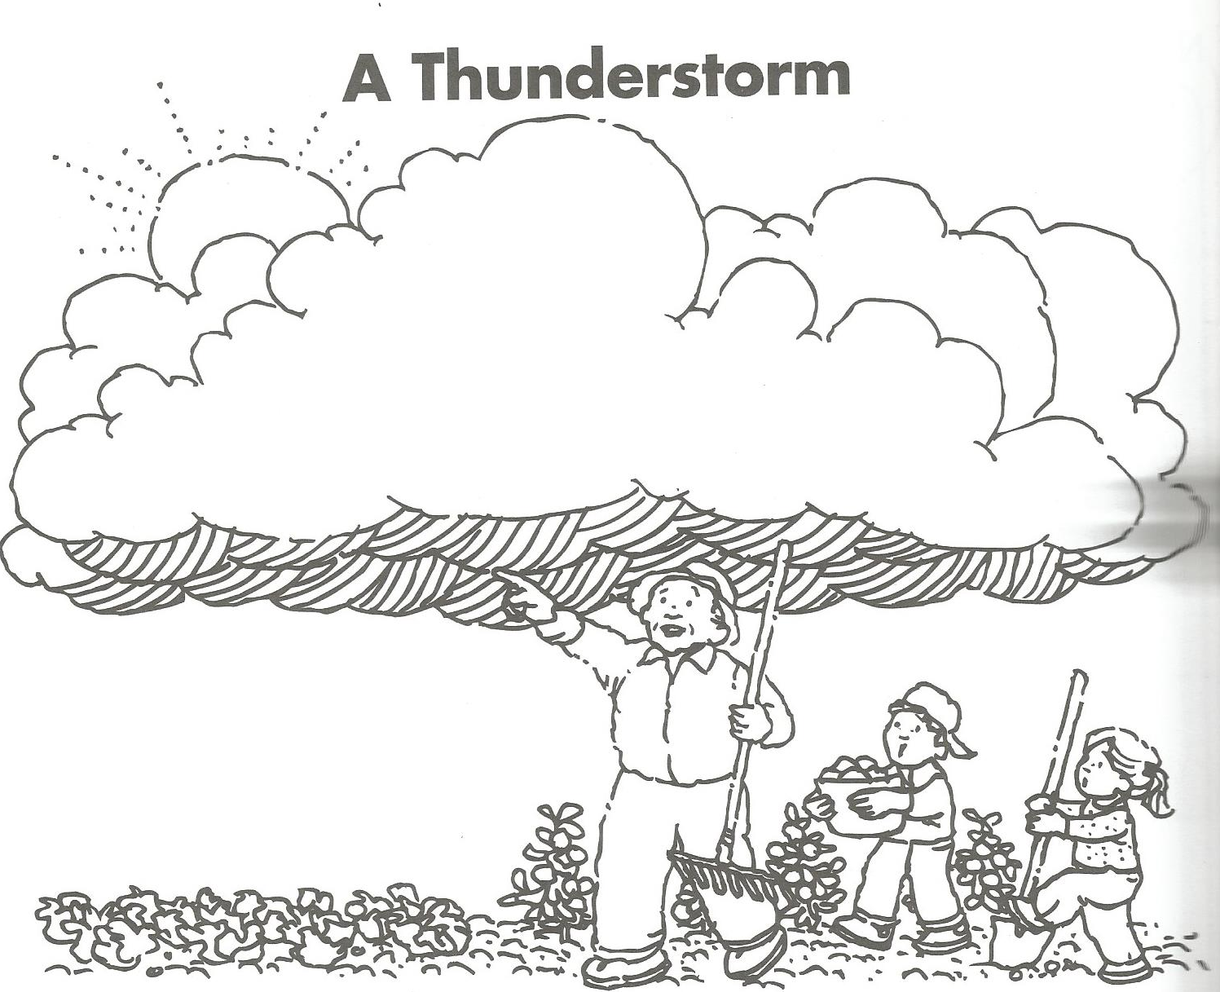

Slide 3
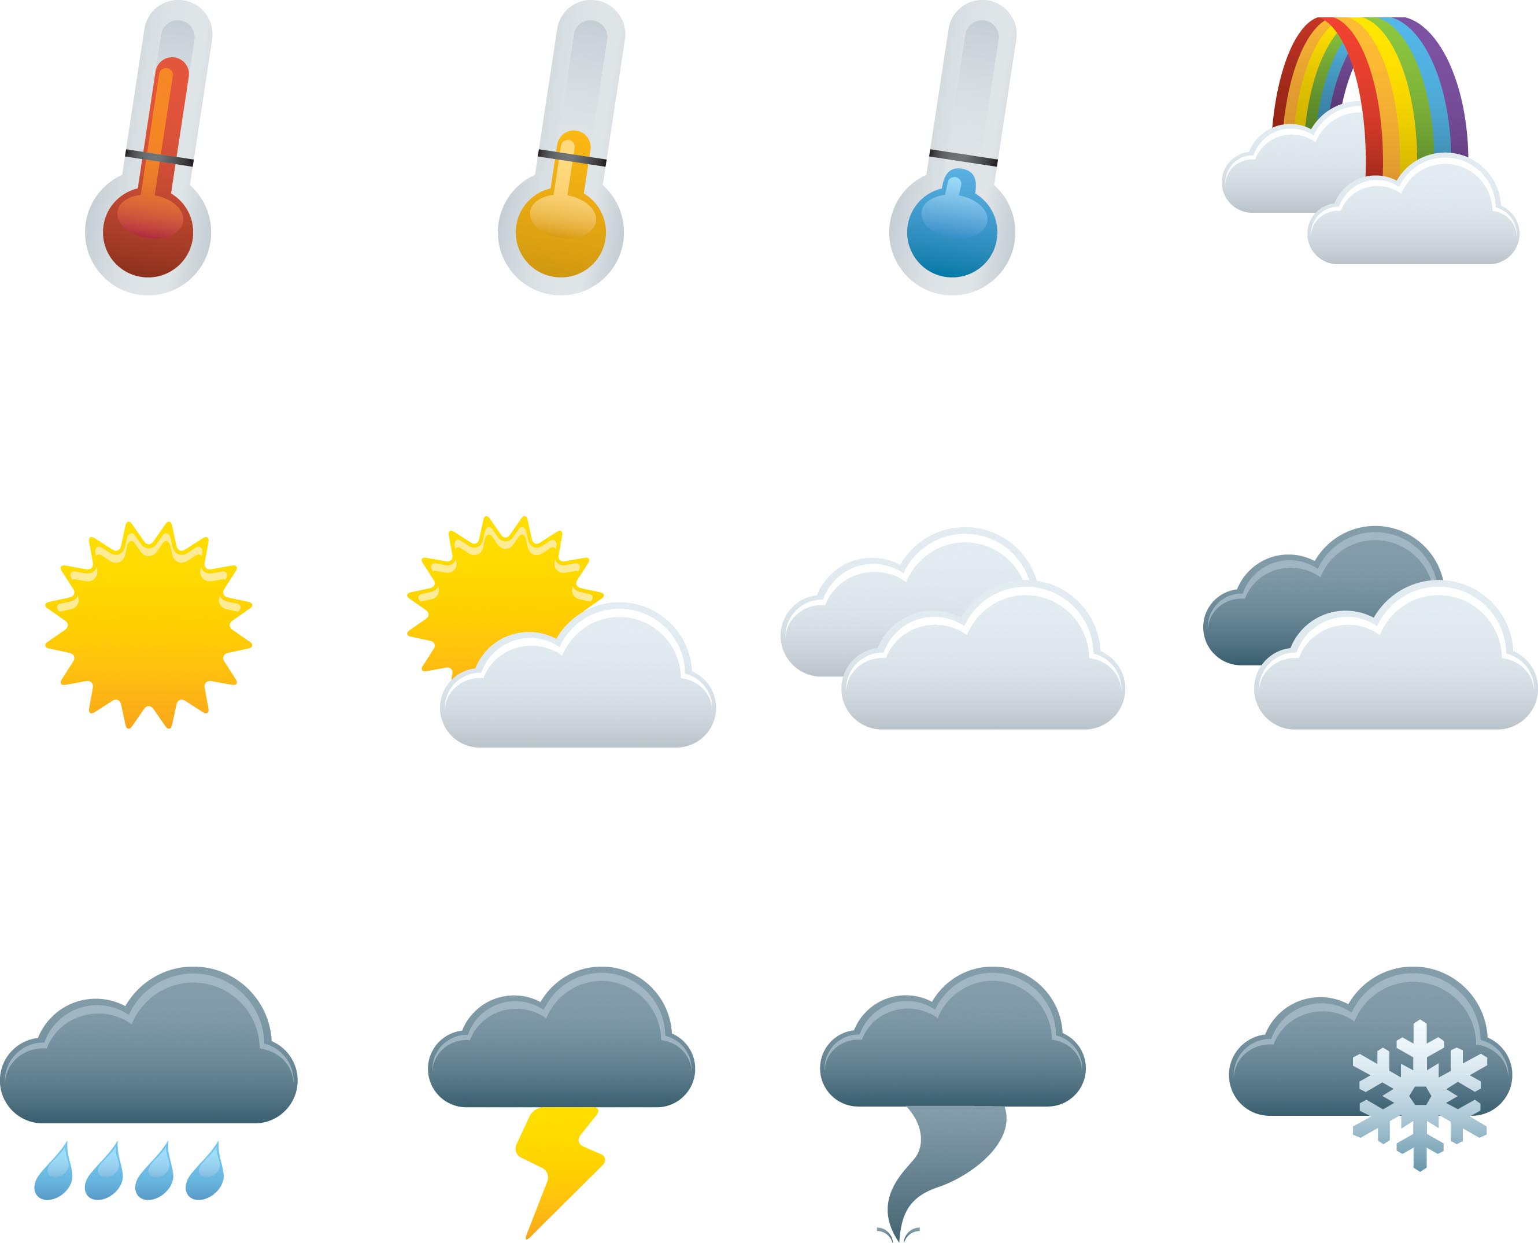
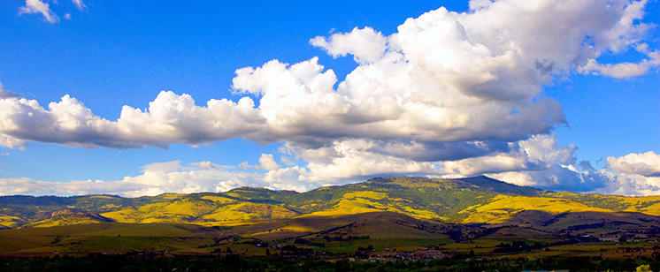
The Weather Channel Review:

Slide 4
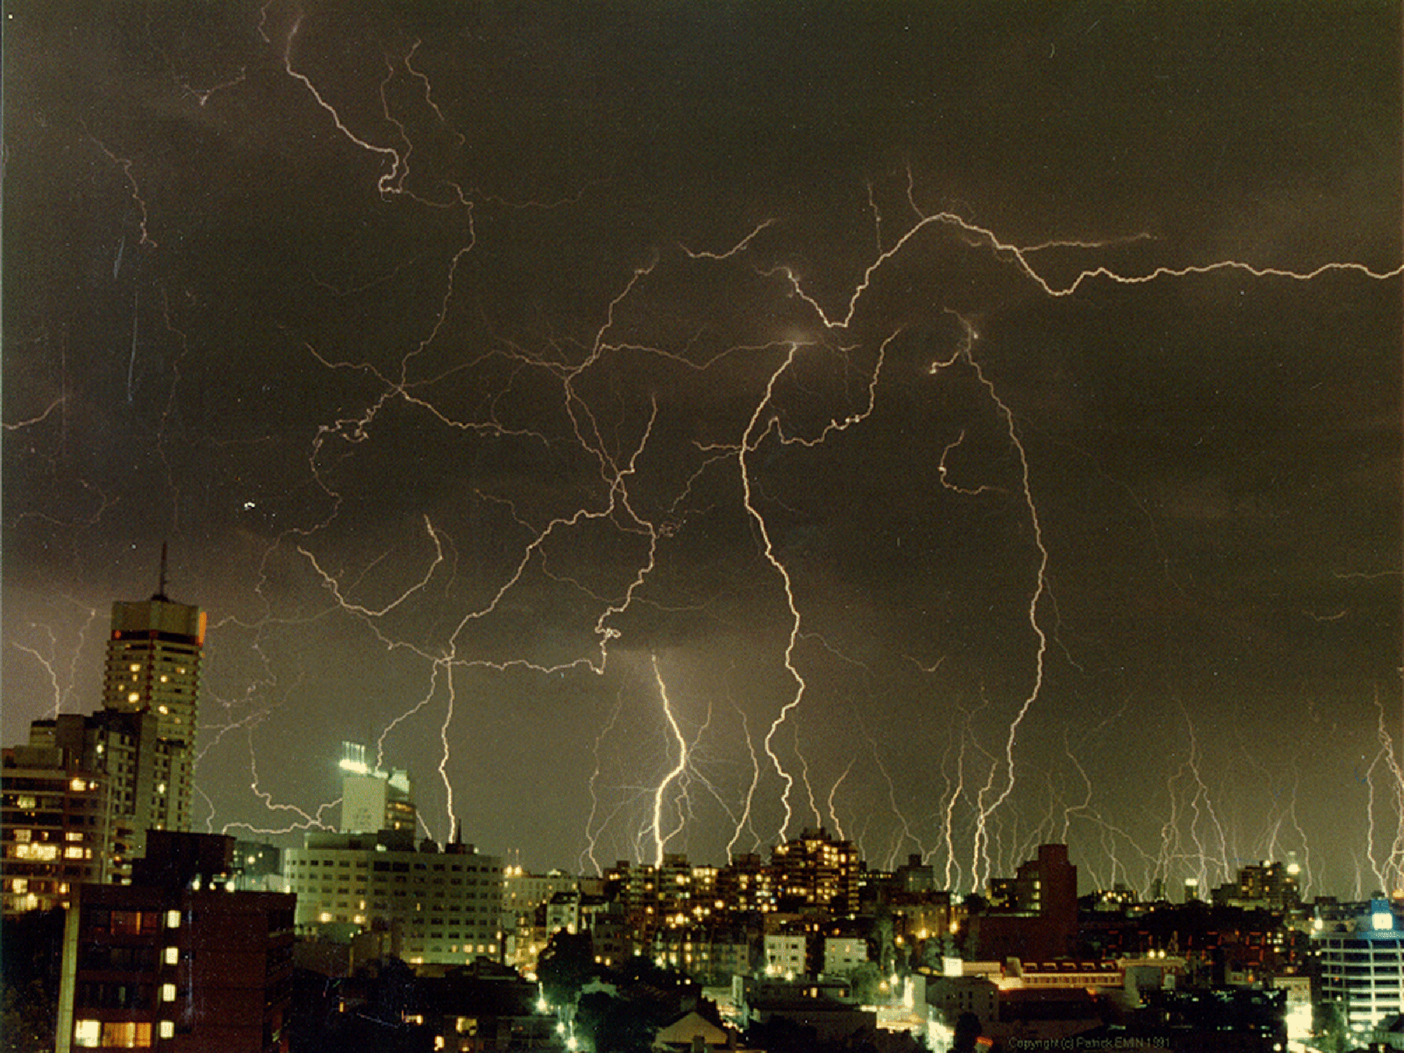

Slide 5
What happens during a thunderstorm?

Slide 6
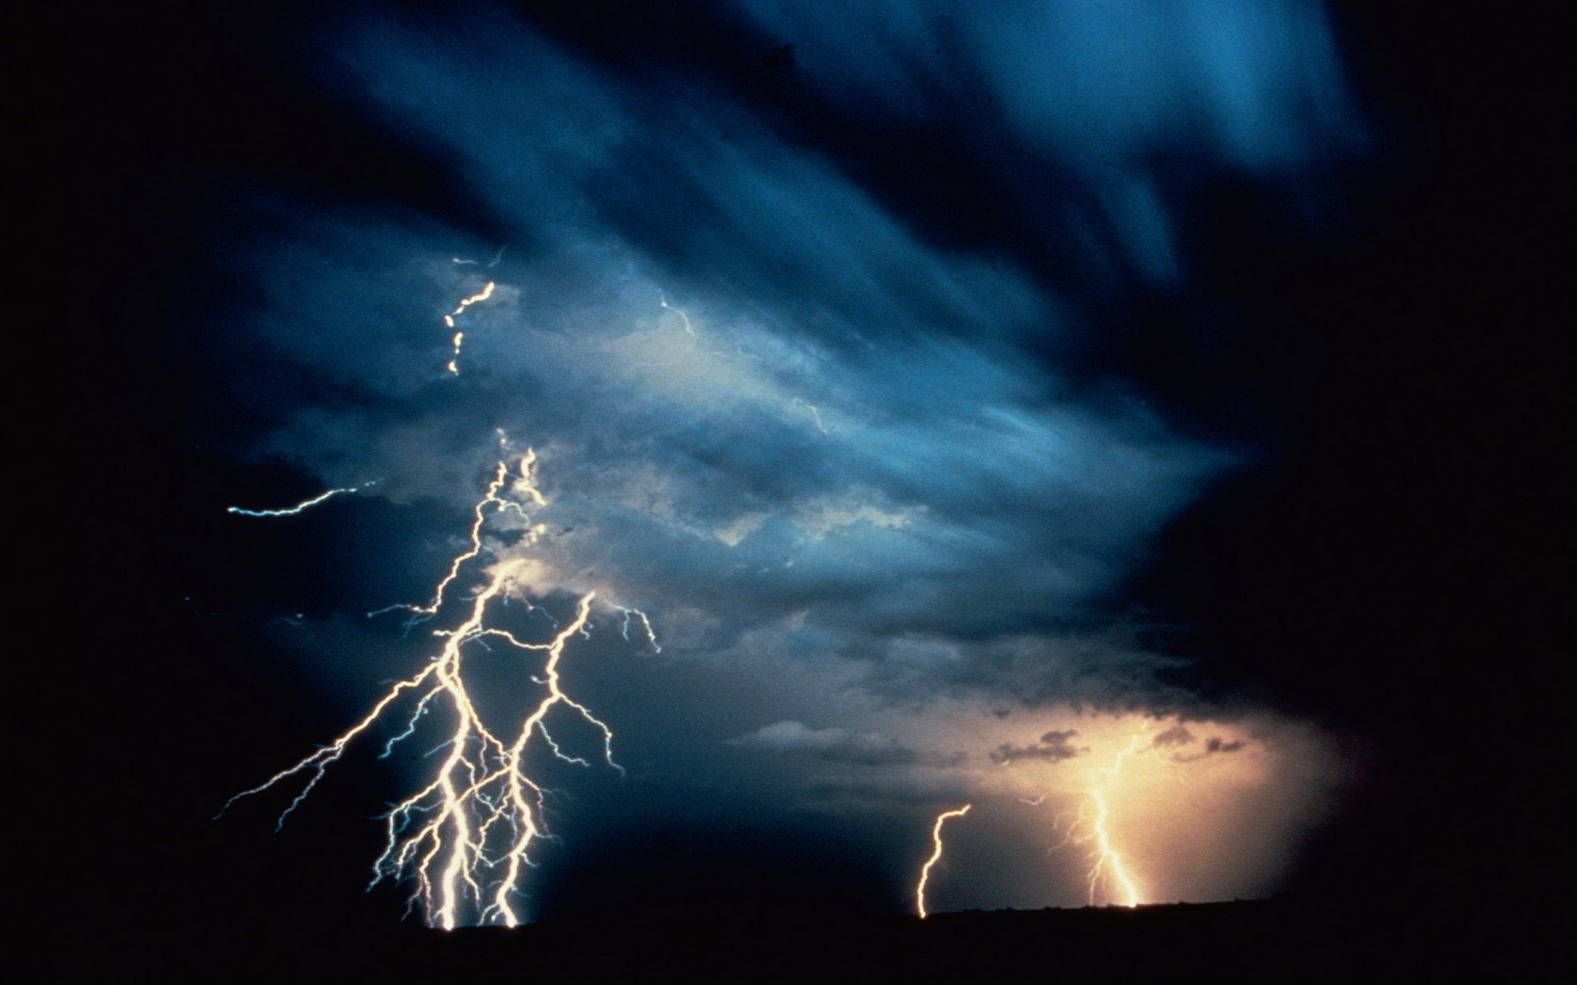

Slide 7
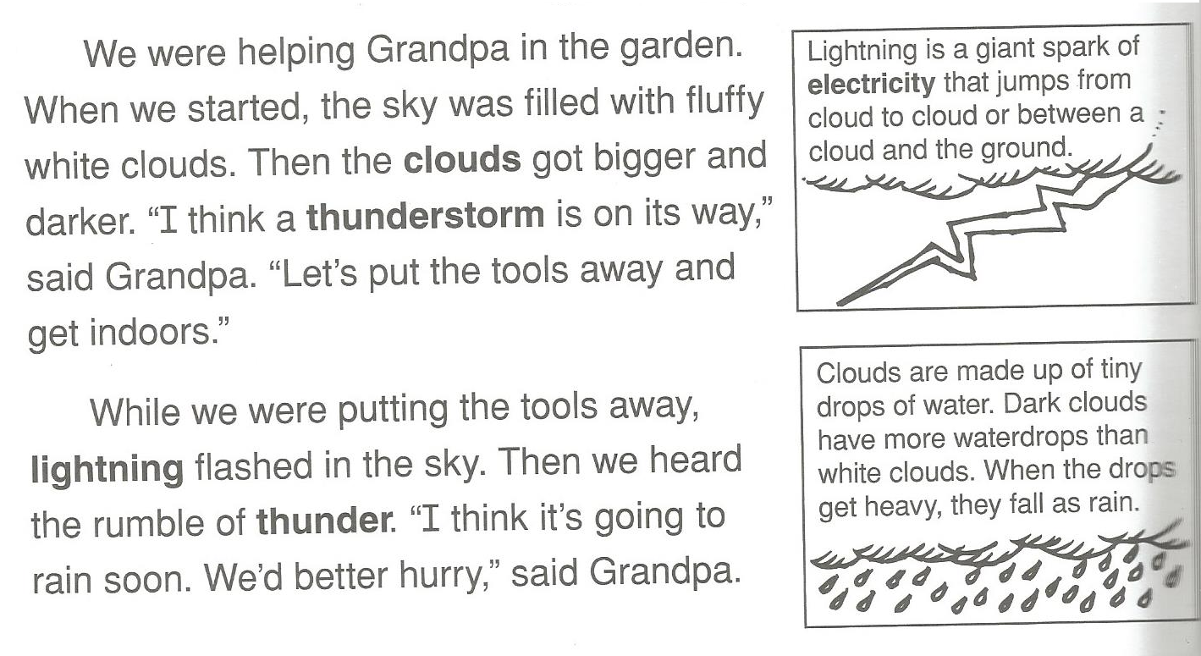

Slide 8
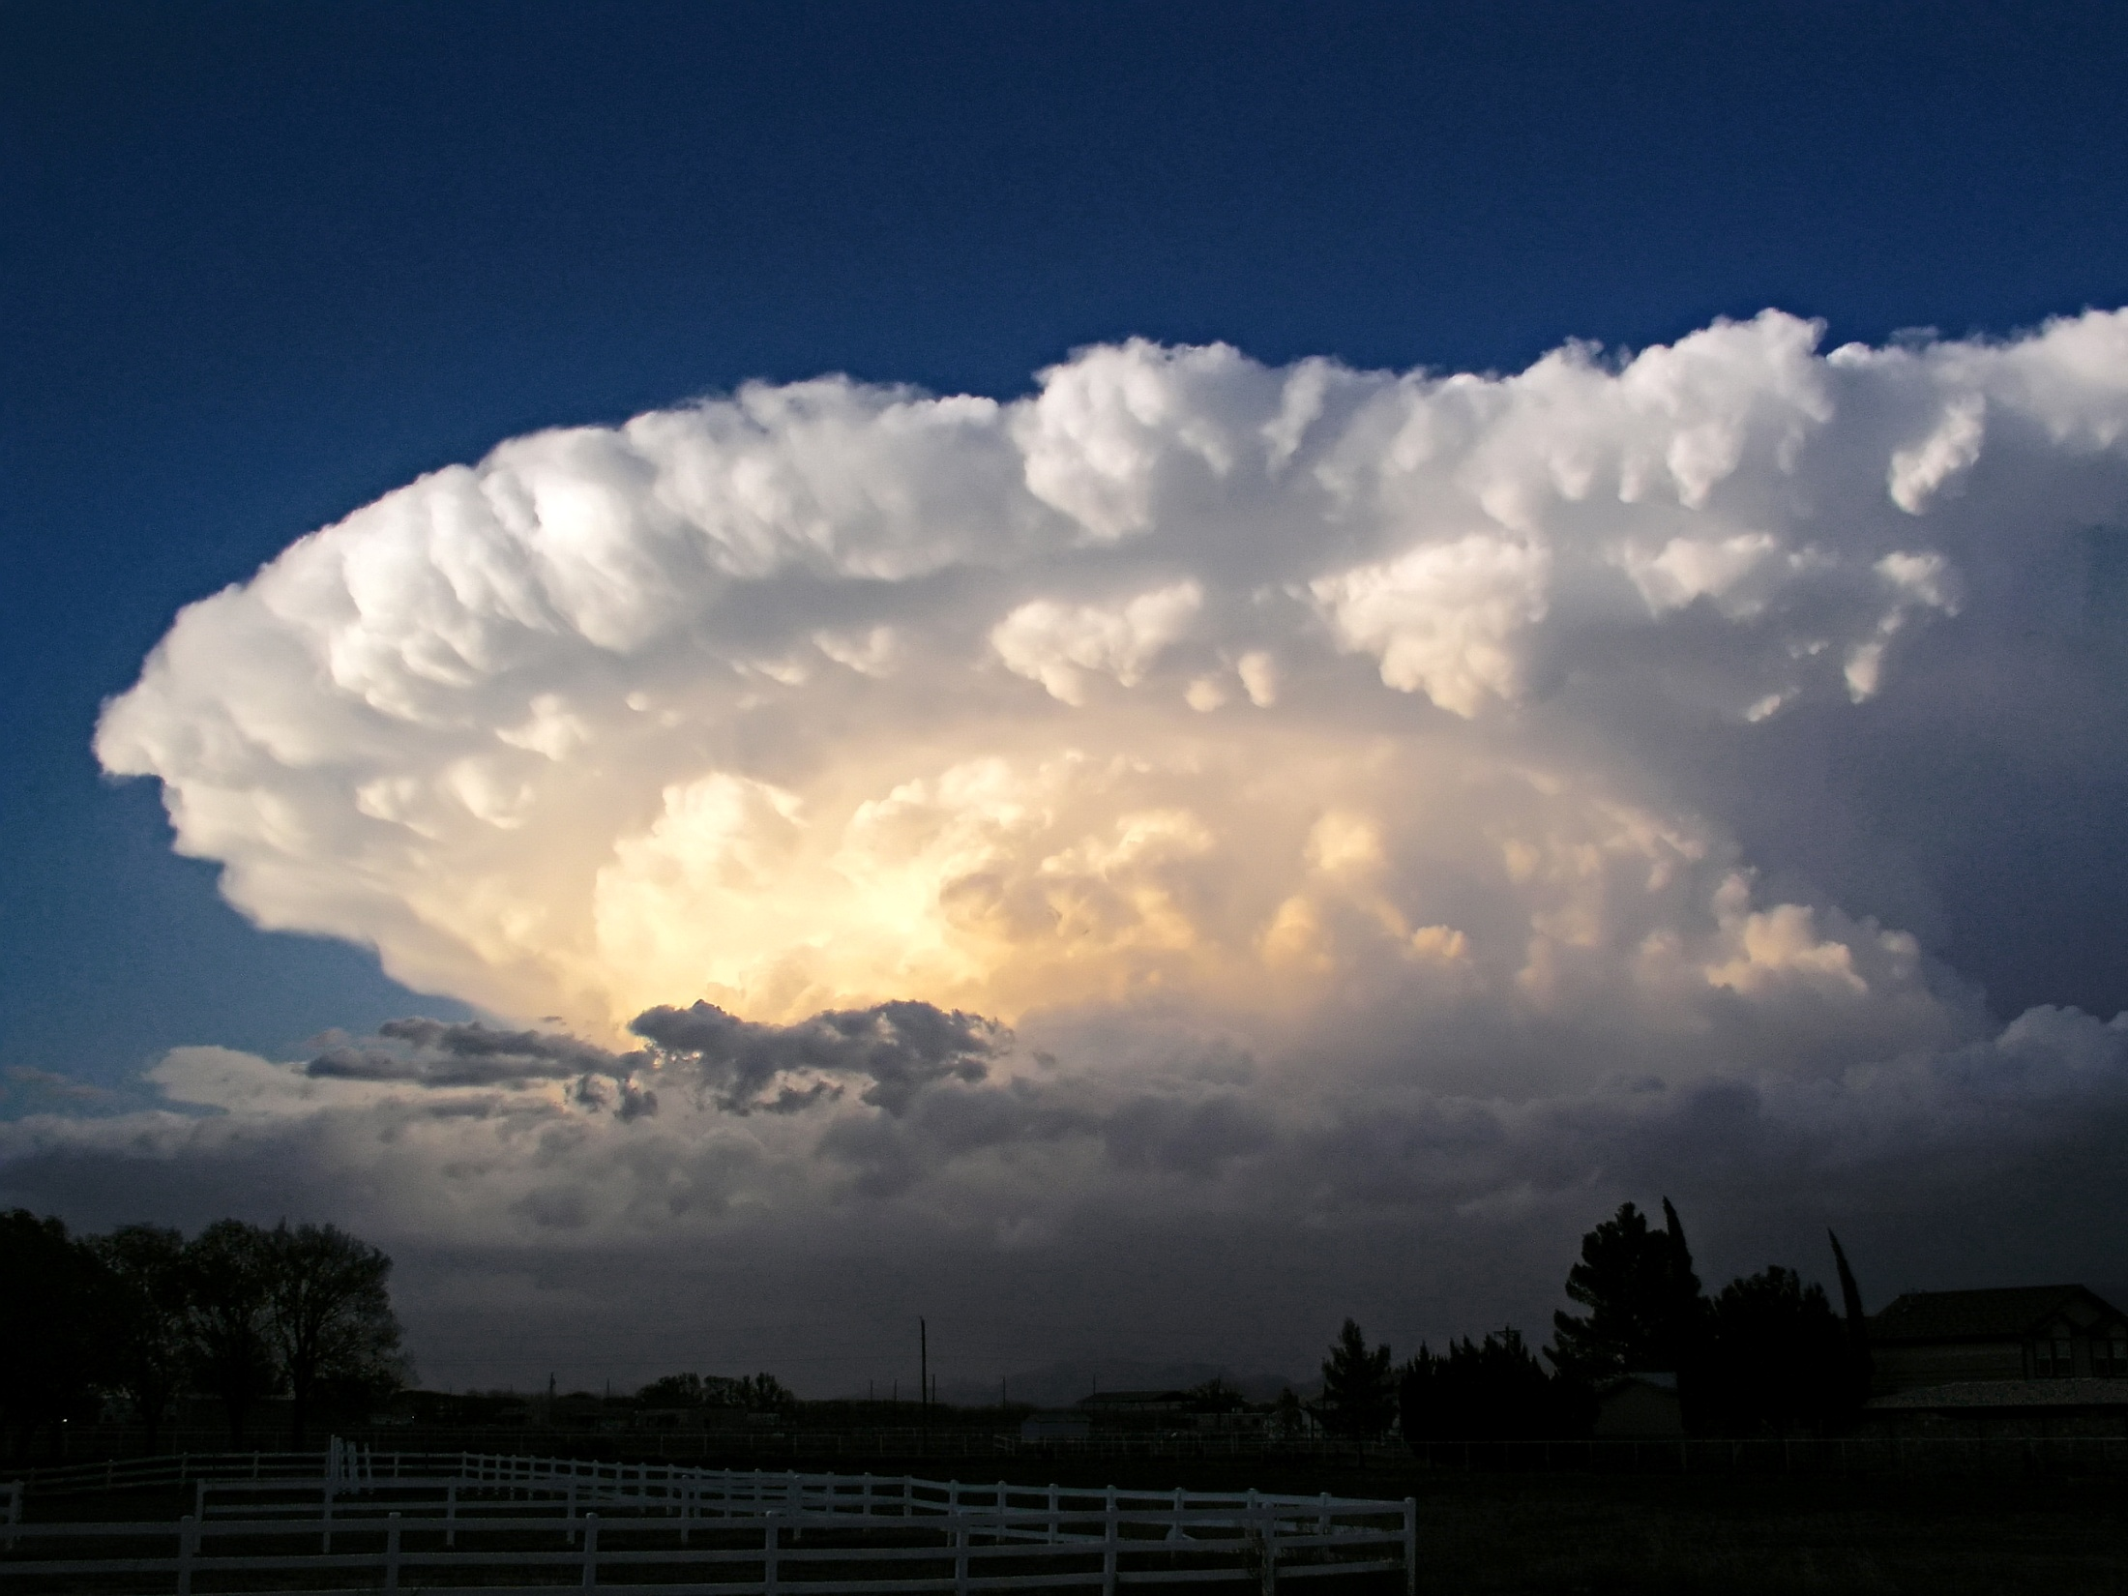

Slide 9
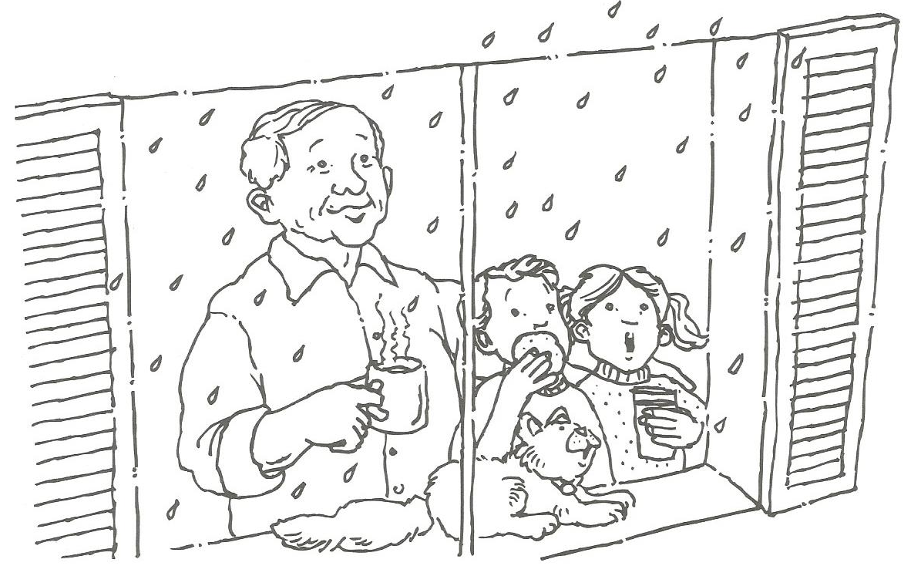
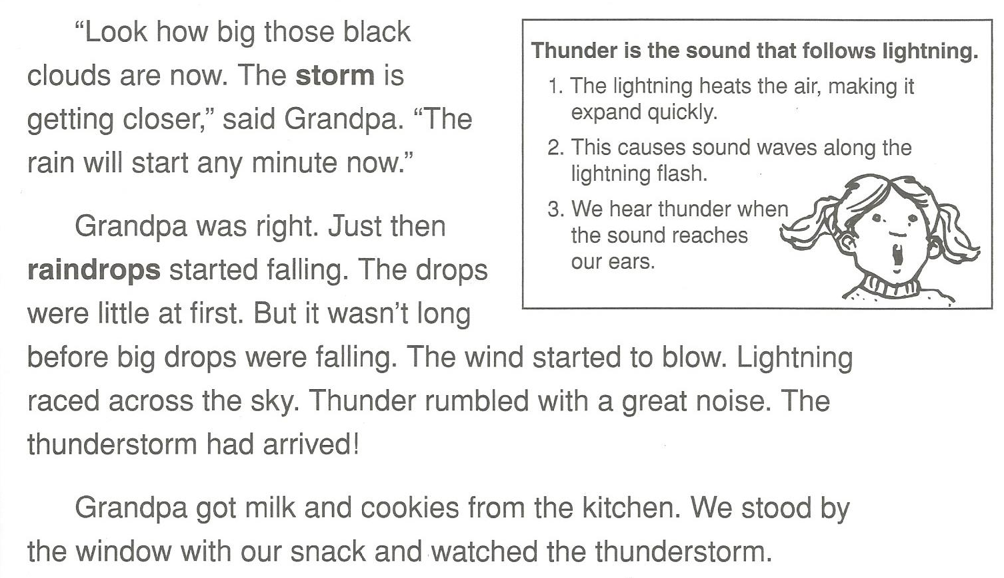

Slide 10
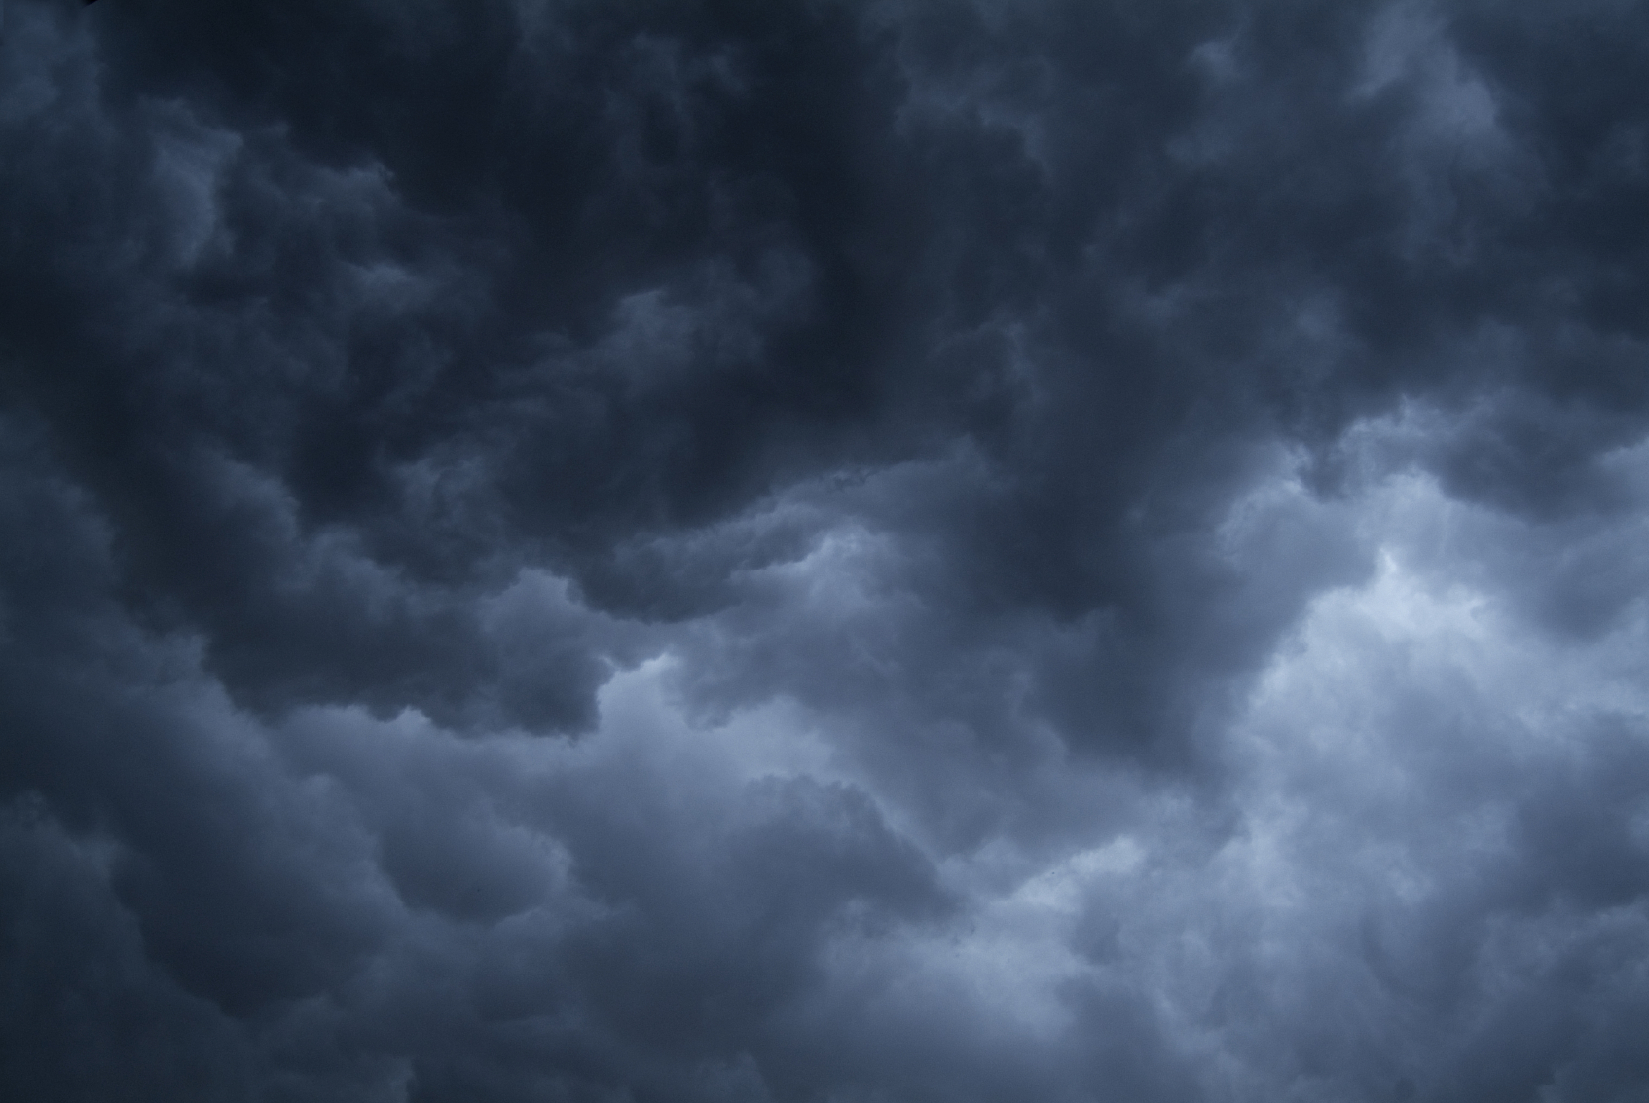

Slide 11

Ways to describe rain:
Mist
Drizzle
Light rain
Heavy rain
Downpour
Raining cats and dogs

Slide 12
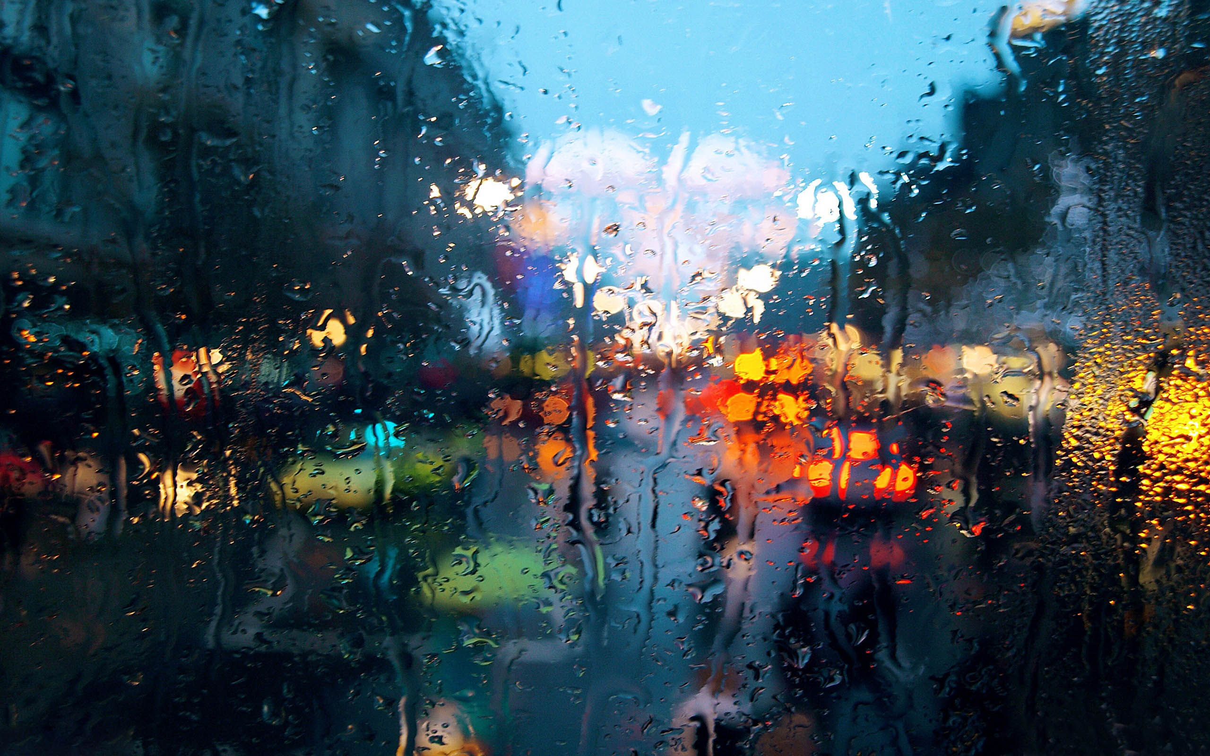

Slide 13
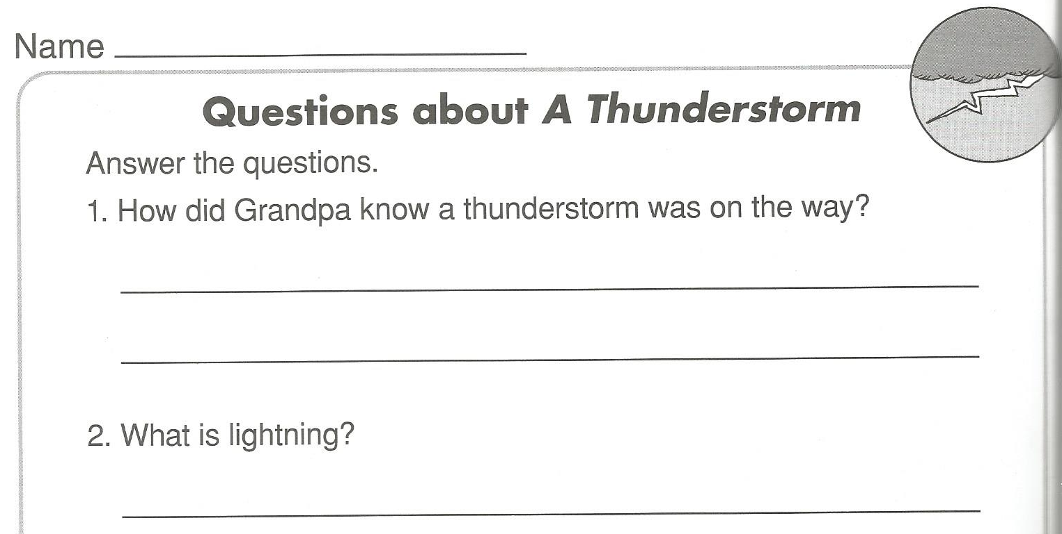

Slide 14
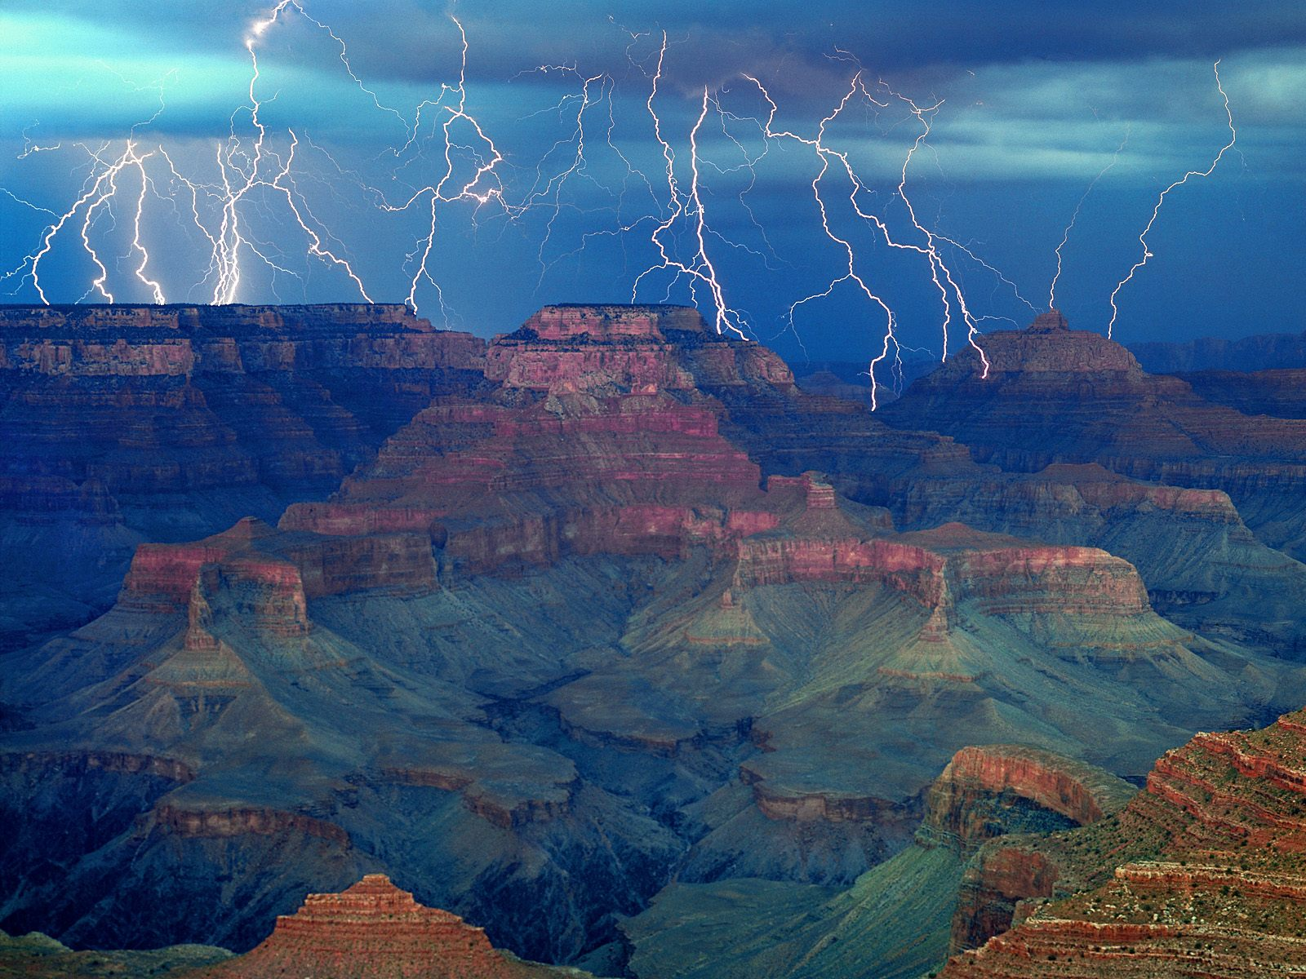

Slide 15
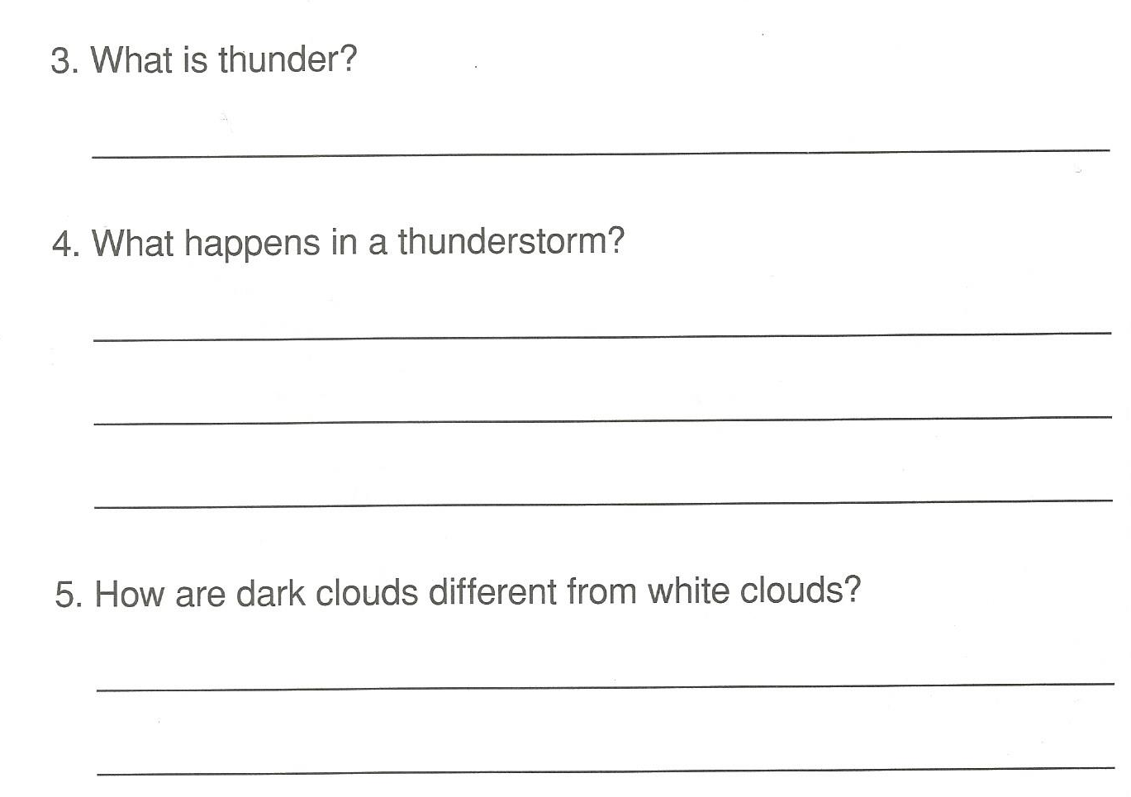

Slide 16
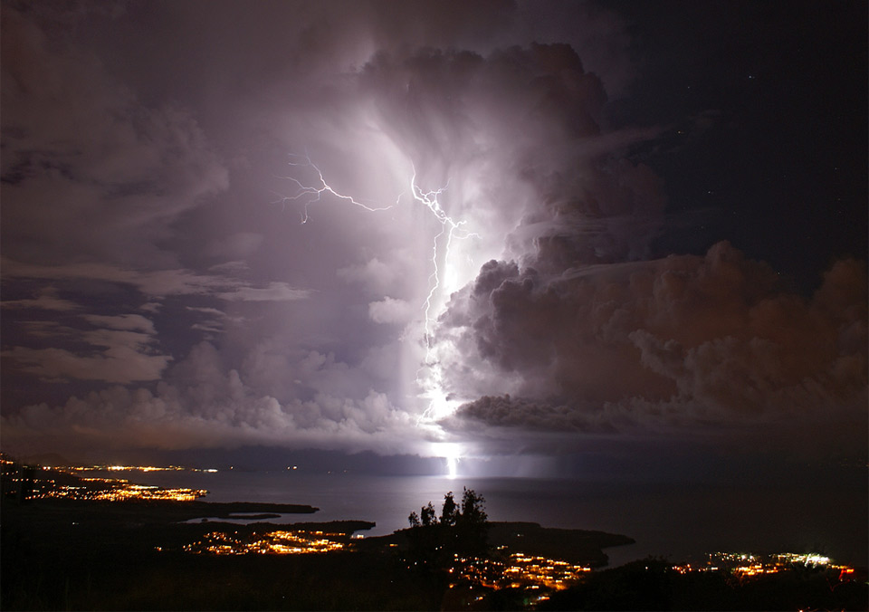

Slide 17
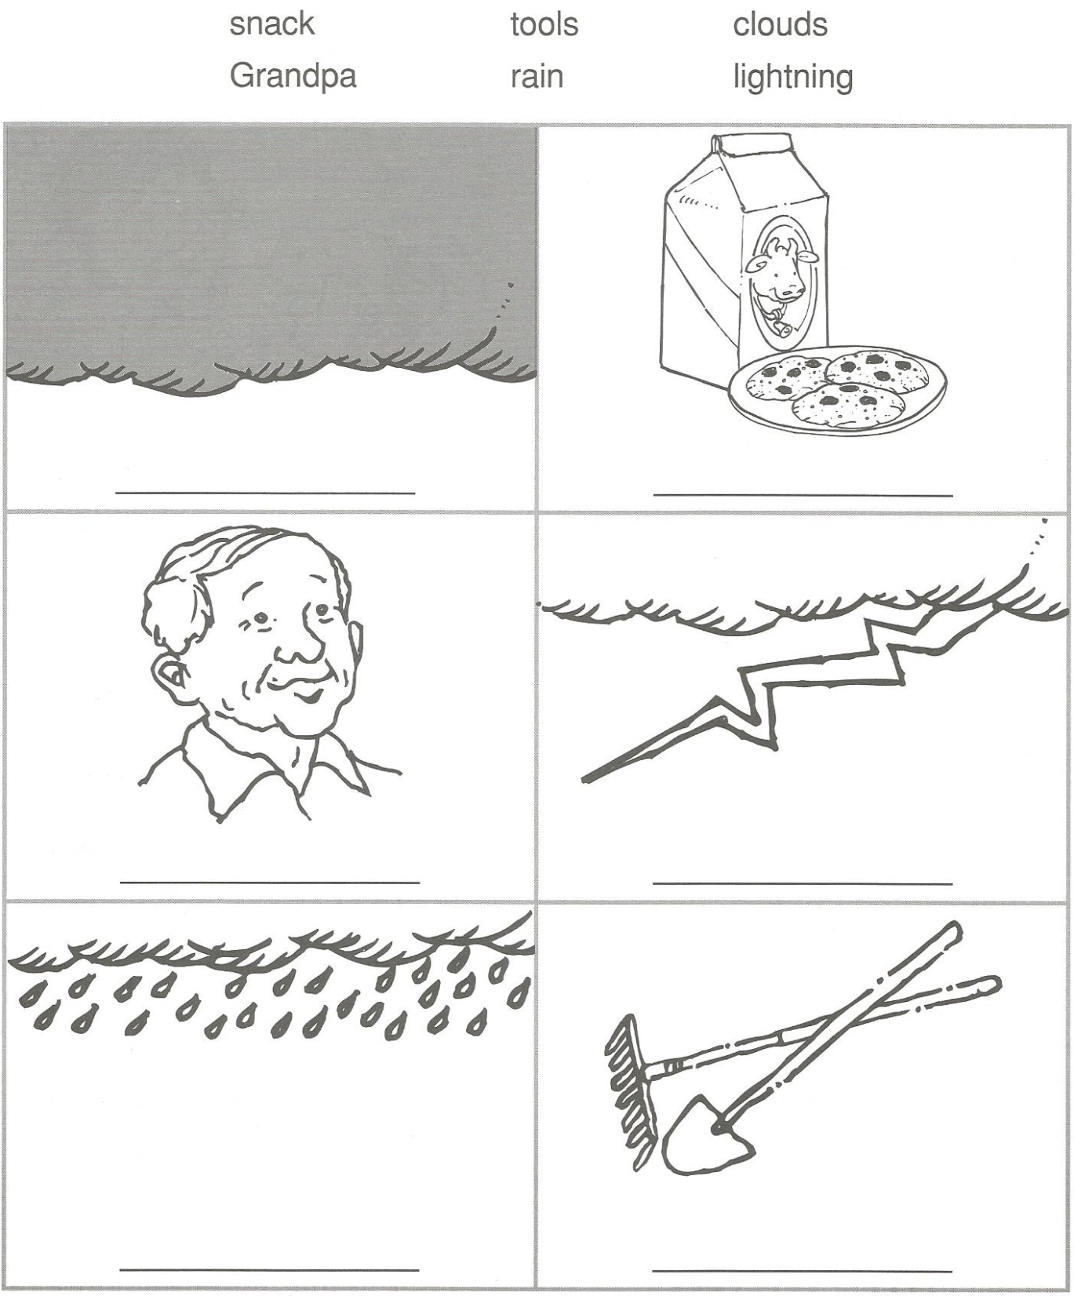

Slide 18
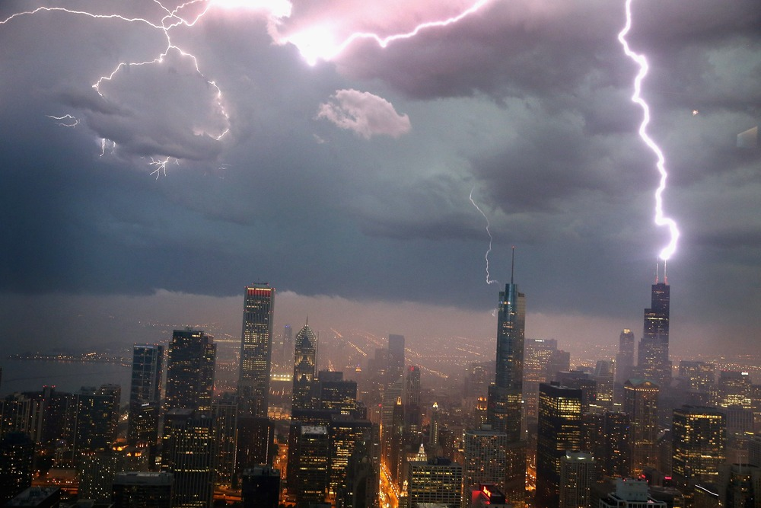

Slide 19
How do clouds form?

Slide 20

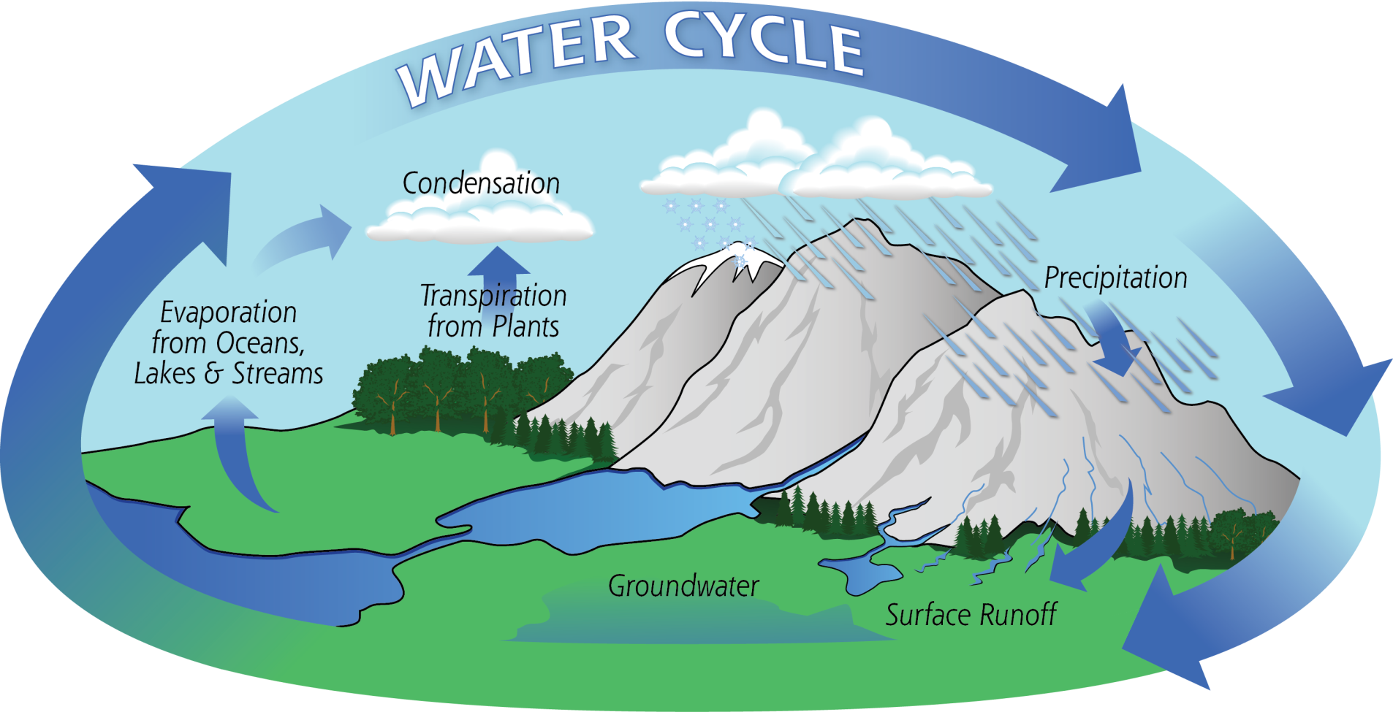

Slide 21
How Clouds Form:
Ingredients:
Temperature change
Moisture
Seeds

Slide 22
Our Own Cloud!

Slide 23
How many words can you make from:
THUNDERSTORM

