Slide 1
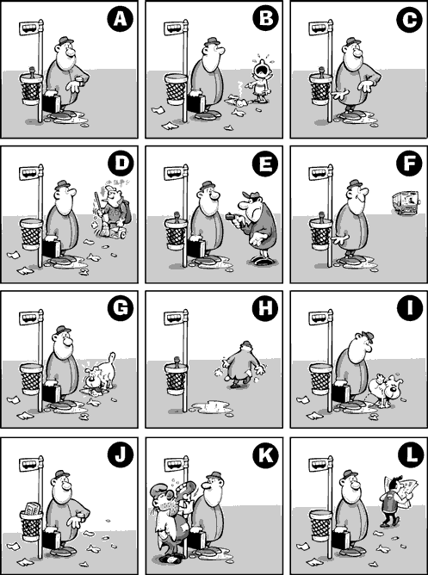
Put these in the correct order:
8
3
10
6
9
11
5
12
4
1
7
2
J-L-B-I-G-D-K-A-E-C-F-H

Slide 2
Lesson 2 – Classifying Objects

Slide 3
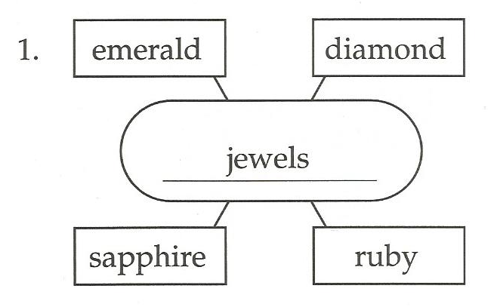
Classifying Objects

Slide 4
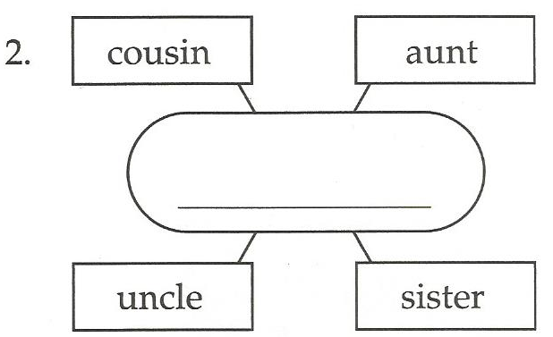
Relatives

Slide 5
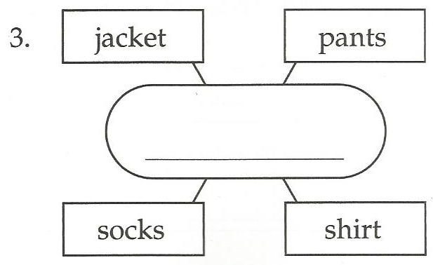
Clothes

Slide 6
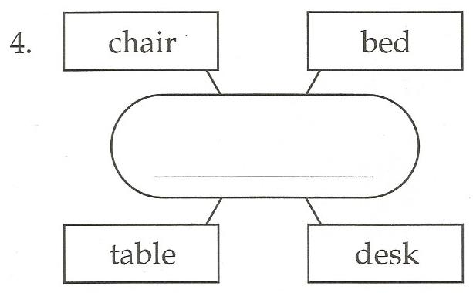
Furniture

Slide 7
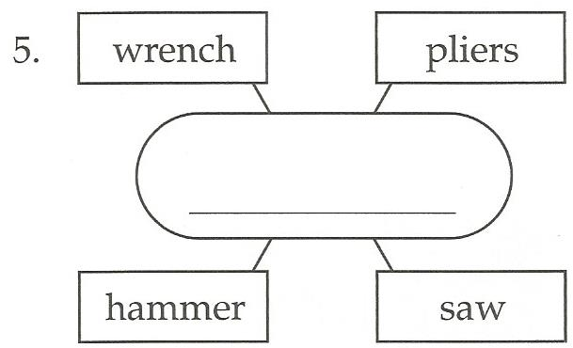
Tools

Slide 8
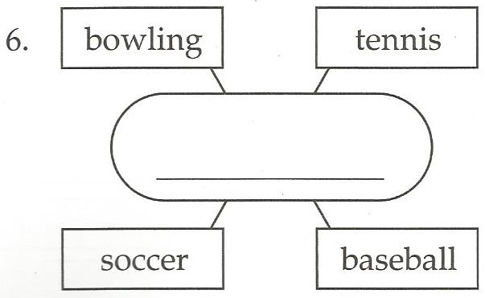
Sports

Slide 9
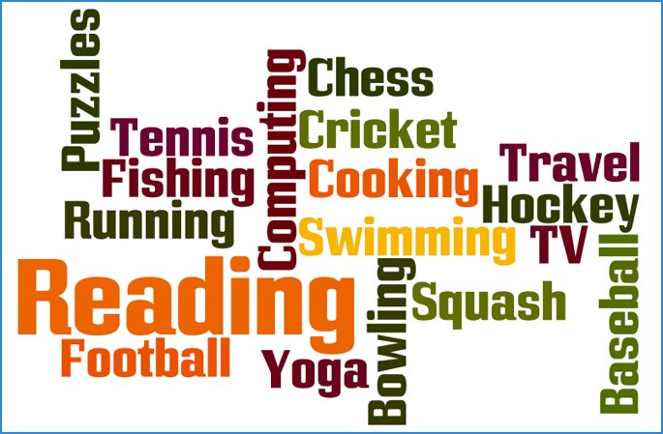
What is the category?

Slide 10
What is the category?

Slide 11
What is the category?

Slide 12
What is the category?

Slide 13
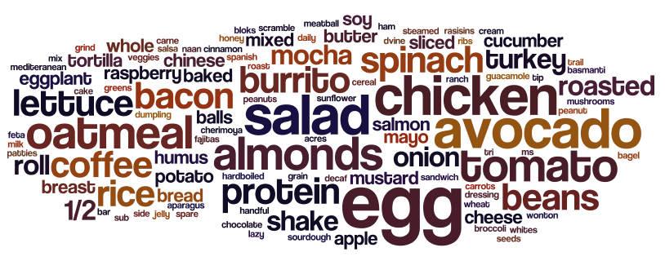
What is the category?

Slide 14
What is the category?

Slide 15
What is the category?

Slide 16
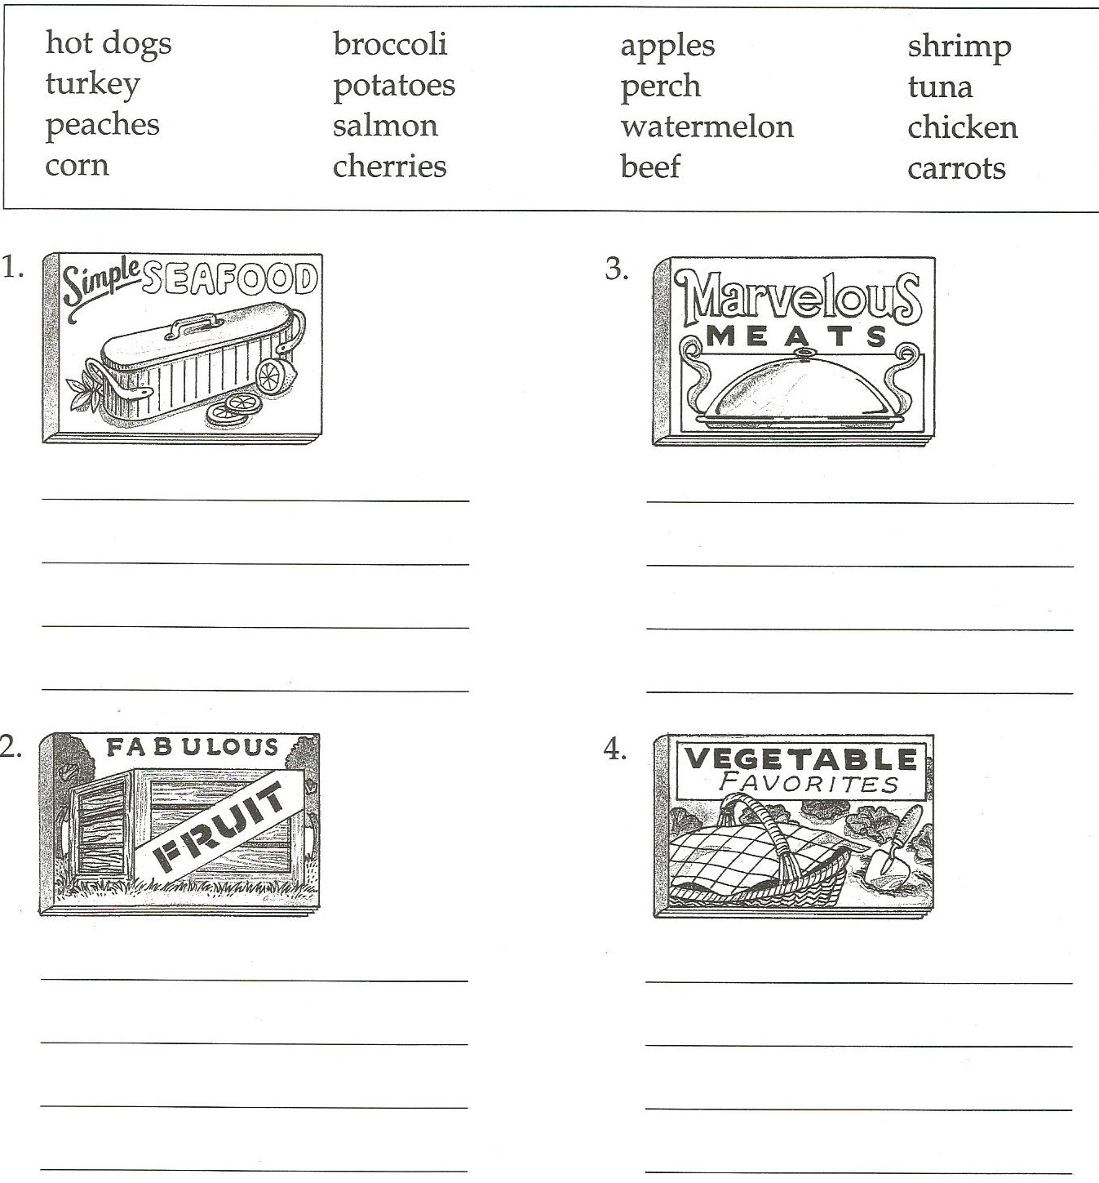
Put these in the correct cookbook:

Slide 17
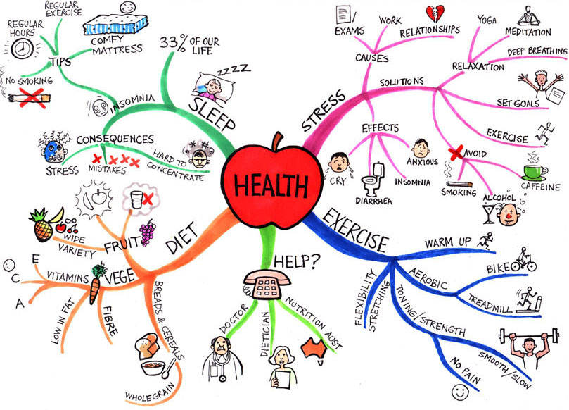
Making a Mind Map

Slide 18
Making a Mind Map
Food Groups

Slide 19
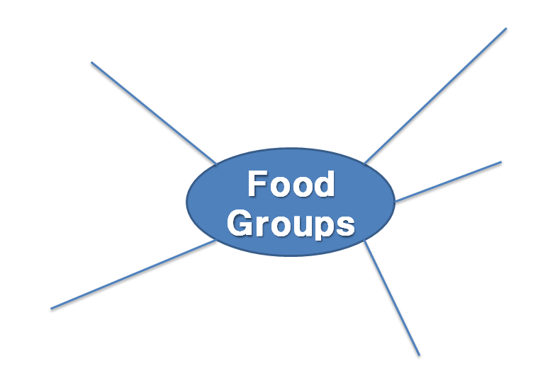
Food Groups

Slide 20
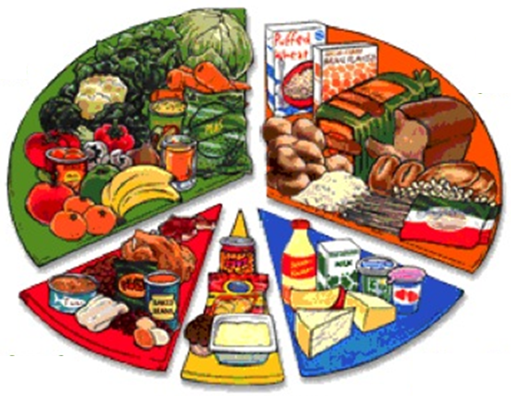
Food Groups:
Fruits and
Vegetables
Grains and
Cereal
Meat, Fish
And Eggs
Dairy
Products
Junk Food

Slide 21
Grains and
Cereal
Fruits and
Vegetables
Dairy
Products
Food Groups
Meat, Fish
And Eggs
Junk Food

Slide 22
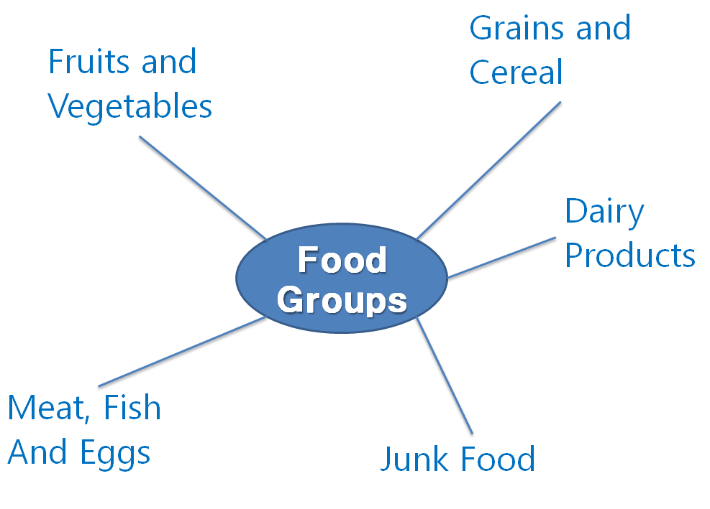

Slide 23
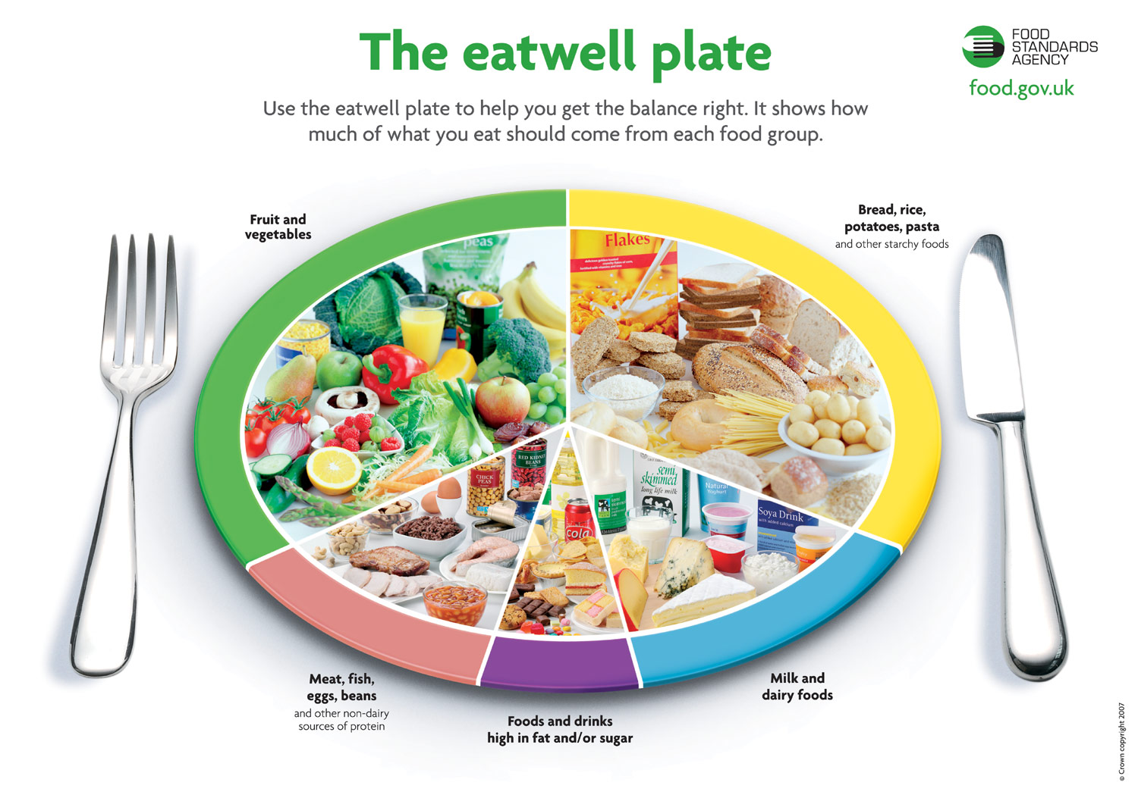

Slide 24
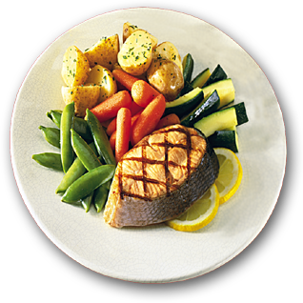

Slide 25
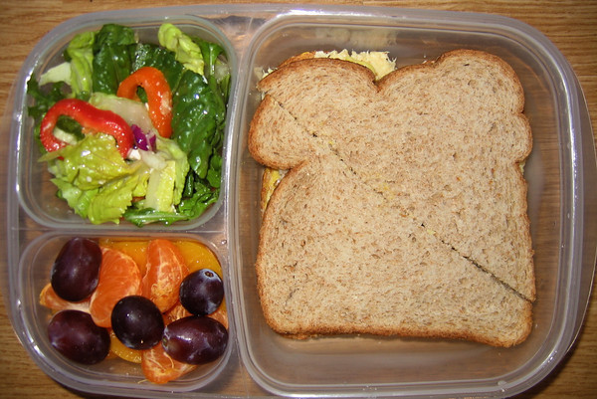

Slide 26
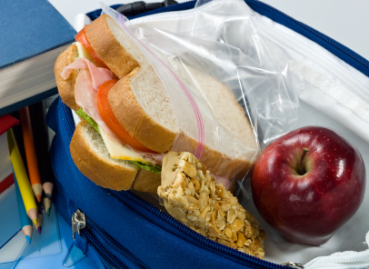

Slide 28
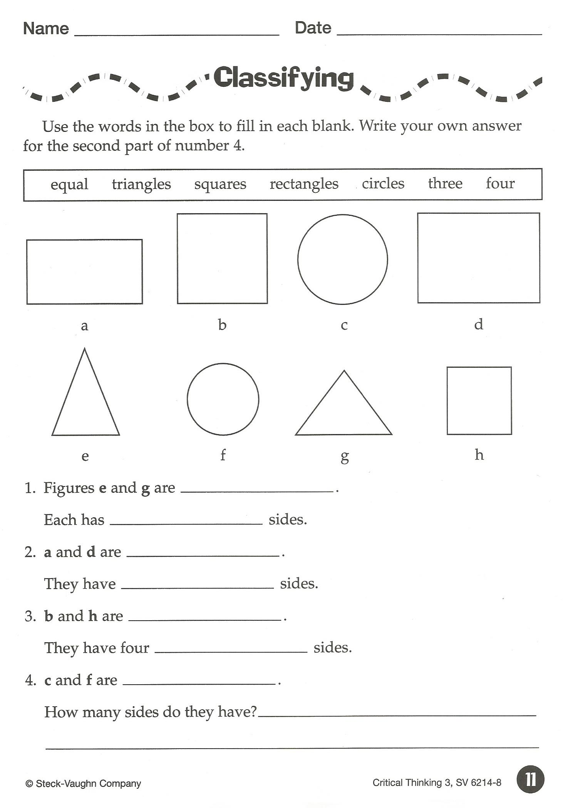

Slide 29
Pictureka

