Slide 1
Red Riding Hood Again

Slide 2
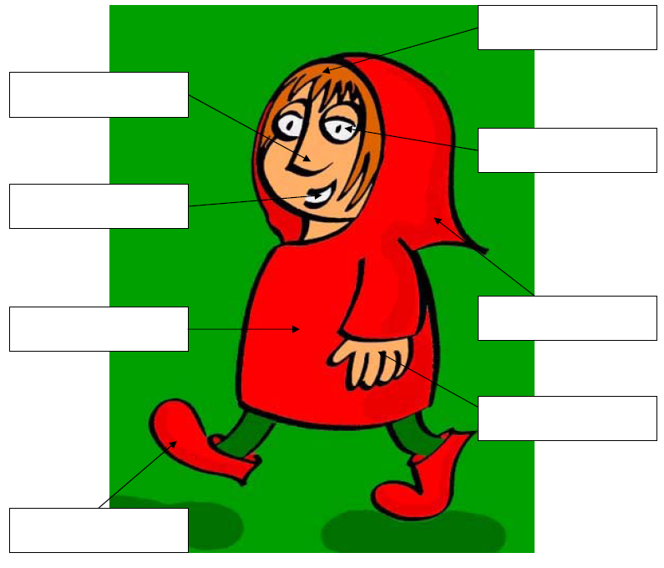

Slide 3
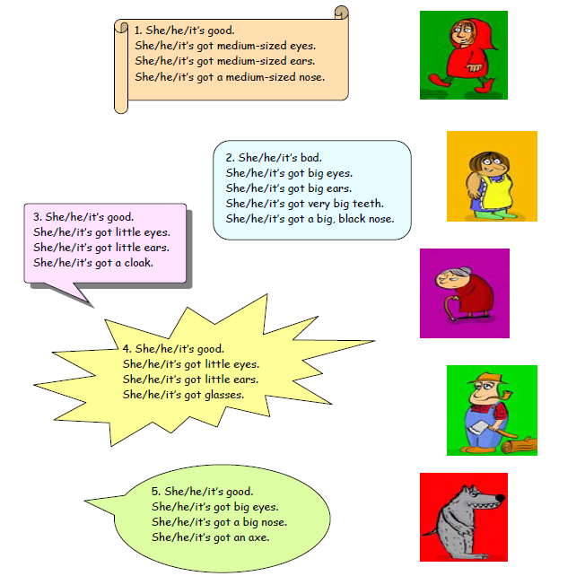

Slide 4
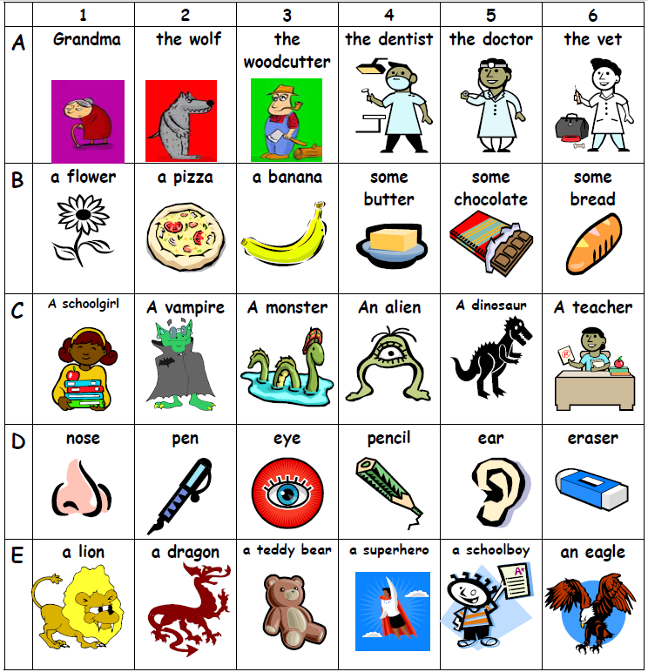
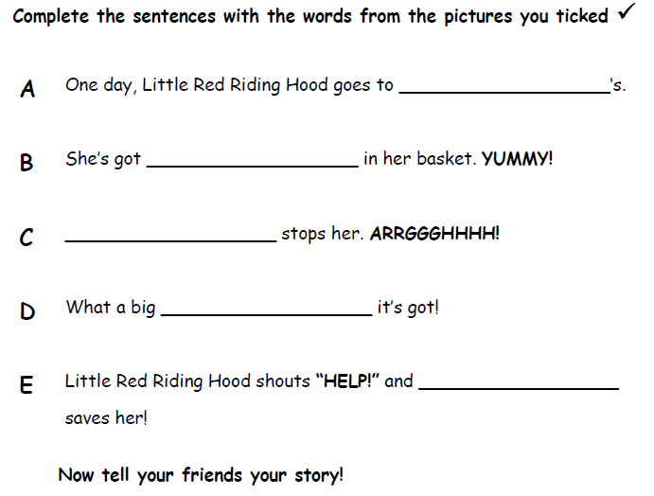
Make Your Own Story

Slide 6
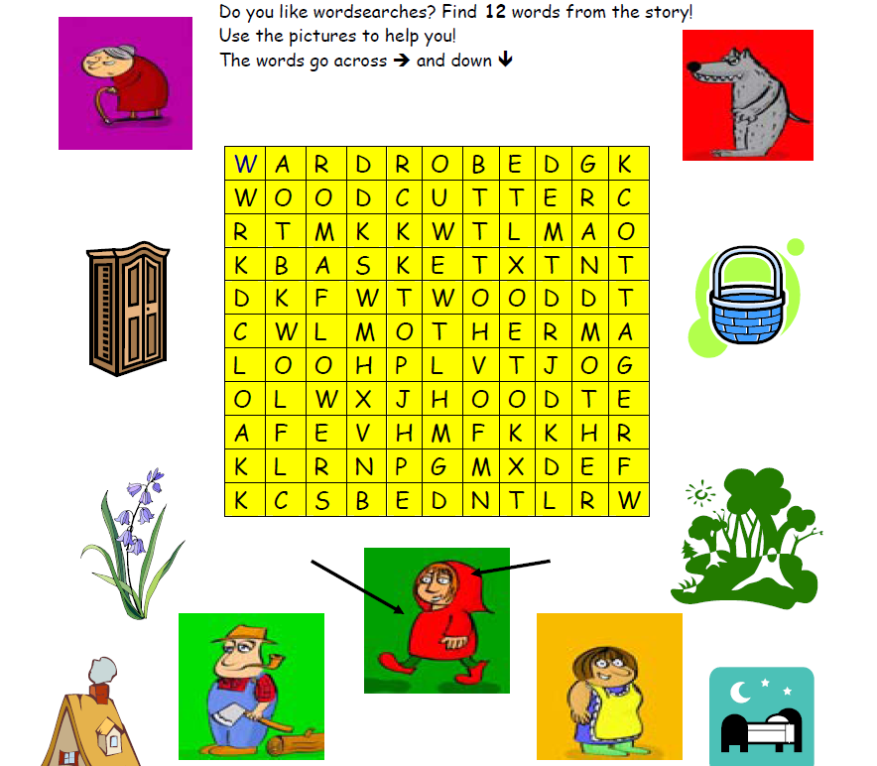
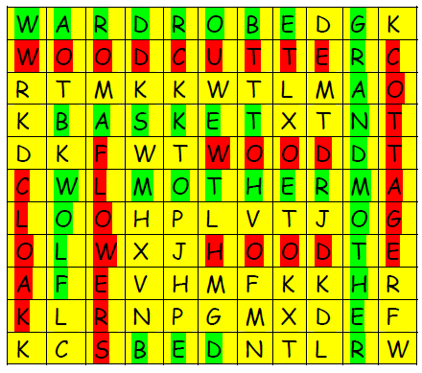

Slide 7
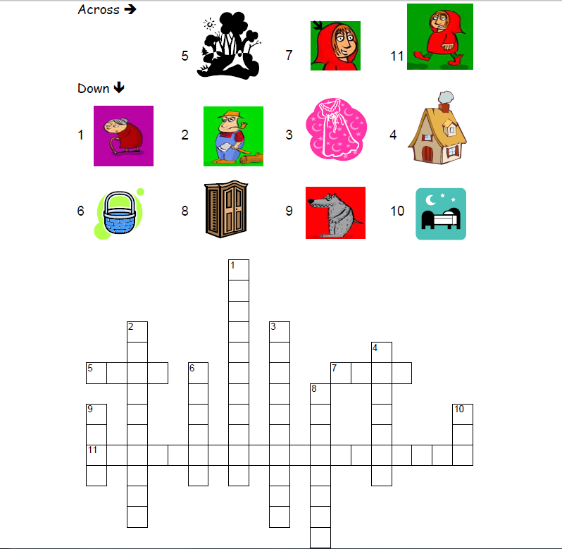

Slide 8
What do I have in My Basket

Slide 9
What do you have in your basket?
Draw some 5 different foods in your basket. (keep it secret)
Other students will ask, “Do you have _________ in your basket?”
Say, “yes” or say, “no”

