Slide 1
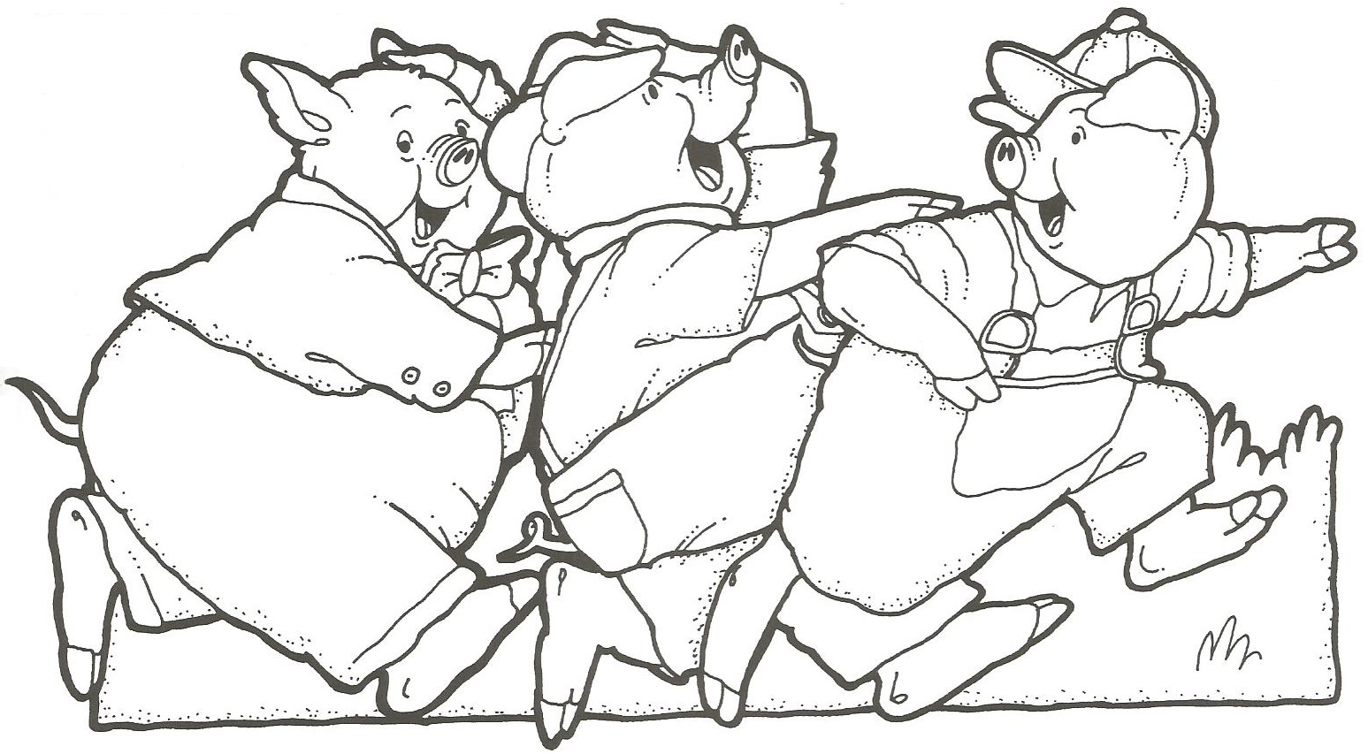
Three Little Pig Analysis

Slide 2
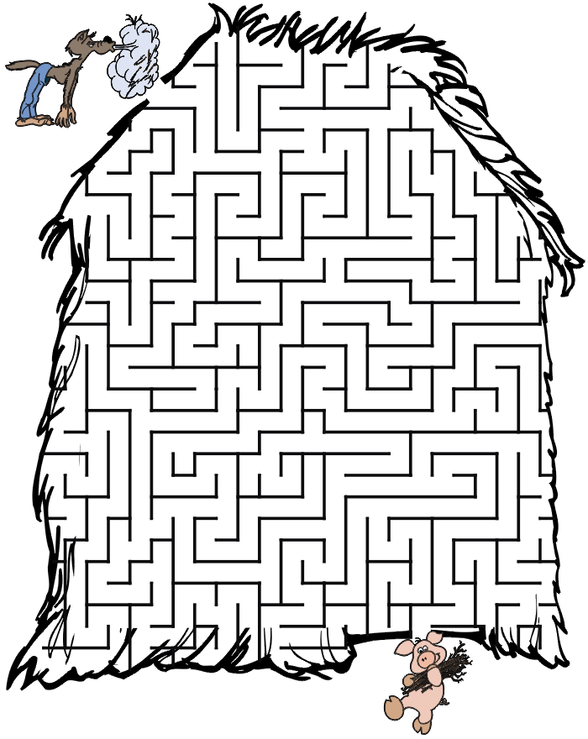

Slide 3
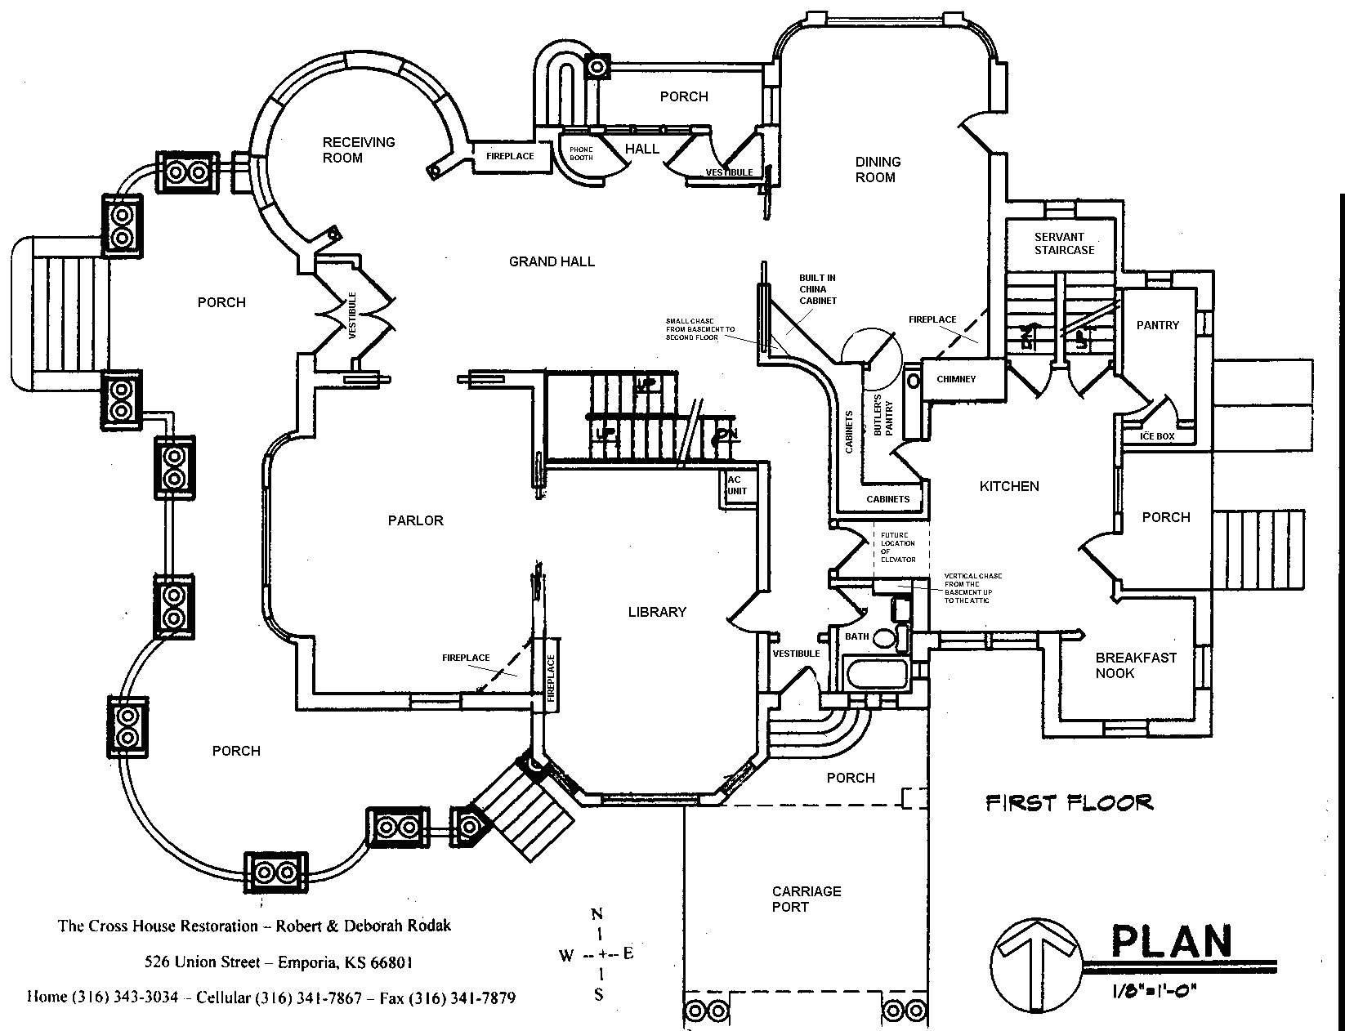
Draw your DREAM HOUSE:

Slide 4

Michael wants a house with:
3 bedrooms
A large living room

Slide 5
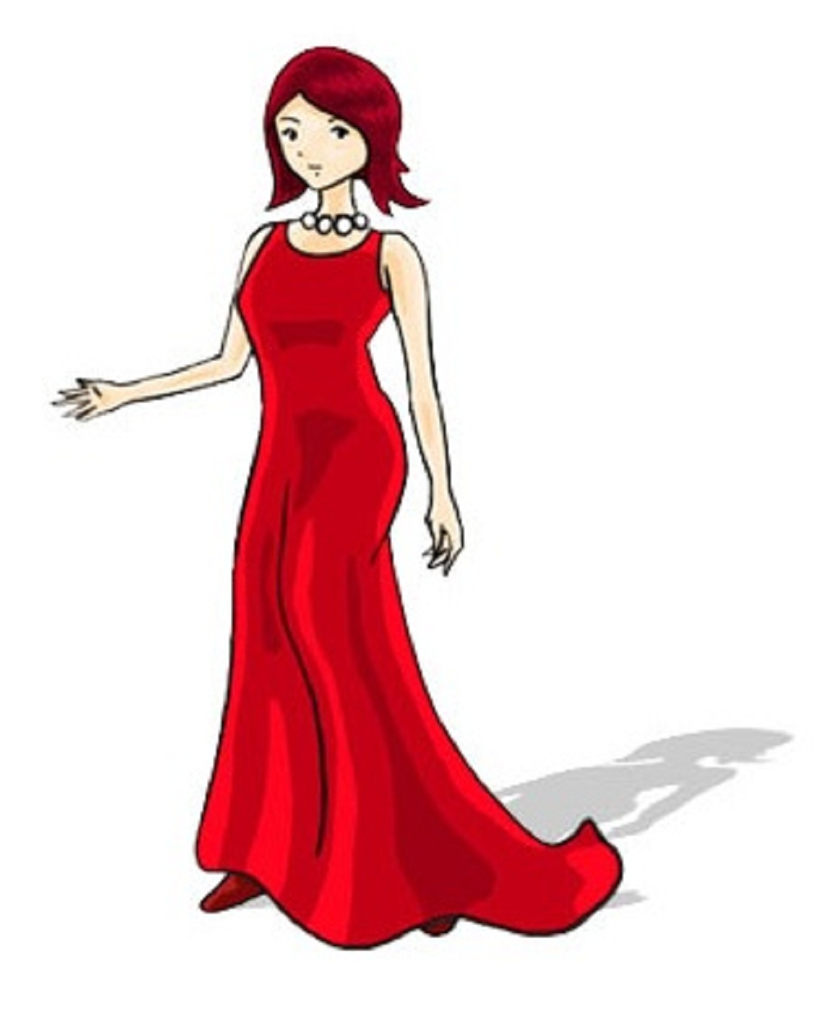
Jessica wants a house with:
Only 1 bedroom
An office

Slide 6

Lloyd wants a house with:
A place to play games
A nice kitchen

Slide 7

Sally wants a house with:
At least 2 bedrooms
2 bathrooms

Slide 8

Gina wants a house with:
A porch
A kitchen
A living room

Slide 9

Ted wants a house with:
A room to play games
The living room is the biggest room
One or two bedrooms
One bathroom

Slide 10

Gary wants a house with:
Two floors
Master Bedroom upstairs
A laundry room

Slide 11

Celina wants a house with:
Two bedrooms in the basement
A dining room attached to the kitchen
A porch behind the house

Slide 12

Helen wants a house with:
Master bedroom is the largest room.
A unique room.
A large foyer.

Slide 13
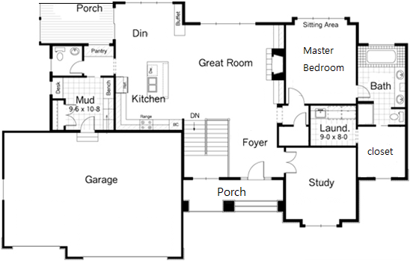
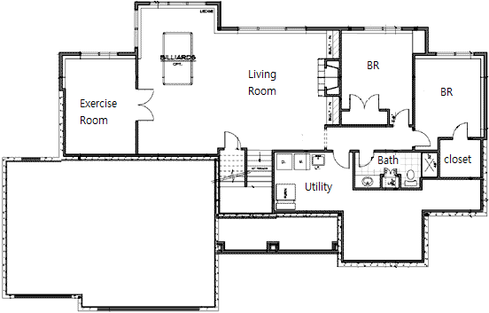
Put a dot where you think the picture was taken.

Slide 14
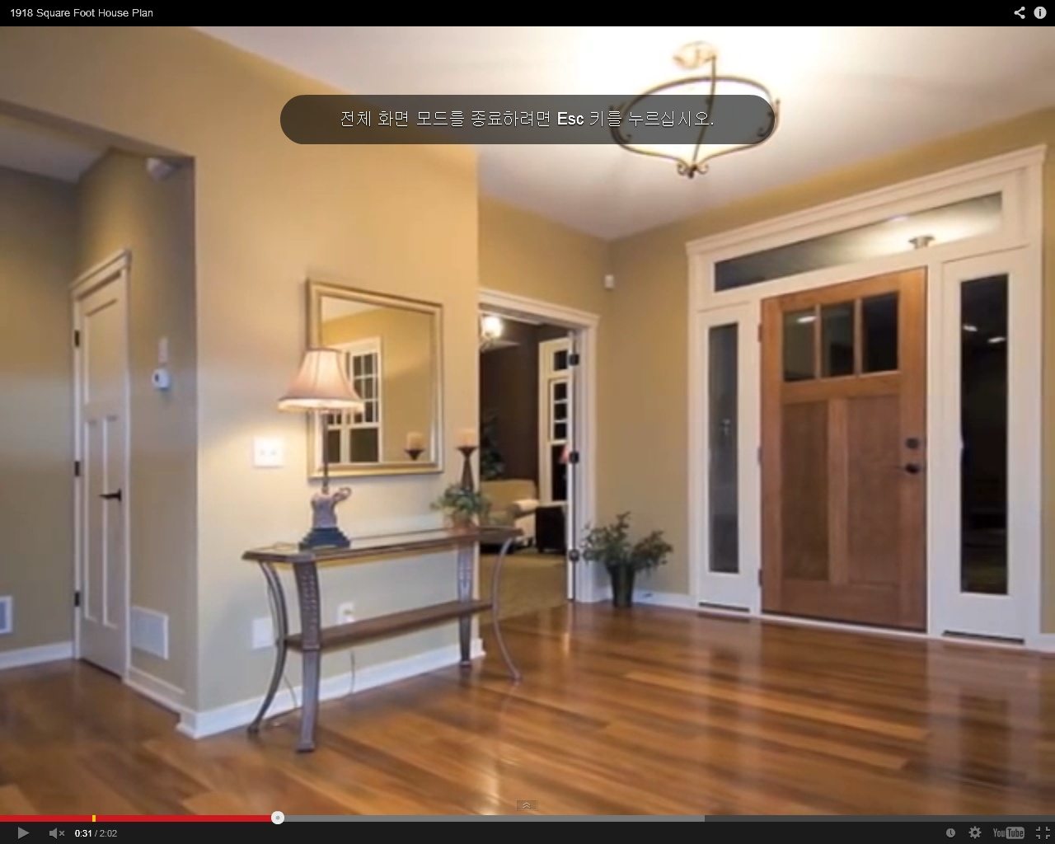
Blue Dot

Slide 15
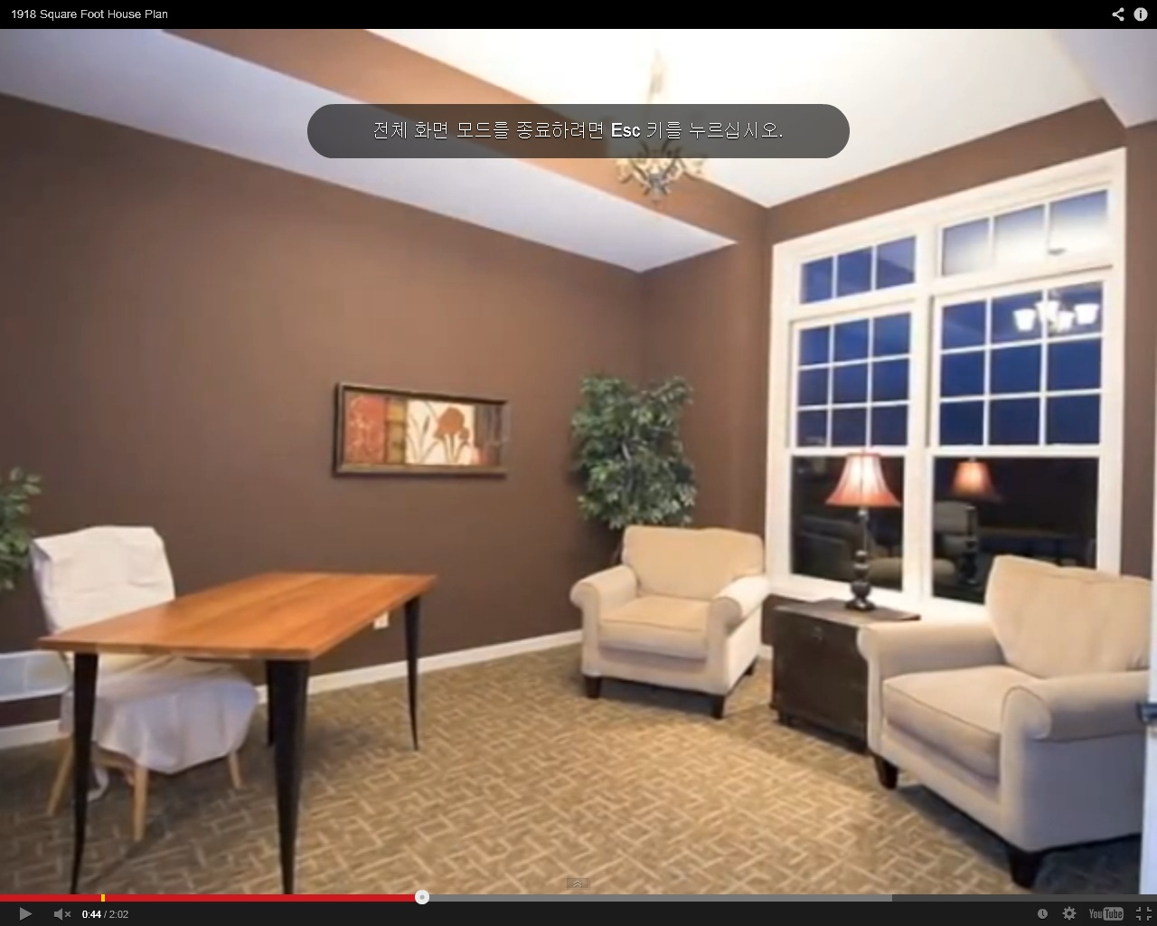
Red Dot

Slide 16
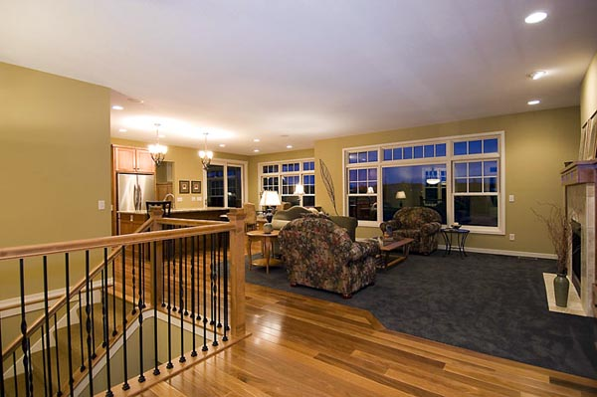
Purple Dot

Slide 17
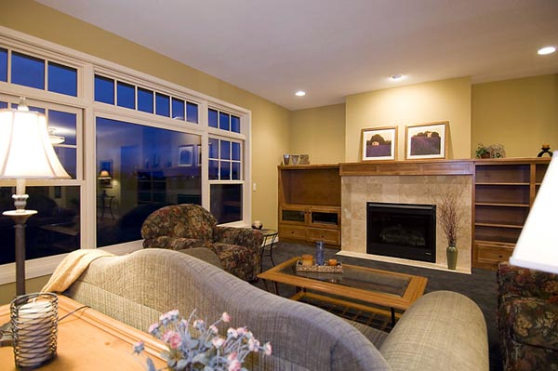
Green Dot

Slide 18
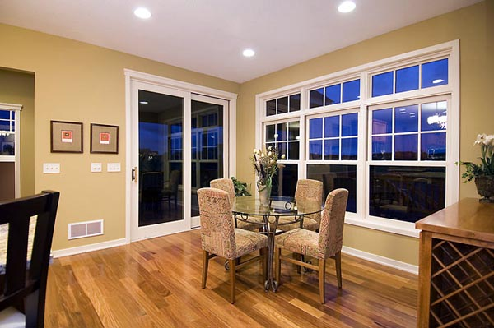
Orange Dot

Slide 19
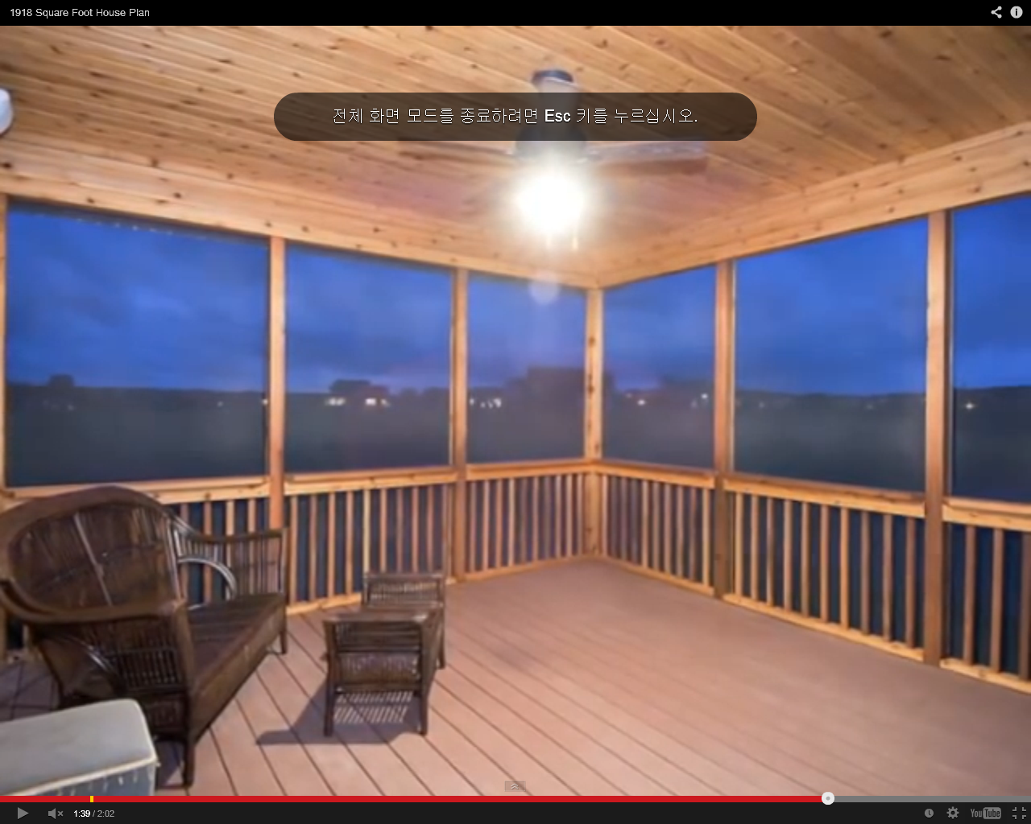
Black Dot

Slide 20
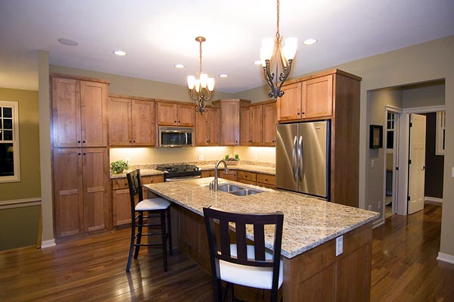
Yellow Dot

Slide 22
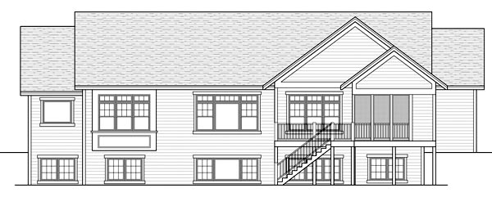
http://www.coolhouseplans.com/details.html?pid=chp-47121

Slide 23
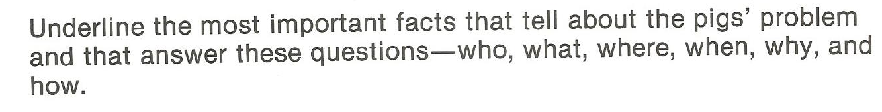
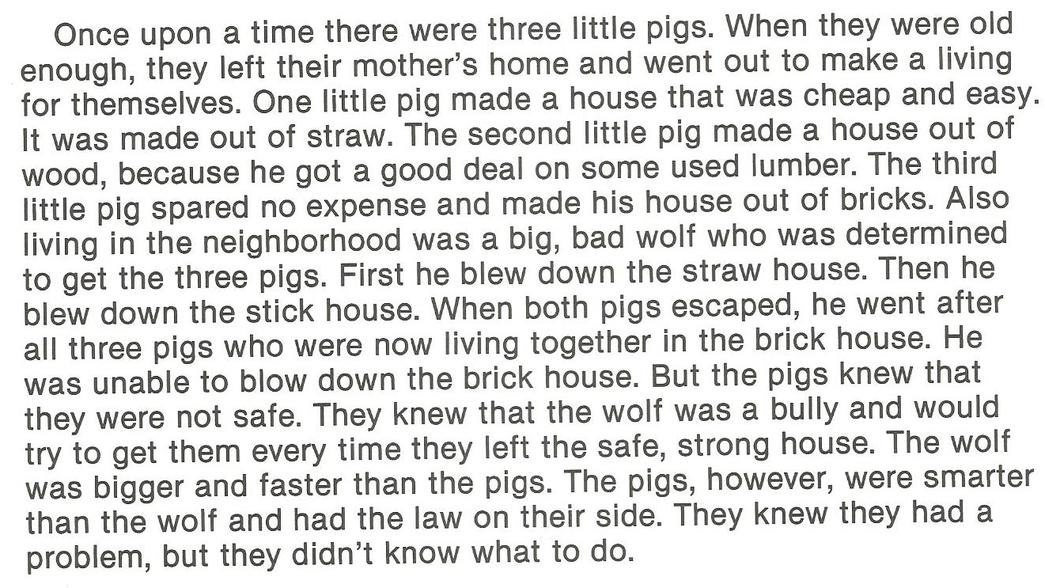

Slide 24
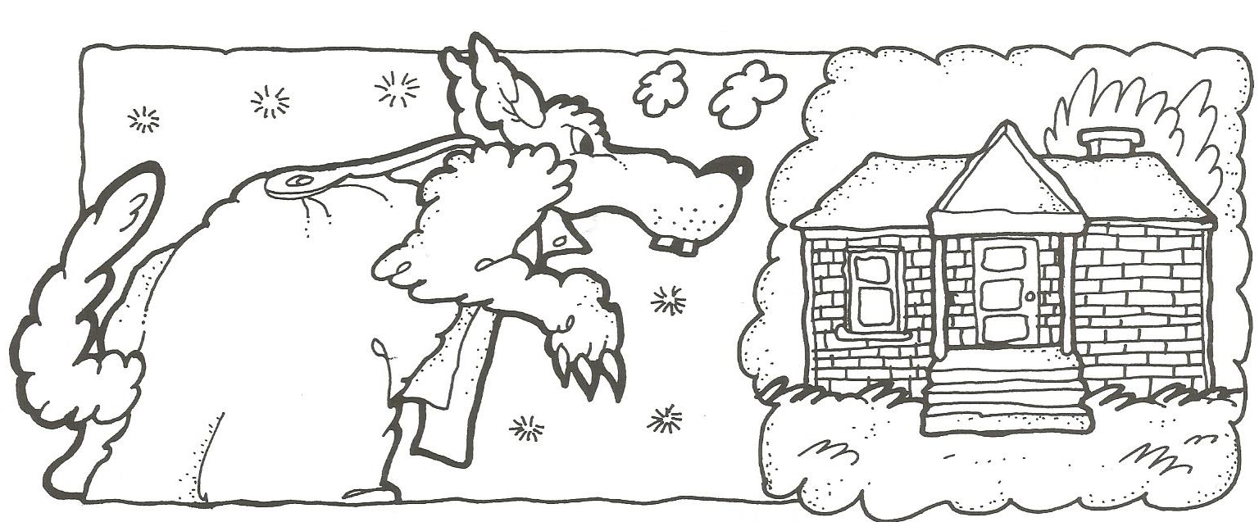
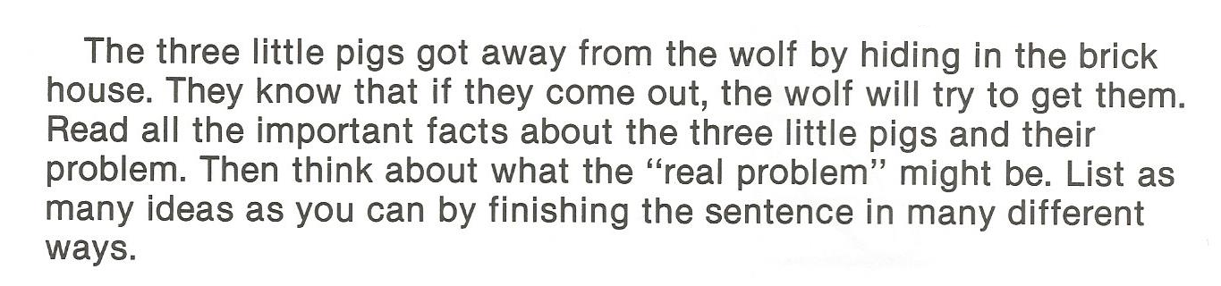

Slide 25
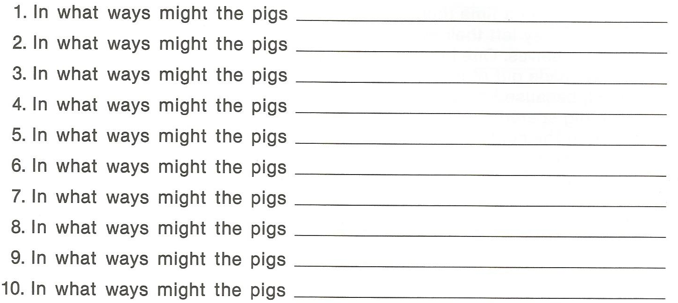

Slide 26
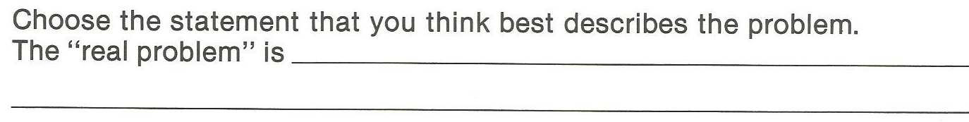

Slide 27

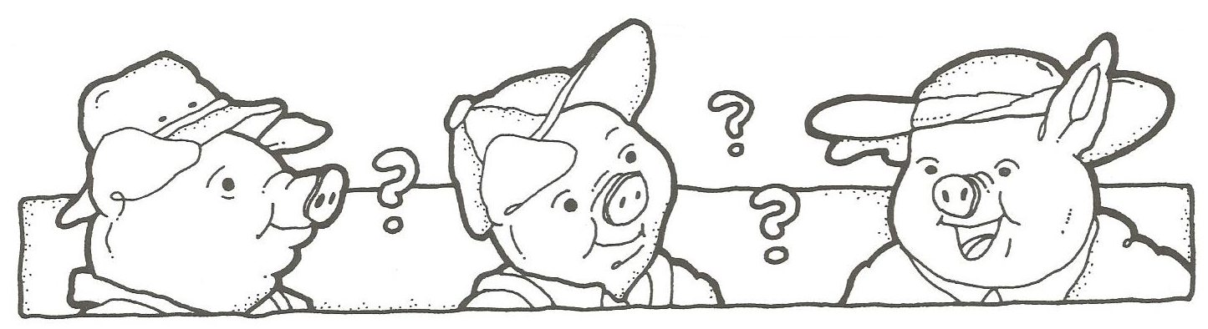
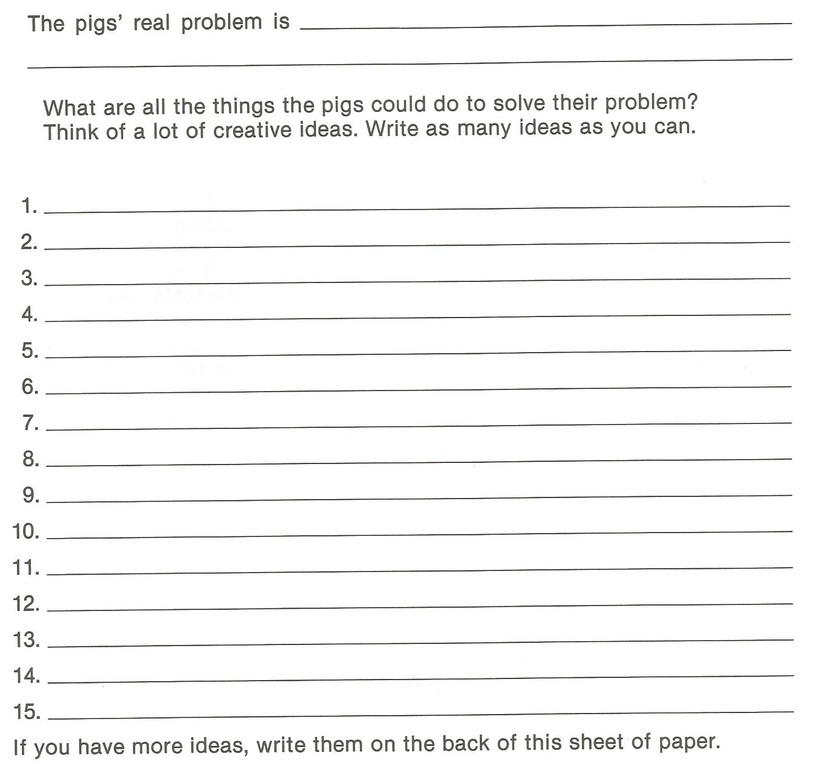

Slide 28
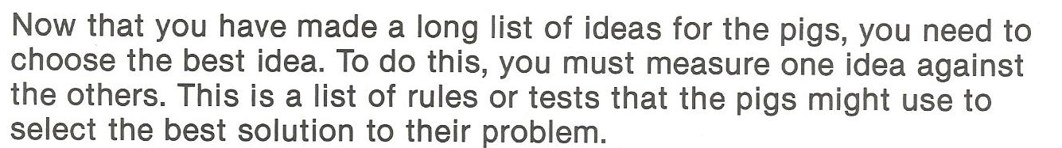
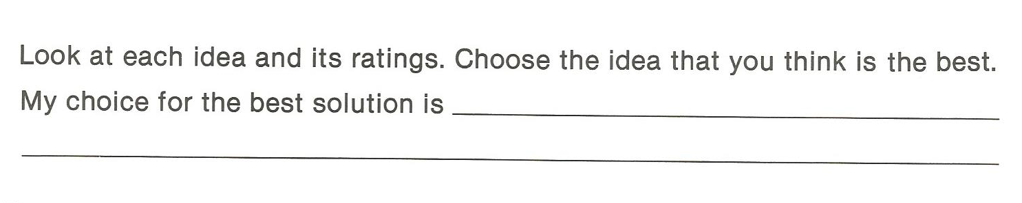
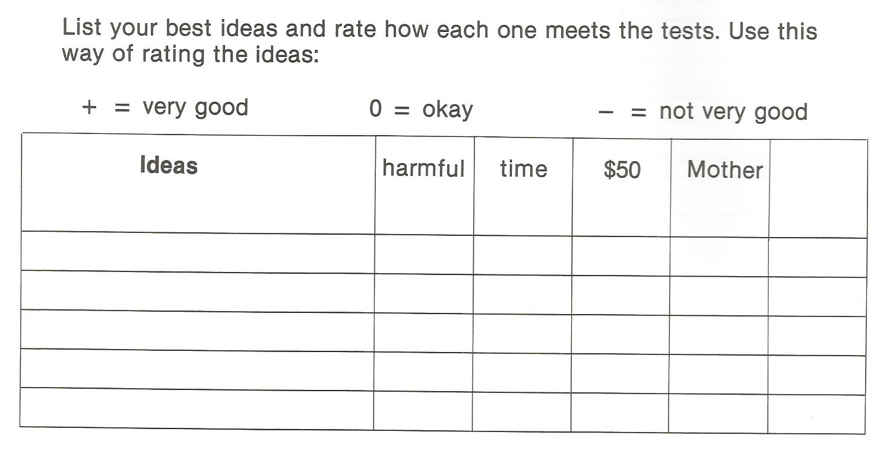
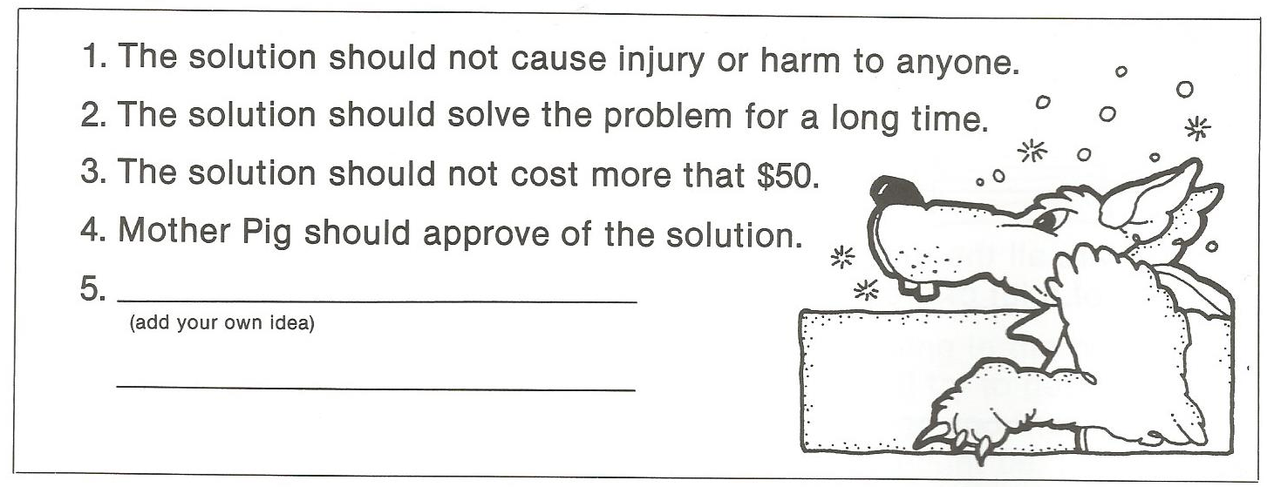

Slide 29
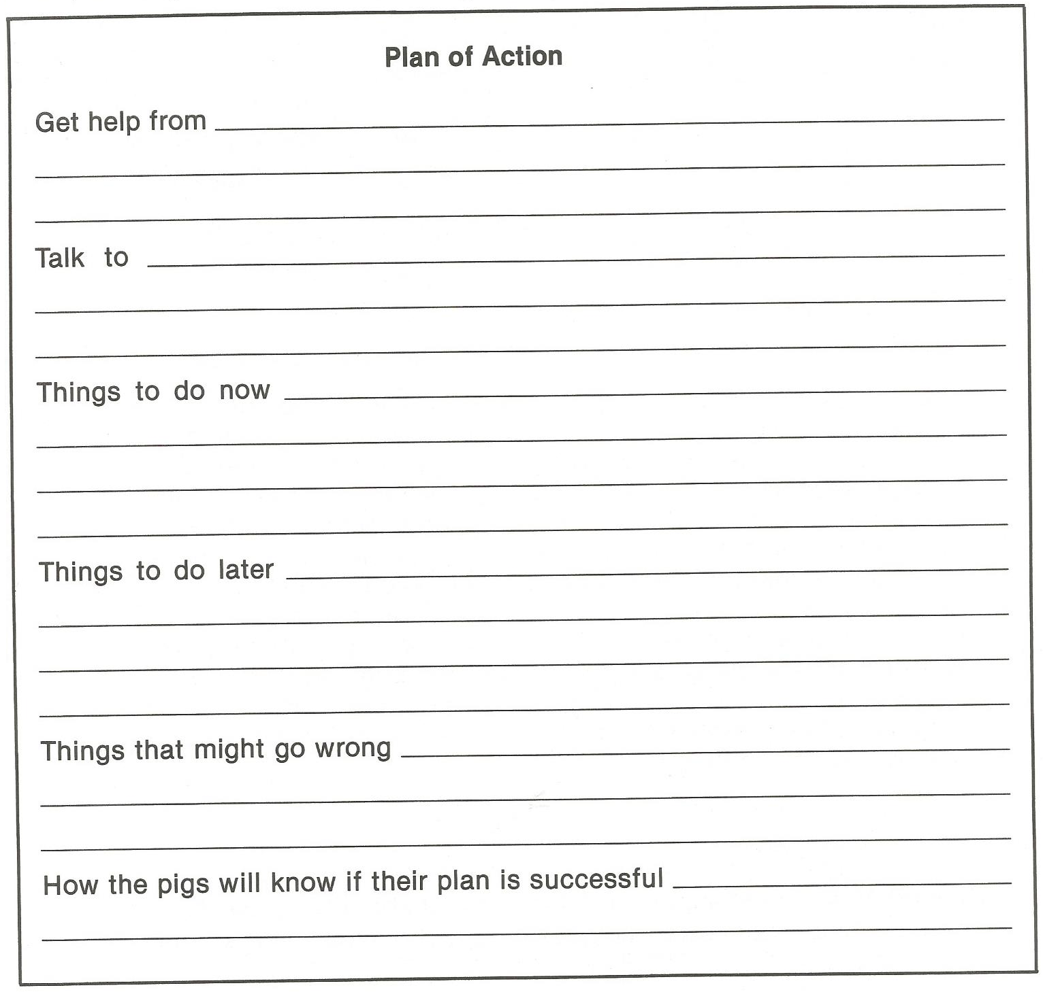

Slide 30

Hidden Objects Game

