Slide 1
The Moral of the Story

Slide 2
What is a moral?
It is a lesson about right and wrong

Slide 3
What is the moral of…

Slide 4
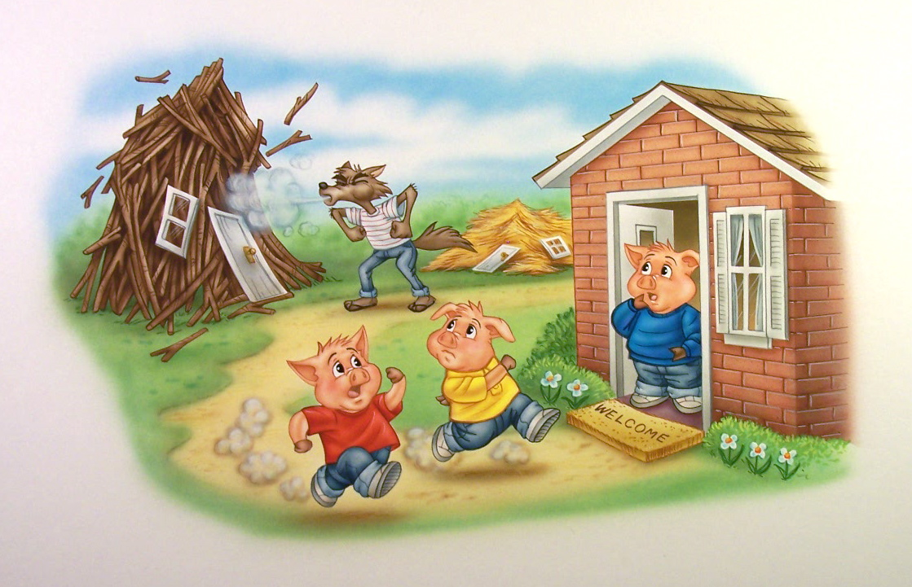

Slide 6
Red Riding Hood
Billy Goats Gruff
Three Little Pigs
Build a strong house
Don’t talk to strangers
Don’t be greedy

Slide 7
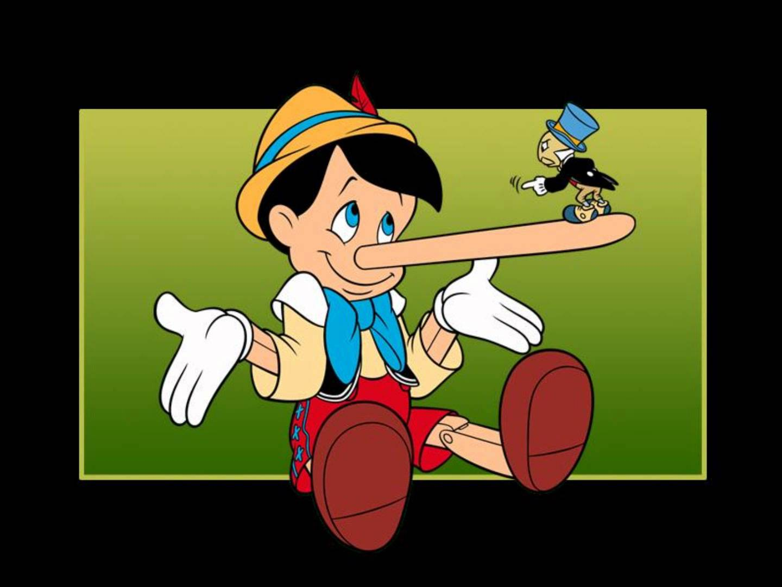

Slide 9
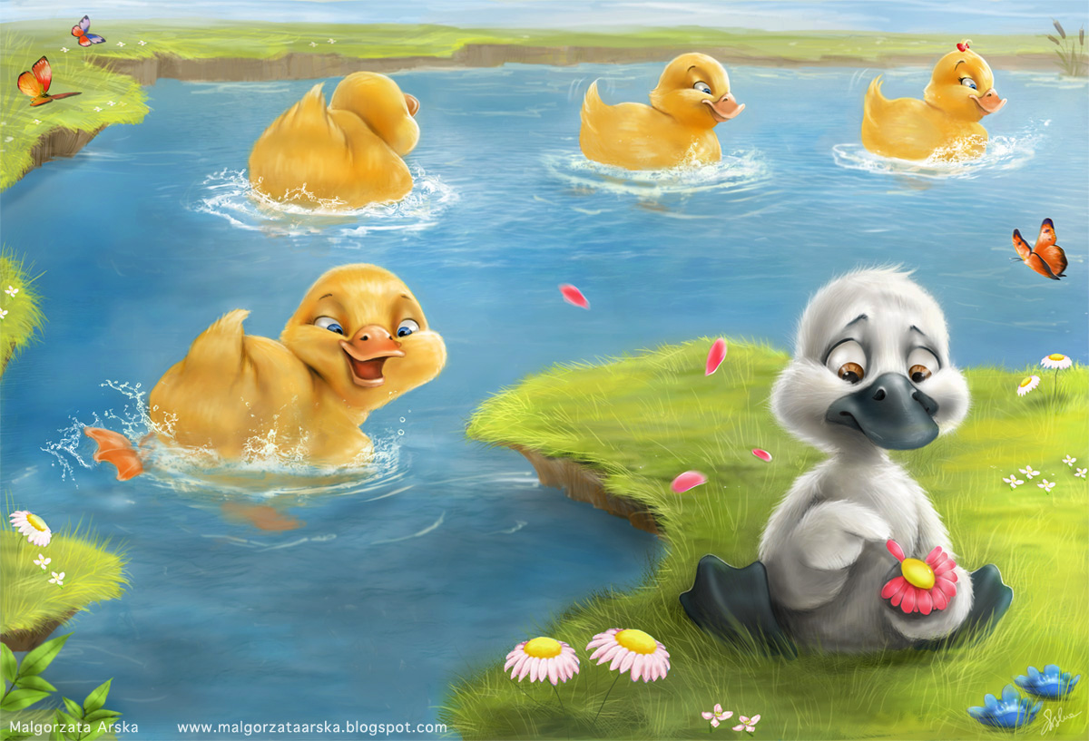

Slide 11
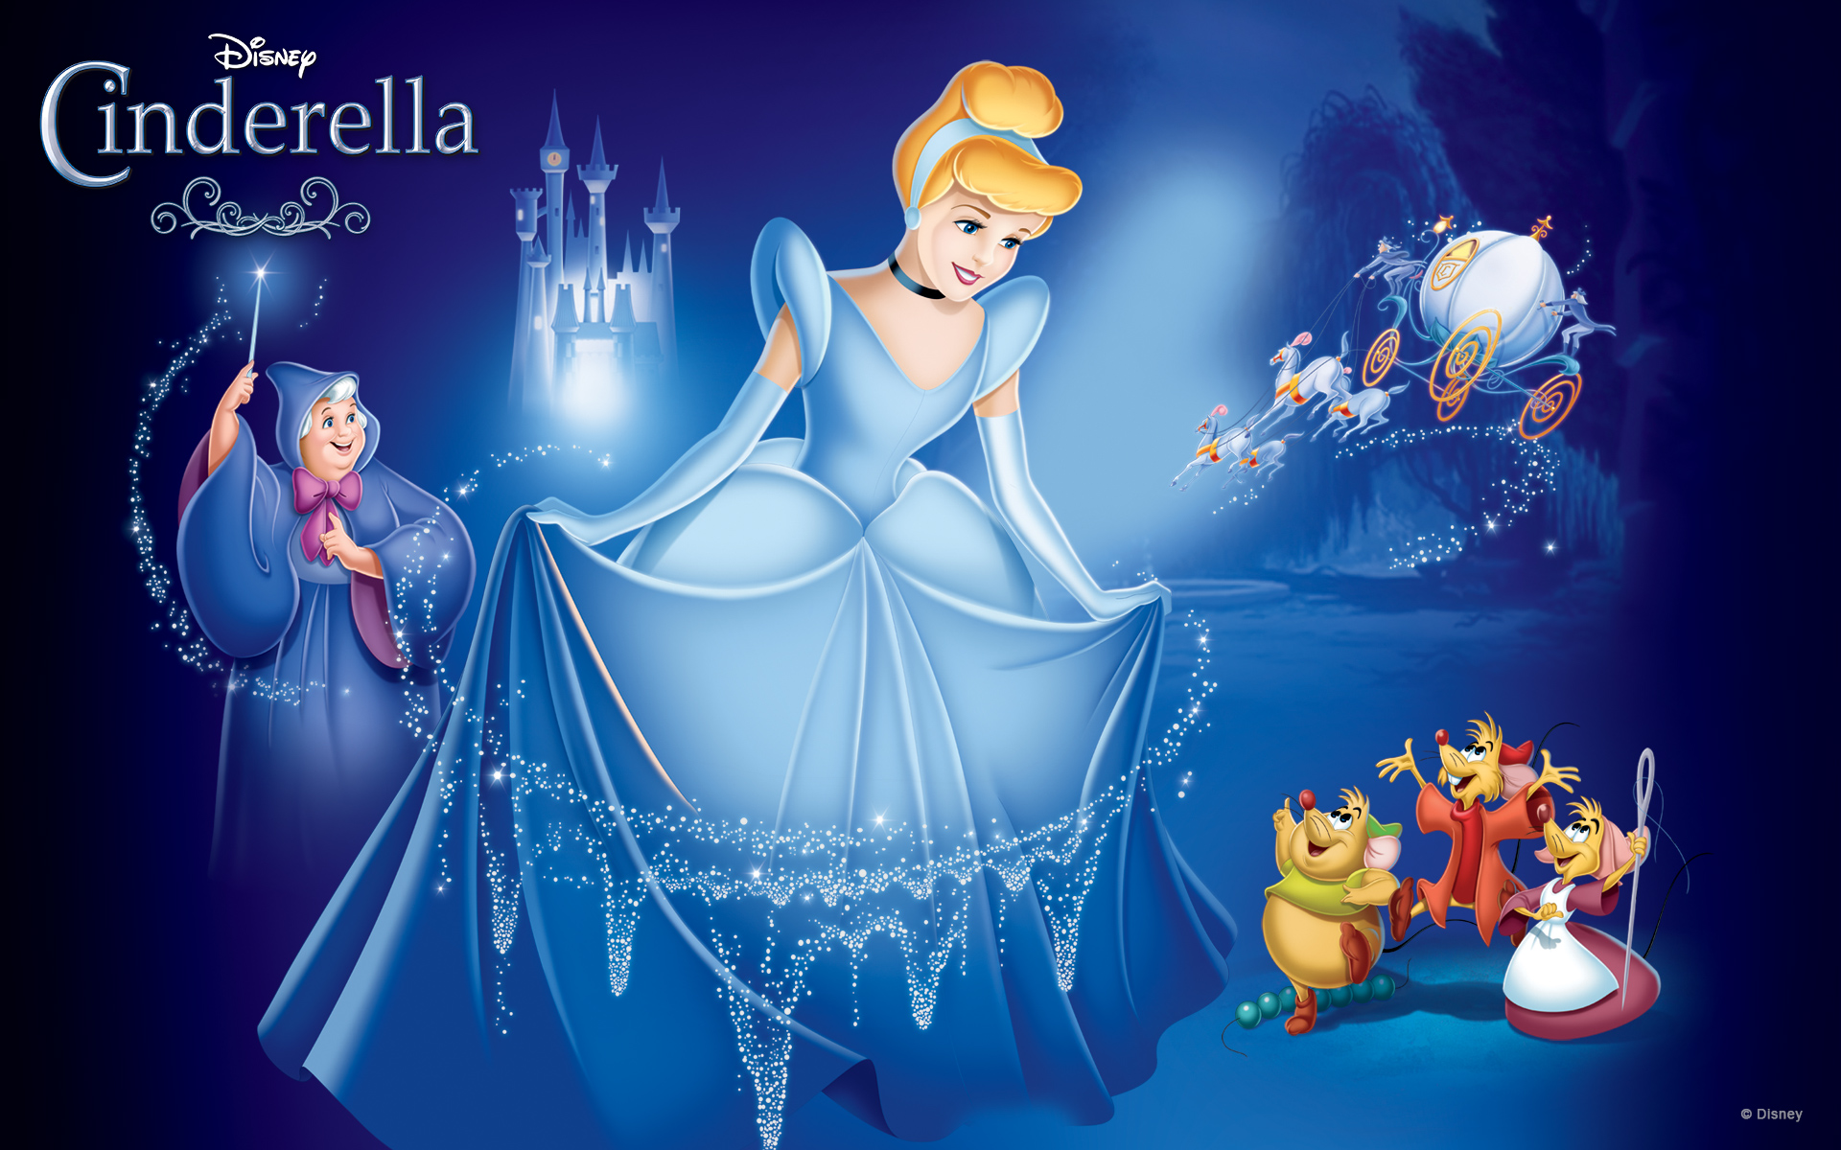

Slide 12
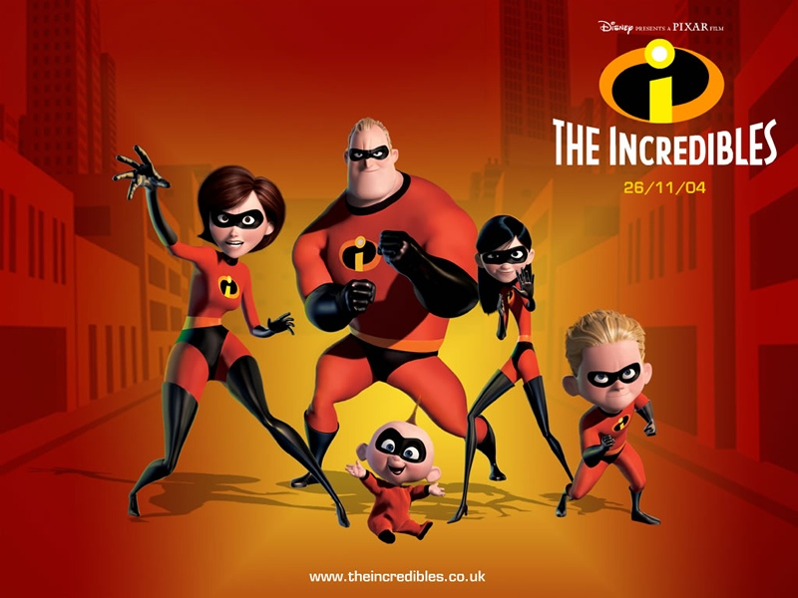

Slide 14
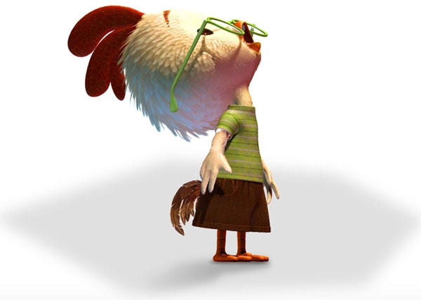
Chicken Little
What is the moral of the story?

Slide 15
https://www.youtube.com/watch?v=NRLXp3R7uZY

Slide 16
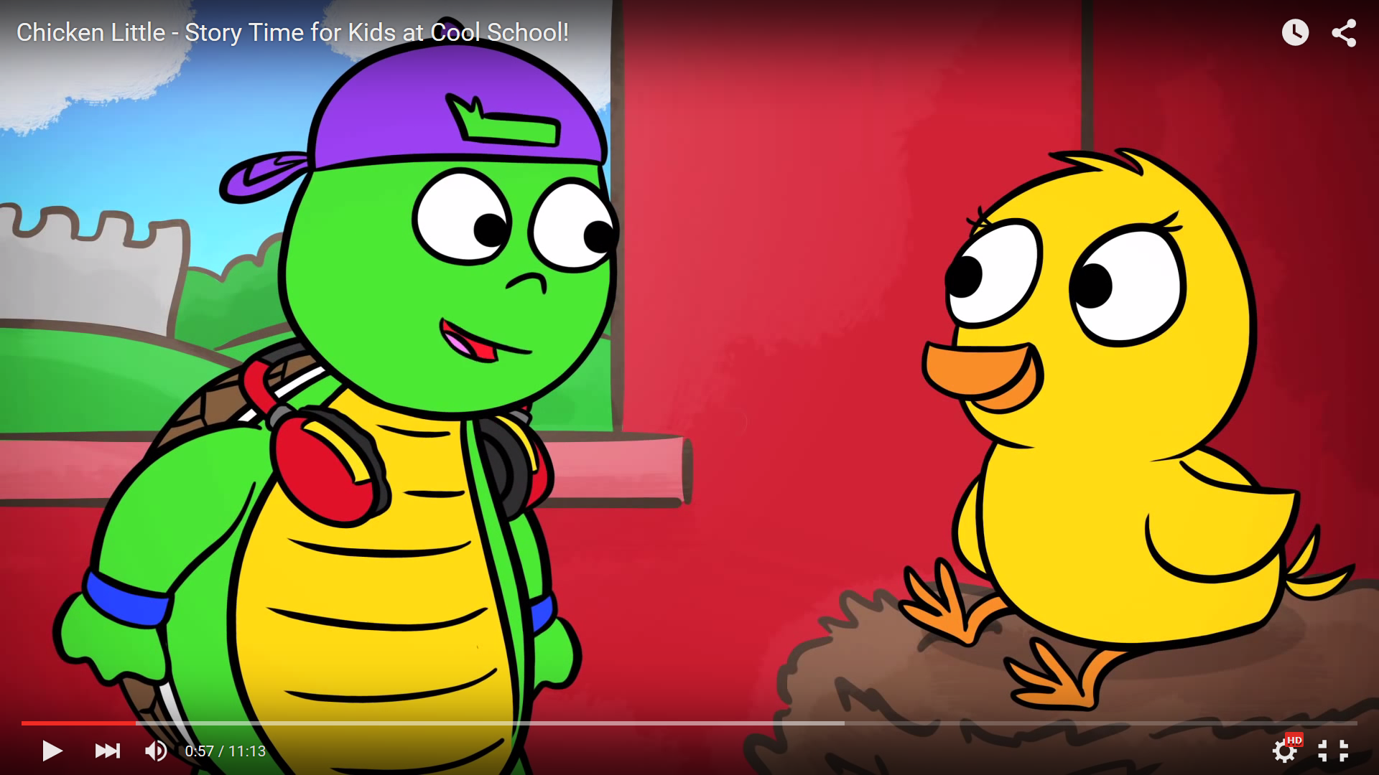
Who has all the answers?

Slide 17
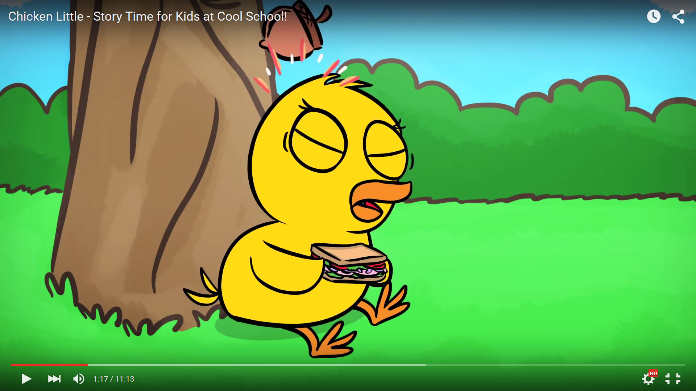
What fell on Chicken Little’s head?

Slide 18
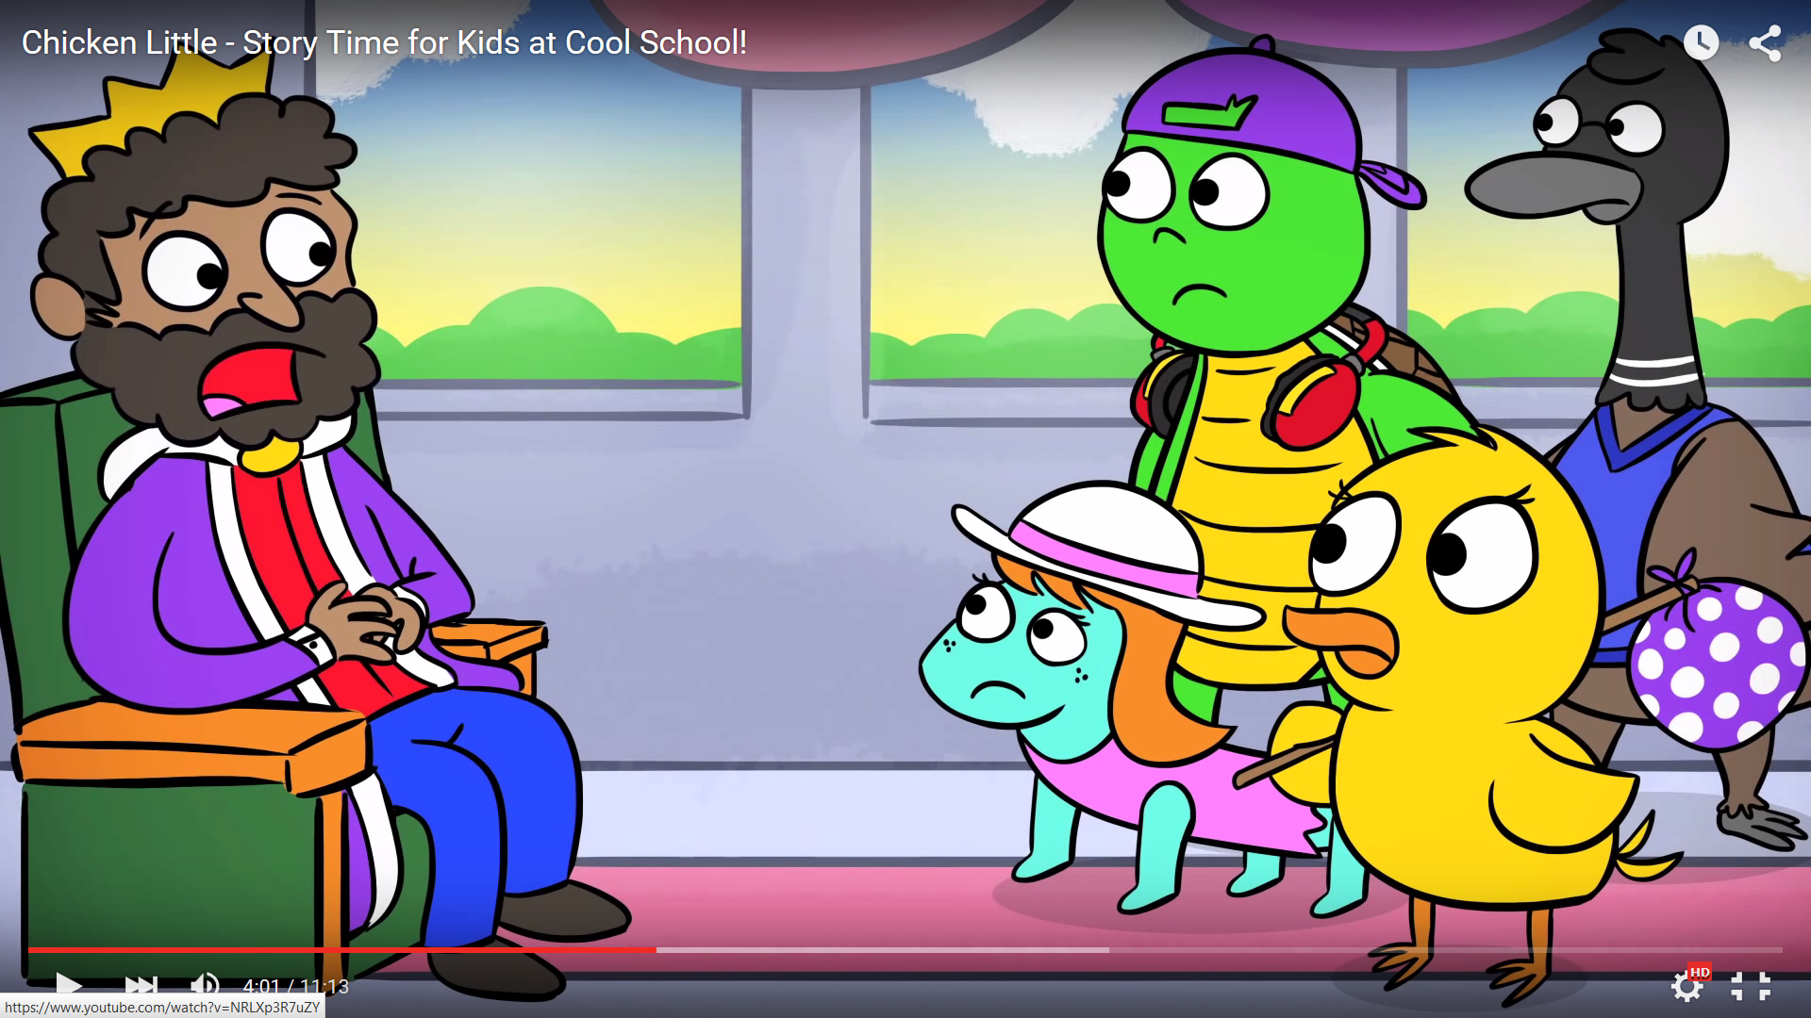
Who did she want to tell?

Slide 19
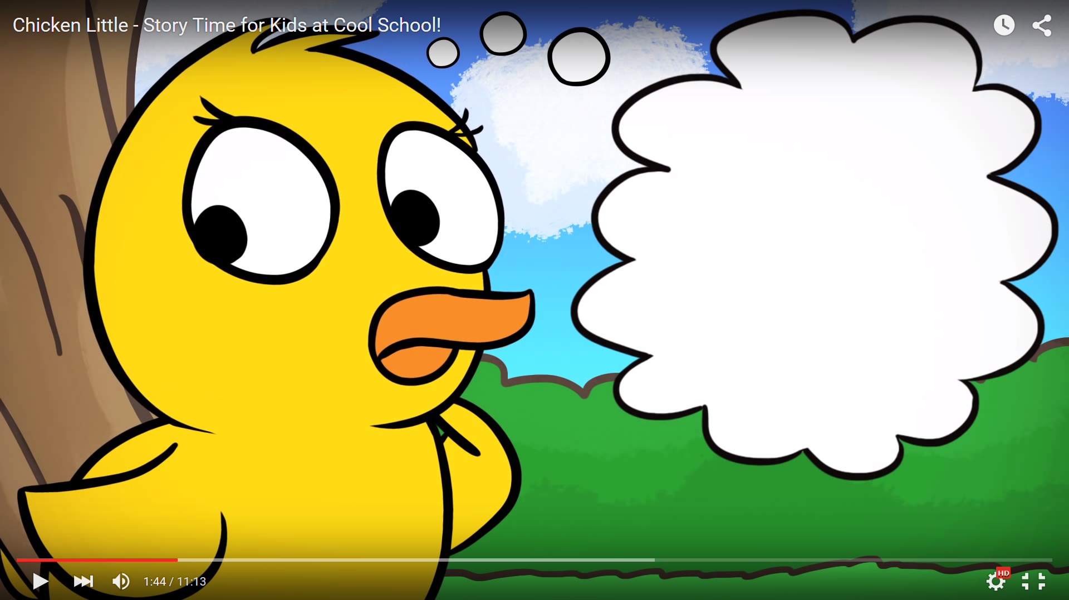
“I can’t put my finger on it”

Slide 20
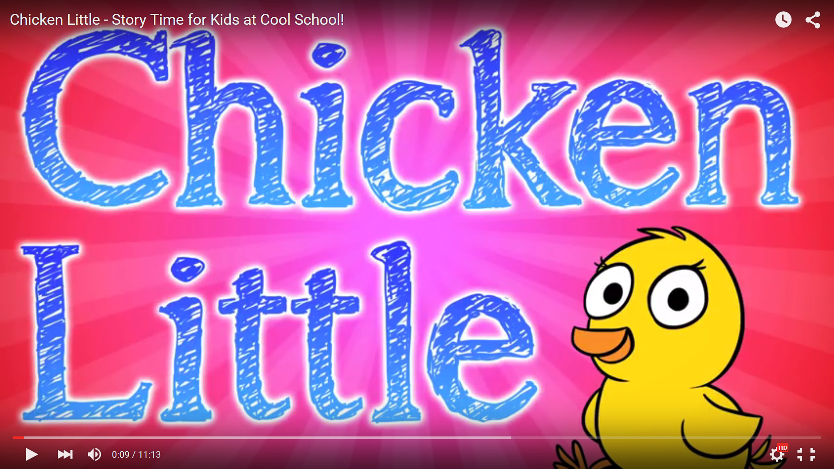
What is the moral of the story?

Slide 21
