Slide 1
Castles and Knights

Slide 2
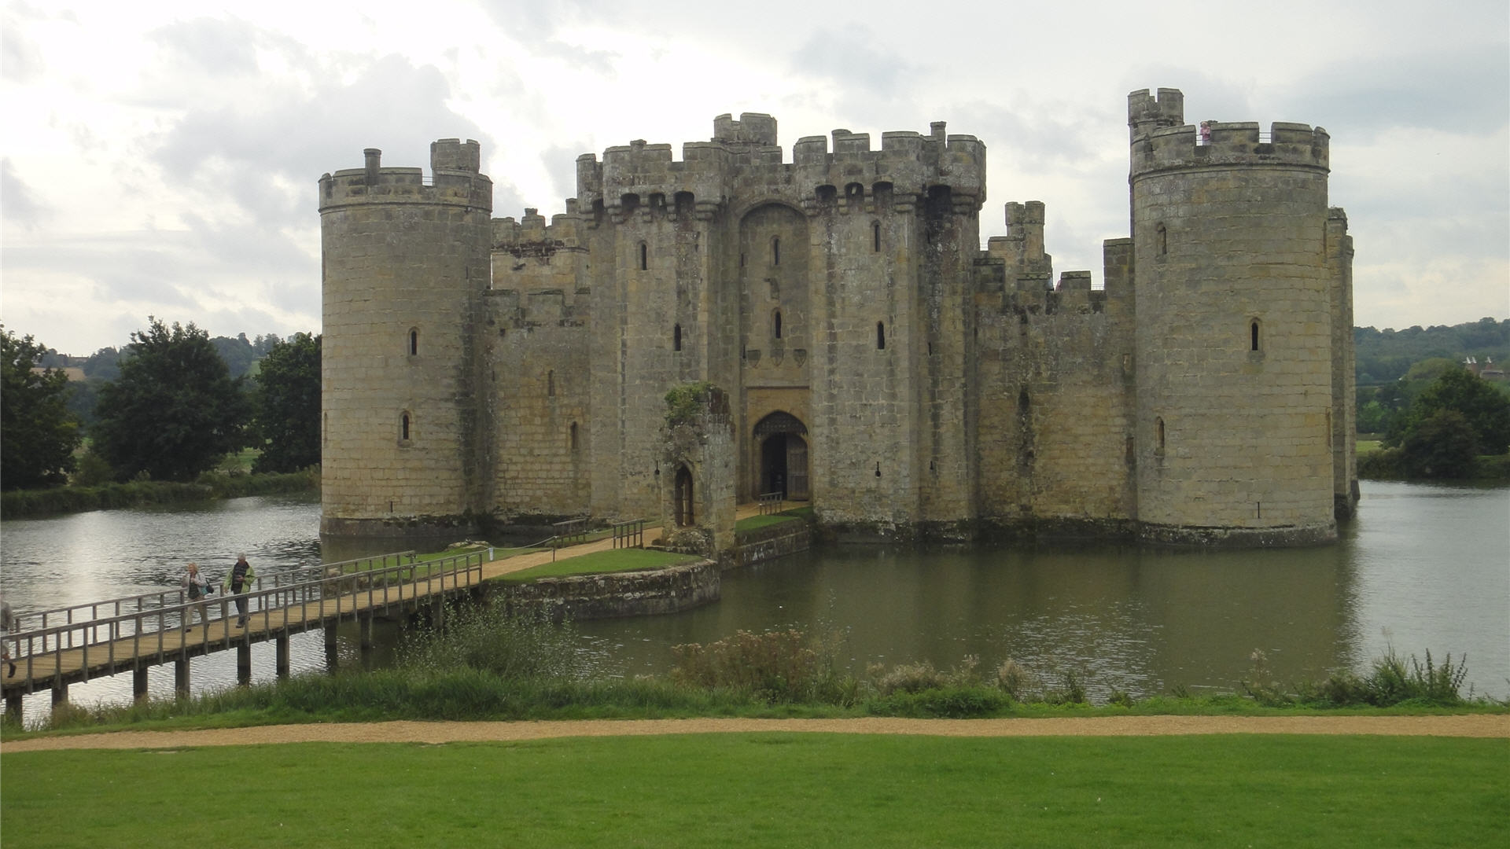

Slide 3
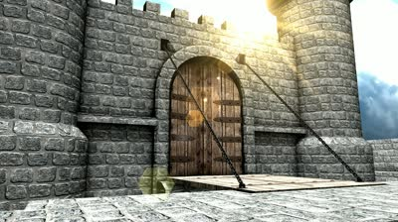
Castle
Drawbridge

Slide 4
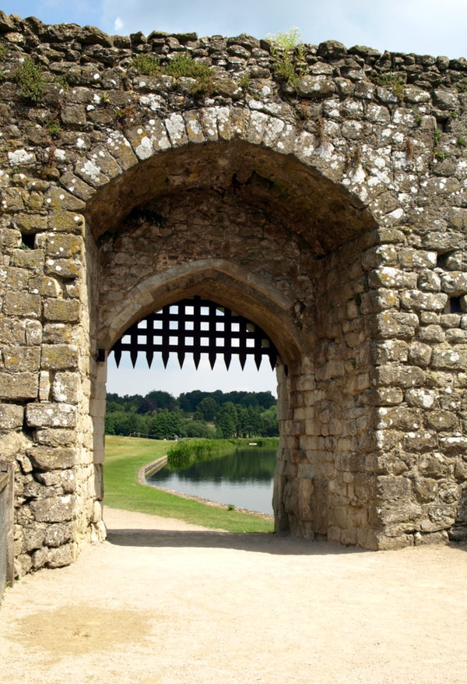
Castle
Drawbridge
Gate

Slide 5
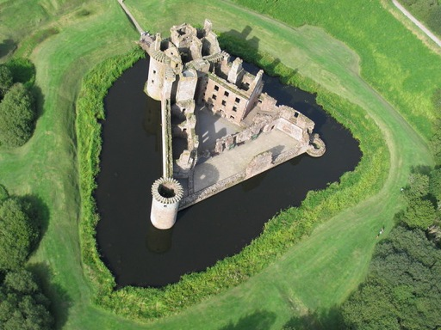
Castle
Drawbridge
Gate
Moat

Slide 6
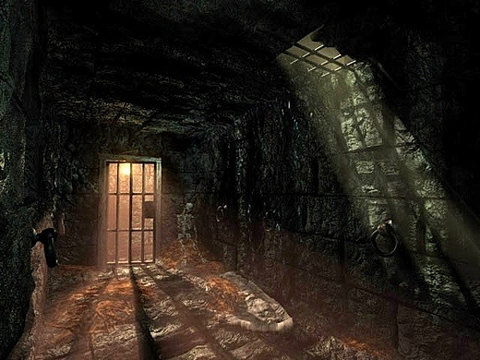
Castle
Drawbridge
Gate
Moat
Dungeon

Slide 7
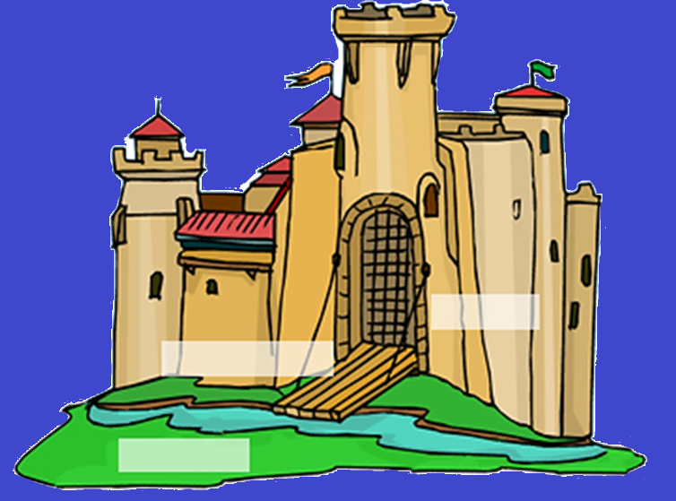
Castle

Slide 8
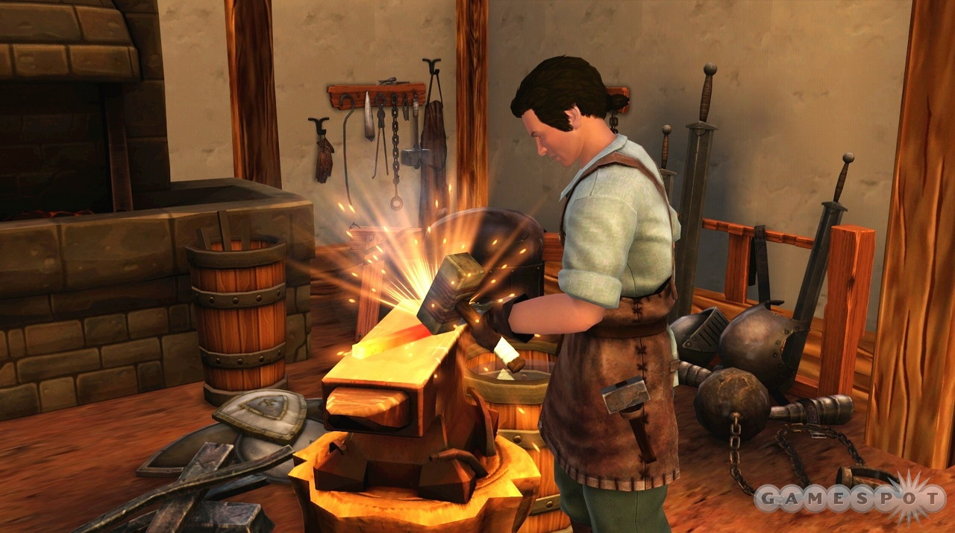
Blacksmith

Slide 9
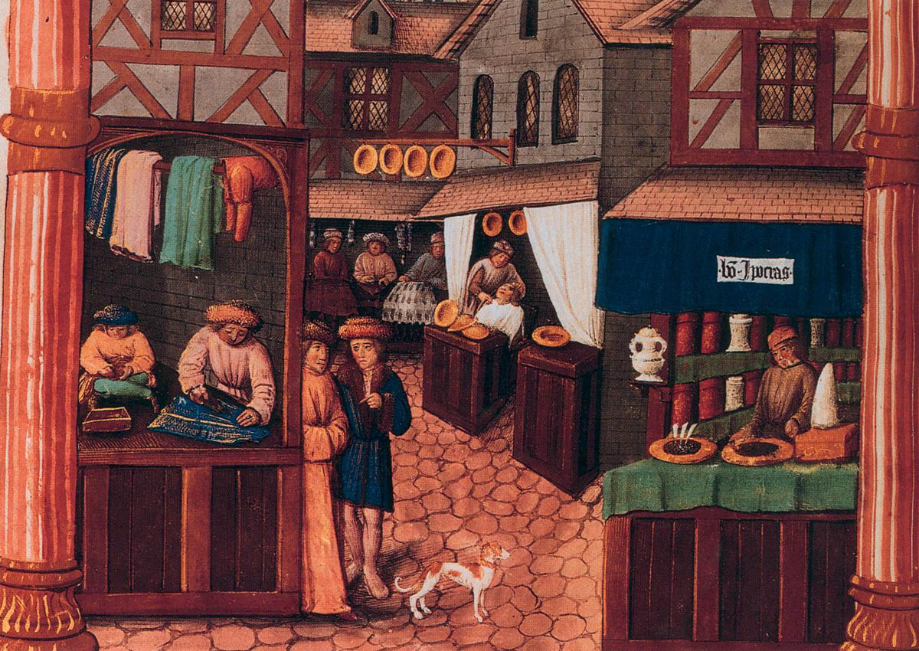
Merchant

Slide 10
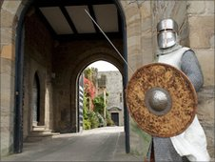
Guard

Slide 11
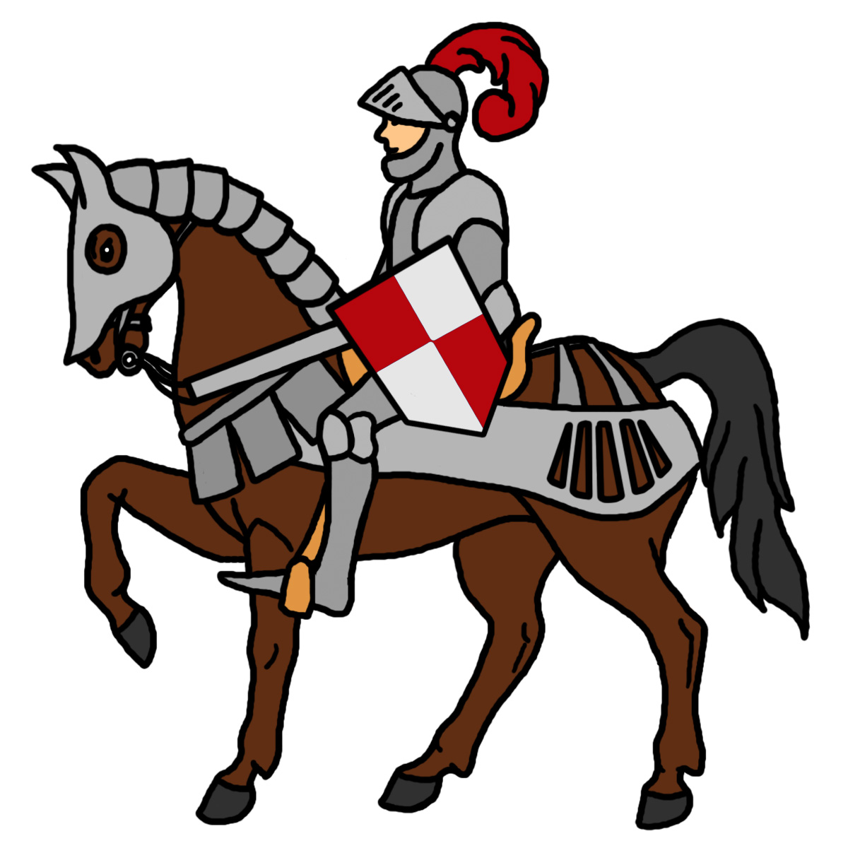
Knight

Slide 12
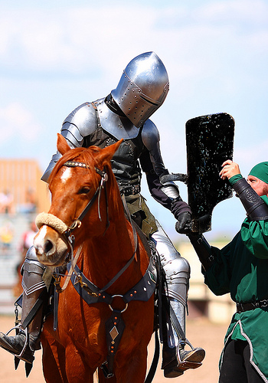
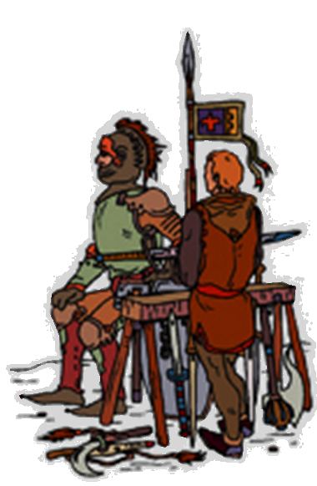
Squire

Slide 13
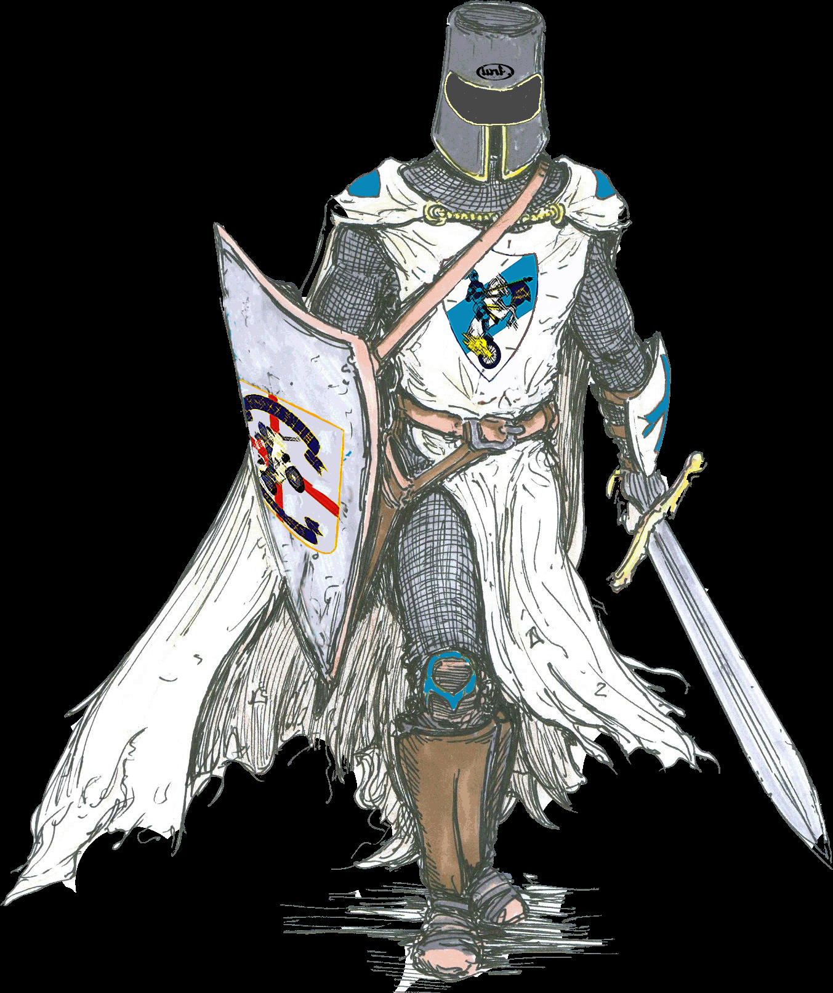
Armor and Weapons

Slide 14
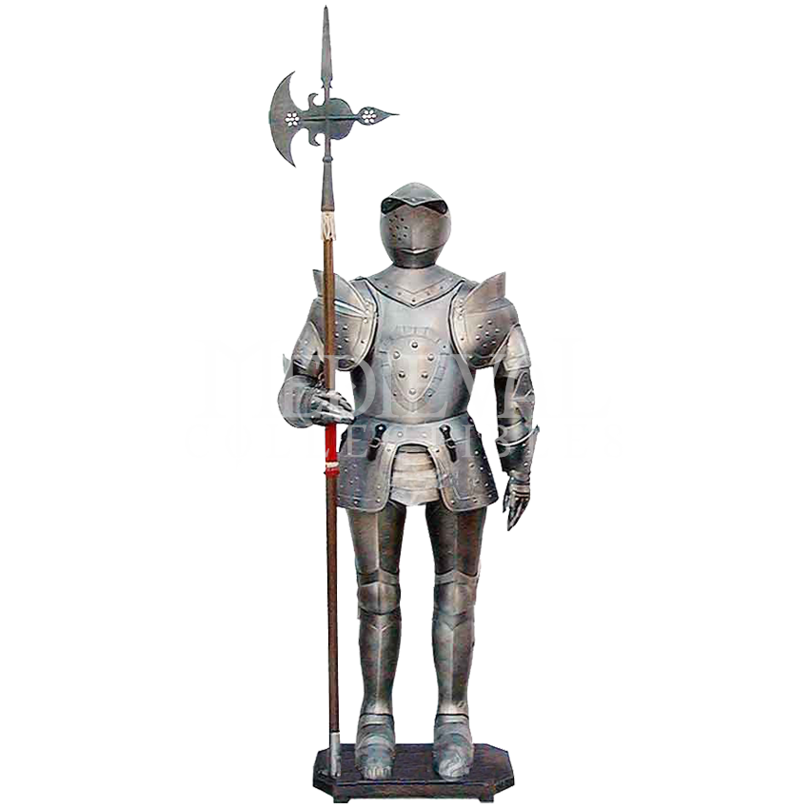
Armor
Suit of Armor

Slide 15
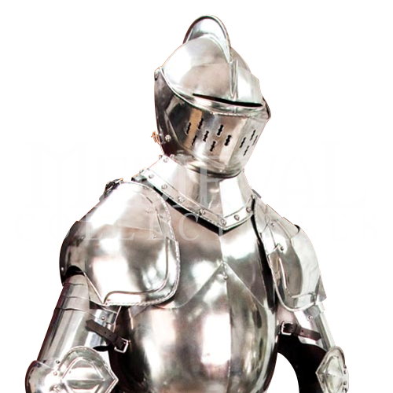
Armor
Suit of Armor
Helmet

Slide 16
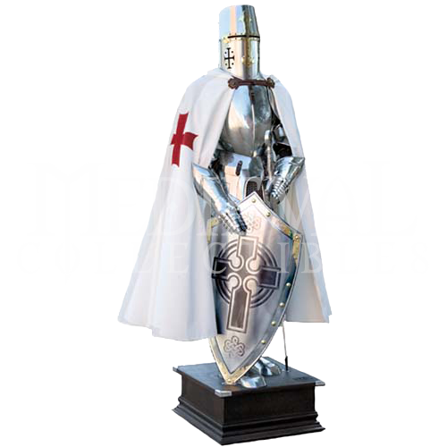
Armor
Suit of Armor
Helmet
Shield

Slide 17
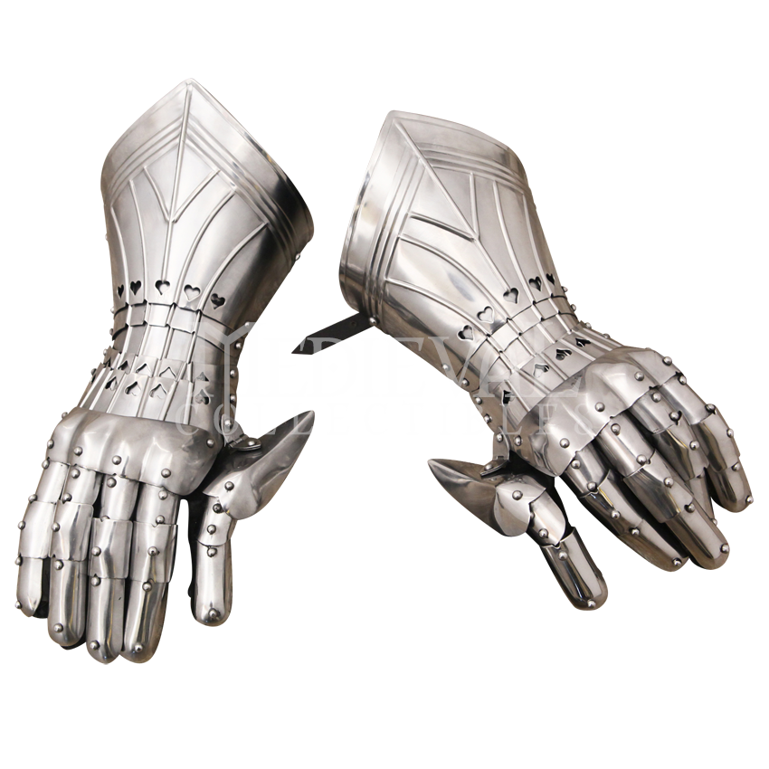
Armor
Suit of Armor
Helmet
Shield
Gauntlets

Slide 18
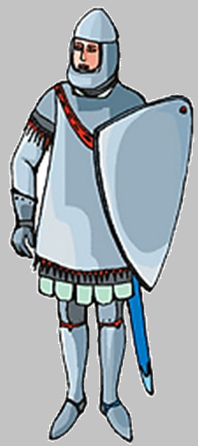
Armor

Slide 19
Types of Fighting:

Slide 20
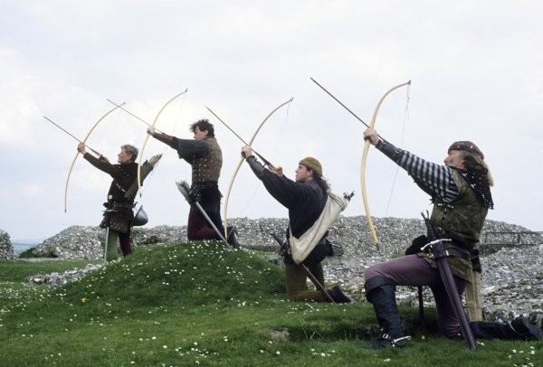
Types of Fighting:
Long Range

Slide 21
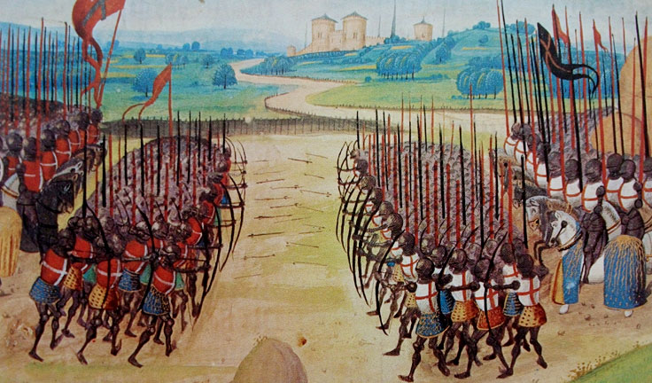
Types of Fighting:
Hand to Hand

Slide 22
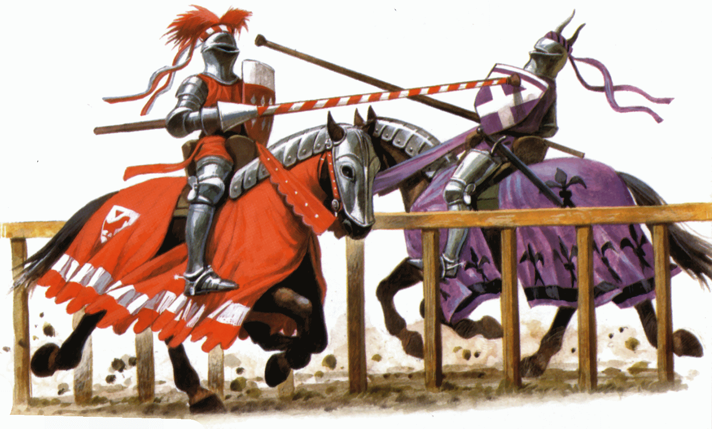
Types of Fighting:
Jousting

Slide 23
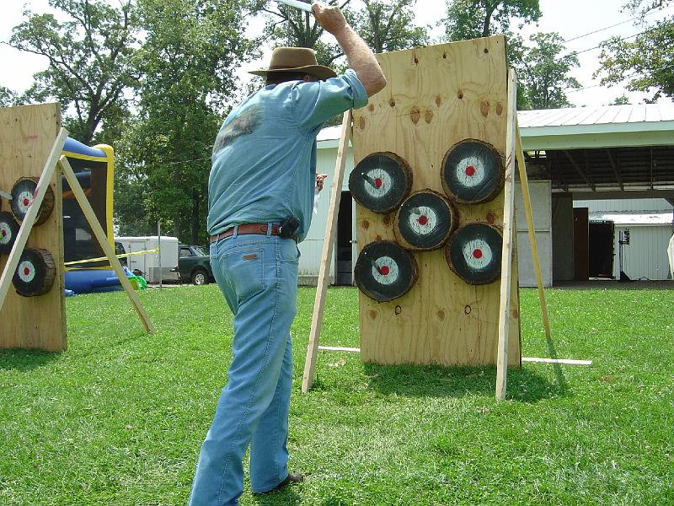
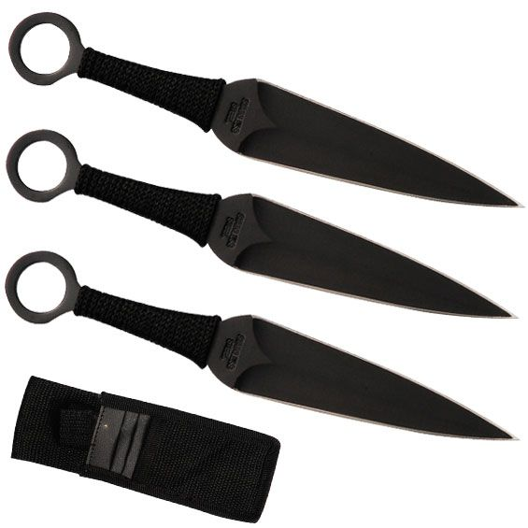
Long Range Weapons
Throwing Knives?

Slide 24
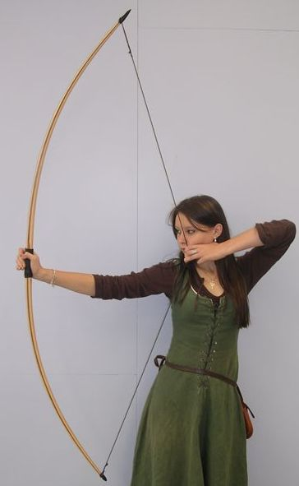
Long Range Weapons
Bow and Arrow
Longbow
Archer

Slide 25
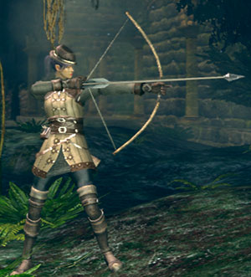
Long Range Weapons
Bow and Arrow
Longbow
Short bow

Slide 26
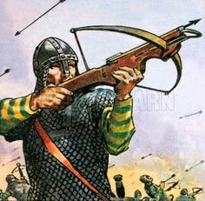
Long Range Weapons
Bow and Arrow
Longbow
Short bow
Crossbow

Slide 27
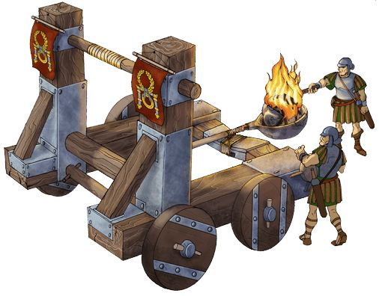
Long Range Weapons
Bow and Arrow
Longbow
Short bow
Crossbow
Catapult

Slide 28
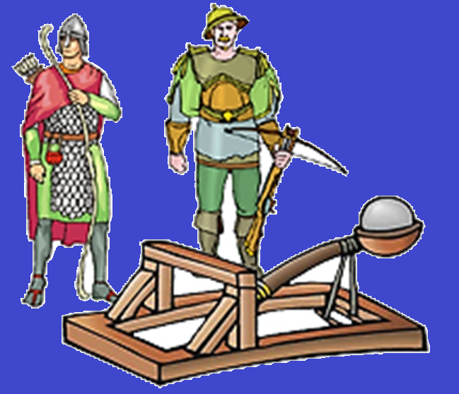
Long Range Weapons

Slide 29
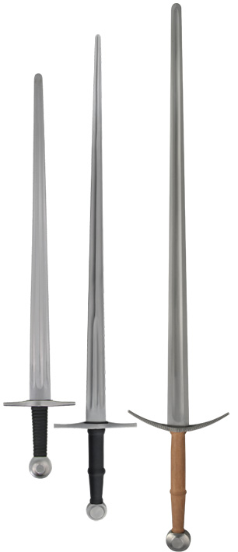
Hand to Hand Combat
Sword

Slide 30
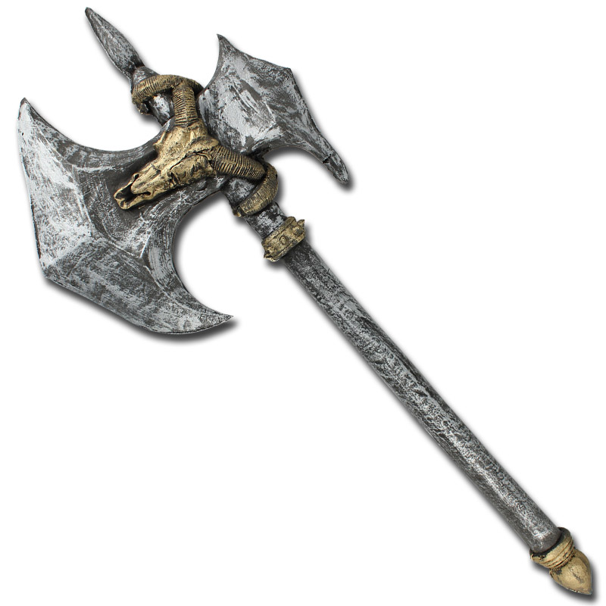
Hand to Hand Combat
Axe

Slide 31
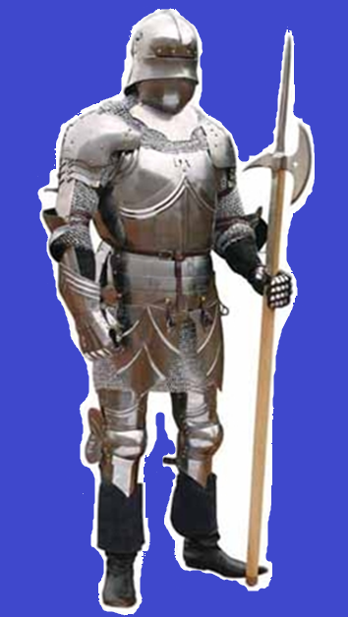
Hand to Hand Combat
Poleaxe

Slide 32
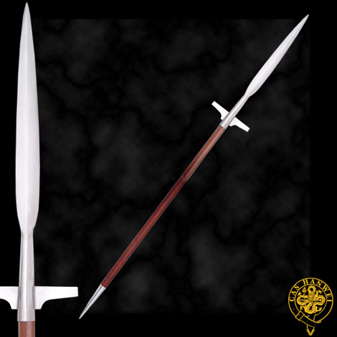
Hand to Hand Combat
Spear

Slide 33
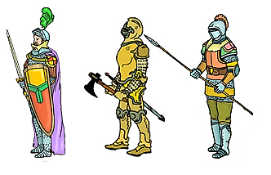
Hand to Hand Combat

Slide 34
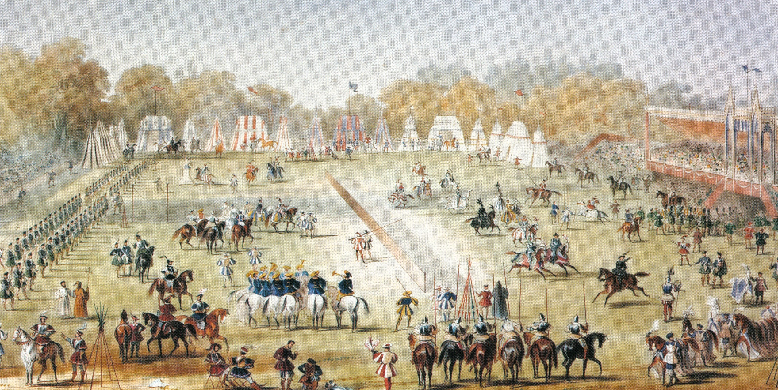
Tournament

Slide 35
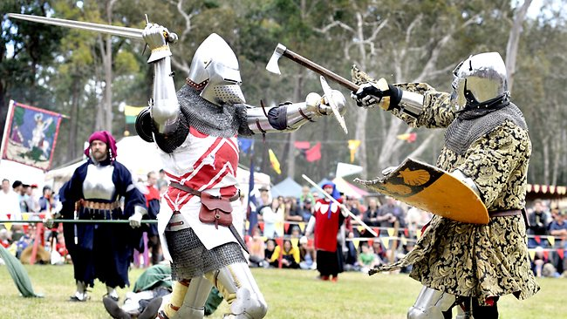

Slide 36
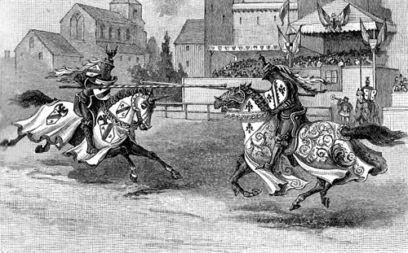
Jousting

Slide 37
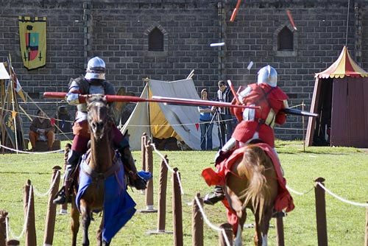
Jousting
Lance

Slide 38
Medieval Times
https://www.youtube.com/watch?v=1BxAEbf_eBM

Slide 39
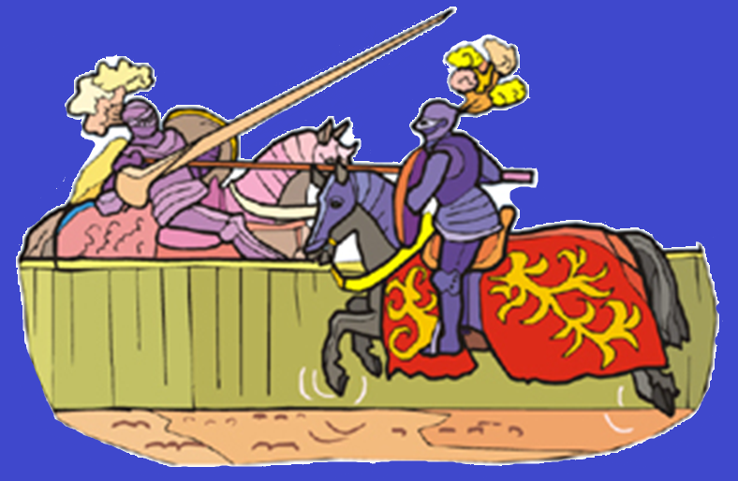

Slide 40
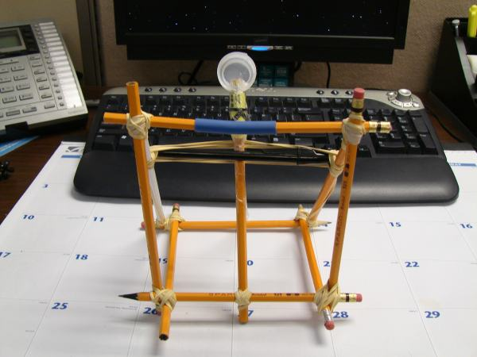
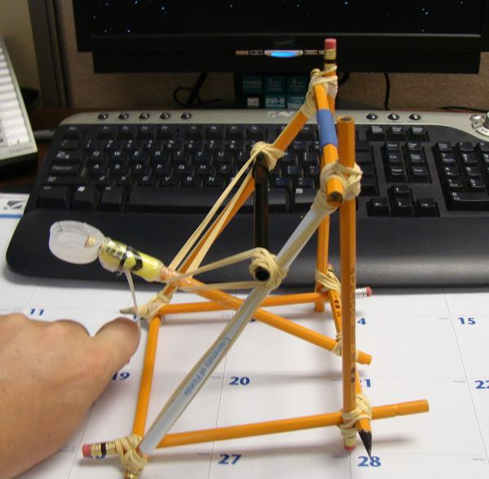
Make your own catapult:

Slide 41
