Slide 1
A Knight’s Tale

Slide 2
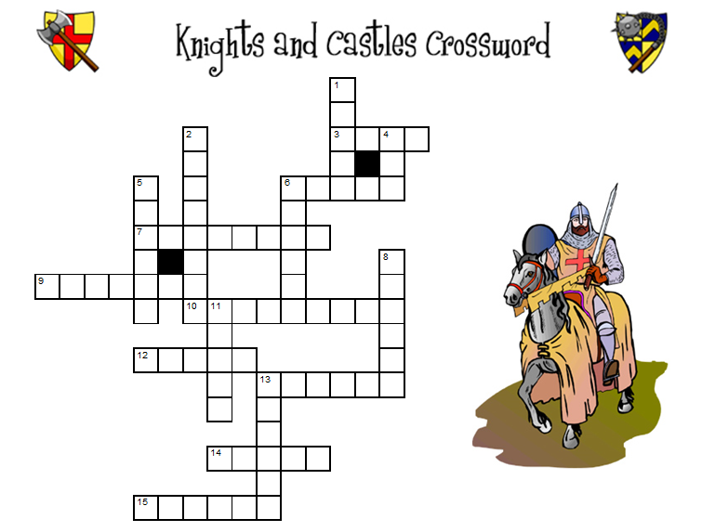

Slide 3

What is his job?

Slide 4
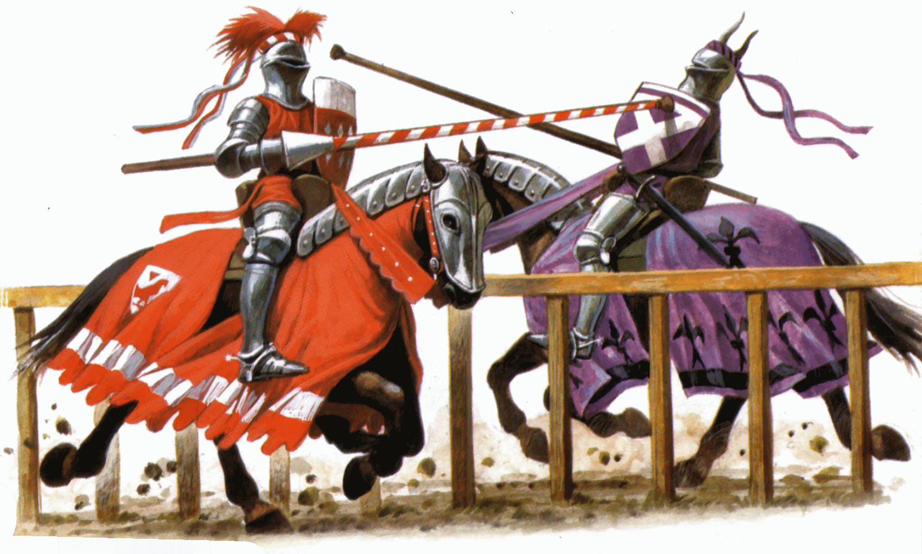

Slide 5
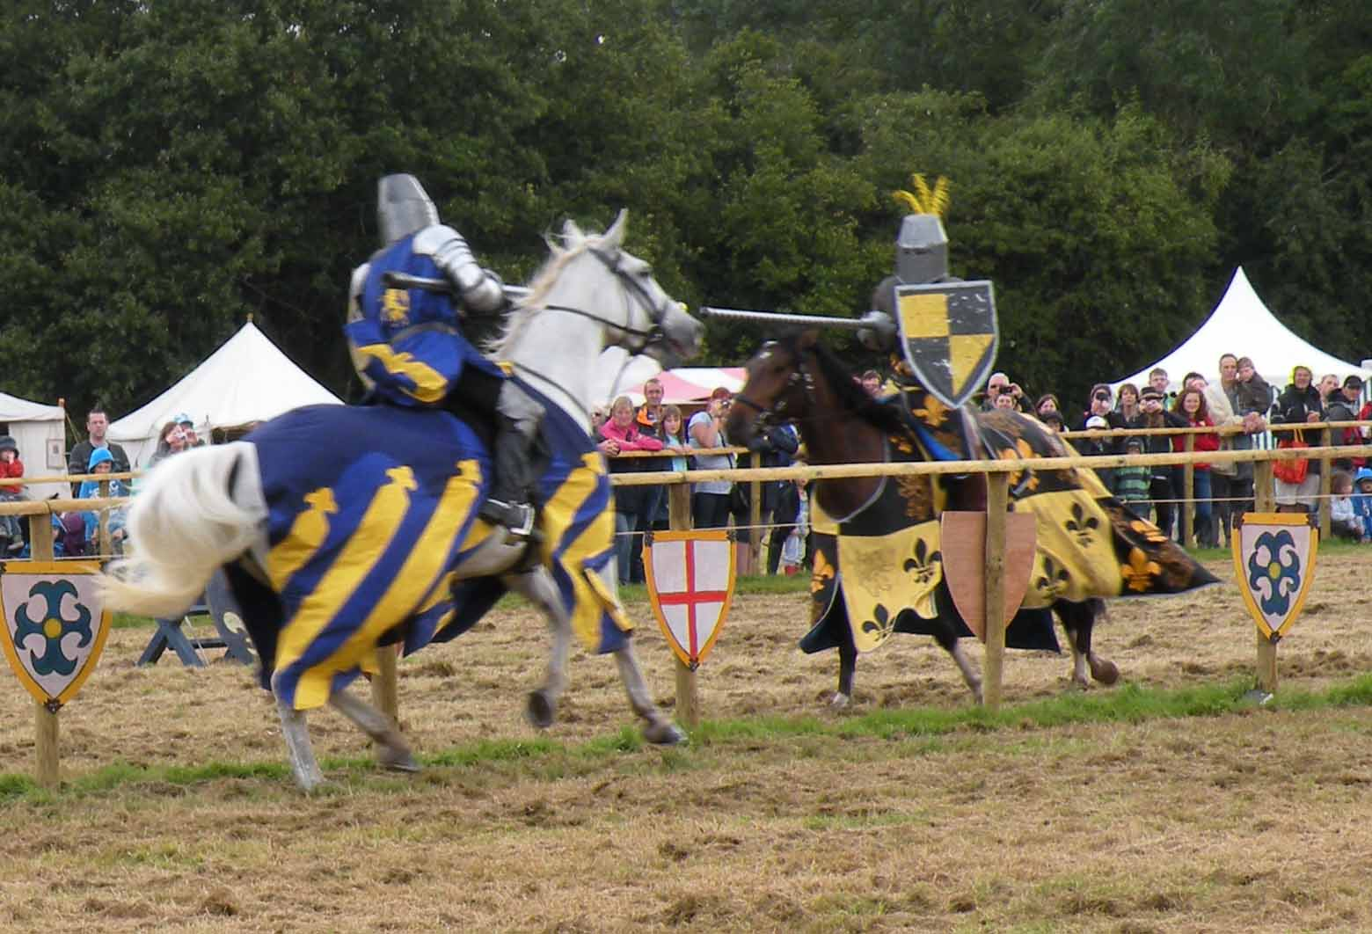

Slide 6


Slide 7
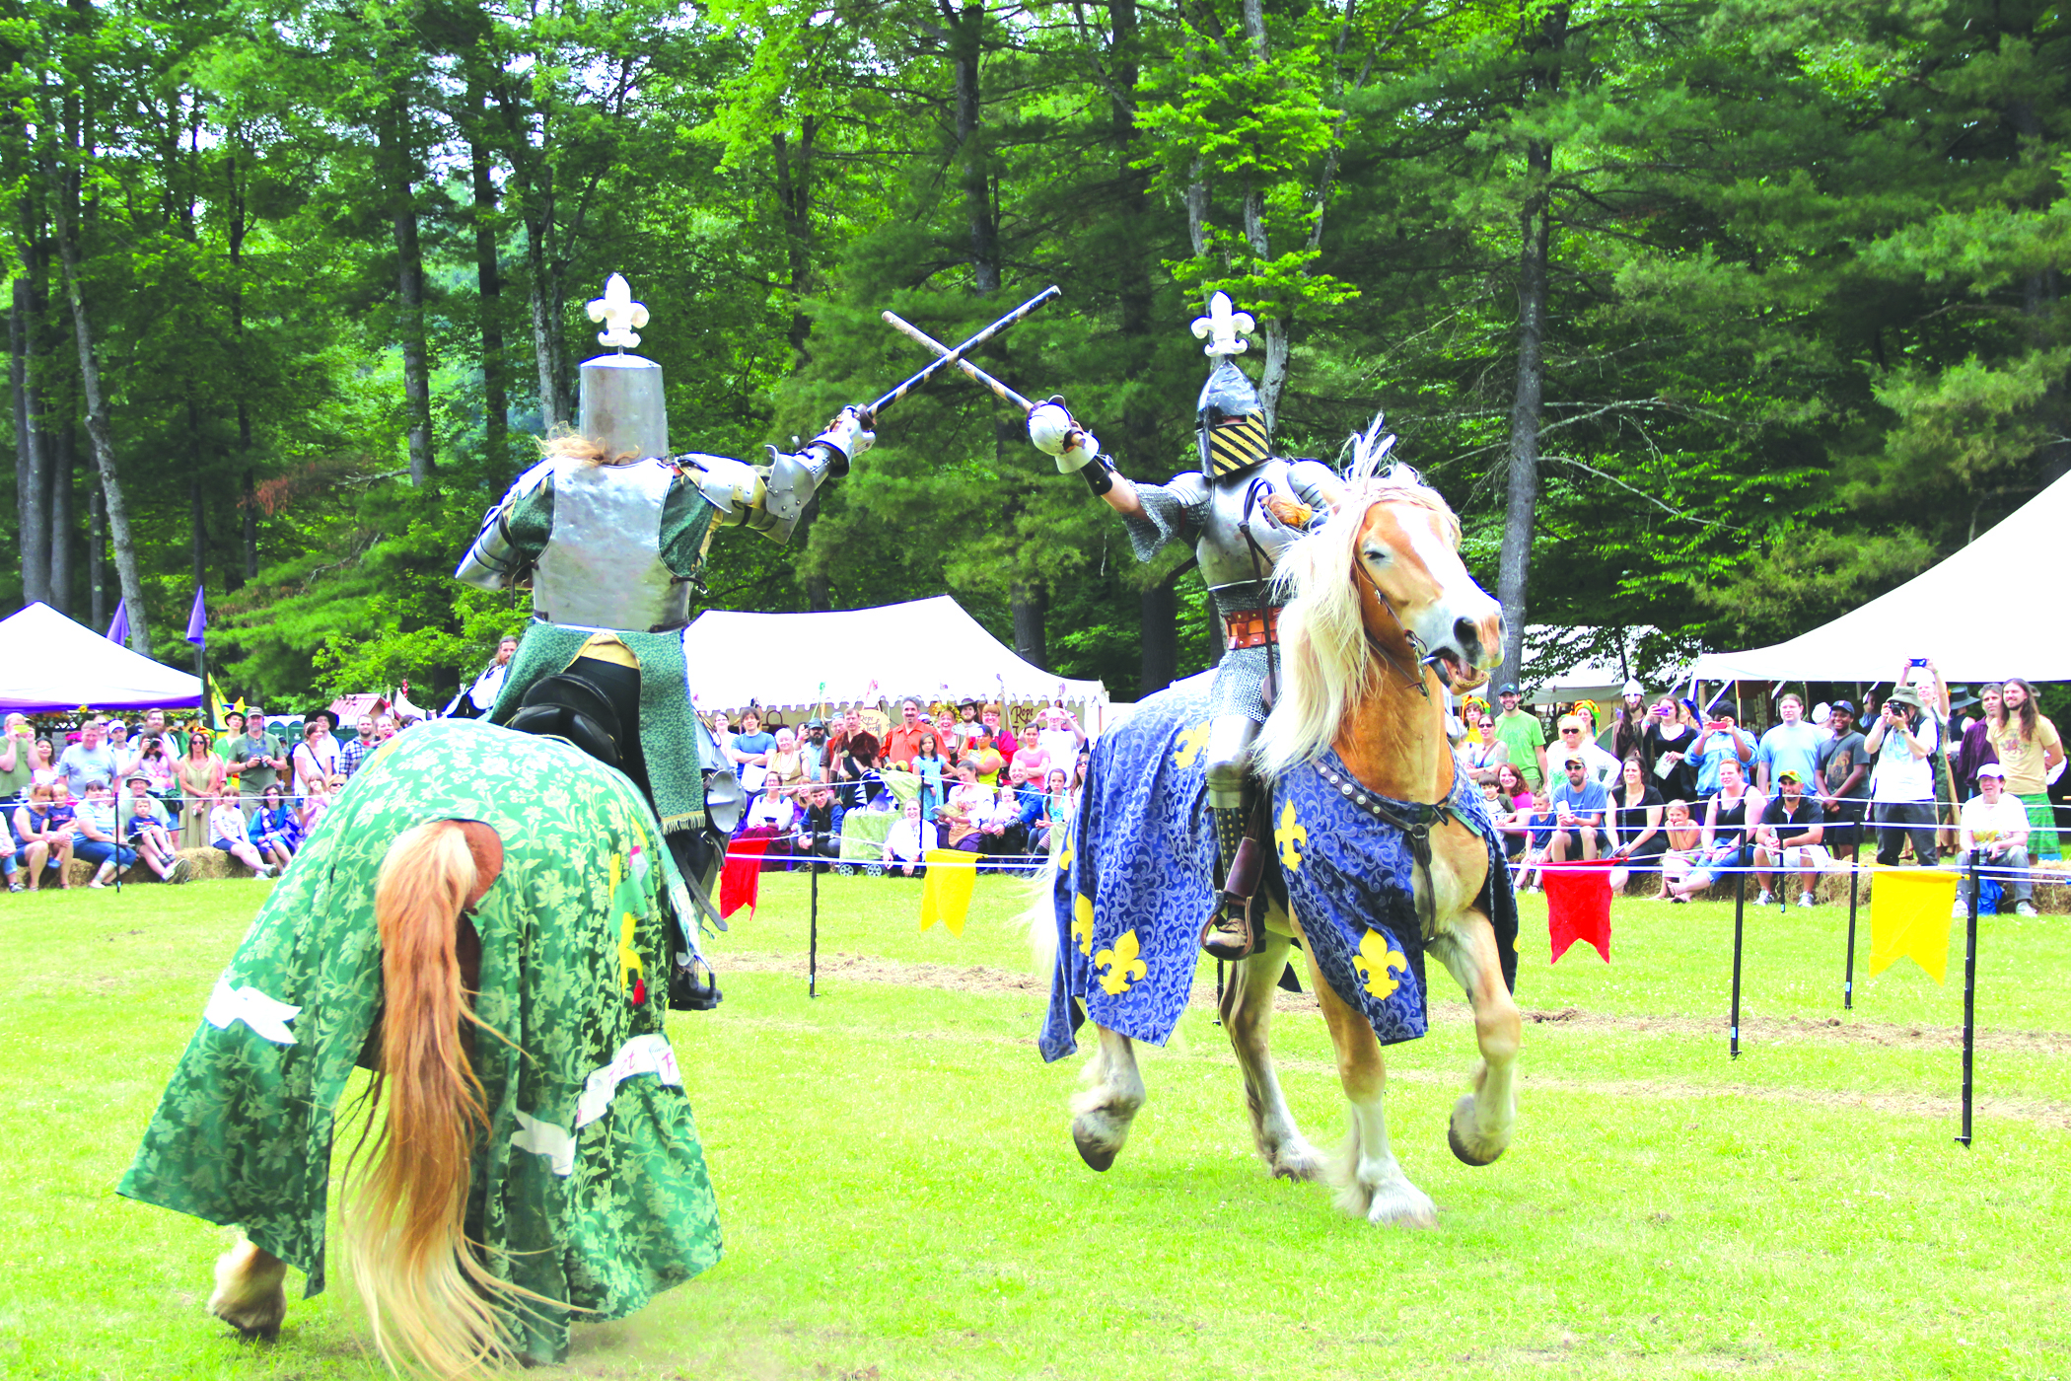

Slide 8


Slide 9
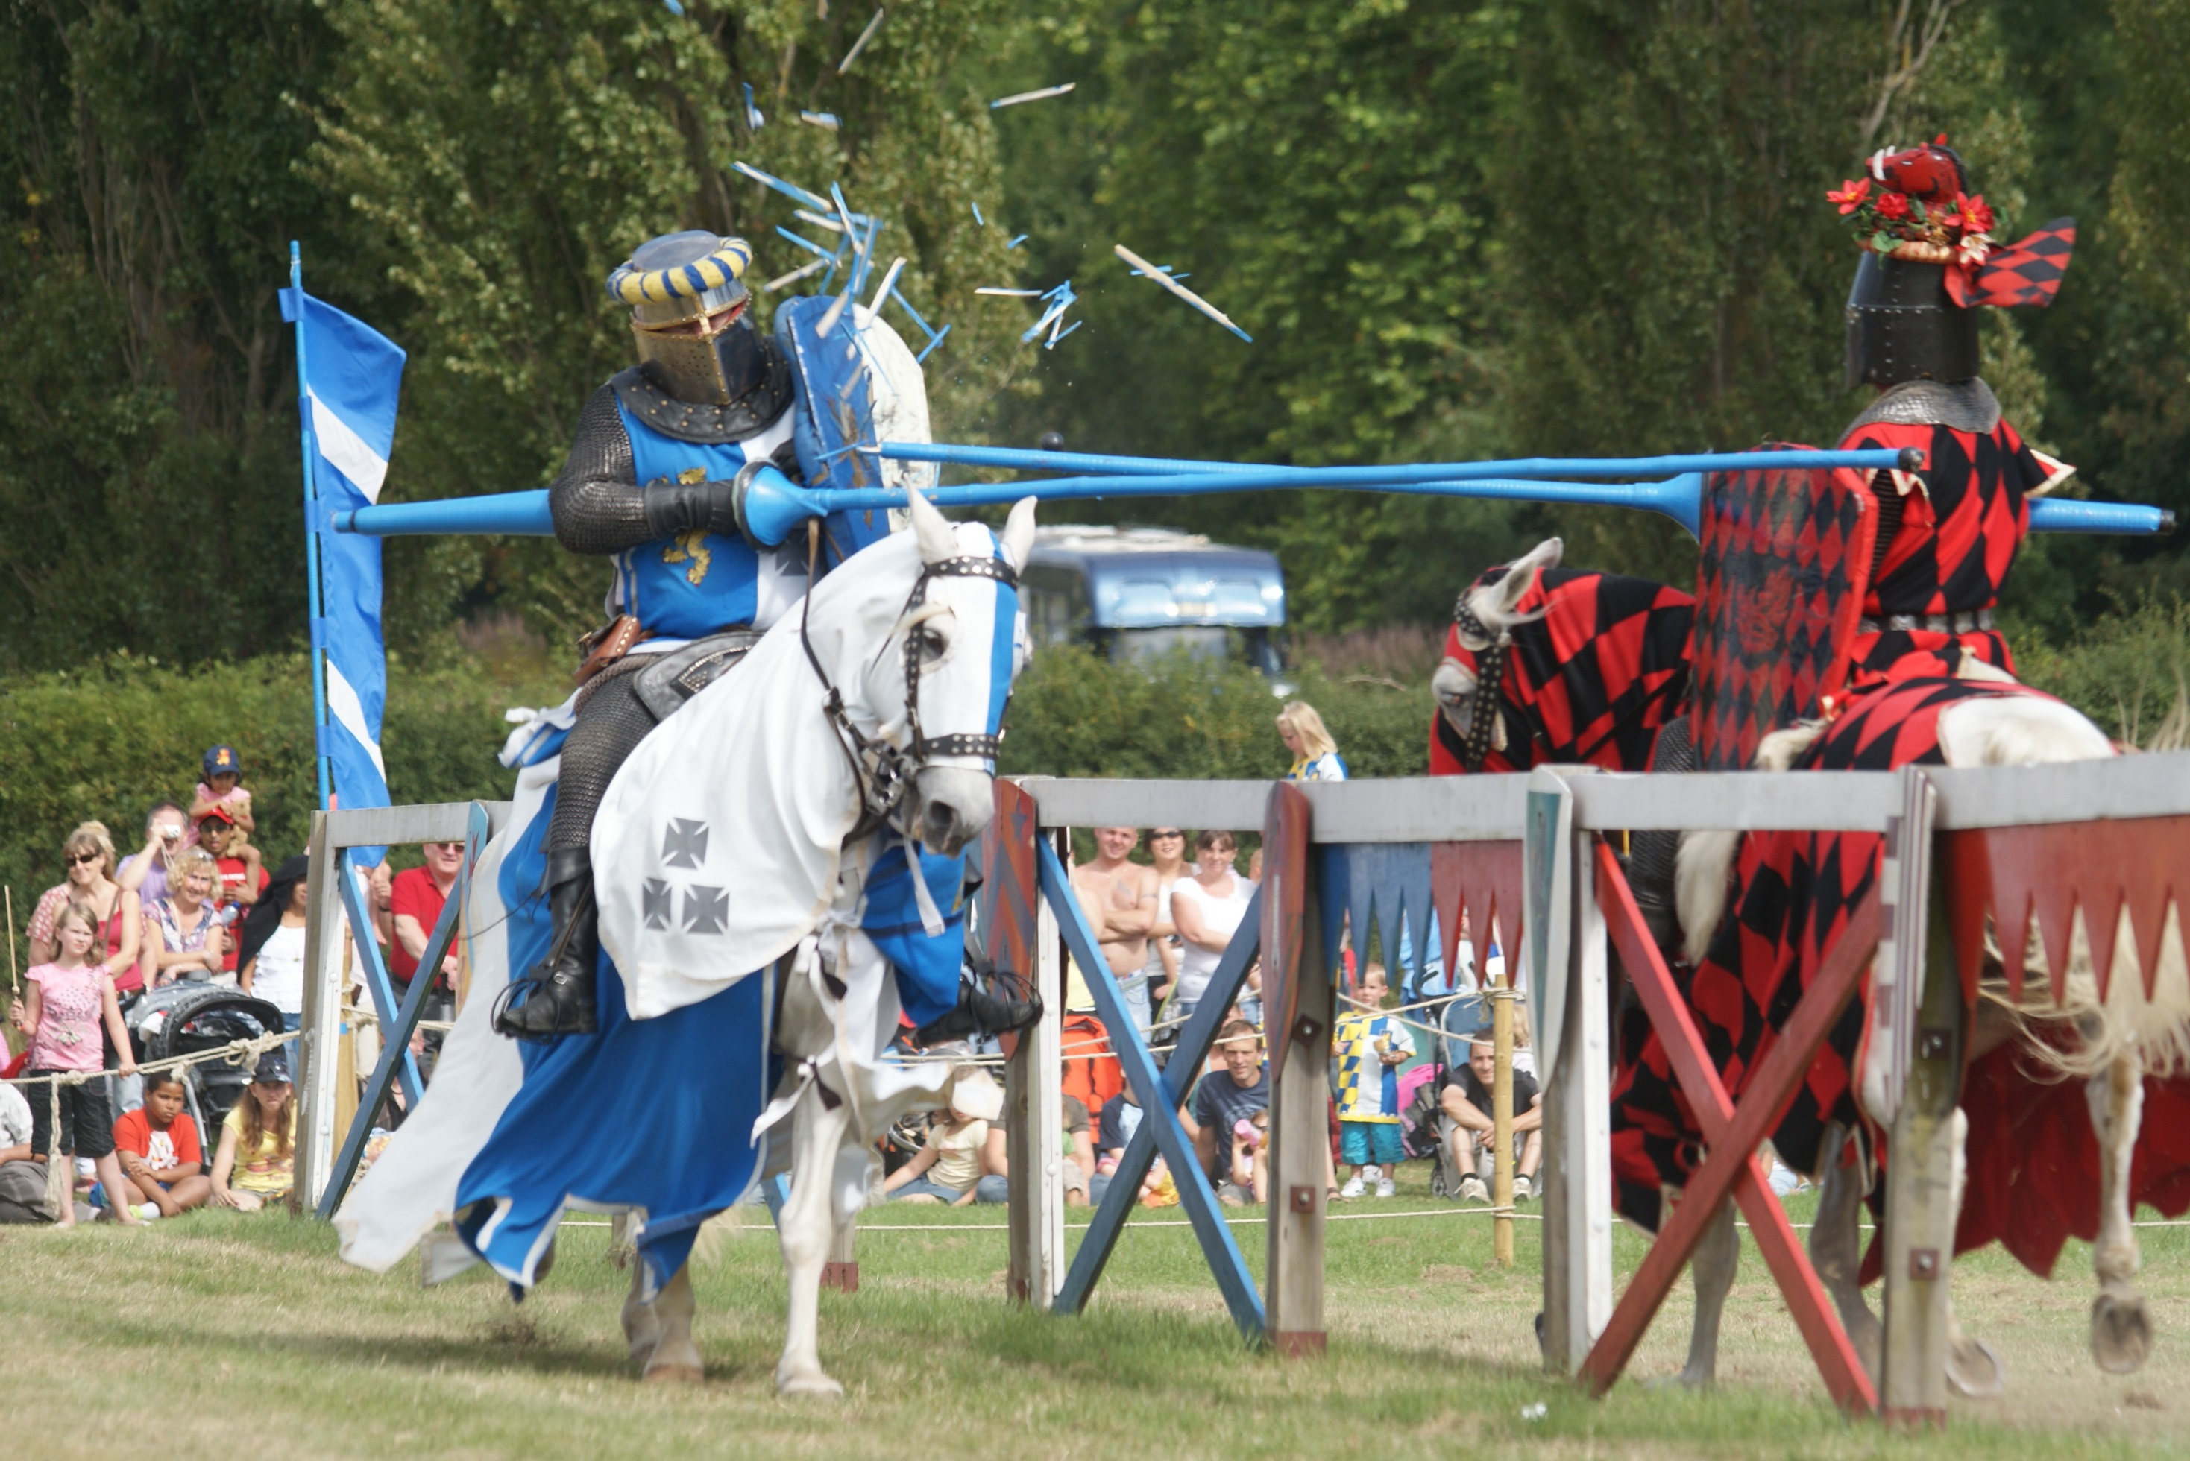

Slide 10


Slide 11
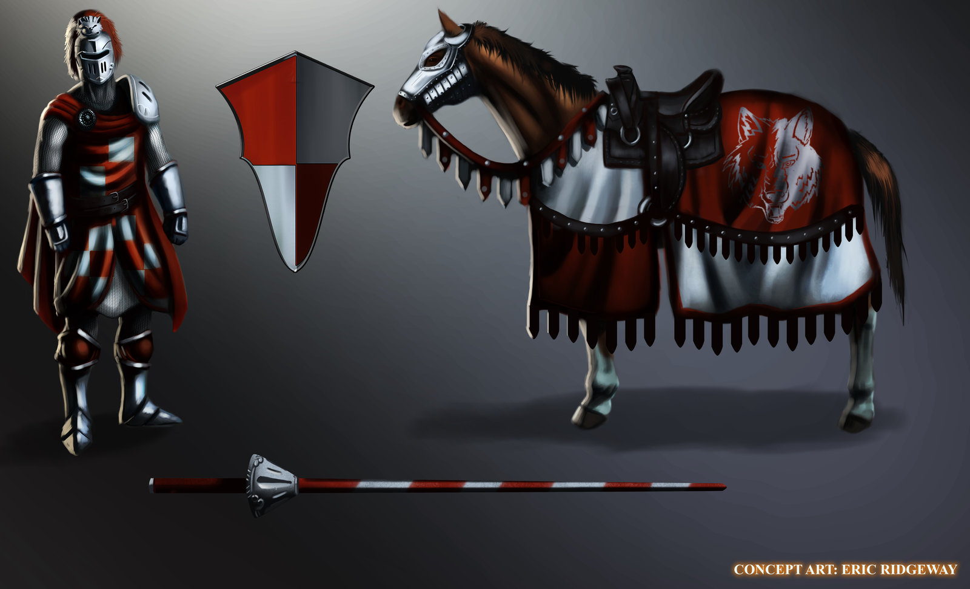

Slide 12
Make a Champion
Bonus for attack rolls:
5/6 = -3
6/7 = -2
8/9 = -1
10 = 0
11/12 = +1
13/14 = +2
15 = +3
Number required to hit you
Stats (40 total)
(minimum 5 / Maximum 15)
Armor:
Weapon:
Damage:
Health:
If you win an attack, you can use this dice for damage:
5,6,7 = d4
8,9,10 = d6
11,12 = d8
13,14 = d10
15 = d12
How much damage you can before you die.

Slide 13
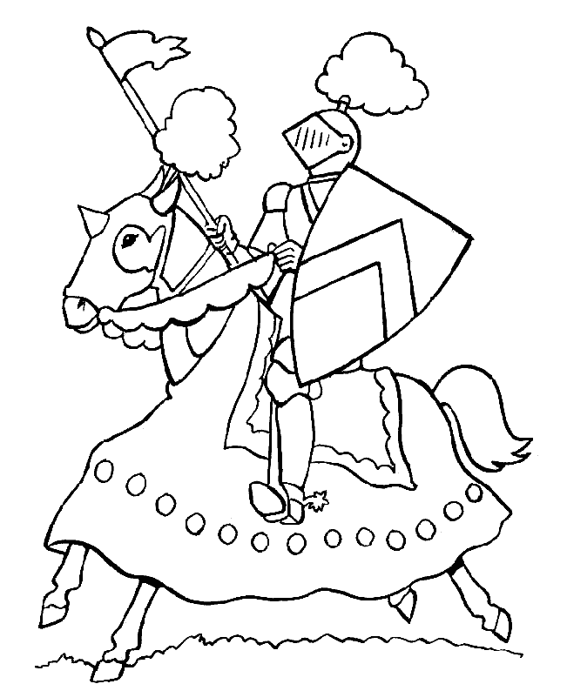
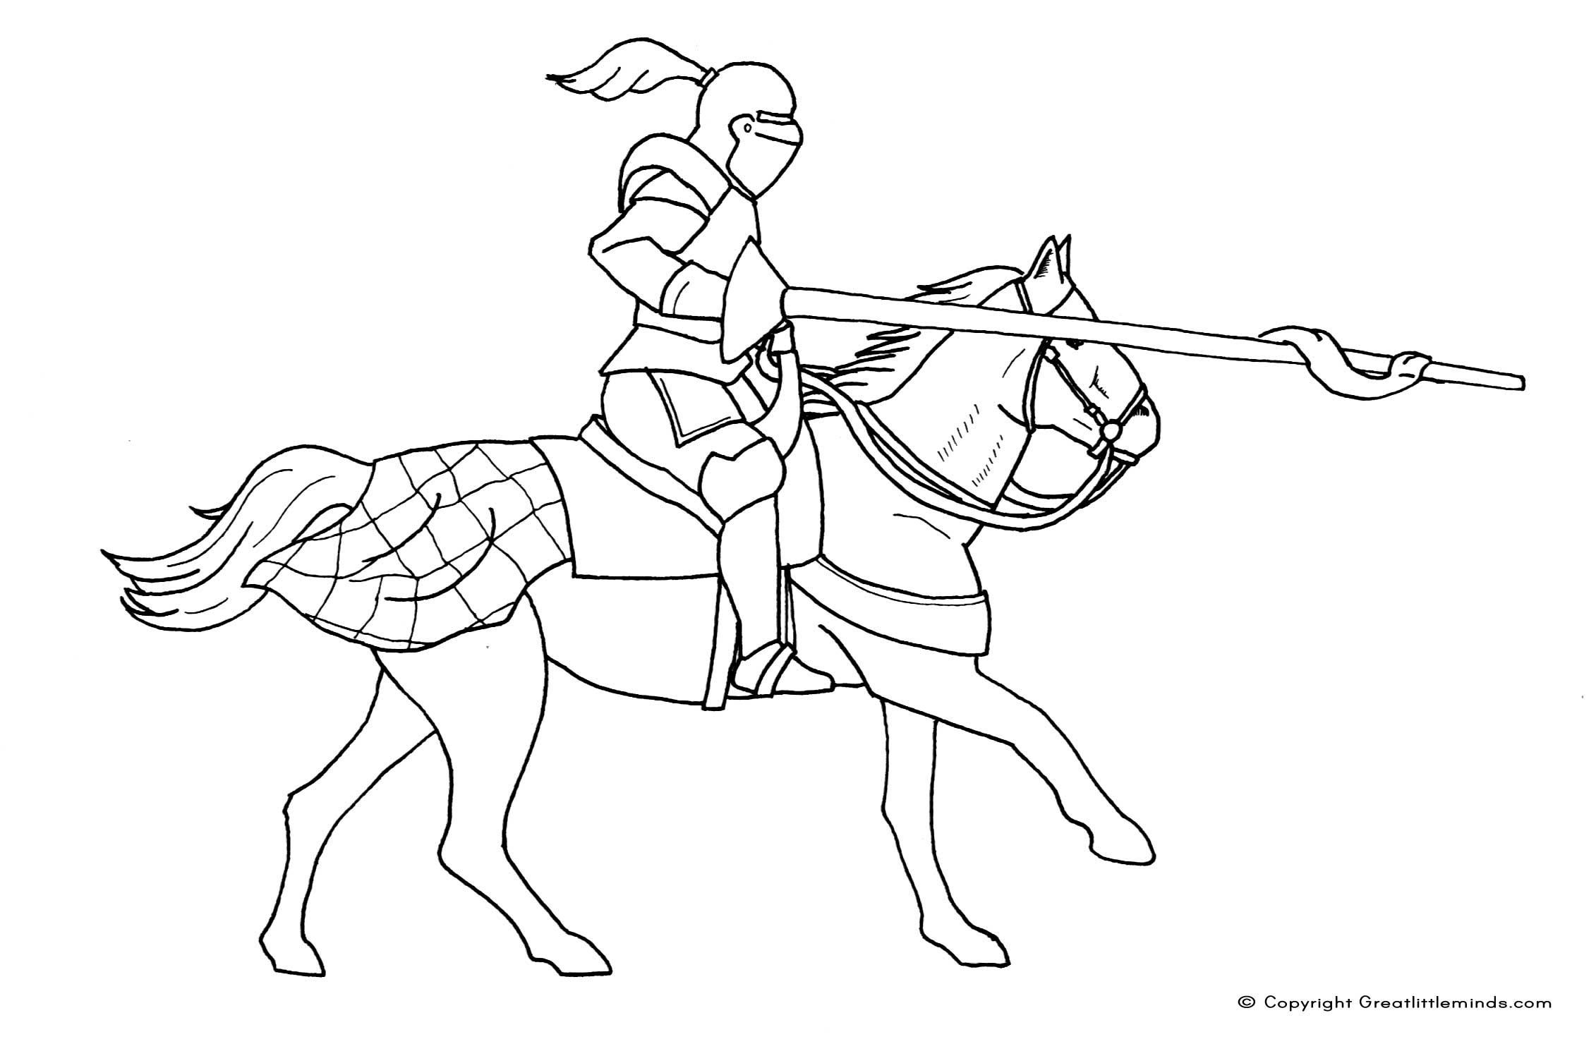
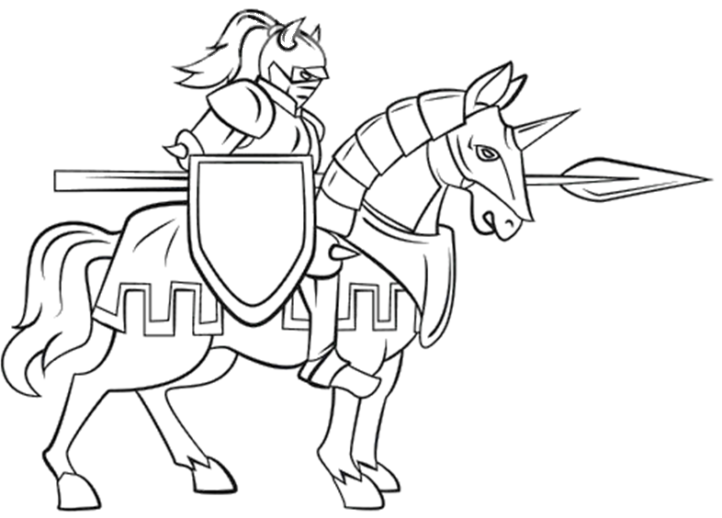
Color your Champion

