Slide 1
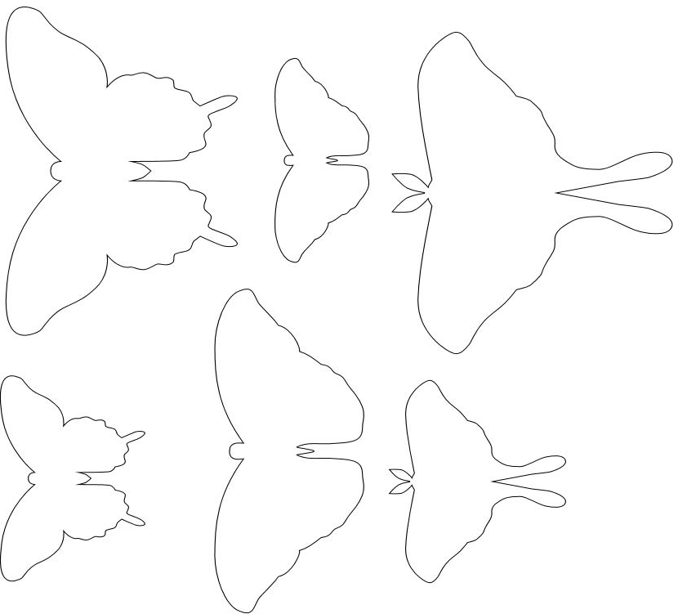
Butterflies and Moths

Slide 2
