Slide 1
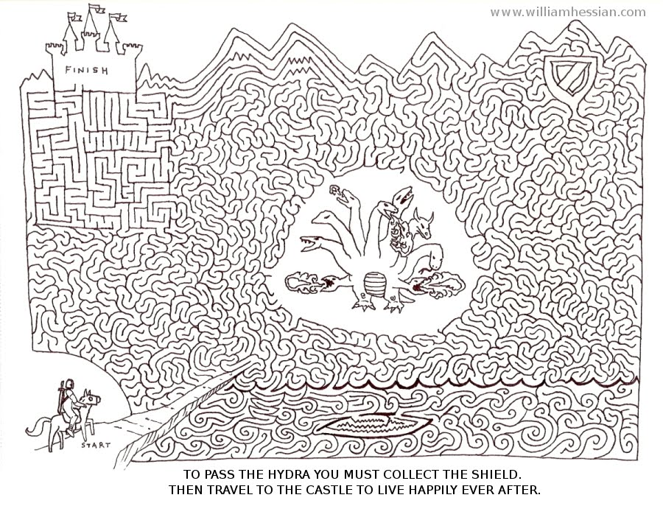

Slide 2
King Arthur

Slide 4
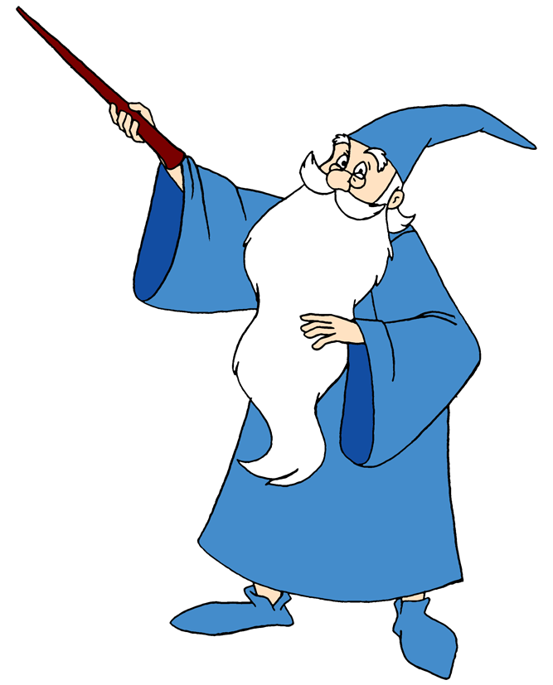

Slide 5
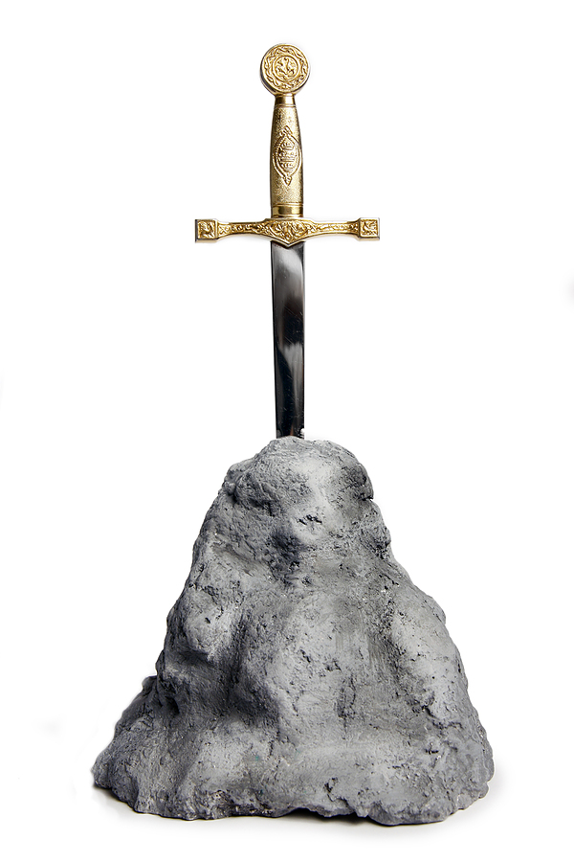

Slide 8
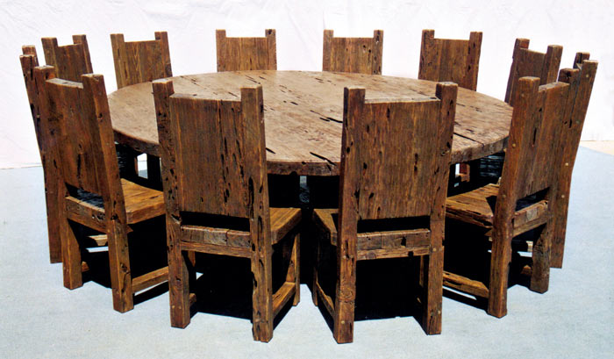

Slide 10
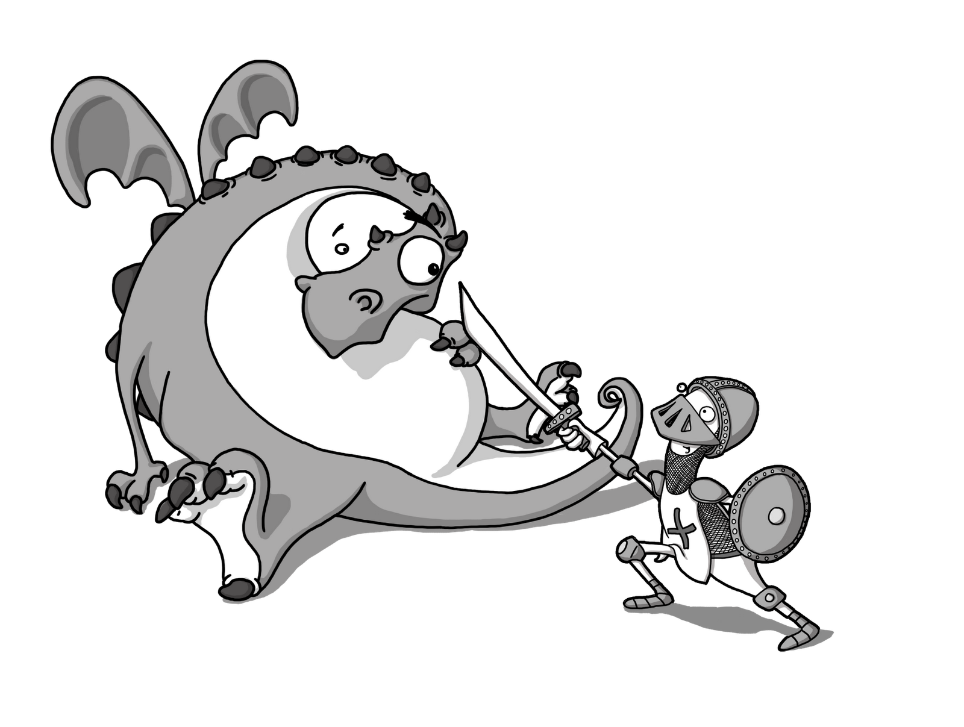

Slide 13
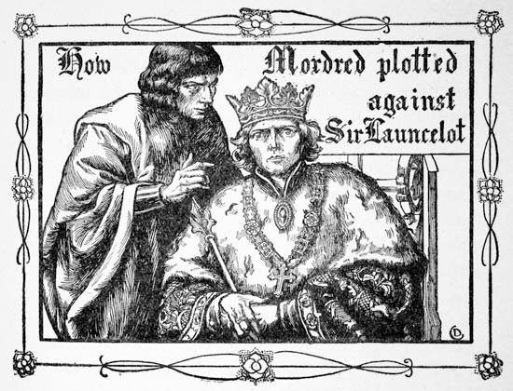

Slide 14
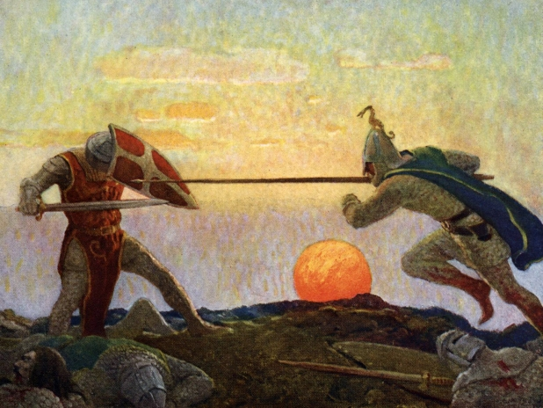

Slide 16
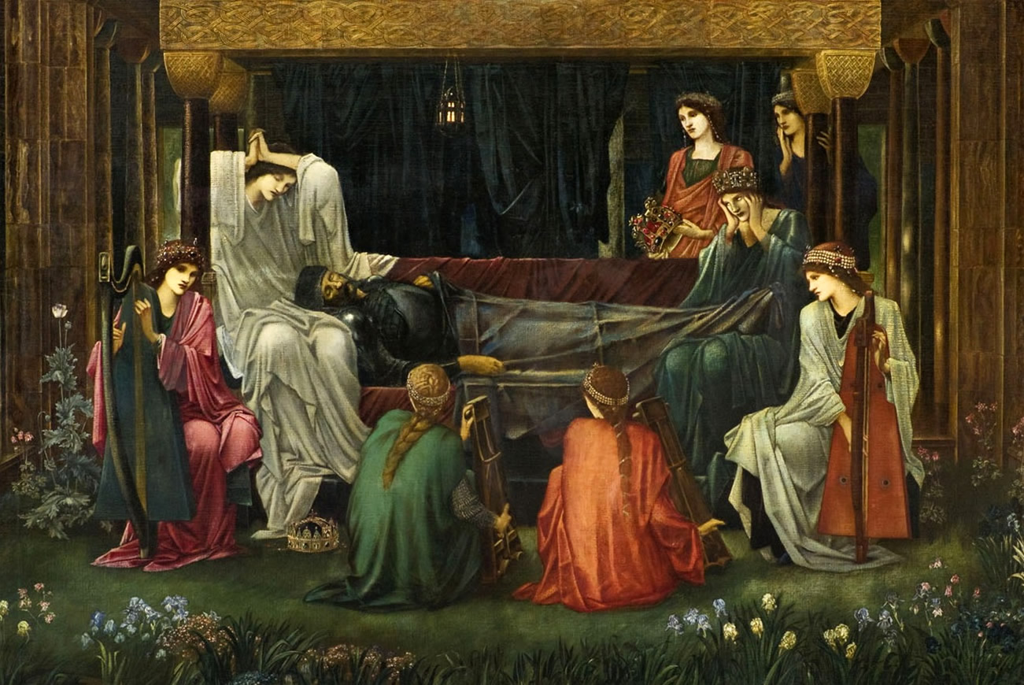

Slide 17
Questions:
Who was the first High-King mentioned in the story? What was his name?
Who was he in love with?
Was his love single or married?
How did he manage to marry her?
Did they have any children?

Slide 18
Questions:
Whom did the King give his son?
Why did he give it to Merlin?
Where was Arthur raised?
Did he know his parents?
What happened when King Uther died?

Slide 19
Questions:
What magically appeared in St. Paul's Cathedral in London?
What was the message on the sword?
Why did Arthur and his family go to London?
What did Arthur forget?
Did Arthur find another sword? Where?

Slide 20
Questions:
Did people first believe that Arthur pulled the sword out?
Was he crowned for the King?
What is the difference between the King and the High-King?
What did 11 local knights do?
Who helped Arthur rule the Britain?

Slide 21
Questions:
What happened with the Lady of the Lake?
Why was it said that Excalibur had the magic power?
Where did Arthur build his royal palace?
Did he fall in love and get married? To whom?
What did Guinevere's father give them as a wedding present?

Slide 22
Questions:
Who could sit there? How were the knights called?
Did Arthur and his army defeat Saxons?
Where did they go after conquering the Britain?
What did the Roman Emperor give to Arthur?
What kind of adventured did Knights of the Round Table have?

Slide 23
Questions:
Who was Sir Lancelot?
Who fell in love with him?
Did Arthur know about them?
Who told him?
Who was Mordred? Was he a kind man?

Slide 24
Questions:
What happened to Lancelot?
Was Guinevere burnt to death? What happened?
What did Arthur do to punish his wife and Lancelot?
Who took care of the kingdom?
What did Mordred lie?

Slide 25
Questions:
Did people like Mordred?
What did Arthur do when found out about Mordred?
Did he fight Mordred with Excalibur?
Who died and who was hurt in a battle?
What did Arthur order Bedivere to do with the sword?

Slide 26
Questions:
How could he recognize a lie?
What happened at the end with King Arthur?
What is Avalon?

