Slide 1
Christmas Wish List

Slide 3
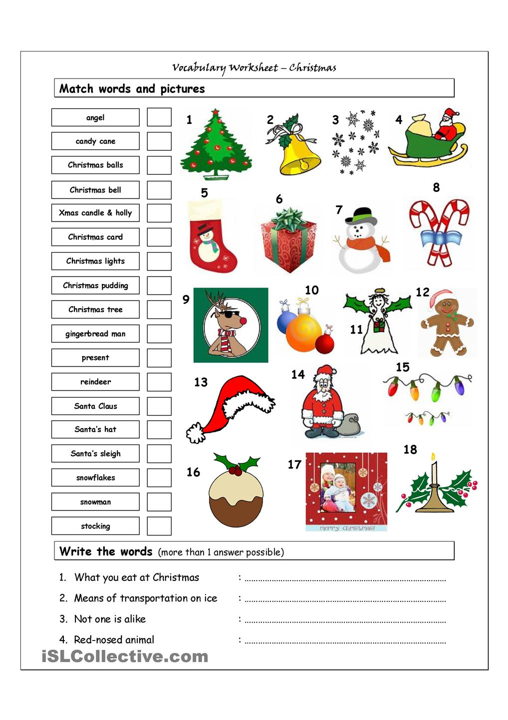
Christmas Things

Slide 4
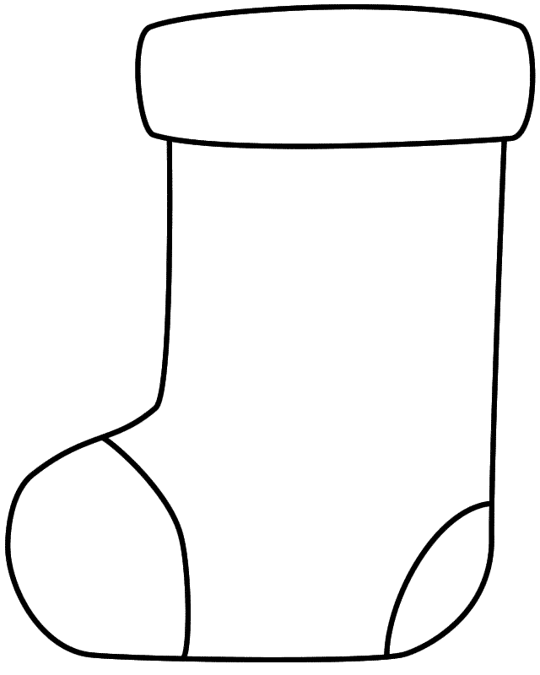
What do you want in your stocking?
Draw what you want in your stocking

Slide 5
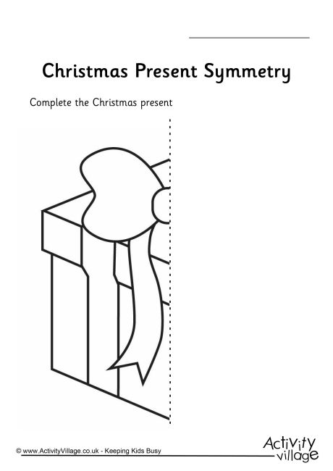
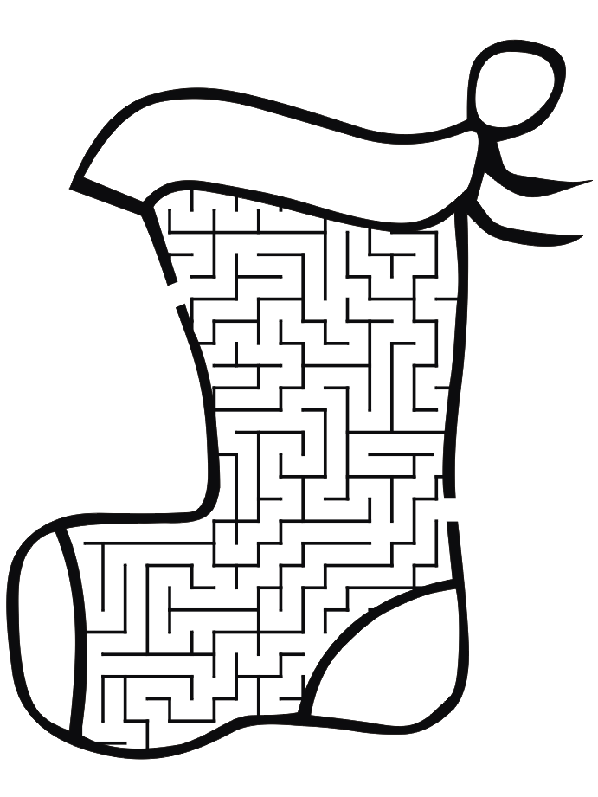

Slide 6
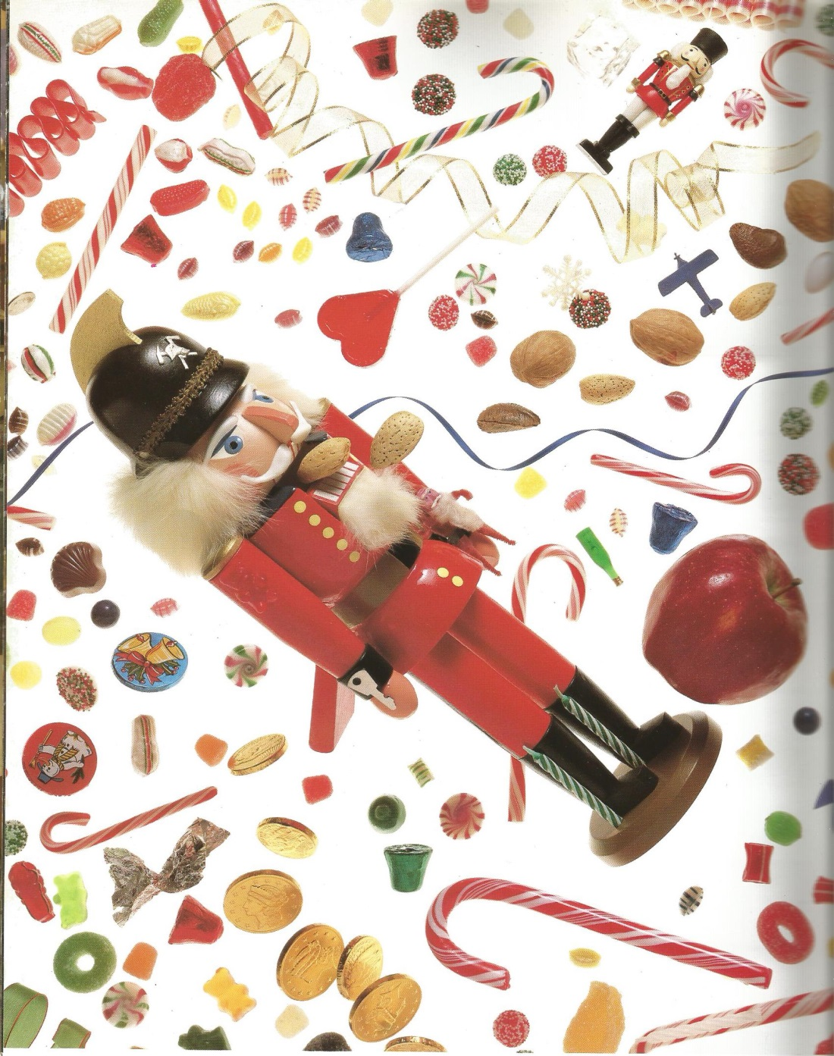
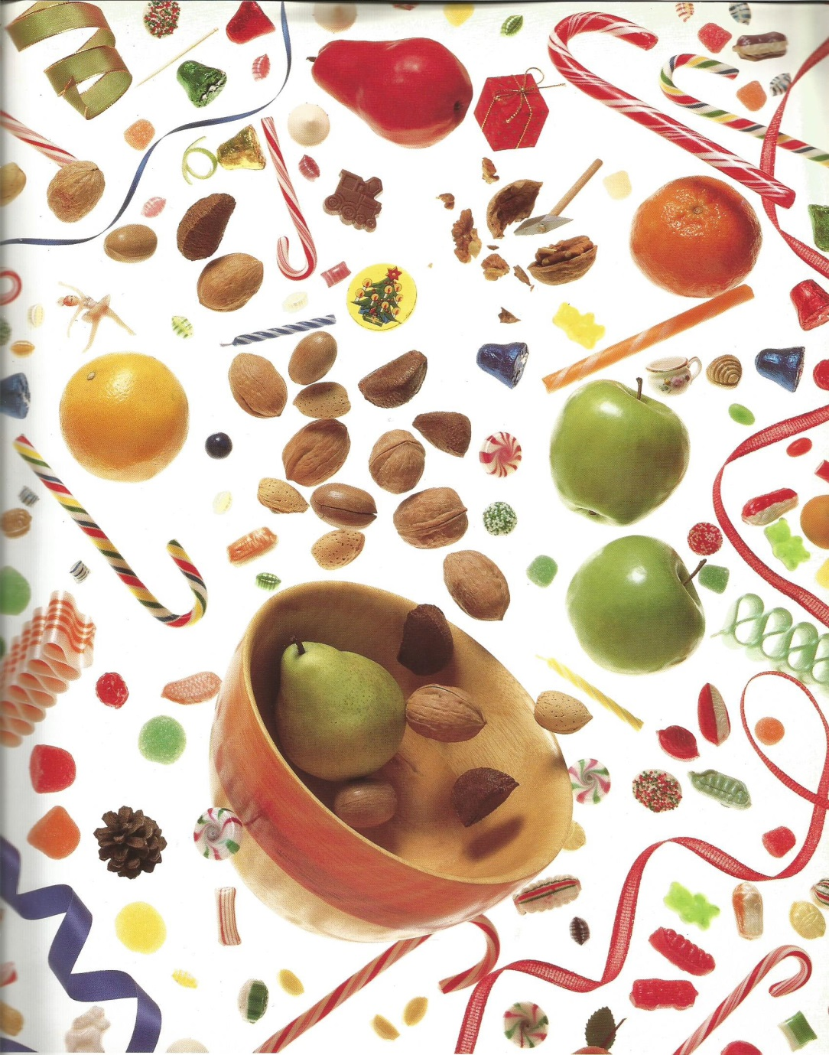
I spy an ice cube, a golden bell, a carrot for a nose, a chocolate shell; a hatchet at work, a bottle, a key, a pine cone, a plane and a Christmas tree.

Slide 7
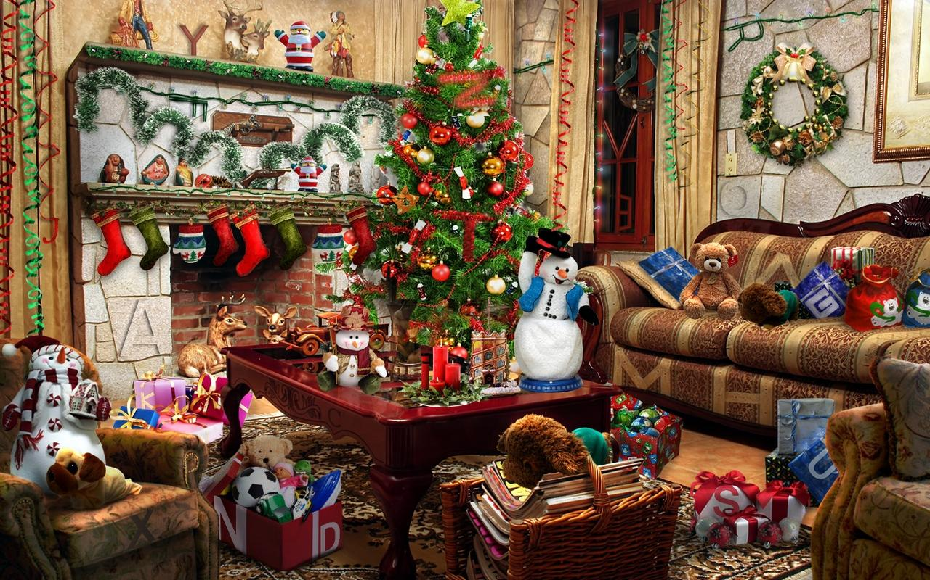
Soccer ball
Wreath
Y
R
Green star
Candle

Slide 8
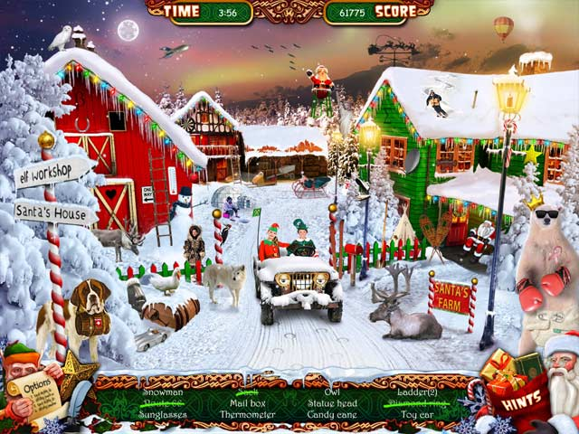
Snowman
Sunglasses
Mailbox
Thermometer
Owl
Candy Cane
Toy Car
Diamond Ring

Slide 9
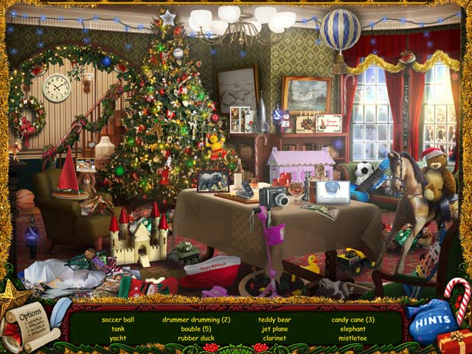
Soccer Ball
Candy Cane (3)
Tank
Jet Plane
Clarinet (Recorder)

Slide 10
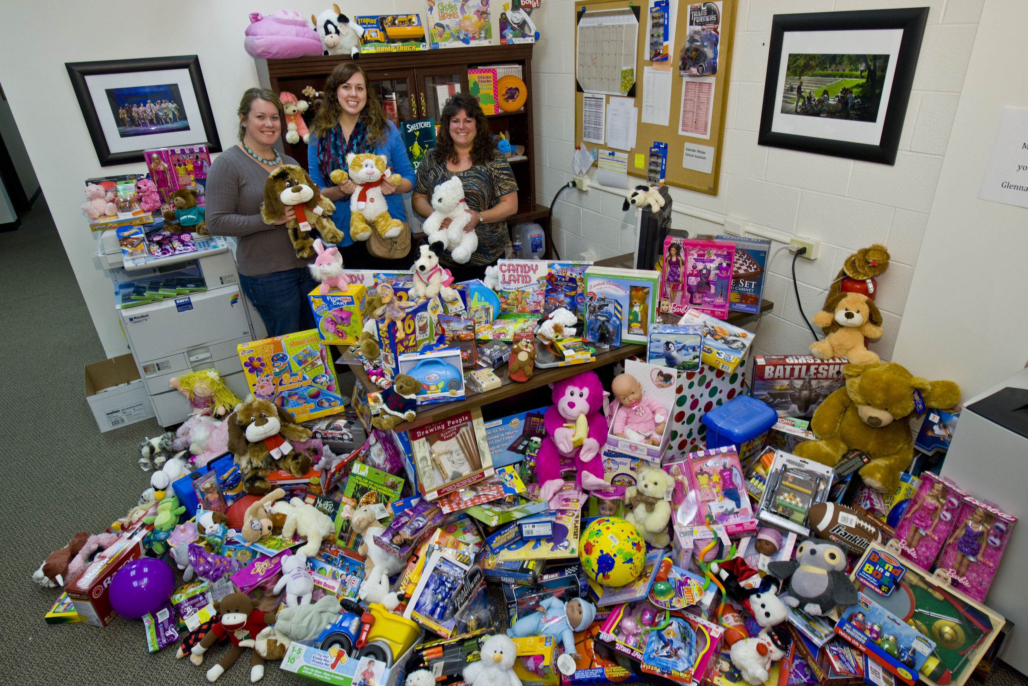

Slide 11
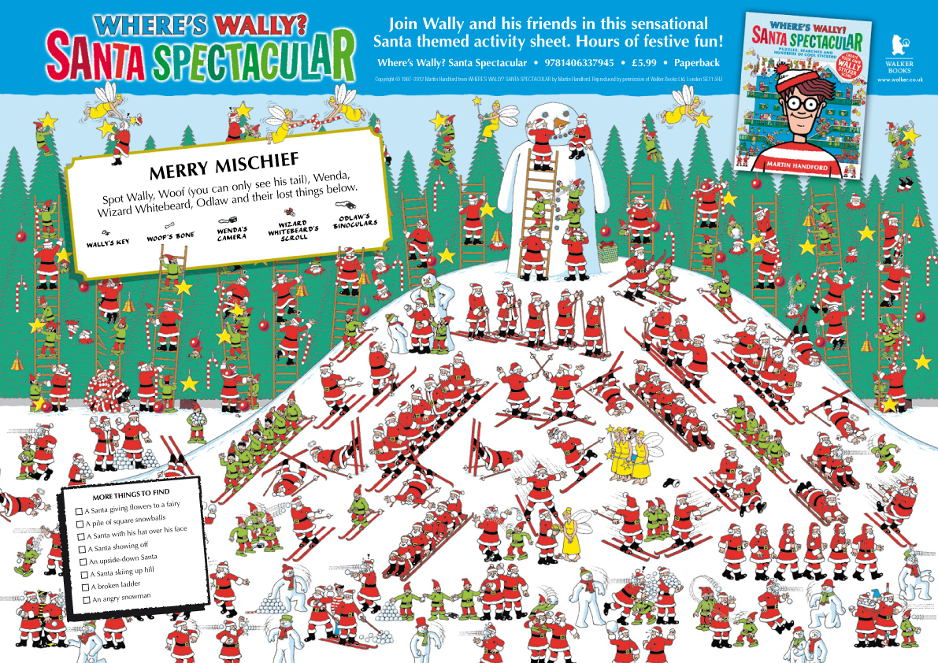

Slide 12
