Slide 1
Idiot Test
http://www.coolgames.com/the-ultimate-idiot-test.html

Slide 2
Lesson 4 – Examples and Definitions

Slide 3
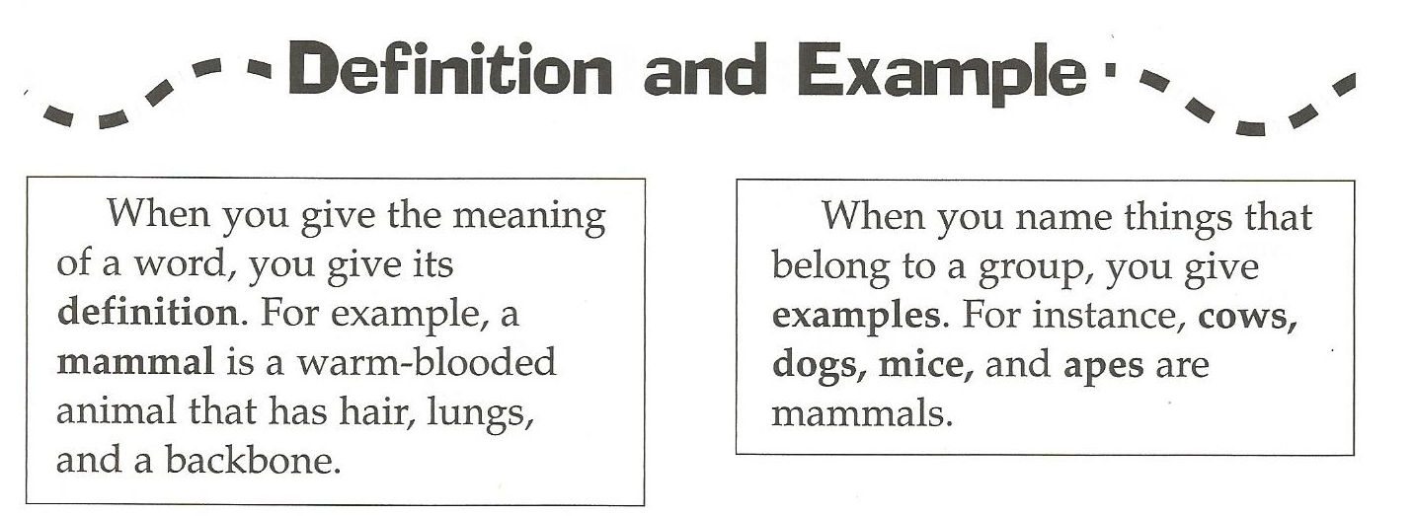
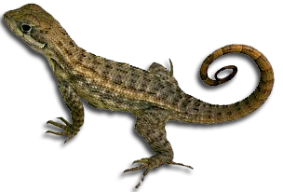
1. A reptile is a cold blooded animal that creeps or crawls.

Slide 4
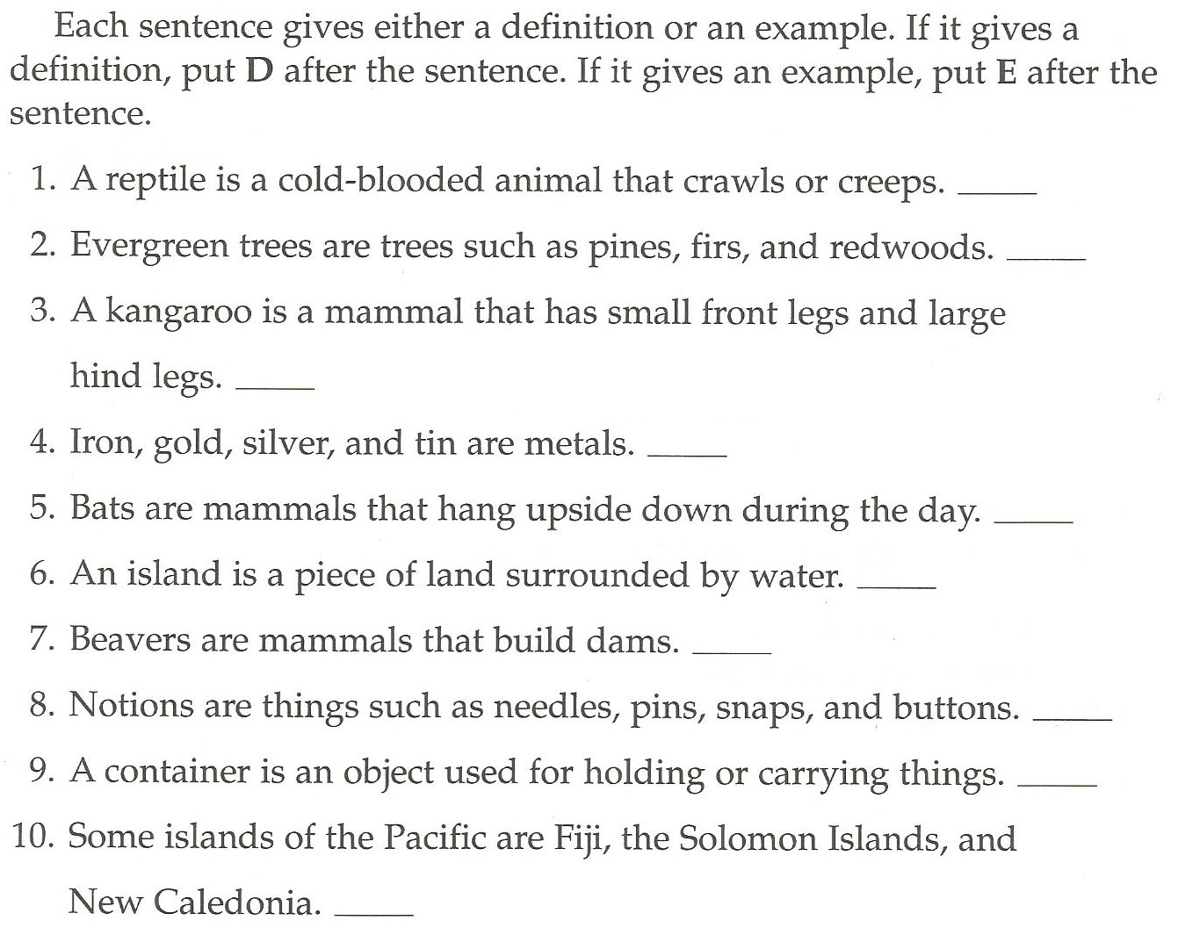

Slide 5
Jeopardy
I’ll give you a definition, and you tell what it is…

Slide 8
Examples Game:
Secretly write examples on your card.
Give the card back to Mr. S
Listen and guess what the examples are of…
Don’t guess your own!!

