Slide 1
Lesson 5 - Culture

Slide 2
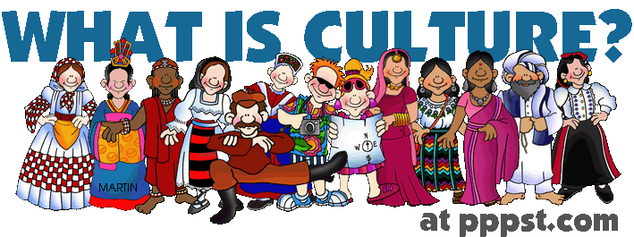
What is culture?
The differences between countries
The things people do

Slide 3
What are some elements (parts) of culture?

Slide 4
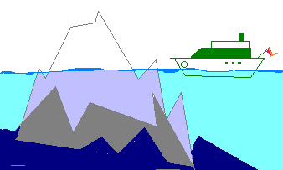
WHY IS CULTURE SOMETIMES COMPARED TO AN ICEBERG?
Facial expressions
Religious beliefs
Foods
Eating habits
Paintings
Concept of self
Work ethic
Styles of dress
Literature
Concept of fairness
Childraising beliefs
YOU CAN SEE
YOU CAN’T SEE

Slide 5
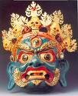
Whose culture is being identified in the following images???:
writing
Architecture/ religion
Art
Art/mythology
clothing
food
What elements of culture do we see in these images?

Slide 6
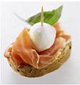
Whose culture is identified in these images?
TAPAS/ FOOD
ARCHITECTURE
DANCE/ CLOTHING
SPORTS/ GAMES
ARCHITECTURE

Slide 7
Korean Culture
Games
Values
Food
Places
Clothes
More things

Slide 8
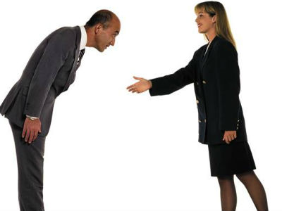

Slide 9
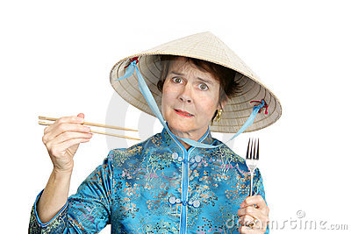
Culture Shock

Slide 10
Have you been to another country?
Where did you go?
How is it different from Korea?

Slide 11
http://matadornetwork.com/life/can-match-foods-place-originated-quiz/
http://www.st.rim.or.jp/~cycle/joshiki/JOSHIKI3E.HTML

