Slide 1
Culture Review
What are some parts of culture.
Describe Korean culture.

Slide 2
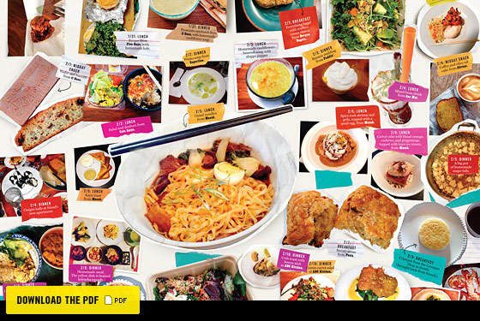
Lesson 6 – Food Culture

Slide 3
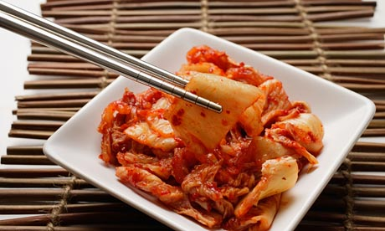
Kimchi

Slide 4
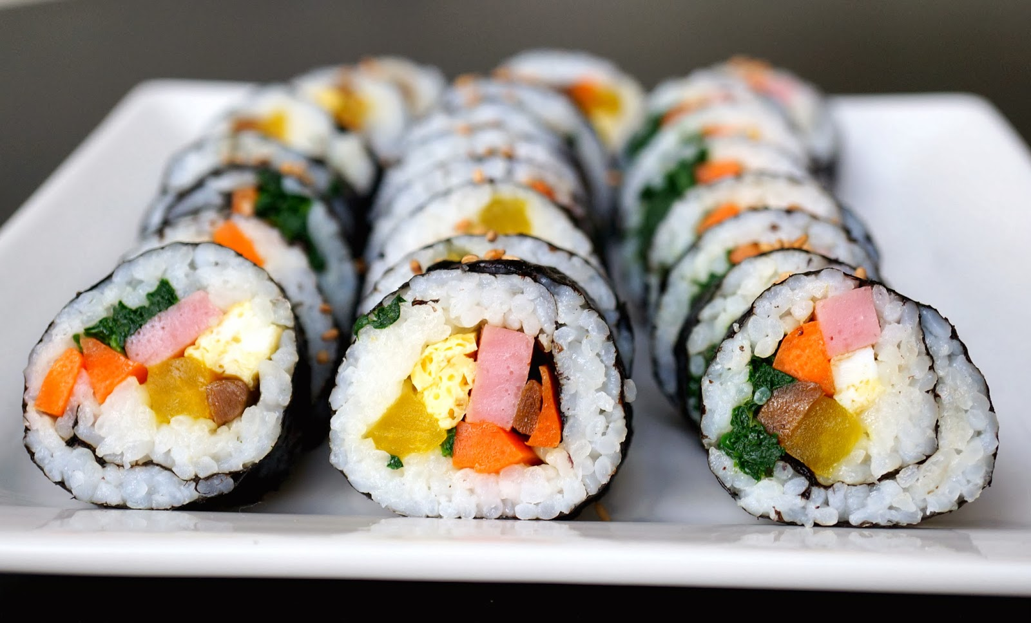
Kimbap

Slide 5
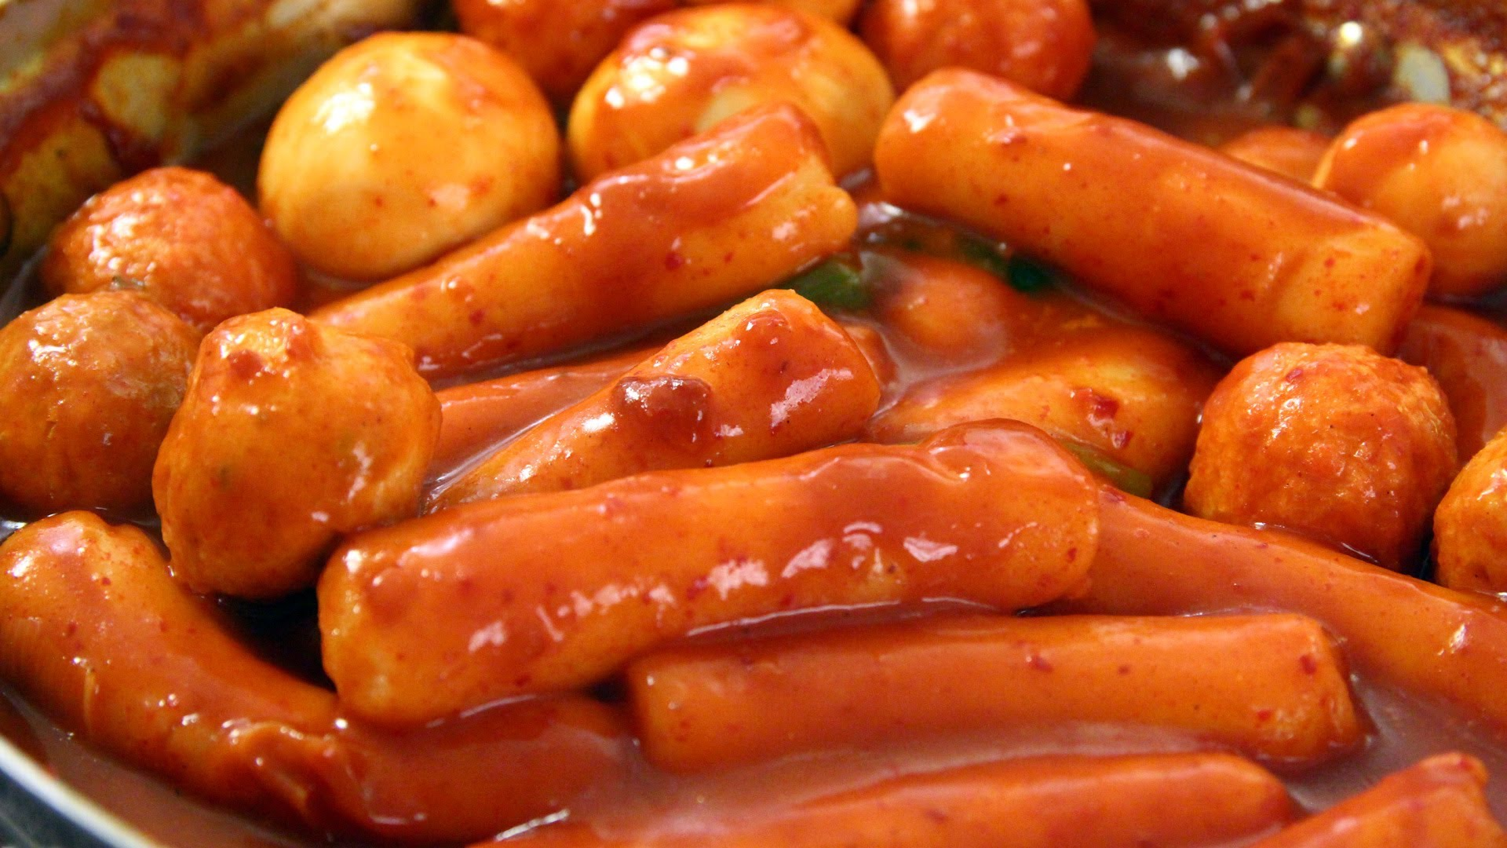
Ddeokbokki

Slide 6
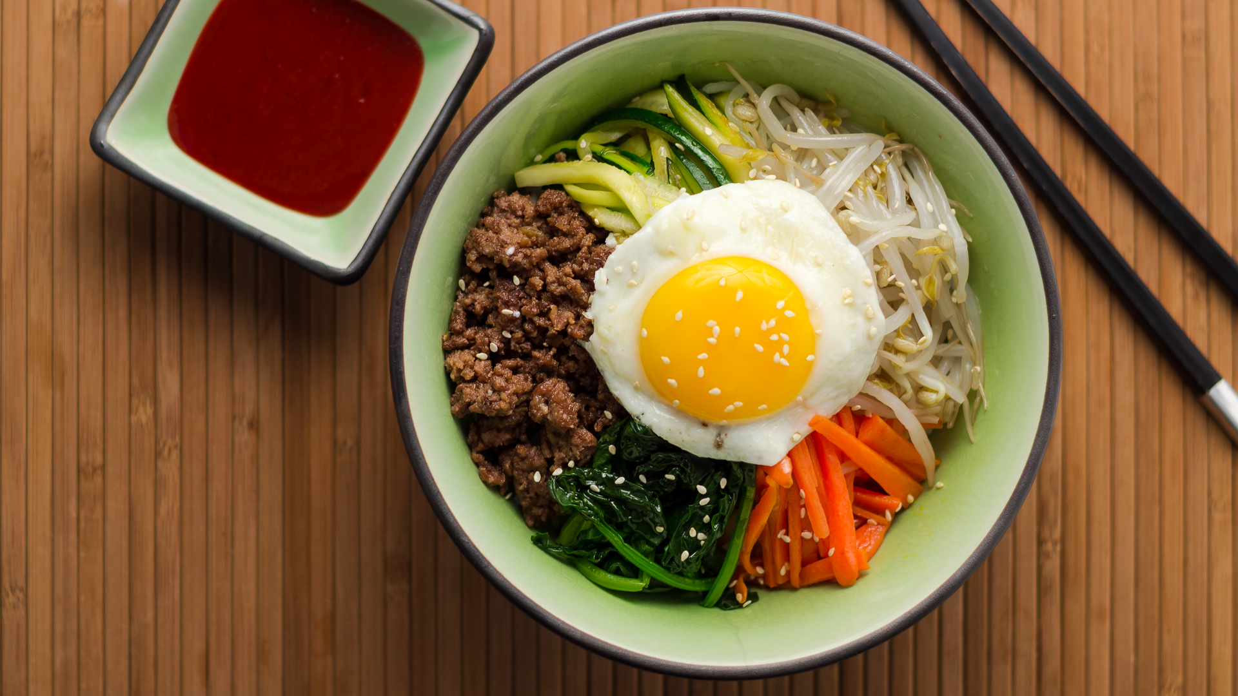
Bibimbap (mixed rice)

Slide 7
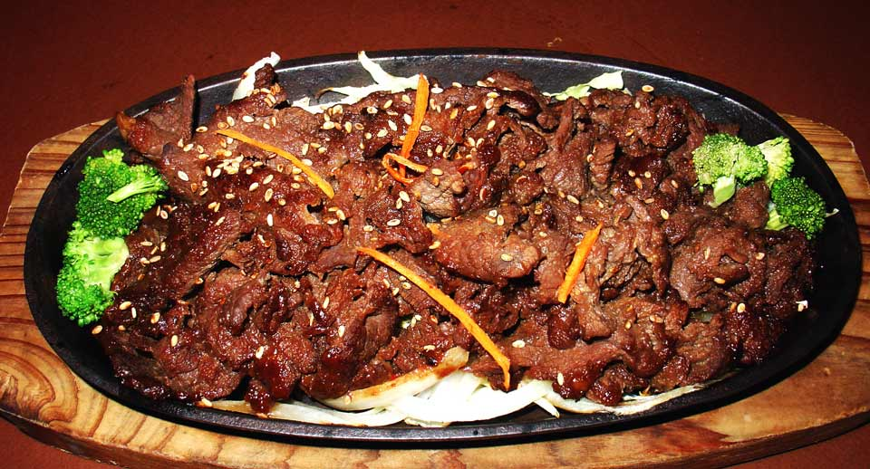
Bulgogi (marinated beef)

Slide 8
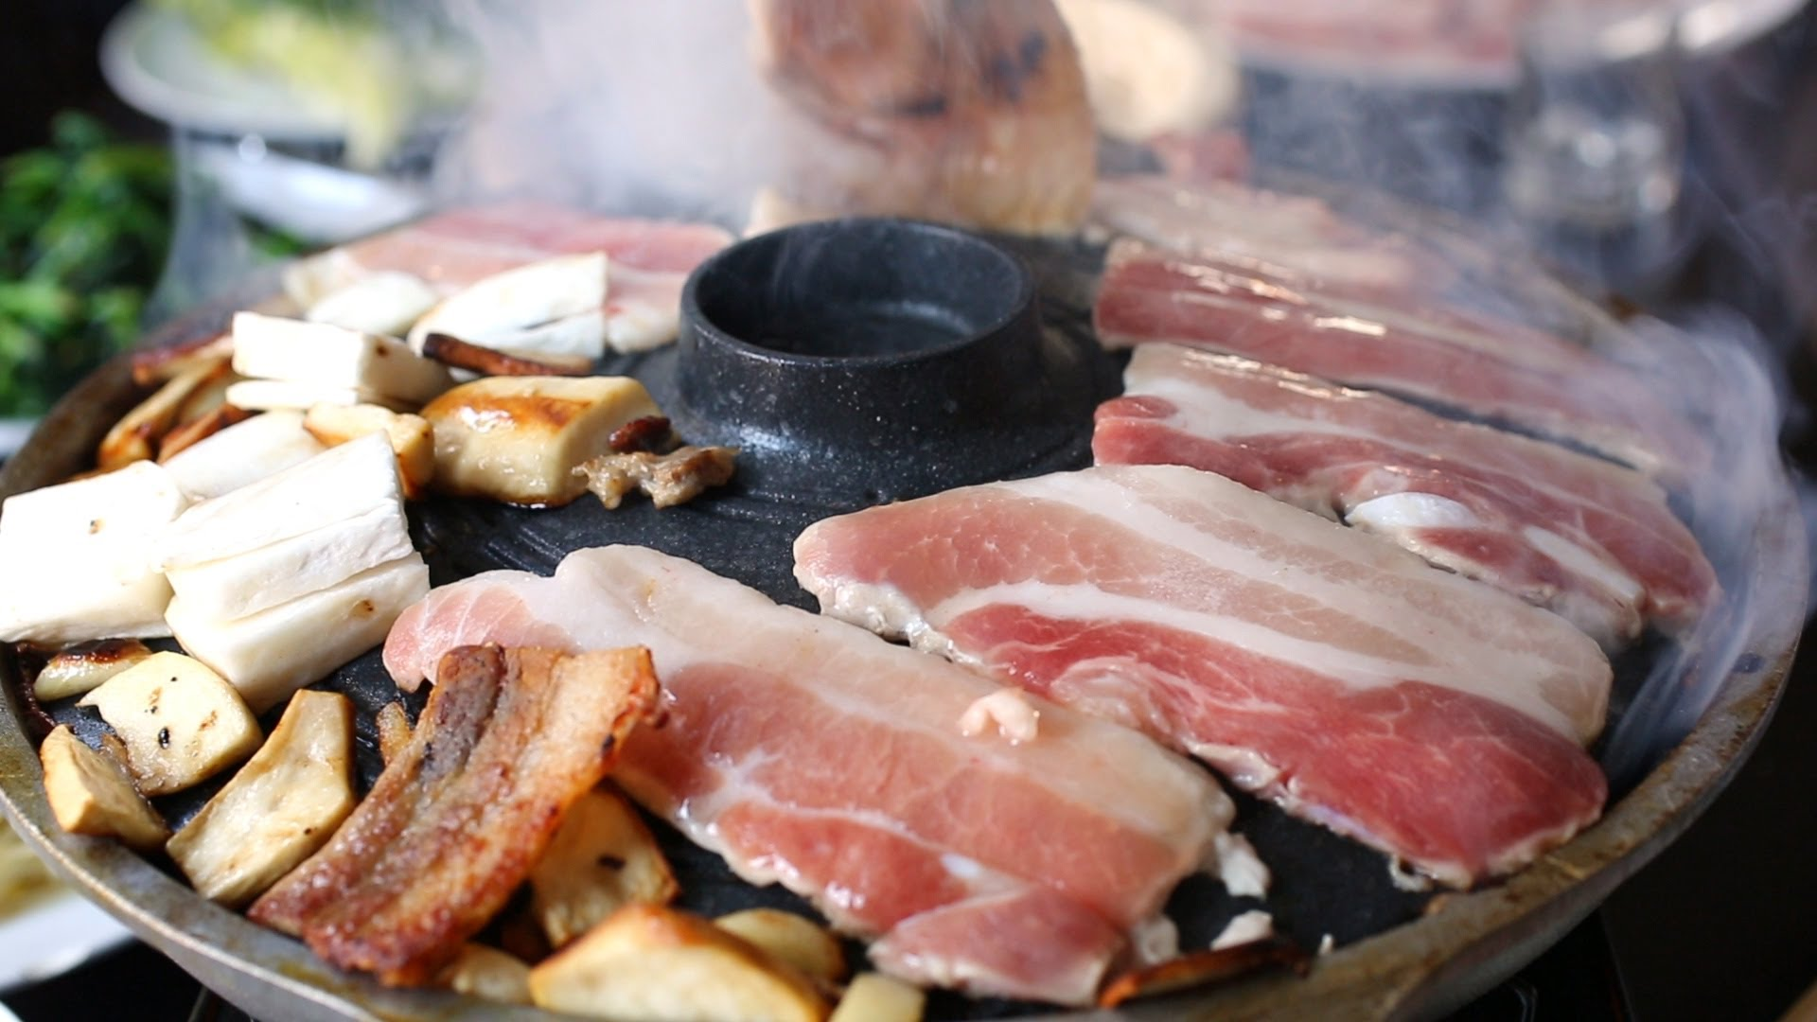
Samgyeopsal

Slide 9
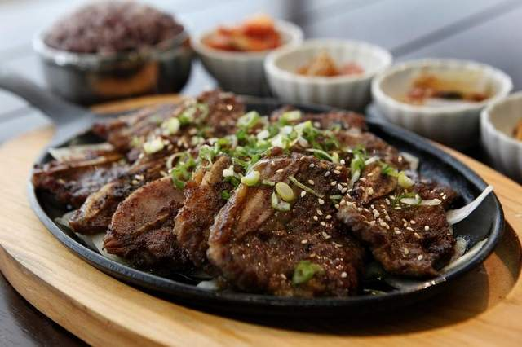
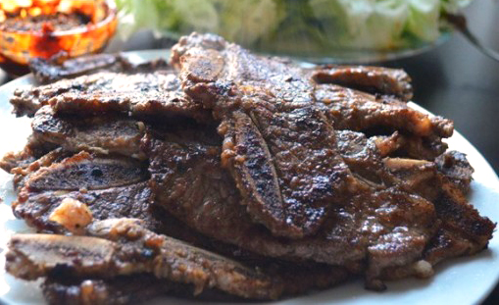
Galbi (ribs)

Slide 10
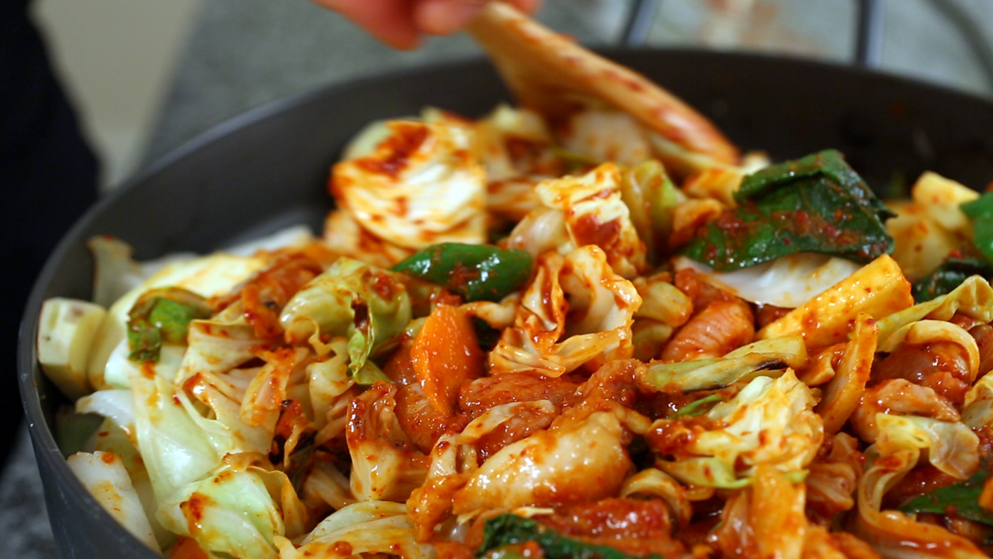
Dakgalbi

Slide 11
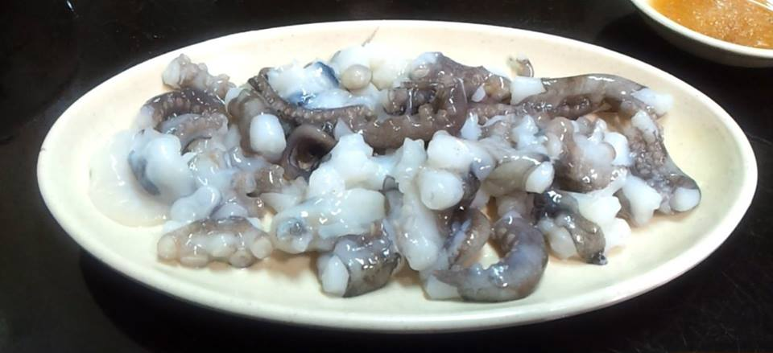
Sannakji (Live Octopus)

Slide 12
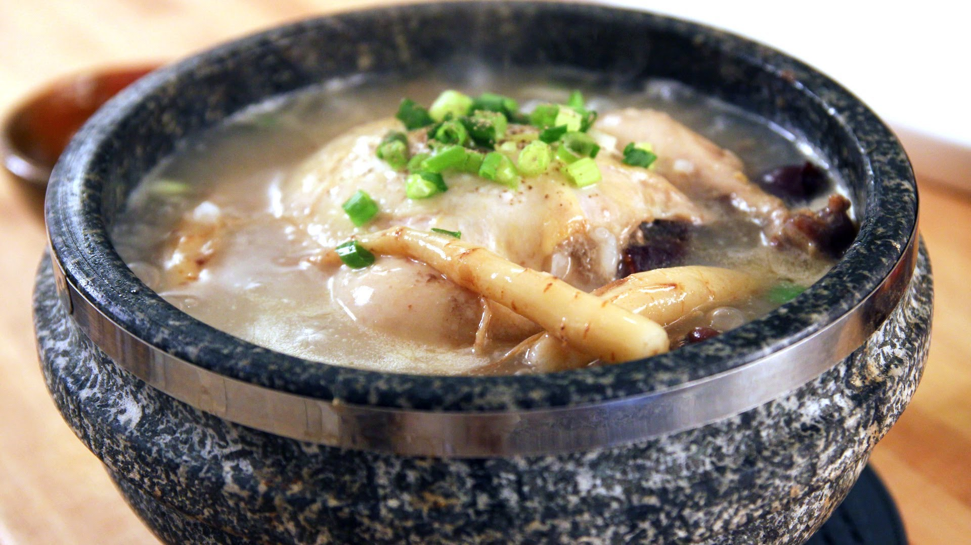
Samgyetang
(Ginger Chicken Soup)

Slide 13
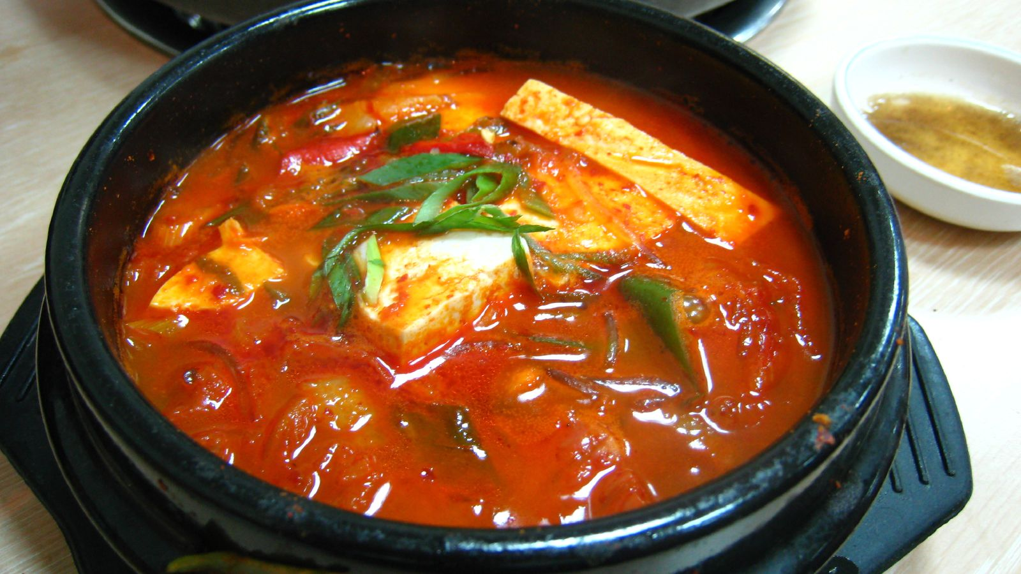
Kimchi jjigae (Kimchi Stew)

Slide 14
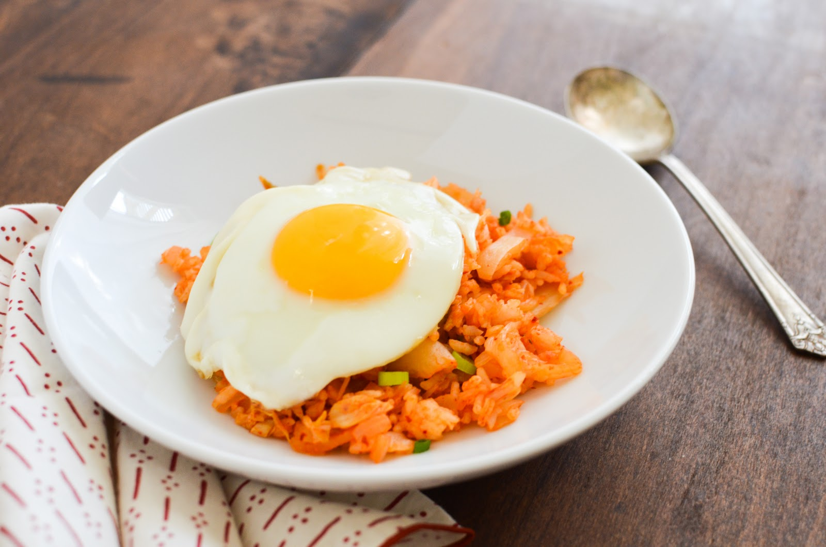
Kimchi Bokkeumbap
(Kimchi Fried Rice)

Slide 15
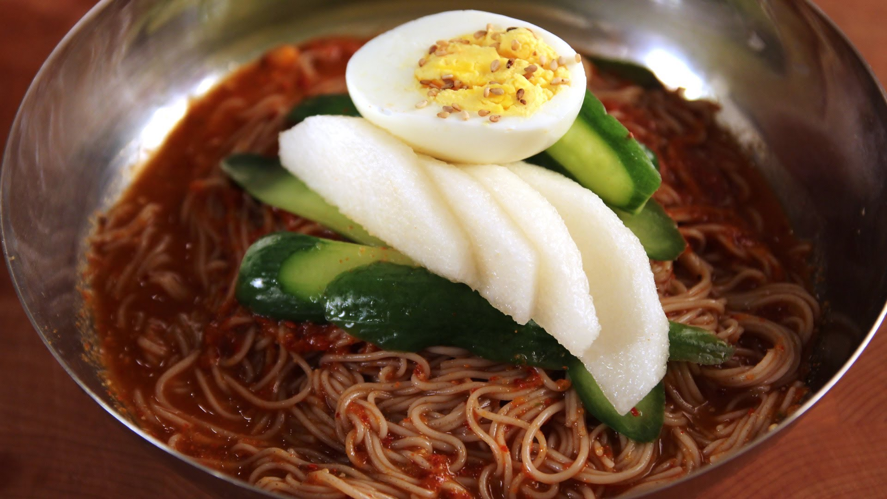
Naengmyeon (Cold Noodles)

Slide 16
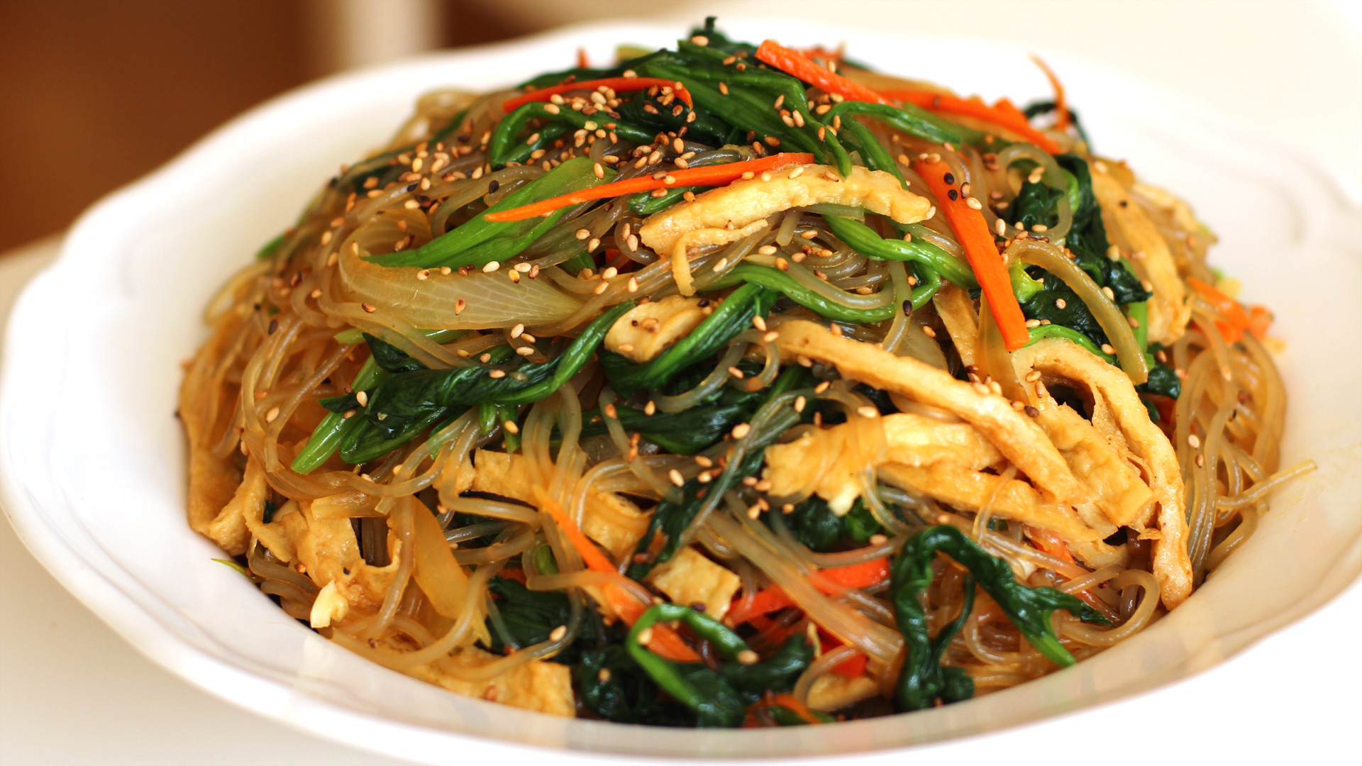
Japchae

Slide 17
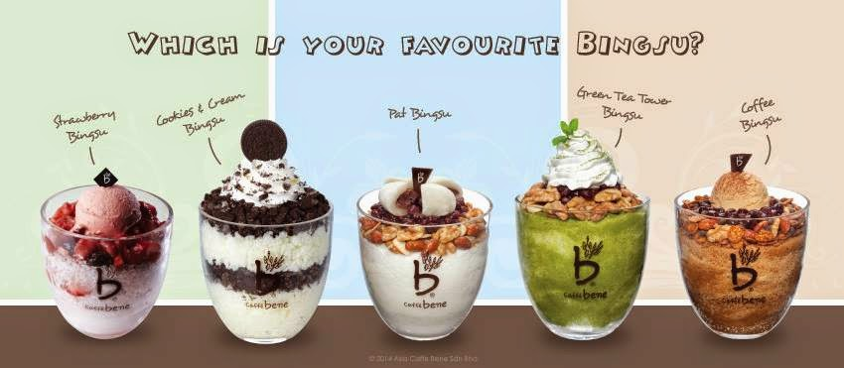
Bingsu (Ice Flakes)

Slide 18
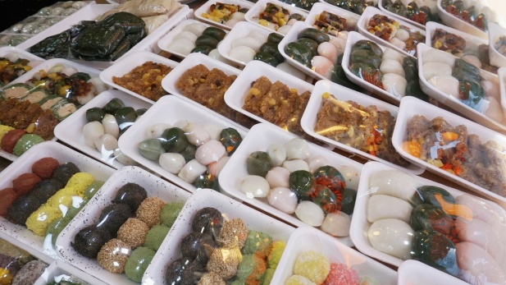
Ddeok (Korean rice cake)

Slide 19
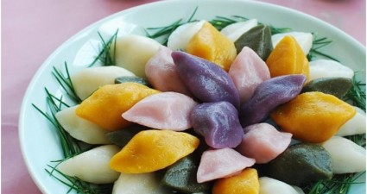
Songpyeon (stuffed rice cake)

Slide 20
Korea is known for spicy food.
What are some more countries known for spicy food?

Slide 21
Countries with Spicy Food:
India
Thailand
Mexico
Ethiopia
Jamaica
Malaysia
China
Some parts of USA

Slide 22
Food Quiz
http://matadornetwork.com/life/country-cuisine-quiz/

Slide 23
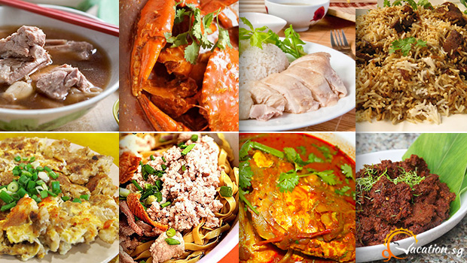
Singapore’s Food

Slide 24
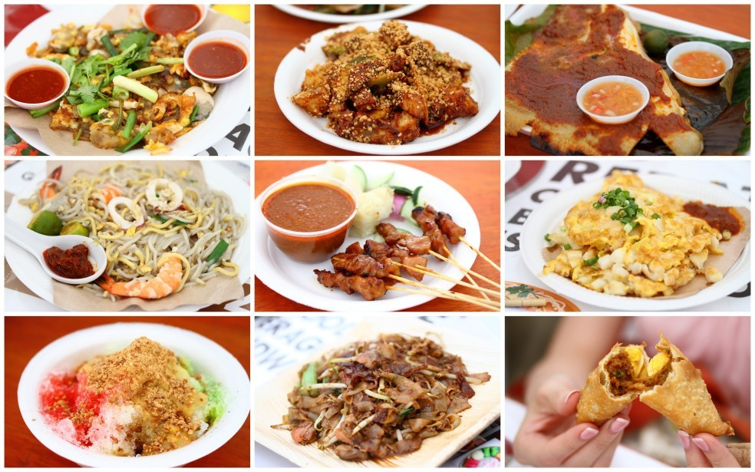
Singapore’s Food

Slide 25
3 Cultures in one Country
Chinese
Indian
Malay

Slide 26
Food in Daily Life
Rice, fish, chicken, and vegetables are the staples. When these ingredients are mixed with a rich variety of spices, chilies, coconuts, lime, and tamarind, the variations are endless.

Slide 27
Food in Daily Life
Food is often eaten outside the home in food centers where food is cheap, tasty, and freshly made. There are many cafés, coffeehouses and teahouses, and formal restaurants.

Slide 28
Food in Daily Life
Rice, fish, chicken, and vegetables are the staples. When Forks and spoons are used, but Chinese food is eaten with chopsticks, and Indian and Malay food may be eaten with the hand.

Slide 29
Food in Daily Life
The three main meals are breakfast, lunch, and dinner. Most meals are eaten hot. Malays do not eat pork, Indians do not eat beef, and many Buddhist Chinese are part-time vegetarians. Many people do not drink alcohol.

Slide 30
Ask your Pen Pal
If you want to know more about Singapore’s food, ask your pen pal.

Slide 31
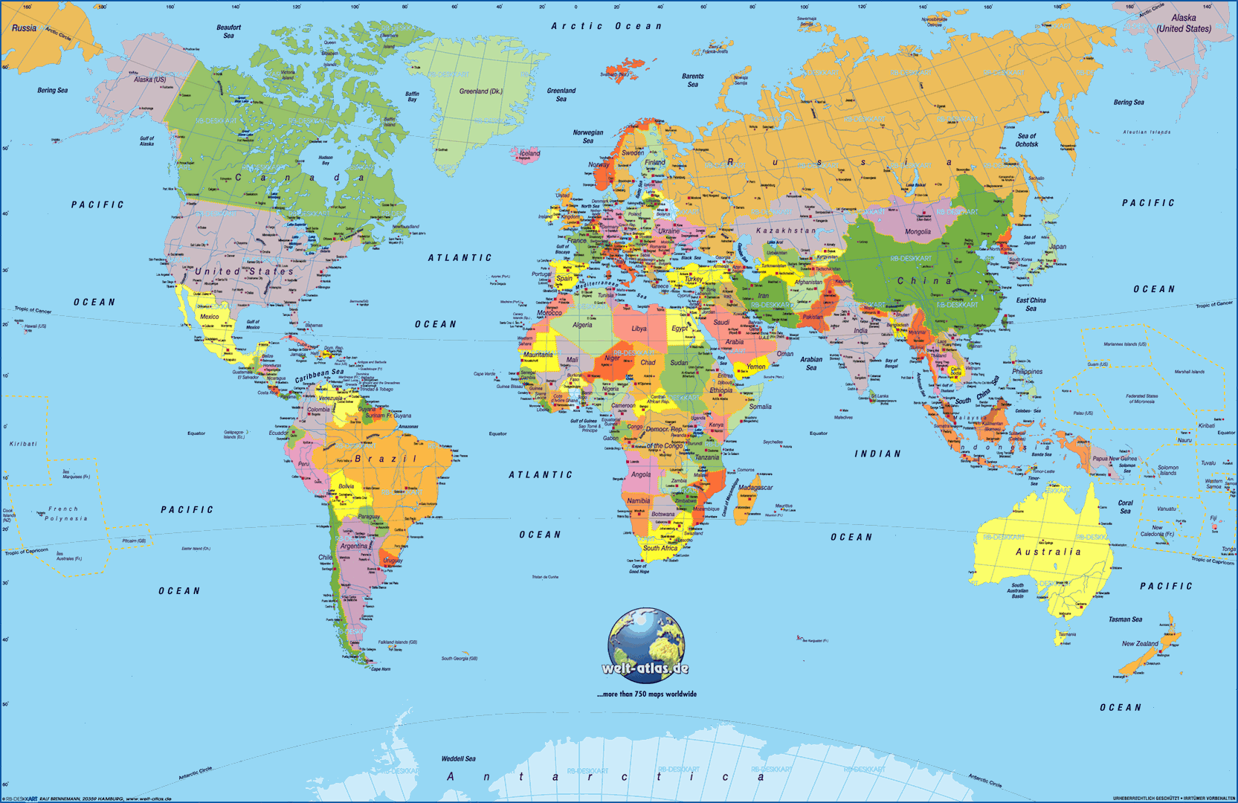
Where is Singapore?

