Slide 1
Lesson 7 – A Plant’s Life

Slide 2
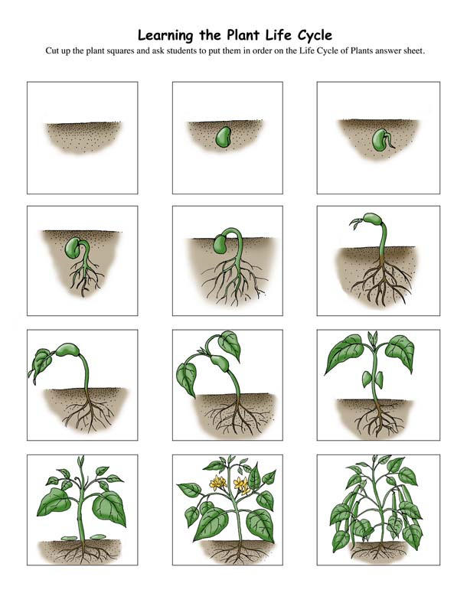
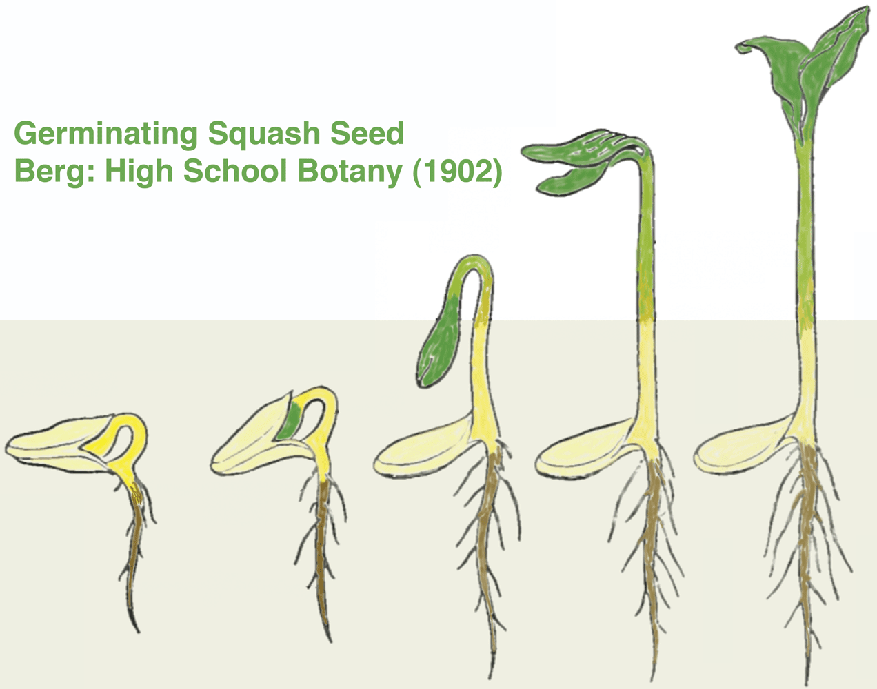
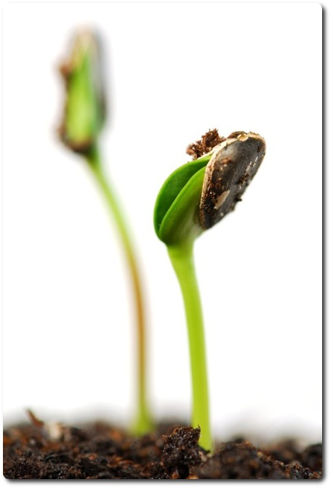
How do plants grow?
https://www.youtube.com/watch?v=G2RuVxdr0mA

Slide 3

How do plants grow?
What do they need to grow?
Water
Sunlight
Fertilizer (soil)

Slide 4

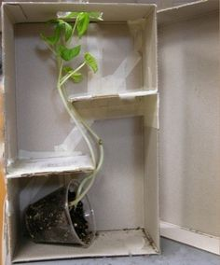
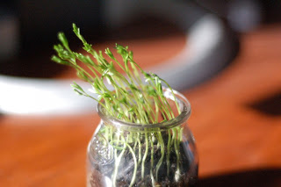
How do plants grow?
Which direction do they grow?
Towards the sun
https://www.youtube.com/watch?v=w-adcjH-xyk

Slide 5
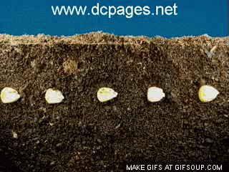
A Plant’s Life: Germinate
Our Germination Time:
7 days

Slide 7
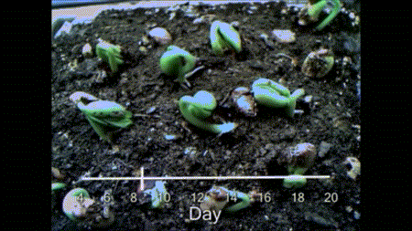
A Plant’s Life: Sprout
Our Sprouting Time:
14 days

Slide 9
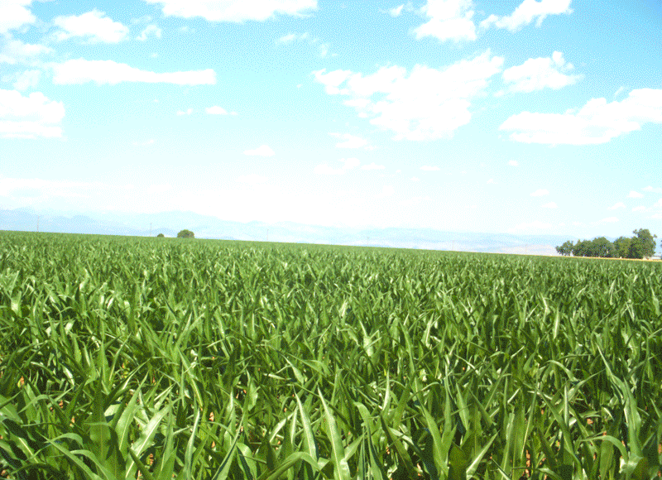
A Plant’s Life: Grow
Our Growing Time:
All Spring and Summer

Slide 11

A Plant’s Life: Bloom
Our Blooming Time:
4 – 6 weeks (then all spring and summer)

Slide 13
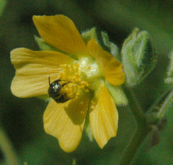
A Plant’s Life: Pollination

Slide 15
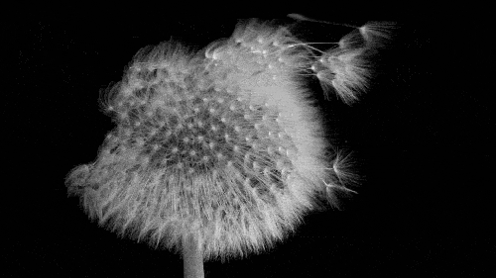
A Plant’s Life: Seed

Slide 17
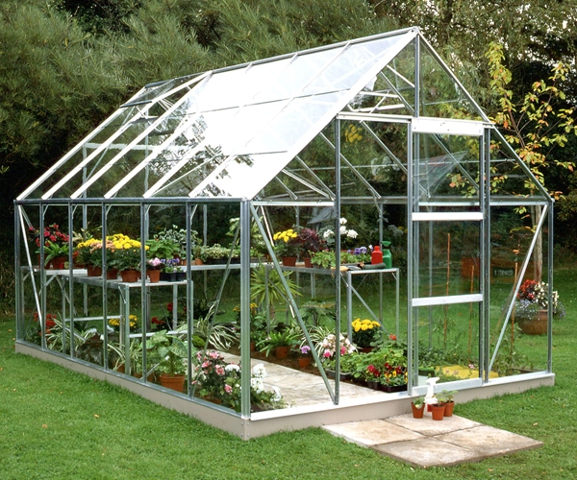
Greenhouse

Slide 18
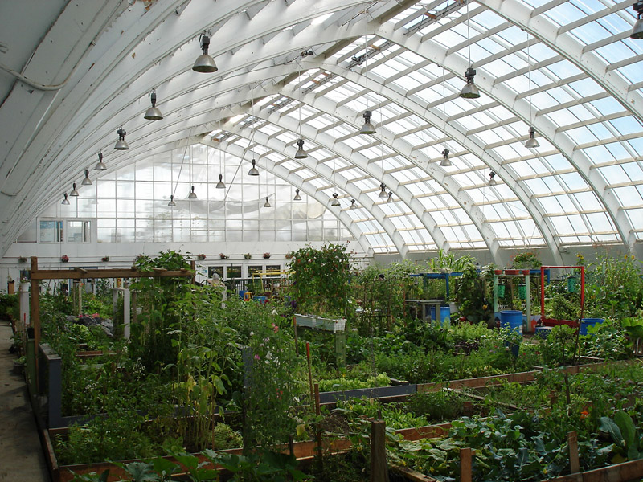

Slide 19
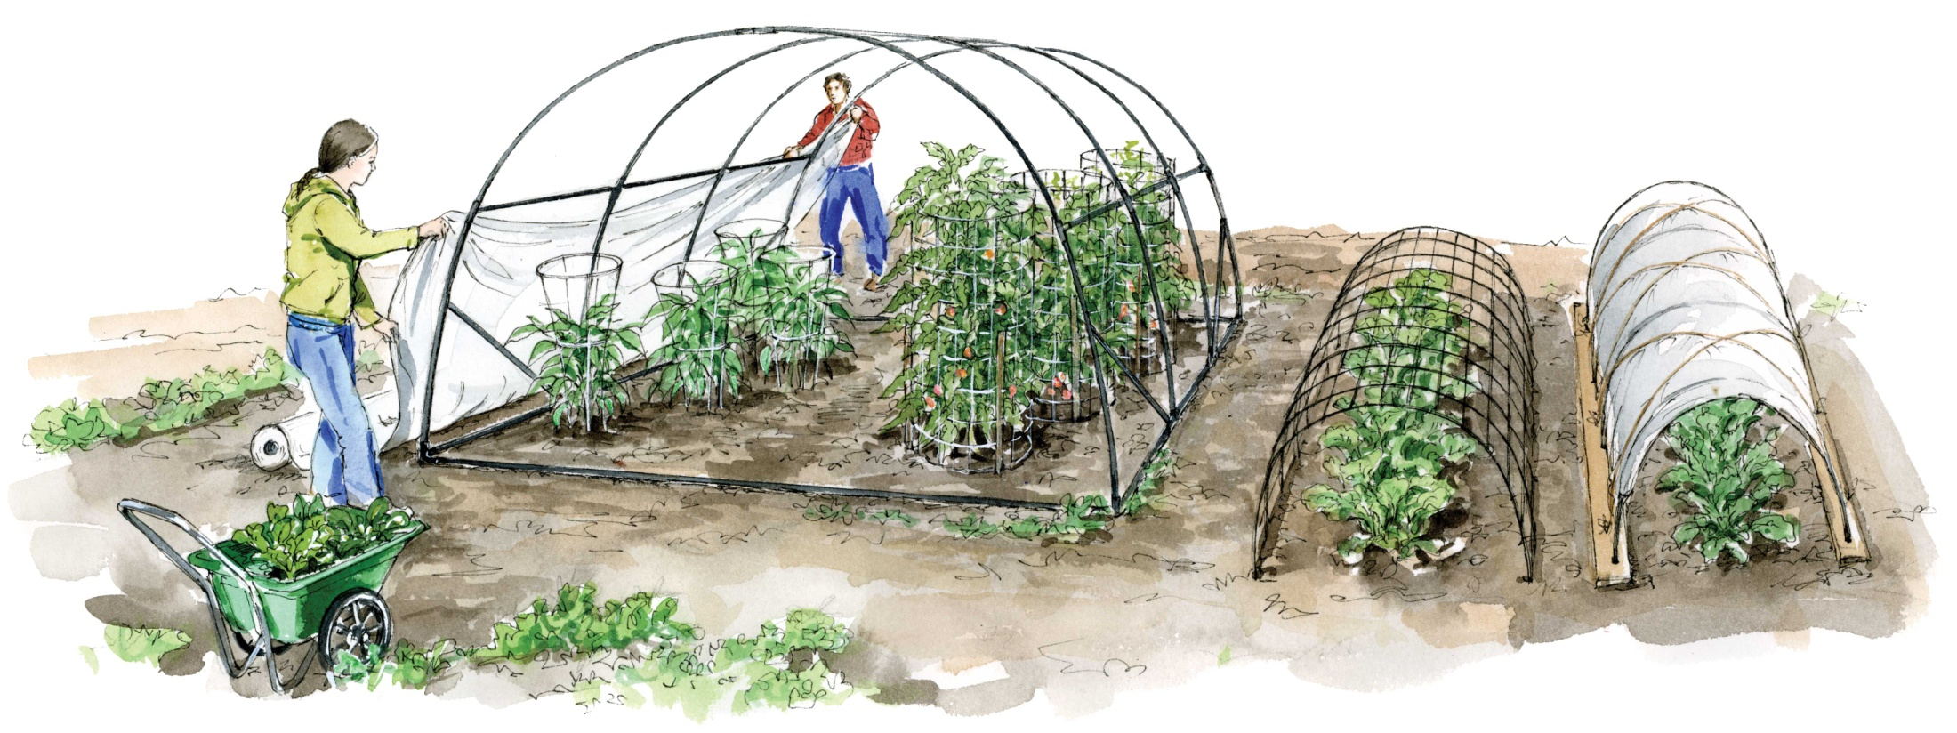
What is it?
It’s a building with walls and a roof of glass or plastic…

Slide 20
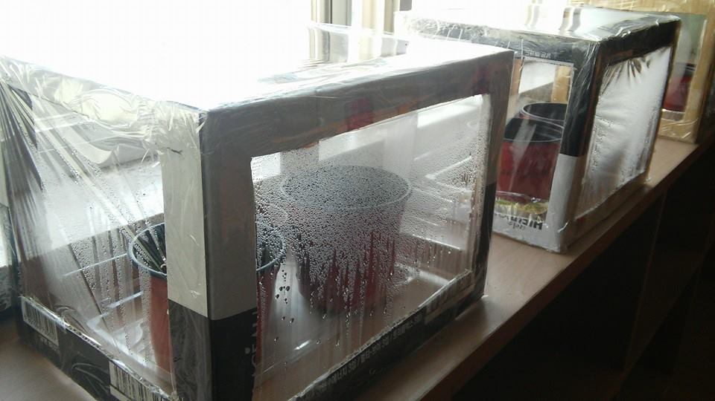
Our greenhouse!

Slide 21
What do they do?

Slide 22
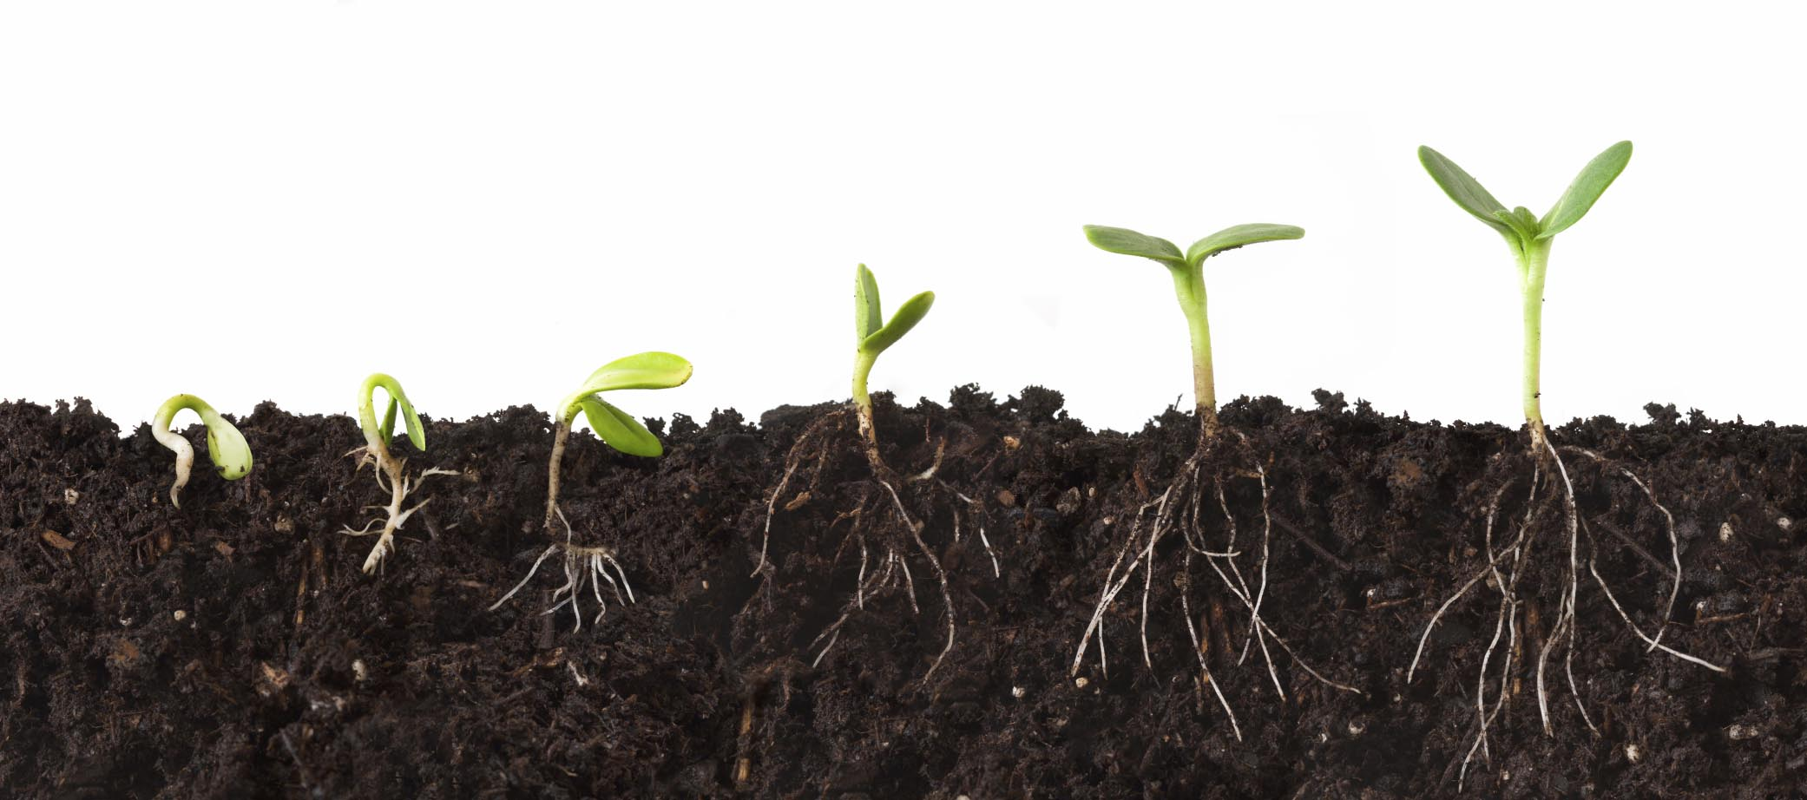
How do they work?

Slide 23
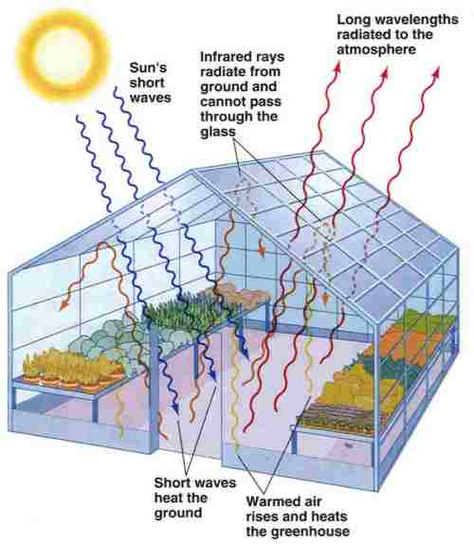

Slide 24


Slide 25
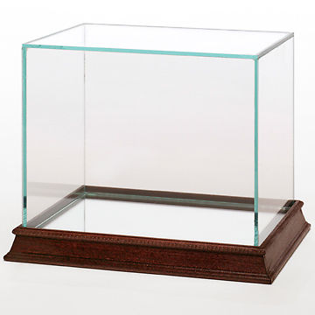


Slide 26
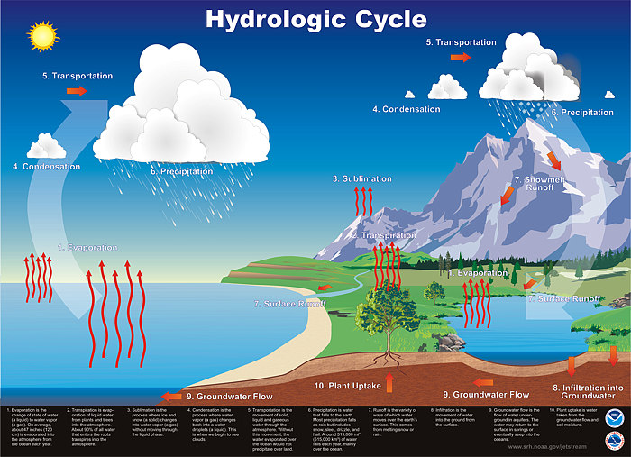

Slide 27

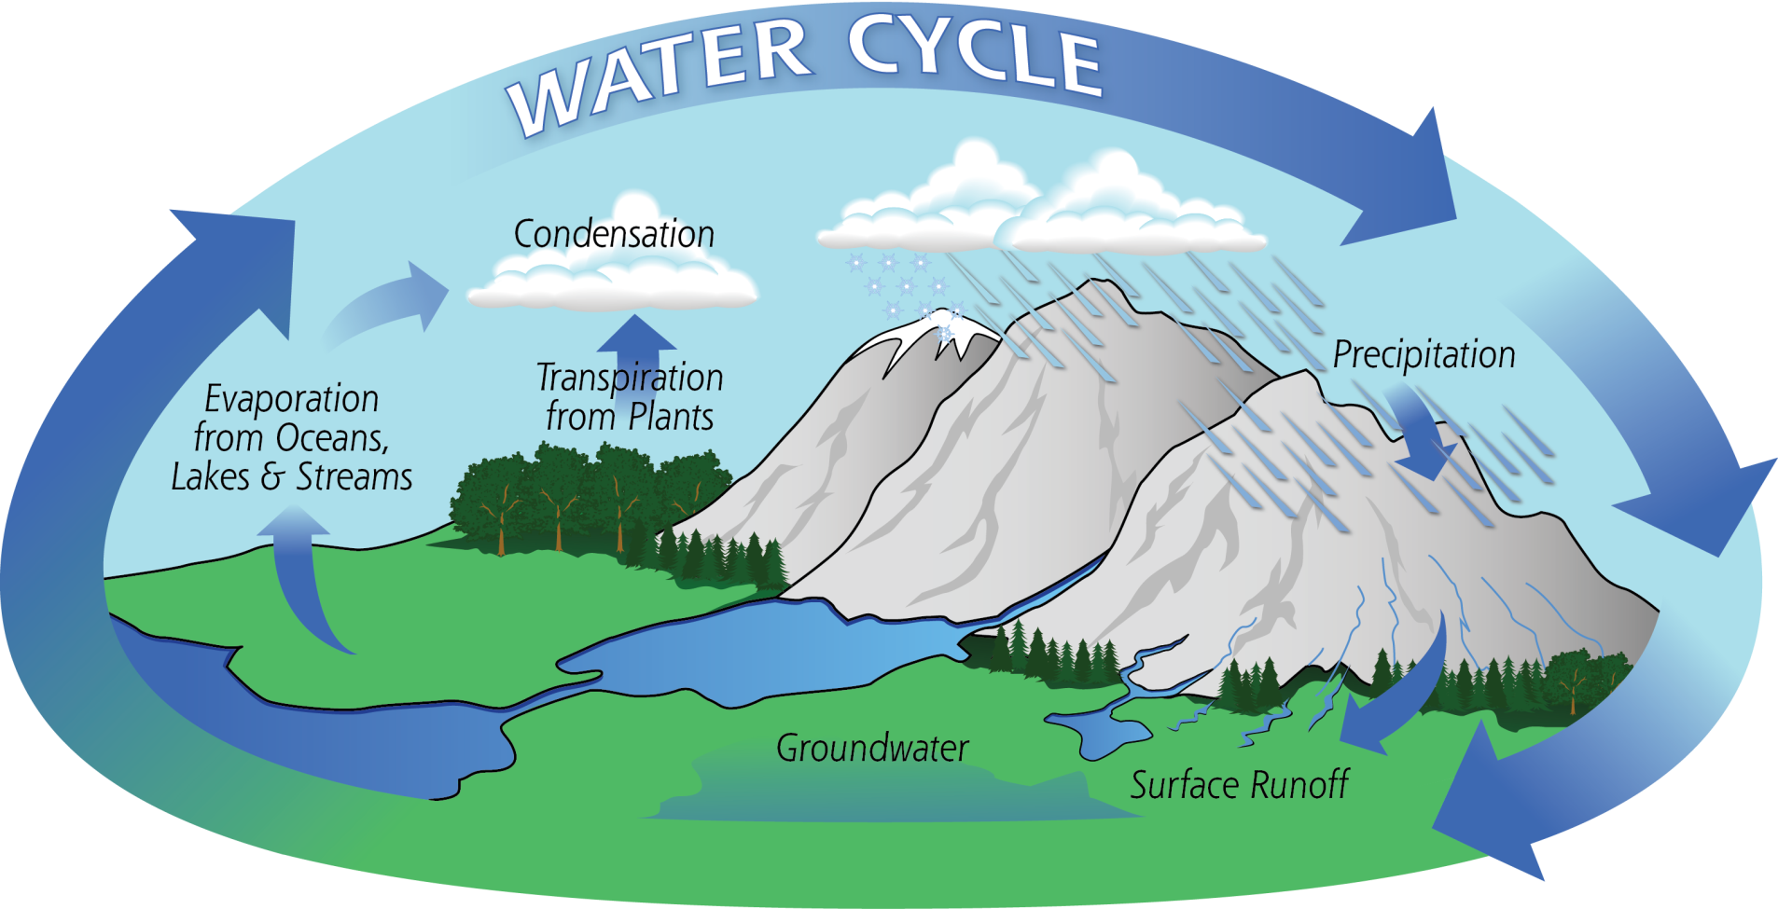

Slide 28
