Slide 1
Lesson 7 – Sharing Culture
Gift Box Ideas

Slide 2
Famous for…

Slide 3
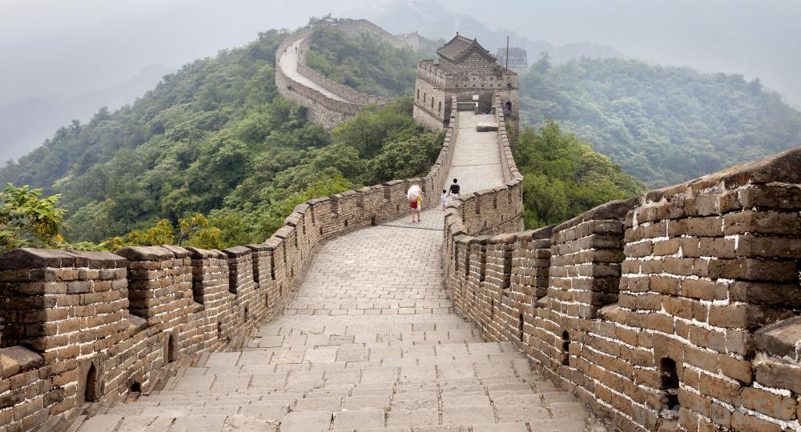
What is China famous for?

Slide 4
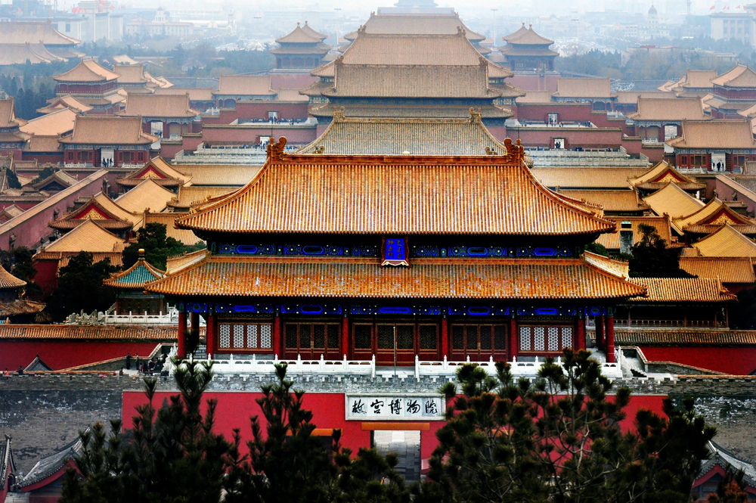

Slide 5
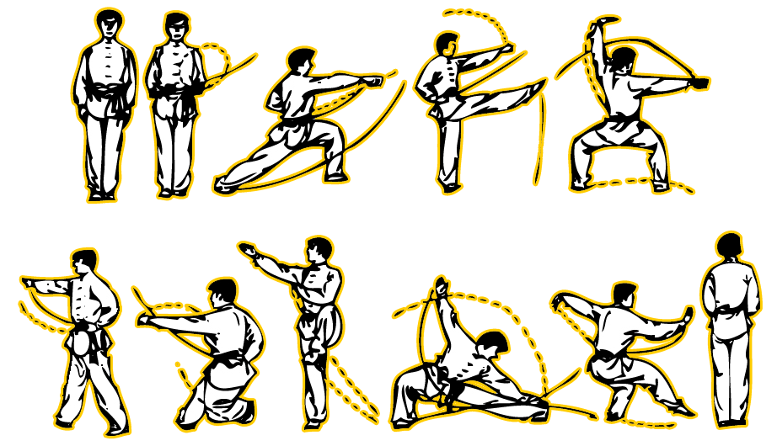

Slide 6
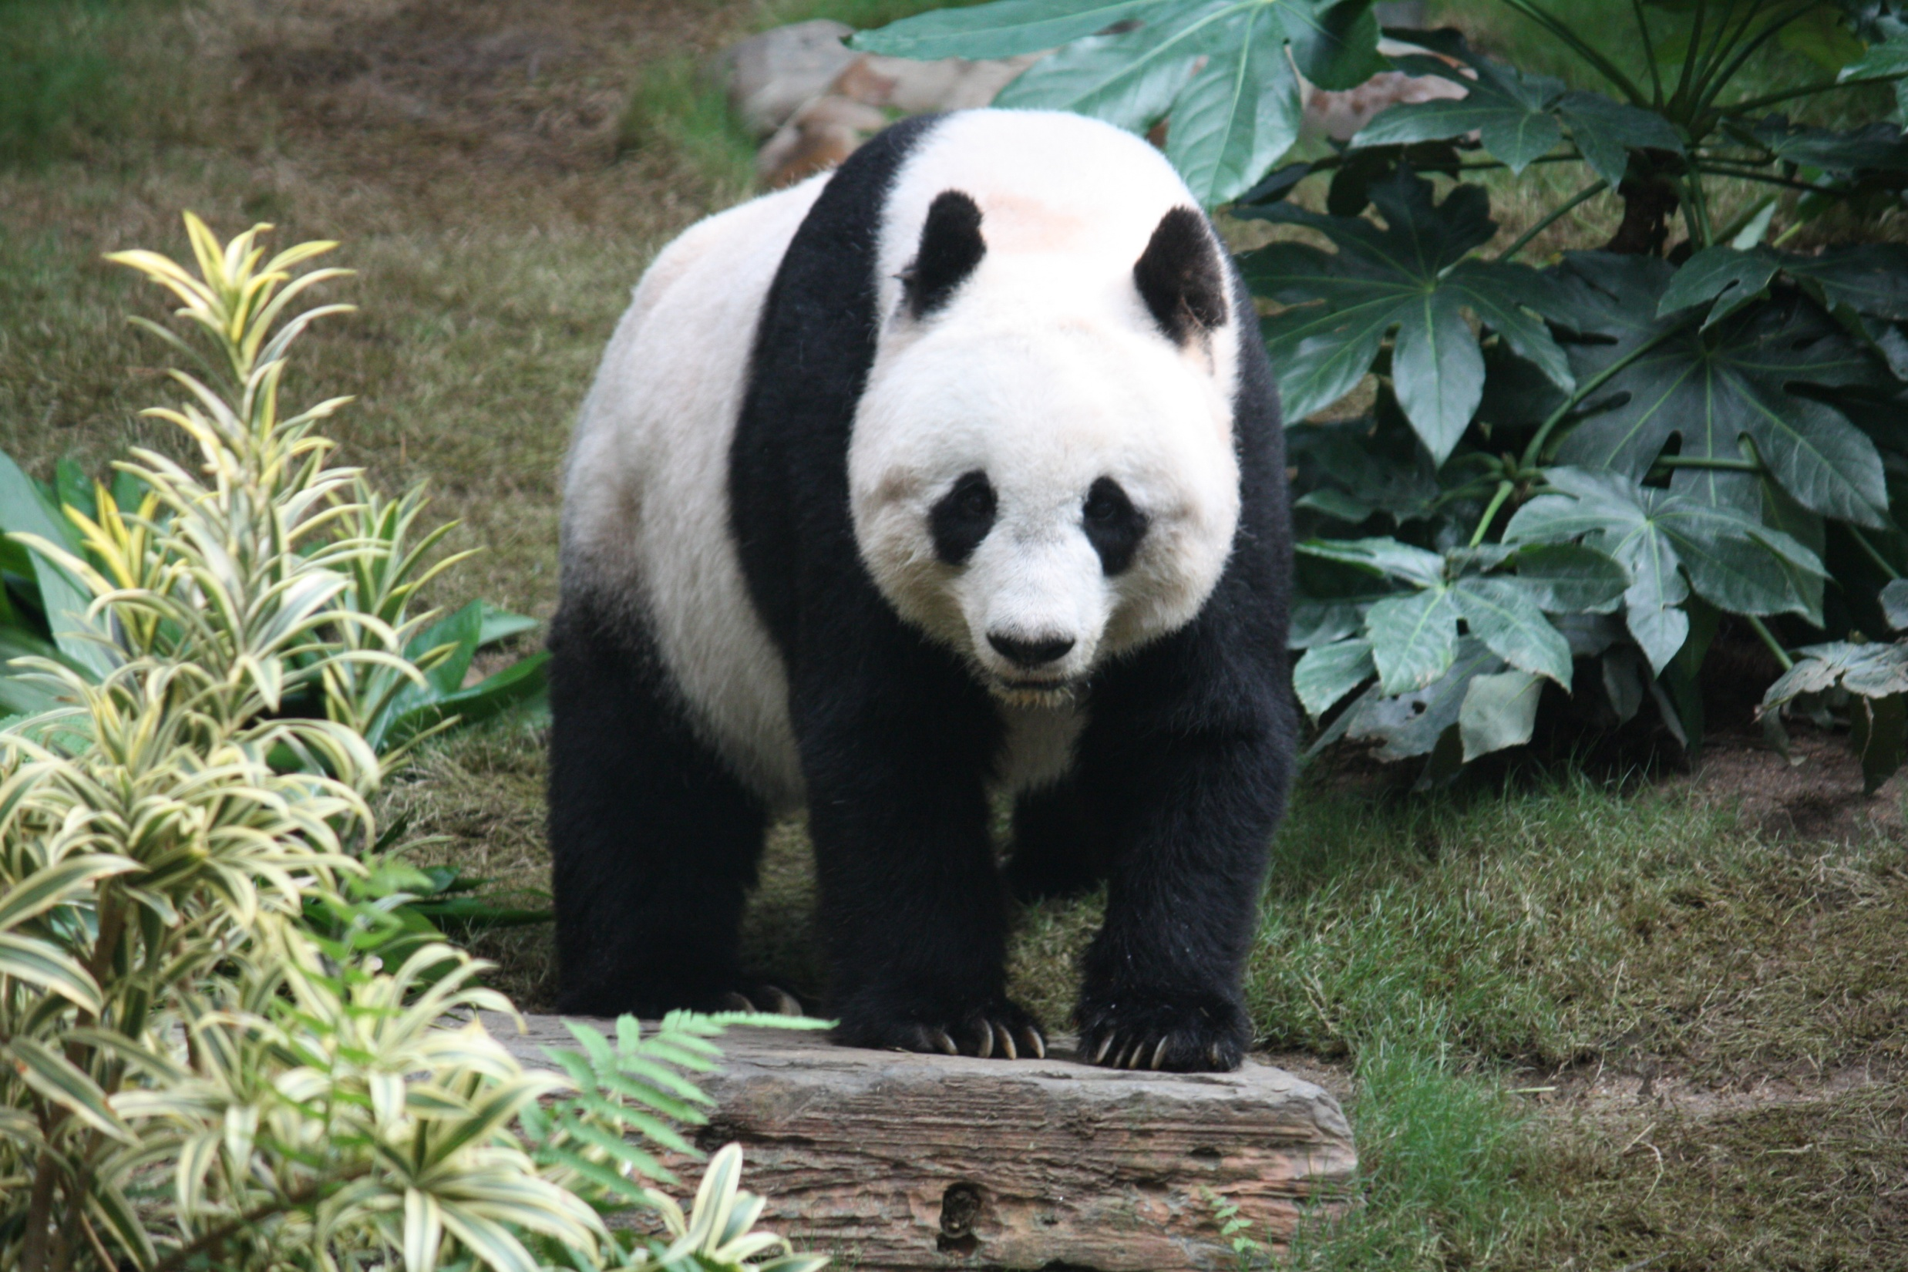

Slide 7
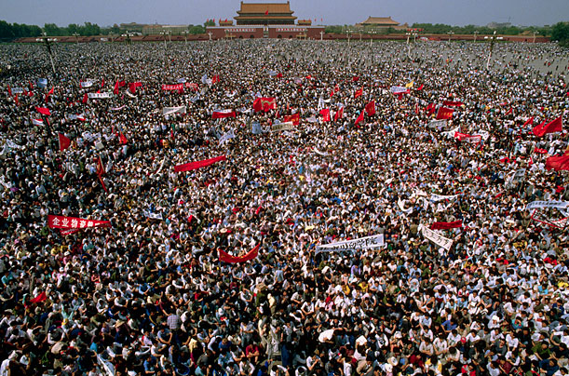

Slide 8
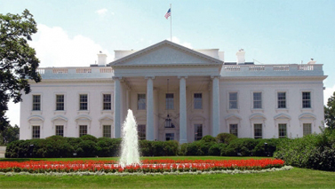
What is America famous for?

Slide 9
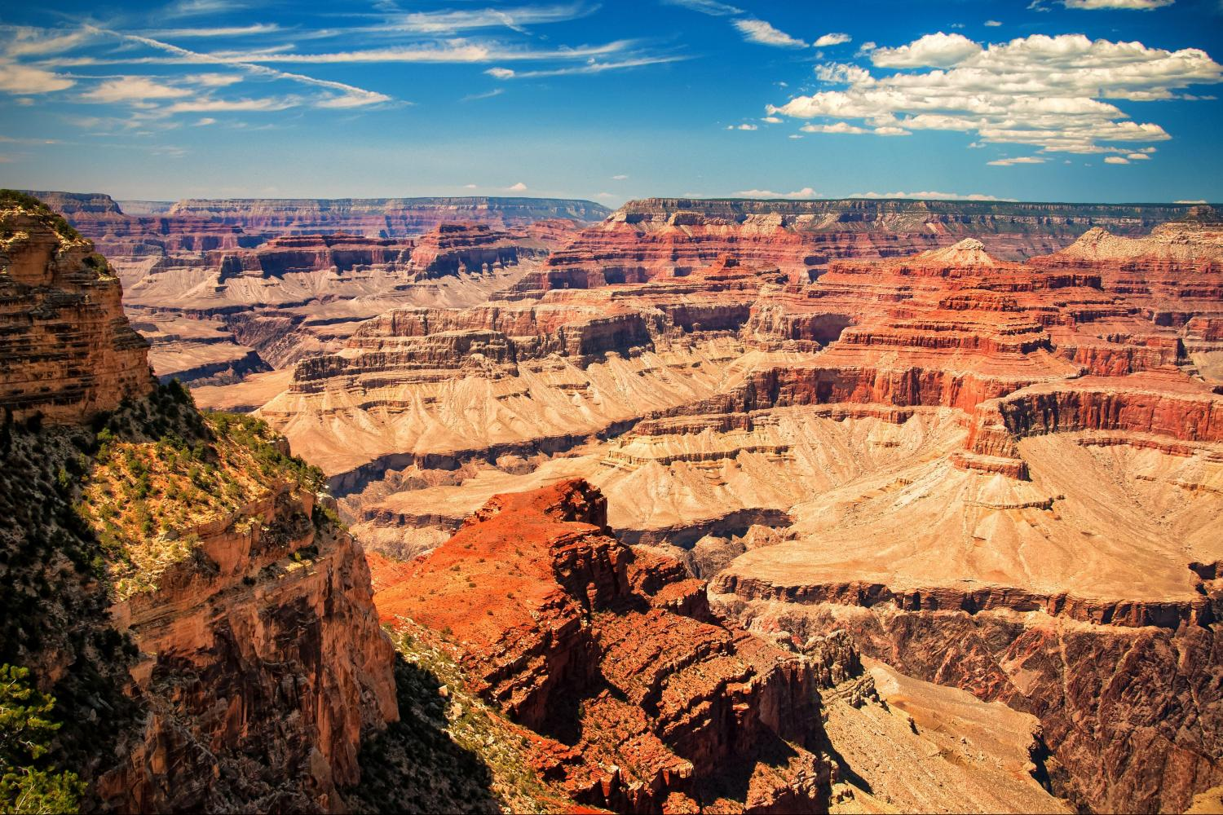

Slide 10
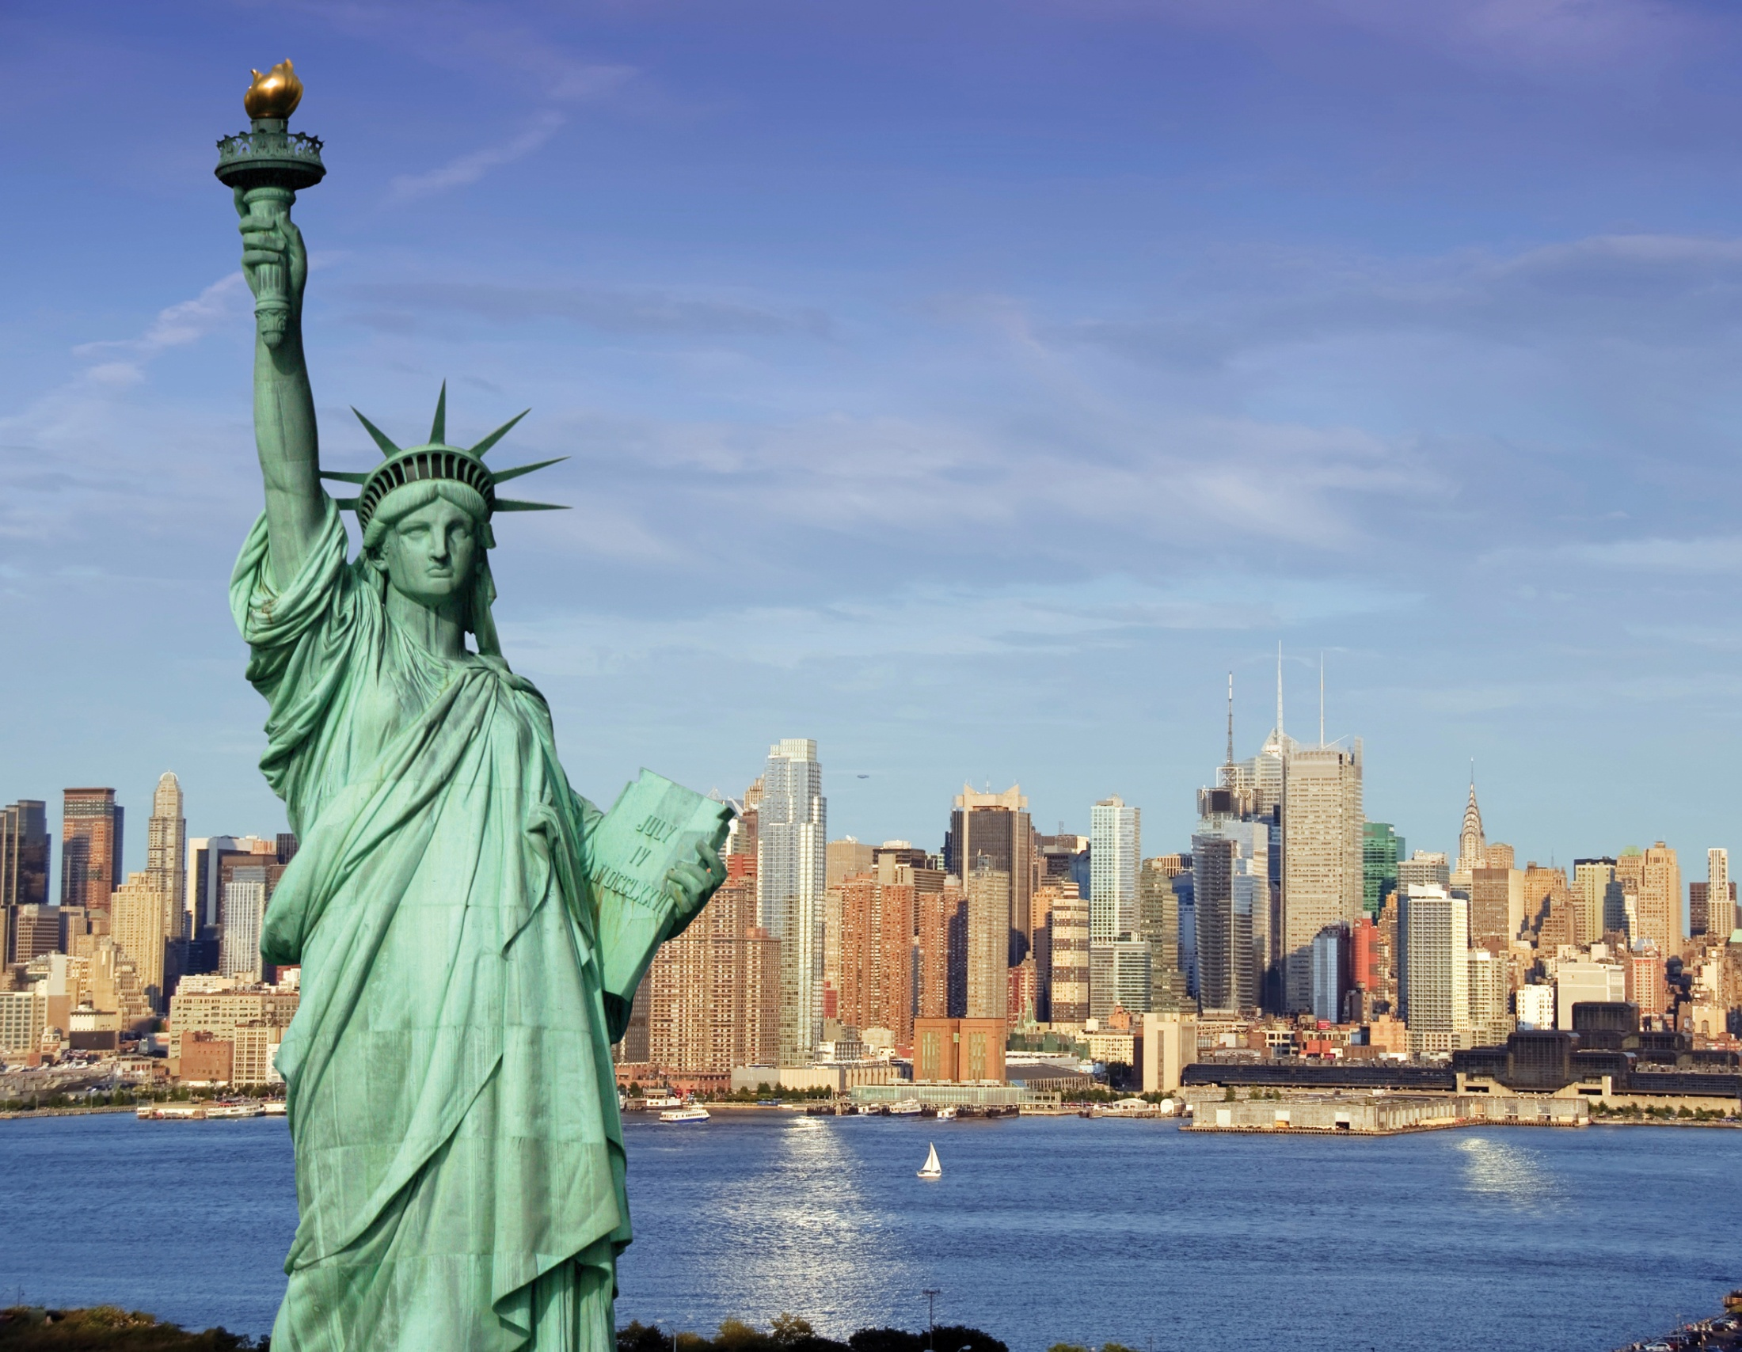

Slide 12
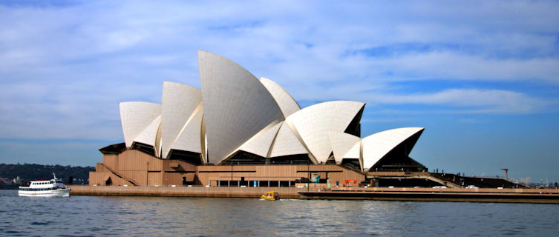
What is Australia famous for?

Slide 13
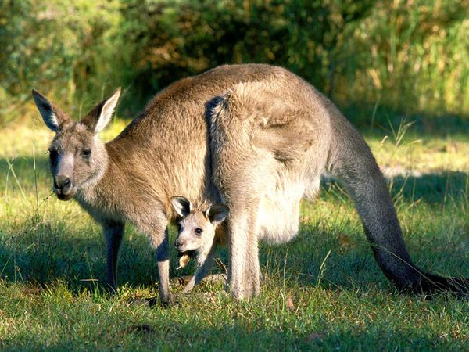

Slide 14
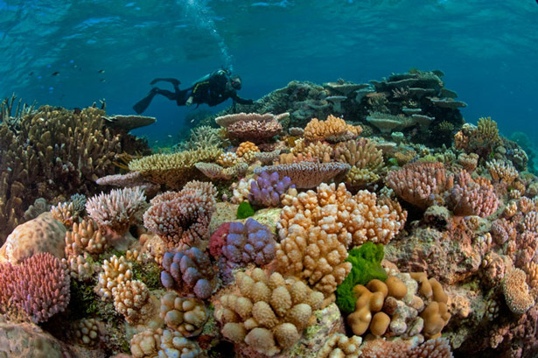

Slide 15
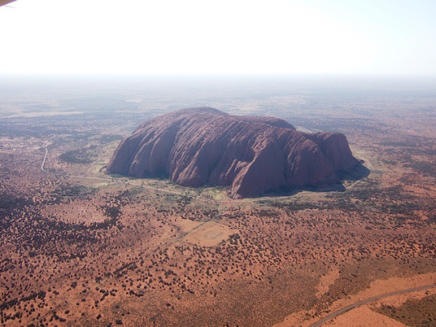

Slide 16
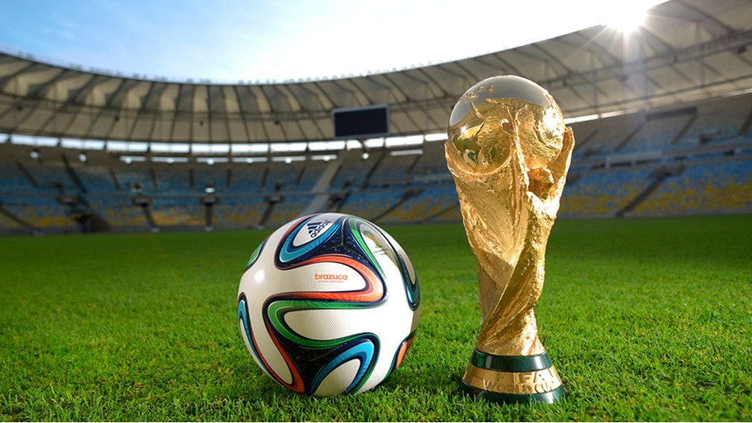
What is Brazil famous for?

Slide 18
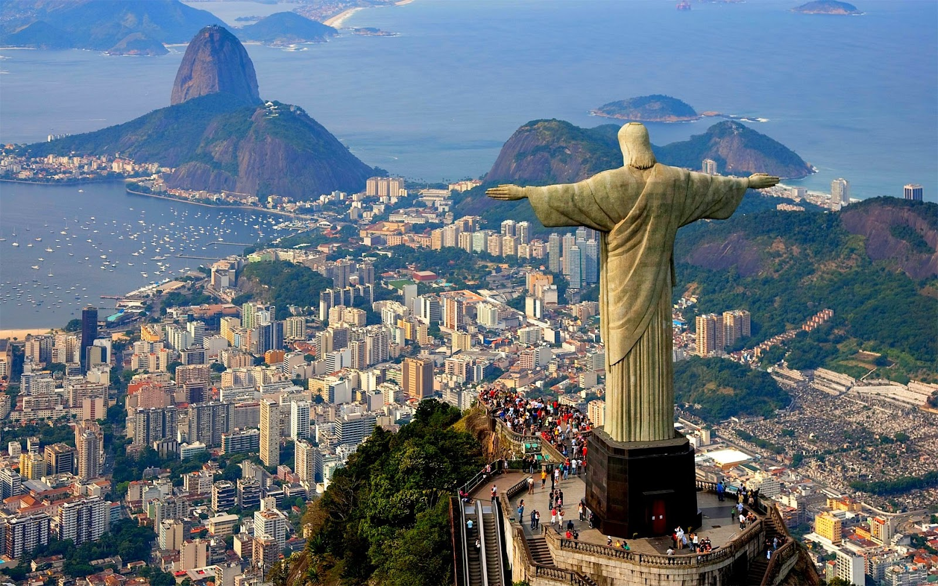

Slide 19
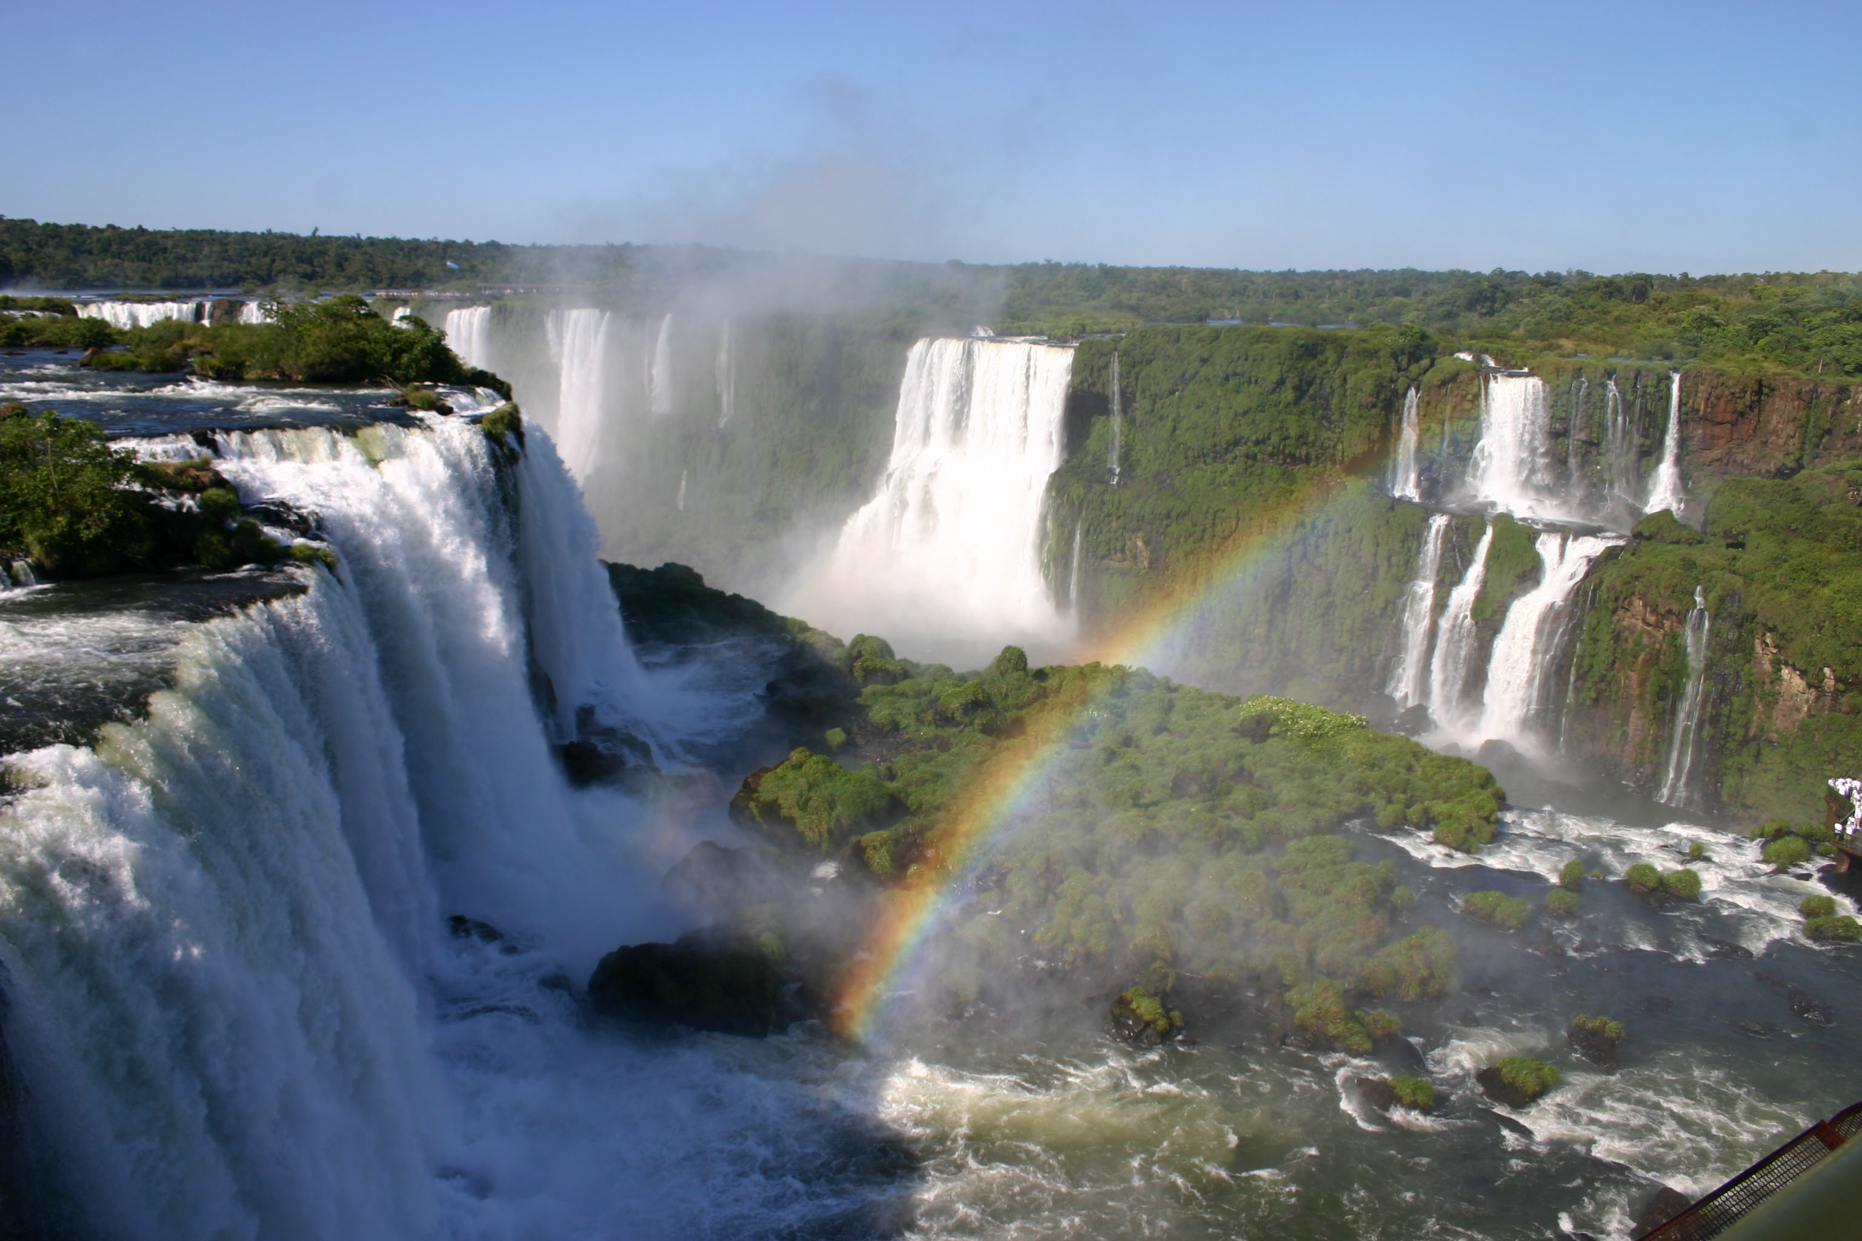

Slide 20
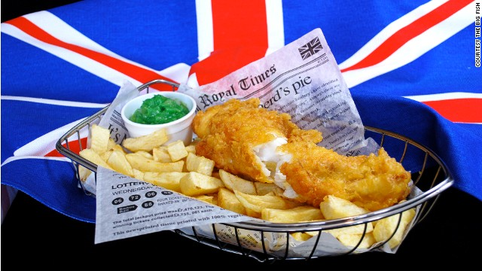
What is England famous for?

Slide 21
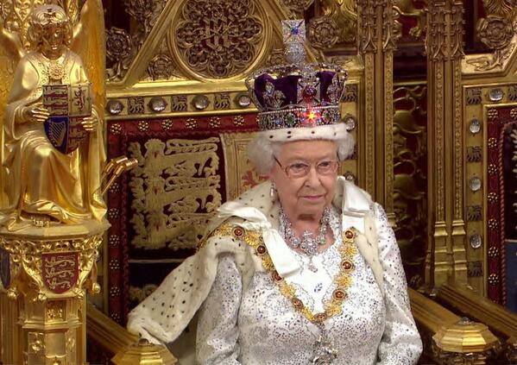

Slide 22
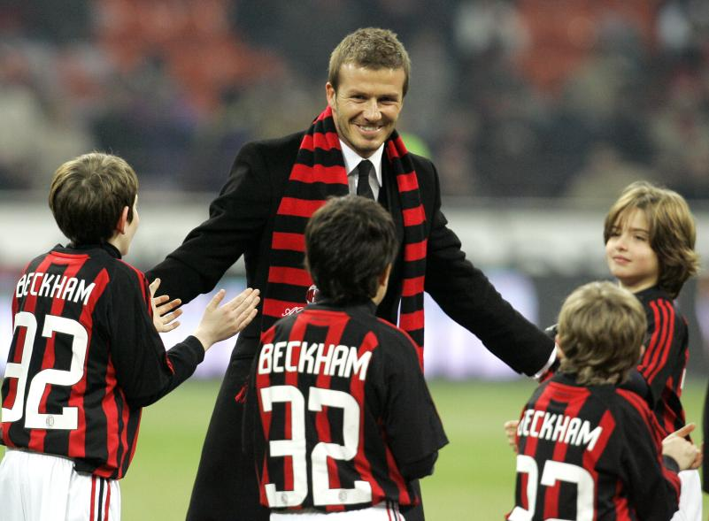

Slide 23
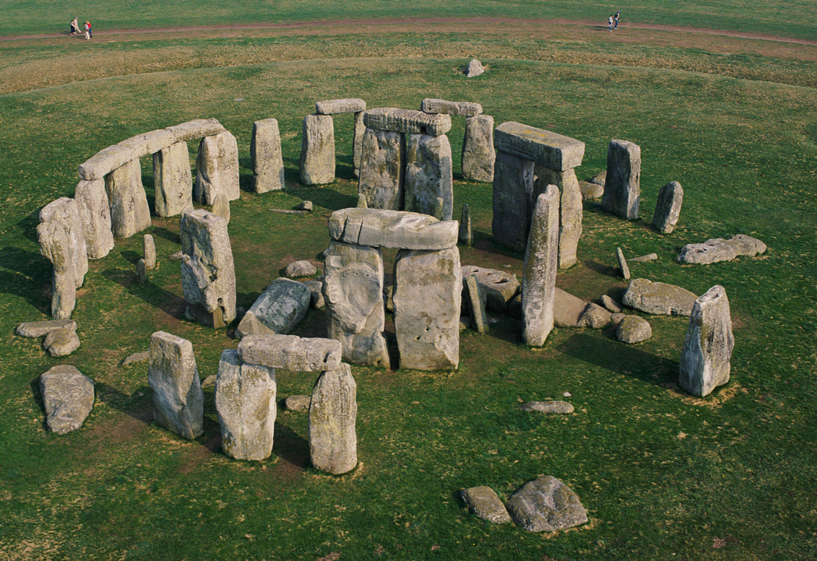

Slide 24
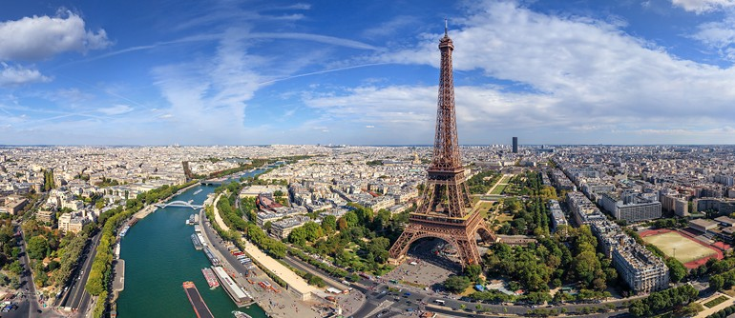
What is France famous for?

Slide 25
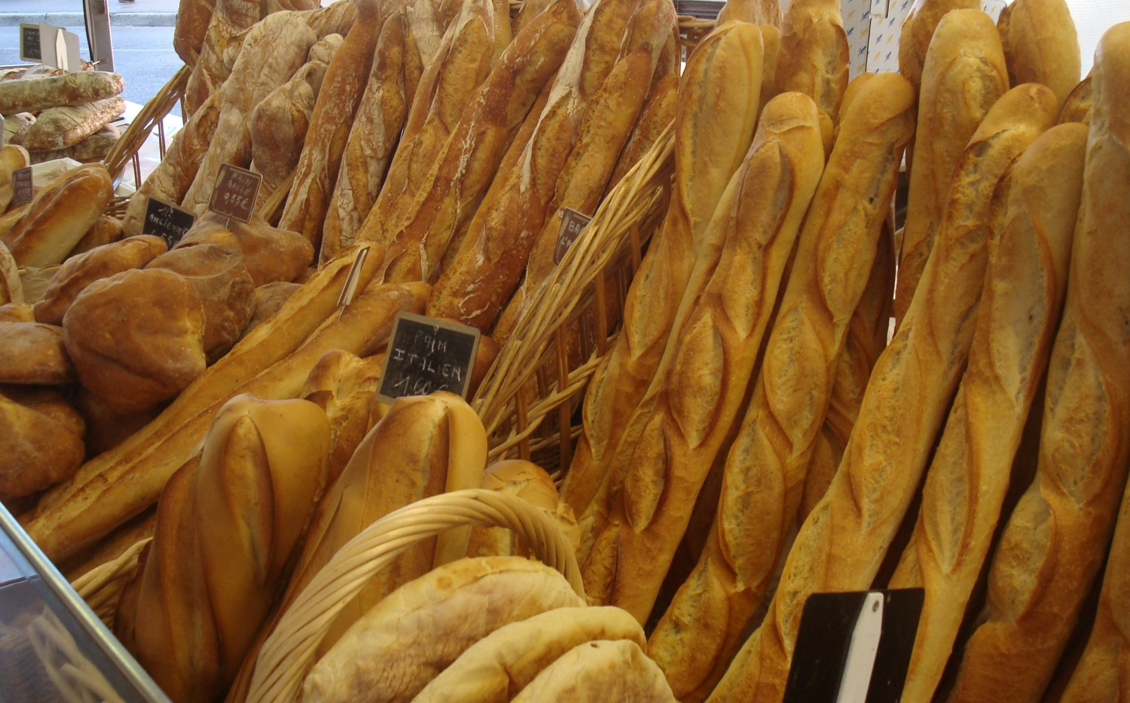

Slide 26
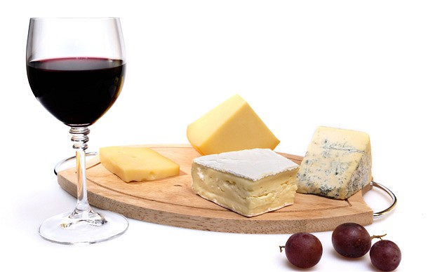

Slide 27
What is Canada famous for?

Slide 29
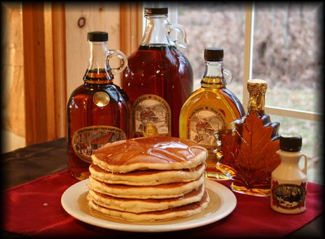

Slide 30
Famous For Quiz
http://www.mnn.com/lifestyle/arts-culture/quiz/what-are-countries-best-known

Slide 31
What is Korea Famous For?

Slide 32
Gift Box
What can we send that Korea is famous for?
What snack food should we send?
What is your favorite snack food?

Slide 33
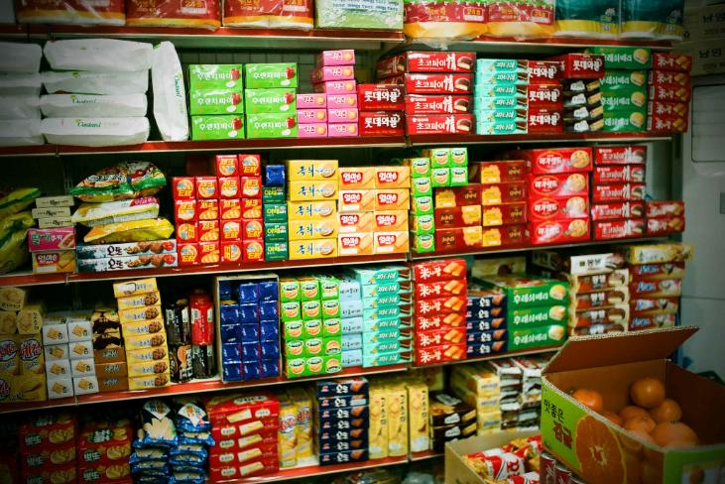
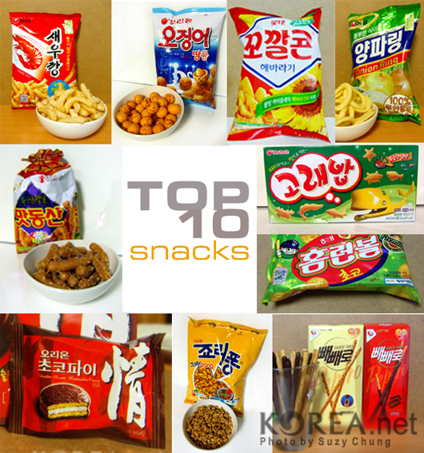
Add Some Snack Food:

