Slide 1
Lesson 9 – Structure

Slide 2

Structure

Slide 3

Structure –
How you put it together

Slide 4

Structure in Writing:

Slide 5
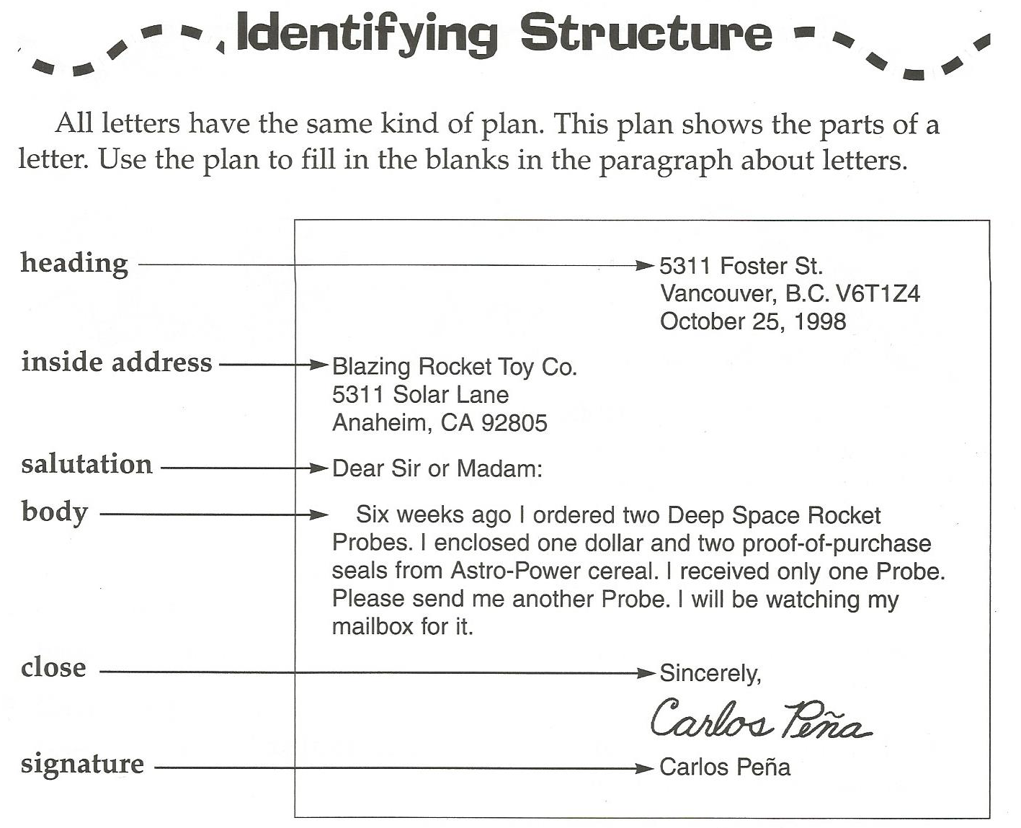

Slide 7
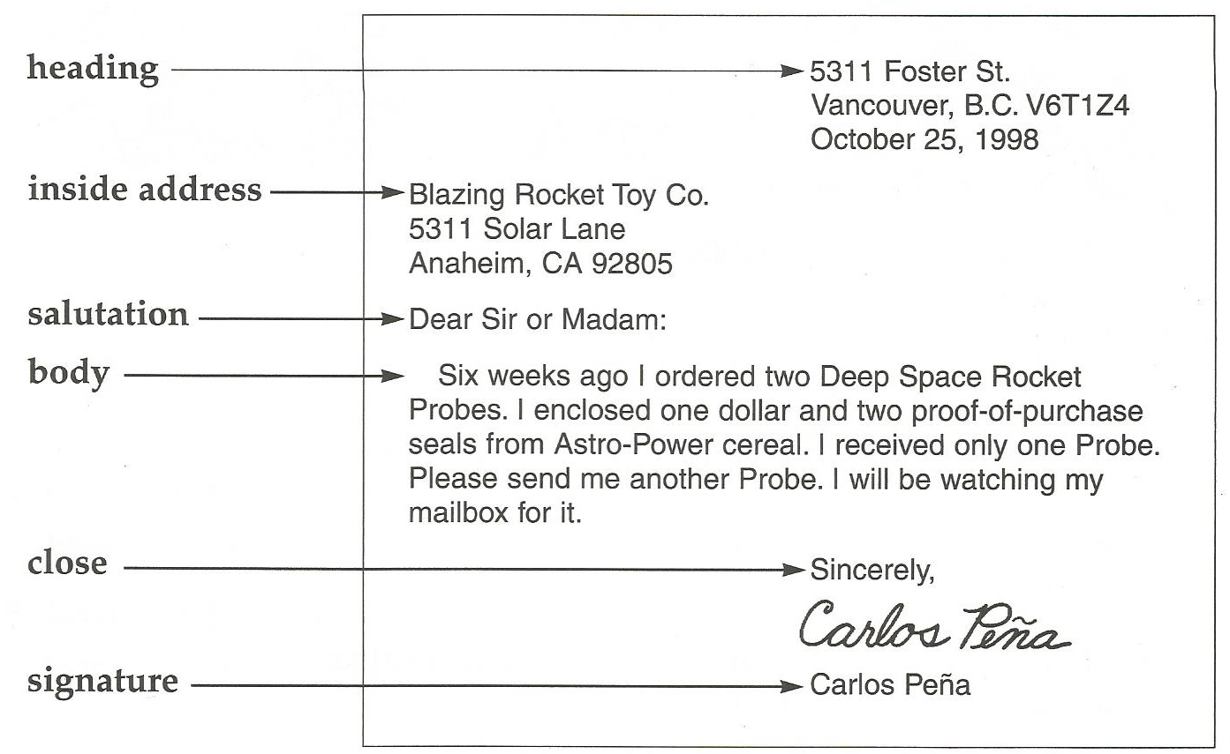
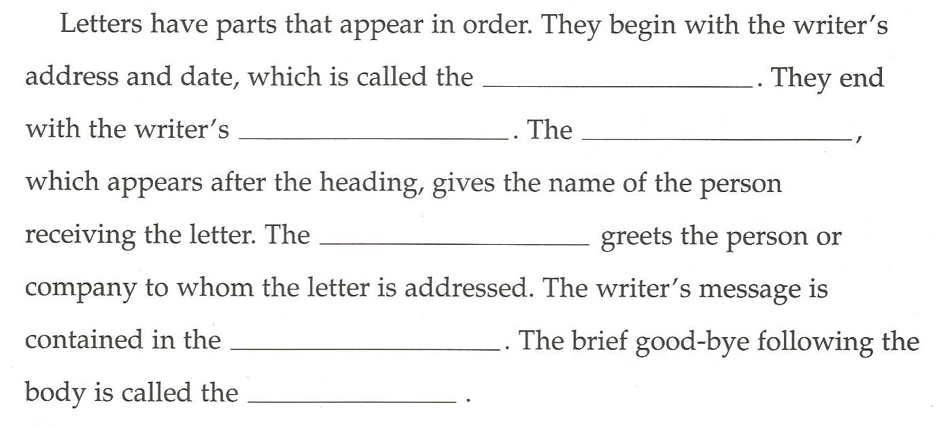

Slide 8
Email Structure
From:
To:
Subject:

Slide 9
Let’s write a letter to a sick kid…
http://www.postpals.co.uk/find-pals/

Slide 10
Write an email to your favorite celebrity

