Slide 3
Lesson 13 – Comparing Word Meanings

Slide 4
Synonym

Slide 5
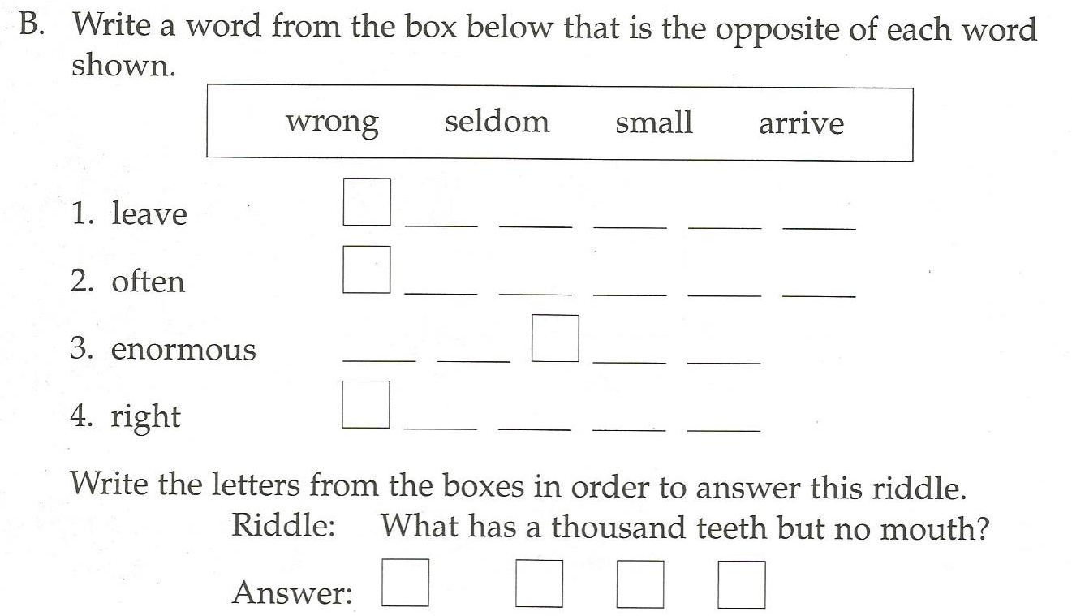
Antonym

Slide 6
Synonym or Antonym?
I
Me

Slide 7
Synonym or Antonym?
I
You

Slide 8
Synonym or Antonym?
Poor
Rich

Slide 9
Synonym or Antonym?
Full
Empty

Slide 10
Synonym or Antonym?
Smart
Intelligent

Slide 11
Synonym or Antonym?
Sleepy
Tired

Slide 12
Synonym or Antonym?
Large
Huge

Slide 13
Synonym or Antonym?
Strong
Weak

Slide 14
Synonym or Antonym?
Liquid
Solid

Slide 15
Synonym or Antonym?
Sharp
Dull

Slide 16
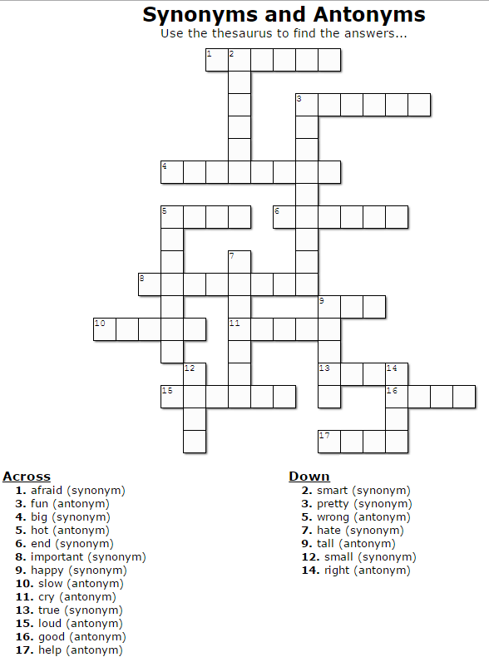
Using a Thesaurus

Slide 17
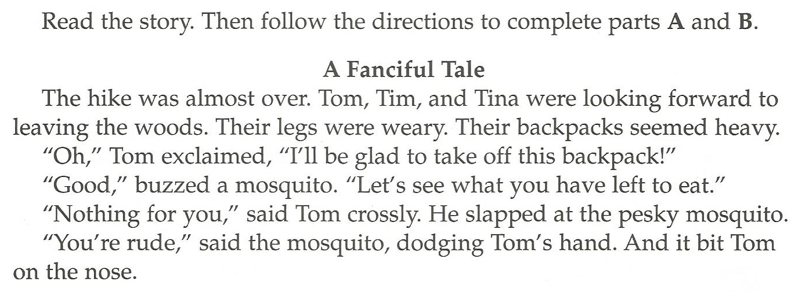
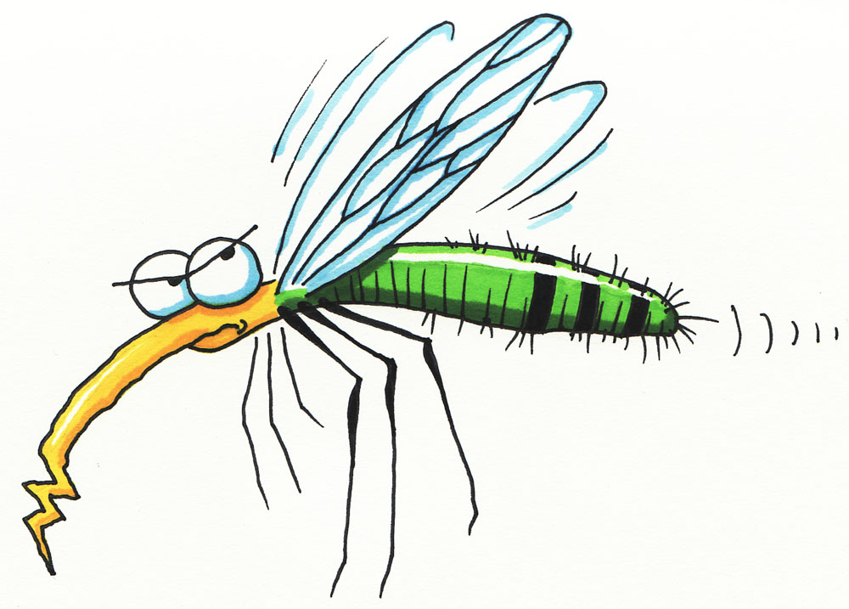

Slide 18
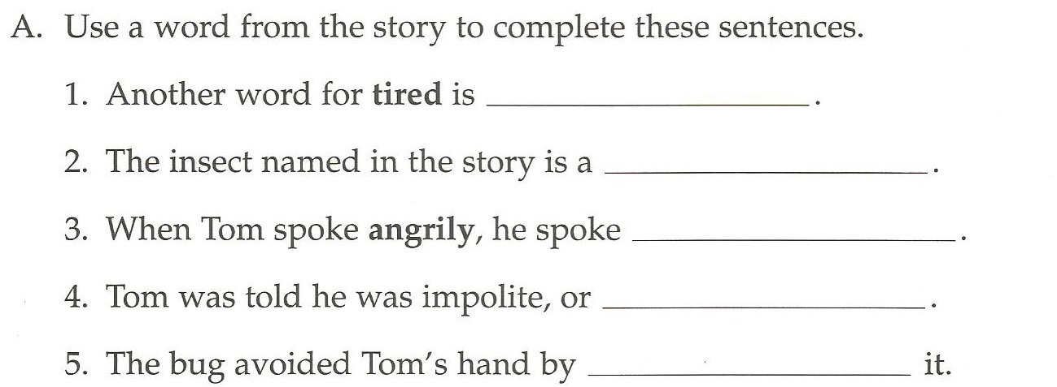

Slide 19
