Slide 1
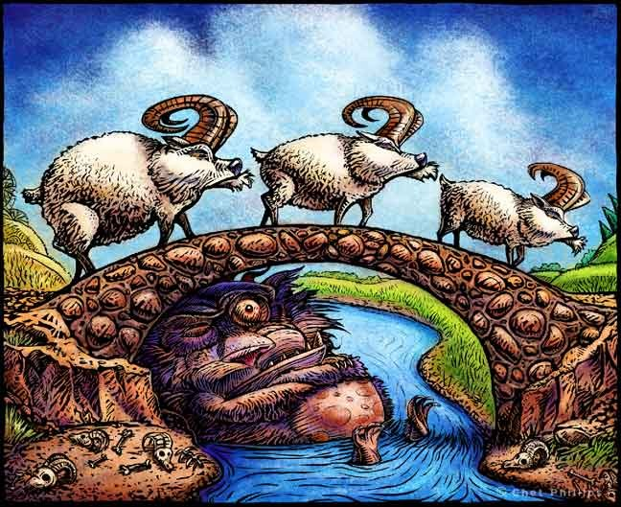
Three Billy-Goats Gruff

Slide 3
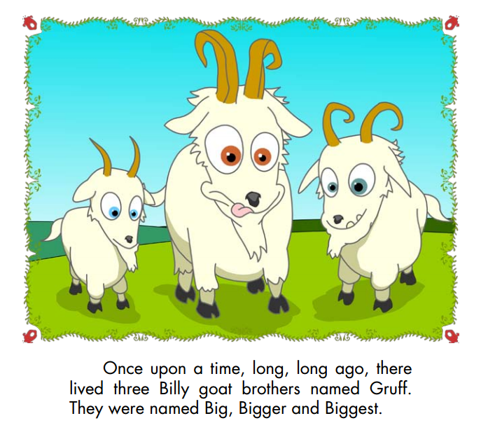

Slide 5
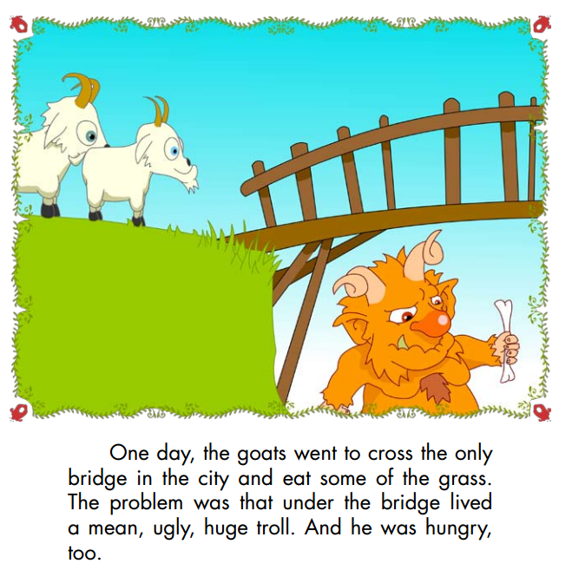

Slide 6
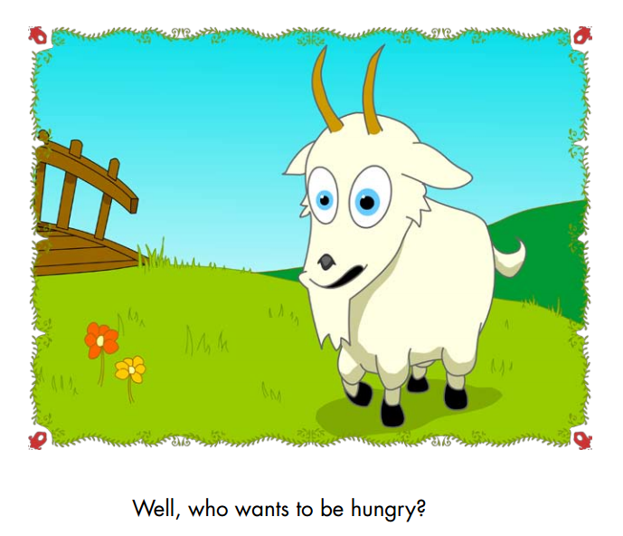

Slide 7
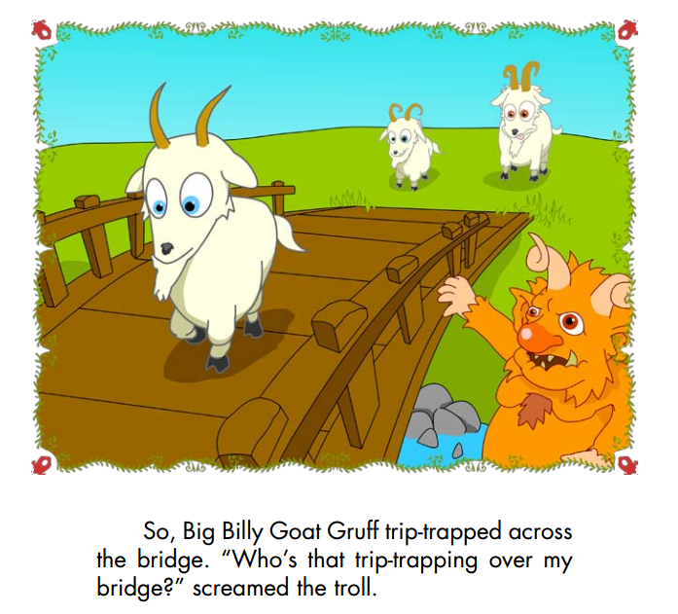

Slide 8
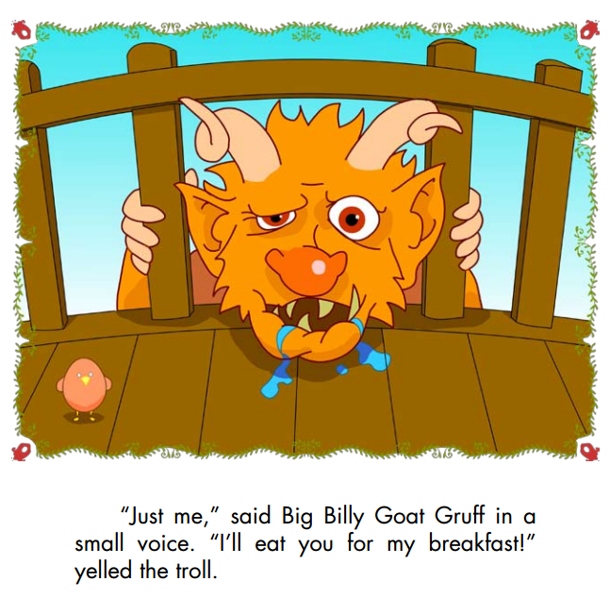

Slide 9
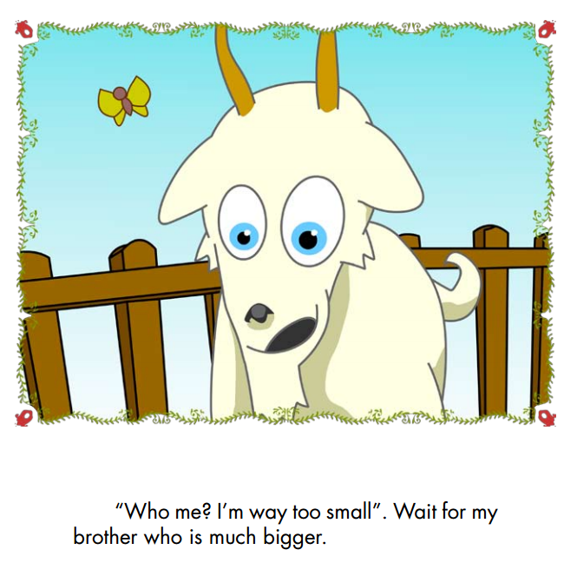

Slide 10
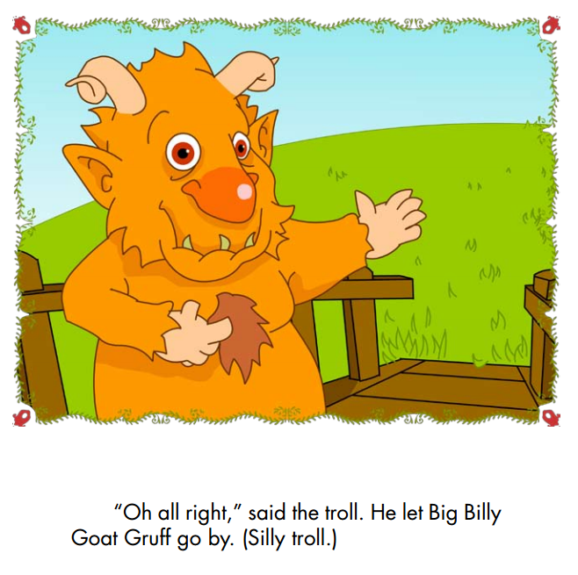

Slide 12
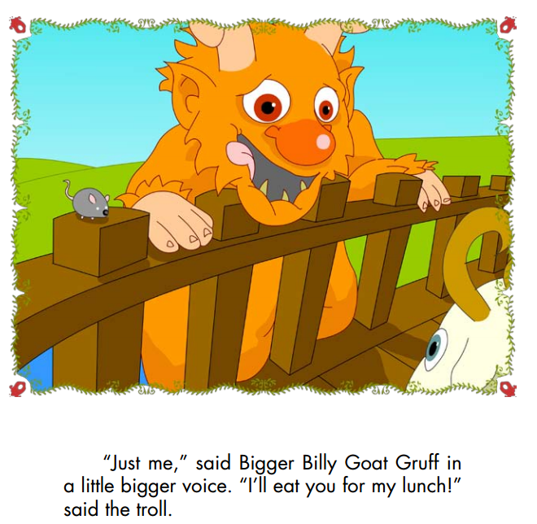

Slide 14
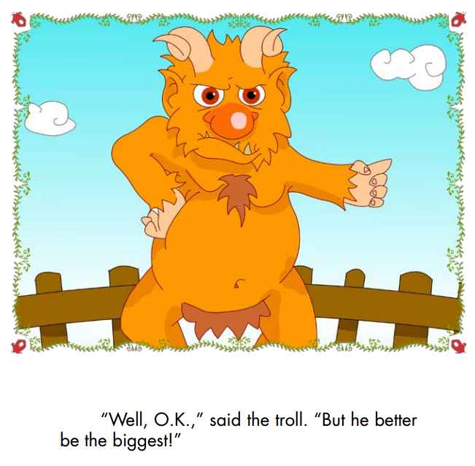

Slide 16
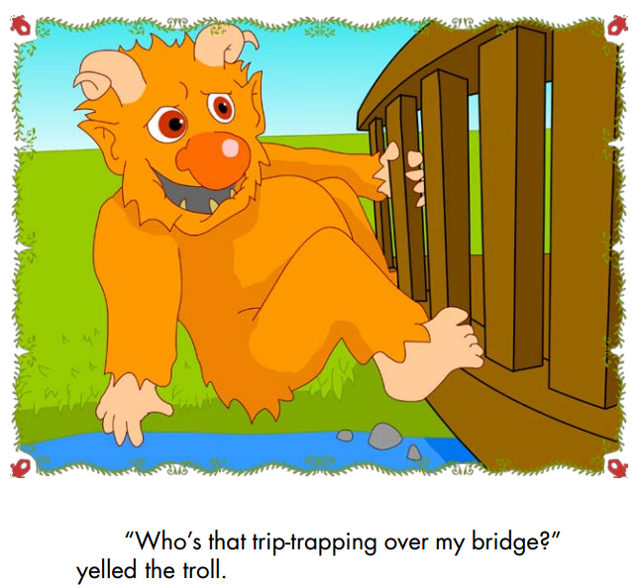

Slide 17
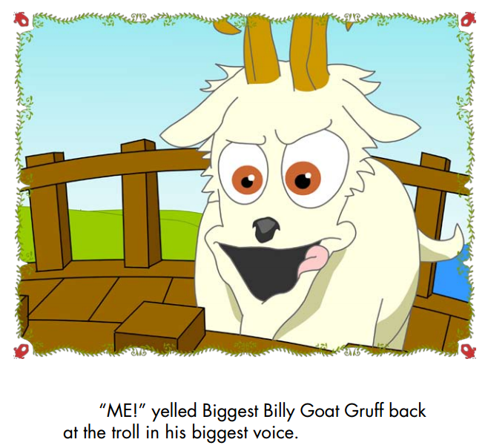

Slide 18
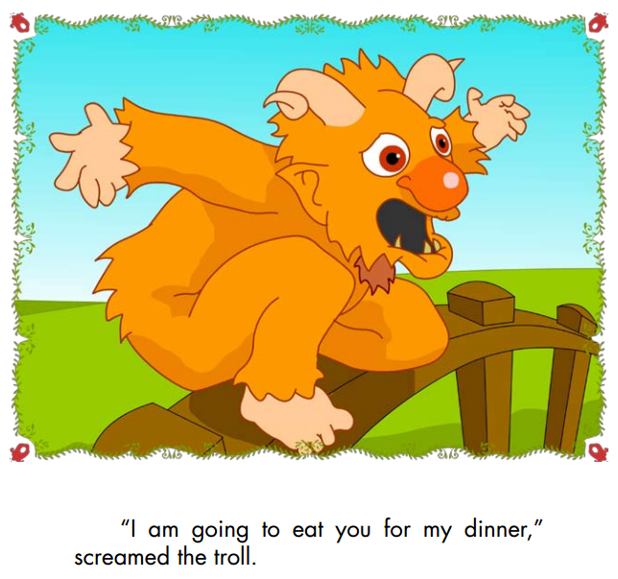

Slide 19
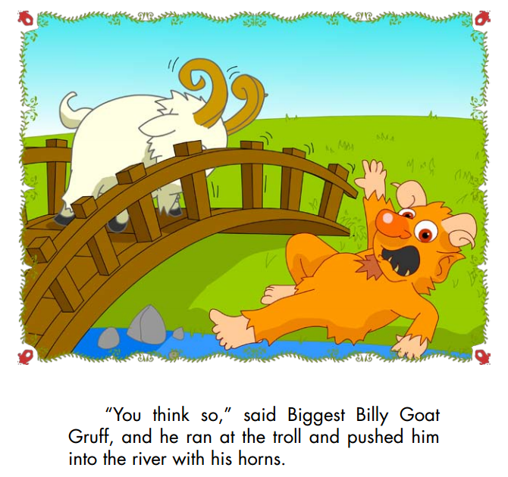

Slide 20
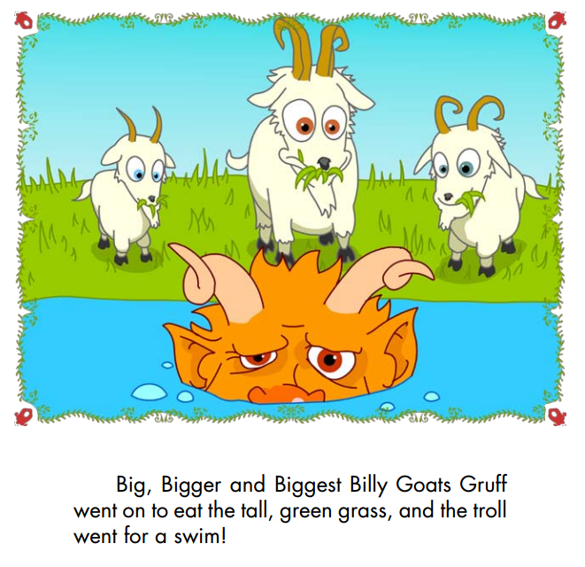

Slide 21
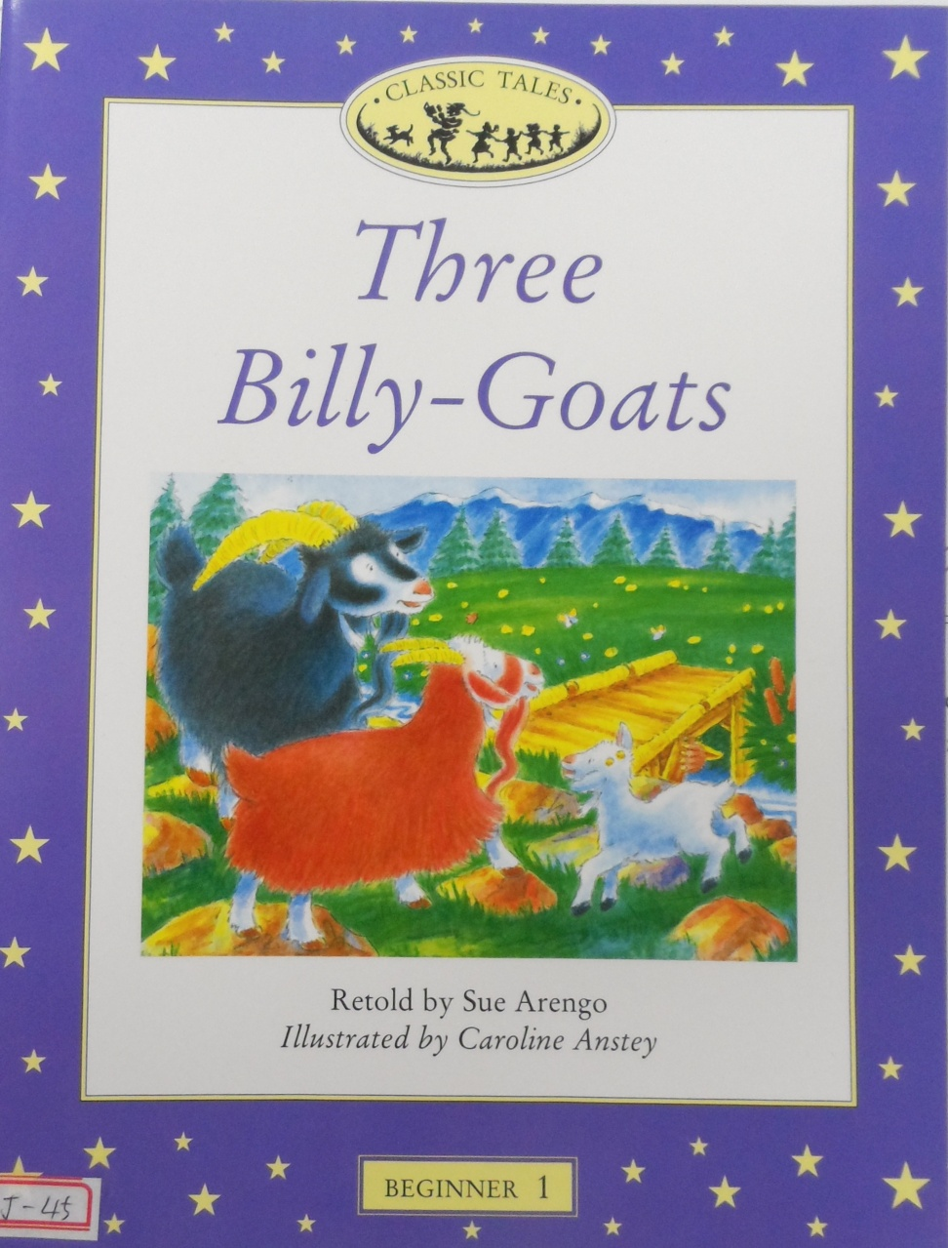
Three Billy-Goats Gruff
Book questions

Slide 22
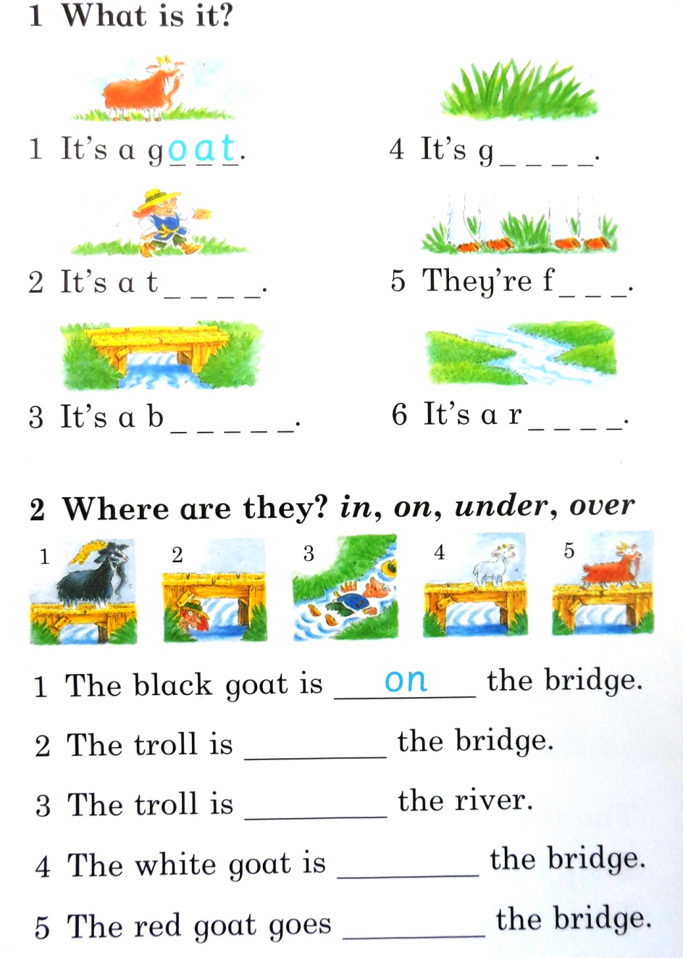
troll
grass
feet
bridge
river

Slide 23
under
in
on
across

Slide 24
Comparatives
Comparing two things

Slide 25
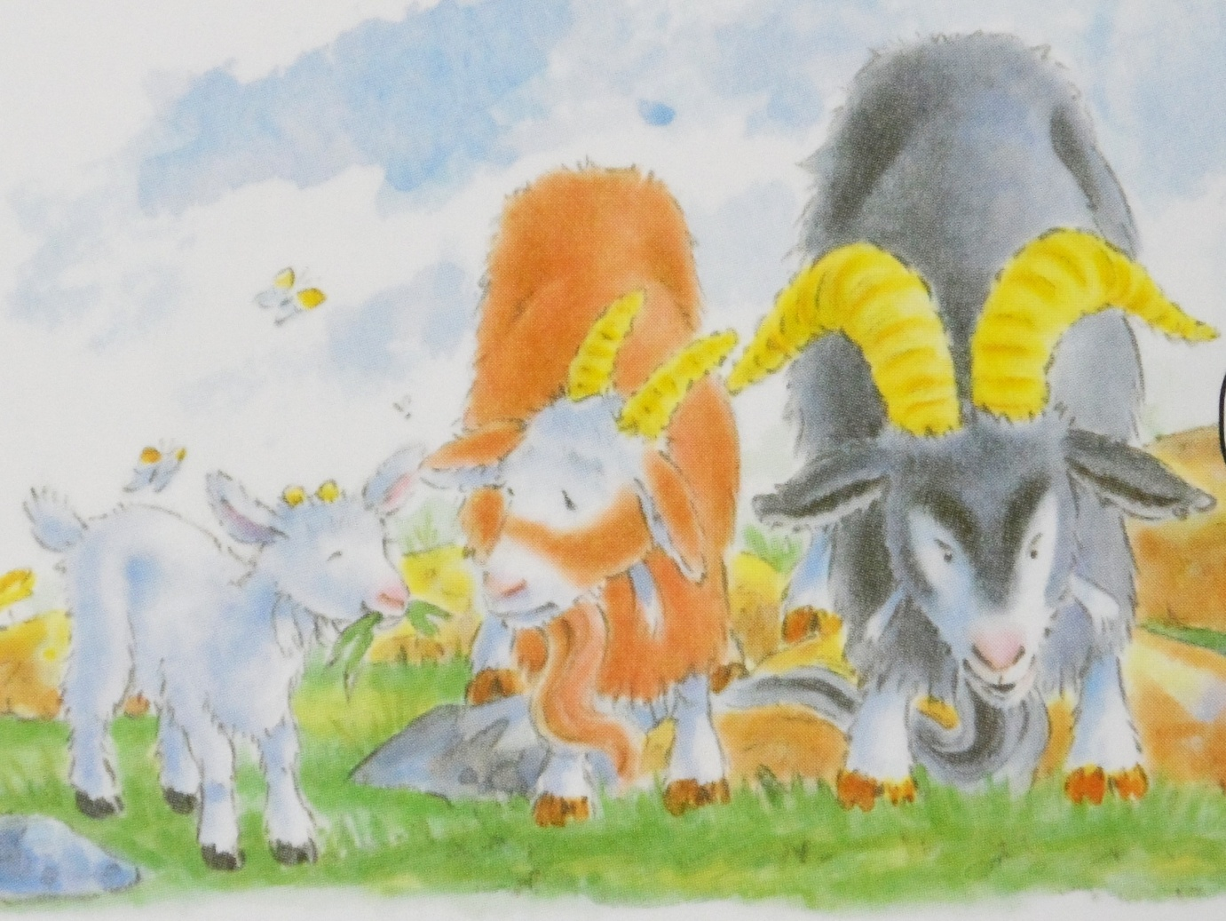
Compare two things:
The red goat is __________ than the white goat.
bigger

Slide 26
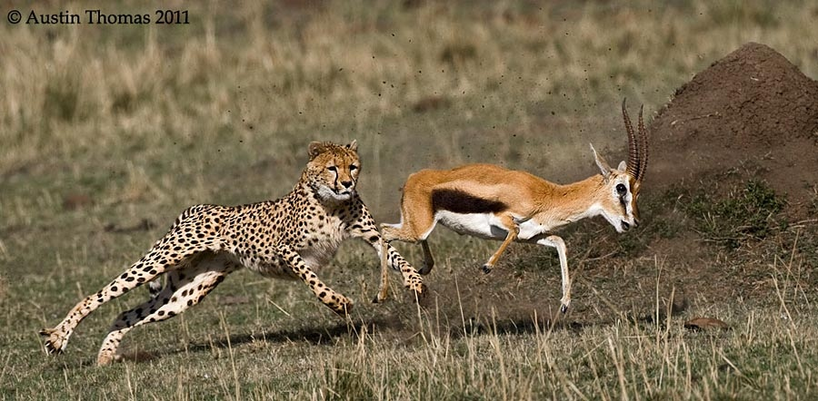
Compare two things:
The cheetah is __________ than the gazelle.
faster

Slide 27
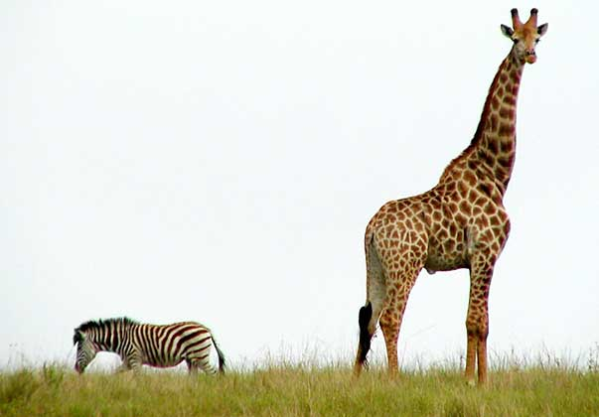
Compare two things:

Slide 28
Compare two things:
Mary
Anne

Slide 29
Compare two things:
pencil
crayon

Slide 30
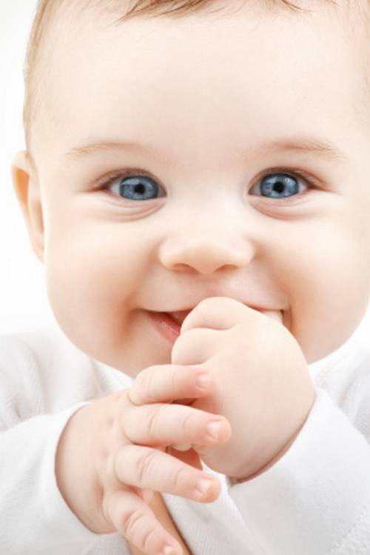
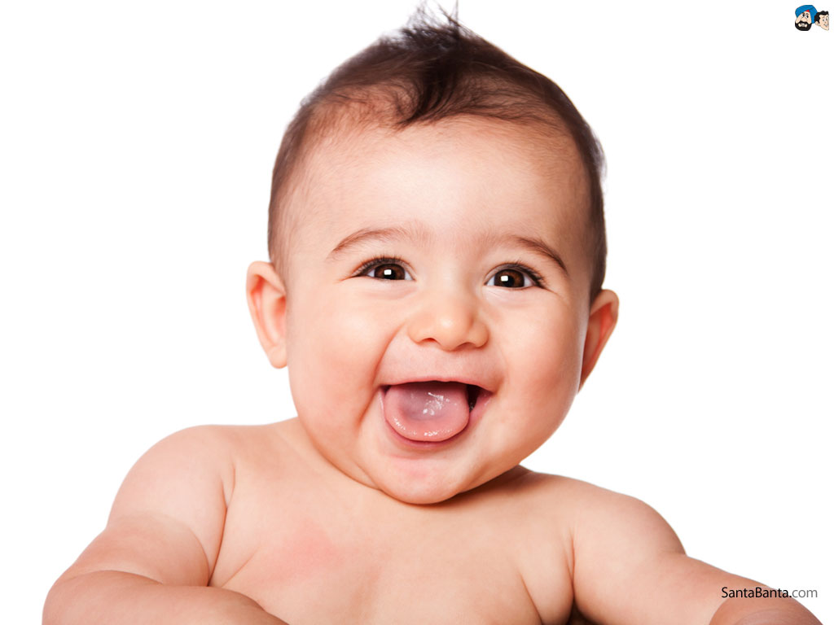
Compare two things:
Josh
Evan

Slide 31
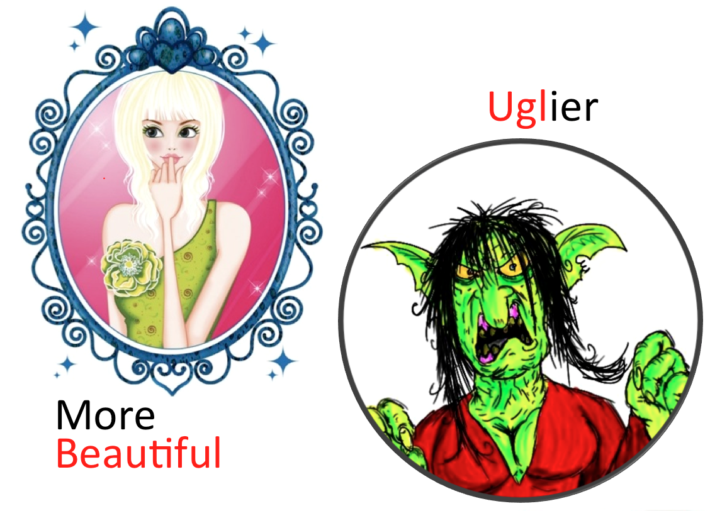
Compare two things:

Slide 32
More...
Beautiful
Handsome
Dangerous
Intelligent
Interesting
Difficult
Frustrating

Slide 33
Superlatives
Comparing three or more things

Slide 34
Compare many things:
The black goat is the __________.
biggest

Slide 35
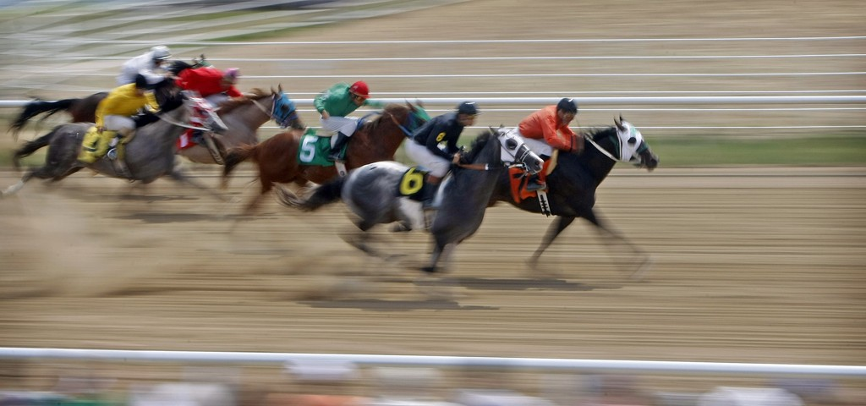
Compare these things:
Number 7 is the __________.
fastest

Slide 36
Compare these things:
Todd
Mike
Fred
Dean
Roger

Slide 37
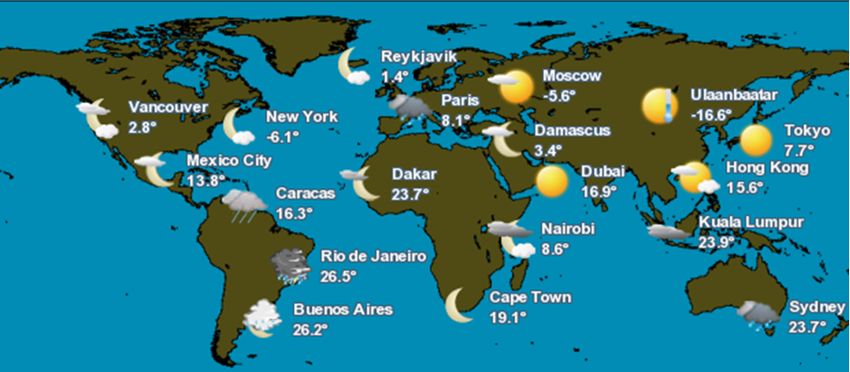
Compare these things:

Slide 38
Compare these people:
 | height | weight | IQ
Luke | 163 | 76 | 175
Abby | 171 | 92 | 111
Brian | 158 | 54 | 93
Dave | 166 | 69 | 88
Kim | 184 | 83 | 127
Jen | 152 | 60 | 107
smartest
heaviest
lightest
stupidest
tallest
shortest

Slide 39
Intelligent – More Intelligent -______ Intelligent
most

Slide 40
Review
Good – Better – Best
1 thing
2 things
3+ things

Slide 41
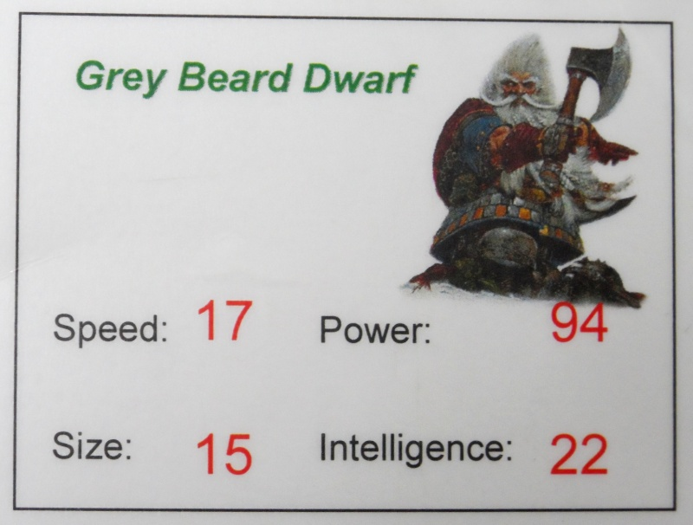
Comparatives Game
Chose a group.
Choose a card
Rock / Paper / Scissors
Name an attribute
The winner MUST use the correct sentence

Slide 42
Reading with Punctuation:

Slide 43
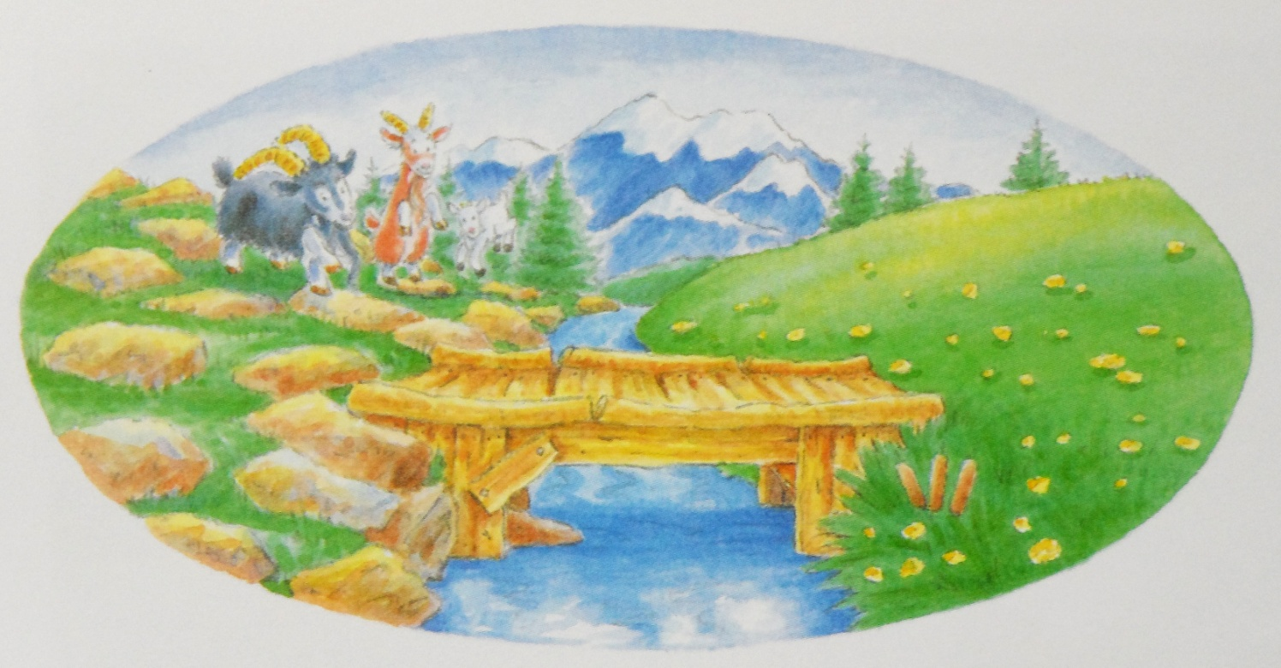
Punctuation
The three goats see a river.

Slide 44
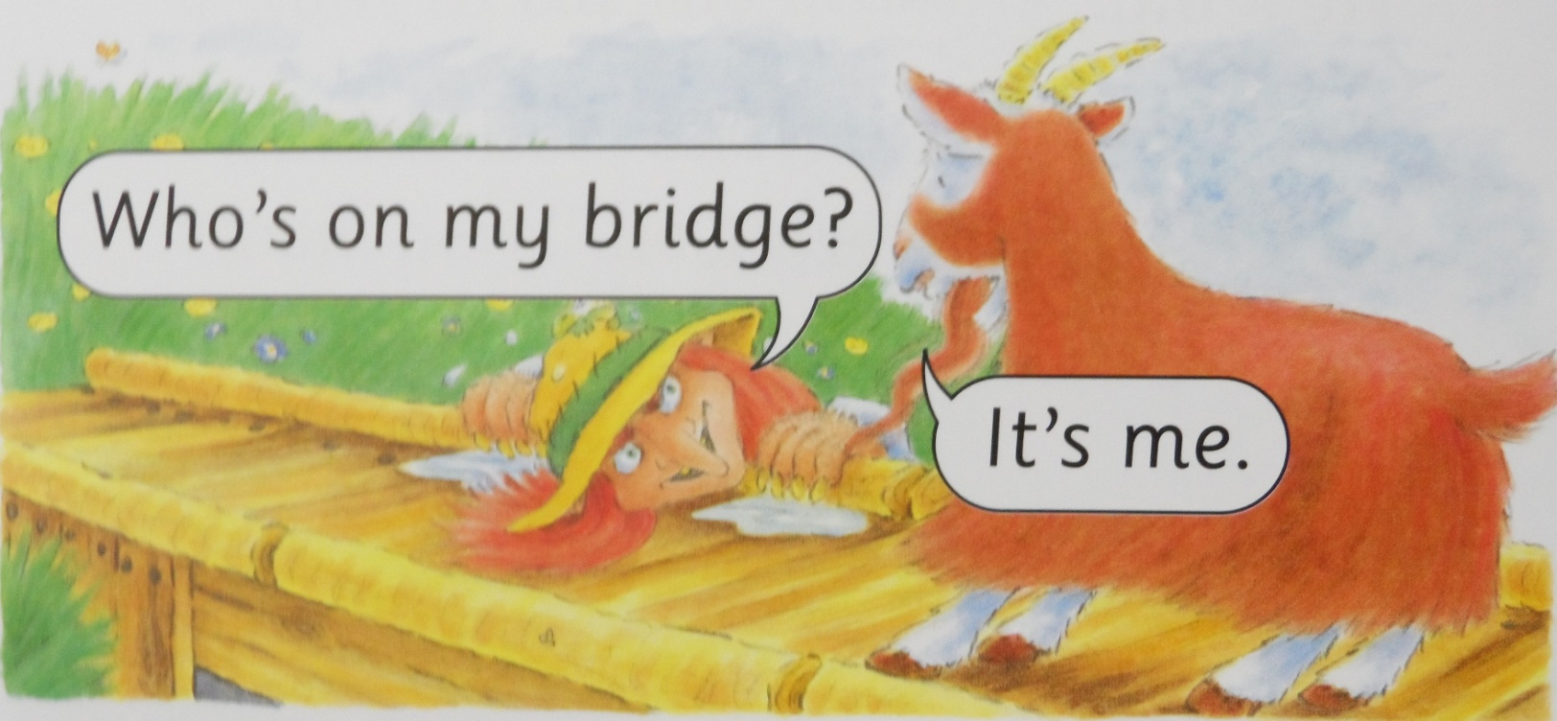
Punctuation
Who’s on my bridge?

Slide 45
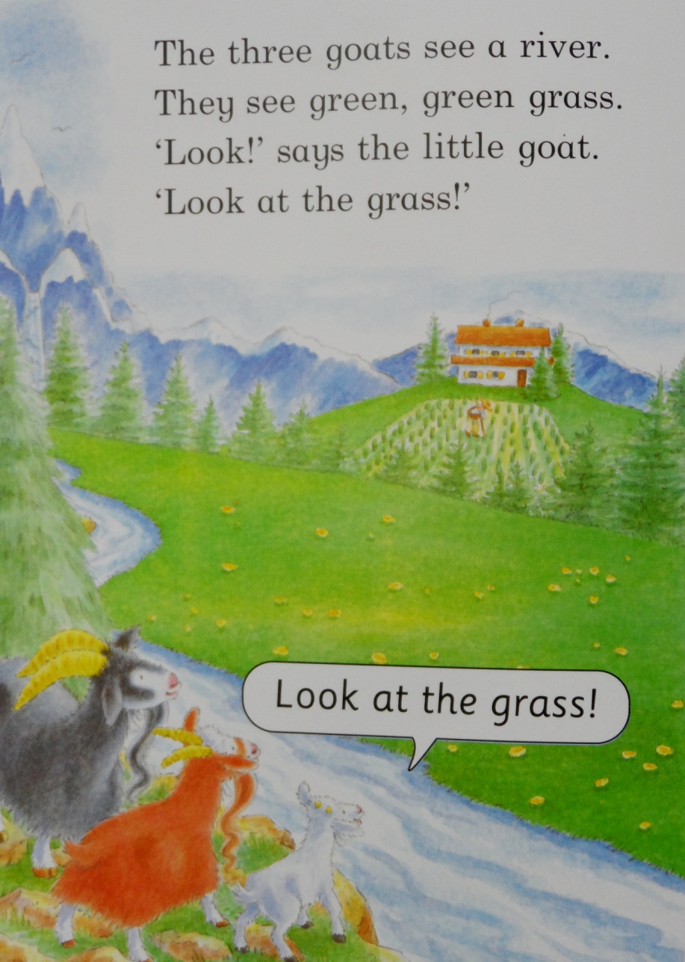
Punctuation
GRASS
Look at the grass!

Slide 46
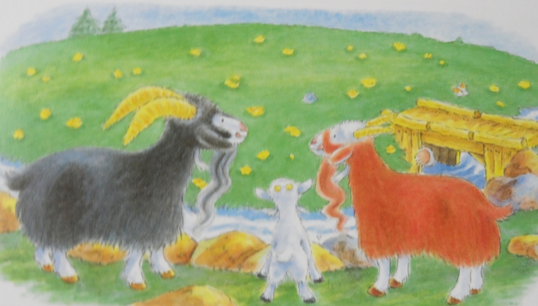
Punctuation
They want the green, green grass
pause

Slide 47
Punctuation
There are three goats; a little goat, a big goat, and a very big goat.

Slide 48
Punctuation
“I’m hungry!” says the very big black goat.
quotes
“Ok,” says the troll.
The troll says, “Ok.”

Slide 49
Punctuation
Oh...

Slide 50
Let’s read again.

Slide 51
Goats Gruff Game

Slide 52
Goats Gruff Game
Place a bridge
Move the goat (dice)
Move the troll

