Slide 1
Goats Gruff Game

Slide 2
Reading with Punctuation:

Slide 3
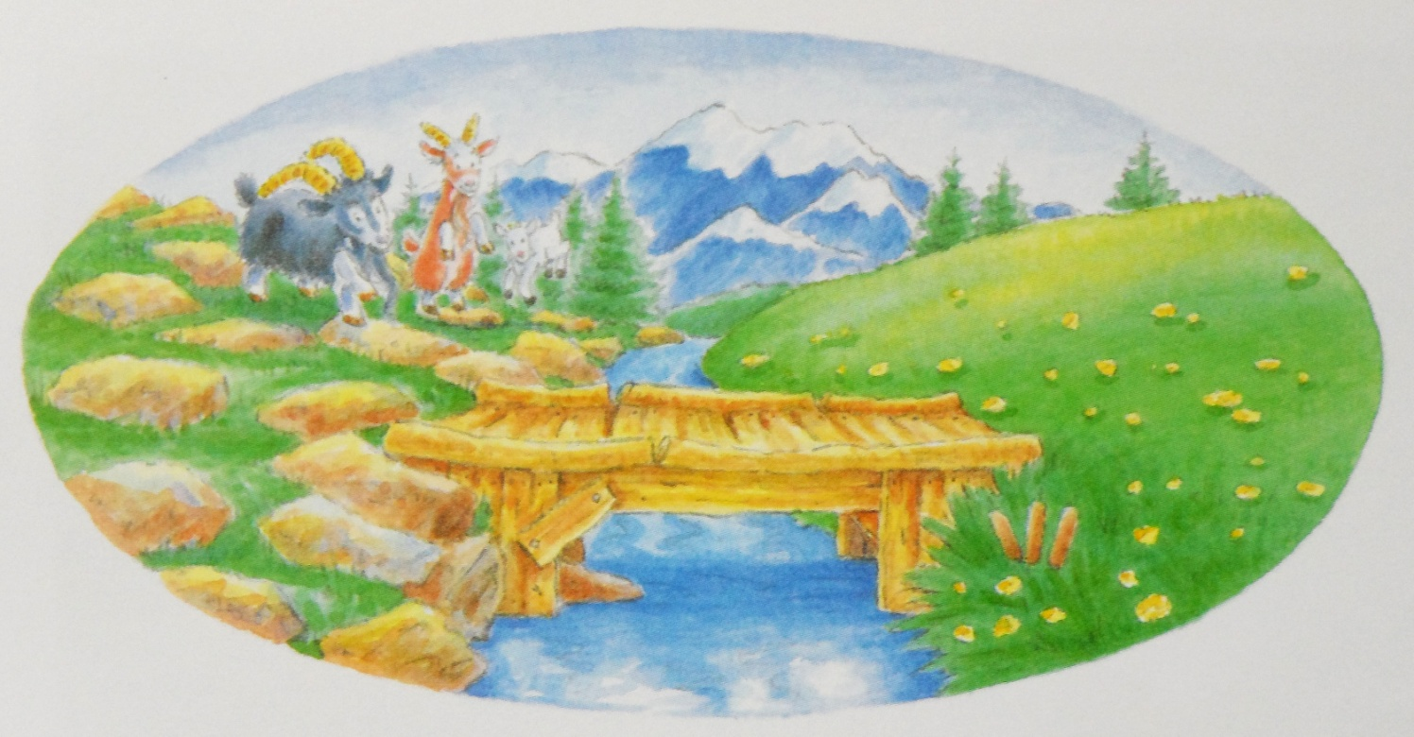
Punctuation
The three goats see a river.

Slide 4
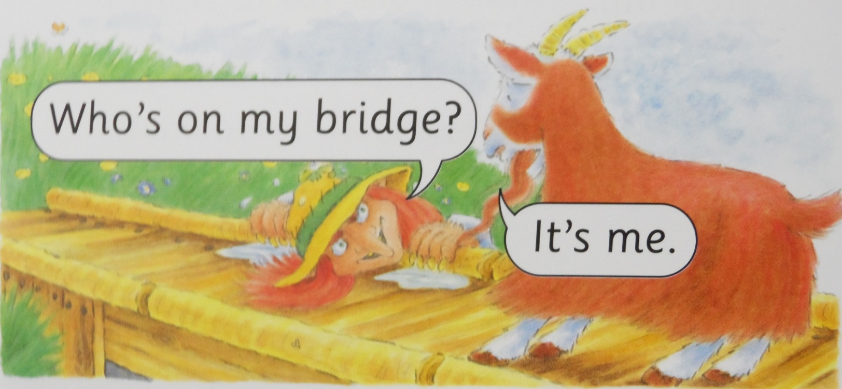
Punctuation
Who’s on my bridge?

Slide 5
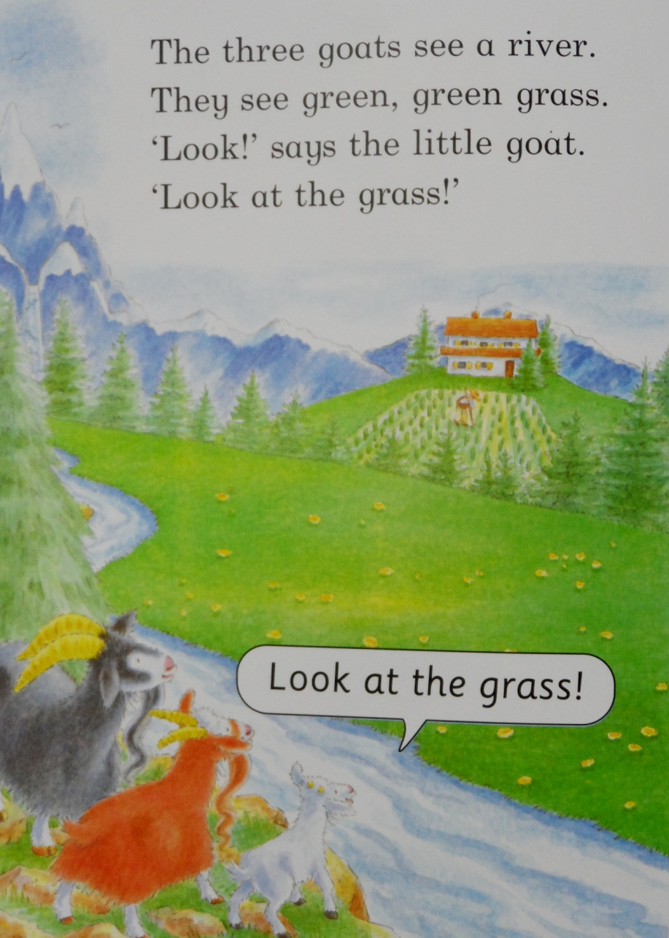
Punctuation
GRASS
Look at the grass!

Slide 6
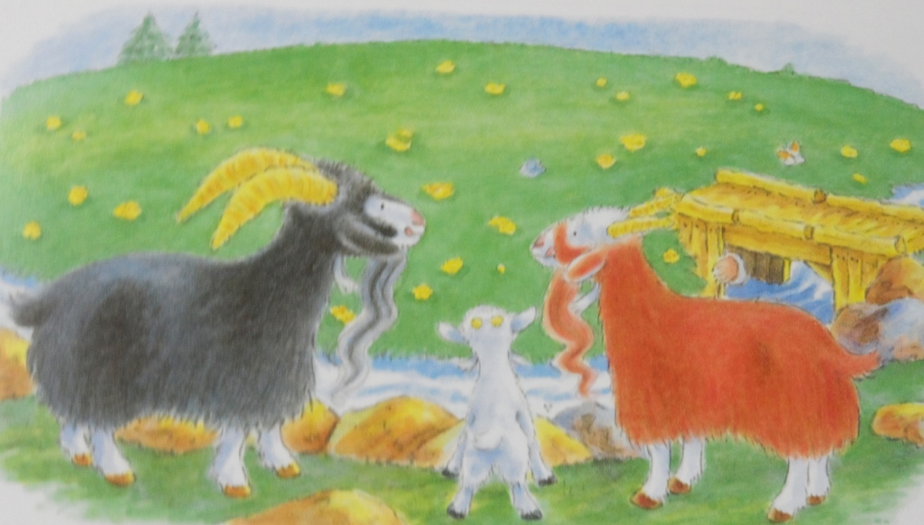
Punctuation
They want the green, green grass
pause

Slide 7
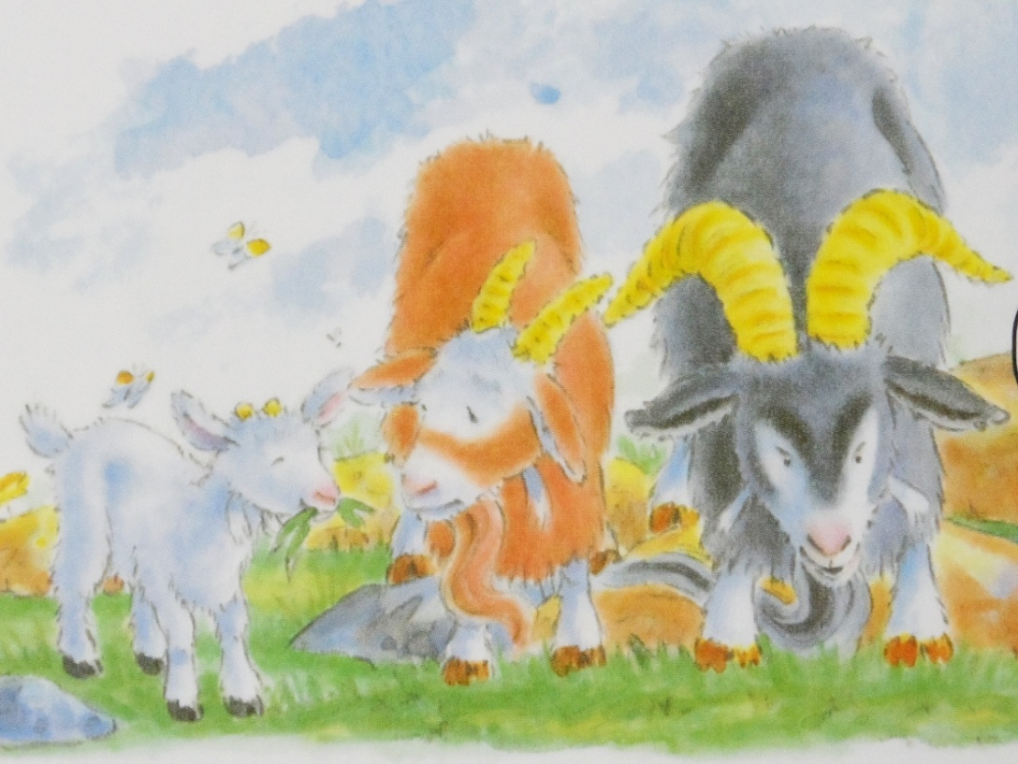
Punctuation
There are three goats; a little goat, a big goat, and a very big goat.

Slide 8
Punctuation
“I’m hungry!” says the very big black goat.
quotes
“Ok,” says the troll.
The troll says, “Ok.”

Slide 9
Punctuation
Oh...

Slide 10
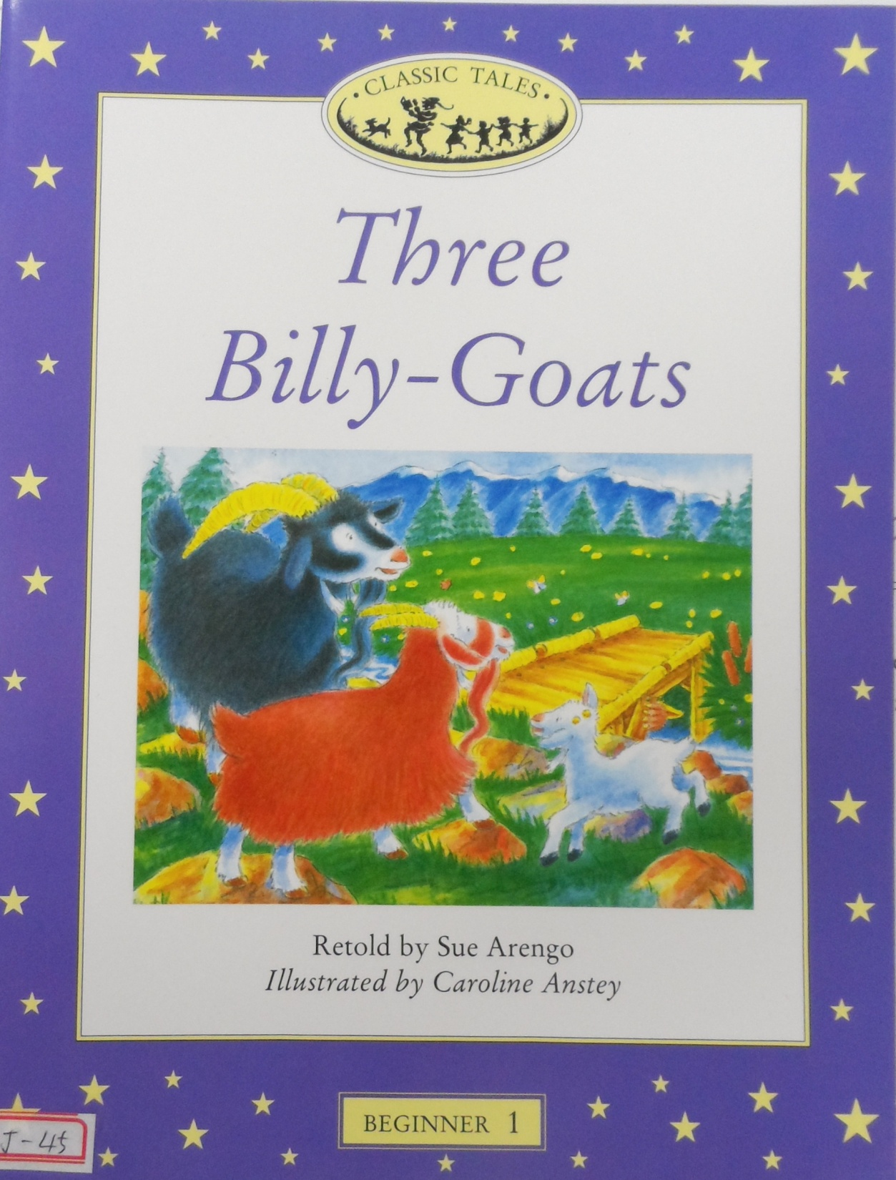
Let’s read again.

Slide 12
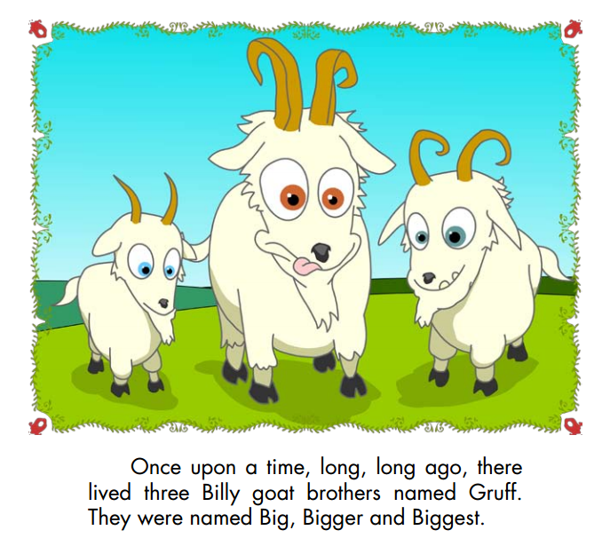

Slide 14
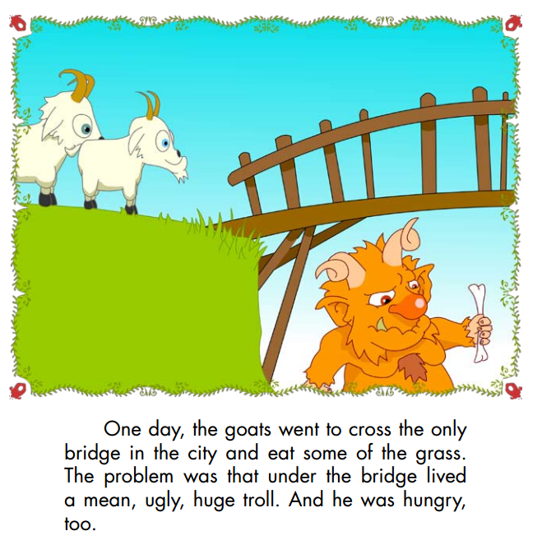

Slide 15
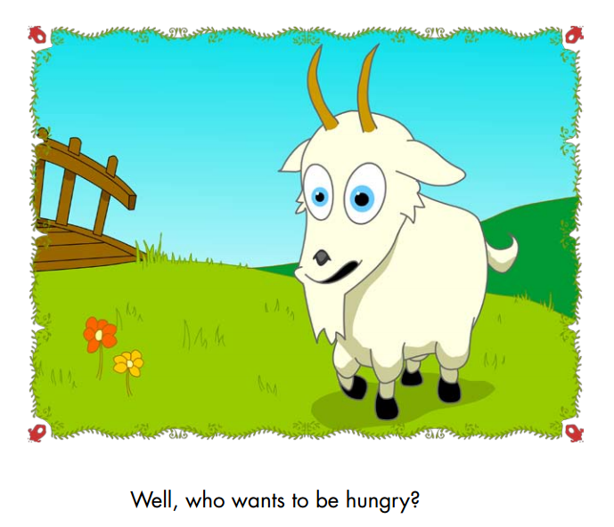

Slide 16
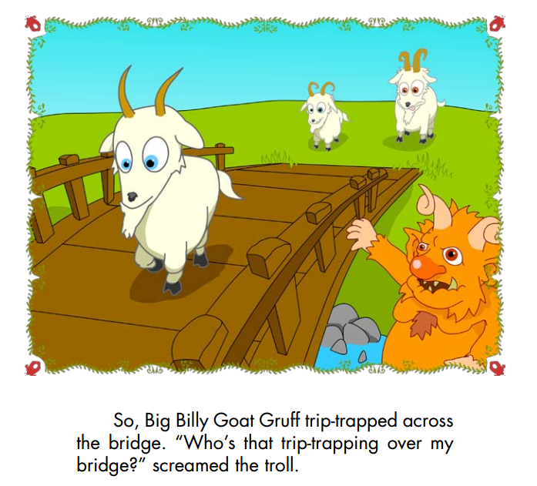

Slide 17
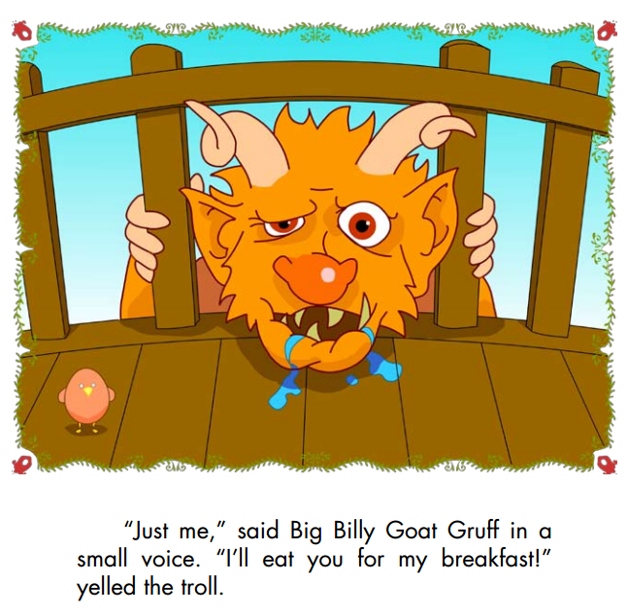

Slide 18
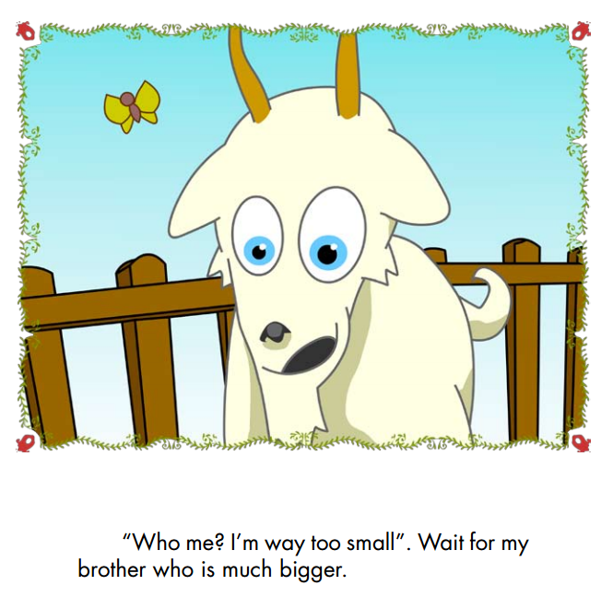

Slide 19
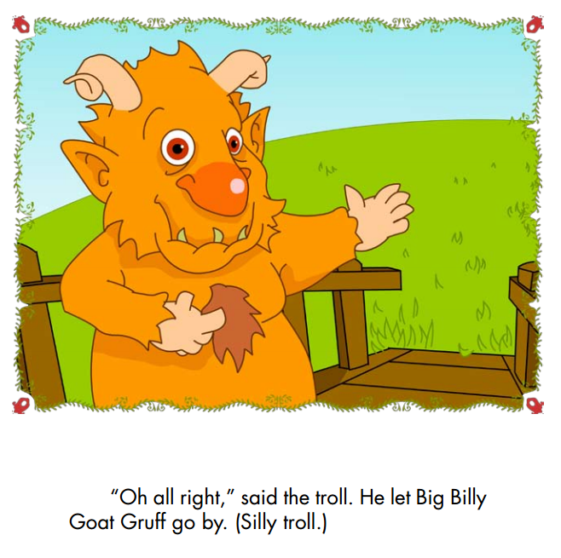

Slide 21
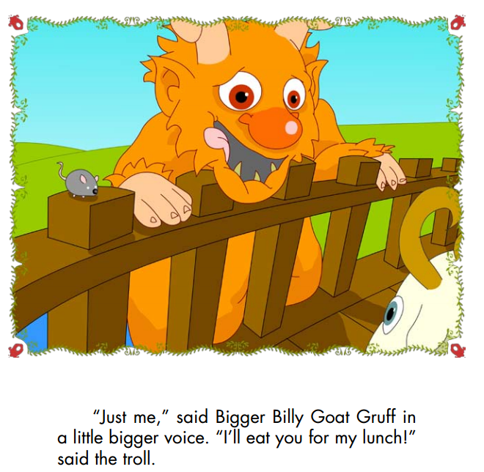

Slide 23
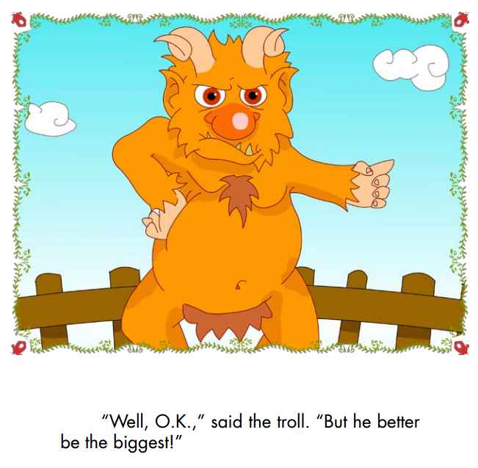

Slide 25
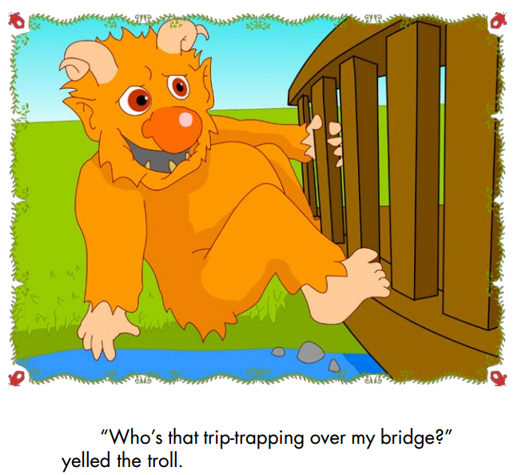

Slide 26
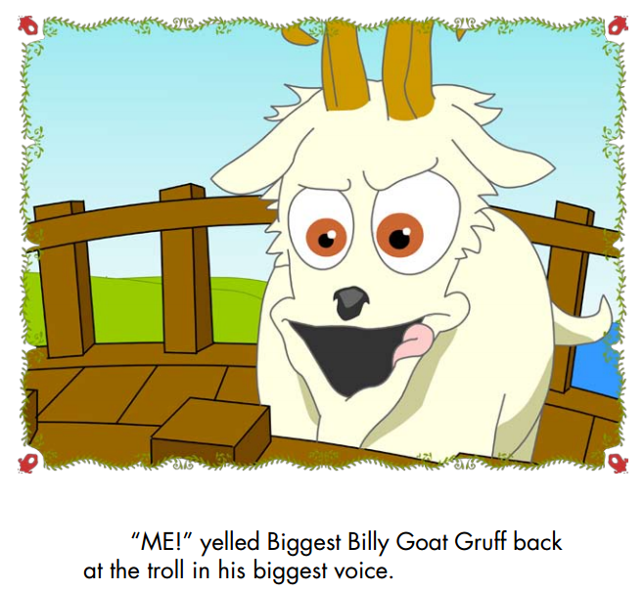

Slide 27
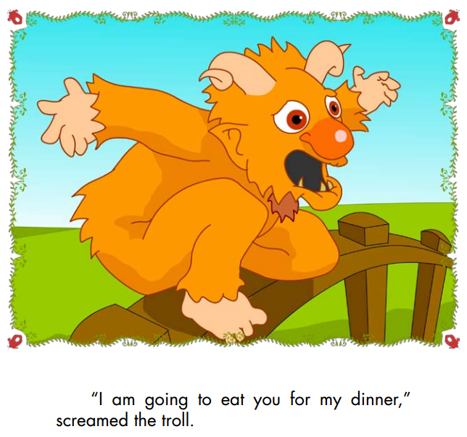

Slide 28
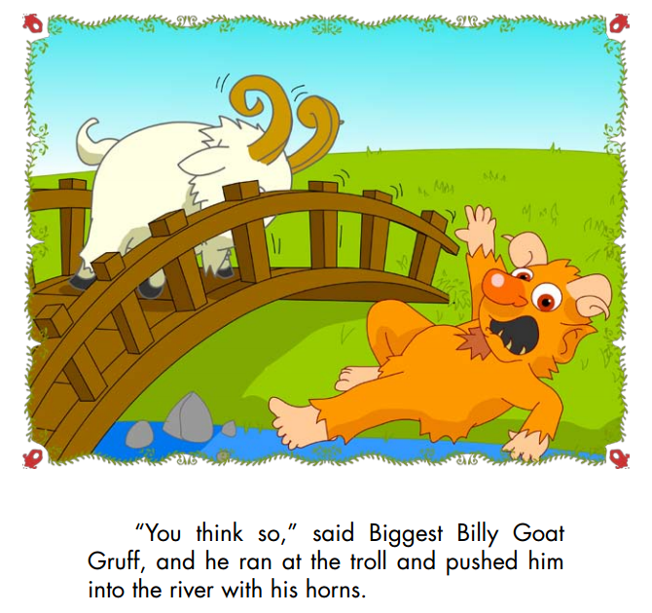

Slide 29
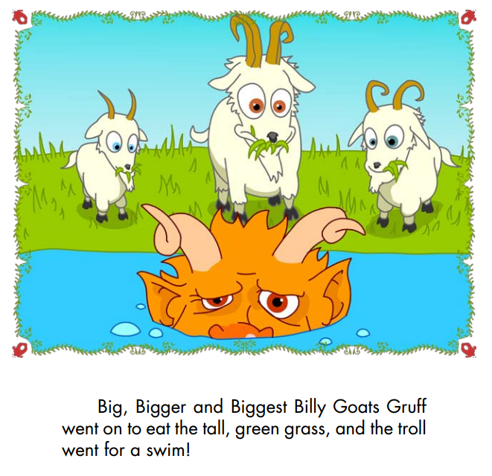

Slide 30
Goats Gruff Game

Slide 31
Goats Gruff Game
Place a bridge
Move the goat (dice)
Move the troll

