Slide 1
Apples to Apples Day
Welcome new students

Slide 2
Folders
Write your name on the folder.
Put your papers into the folder.
Keep the folder here.

Slide 3
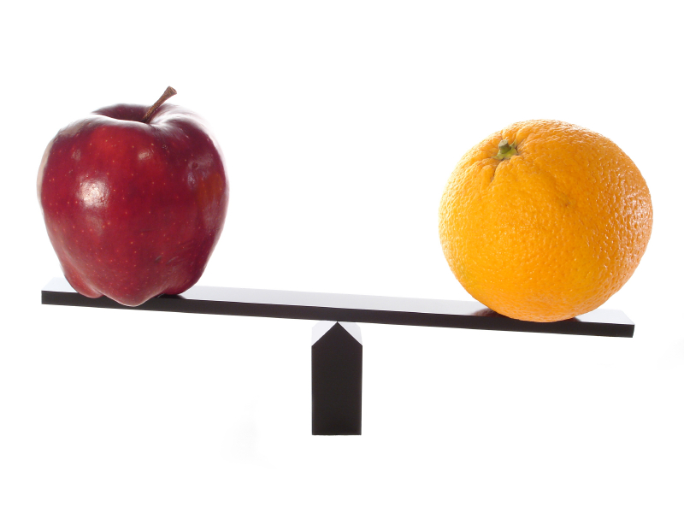
Apples to Oranges Game
What was it about?

Slide 4
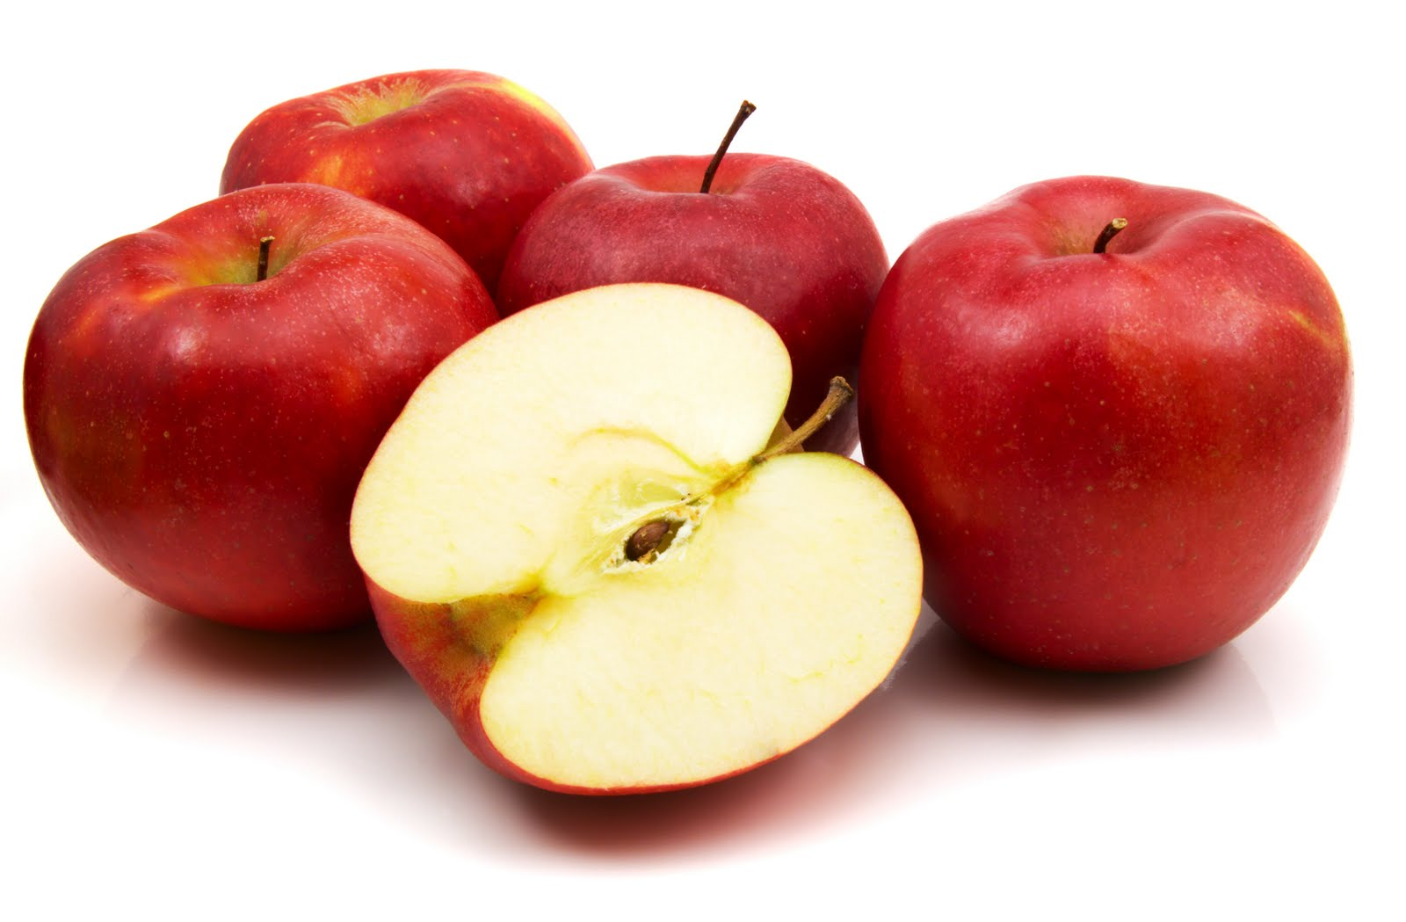
Apples to Apples Game
What do you think it is about?

Slide 5
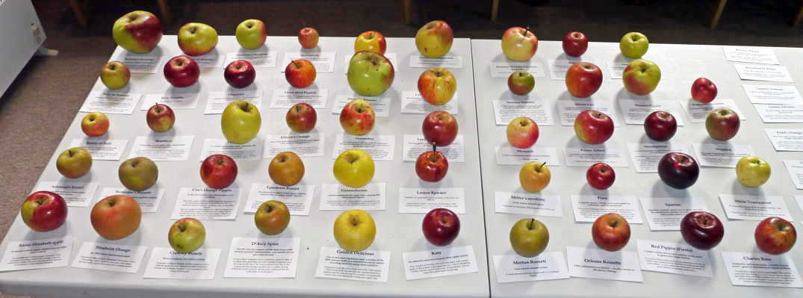
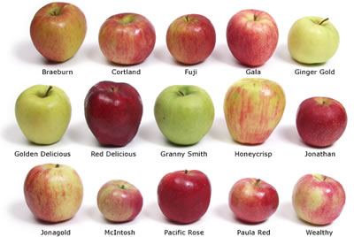

Slide 6
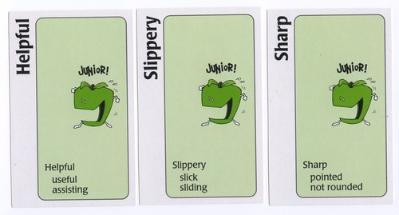
Each Card has an adjective on it.
What is an adjective?
describing word

Slide 7
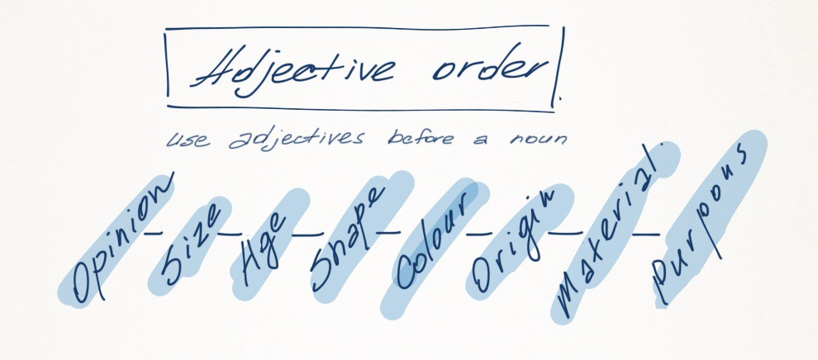
Types of Adjectives

Slide 8
Find the adjective:

Slide 9
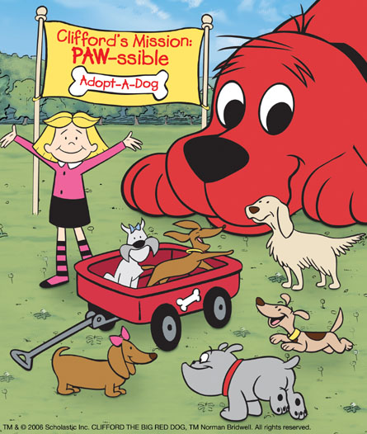
The big, red dog.

Slide 10
1. The man is an old, ugly, and grey man.
2. Be careful by the scary, and large house.
3. Where are the delicious candies that I ordered?

Slide 11
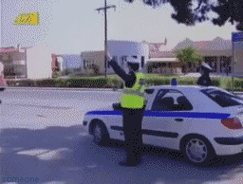
Good Job

Slide 13
Opinion

Slide 14
Opinion
Best, Worst, Delicious, Beautiful, Horrible

Slide 15
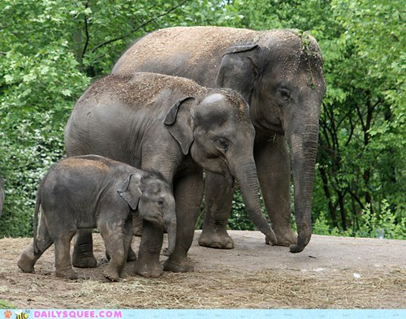
Size

Slide 16
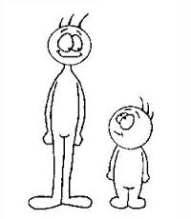

Slide 17
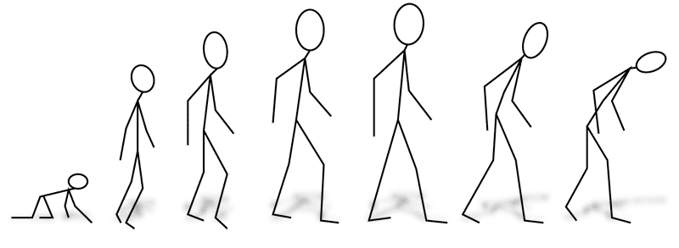
Age

Slide 18
Shape

Slide 19
Shapes

Slide 20
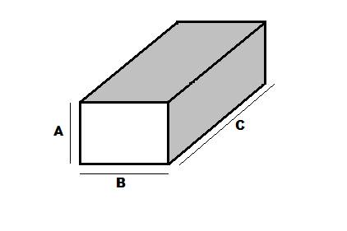
Rectangle = Rectangular

Slide 21
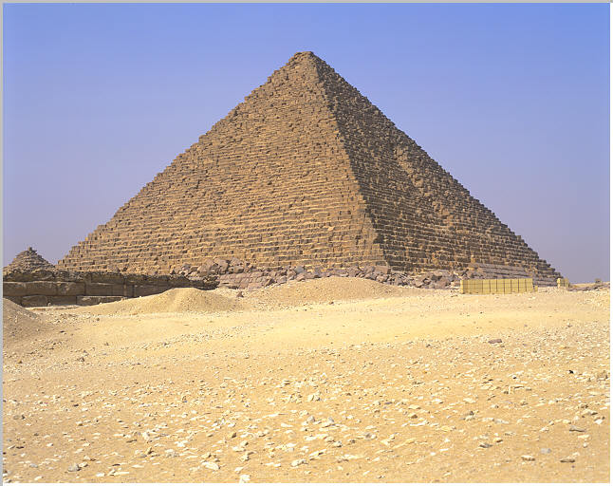
Triangle = Triangular

Slide 22
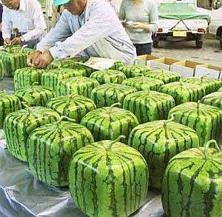
Square = Square

Slide 23
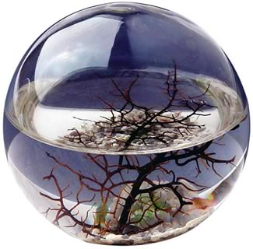
Circle = Round

Slide 24
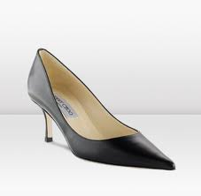
Pointy

Slide 25
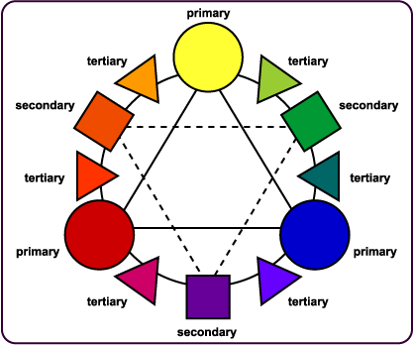

Slide 26
Color

Slide 27
Pink

Slide 28
Brown

Slide 29
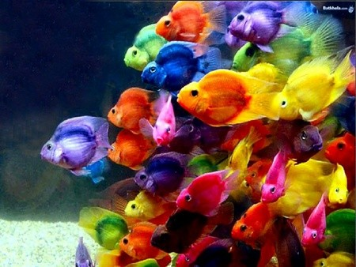
Colorful

Slide 30
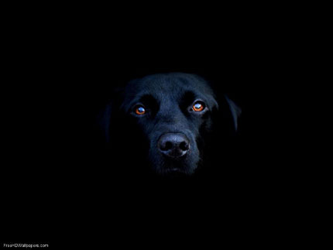
Black

Slide 31
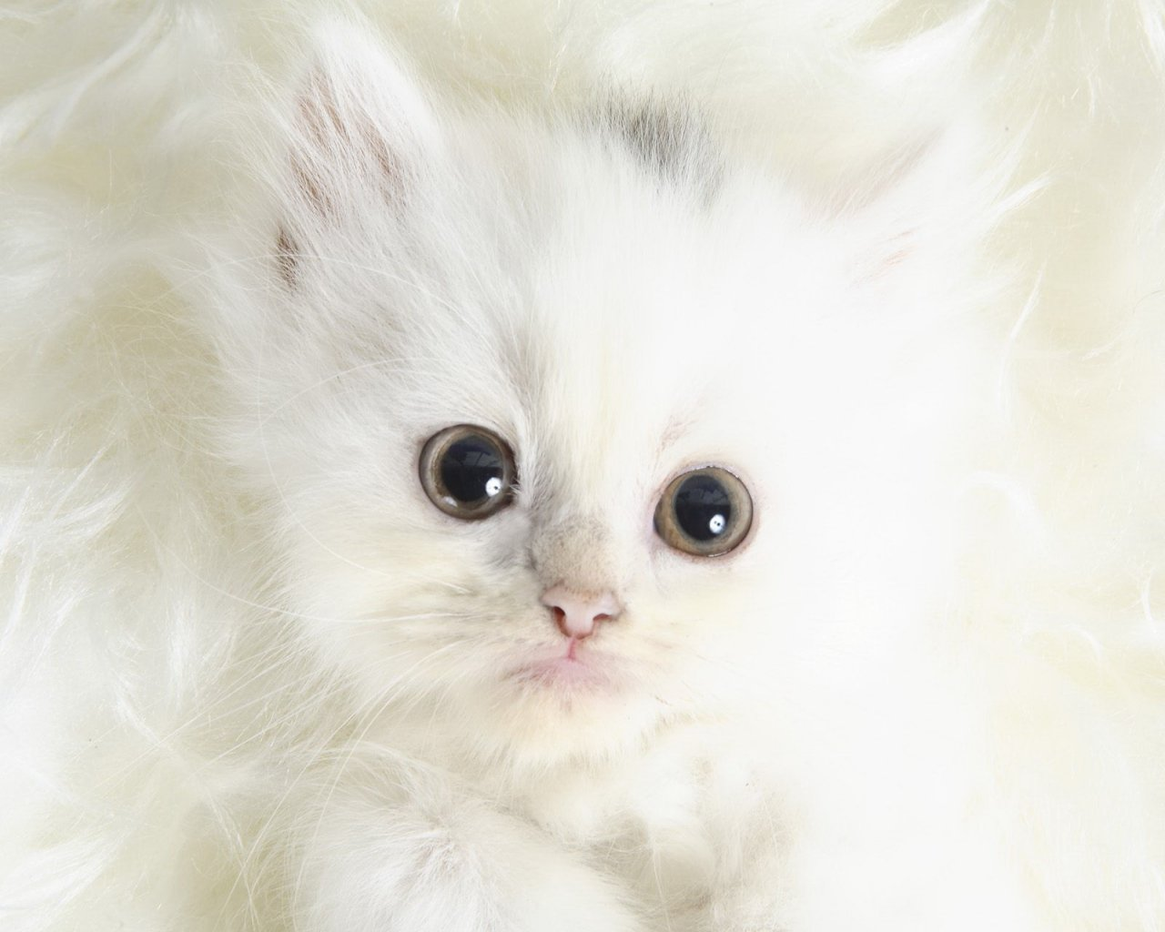
White

Slide 32
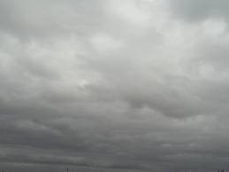
Grey

Slide 33
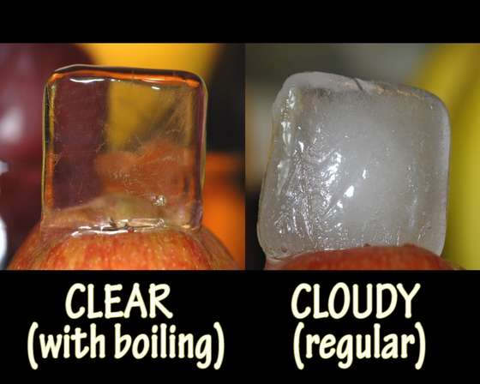

Slide 34
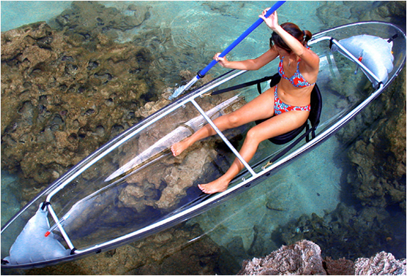
Clear

Slide 35
Origin

Slide 36
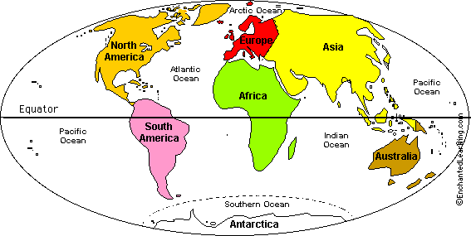

Slide 37
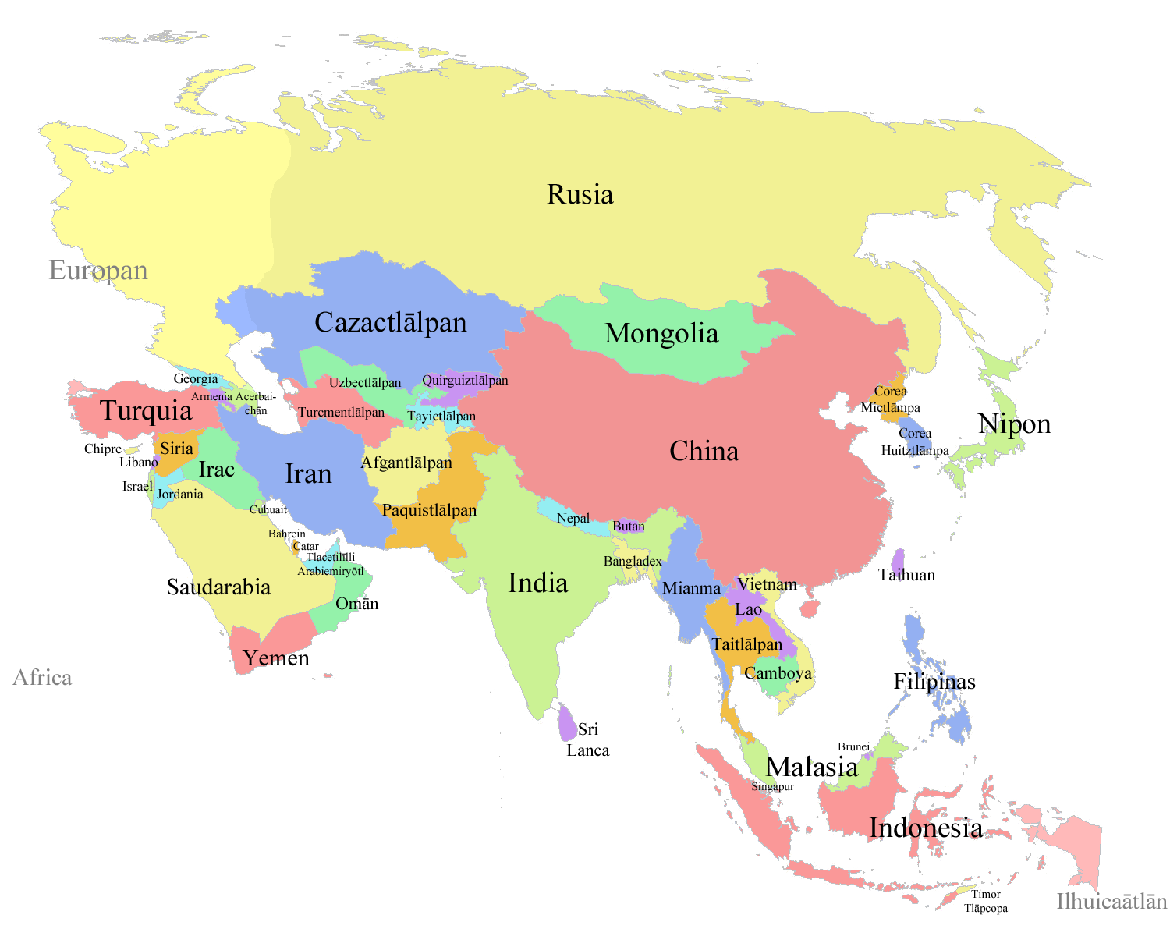
Asian

Slide 38
Australian

Slide 39
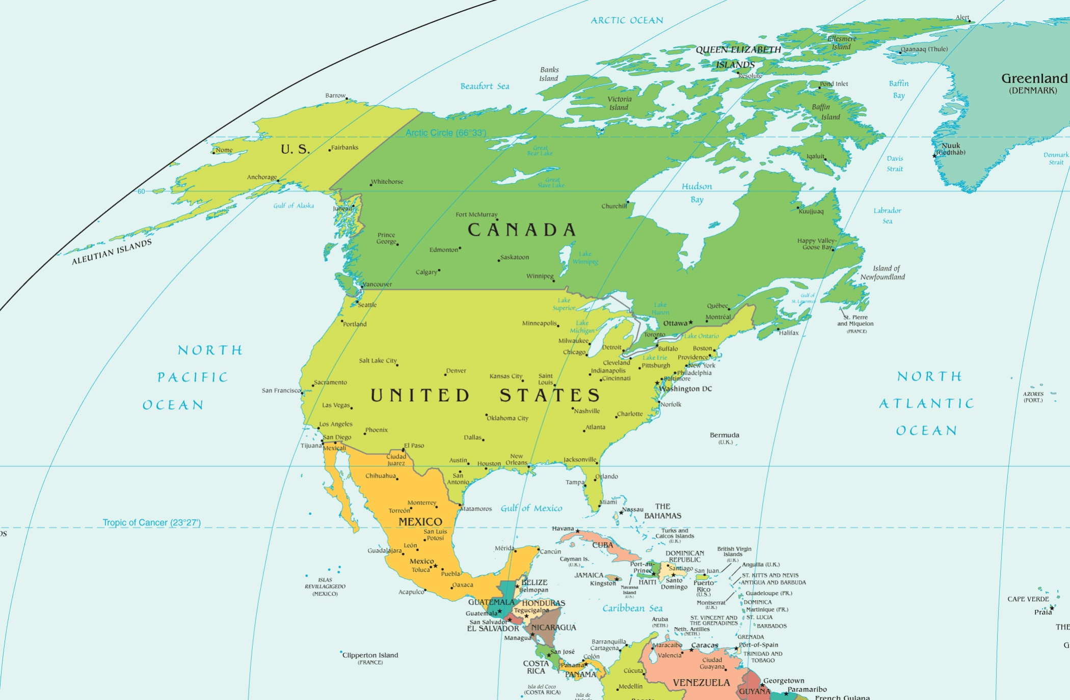
North American

Slide 40
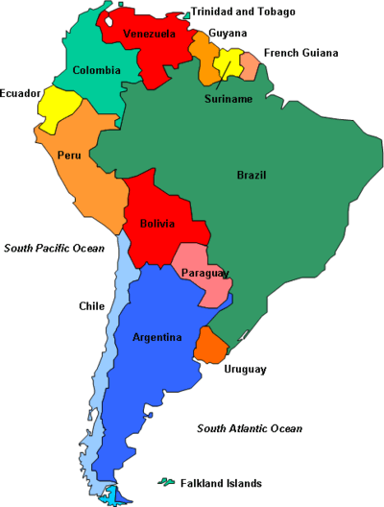
South American

Slide 41
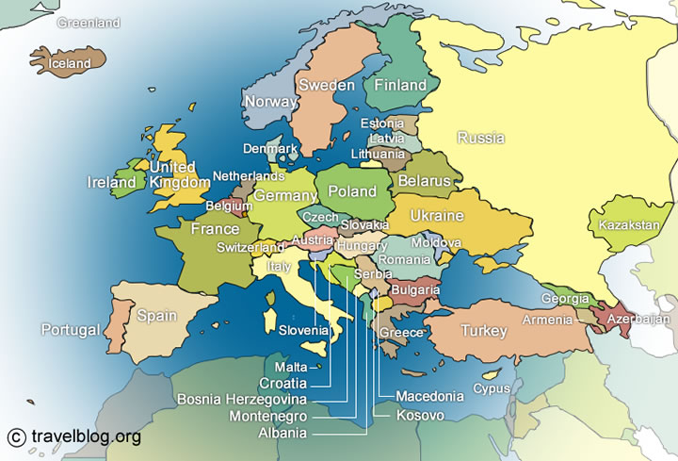
European

Slide 42
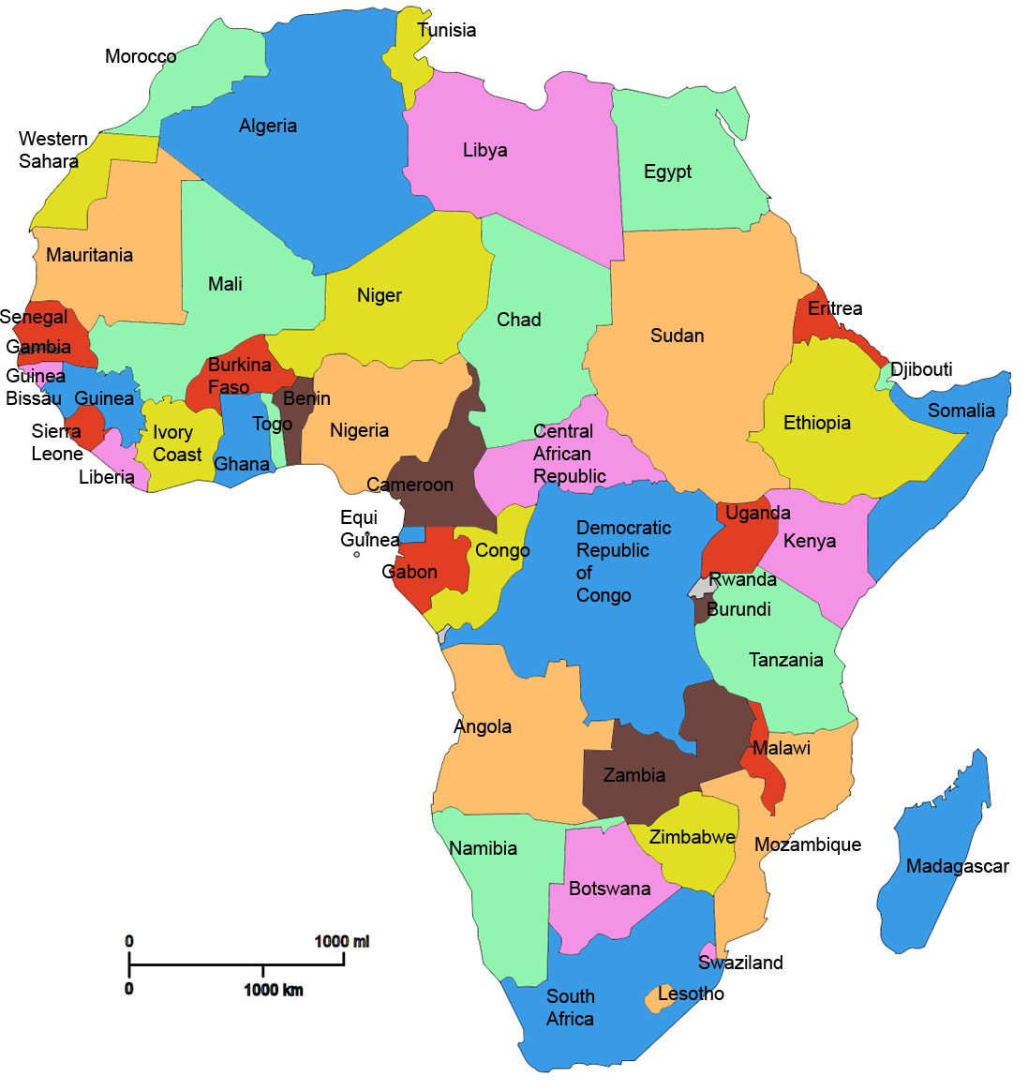
African

Slide 43
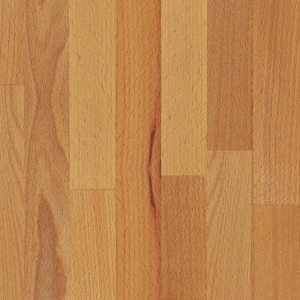
Material

Slide 44
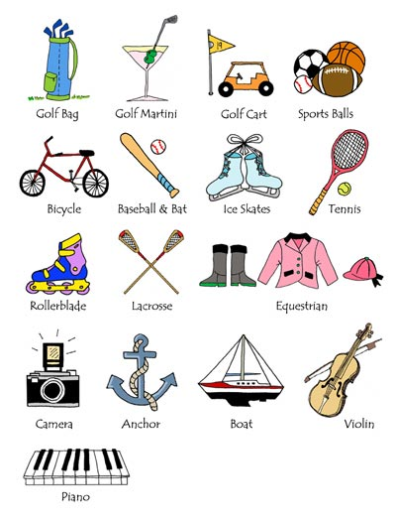
Purpose

Slide 45
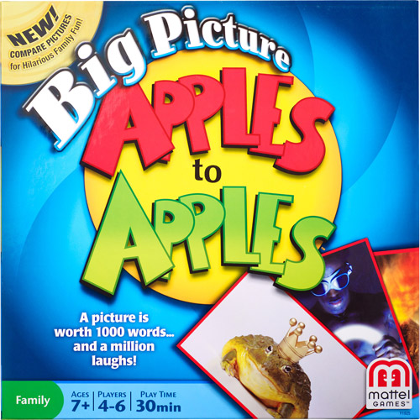

Slide 46
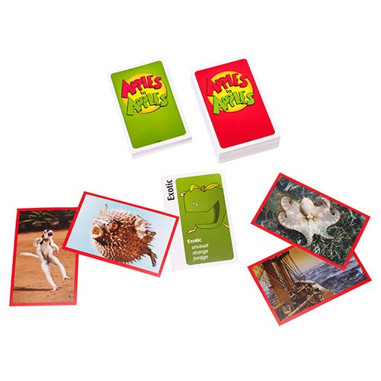

Slide 48
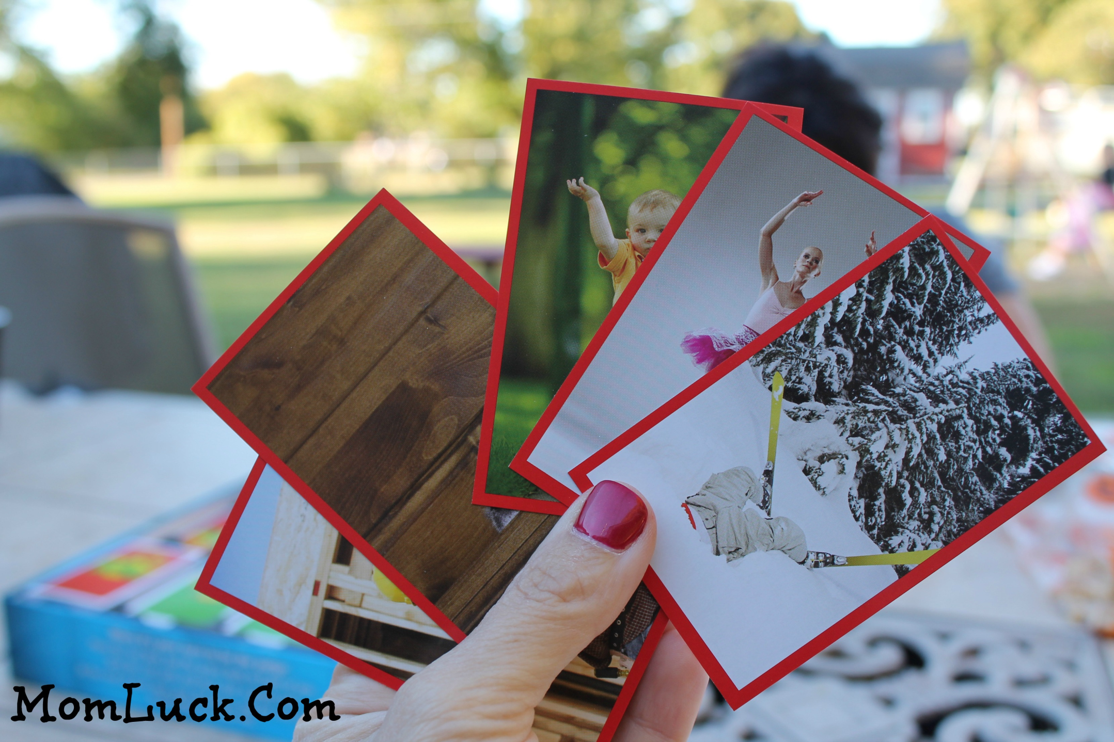

Slide 49
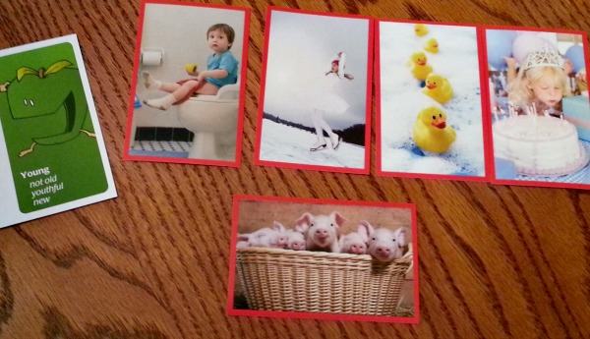

Slide 50
