Slide 1
Three Little Pigs
Story and Houses

Slide 2
How did they build their homes?
The first pig
The second pig
The third pig
Stick House
Straw House
Brick House

Slide 3
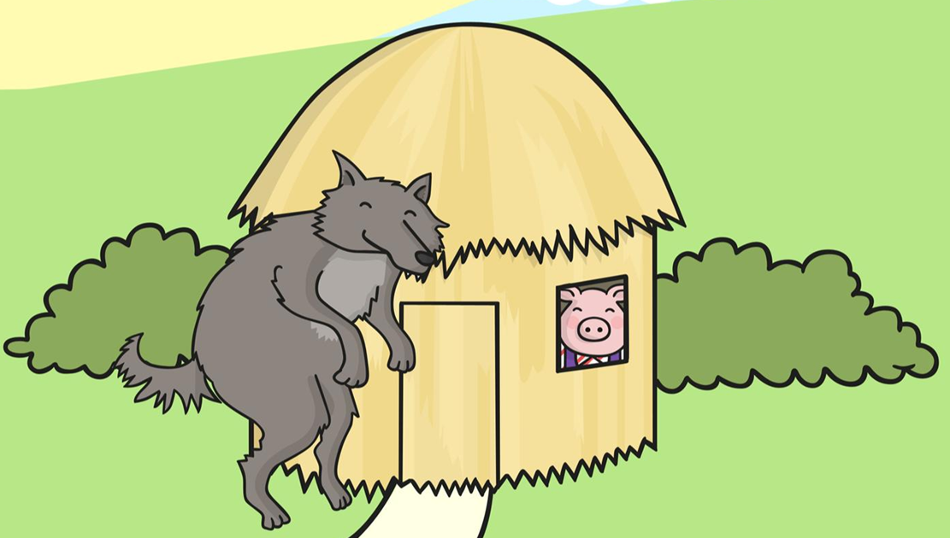
What happened?

Slide 4
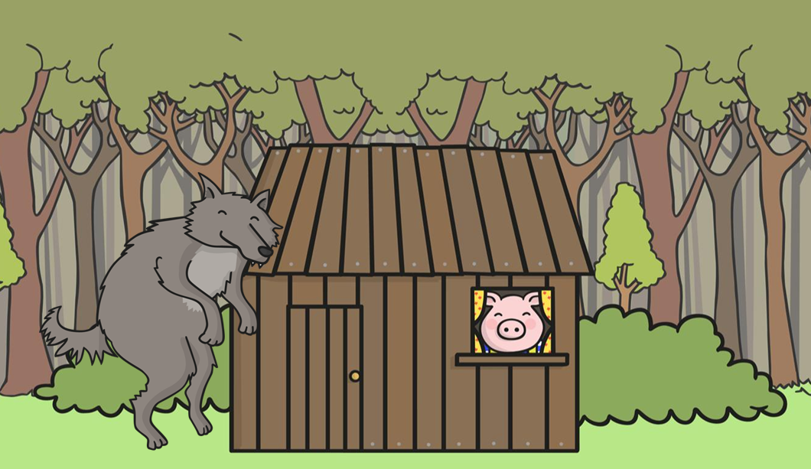
What happened?

Slide 5
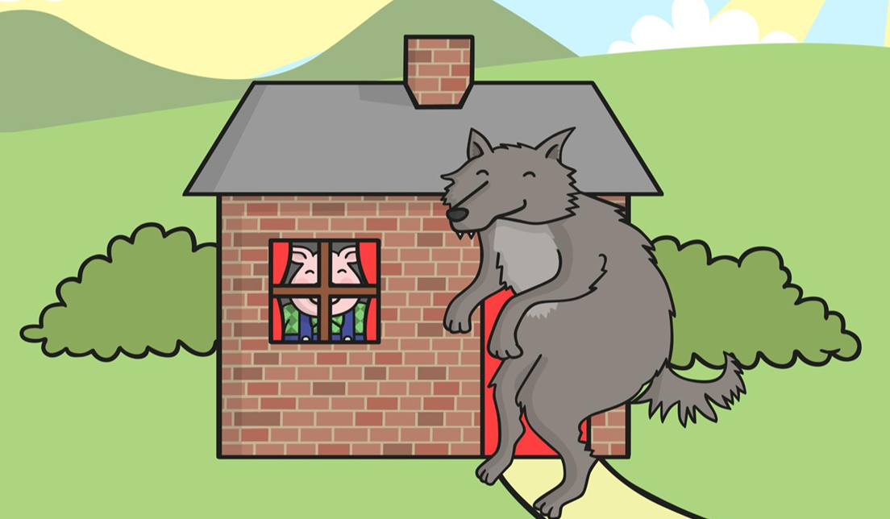
What happened?

Slide 6
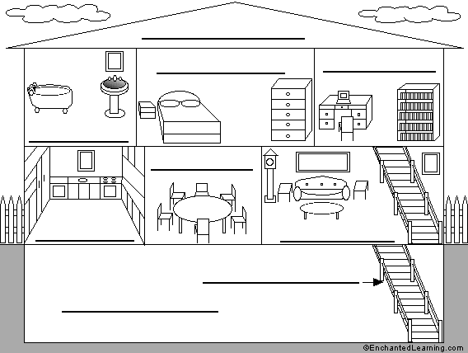
Rooms in a House
Attic
Bedroom
Office
Bathroom
Dining room
Kitchen
Living room
Stairs
Basement

Slide 7
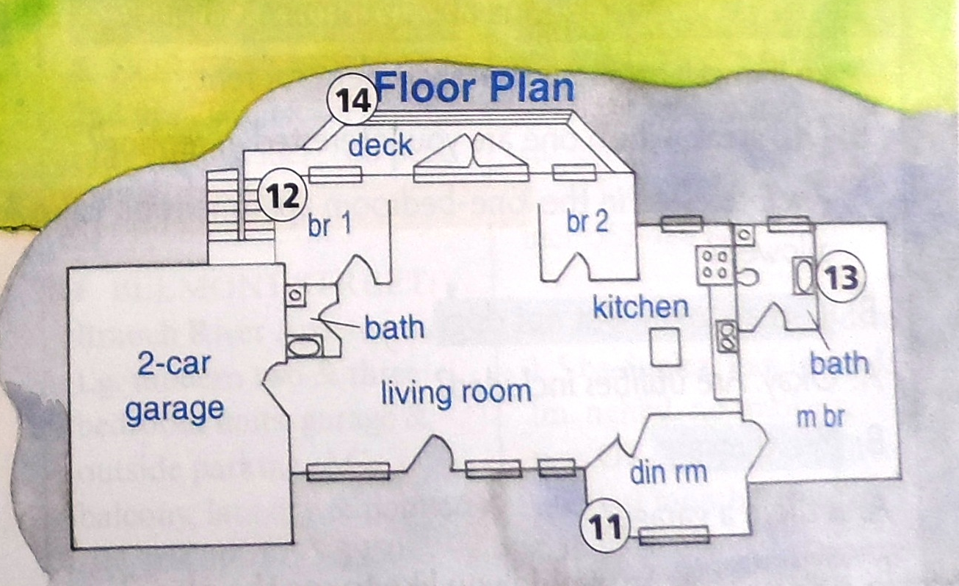
Match the item with the room.

Slide 8
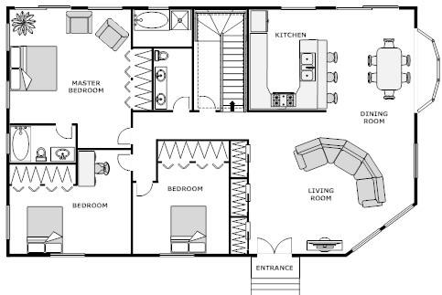
Blueprint

Slide 9
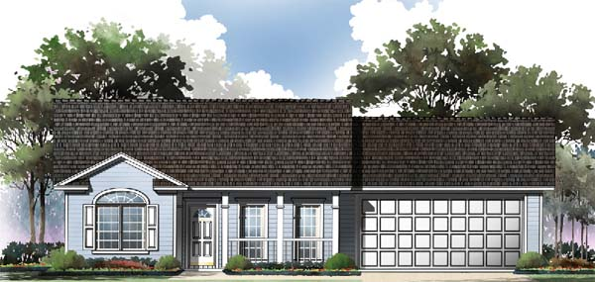
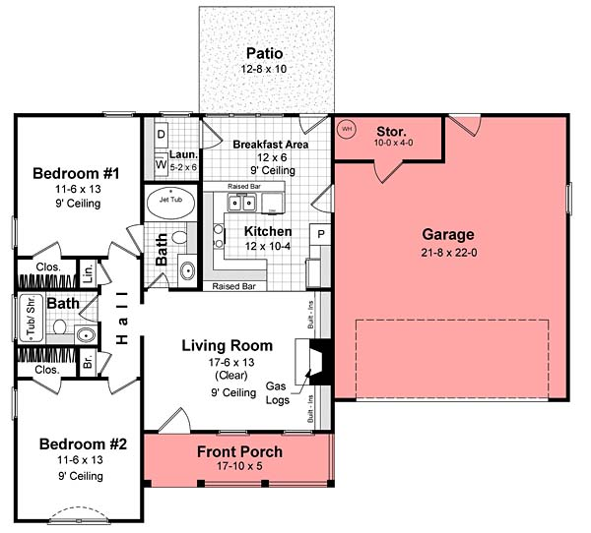
Blueprint

Slide 10
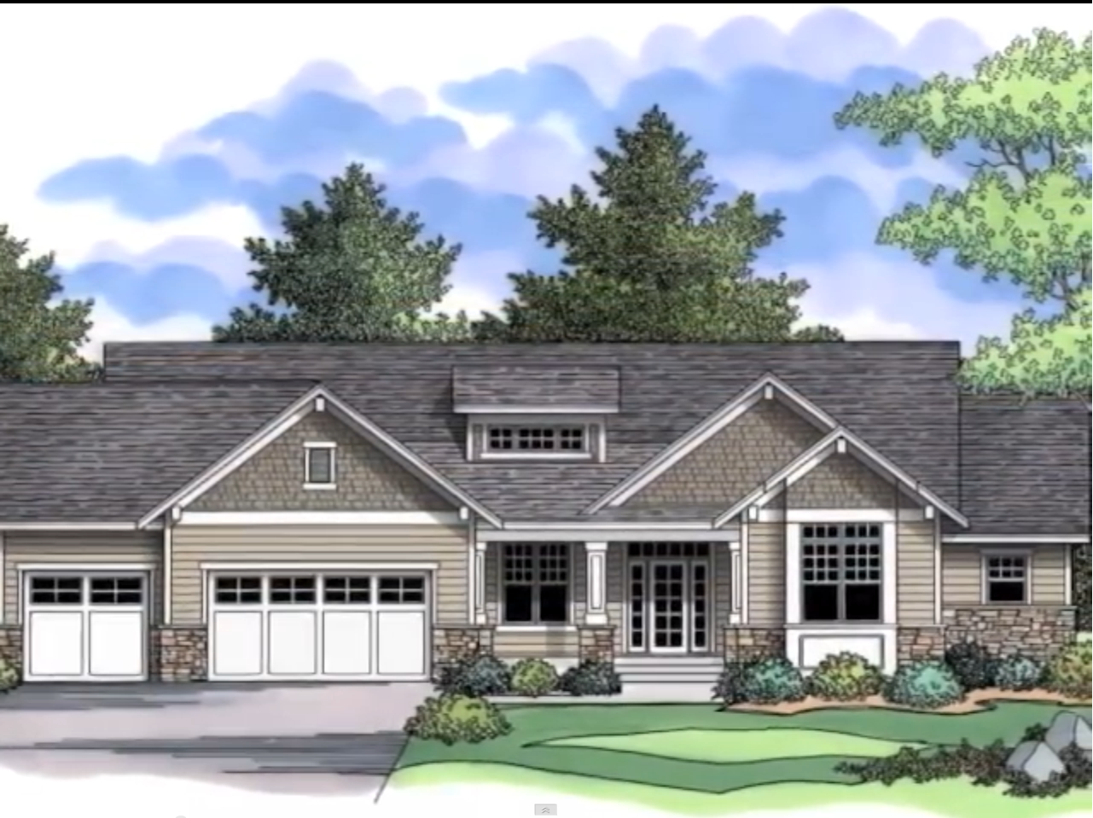

Slide 11
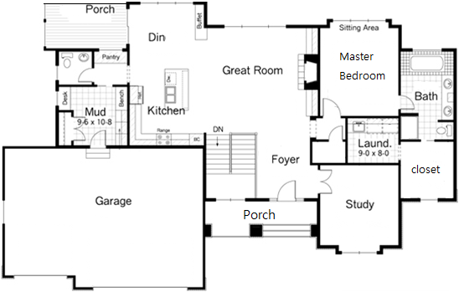

Slide 12
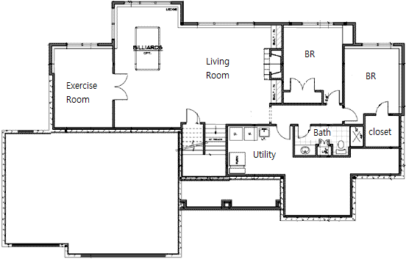

Slide 14
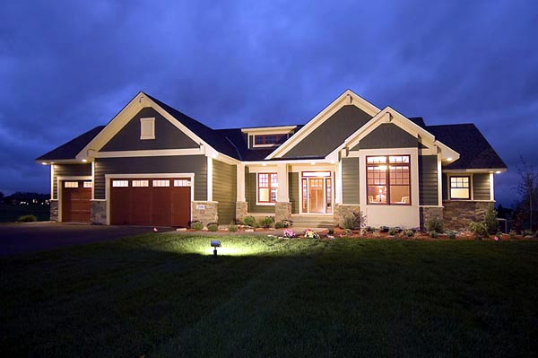
How many bed rooms?
How many bathrooms?
What is the FOYER?

Slide 15
What is in the Living Room?
What room can be changed to a 4th bedroom?

Slide 16
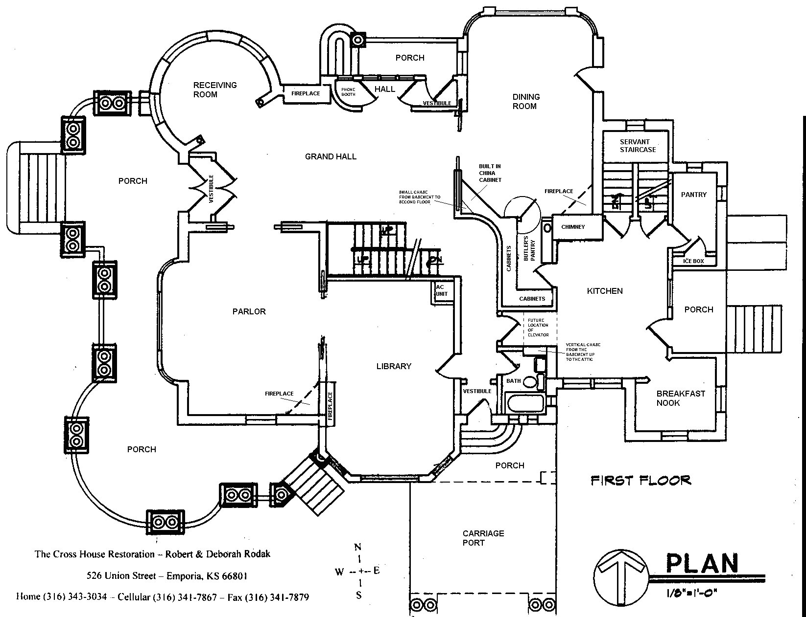
Draw your DREAM HOUSE:

Slide 17
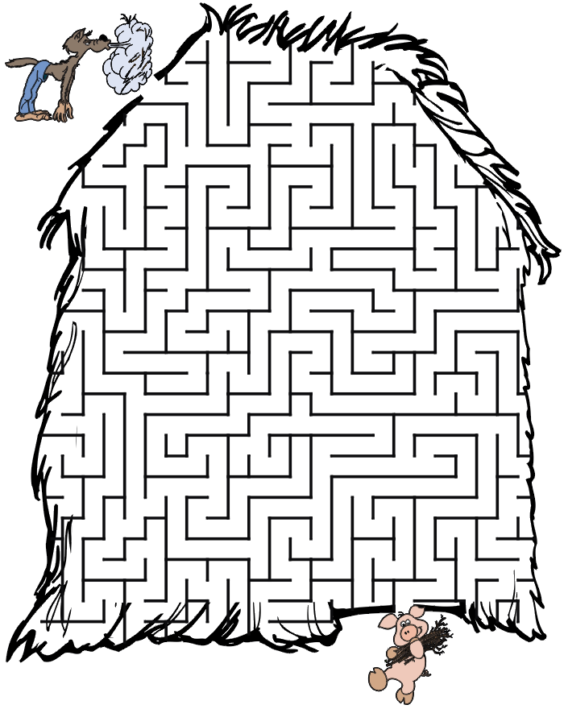

Slide 18
Michael wants a house with:
4 bedrooms
A large living room

Slide 19
Jessica wants a house with:
Only 1 bedroom
An office

Slide 20
Lloyd wants a house with:
A place to play games
A nice kitchen

Slide 21
Sally wants a house with:
At least 2 bedrooms
2 bathrooms

Slide 22
Gina wants a house with:
A porch
A kitchen
A living room

Slide 23
Ted wants a house with:
A room to play games
The living room is the biggest room
One or two bedrooms
One bathroom

Slide 24
Gary wants a house with:
Two floors
Master Bedroom upstairs
A laundry room

Slide 25
Celina wants a house with:
Two bedrooms in the basement
A dining room attached to the kitchen
A porch behind the house

Slide 26
Helen wants a house with:
Master bedroom is the largest room.
A unique room.
A large foyer.

Slide 27
Put a dot where you think the picture was taken.

Slide 28
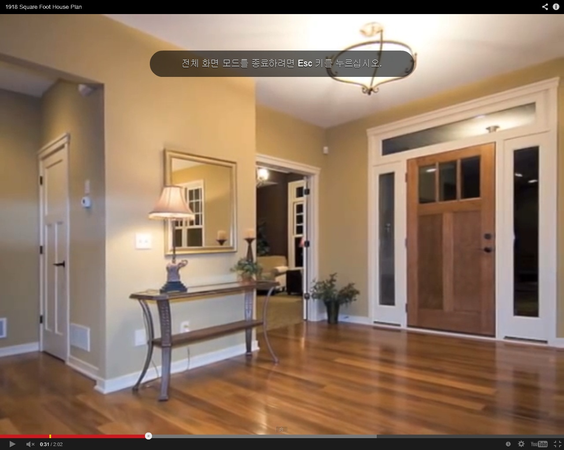
Blue Dot

Slide 29
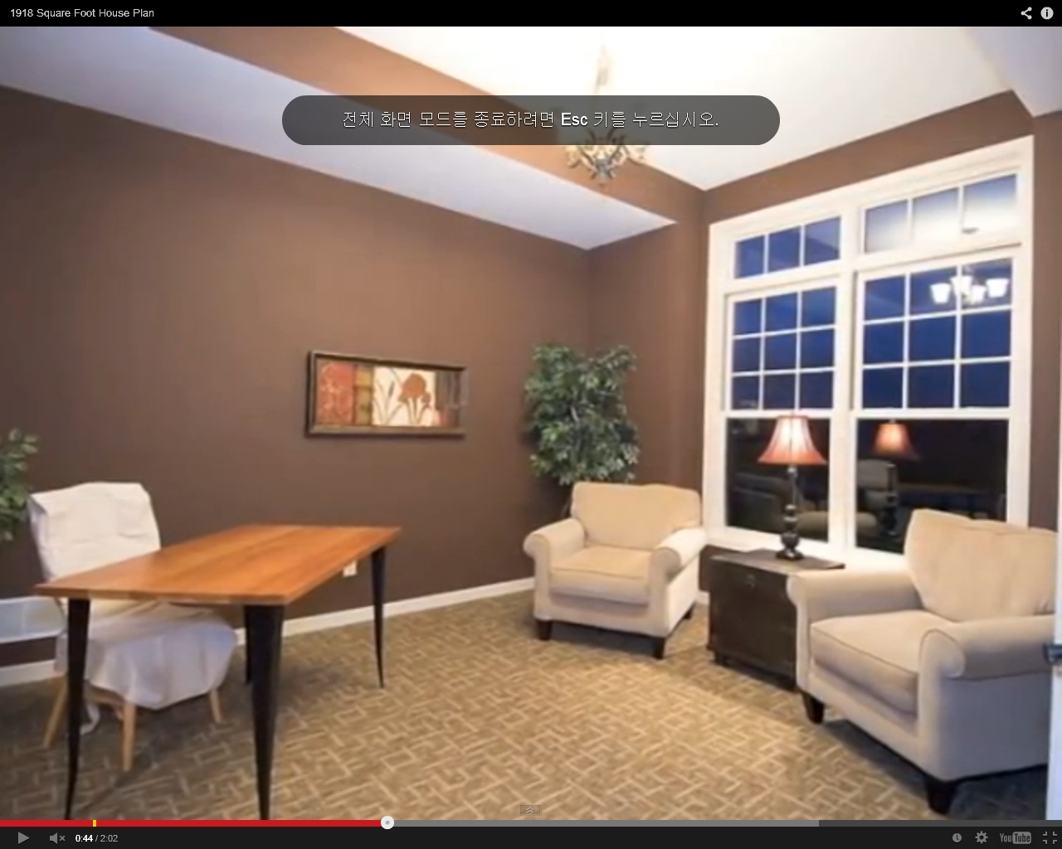
Red Dot

Slide 30
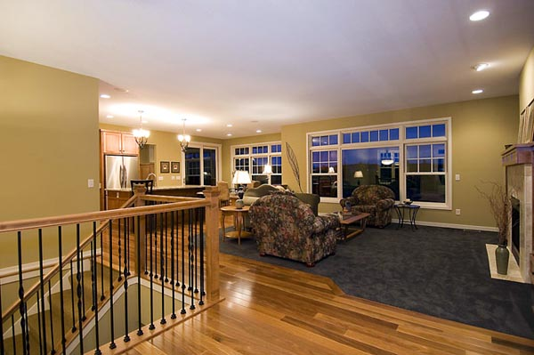
Purple Dot

Slide 31
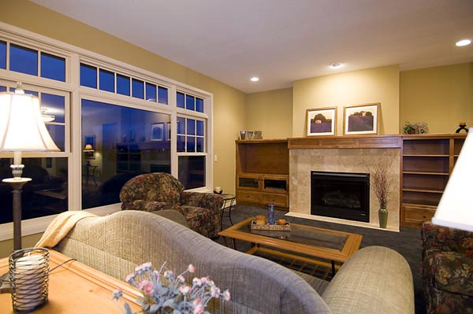
Green Dot

Slide 32
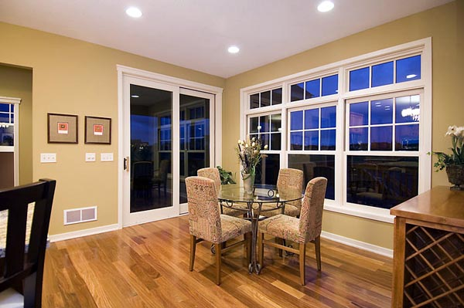
Orange Dot

Slide 33
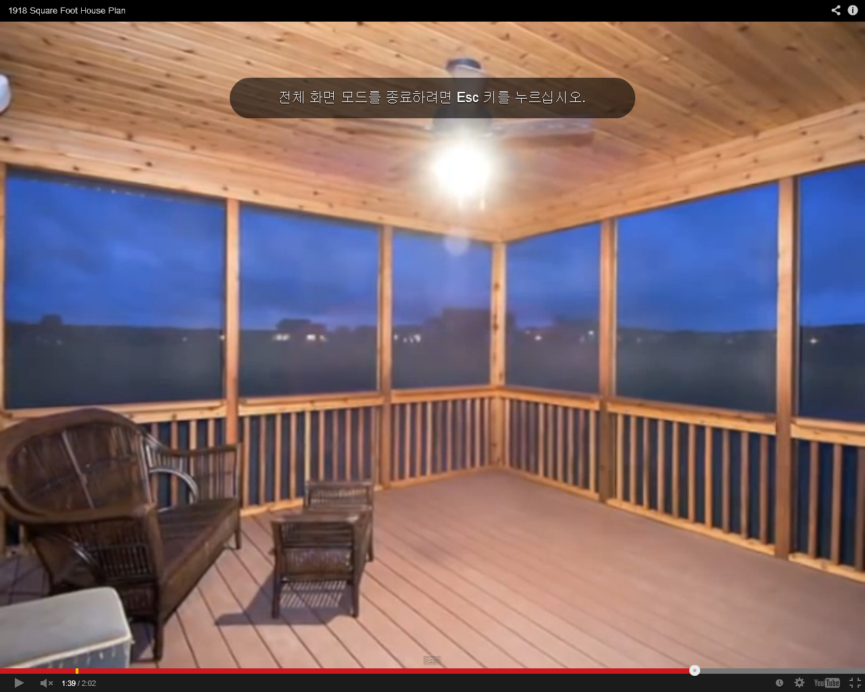
Black Dot

Slide 34
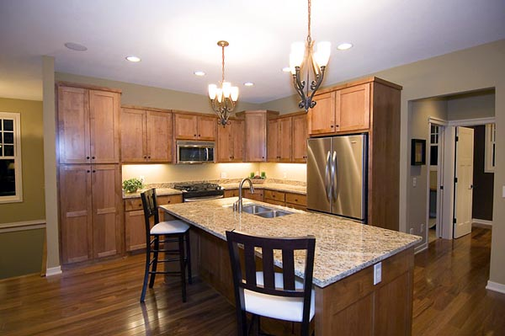
Yellow Dot

Slide 36
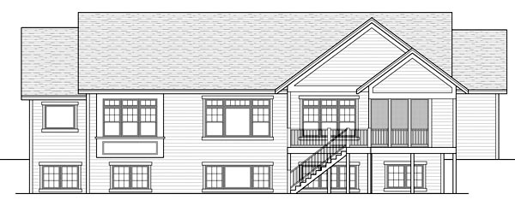
http://www.coolhouseplans.com/details.html?pid=chp-47121

