Slide 1
More Adjectives!

Slide 2
Describe These Pictures:

Slide 3
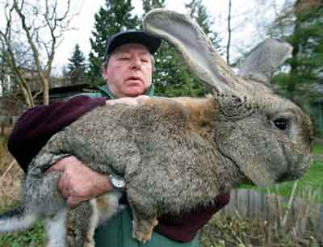

Slide 4
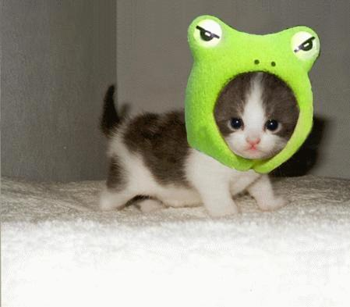

Slide 5
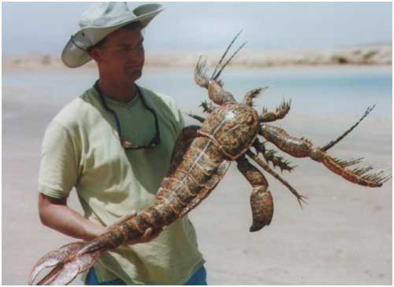

Slide 6
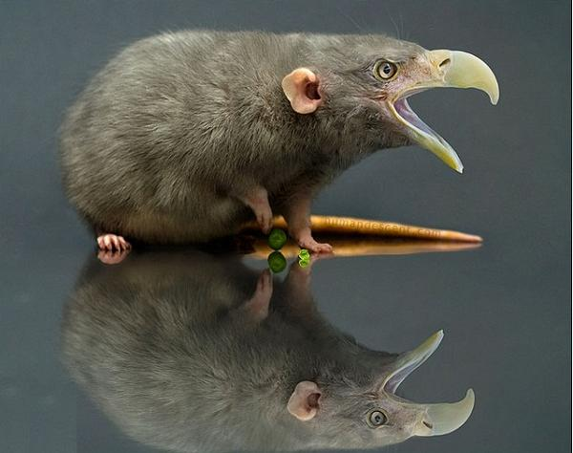

Slide 7
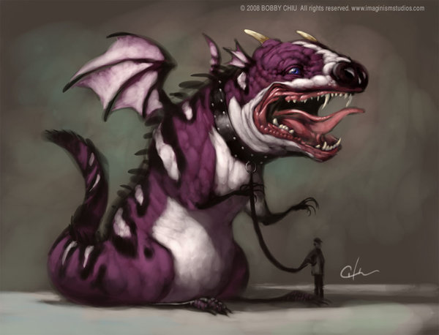

Slide 8
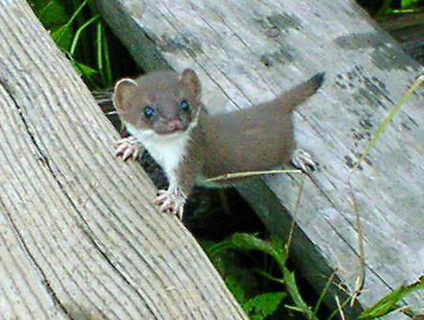

Slide 9
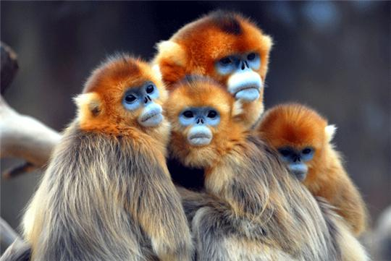

Slide 10
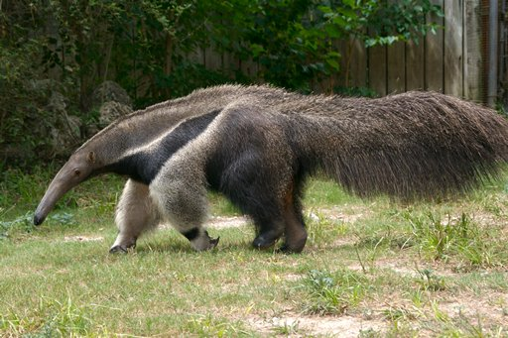
Ant eater

Slide 11
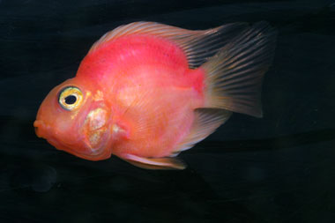
Parrot fish

Slide 12
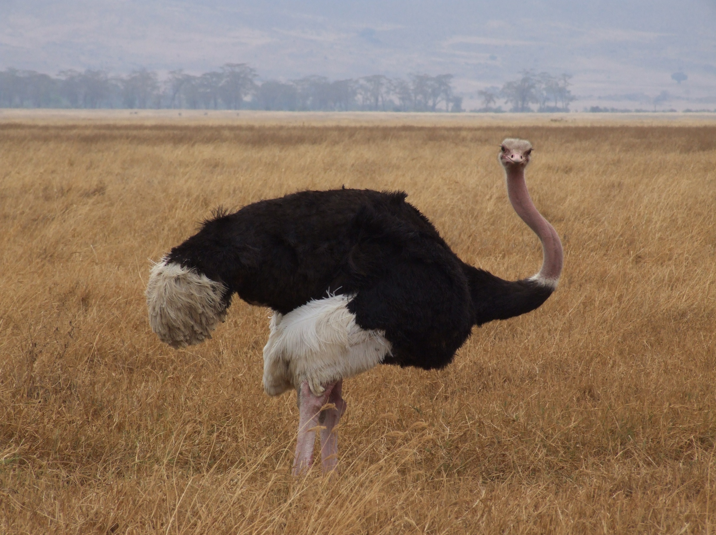
Ostrich

Slide 13
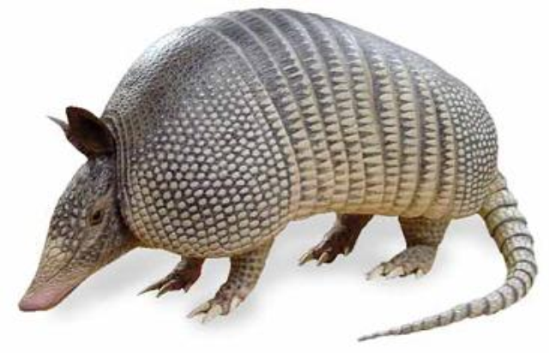
Armadillo

Slide 14
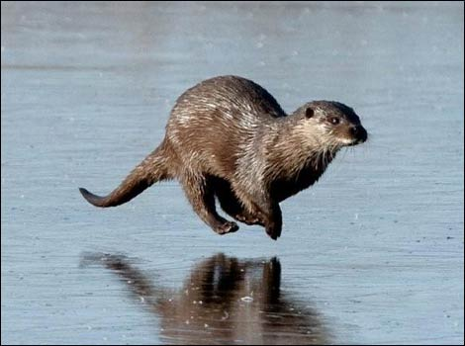
Otter

Slide 15
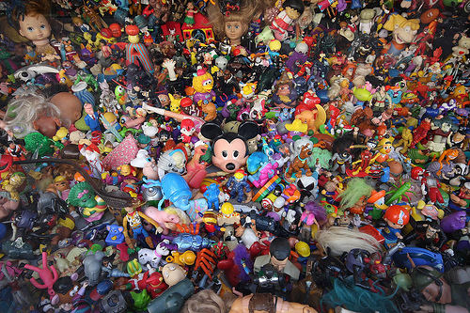
Eye Spy
Eye spy with my little eye, something that is...

Slide 16
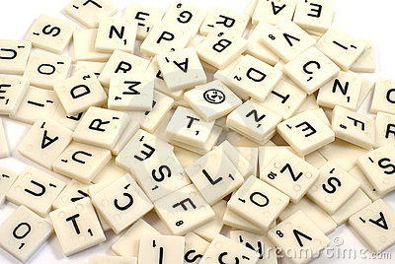
Letter and Adjective

Slide 17
Letters and Adjectives
One letter and a number of adjectives will be selected.
You must find the noun that makes sense.
First one gets the points.

Slide 18
Guessing Game
Ask questions to learn about the “noun”
Guess what it is.
“Yes” or “No”
Whoever guesses correctly gets to choose the next player.

Slide 19
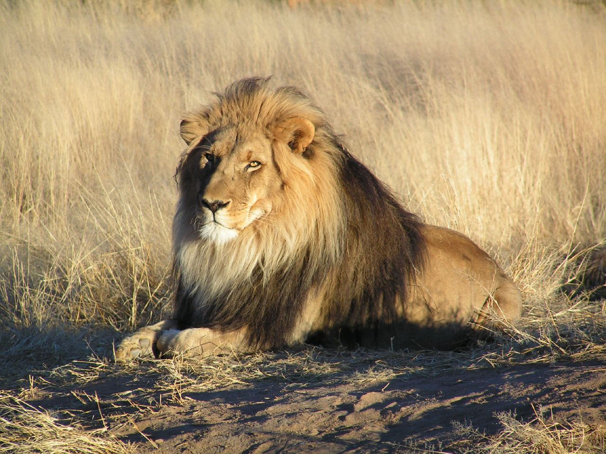

Slide 21
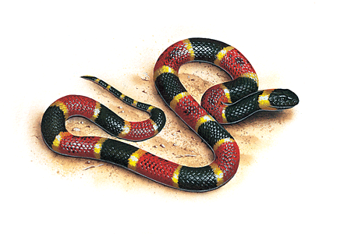

Slide 24
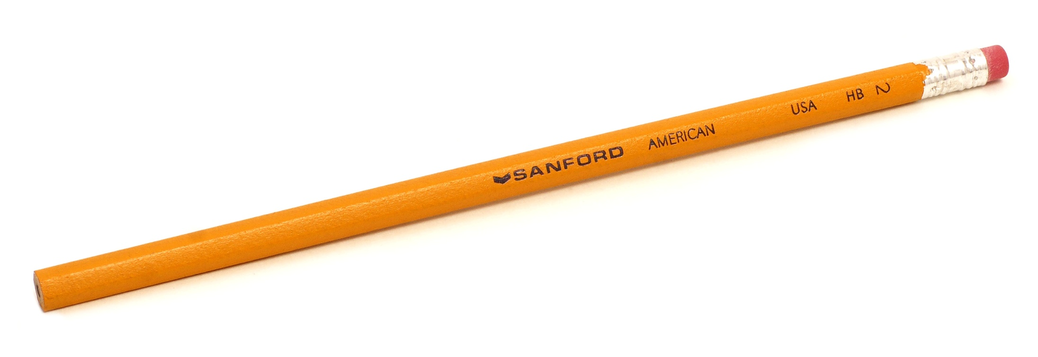

Slide 25
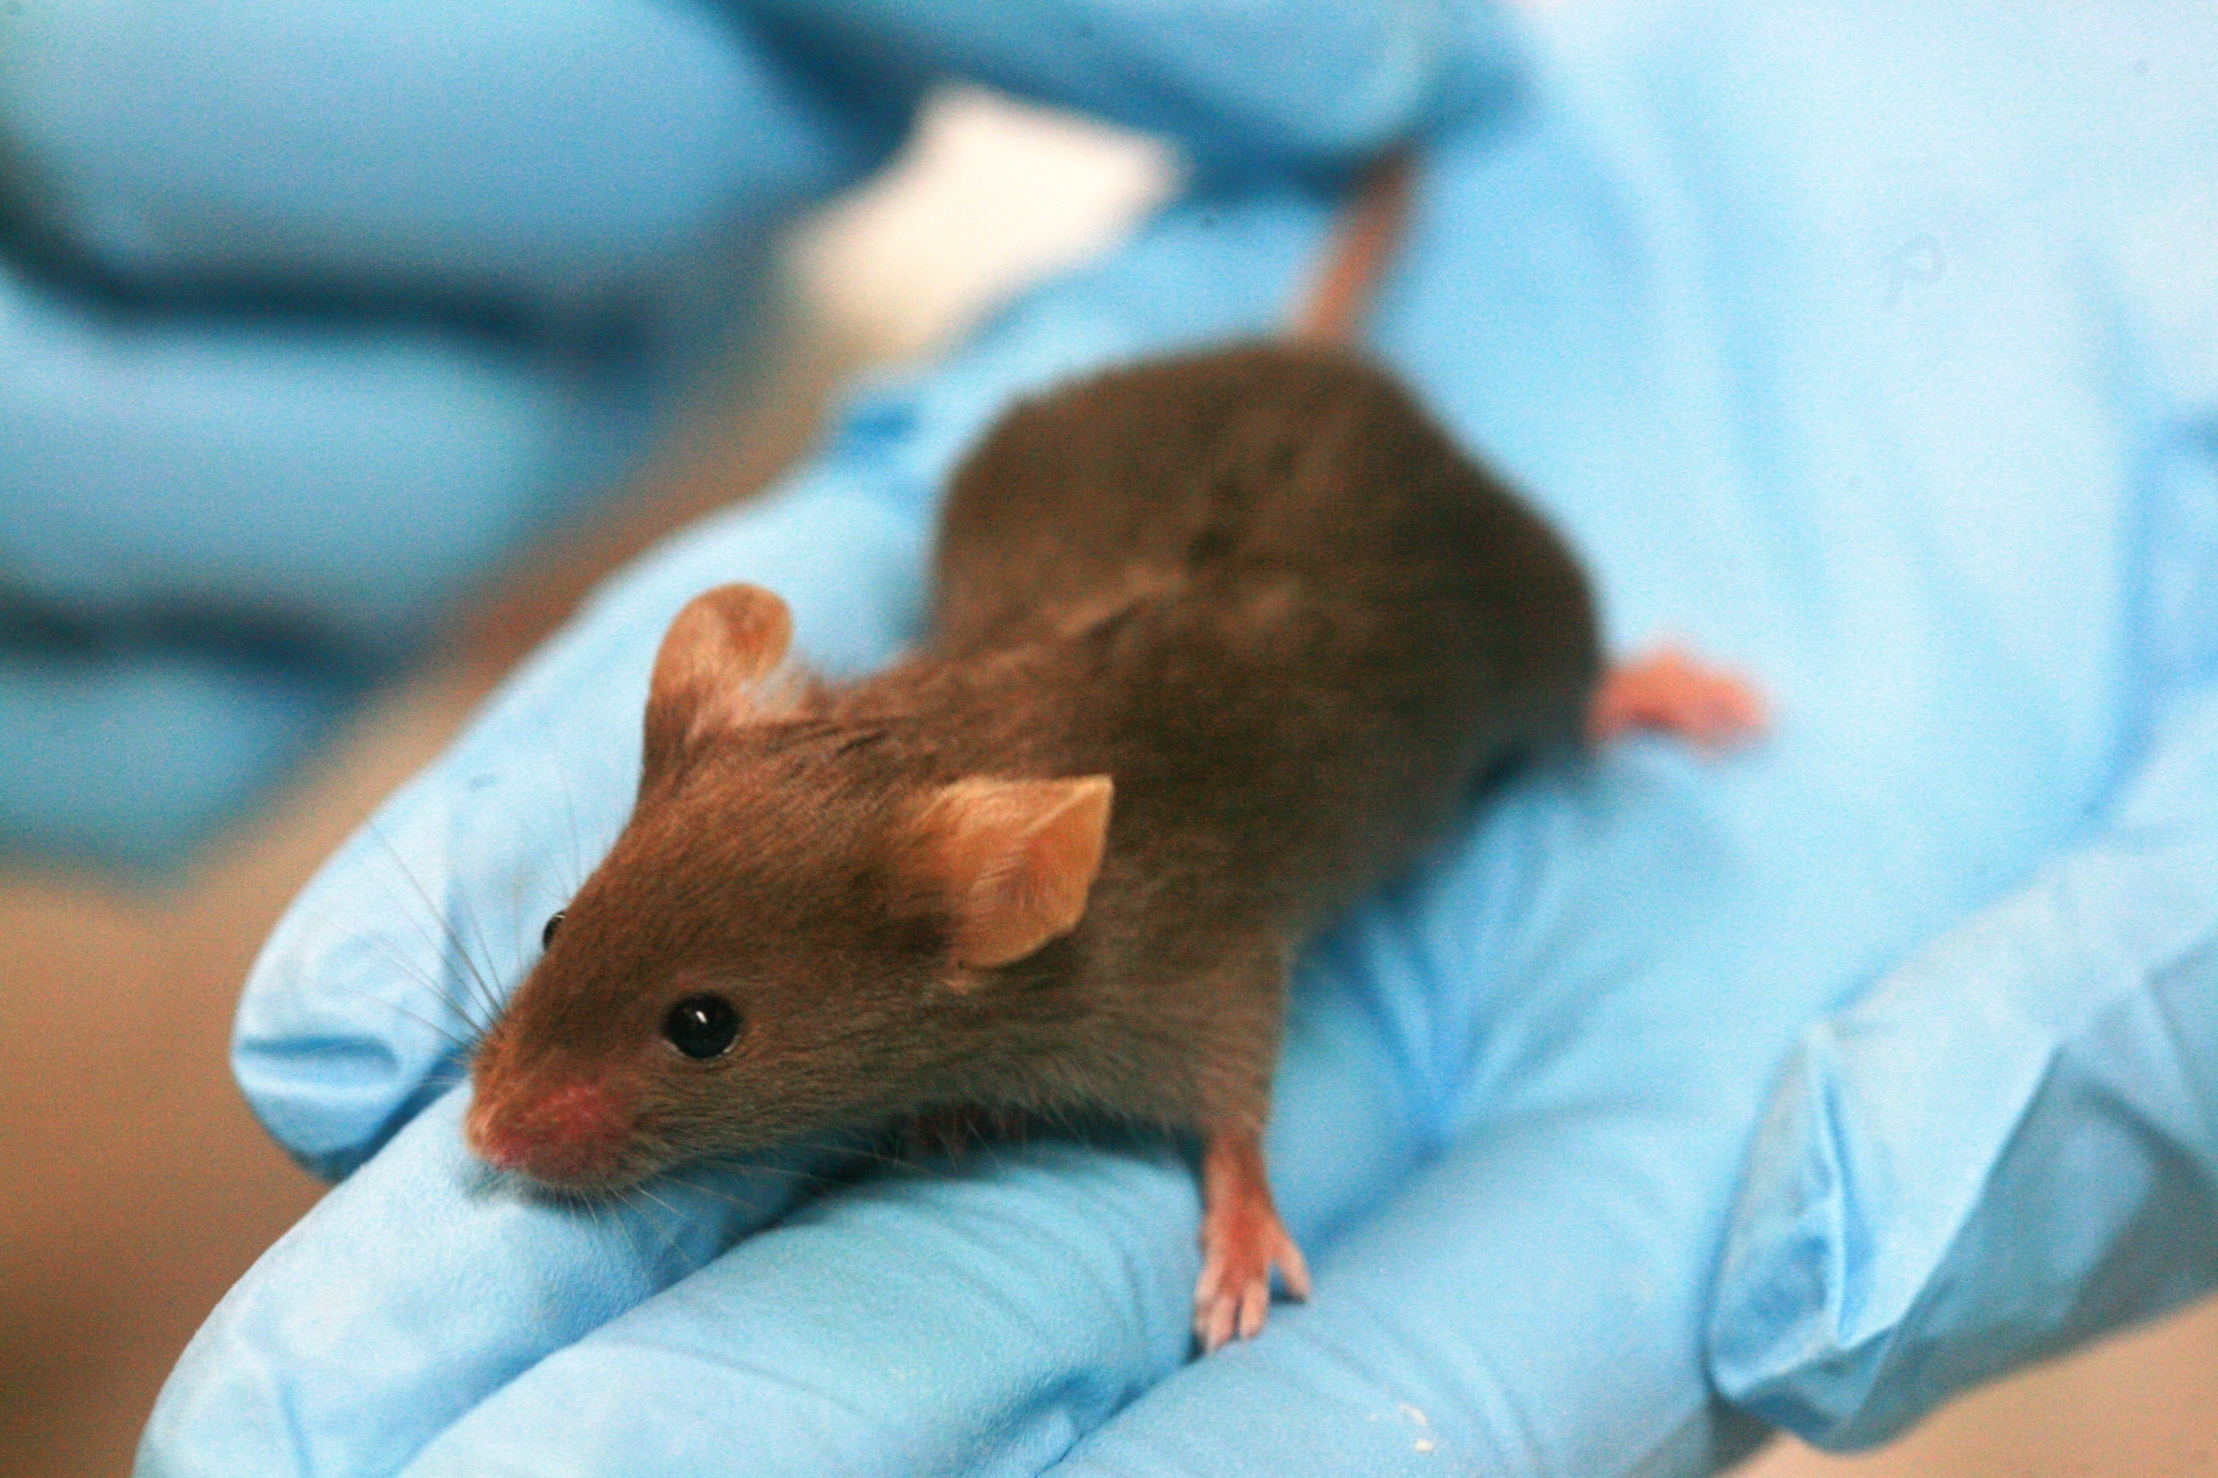

Slide 27
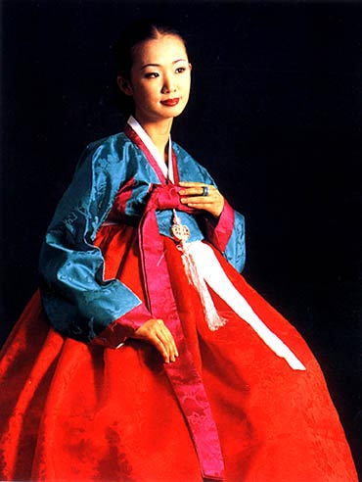

Slide 29
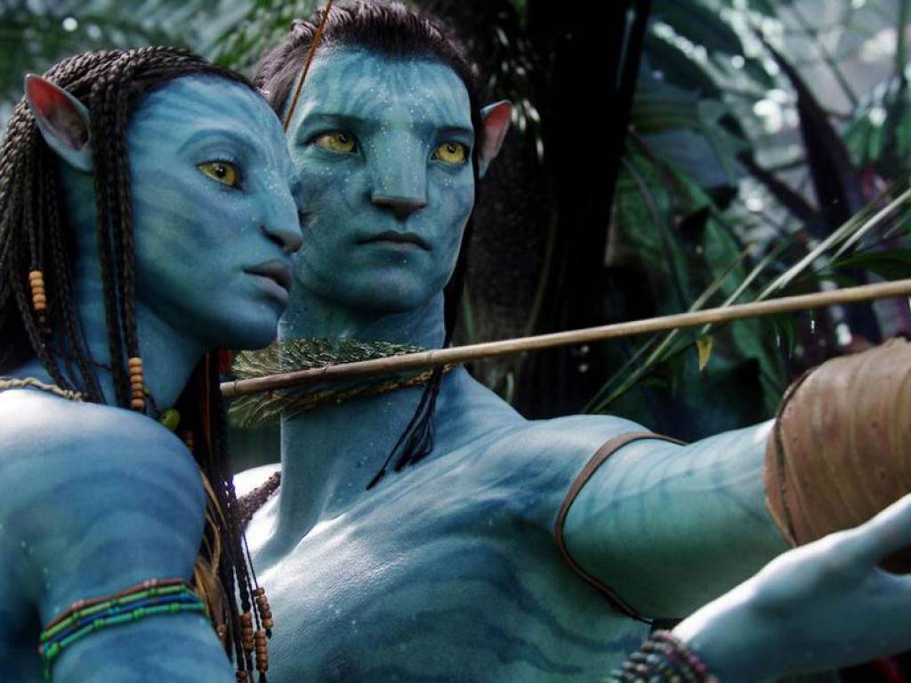

Slide 30
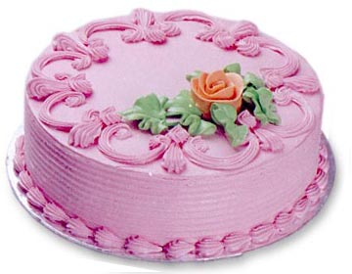

Slide 31
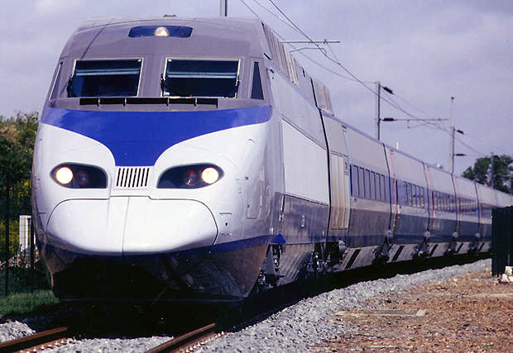

Slide 32
Scattegories
Partner game. (2 people)
Find an answer to the clues.
Answers used by other teams do not
count.

