Slide 1
Siege Game (dnd)

Slide 2
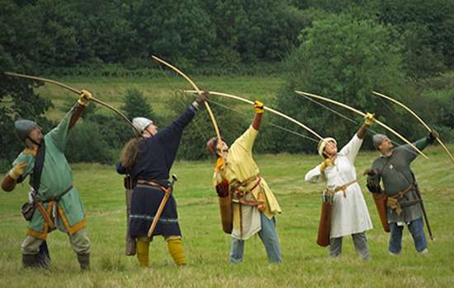
5 archers
Range: 10
Weapon: 1d6
Armor: 4
Health: Archer 1 – 15
Archer 2 – 15
Archer 3 – 15
Archer 4 – 15
Archer 5 – 15

Slide 3
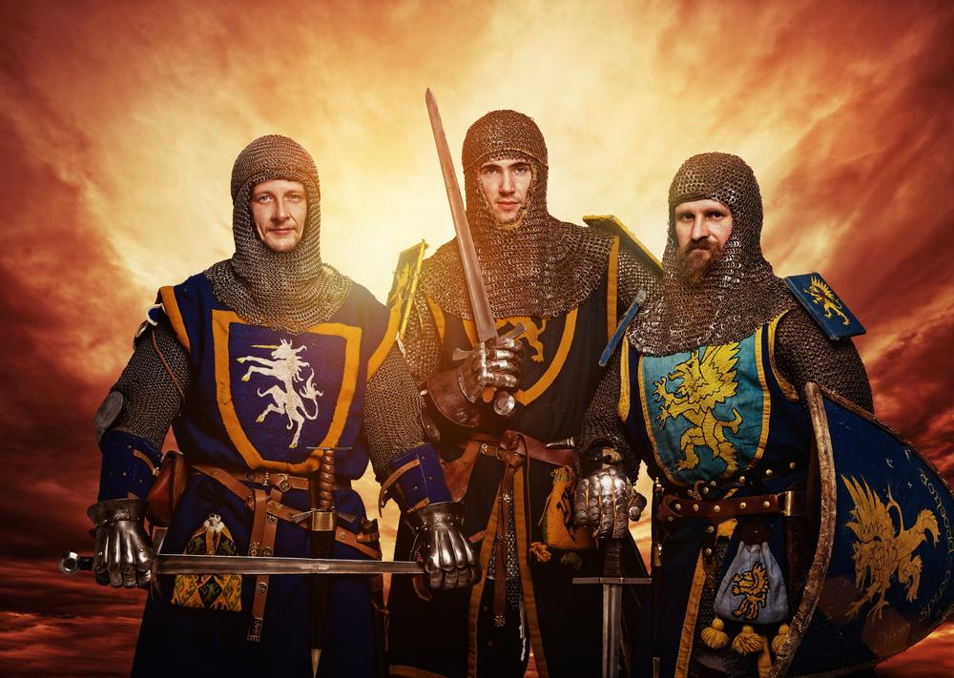
3 Knights
Range: 1
Weapon: 1d8
Armor: 12
Health: Knight 1: 20
Knight 2: 20
Knight 2: 20

Slide 4
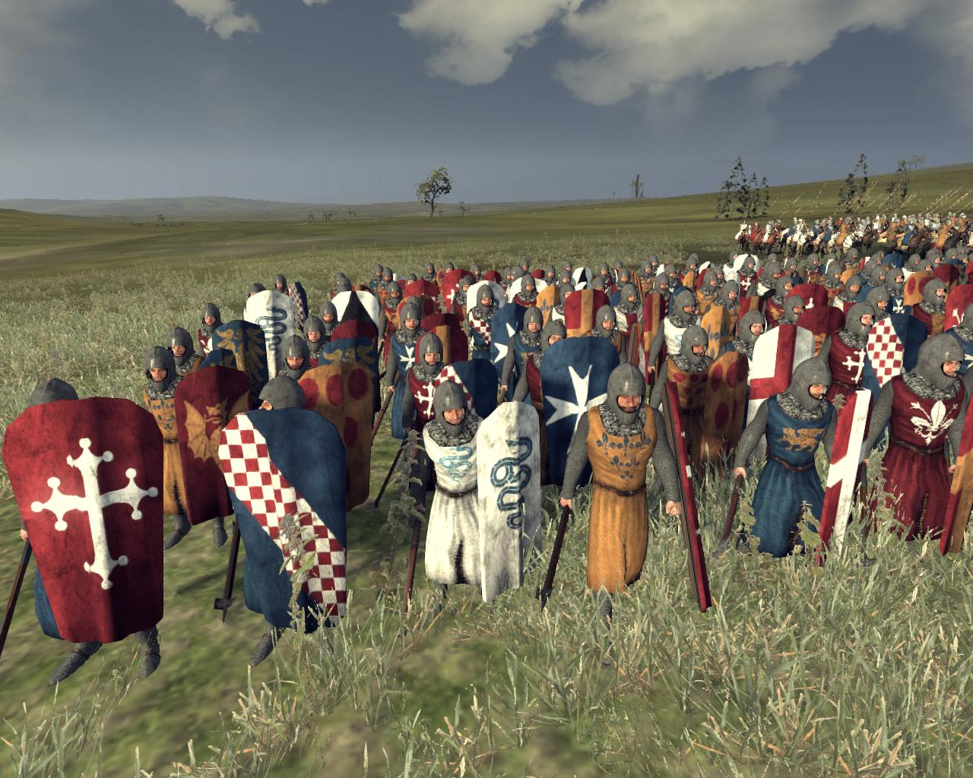
Infantry
Range: 1
Weapon: 1d4
Armor: 8
Health: Infantry 1: 10
Infantry 2: 10
Infantry 3: 10
Infantry 4: 10
Infantry 5: 10
Infantry 6: 10
Infantry 7: 10
Infantry 8: 10

Slide 5
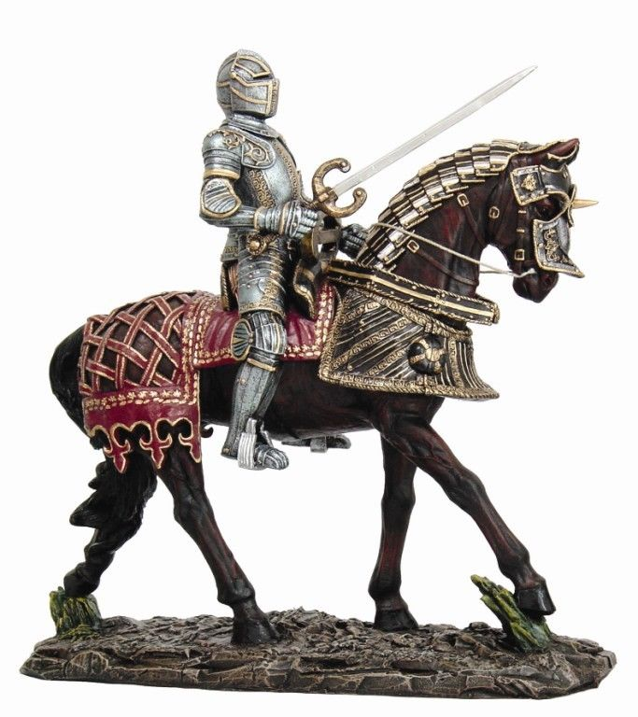
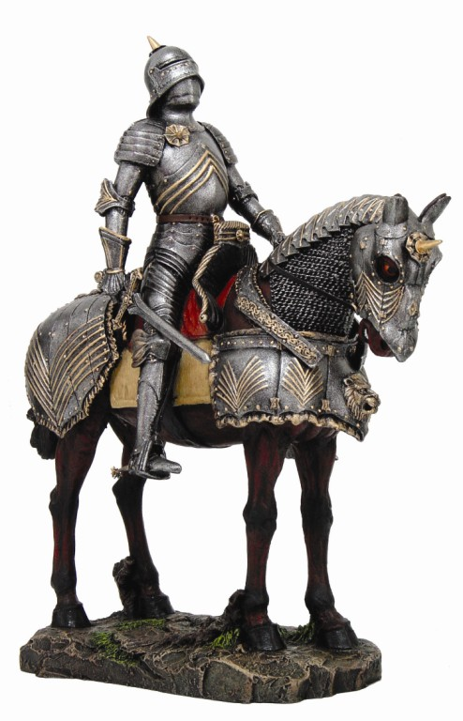
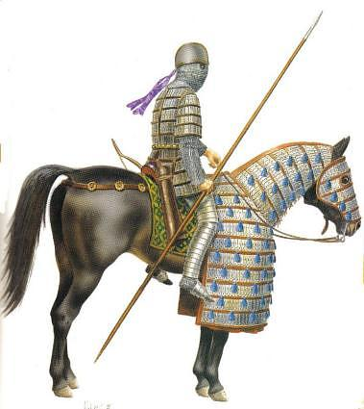
Calvary
Range: 2
Weapon: 1d6
Armor: 9
Health: Calvary 1 – 15
Calvary 2 – 15
Calvary 3 – 15

Slide 6
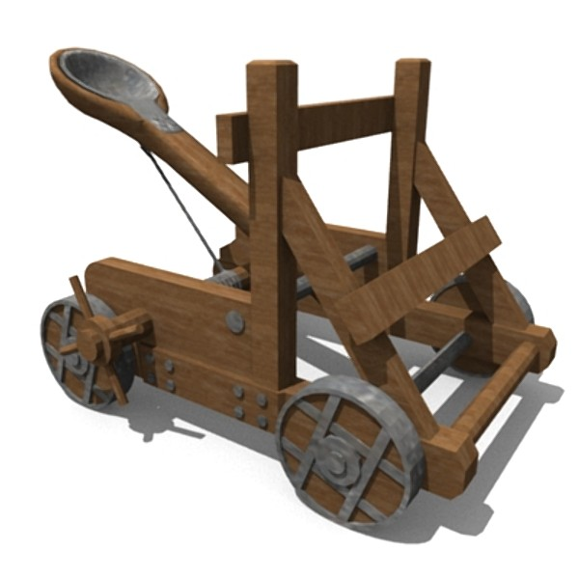
Catapult
Range: 15
Weapon: 1d20
Armor: 5
*3 People Minimum*
Health: Catapult 1 - 25

Slide 7
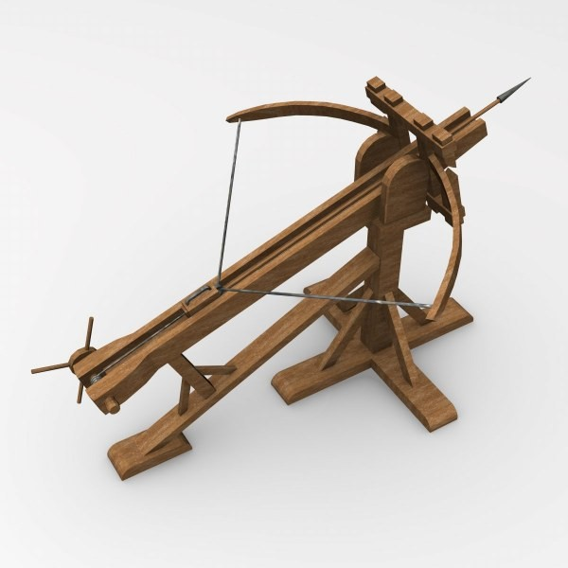
Ballista
Range: 12
Weapon: 2d12
Armor: 8
*2 People Minimum*
Health: Ballista - 25

Slide 8
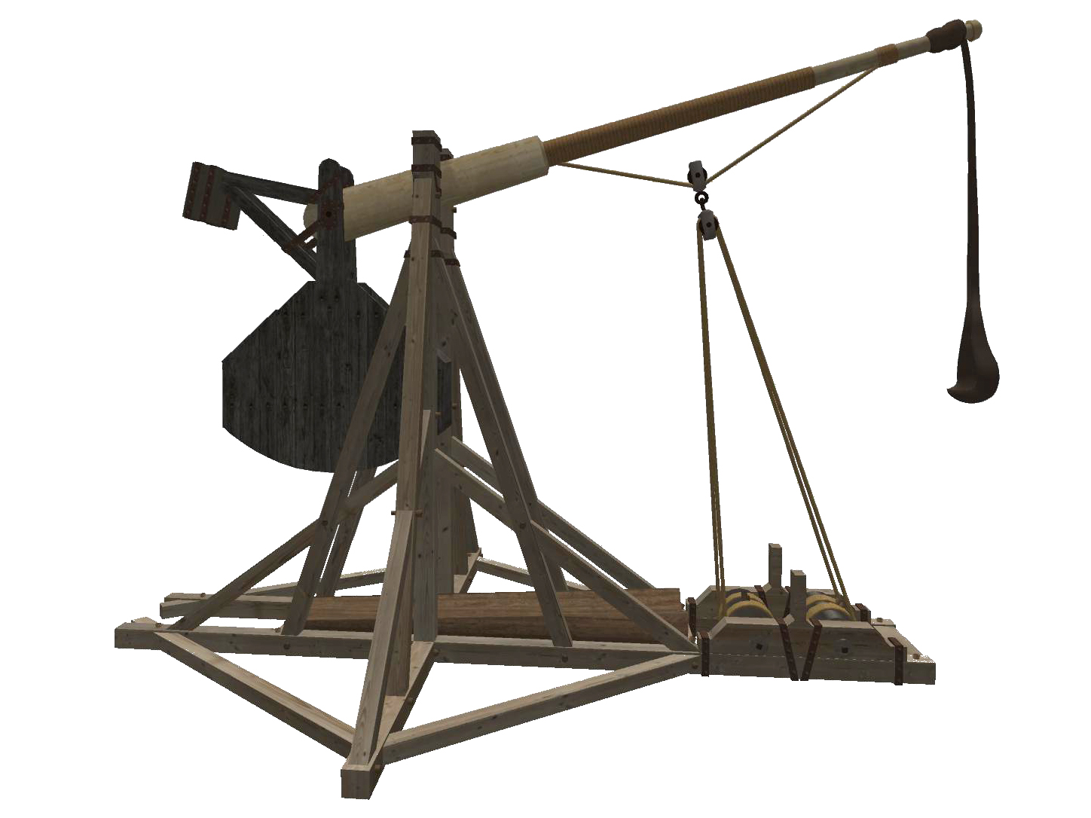
Trebuchet
Range: 20
Weapon: 2d10
Armor: 4
*3 People Minimum*
Health: Trebuchet - 25

Slide 9
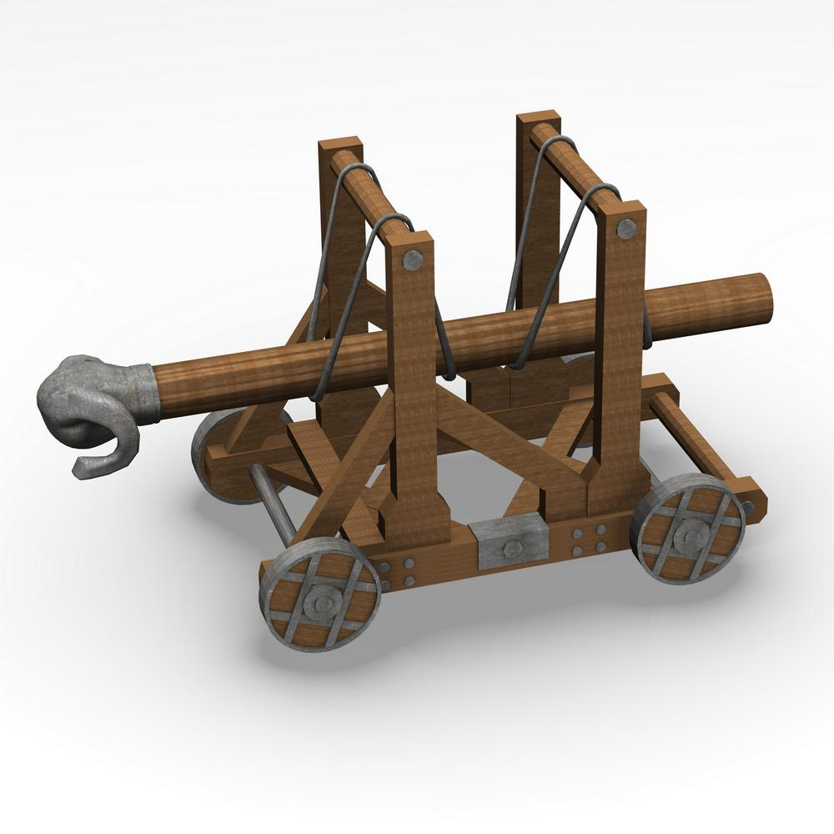
Battering Ram
Range: 1
Weapon: 2d20
Armor: 10
*4 People Minimum*
Health: Battering Ram - 25

Slide 10
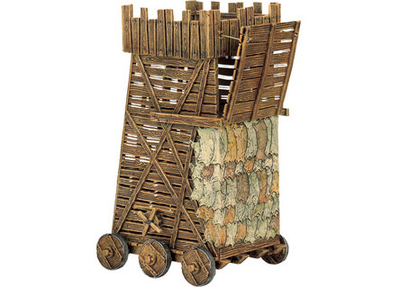
Siege Tower
Range: 1
Weapon: 0
Armor: 15
*3 People Minimum*
Health: Siege Tower - 20

