Slide 1
Listen for Sounds
https://www.youtube.com/watch?v=FqJdzYY_Fas

Slide 2
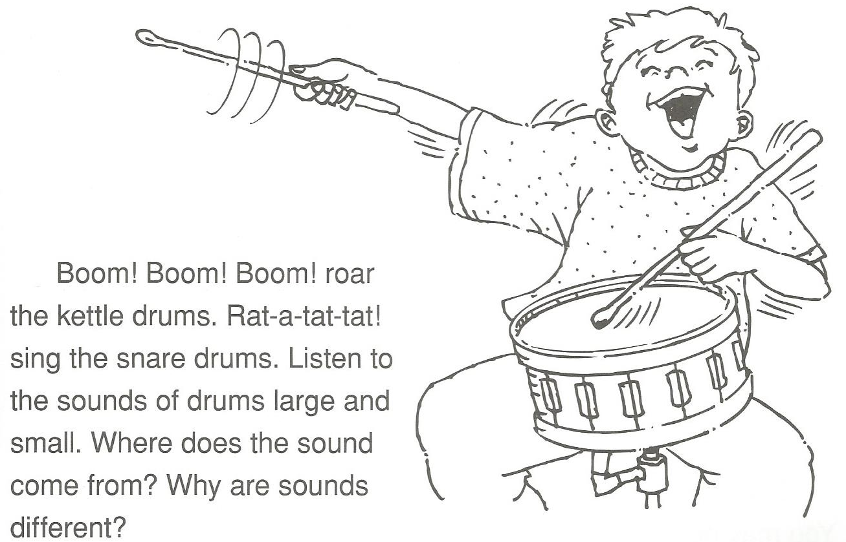

Slide 3
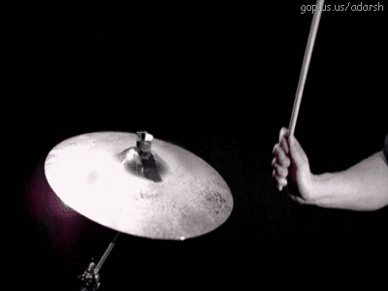
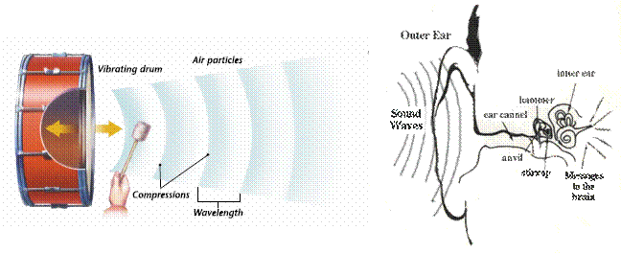

Slide 4
Music in Slow Motion
https://www.youtube.com/watch?v=STSWLX23xqc
http://www.boreme.com/posting.php?id=32544#.VZDK1hvtmko

Slide 5
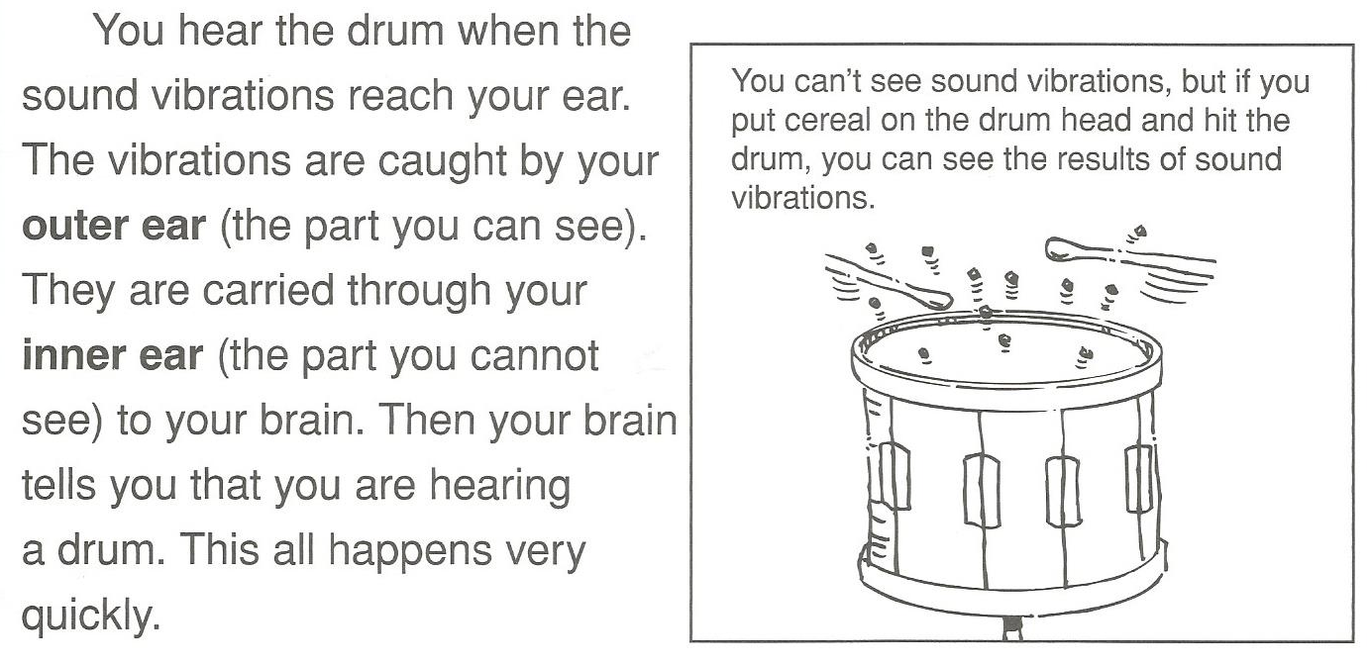
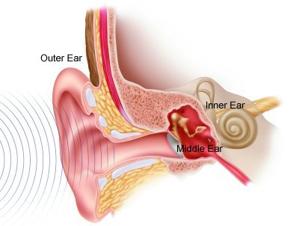

Slide 6
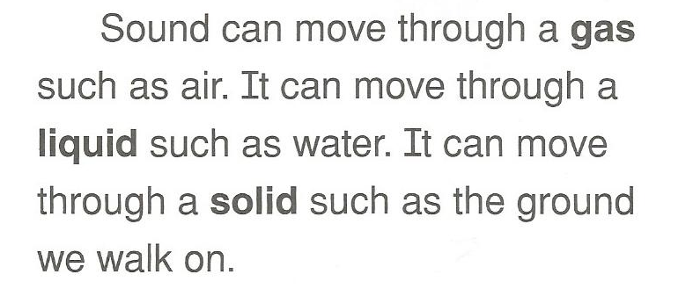
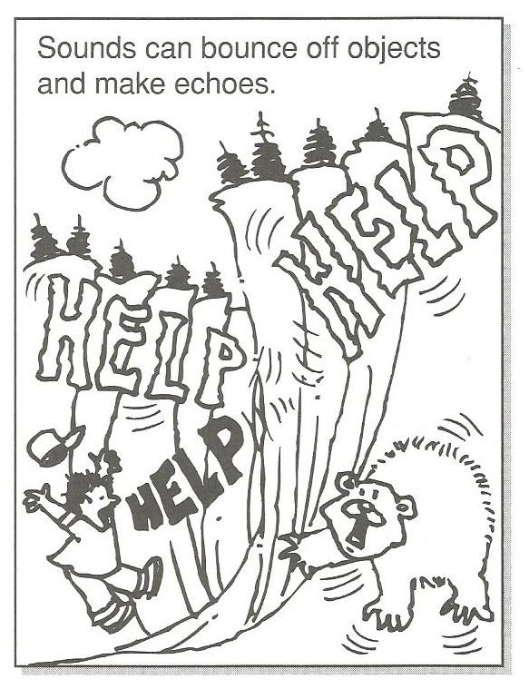
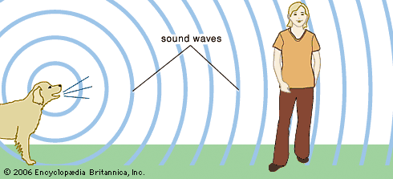
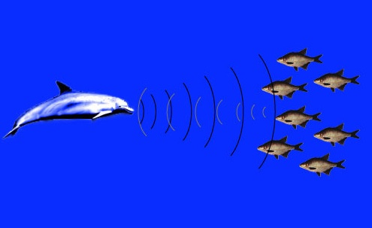

Slide 7
Sound and Water
https://www.youtube.com/watch?v=uENITui5_jU

Slide 8
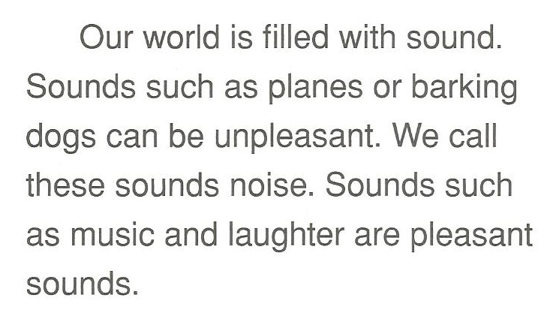
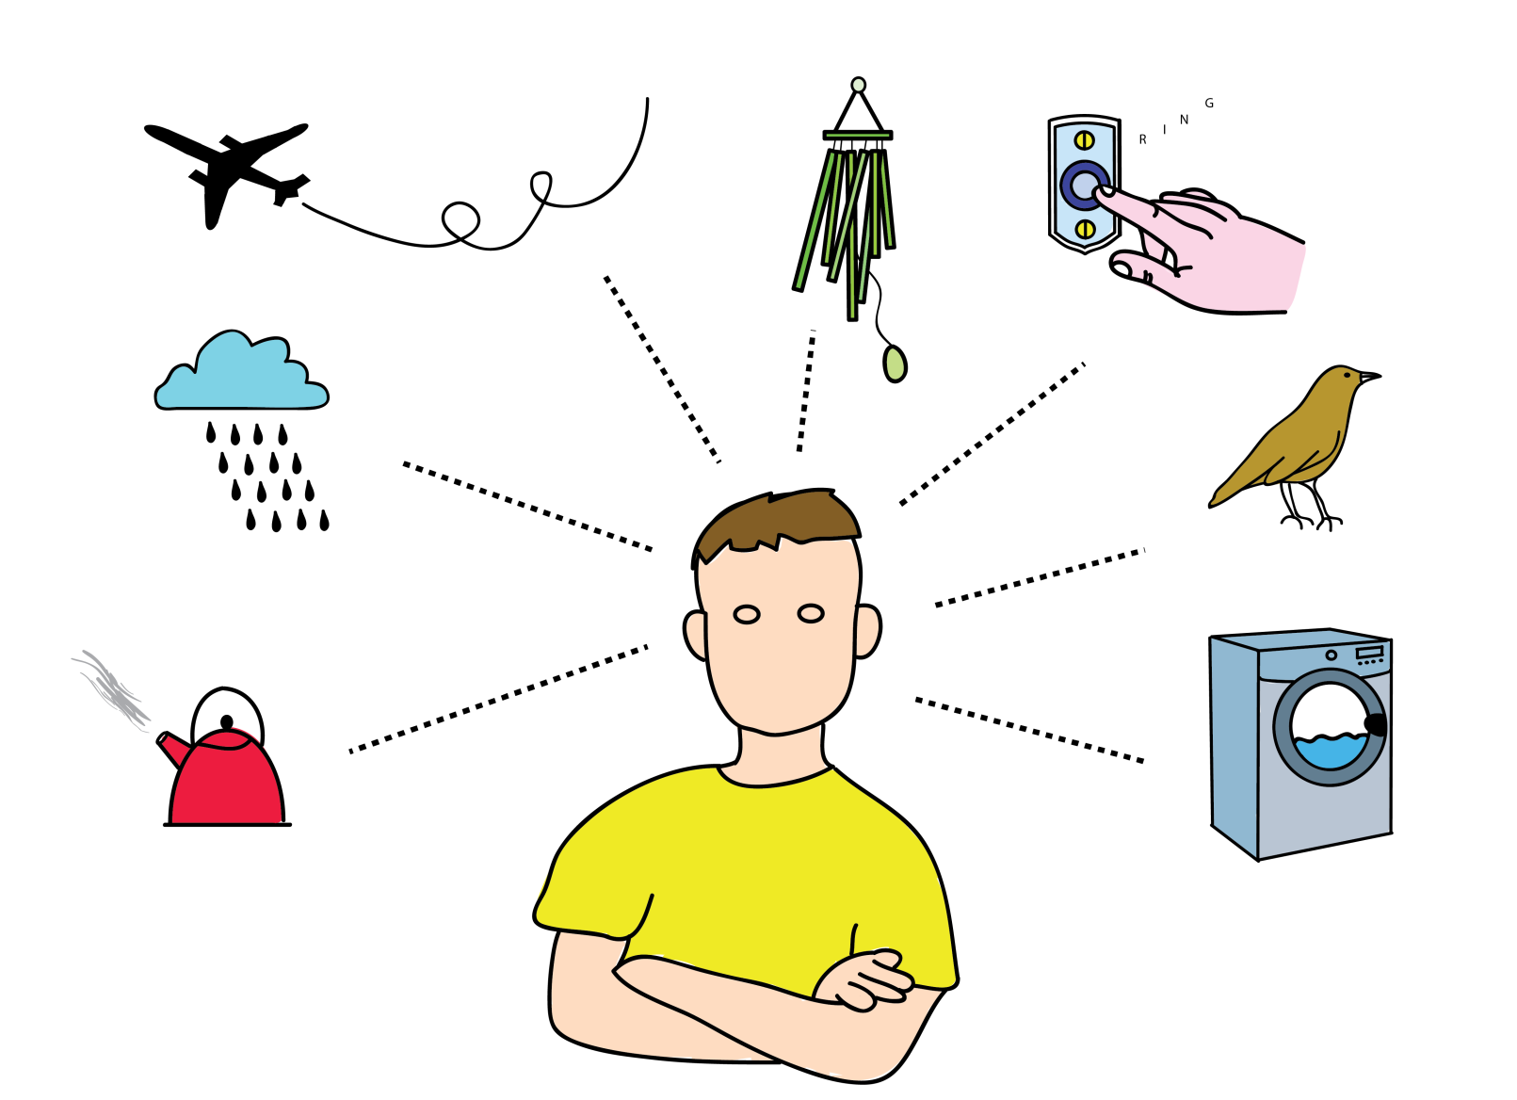

Slide 9
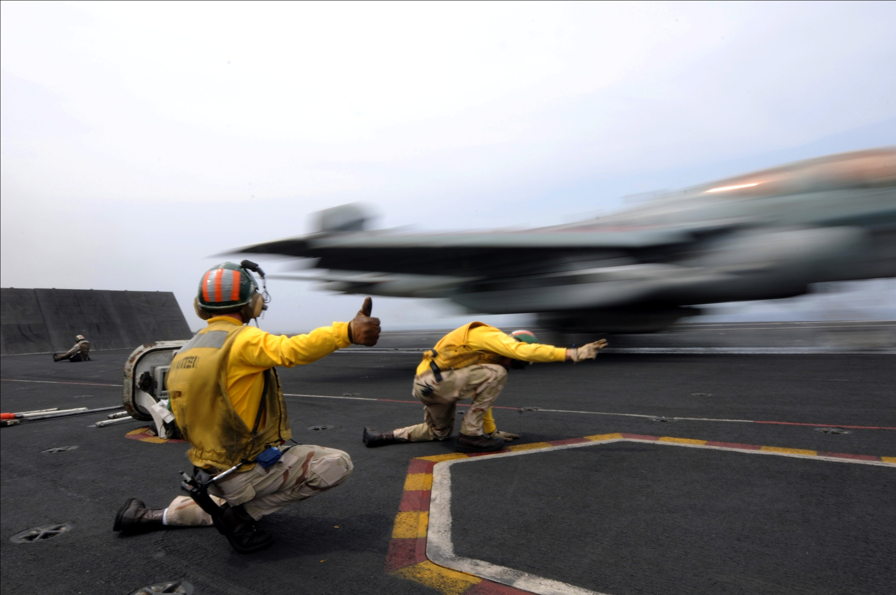

Slide 10
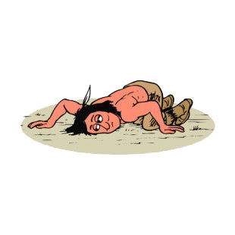
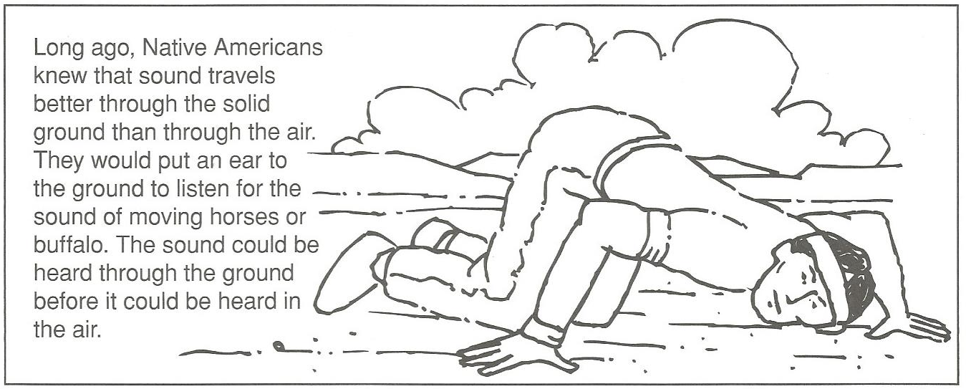

Slide 11
Sound Test
http://www.lancsngfl.ac.uk/curriculum/literacy/lit_site/html/earlyyears/soundgames/soundgames.htm
https://www.youtube.com/watch?v=XIRTWVaptcw

Slide 12
Sound Effects
https://www.youtube.com/watch?v=NkYJxDq3ZKg

Slide 13
Sound Effects Game
https://www.youtube.com/watch?v=vSKn87dtQiI

Slide 14
Music in Slow Motion
https://www.youtube.com/watch?v=QXjdGBZQvLc

