Slide 1
Ordering Objects

Slide 2
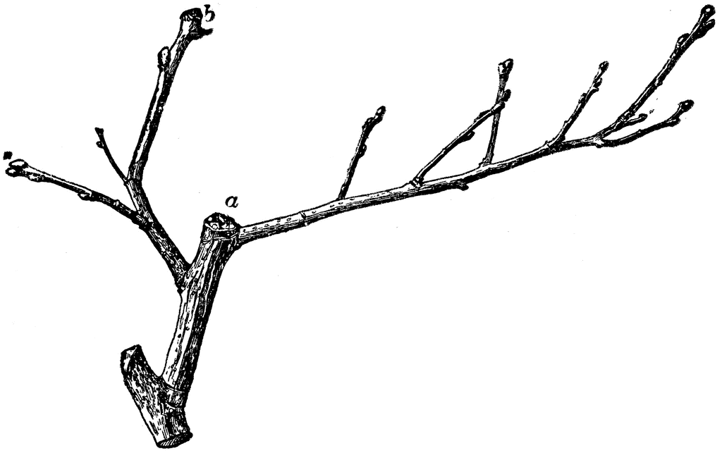
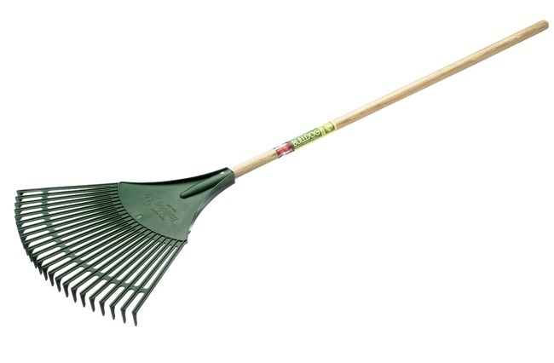
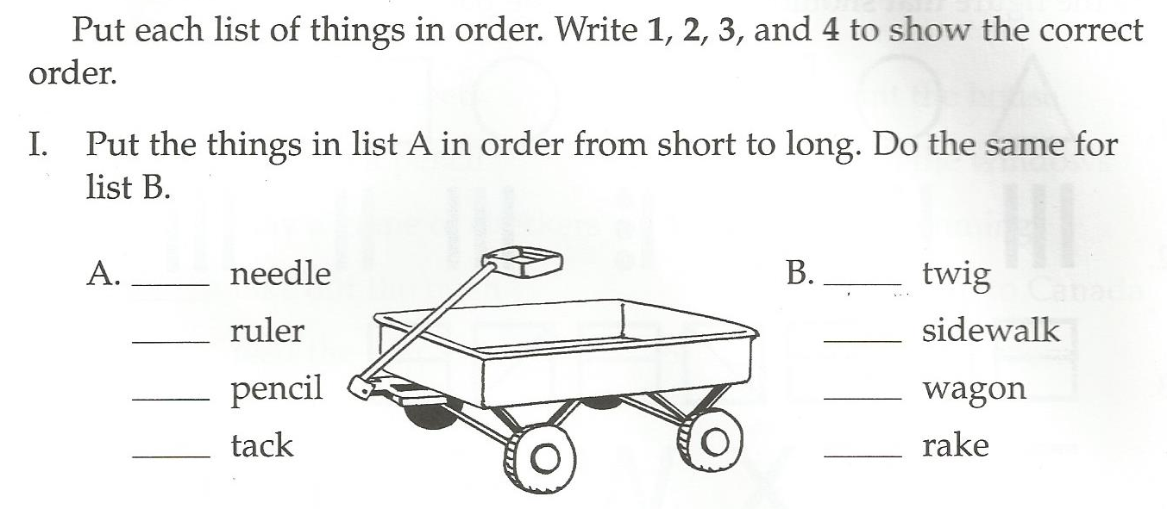

Slide 3
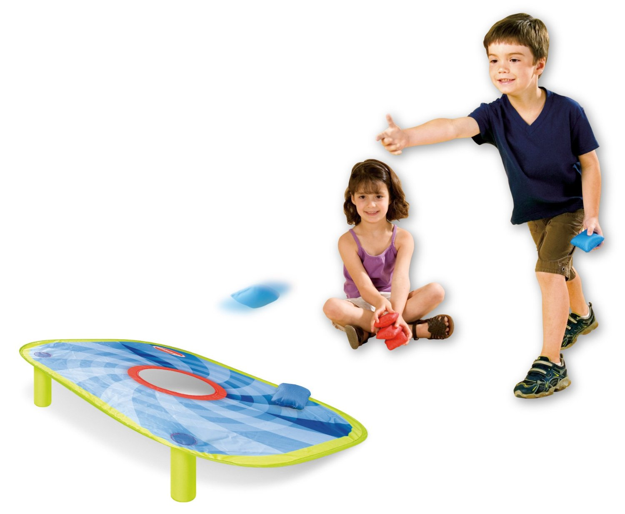
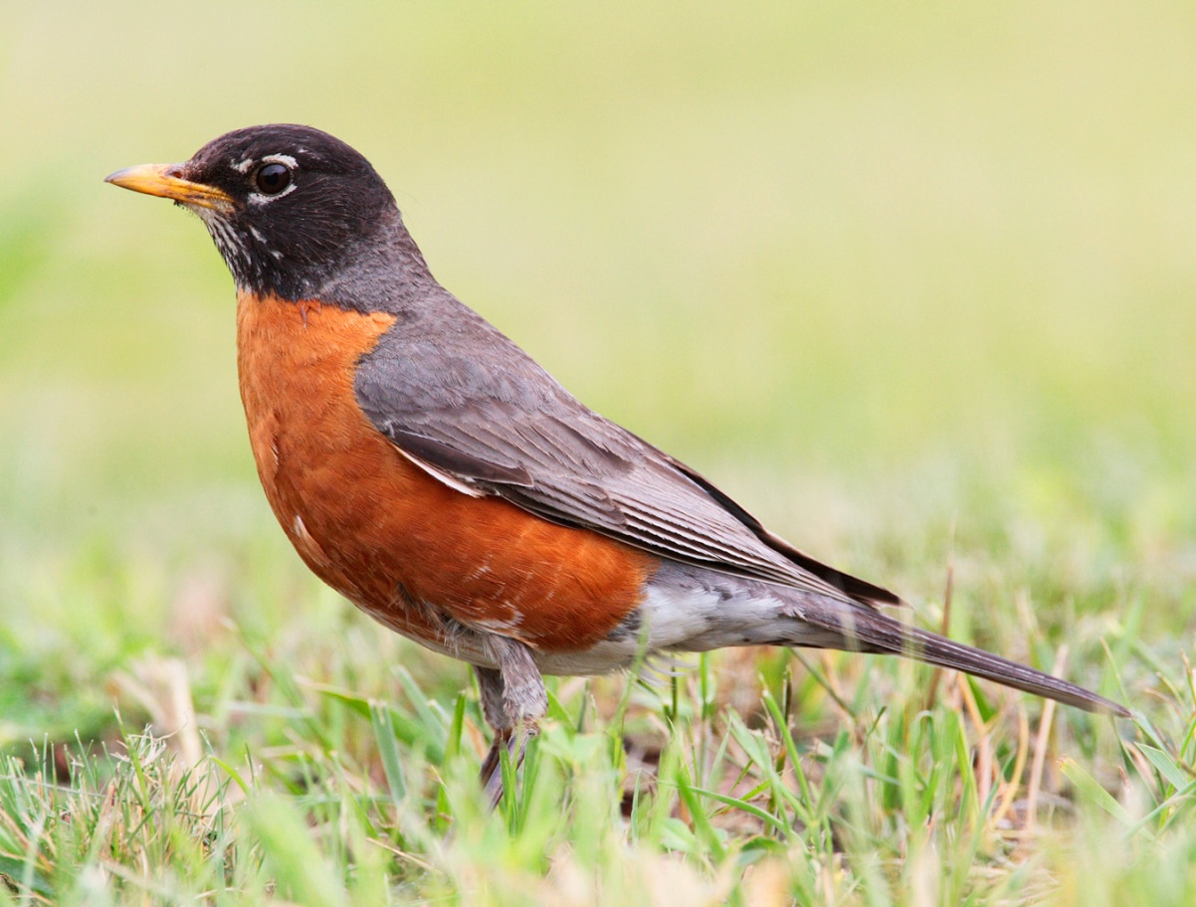
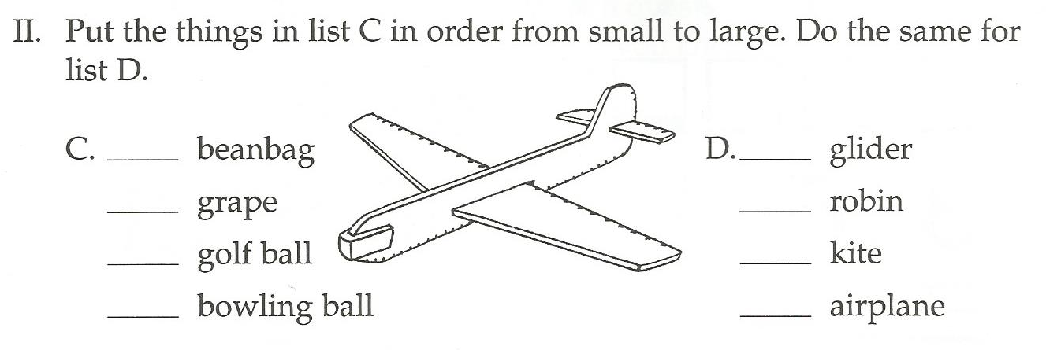

Slide 4
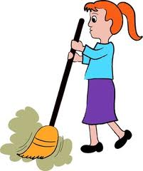
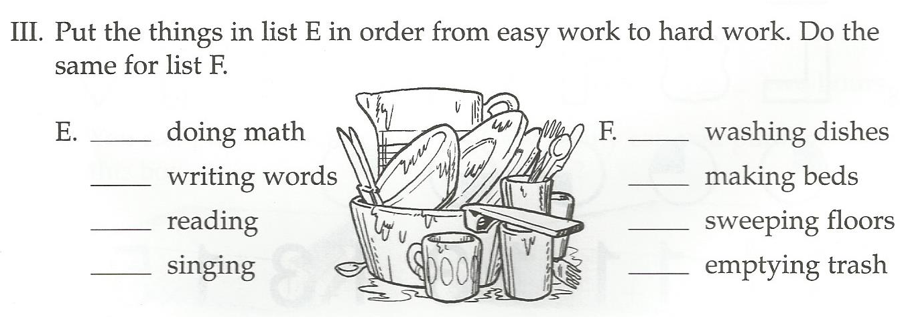

Slide 5
Alphabetical Order
A -> B -> C -> D …

Slide 6
Alphabetical Order
Aa
Ab
Aca
Acb

Slide 7
Put these in alphabetical order:
Dog
Cat
Tiger
Whale

Slide 8
Put these in alphabetical order:
Frog
Fish
Fly
Fox

Slide 9
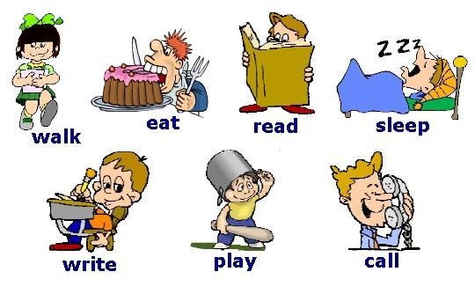
Put these in alphabetical order:

Slide 10
Put these in alphabetical order:

Slide 11
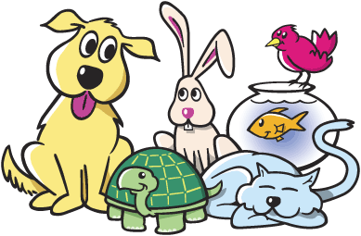
Put these in alphabetical order:

Slide 12
Chronological Order
When did it happen?
(first to last)

Slide 13
Put these in Chronological Order:
Flying to the Moon
Dinosaurs
Building the pyramids
The internet

Slide 14
Put these in Chronological Order:
Light
Smartphone
Computer
TV

Slide 15
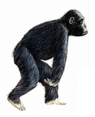
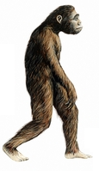
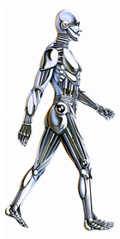
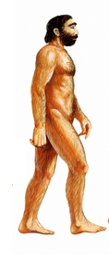
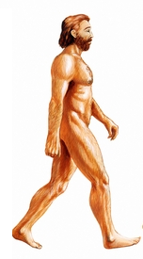
Put these in chronological order:

Slide 16
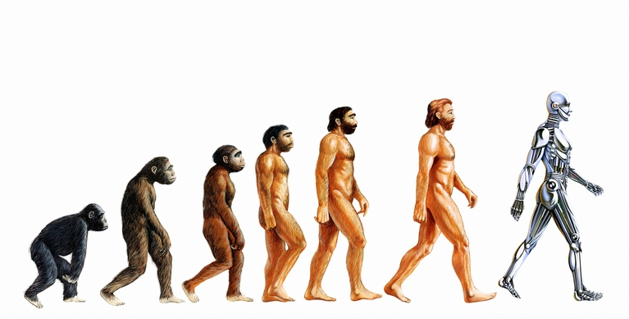
Put these in chronological order:

Slide 18
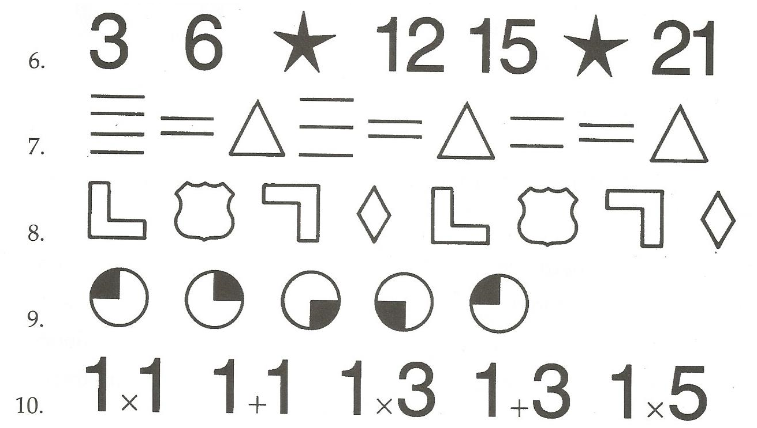

Slide 19
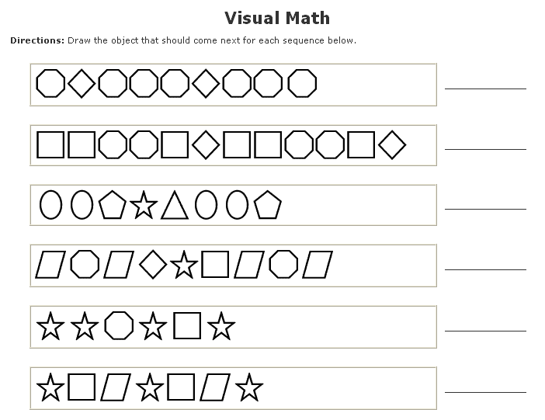

Slide 22
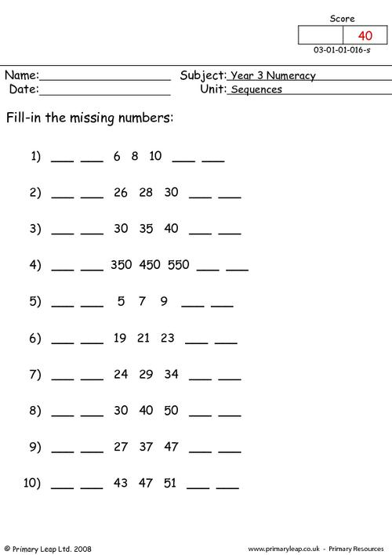

Slide 23
