Slide 1
Why will we write emails?

Slide 2
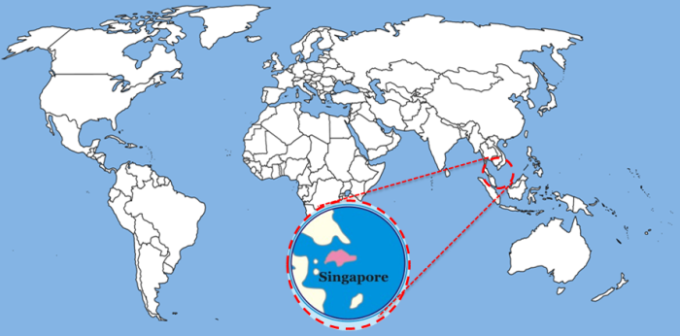
Singapore
Where is it?

Slide 3
https://www.youtube.com/watch?v=WYFe2-hqA2Q

Slide 4
Pen Pals

Slide 6
Fernvale Elementary School

Slide 7
How to write an email

Slide 8
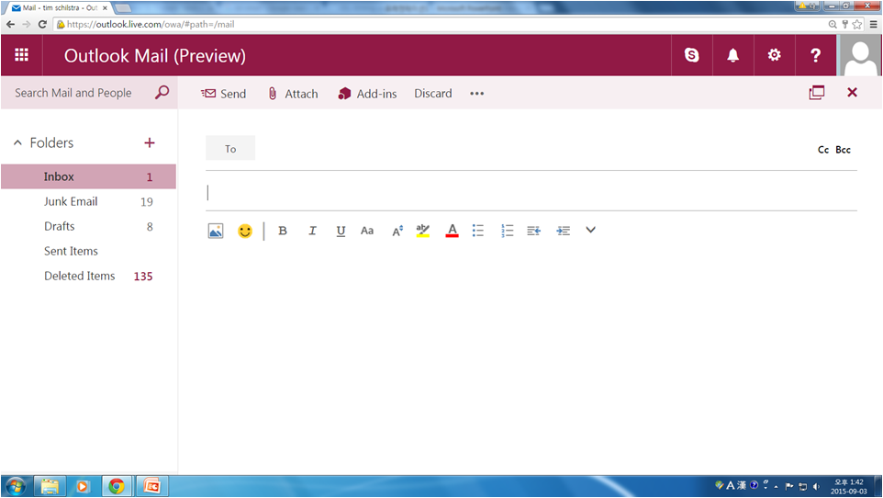
Start at the email site:

Slide 9
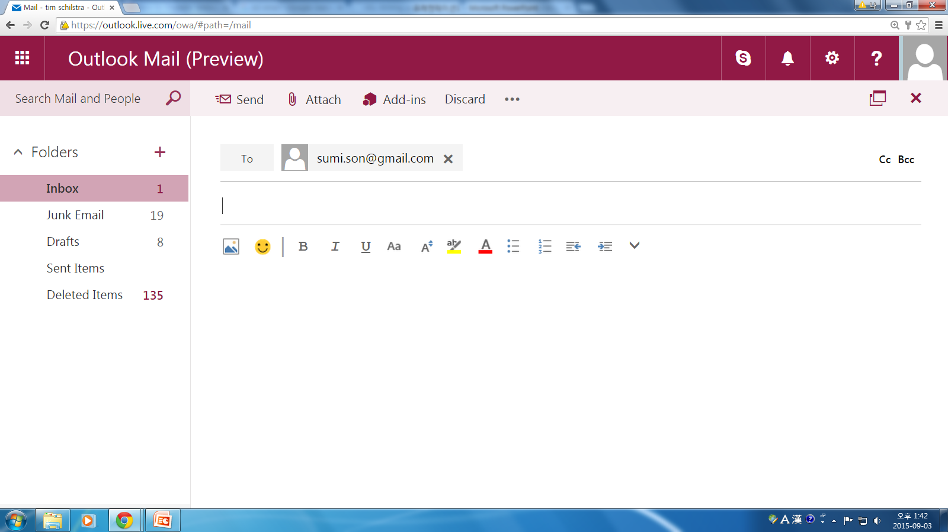
To (the email you are sending to)

Slide 10
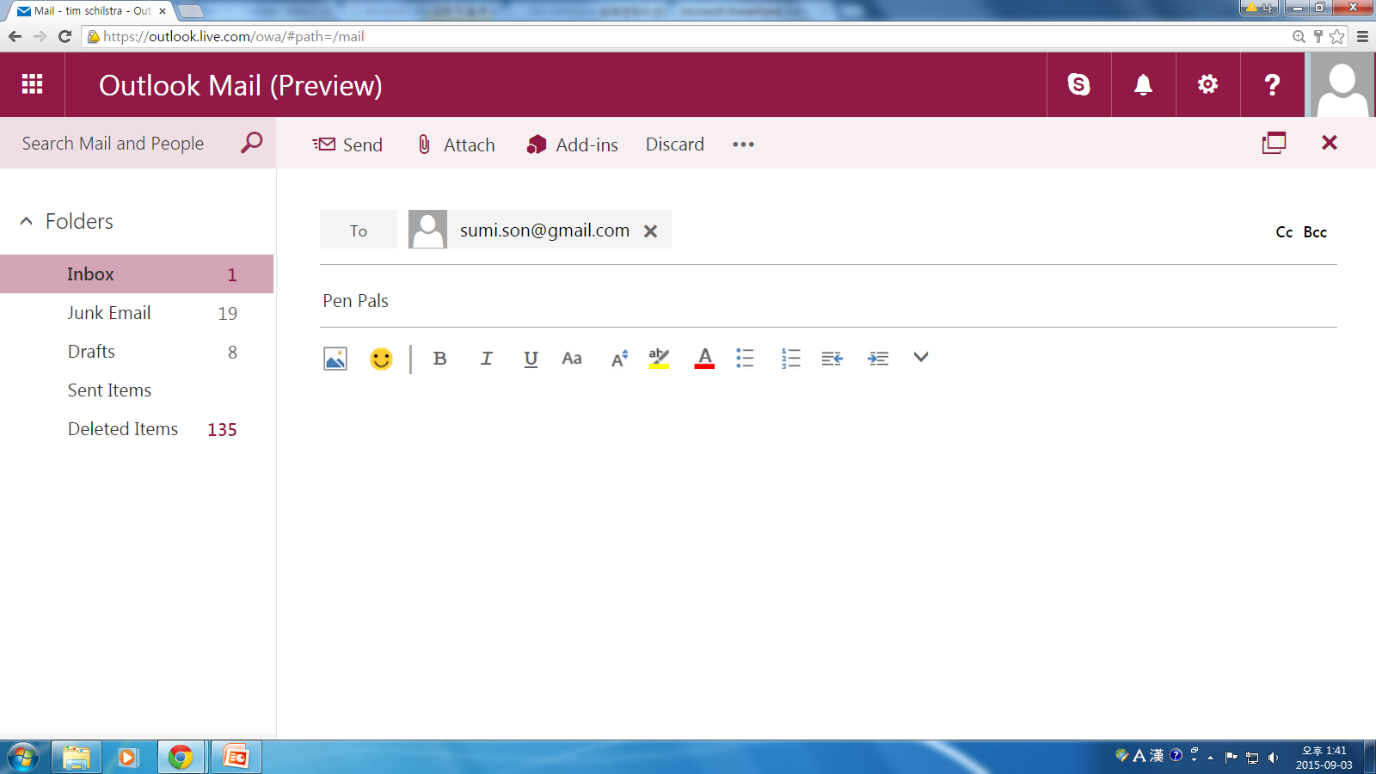
Subject: What is the email about?

Slide 11
Text (what you write)

Slide 12
Greeting (Saying hi)

Slide 13
Greeting (Saying hi)

Slide 14
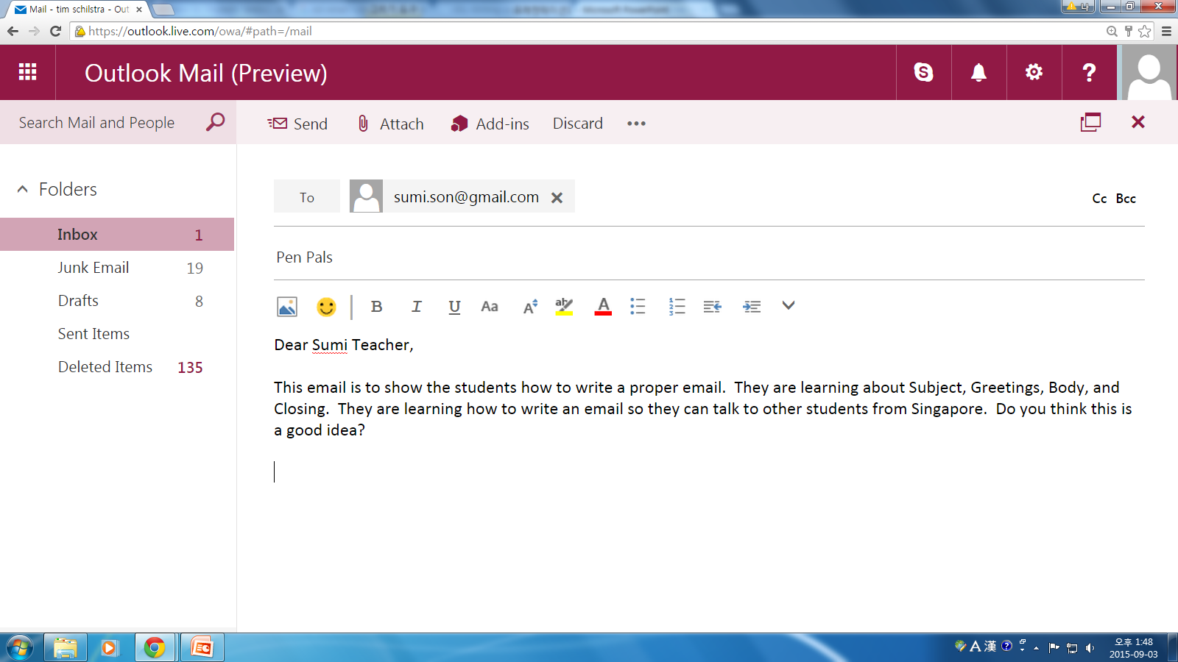
Body (What do you say?)

Slide 15
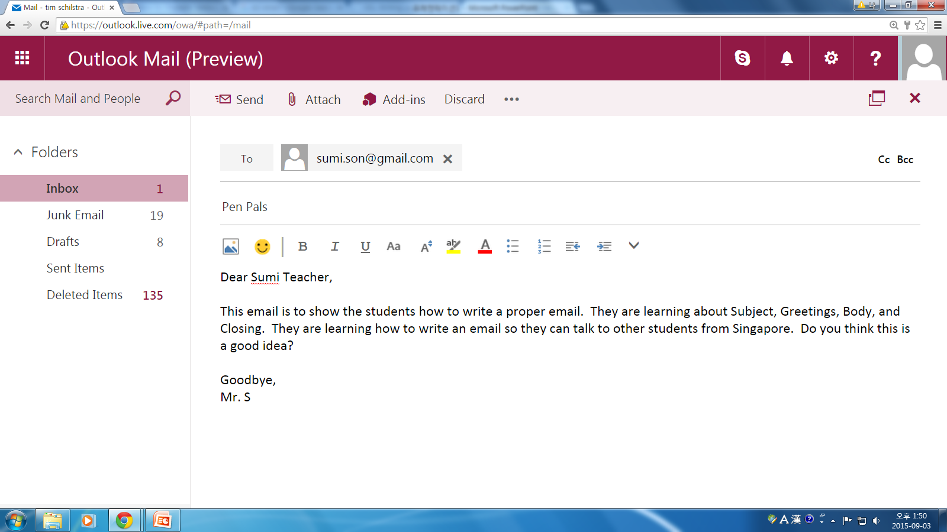
Closing (saying goodbye)

Slide 16
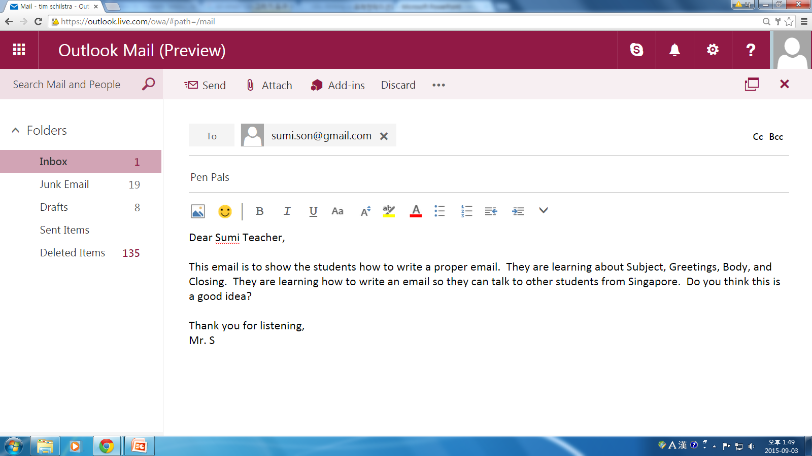
Closing (saying goodbye)

Slide 17
Your e-mail:
You will write an email to a student in Singapore.
Today is a practice day. Practice writing an introduction email.

Slide 18
Introduction e-Mail – What should you say?

