Slide 1
Idioms

Slide 4
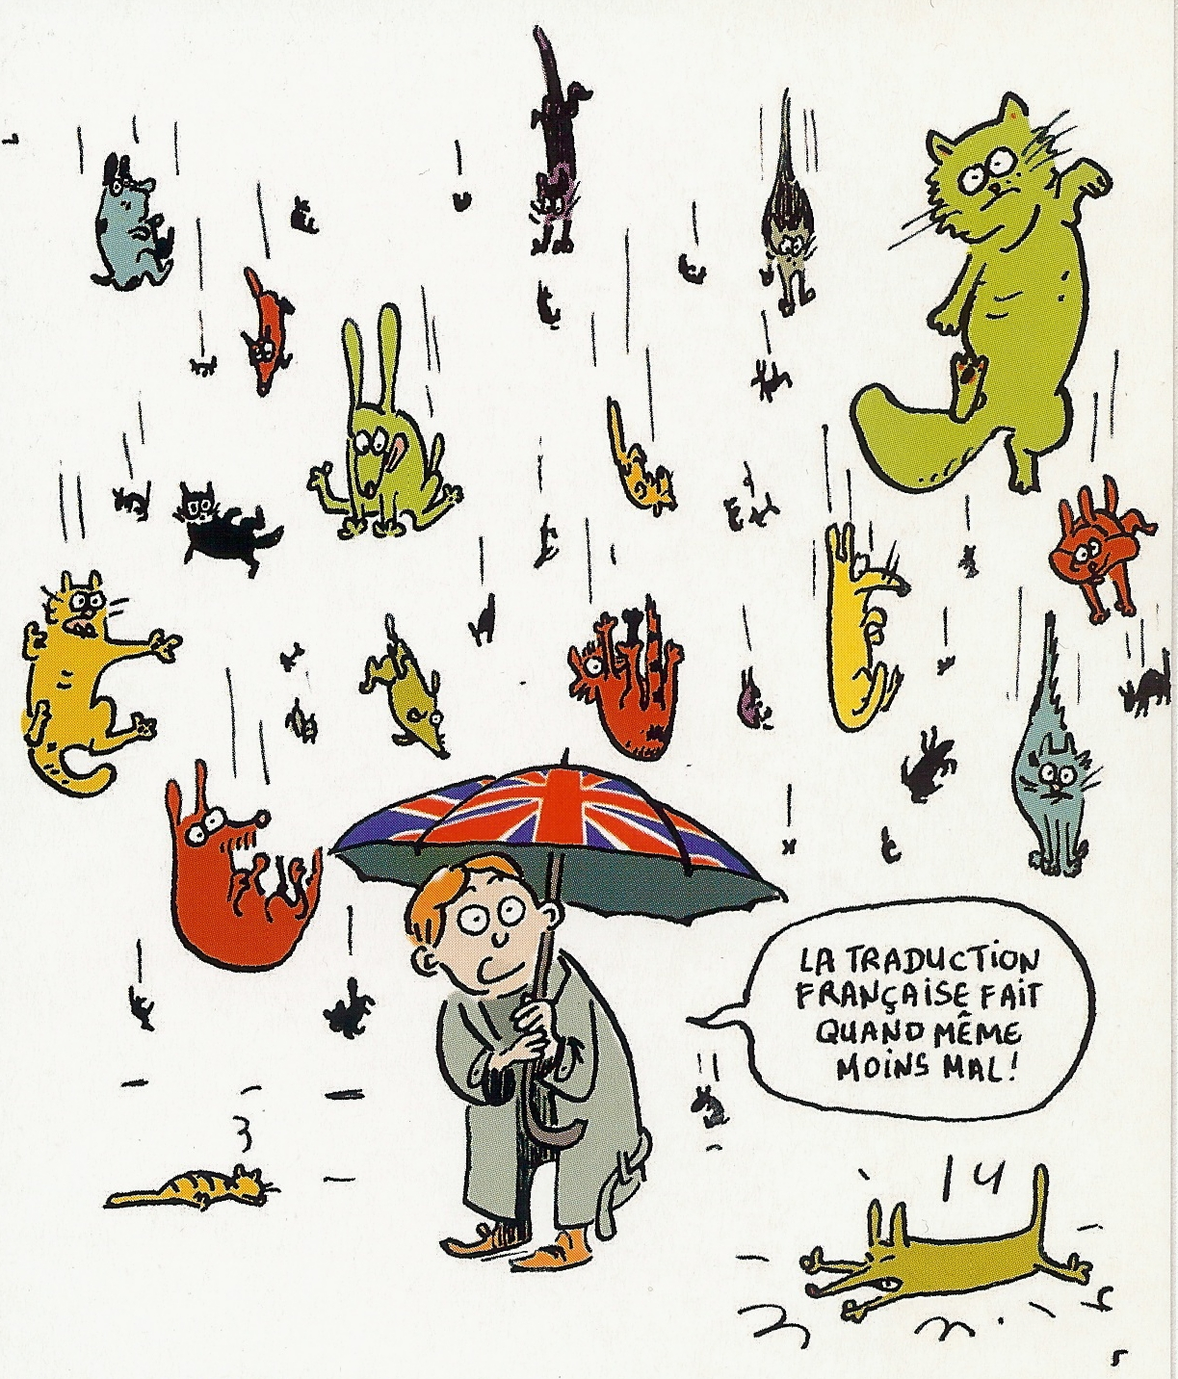
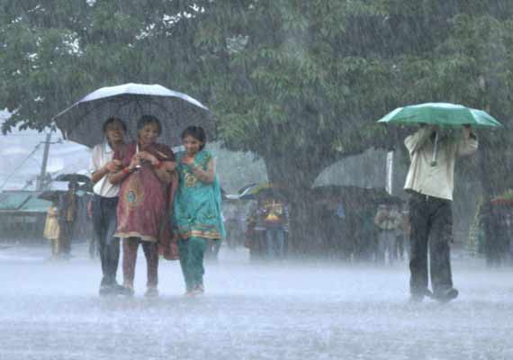
It’s raining cats and dogs.
It’s raining cats and dogs.

Slide 6
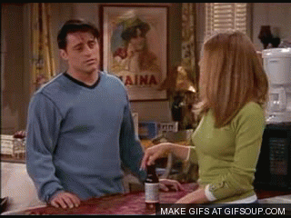
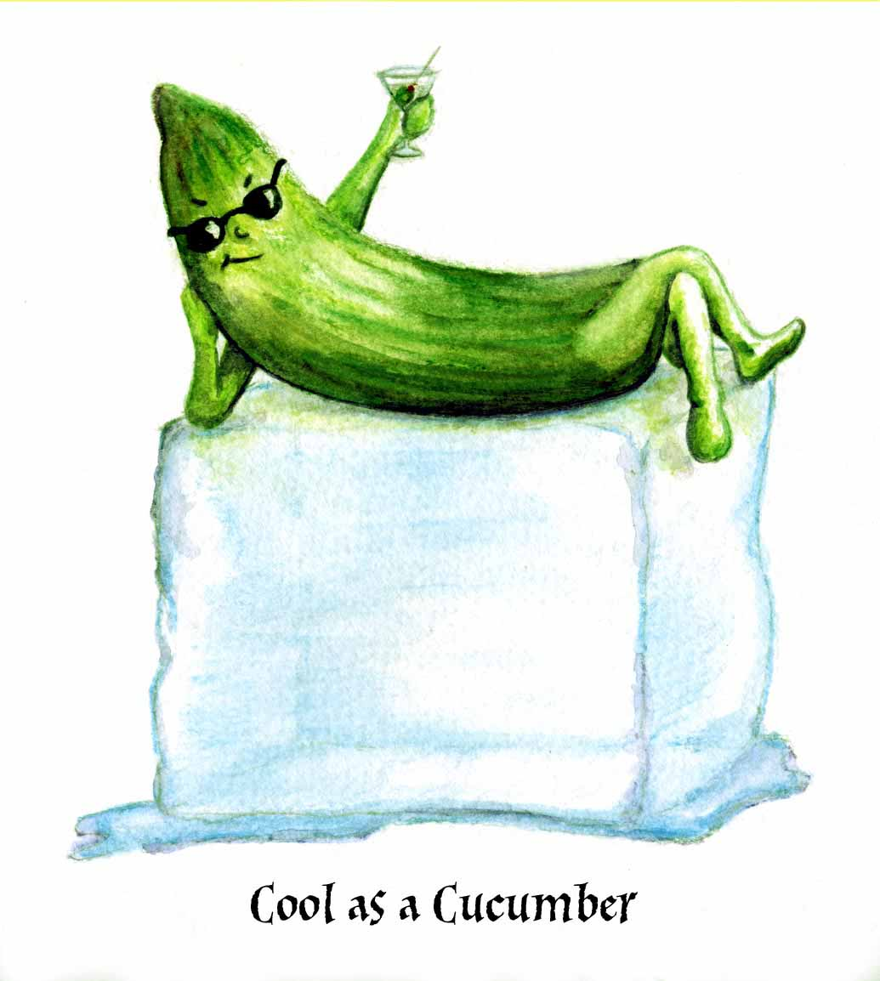
As cool as a cucumber

Slide 8
A drop in the bucket

Slide 10
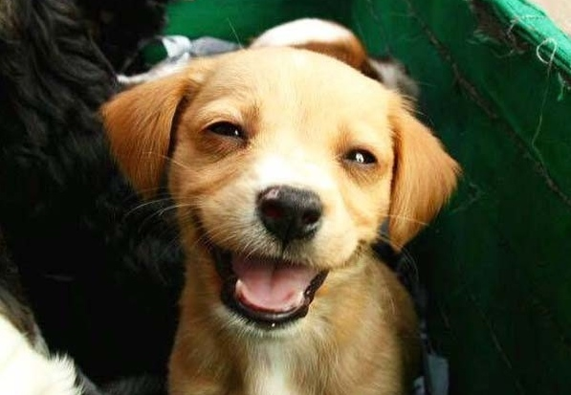
Tickled pink

Slide 12
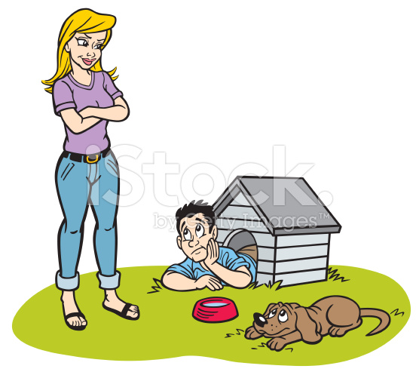
In the doghouse.

Slide 13
Easier Game
http://www.eslgamesplus.com/idiomatic-expressions-common-rally/

Slide 14
And learn about those expressions:

Slide 15
Harder Game, best score
http://www.vocabulary.co.il/idioms/idioms-game-slang-game/

