Slide 1
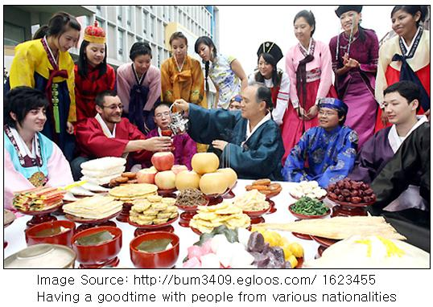
Thanksgiving
Chuseok

Slide 2
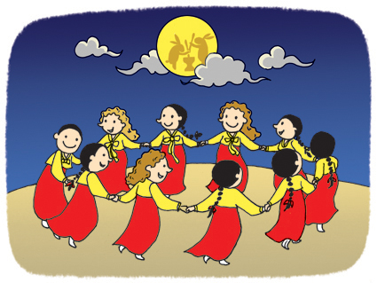
Chuseok Vocabulary

Slide 3
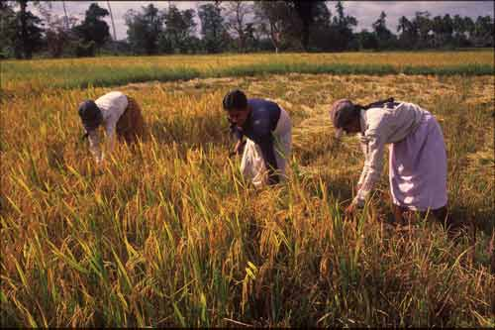
Harvest

Slide 4
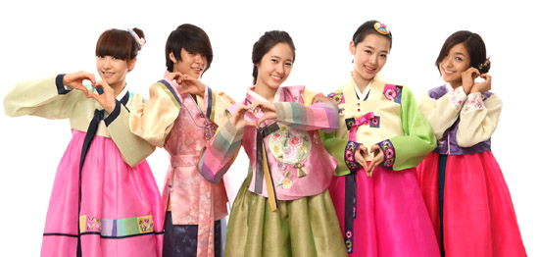
Hanbok

Slide 5
Home Town

Slide 6
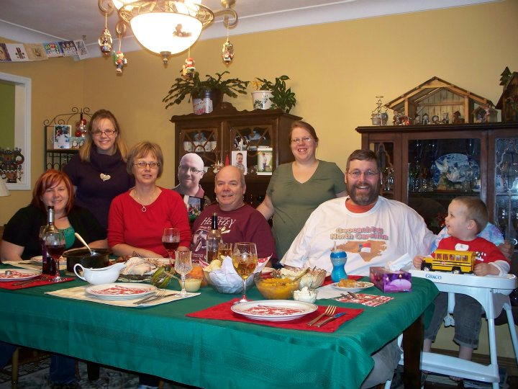
Family

Slide 7
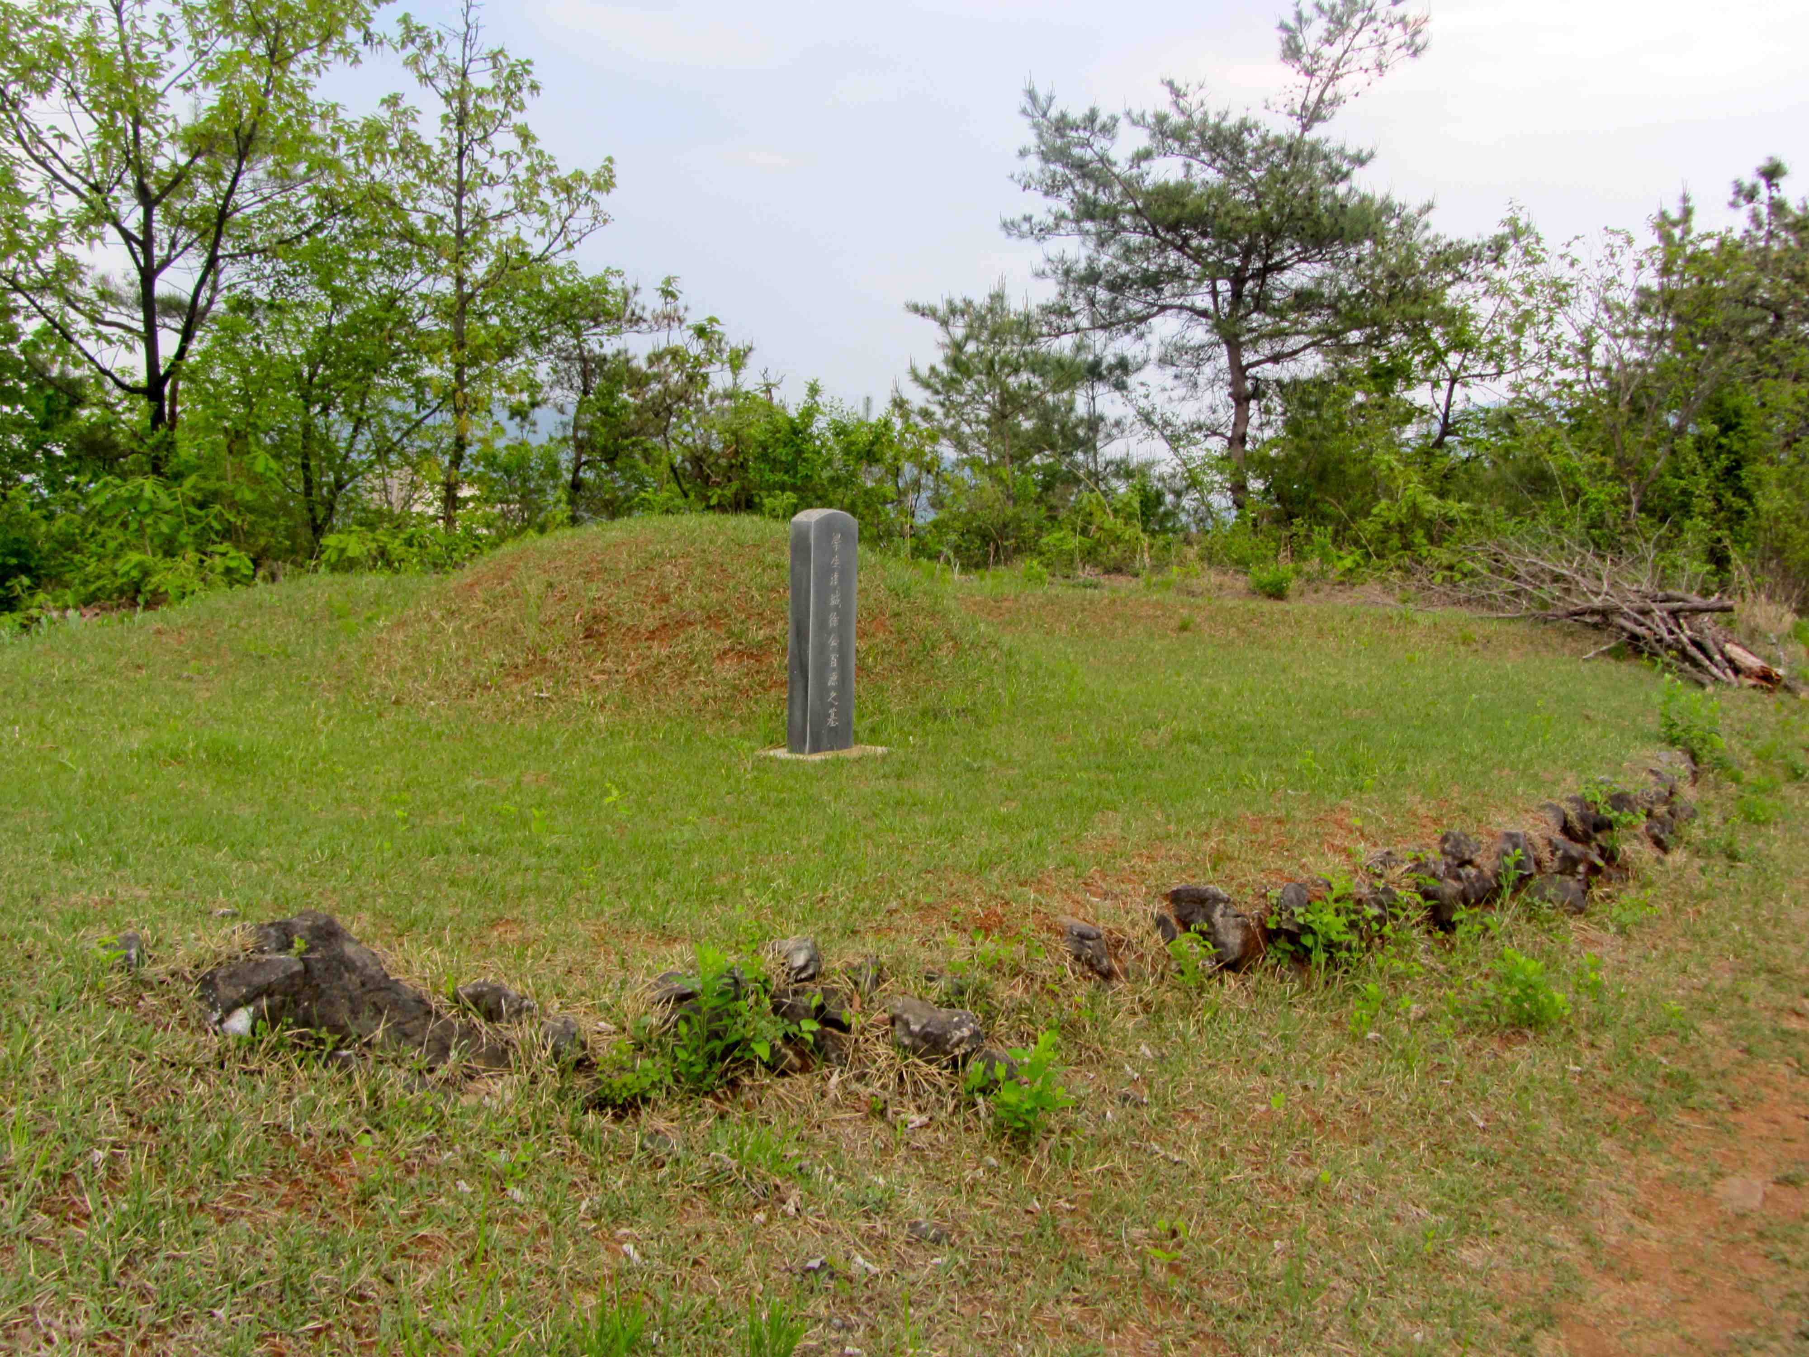
Tomb / Grave

Slide 8
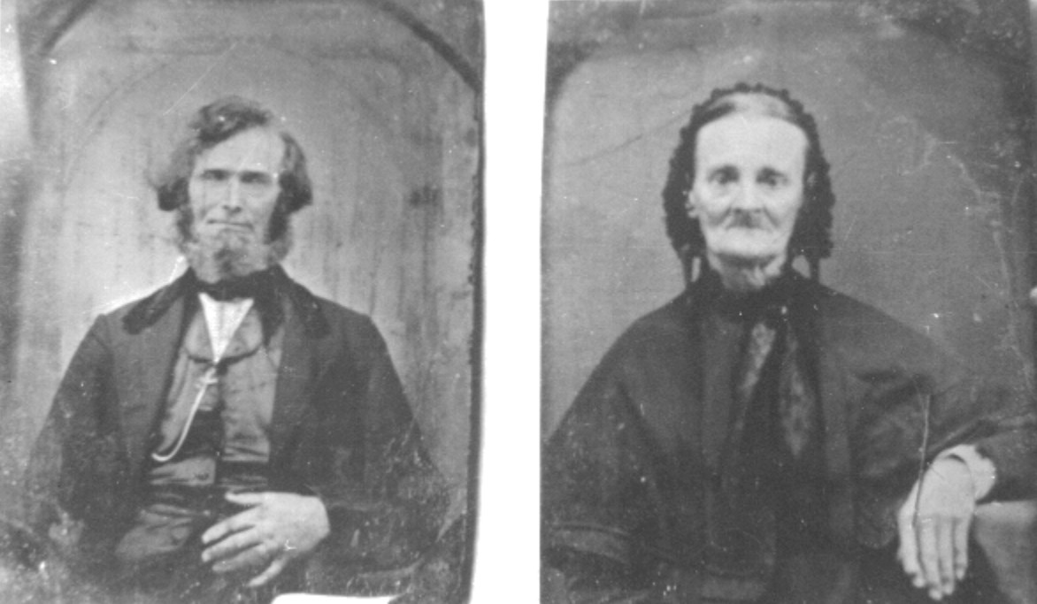
Ancestors

Slide 9
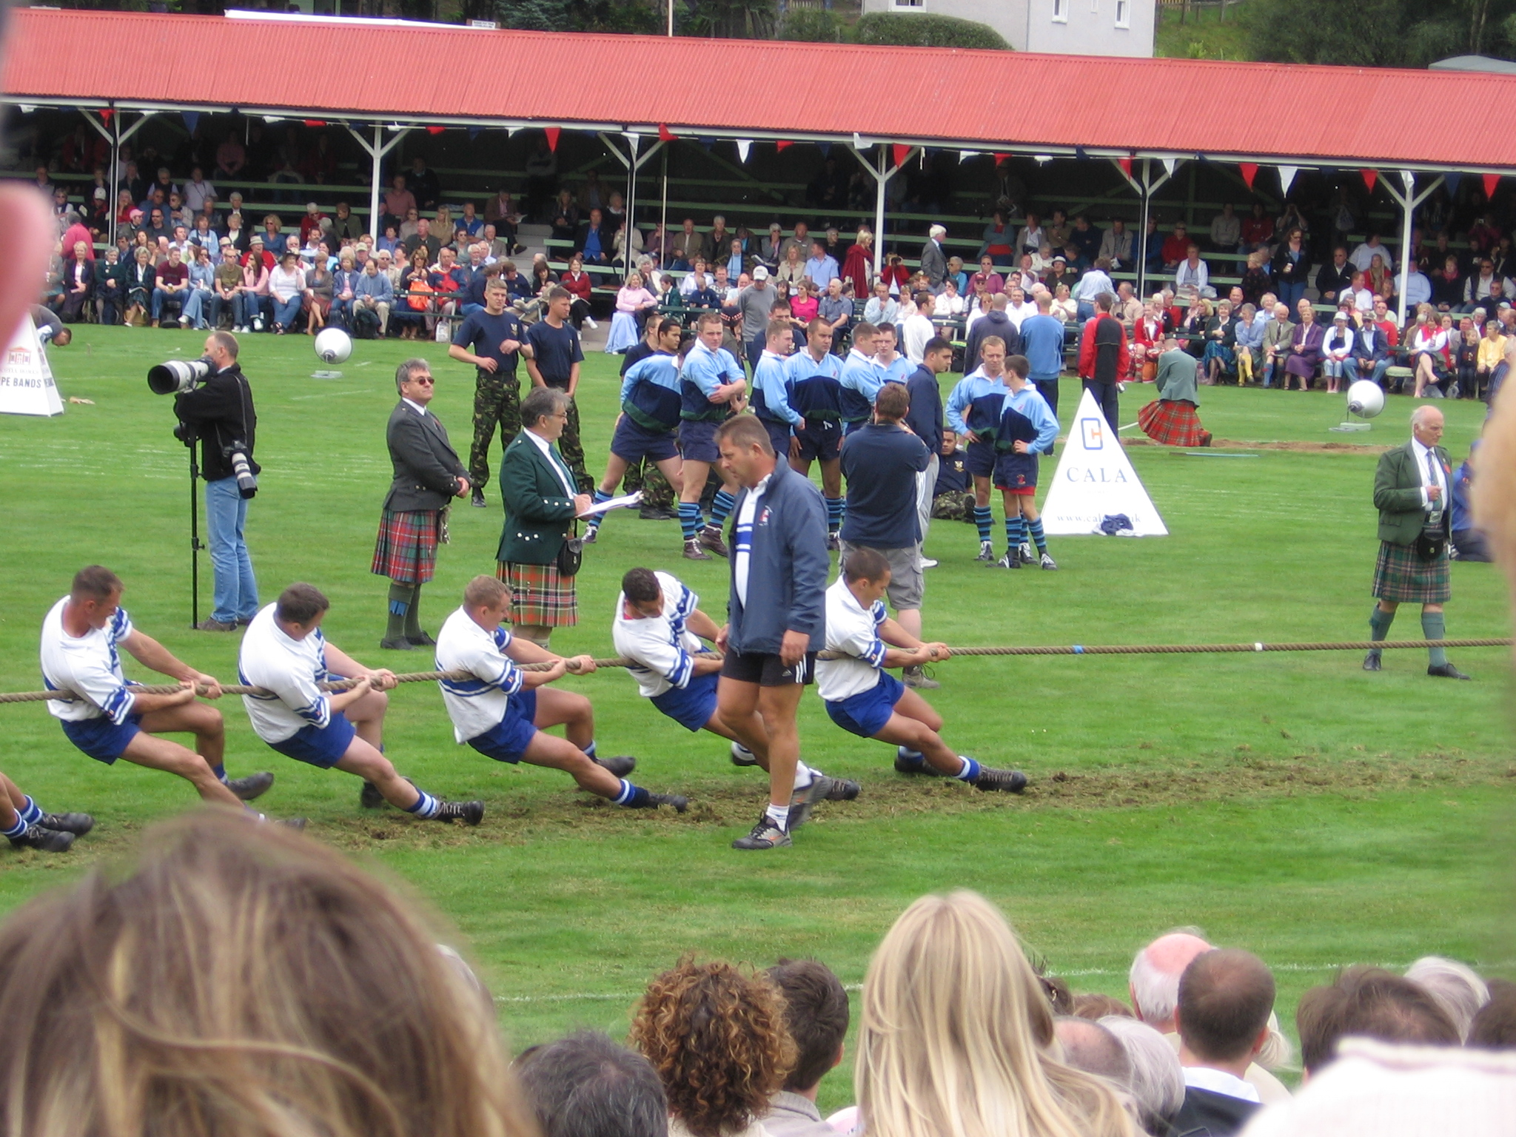
Tug-of-War

Slide 10
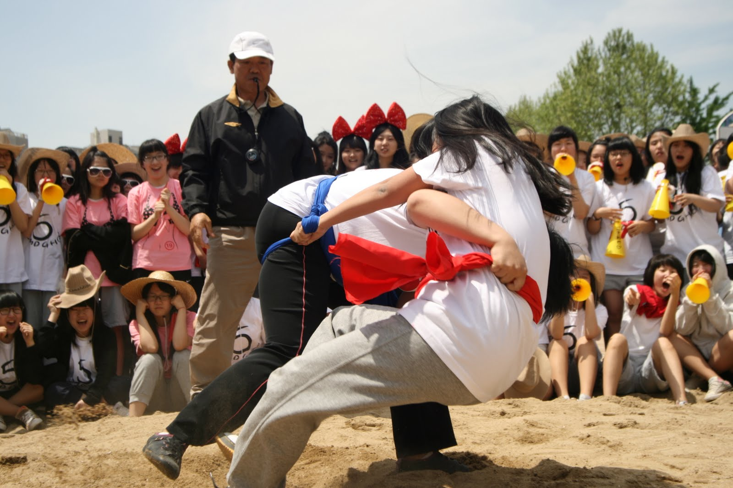
Korean Wrestling

Slide 11
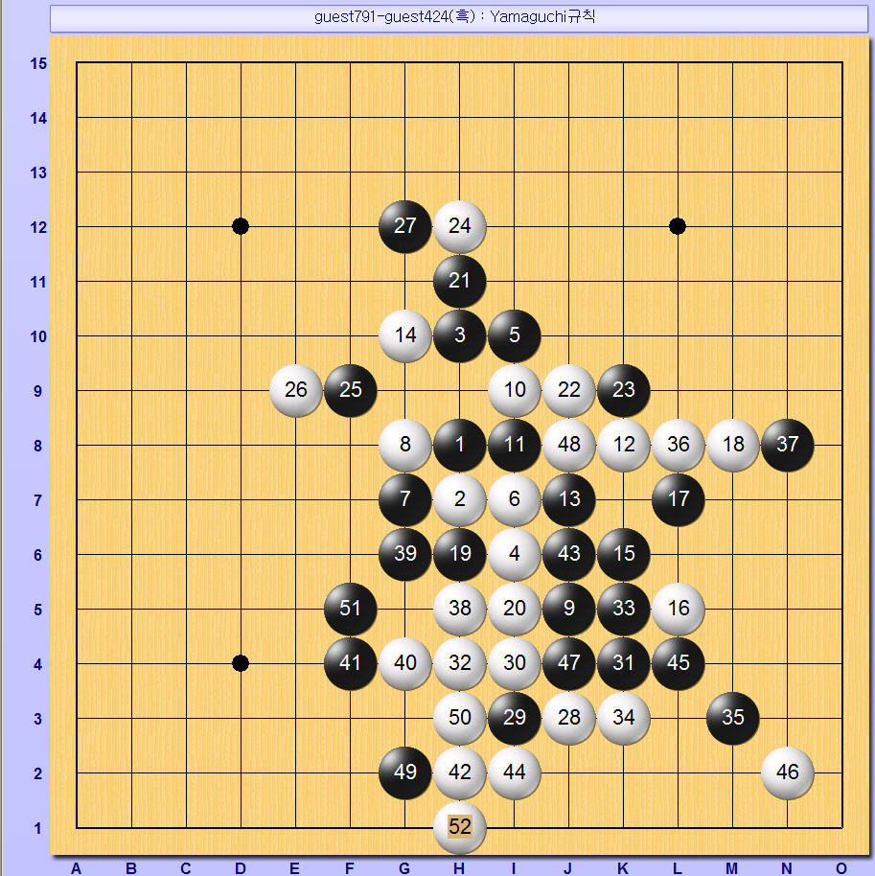
Connect 5

Slide 12
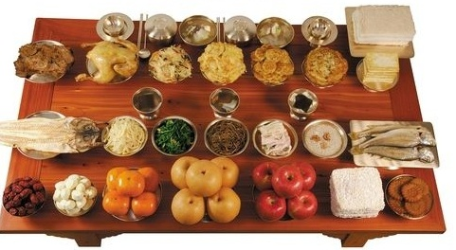
Chuseok Food

Slide 13
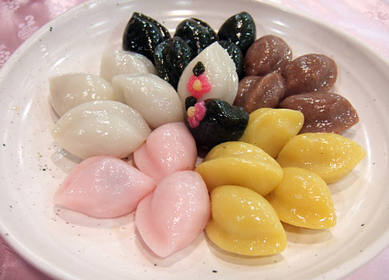
Stuffed Rice Cake

Slide 14
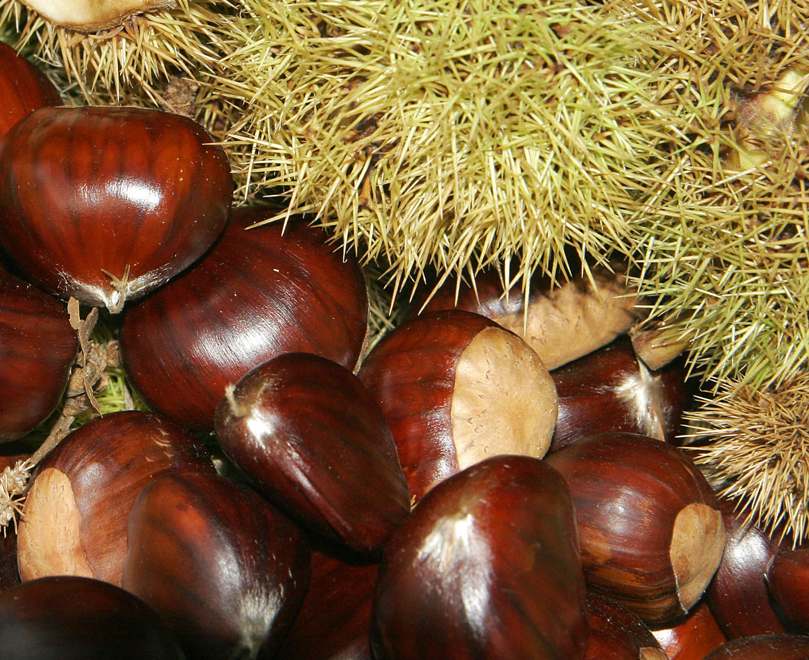
Chestnuts

Slide 15
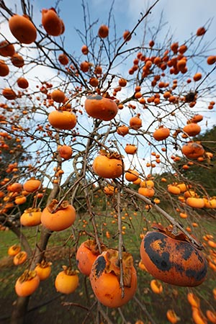
Persimmon

Slide 16
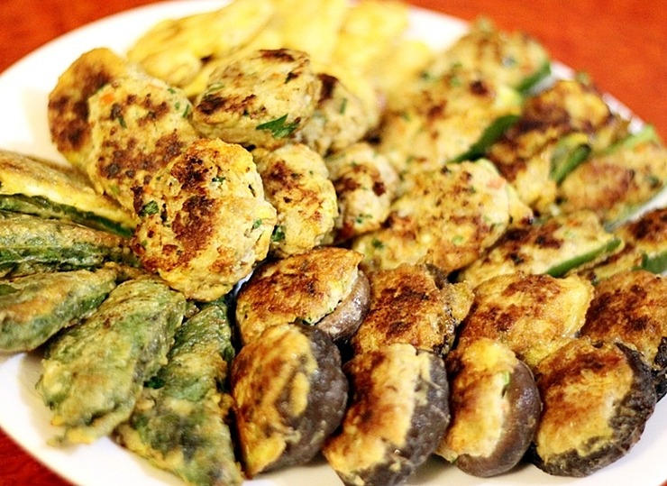
Korean Pancake (pizza)

Slide 17
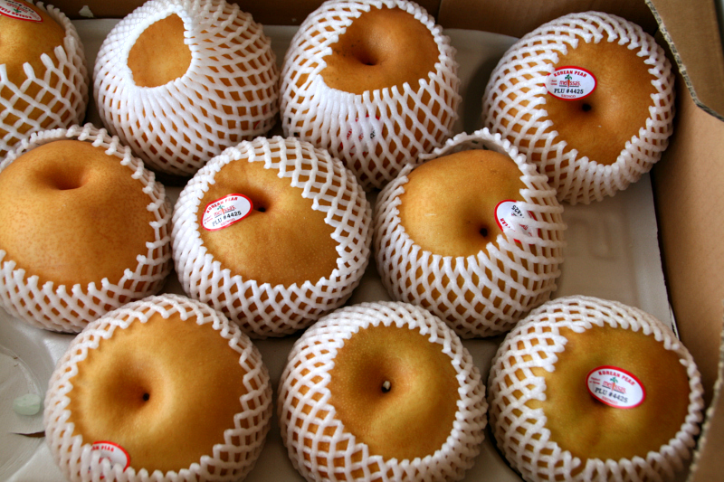
Korean Pear

Slide 18
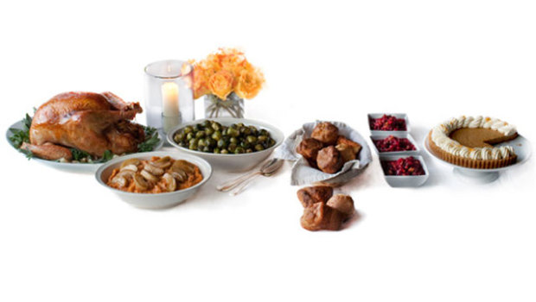
Thanksgiving Food

Slide 19
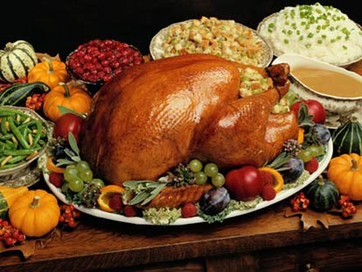
Turkey

Slide 20
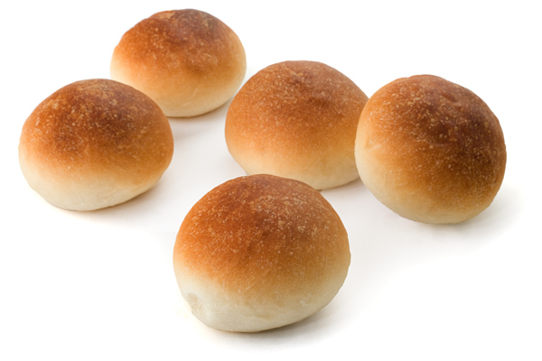
Bun

Slide 21
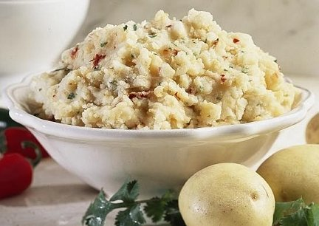
(Mashed) Potato

Slide 22
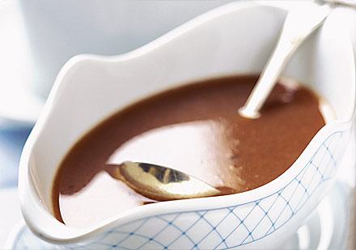
Gravy

Slide 23
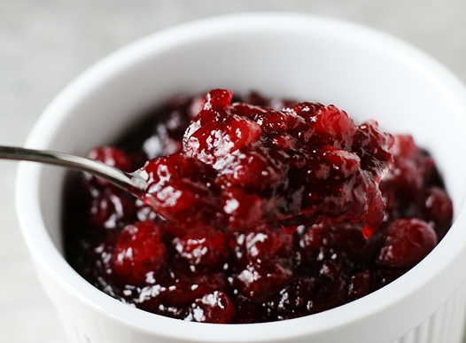
Cranberry Sauce

Slide 24
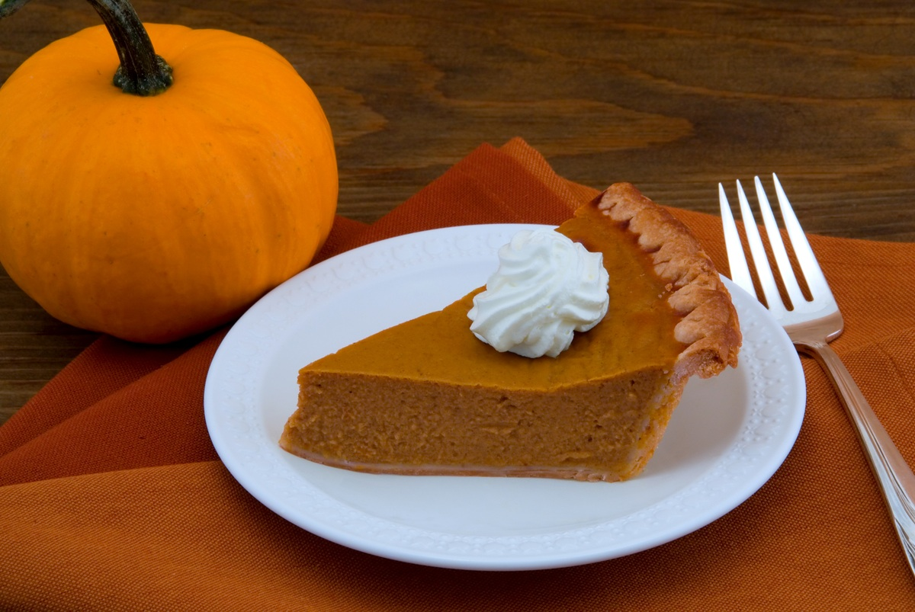
Pumpkin Pie

Slide 25
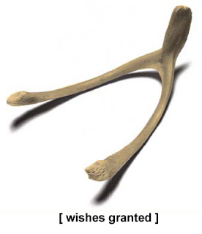
Wish Bone

Slide 26
The largest side gets a wish.

Slide 27
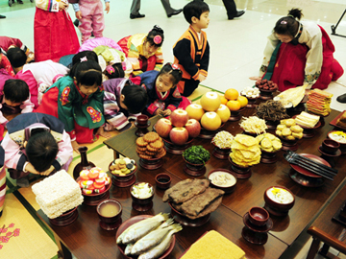
Thank you...
Thankful
I am thankful for _______________.

