Slide 1
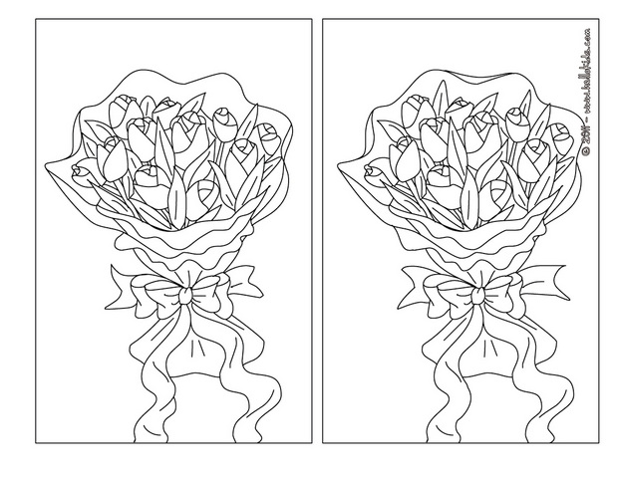
http://www.hellokids.com/c_25502/free-kids-games/find-the-differences/mother-s-day-difference-games/flowers-for-mommy-difference-game

Slide 2
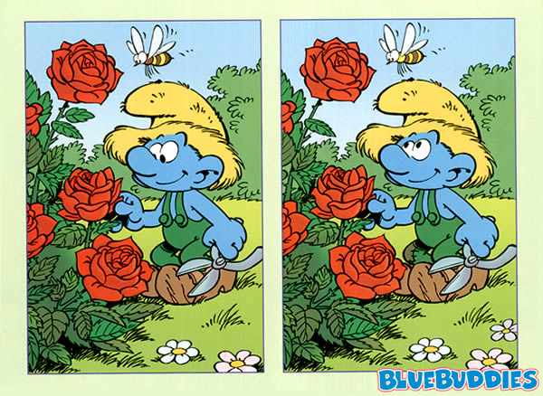
6 differences?

Slide 3
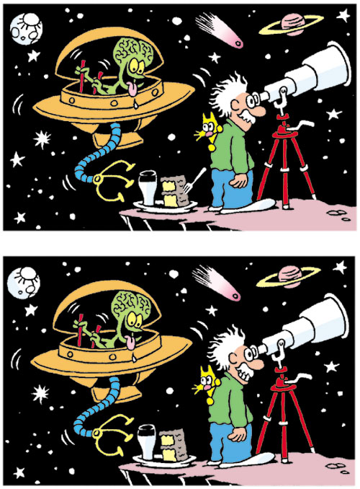

Slide 4
Lesson 8 – Comparing and Contrasting

Slide 5
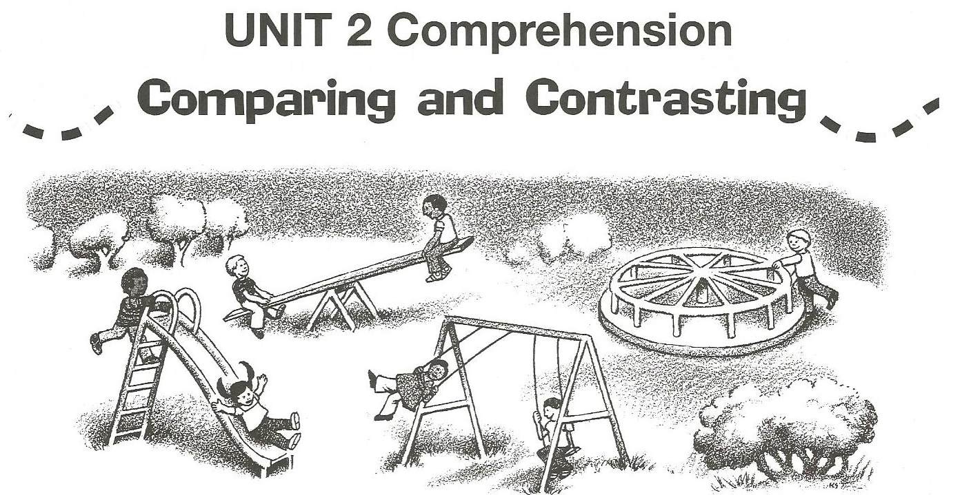
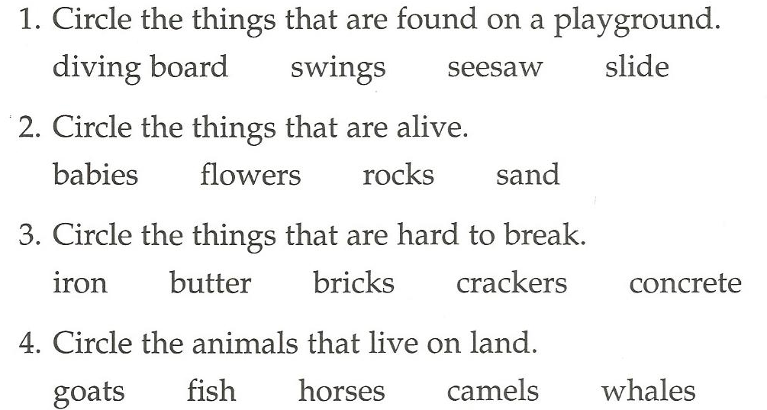

Slide 6
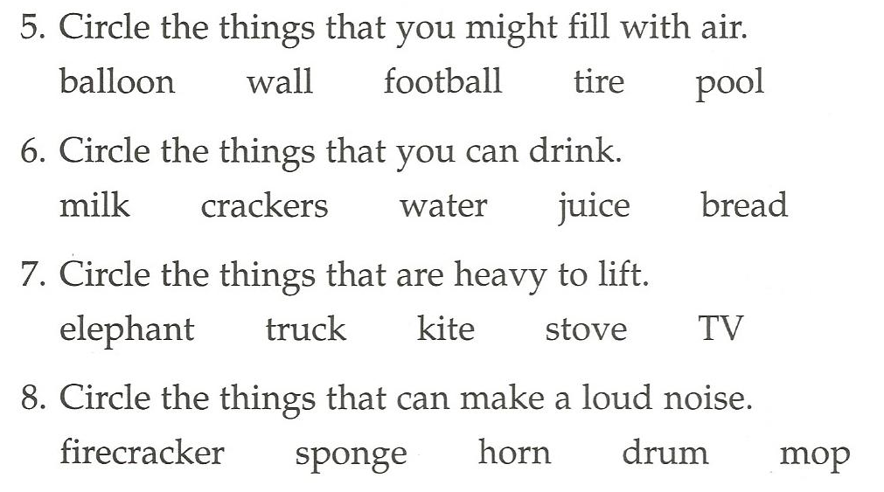

Slide 8
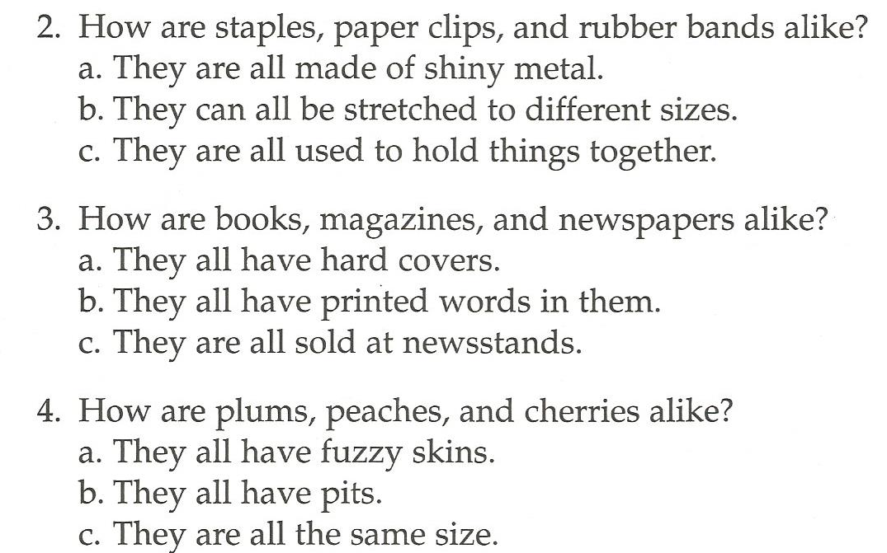

Slide 10
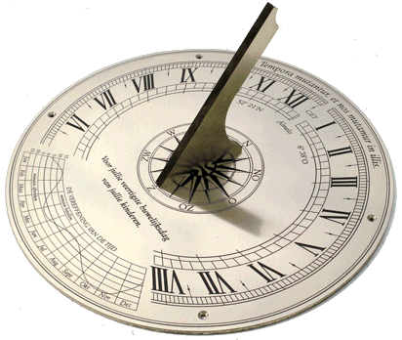
How are they the same?

Slide 11
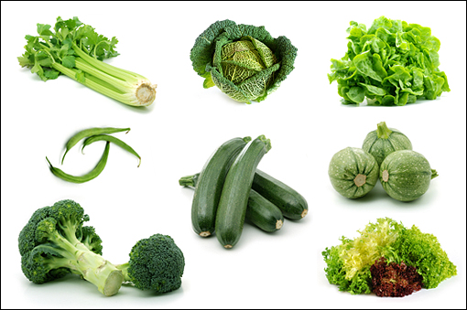
How are they different?

Slide 12
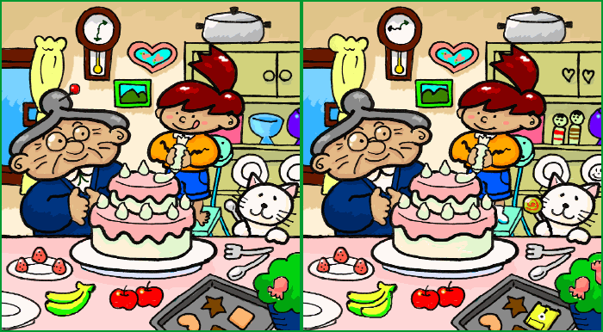
13 differences

Slide 13
How are they the same / different?

Slide 14
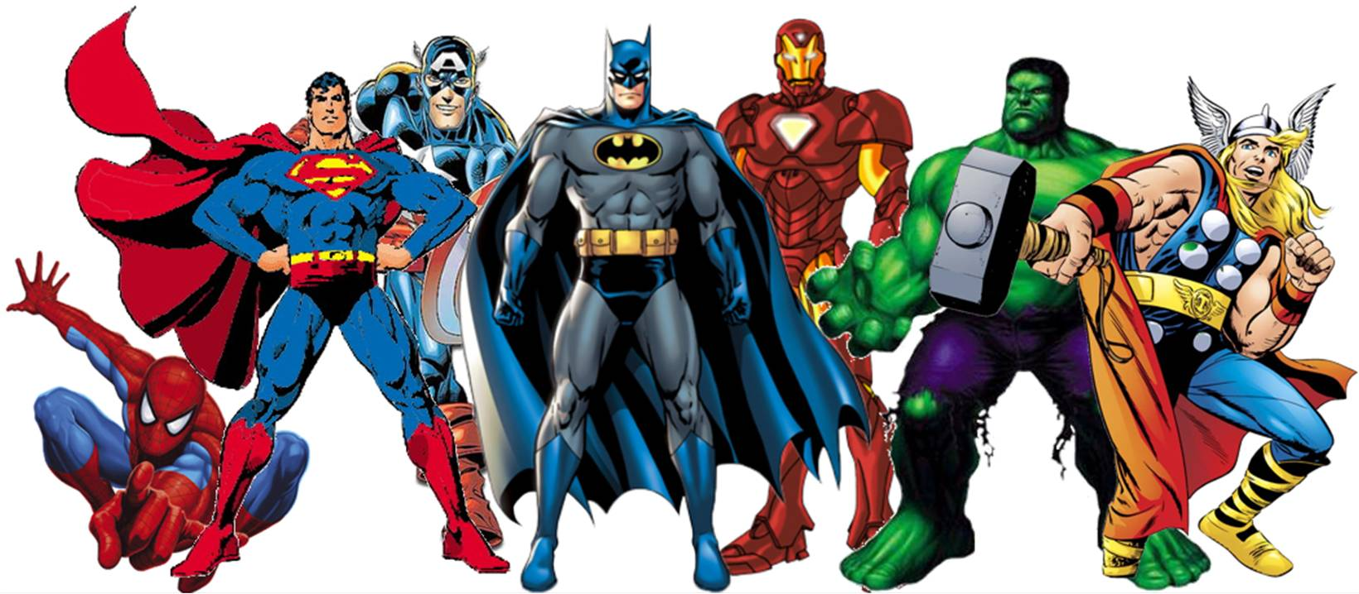
Which one is best?

Slide 15
Which one is worst?

Slide 16
Which is most dangerous?

Slide 17
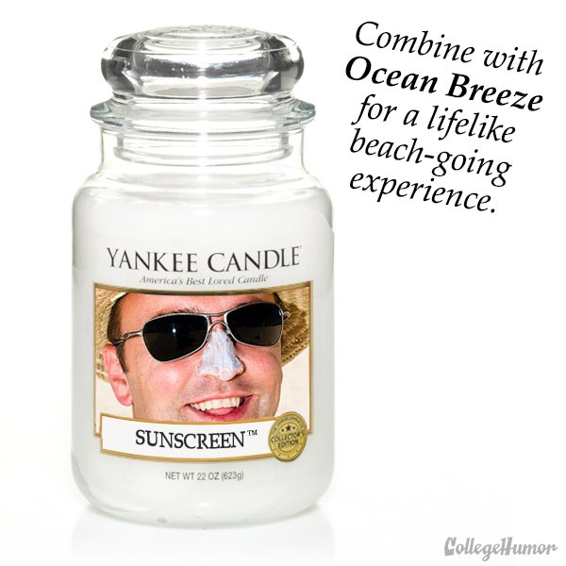
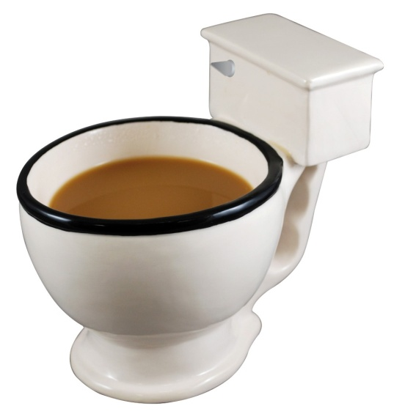
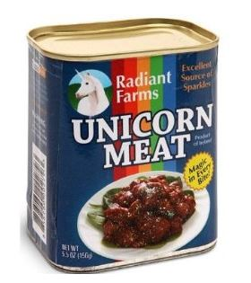
Which would you give as a gift?

Slide 18
How to play:
Take two cards:
Roll the dice
1 – Which is more dangerous?
2 – Which is better to give to as a gift, why?
3 – Which is worse and why?
4 – Which is better and why?
5 – How are they the same?
6 – How are they different?
If it’s a good explanation… you get a point.
Vote

