Slide 1
Tim
Timothy Jack Schilstra

Slide 2
Where am I from?

Slide 3
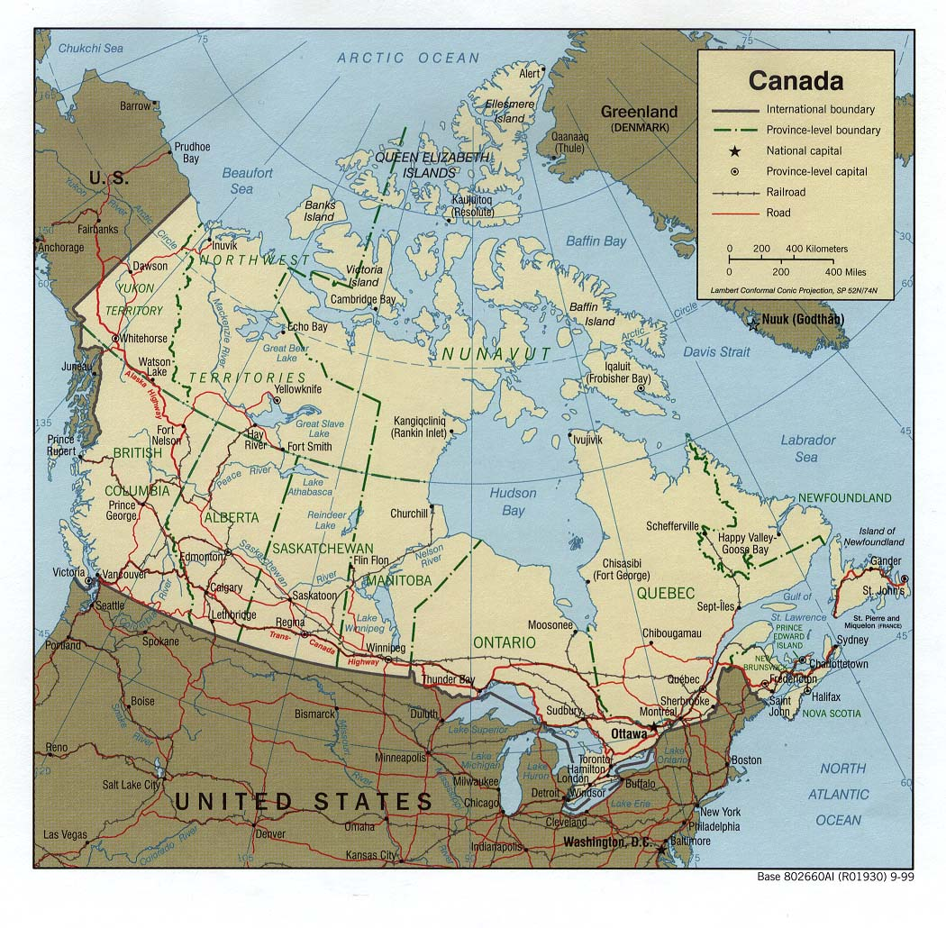
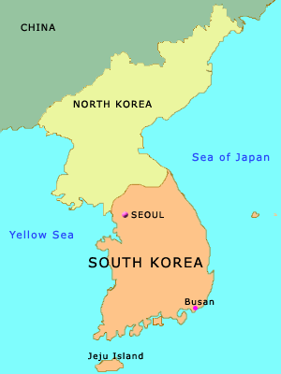

Slide 4
How many are there in my family?

Slide 5
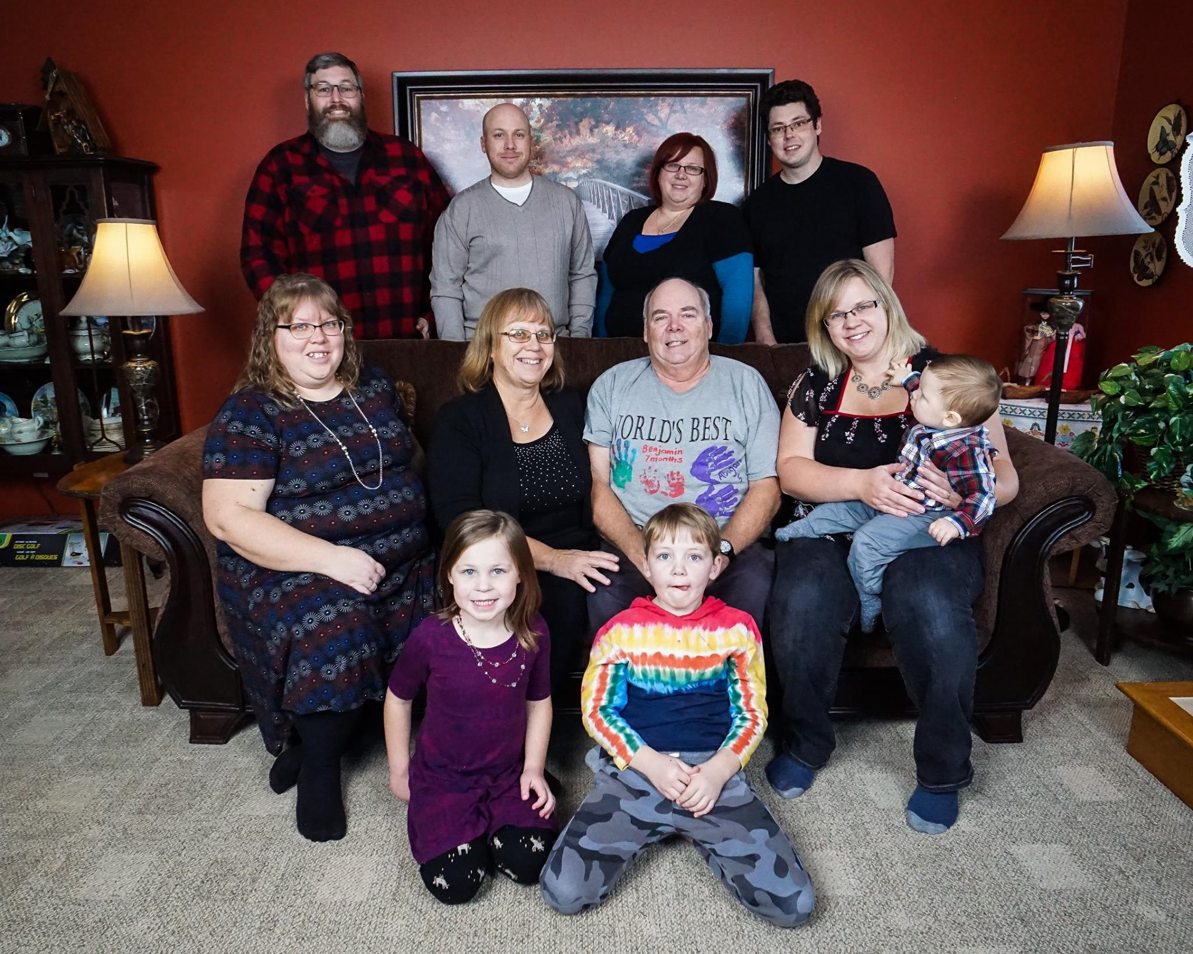
My Family

Slide 6
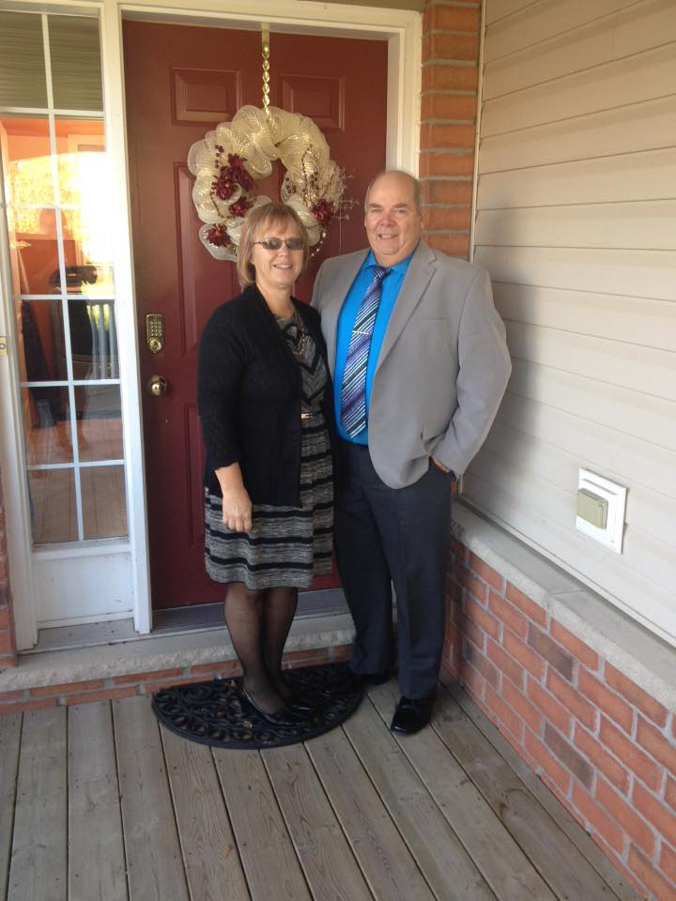
Mother and Father

Slide 7
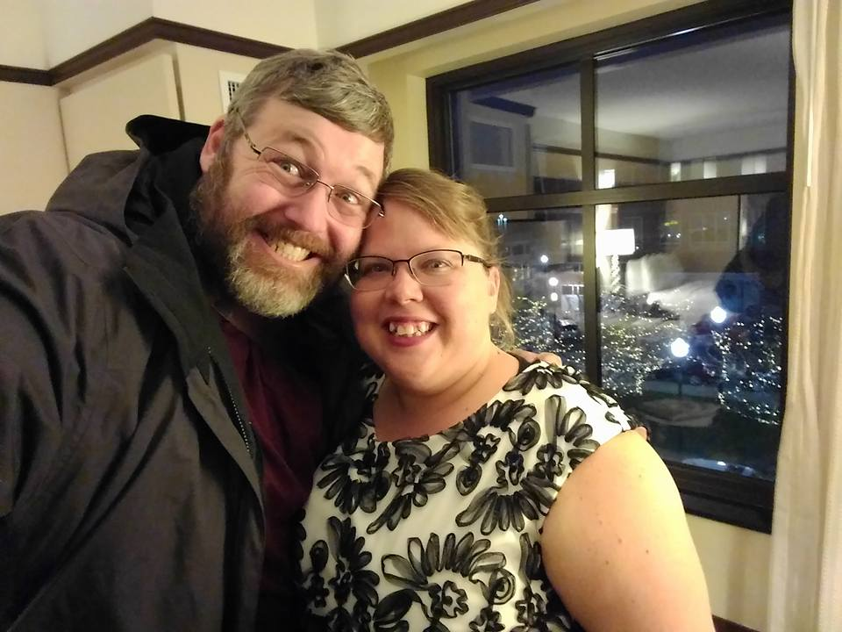
Debbie and Dave

Slide 8
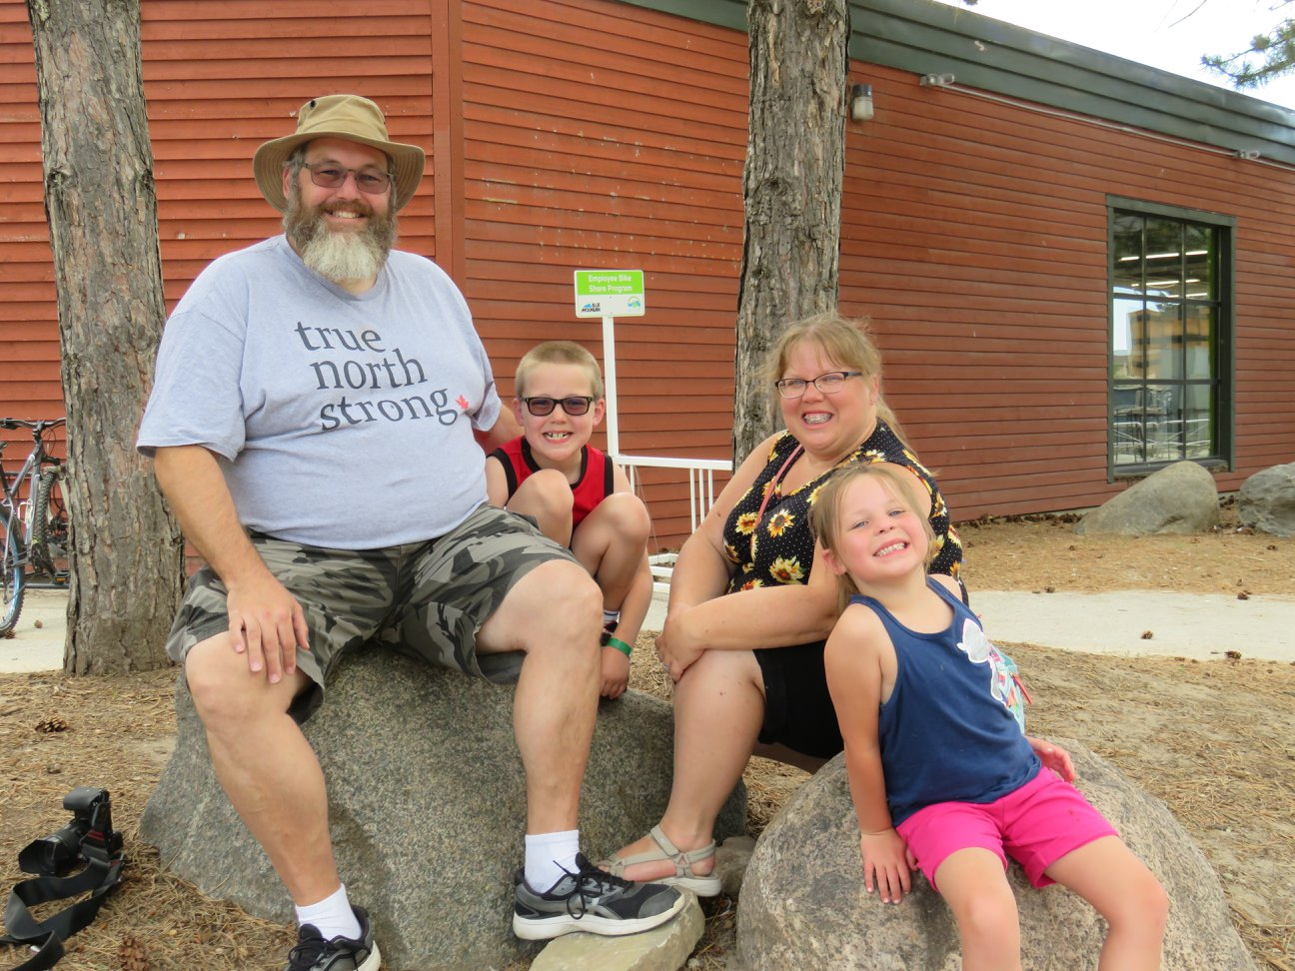
Zeke and Abigail

Slide 9
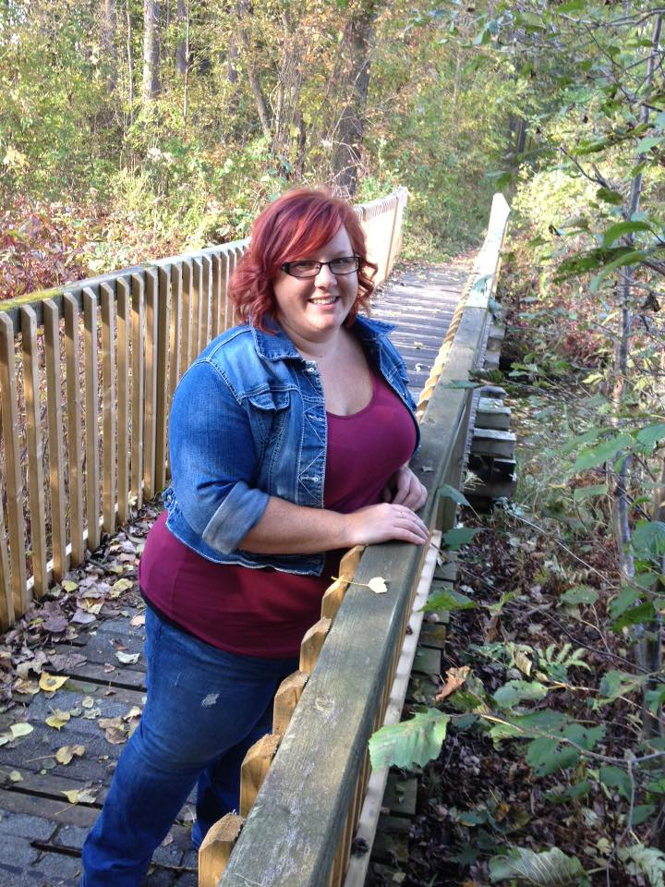
Amanda

Slide 10
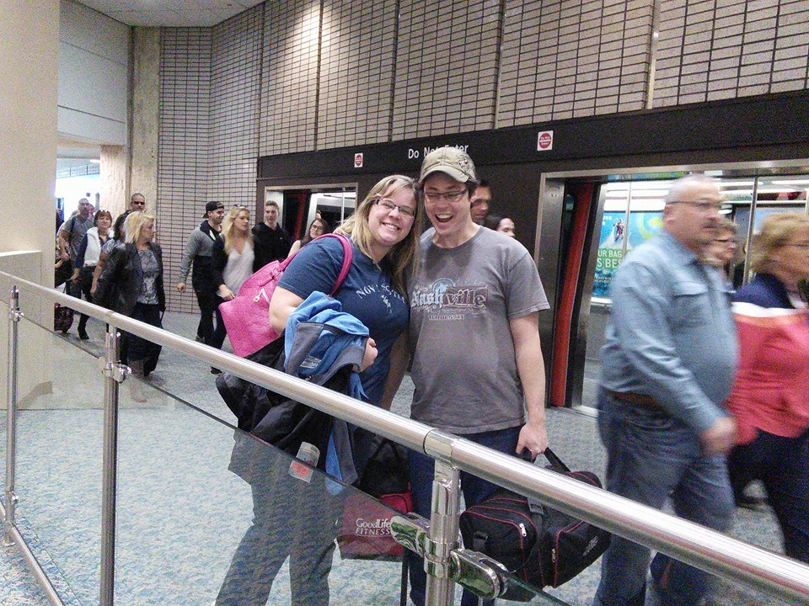
Melissa and Bob

Slide 11
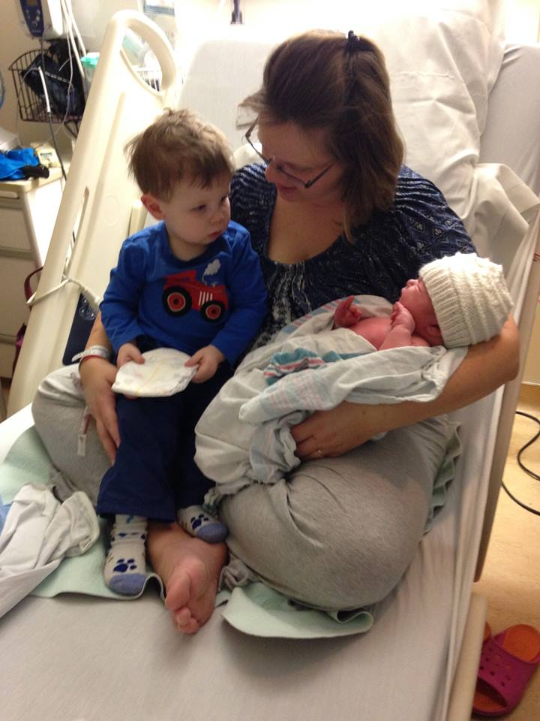
Benjamin Lydia

Slide 12
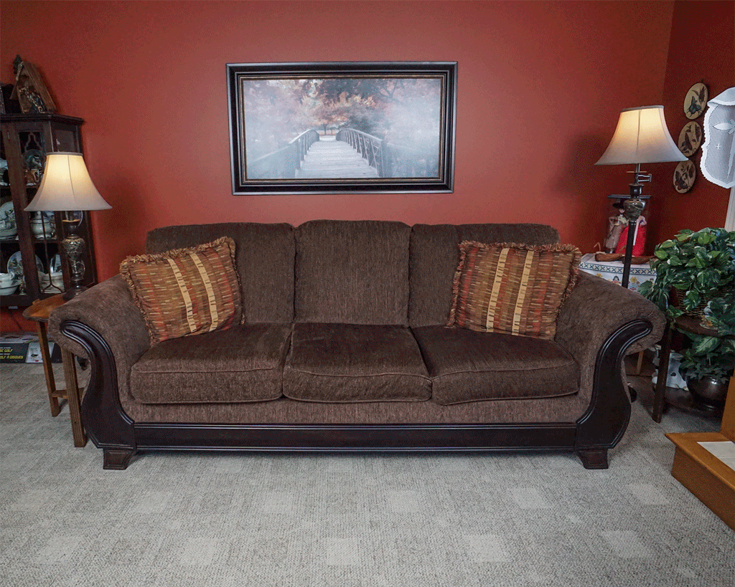

Slide 13
How long have I lived in Korea?

Slide 14
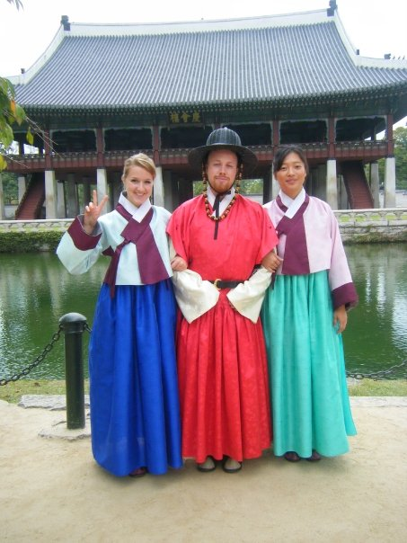
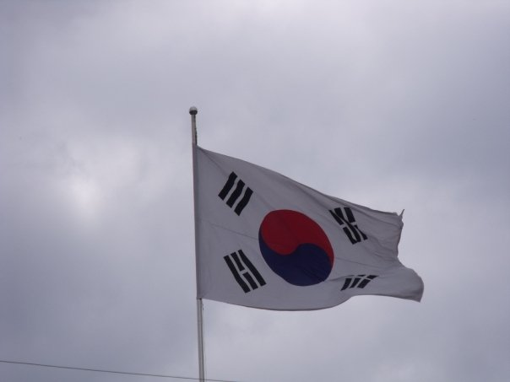
Mr.S in Korea
2009

Slide 15
Yuseong Bio-Science and Technology High School

Slide 16
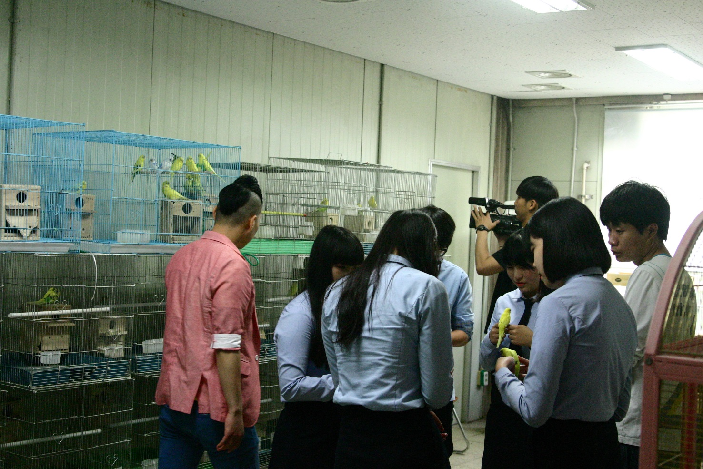
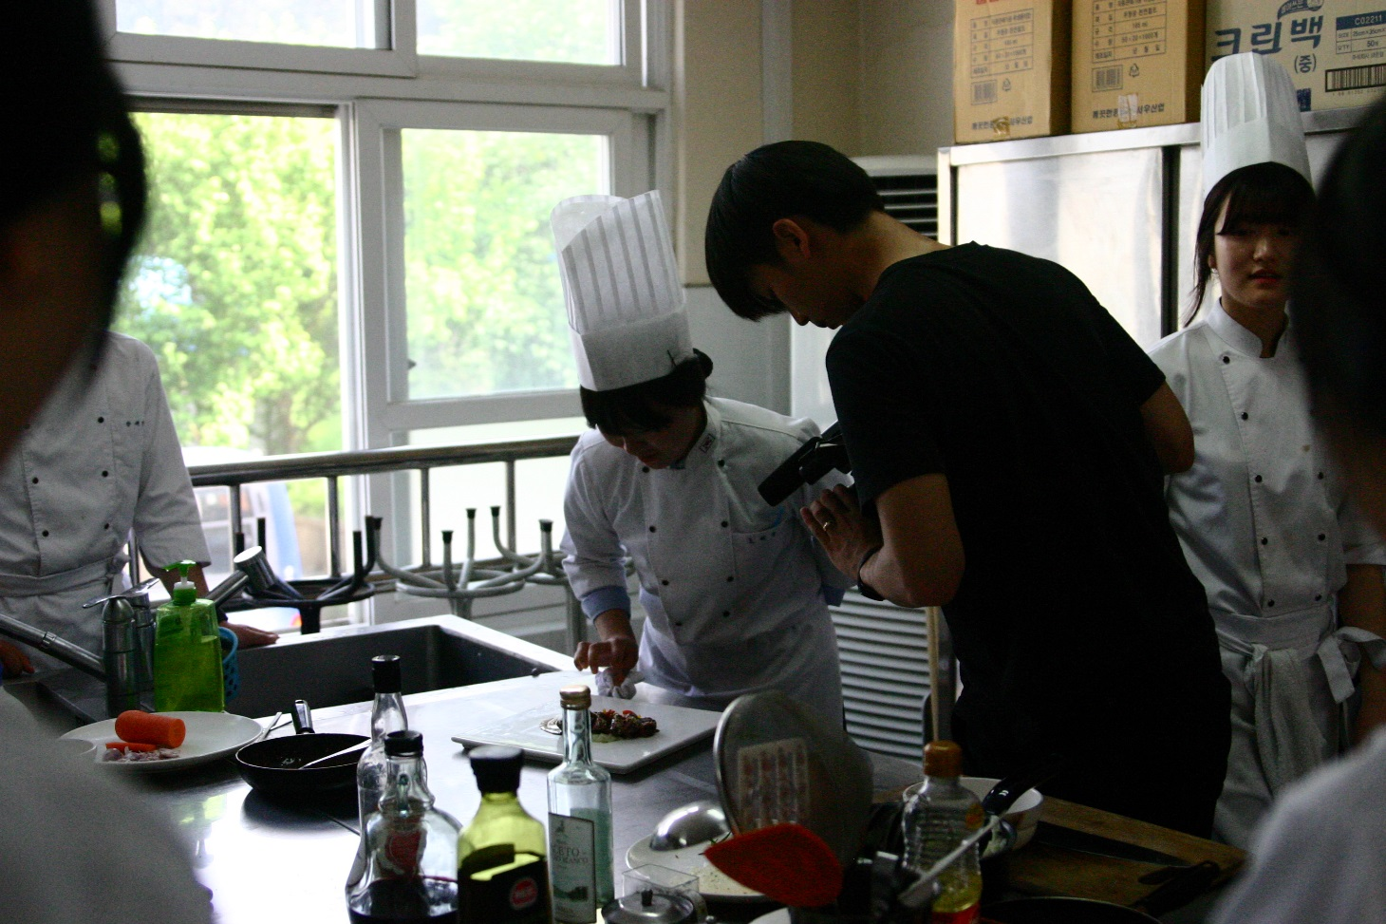
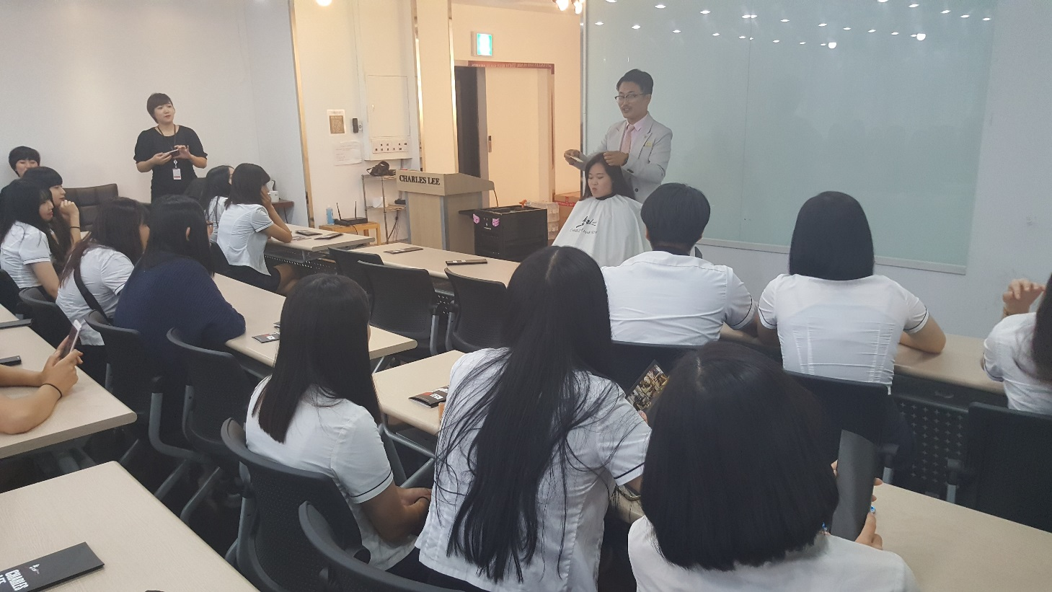

Slide 17
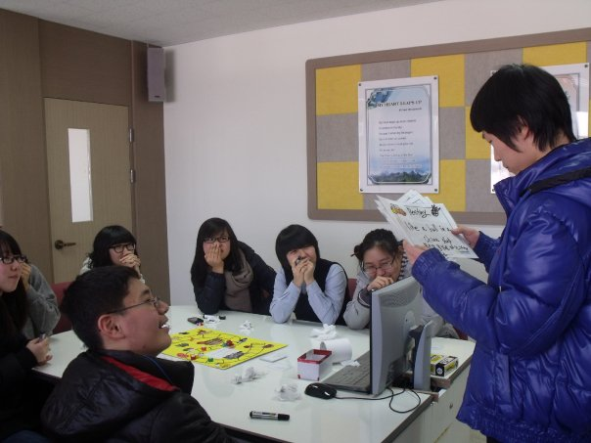
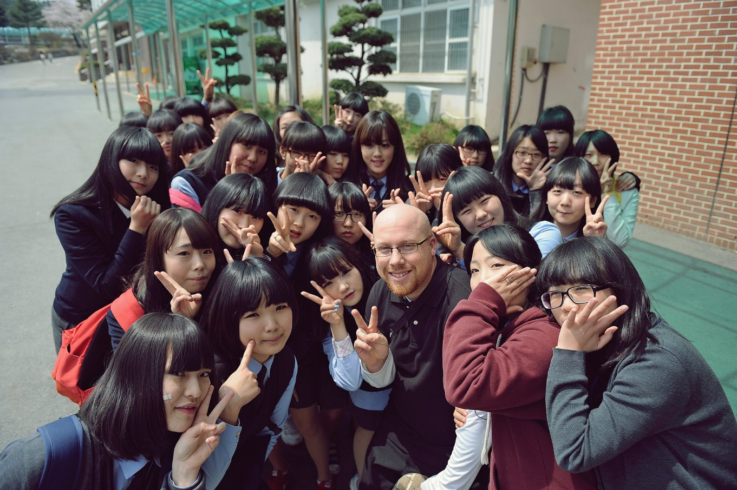

Slide 18
Eoeun Elementary School

Slide 19
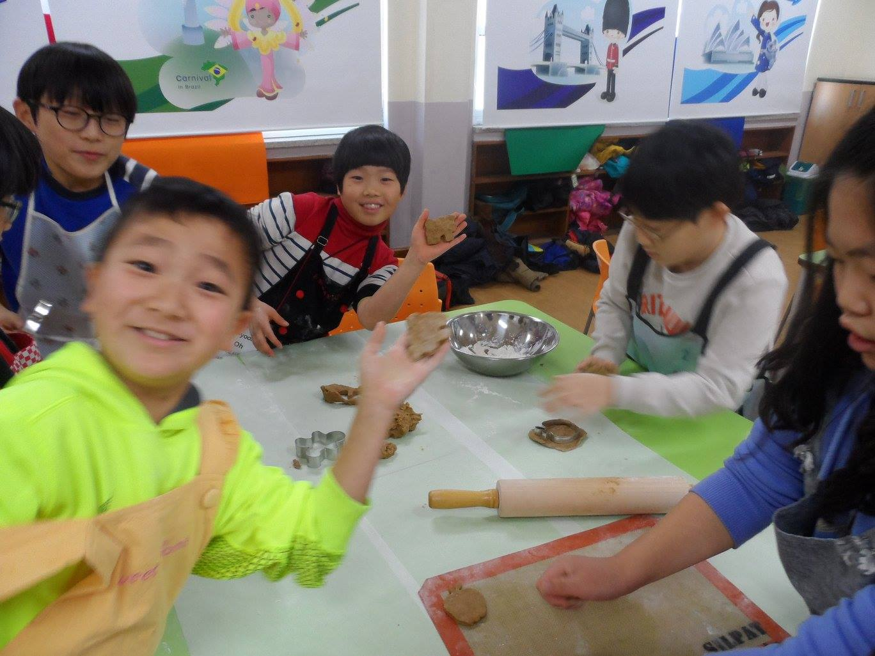

Slide 20
Shinhan High School

Slide 21
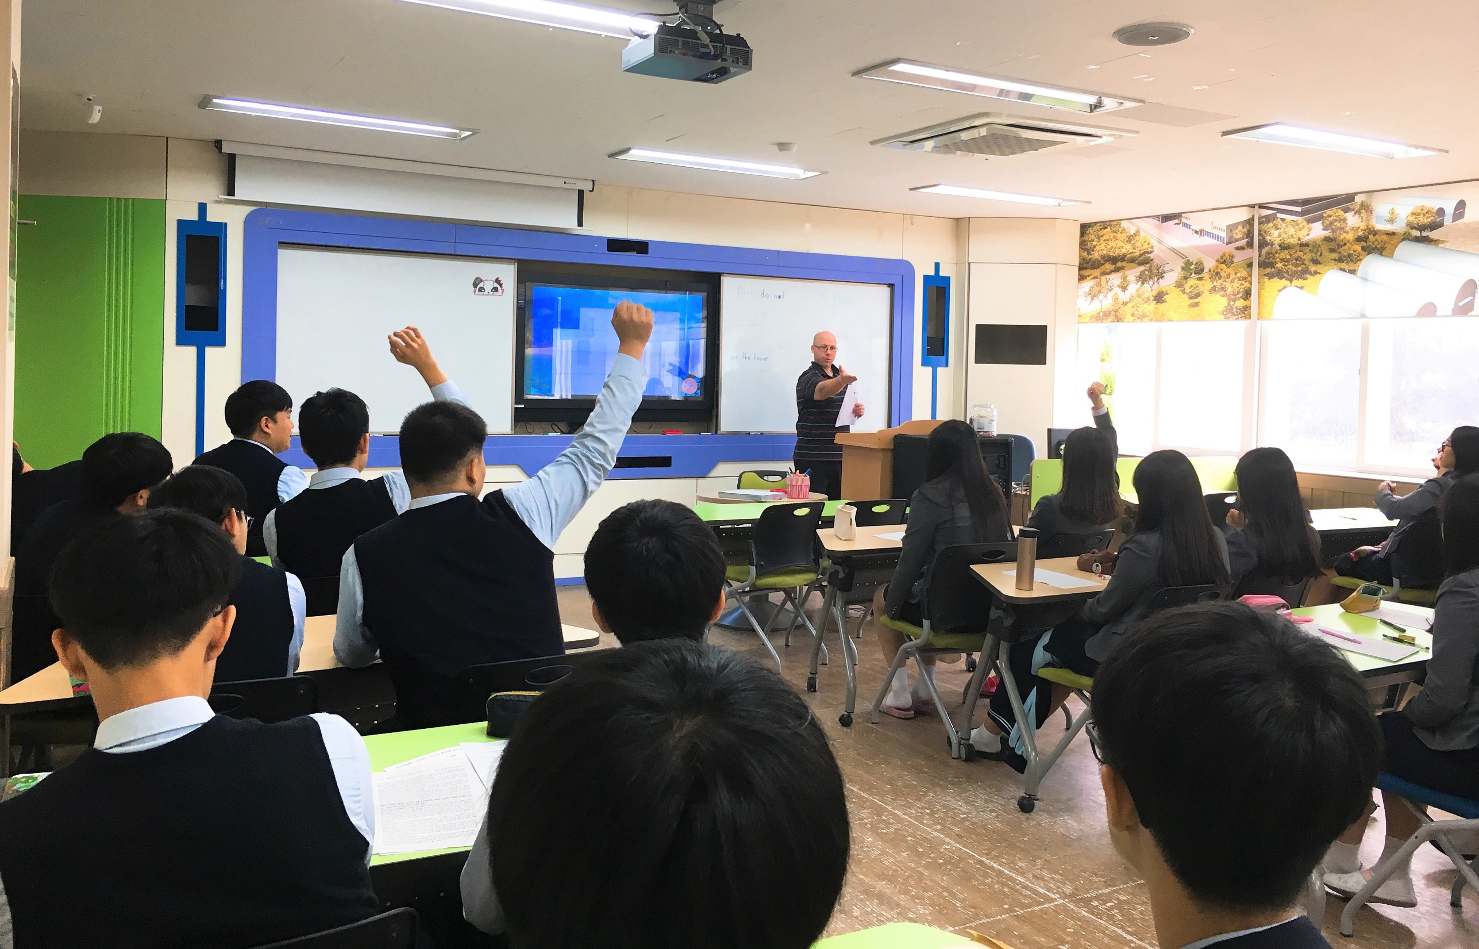
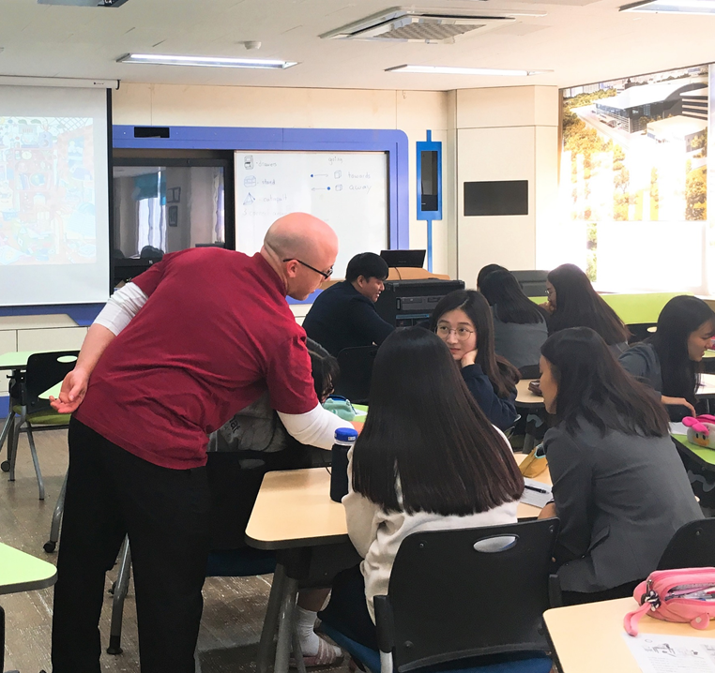

Slide 22
What was my major?

Slide 23
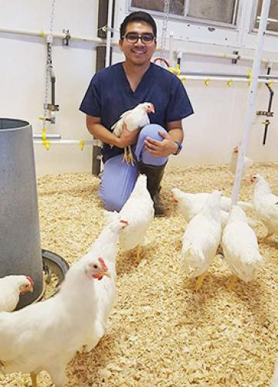

Slide 24
What is my favorite Korean Food?

Slide 25
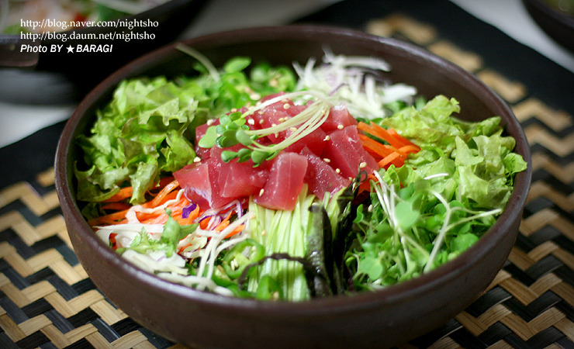
What is my favorite Korean Food?

Slide 26
What is my favorite hobby?

Slide 27
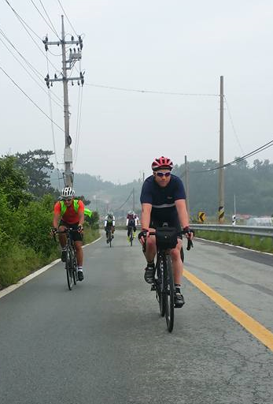
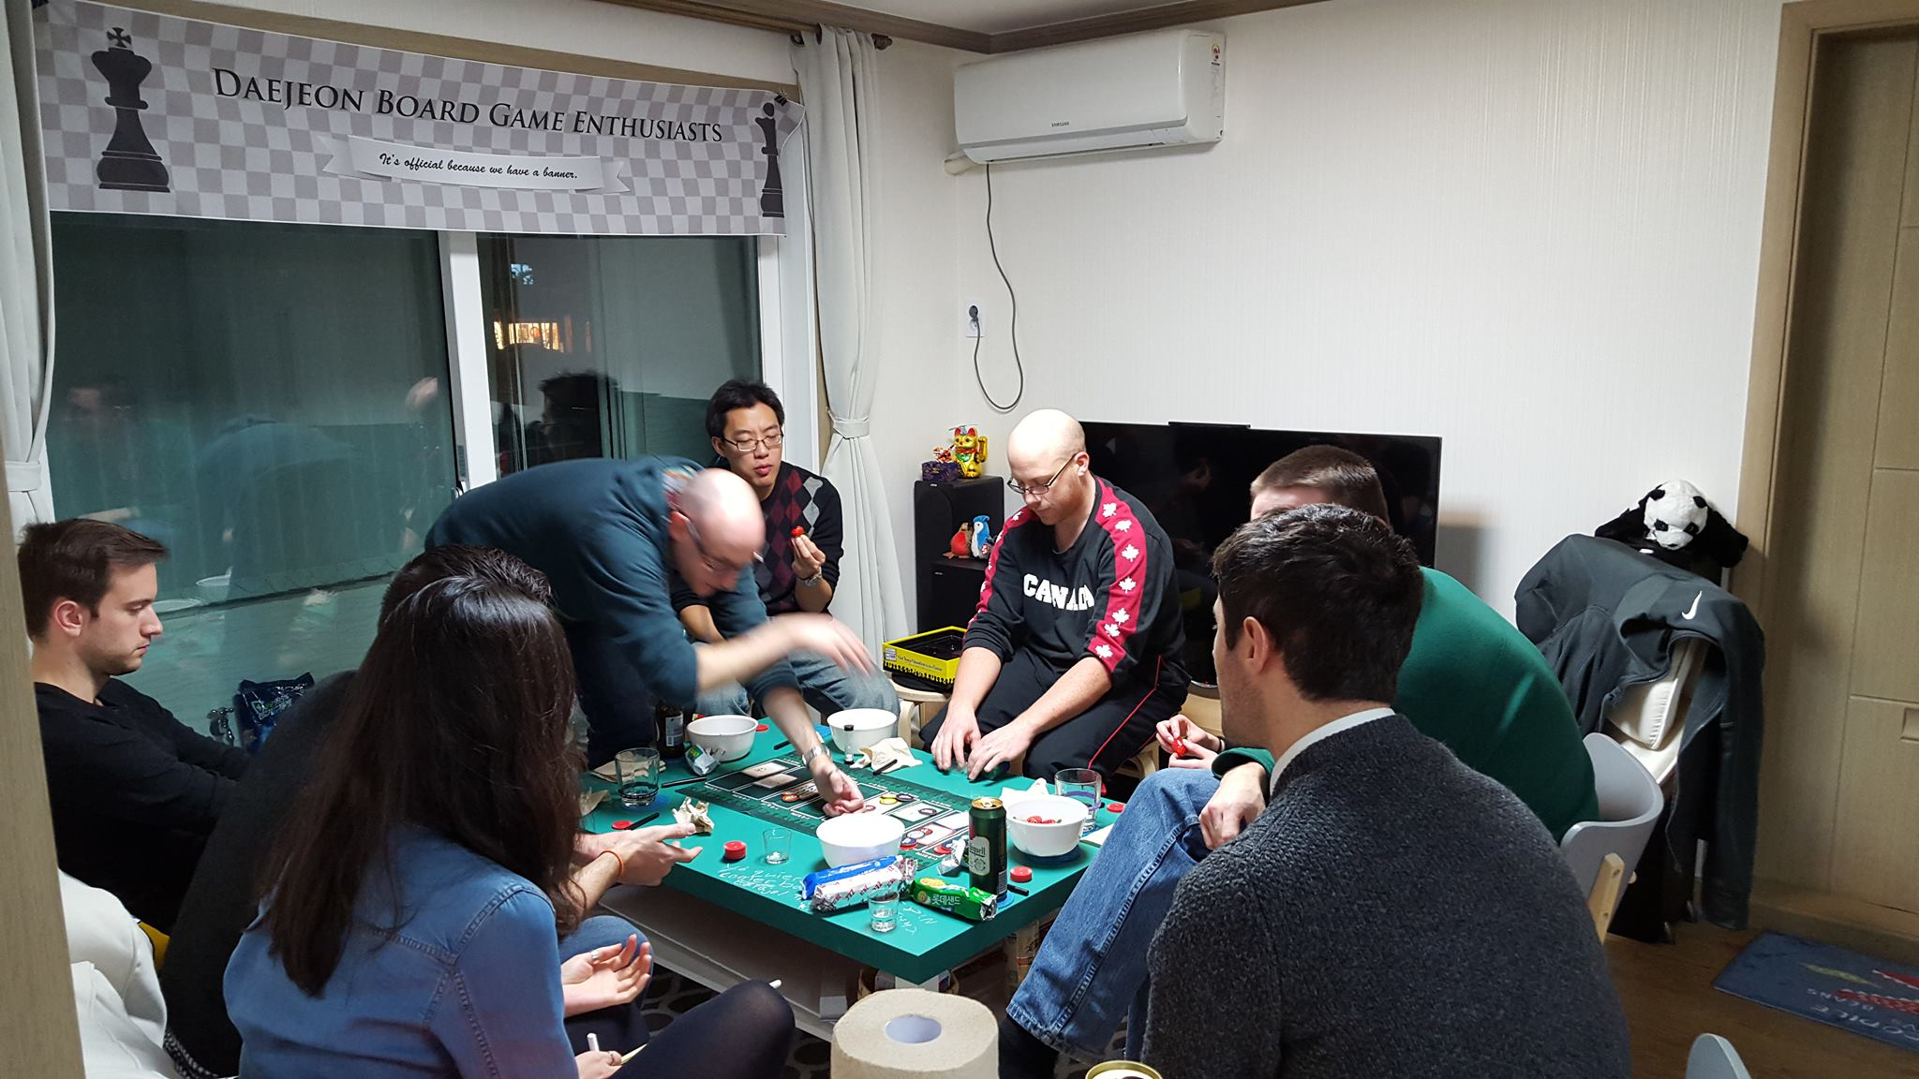
My Hobbies
Cycling
Playing board games

Slide 28
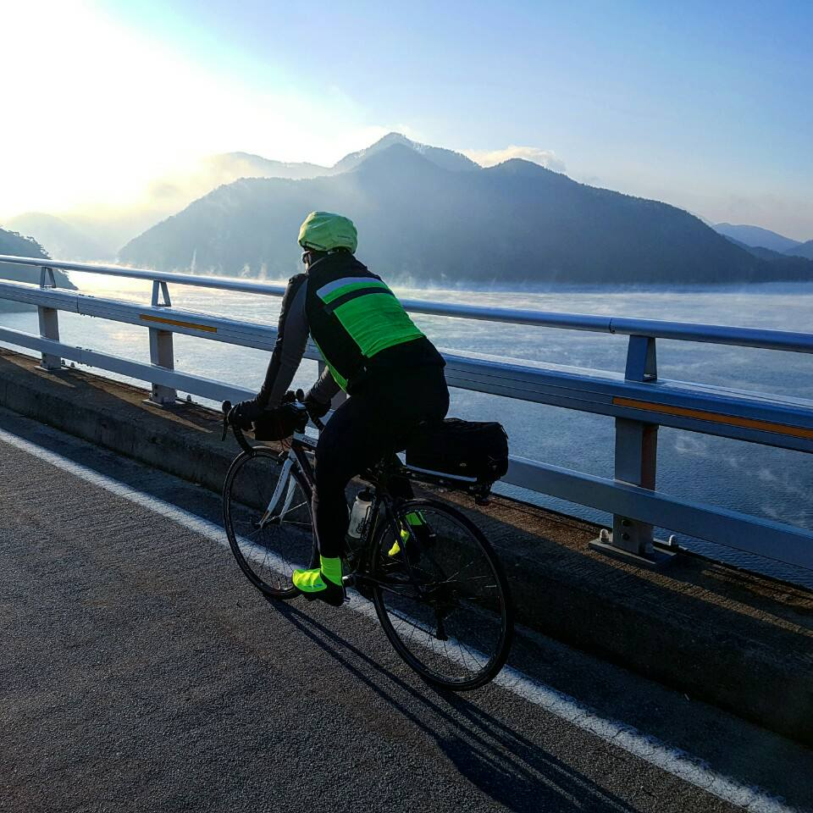
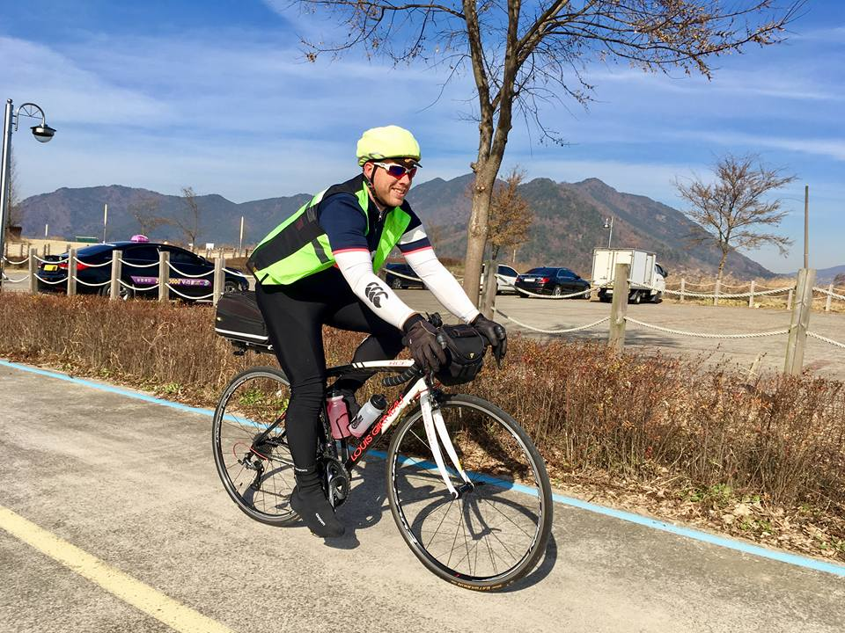
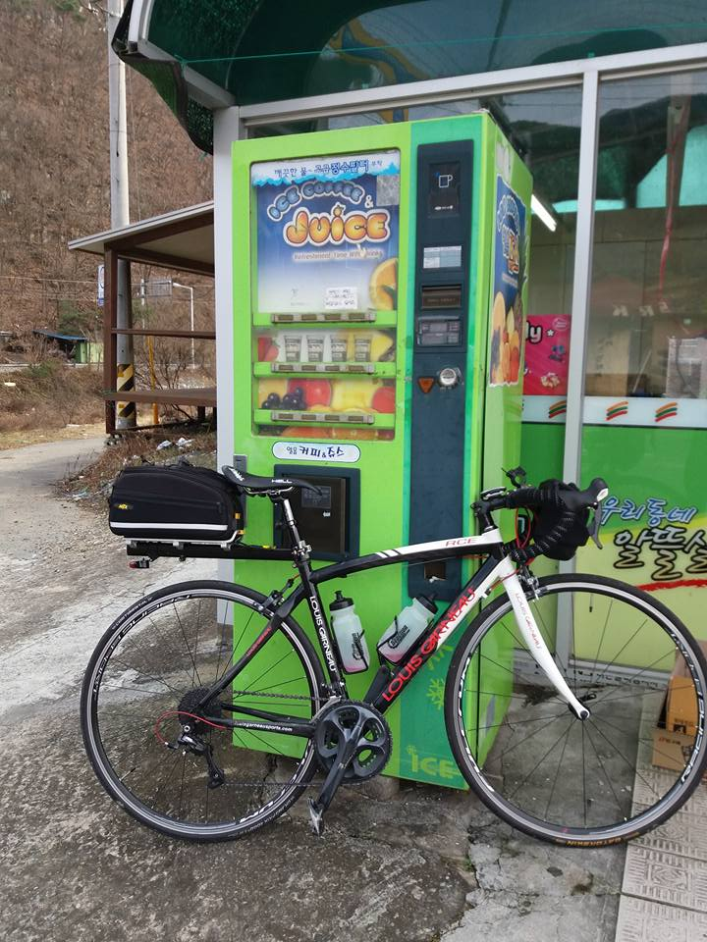
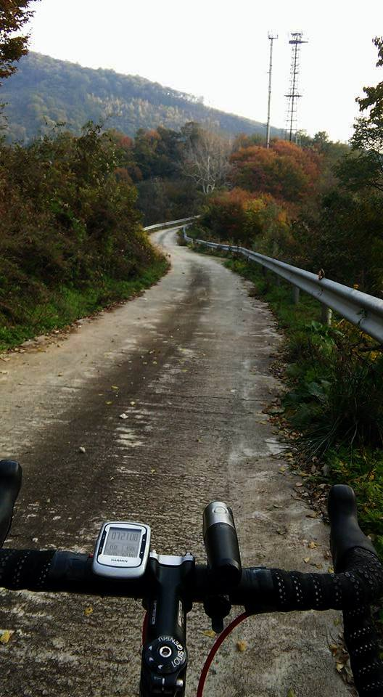
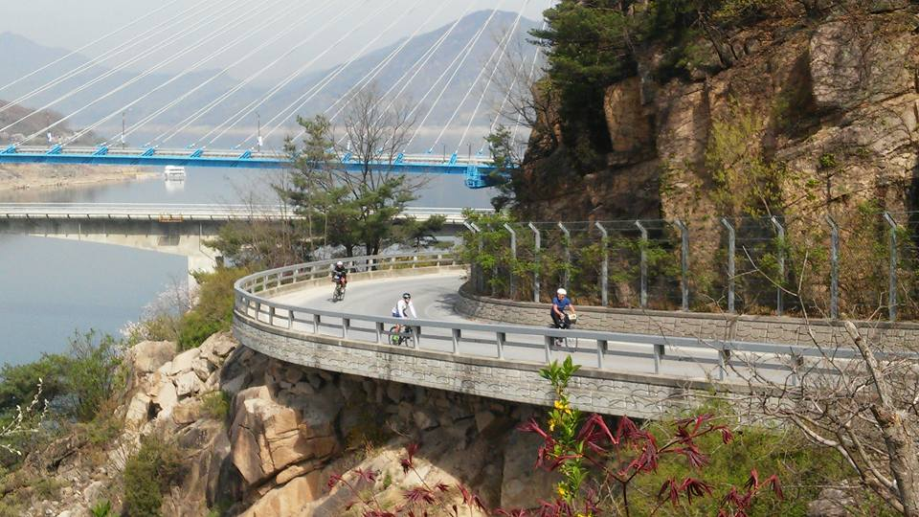
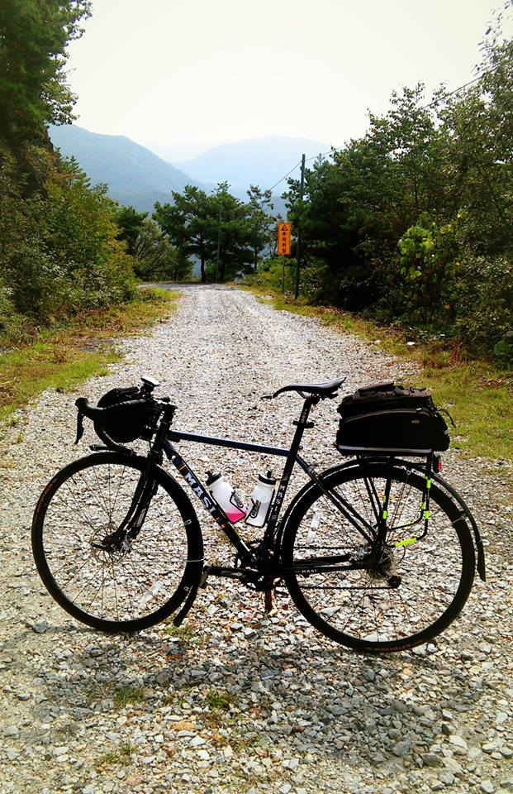
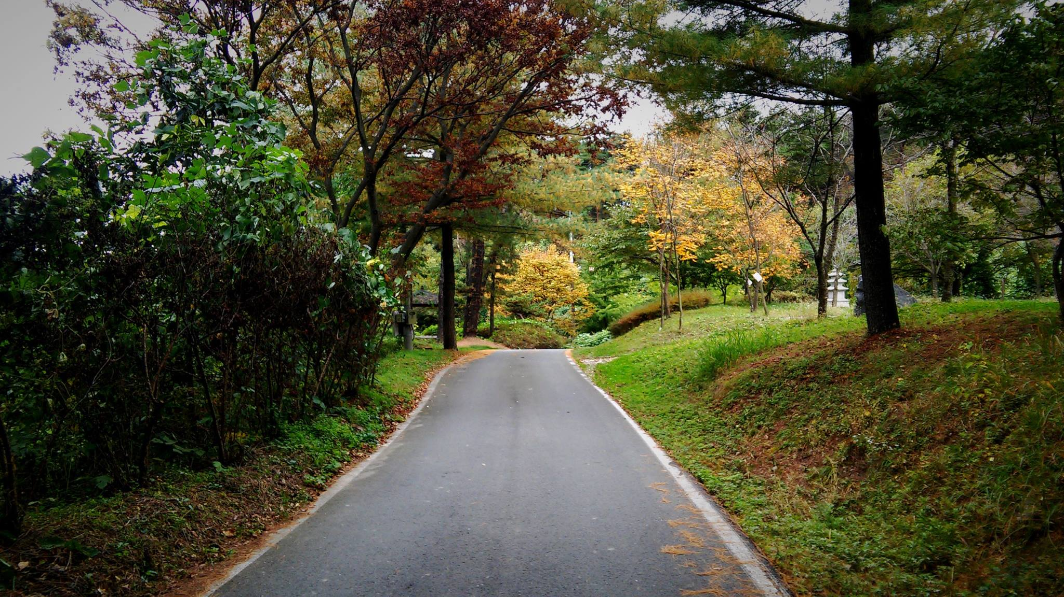
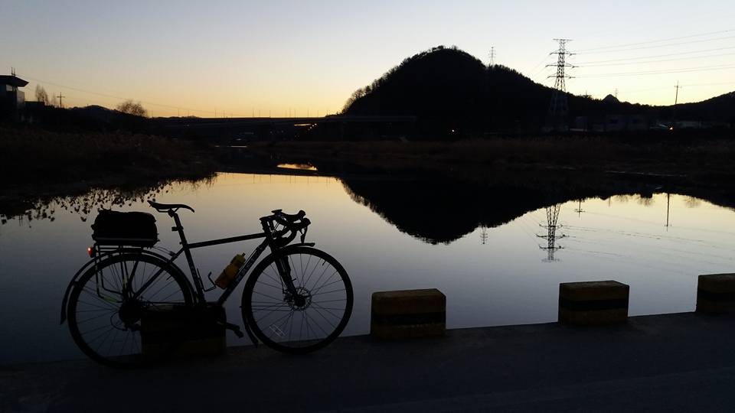

Slide 29
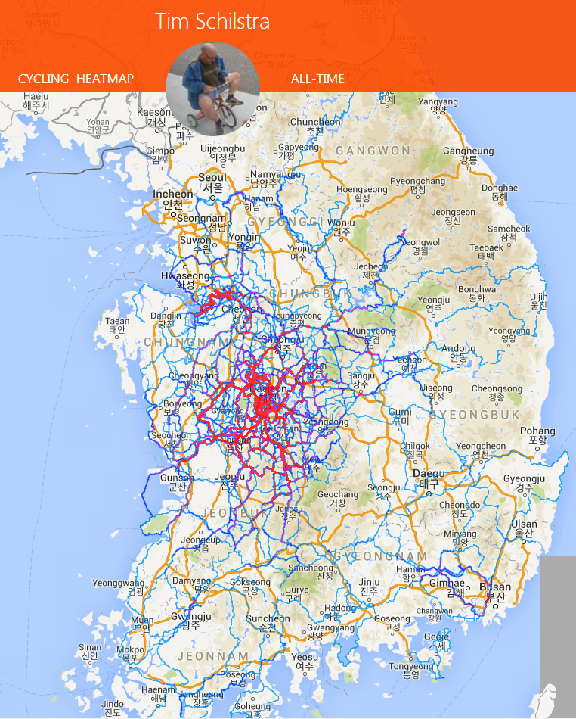
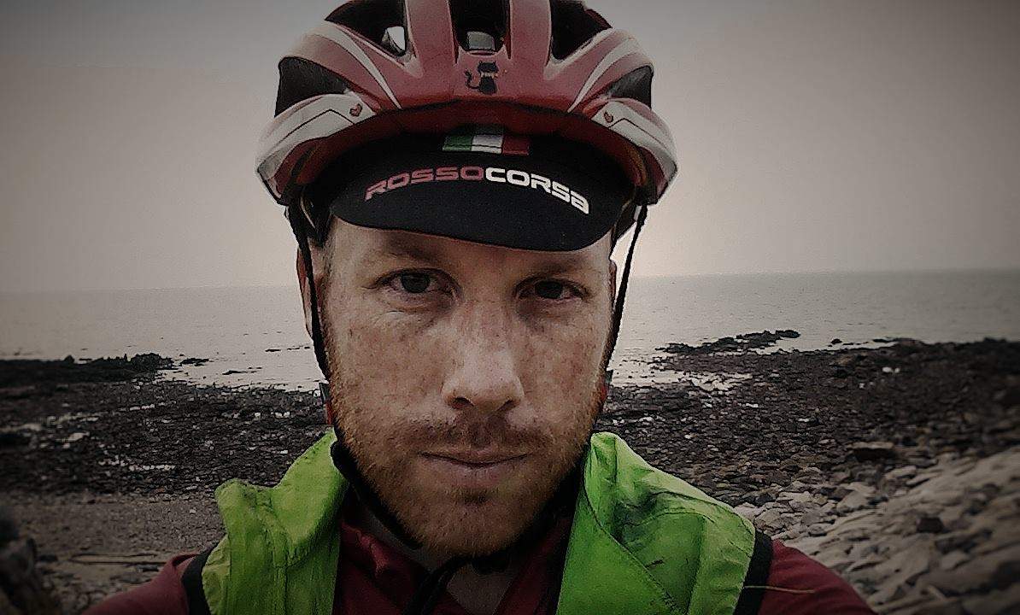

Slide 30
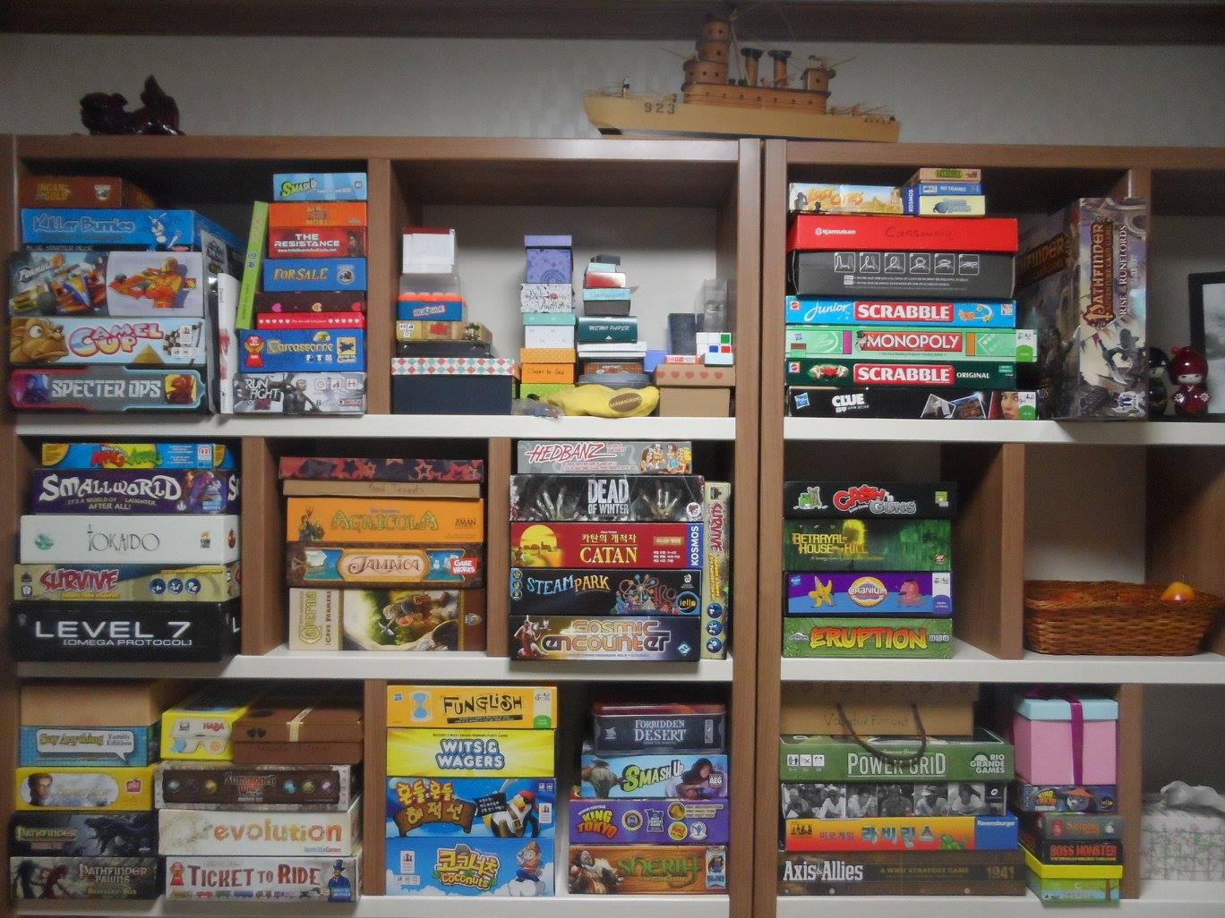
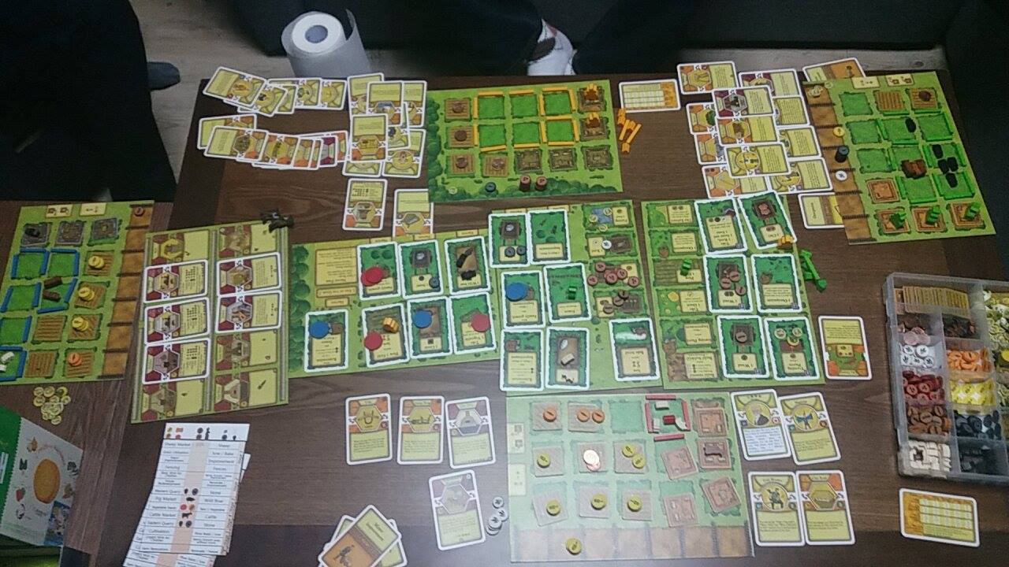
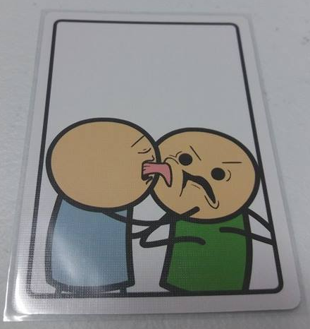

Slide 31
What is my favorite animal?

Slide 32
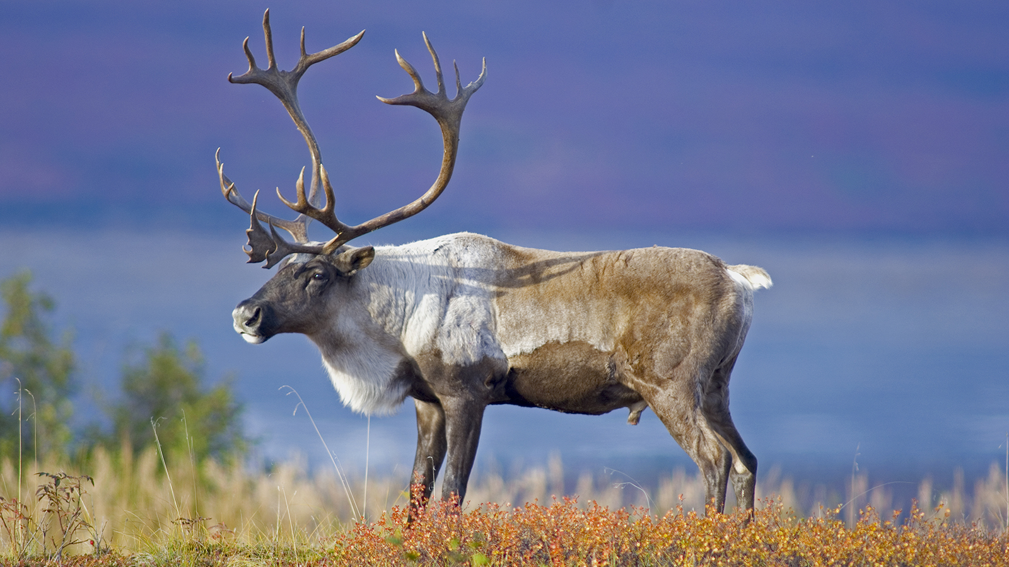
What is my favorite animal?

Slide 33
What is the strangest place I have been?

Slide 34
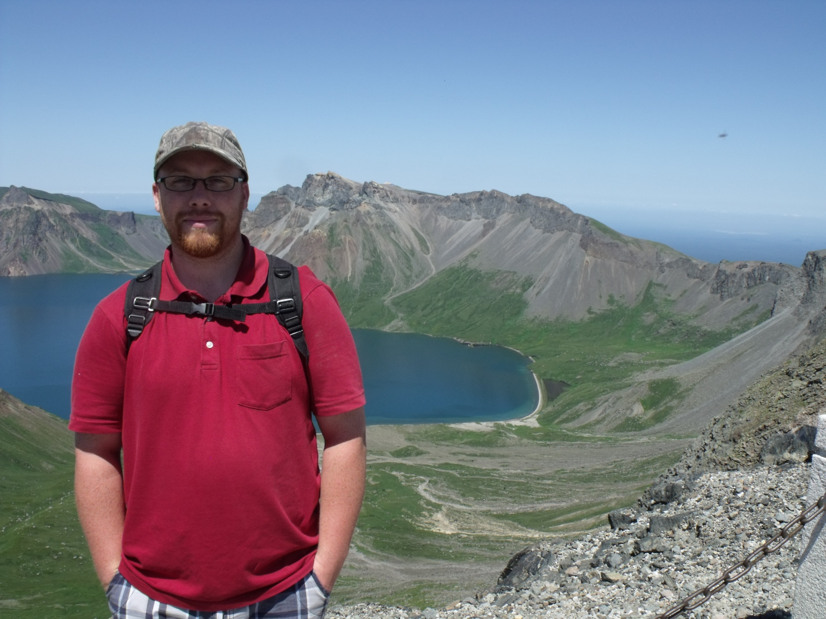

Slide 35
My Goals
Remember your names.
Lessons about reading (6 essential reading skills)
To give you ideas on activities and games to use in the classroom
Experience games
Change some games to be more applicable for you
Make PowerPoint Games

Slide 36
Lateral Thinking
You must think about the question in a unique way
You should ask questions to find the answer
I will answer “Yes”, “No”, or “Irrelevant”

Slide 37
Gloves
A woman leaves home and makes three left turns. She returns home again. On the way she passed by five people with gloves. Who were they?
They are baseball players. She hit a homerun.
Answer

Slide 38
Jane
It’s a hot summer day. Jane is dead on the floor. There is water on the floor and she is naked.
What happened?
Jane is a fish.
The aquarium broke.
Answer

Slide 39
Ancient Invention
There is an ancient invention still used in some parts of the world. It lets you see through walls.
What is it?
A window.
Answer

Slide 40
Soccer Scores
There is a magician who says he knows the score of every soccer game before it starts. He is always right.
How is it possible?
The score before a game starts is 0-0.
Answer

Slide 41
The surgeon
A man and his son were rock climbing and they fell. The son was injured, so he went to the hospital. The surgeon said, “I can’t operate on this boy. He is my son!”
How is this possible?
The surgeon is his mother.
Answer

Slide 42
The trains
There is a bridge that only has one railroad going across it. There are two trains that are moving in opposite directions. They both cross the bridge, but never hit each other.
How is it possible?
They cross the bridge at different times.
Answer

Slide 43
The small Umbrella
Three people try to share a small umbrella. No one gets wet. Why?
It’s not raining.
Answer

Slide 44
Gloves
There is a small lake. A man walks across the lake. There is no bridge, but the man is not wet.
How is it possible?
The lake is frozen (walk on ice)
Answer

Slide 45
The 10th Floor
A woman lives on the 10th floor. At night she gets off on the seventh floor and walks to her apartment.
Why doesn’t she go to the 10th floor?
She is short. She can’t reach the 10th floor button.
Answer

Slide 46
An Unopened Backpack
A man is found dead in the desert. He is wearing an unopened backpack.
How did he die?
The backpack is his parachute.
Answer

Slide 47
20 Questions
Think of something the others don’t know about you.
Secrets
Achievements
Memory
You can only answer “Yes”, “No” or “Irrelevant”
So, I can get to know you better.

