Slide 1
Phonics to Fluency

Slide 2
6 Essential Reading Skills

Slide 3
6 Essential Reading Skills
Oral Language
Phonemic Awareness
Phonics
Fluency
Comprehension
Vocabulary Knowledge

Slide 4
6 Essential Reading Skills
Oral Language
Phonemic Awareness
Phonics
Fluency
Comprehension
Vocabulary Knowledge

Slide 5
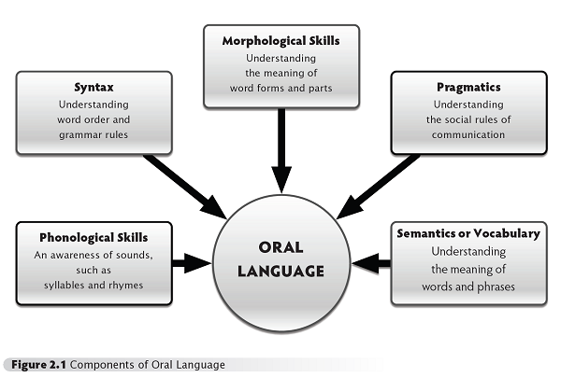
Oral Language
Exposure to phonics
Acquire vocabulary
Syntax

Slide 6
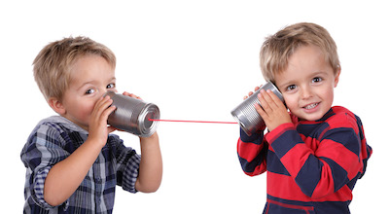
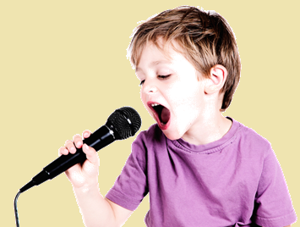
How do students acquire oral language? (Canada vs. Korea)

Slide 7
Improving Oral Language
Let them talk
English class shouldn’t be a quiet classroom
Let them listen
Read to them, speak to them, let them hear the language
Build vocabulary
Start using new words, explain
Support oral language
Avoid interrupting
Show interest
https://education.seattlepi.com/developing-oral-language-kindergarten-5769.html

Slide 8
Teaching Oral Language
Encourage conversation
Model syntactic structure
Maintain eye contact
Remind students to speak loudly and articulate clearly.
Explain the subtleties of tone.
Attend to listening skills.
Incorporate a “Question of the Day.”
Compile a class booklet of students’ phrases.
Question to boost comprehension.
Never assume students understood your instructional talk.
Teach concept words.
http://blog.brookespublishing.com/11-ways-to-improve-your-students-oral-language-skills/

Slide 9
Trouble Understanding?
Mad Gab

Slide 10
Team Oath He
Name

Slide 11
Timothy

Slide 12
May Pole Sir Up
Sugary Food

Slide 13
Maple Syrup

Slide 14
Al Waits beep light
Class Rules

Slide 15
Always be polite.

Slide 16
Dew Wino Hue
First Question

Slide 17
Do I know you?

Slide 18
6 Essential Reading Skills
Oral Language
Phonemic Awareness
Phonics
Fluency
Comprehension
Vocabulary Knowledge

Slide 19
Phonemic Awareness
Understanding that words are made from different sounds (phonemes).
Ball = B + Aw + L

Slide 20
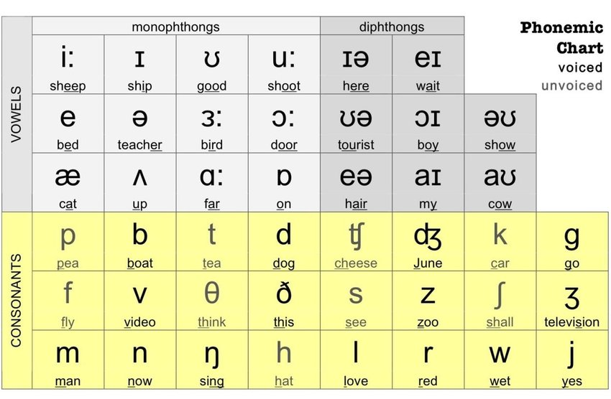
Phonemic Awareness
44 phonemes

Slide 21
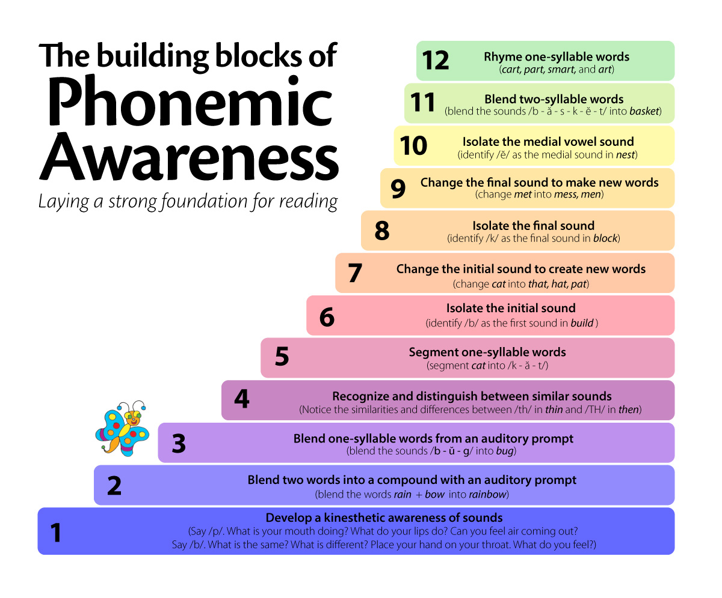
http://www.mrsjudyaraujo.com/phonemic-awareness-for-prek-k-and-1/

Slide 22
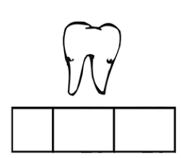
Phonemic Awareness Activities
Listening – where is the sound?, animal noises,
Rhyming – nonsensical rhymes, Dr. Seuss, nursery rhymes
Words – addition, deletion, differences, similarities, alliteration
Blending – letters, compound words
Syllables – count / clap the syllables, segment and blend syllables
Phonemes – break into individual sounds, Elkonin boxes, point to the sound, eye spy

Slide 23
I’m going on vacation
Can you come?

Slide 24
I’m going on vacation
I am going to New York
I will bring a fork, a book and a cheque.
What will you bring?
- I’ll decide who can come with me.

Slide 25
I’m going on vacation
“I am going to Paris
I will bring a pencil, a pillow and a pineapple.”
First letter for learners.

Slide 26
6 Essential Reading Skills
Oral Language
Phonemic Awareness
Phonics
Fluency
Comprehension
Vocabulary Knowledge

Slide 27
Phonics
Associating letters with sounds.
Over 200 ways to spell the 44 phonemes.

Slide 28
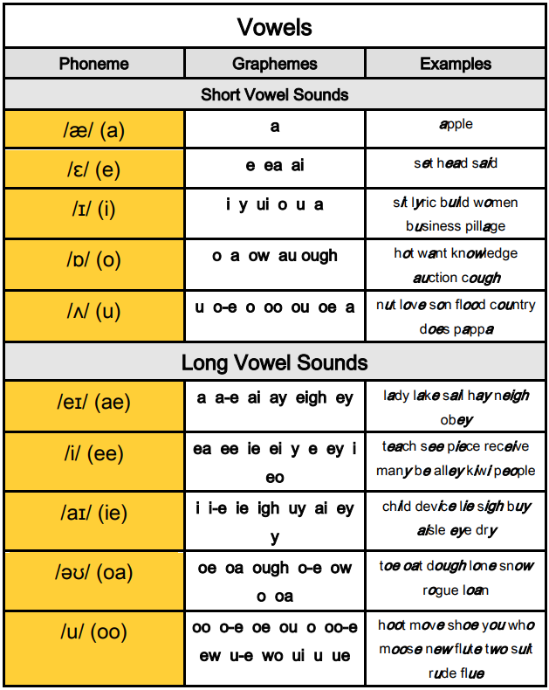
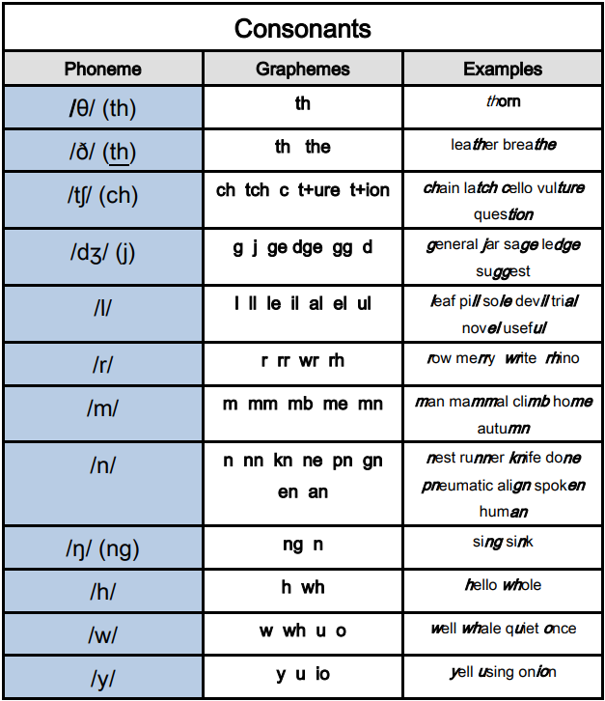
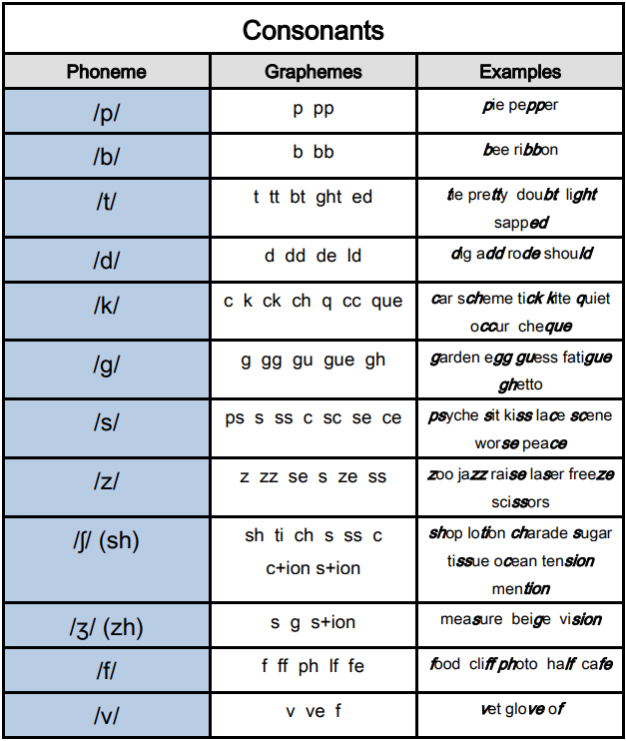
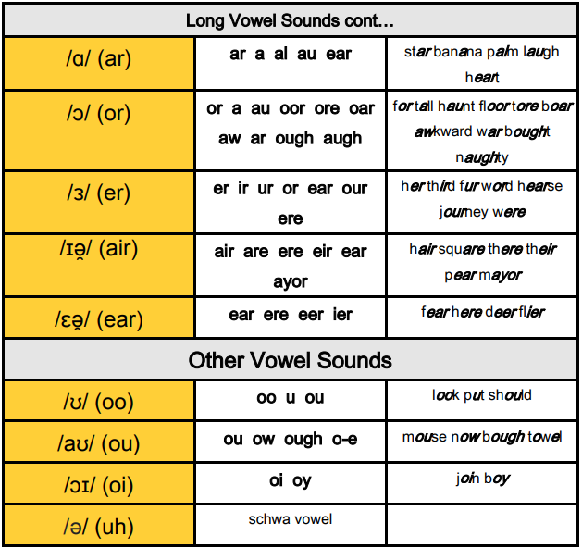
Phonics

Slide 29
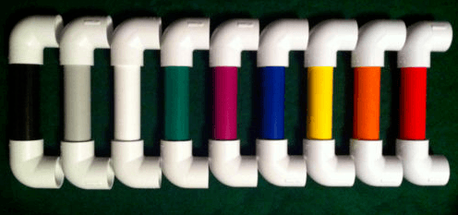
Phonics Phones
Whisper Phones

Slide 30
Phonics Phones

Slide 31
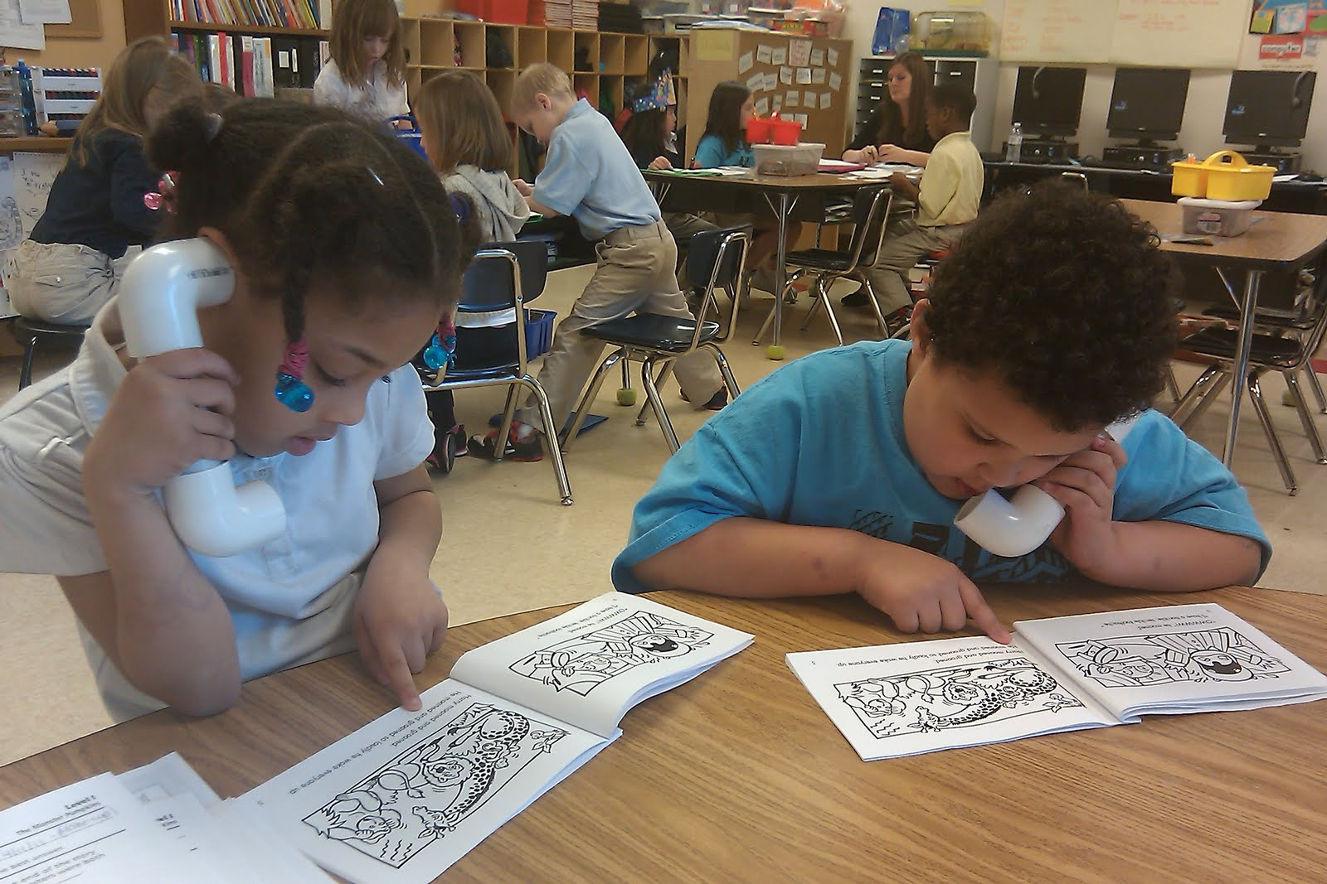

Slide 32
Practice
Tim
Team

Slide 33
Practice
Fart
Part

Slide 34
Practice
lake
rake

Slide 35
Practice
fall
par

Slide 36
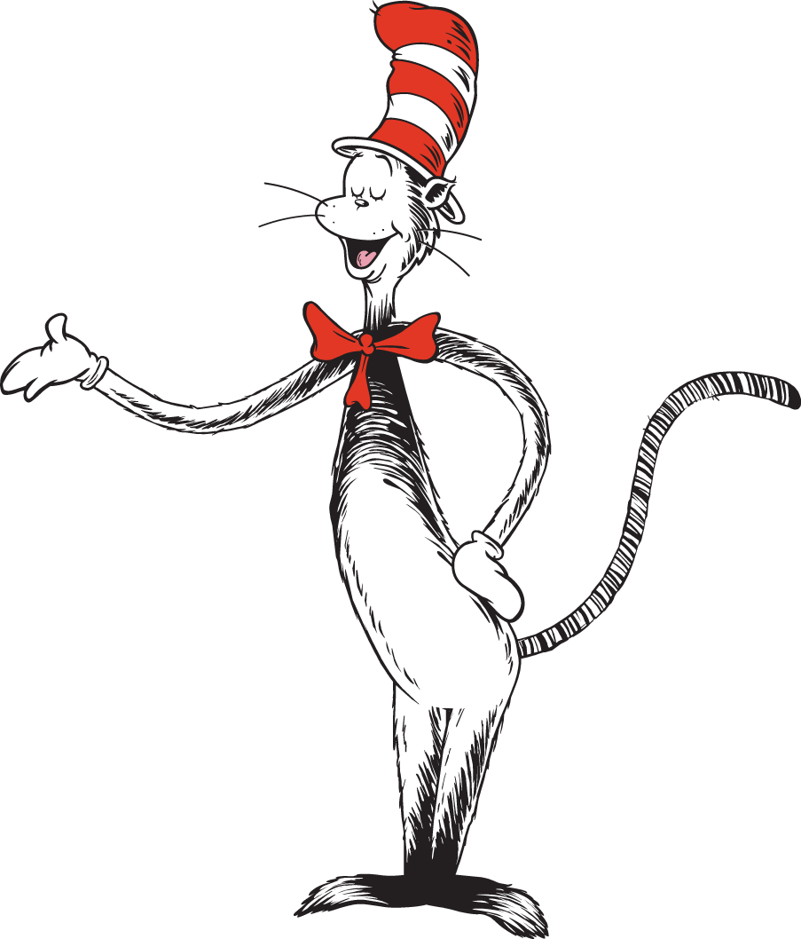
Practice
Cat in the Hat

Slide 37
6 Essential Reading Skills
Oral Language
Phonemic Awareness
Phonics
Fluency
Comprehension
Vocabulary Knowledge

Slide 38
Fluency
Speed
Accuracy
Expression

Slide 39
Fluency
Be a model!
Show students how to read with expression and proper pacing.

Slide 40
Fluency
“Read like talking”
Choral reading, cloze reading, partner reading, class theater, etc.
Use videos to illustrate natural speech.

Slide 41
6 Essential Reading Skills
Oral Language
Phonemic Awareness
Phonics
Fluency
Comprehension
Vocabulary Knowledge

Slide 42
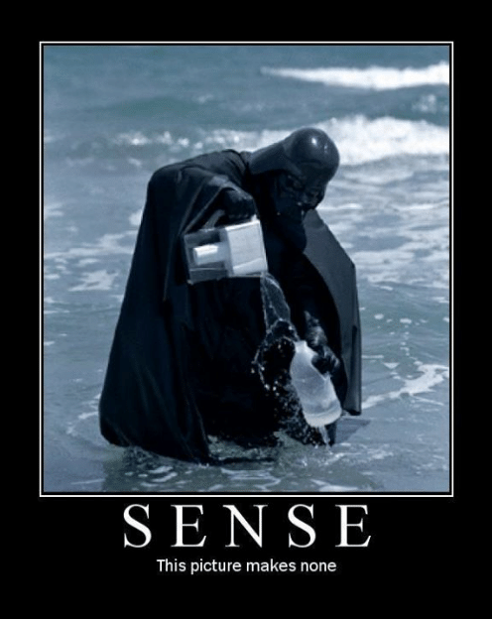
Comprehension
Do the students understand?

Slide 43
Comprehension
Create good questions
“Do you Understand?” X
Ask for feedback
In your own words

Slide 44
6 Essential Reading Skills
Oral Language
Phonemic Awareness
Phonics
Fluency
Comprehension
Vocabulary Knowledge

Slide 45
Vocabulary Knowledge
Acquire new words
Use the new words
Communicative approach
Affixes

