Slide 1
Internet Acronyms

Slide 2
How to play:
Guess what the acronym means
Write it on the white board
Each correct word = 1 point

Slide 3
LOL
Laugh out loud

Slide 5
GL
Good luck

Slide 7
OMG
Oh my god

Slide 8
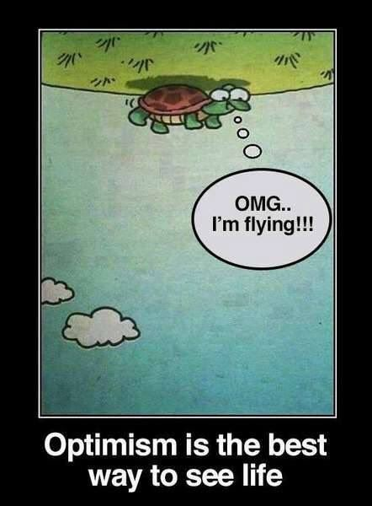

Slide 9
Yolo
You only live once.

Slide 11
JK
Just kidding

Slide 13
BRB
Be right back

Slide 15
IDK
I don’t know

Slide 17
TTYL
Talk to you later

Slide 18
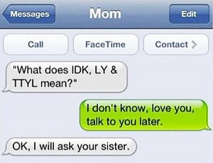

Slide 19
BFF
Best friends forever

Slide 21
IRL
In real life

Slide 23
BTW
By the way

Slide 24
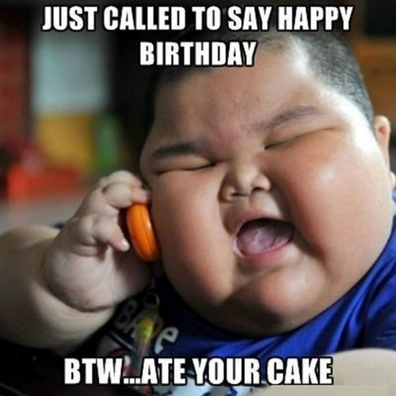

Slide 25
AMA
Ask me anything

Slide 27
FYI
For your information

Slide 28
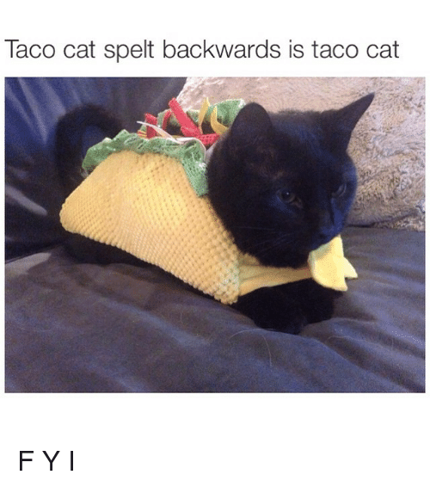

Slide 29
IMO
In my opinion

Slide 30
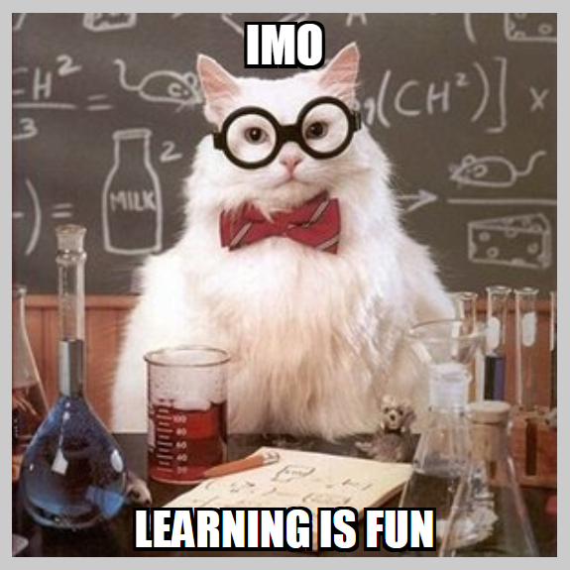

Slide 31
ROTFL
Rolling on the floor laughing

Slide 33
FB
Facebook

Slide 35
WTF
What the F---

Slide 36
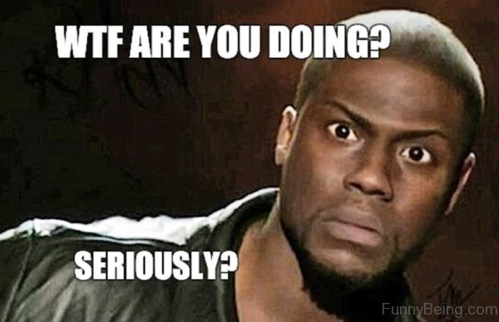

Slide 37
TYVM
Thank you very much

Slide 38
TYVM

Slide 39
TBH
To be honest,

Slide 41
NSFW
Not safe for work

Slide 42
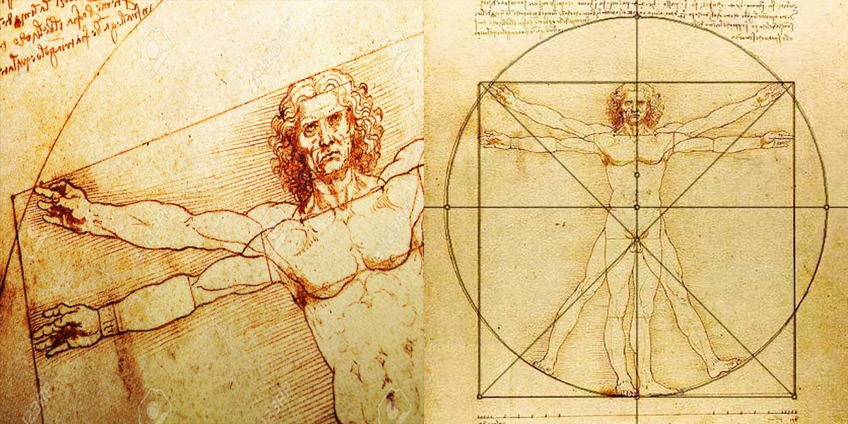

Slide 43
TMI
Too much information

Slide 44
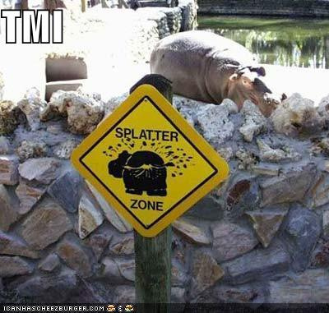

Slide 45
OMW
On my way

Slide 47
G2G
Got to go

Slide 48
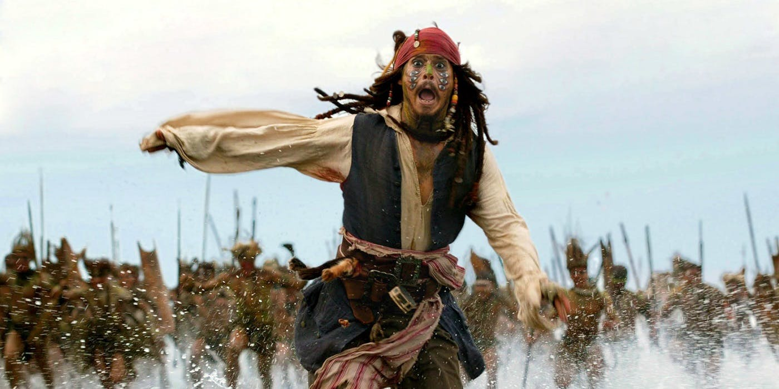
G2G TTYL

Slide 49
TFW
That feeling when…
(MFW = My face when)
(MRW = My reaction when)

Slide 51
FTW
For the win

Slide 53
TIL
Today I learned…

Slide 55
TL;DR
Too long, didn’t read.

Slide 57
Slang
..and new words

Slide 58
Internet examples:
G’nite
Txt
good night
Gratz
text
congratulations
L8r
later
SRSLY
Gr8
seriously
LRN
great
learn

Slide 59
New Words
https://www.youtube.com/watch?v=2IZRFW7da3Y

Slide 60
Triple 5 Rule (Oxford)
Used a lot.
Many places.
For a long time.

Slide 61
Prescriptive vs Descriptive
Prescriptive = Tells how a language should work (grammar police)
Descriptive = Explain how language actually works (dictionaries)

Slide 62
How do we teach?
Prescriptive or Descriptive?
Is this useful?
Are there methods to teach descriptively?

Slide 63
Descriptive Teaching
fluency > accuracy
Foreign films, YouTube videos, plays…
Access to native speakers
Observe how natural speakers talk

Slide 64
New English Words
Can you guess the definition?

Slide 65
Merriam-Webster Dictionary
Adds about 1000 words per year.
“Gochujang” was added in September 2018.
“Bibimbap” as added in September 2017

Slide 66
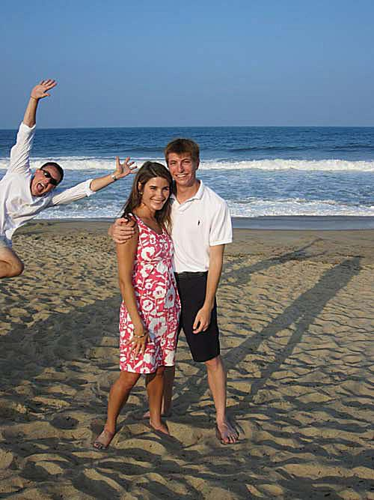
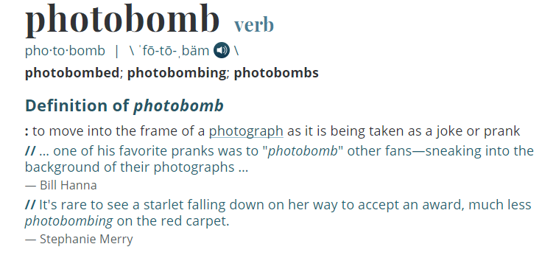
Photobomb

Slide 67
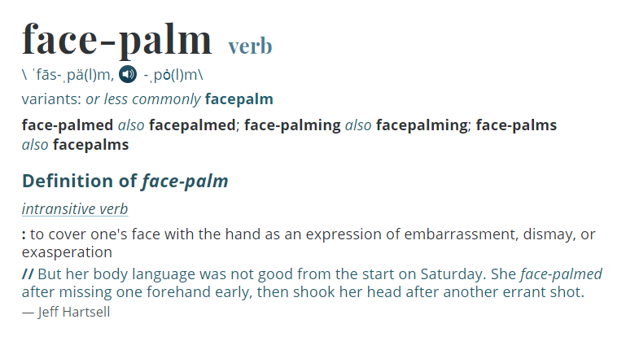
Facepalm

Slide 68
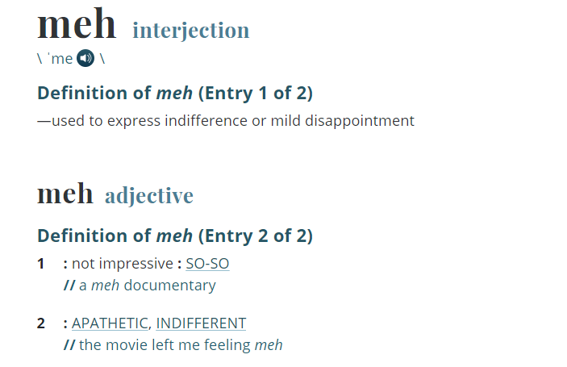
Meh

Slide 69
Balderdash
Choose a leader
The leader will:
Read the word twice
Spell the word once
Secretly write the correct definition
The other players will:
Write the word at the top then…
Secretly write a definition.

Slide 70
Balderdash
The leader will:
Check if any definitions are similar (take it out)
Shuffle the definitions (including the correct one they wrote)
Read the definitions
The other players will:
Choose the one they think is correct

Slide 71
Balderdash Points
Writing a similar definition = 3 points
Guessing the correct answer = 2 points
Someone guesses your answer = 1 point
No one guesses the correct answer = leader gets 3 points

Slide 72
How a dictionary writer defines English
https://www.youtube.com/watch?v=uLgn3geod9Q

