Slide 1
Vocabulary Knowledge

Slide 2
How do students acquire new words?

Slide 3
How do native speakers acquire new words?

Slide 4
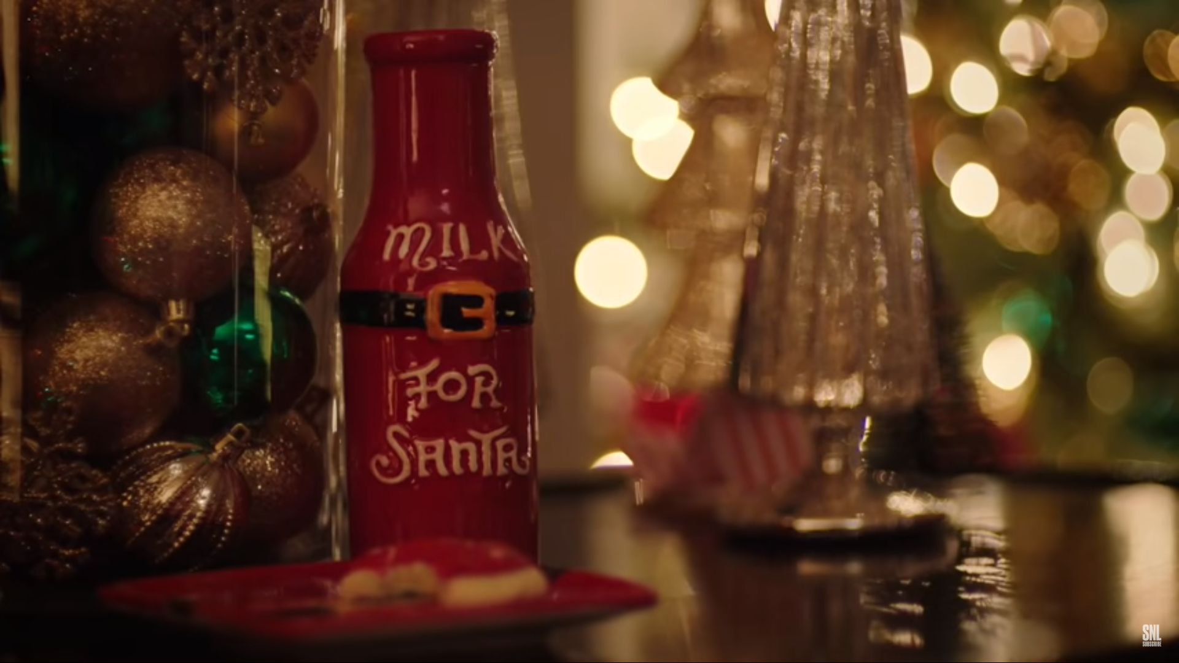
Best Christmas Ever
https://www.youtube.com/watch?v=4WvwX18oMR4

Slide 5
Expectation vs. Reality
Did they tell the truth?

Slide 6
Expectation vs. Reality
Was it a good Christmas?

Slide 7
Expectation vs. Reality
Why is it called,
“Best Christmas Ever”

Slide 8
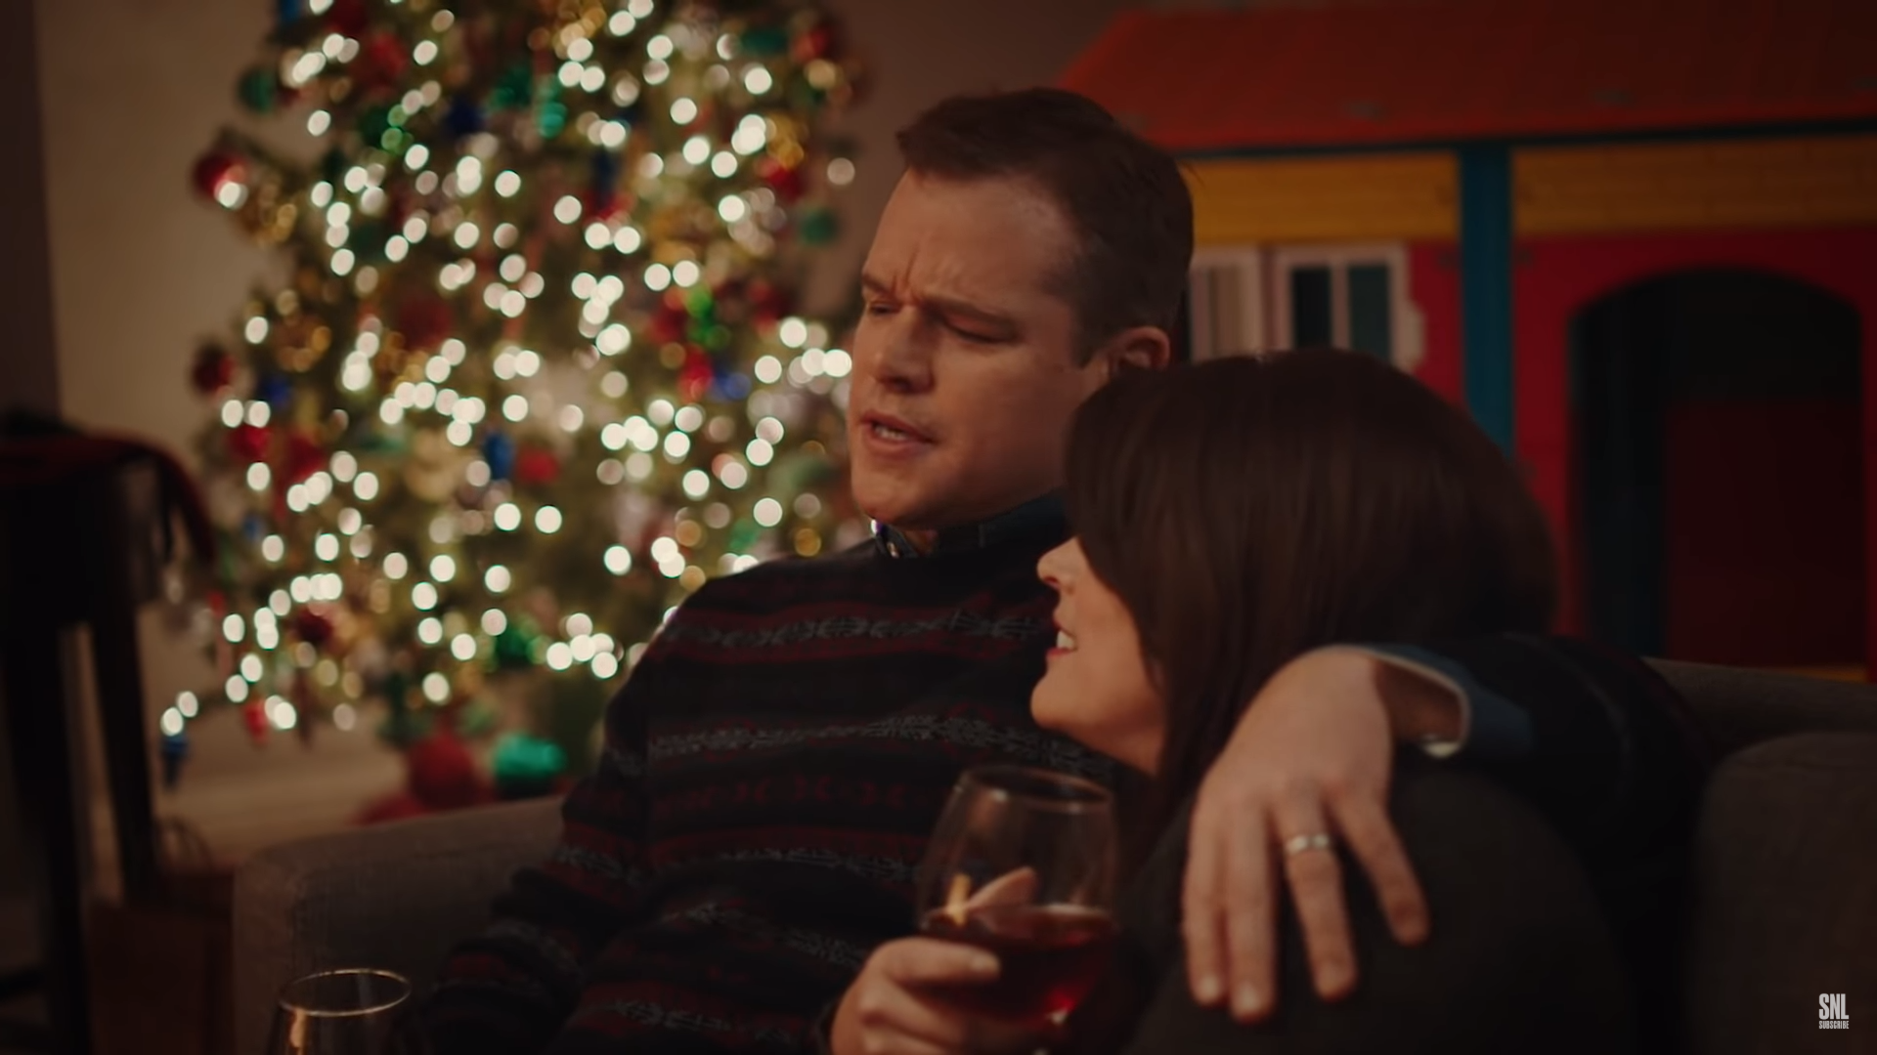
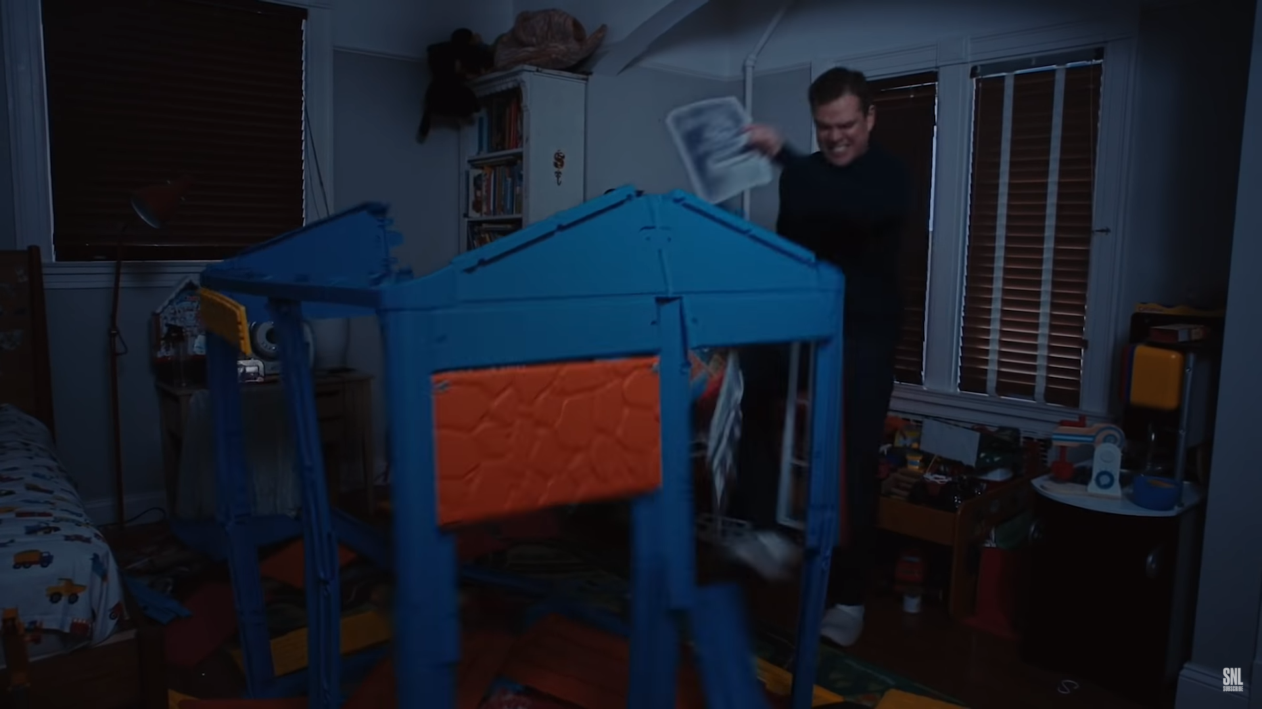
It was a breeze.
Dana loves her playhouse. You weren’t up too late building it, were you?

Slide 9
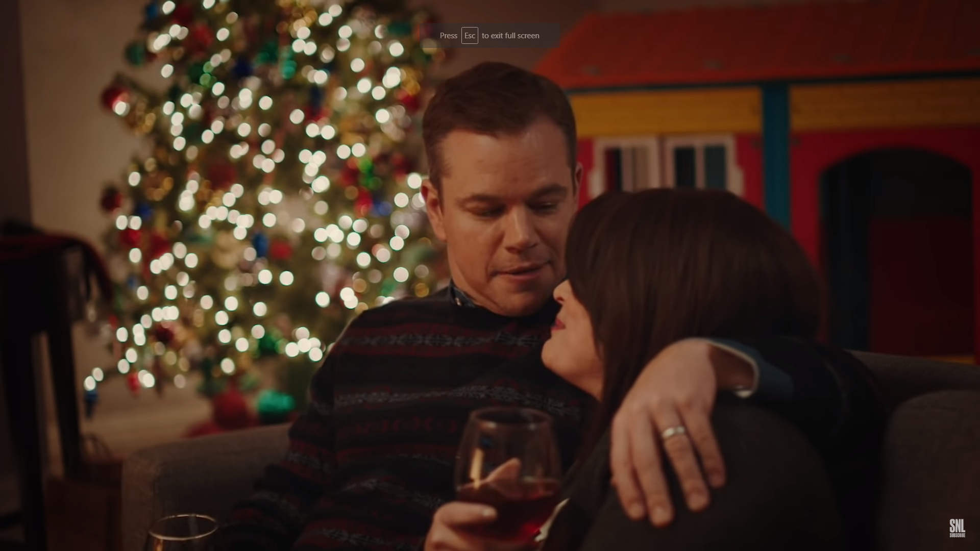
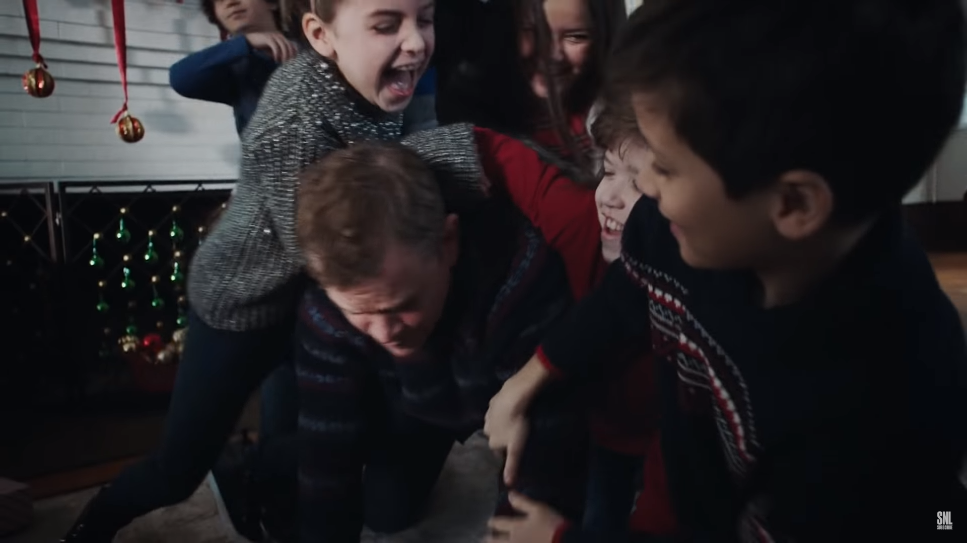
They made my day.
No, I love that we hosted this year. Honestly babe, they made my day.

Slide 10
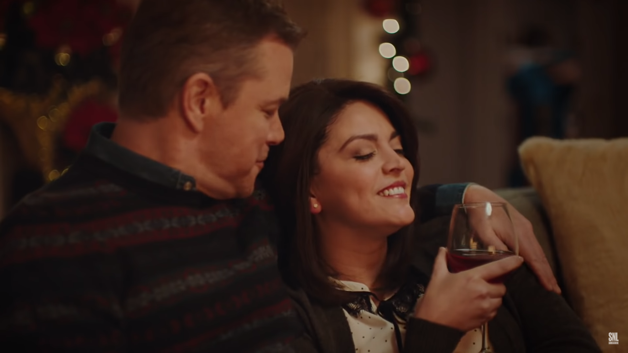
The hostess with the mostest.
How about you, the hostess with the mostest, taking care of everybody..

Slide 11
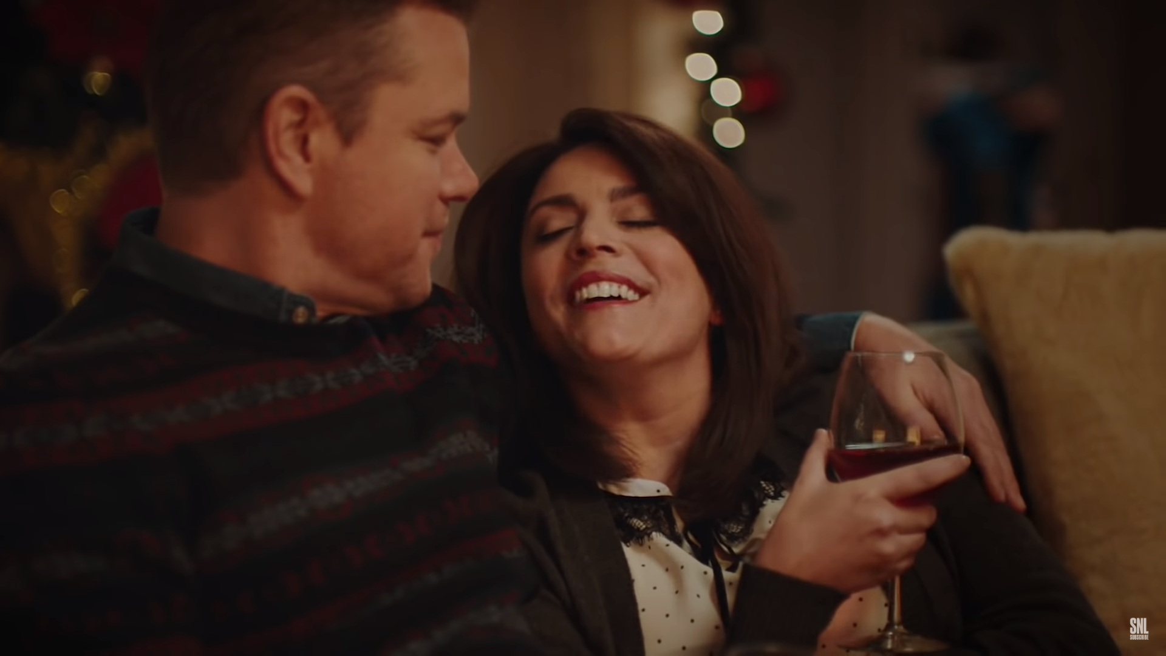
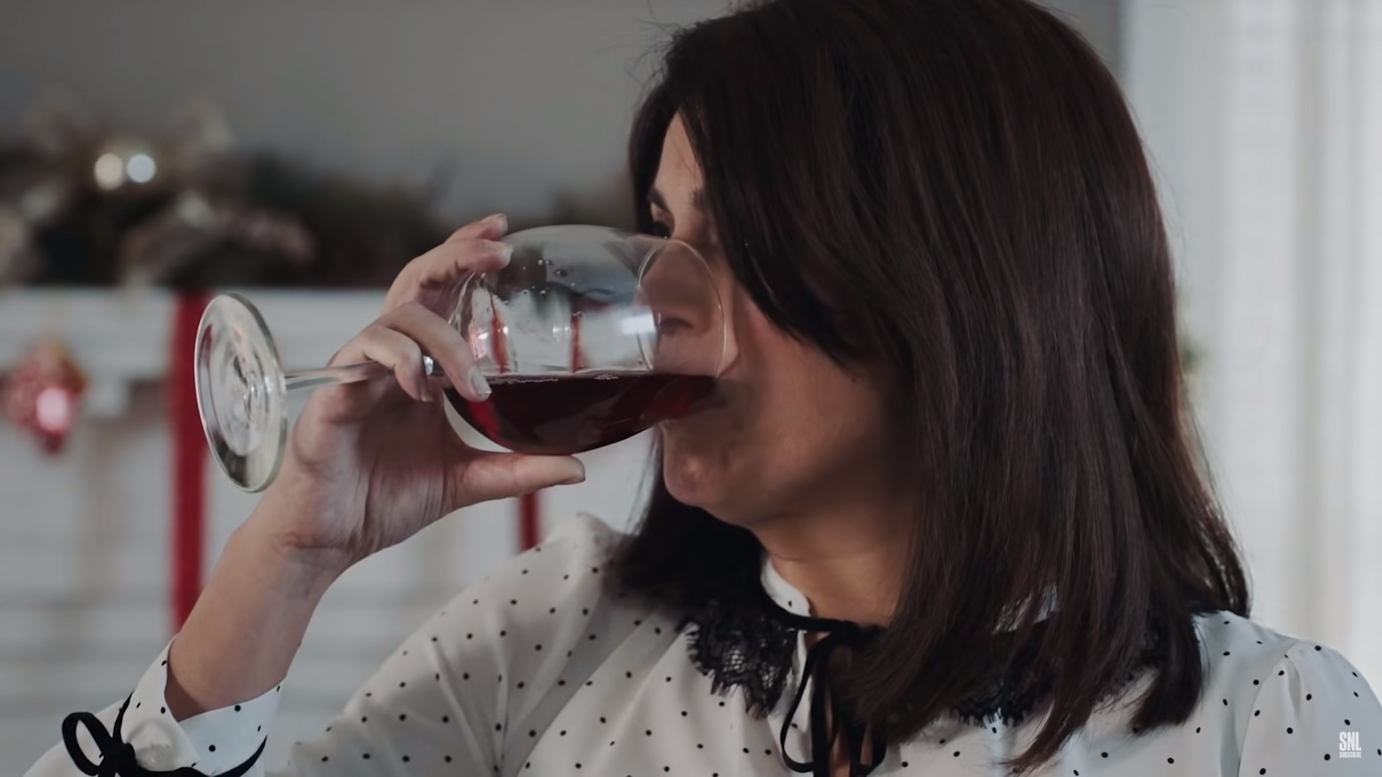
“Christmas cheer”
I guess I was just full of Christmas cheer.

Slide 12
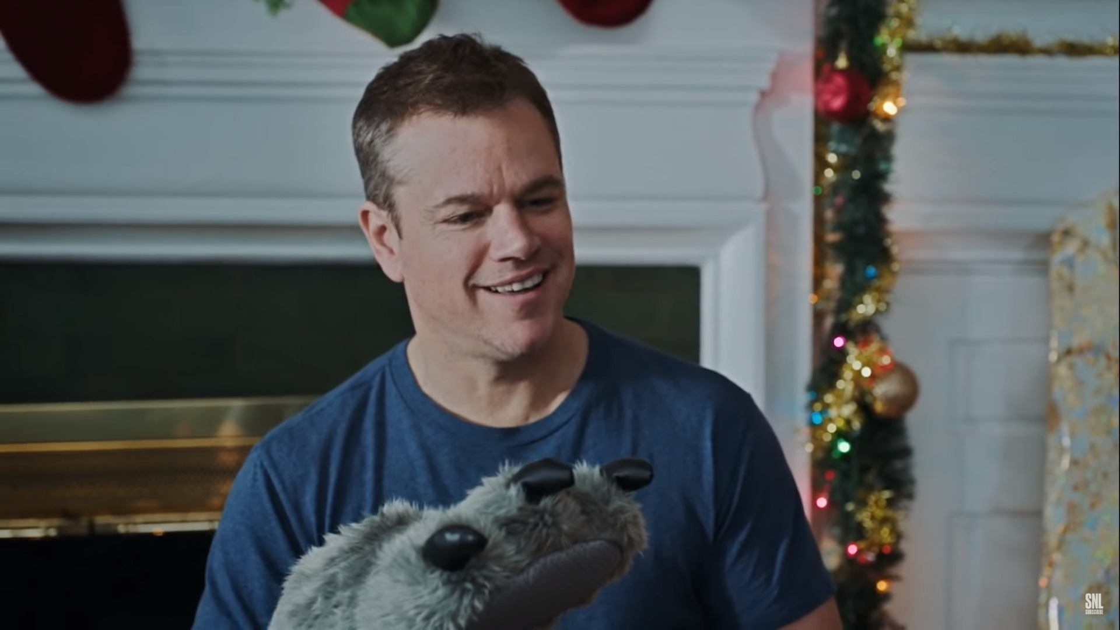
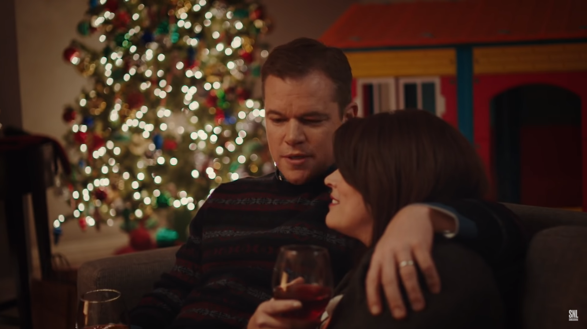
This will sound corny.
But, I don’t know if it was you and the kids, the family being here, but I definitely felt some Christmas magic today.

Slide 14
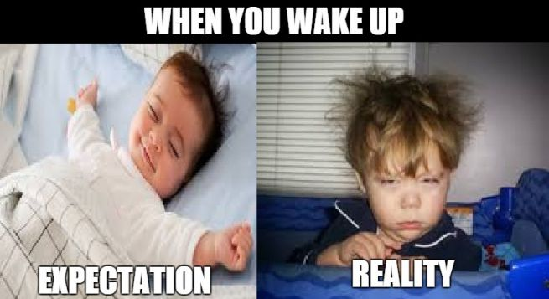

Slide 15
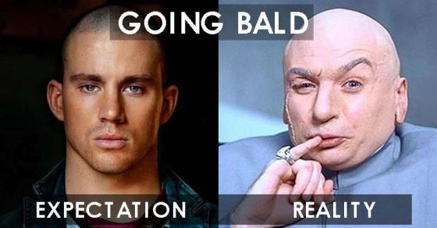

Slide 16
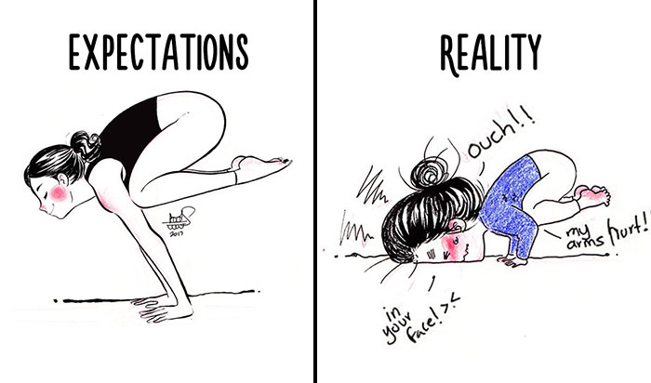

Slide 17
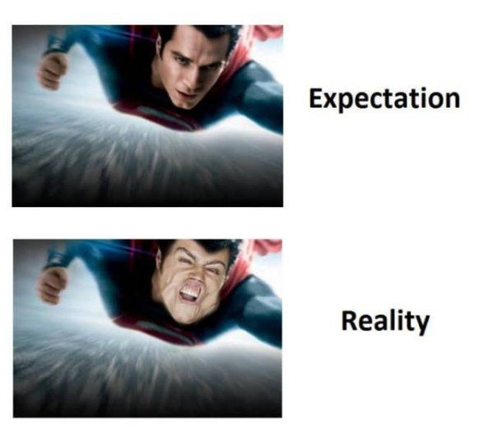

Slide 18
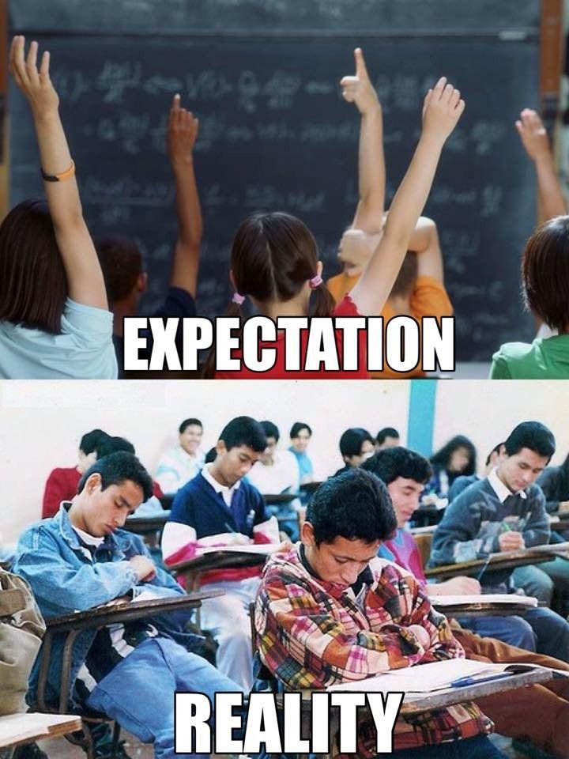

Slide 19
Vocabulary in the Classroom
Notice and Understand
Recognize and Identify
Production

Slide 20
Direct Translation

Slide 21
Matching
Bouquet
신부
Decorations
꽃다발
Bride
장식물
Groom
신랑

Slide 22
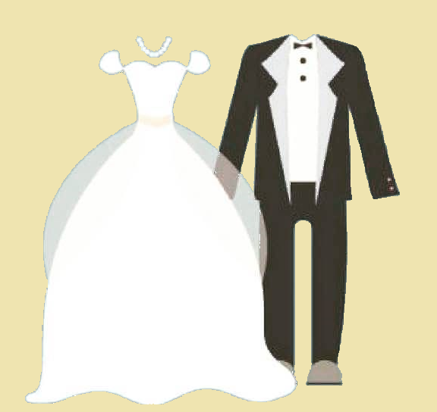
Matching
Bouquet
Decorations
Bride
Groom

Slide 23
Matching (Synonyms)
Bouquet
Girl
Decorations
Boy
Bride
Beautiful things
Groom
Flowers

Slide 24
Matching (Antonyms)
Interesting
Disappointed
Elaborate
Simple
Proud
Calm
Upset
Boring

Slide 25
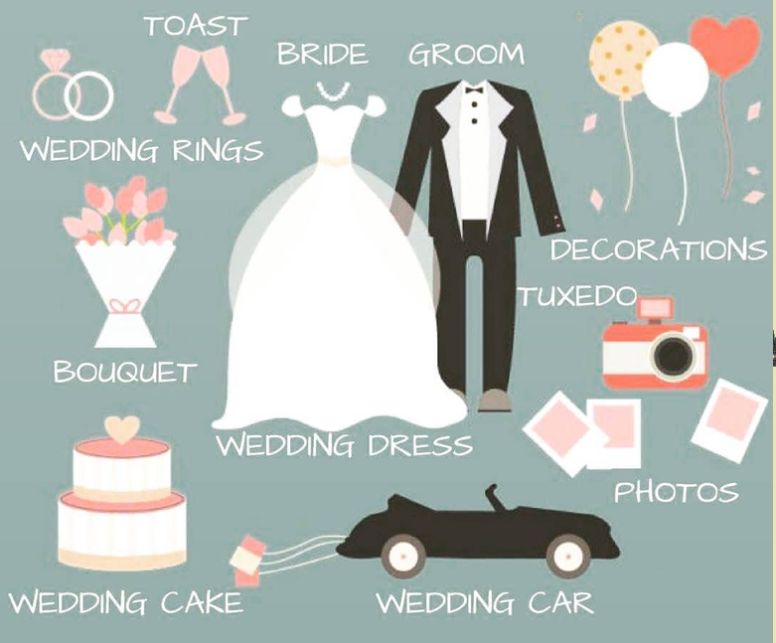
Word bank (Label)
Decorations
Toast
Groom
Photos
Bouquet
Car
Rings
Dress
Bride
Tuxedo
Cake

Slide 26
Word Bank (Fill in the Blank)
The bride and groom arrived to the wedding in a _____. The _________ wore her beautiful ________ and the _________ wore a handsome ____________. They gave each other _______ and the groom’s brother said a great ________. Everyone took ________. They loved the beautiful __________ and the delicious __________. Finally, the bride threw the ___________ as it is tradition.
car
rings
bouquet
groom
toast
bride
cake
tuxedo
dress
photos
decorations

Slide 27
Word Bank (Fill in the Blank)
The bride and groom arrived to the wedding in a _____. The _________ wore her beautiful ________ and the _________ wore a handsome ____________. They gave each other _______ and the groom’s brother said a great ________. Everyone took ________. They loved the beautiful __________ and the delicious __________. Finally, the bride threw the ___________ as it is tradition.
car
rings
bouquet
groom
toast
bride
cake
tuxedo
dress
photos
decorations

Slide 28
Find the words
The bride and groom arrived to the wedding in a car. The bride wore her beautiful dress and the groom wore a handsome tuxedo. They gave each other rings and the groom’s brother said a great toast. Everyone took photos. They loved the beautiful decorations and the delicious cake. Finally, the bride threw the bouquet as it is tradition.
Underline the adjectives.
Circle the Nouns.
Find “toast”
Circle what the man wore. (context)

Slide 29
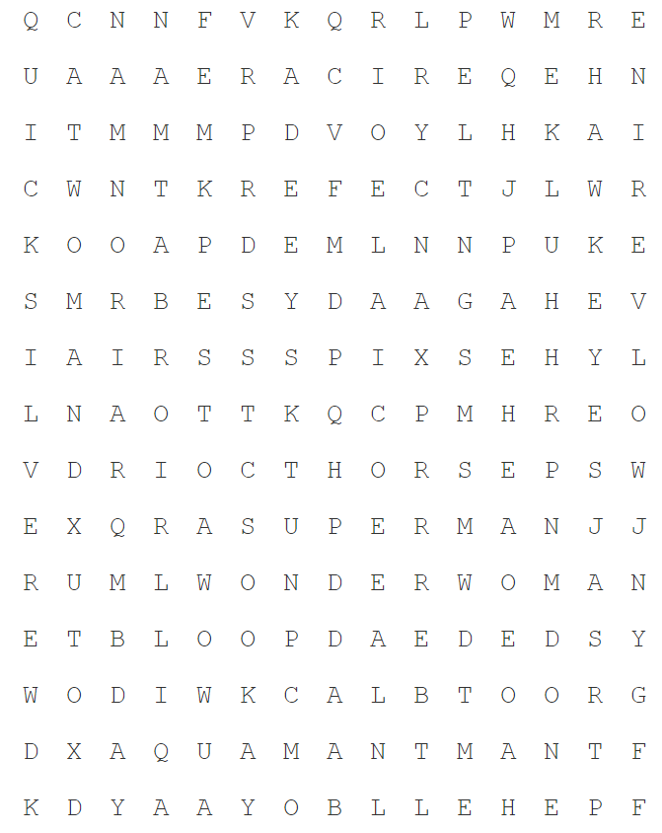
Find the words (Superheroes)
ANTMAN | AQUAMAN | AVENGERS
BATMAN | BLACKPANTHER | BLACKWIDOW
CATWOMAN | DAREDEVIL | DEADPOOL
FLASH | GROOT | HANCOCK
HAWKEYE | HELLBOY | HULK
IRONMAN | MYSTIQUE | PROFESSORX
QUICKSILVER | SPIDERMAN | STORM
SUPERMAN | THOR | WOLVERINE
WONDERWOMAN | XMEN | 26 Heroes

Slide 30
Crossword

Slide 31
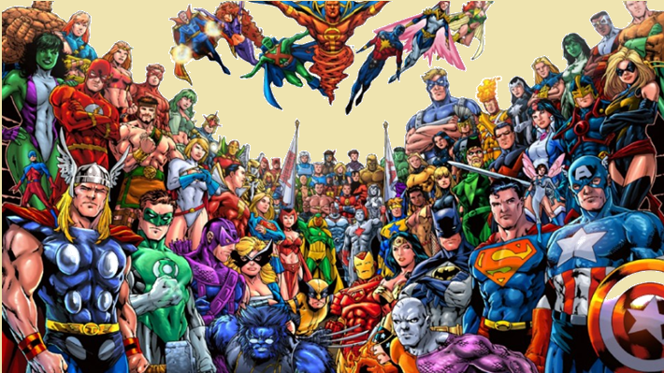
Elicit information
Who is your favorite Superhero?
What superheroes do you know?
What superpower do you want?
Who is your favorite Superhero?
Who is stronger, Hulk or Superman?
Which superhero has the best power?

Slide 32
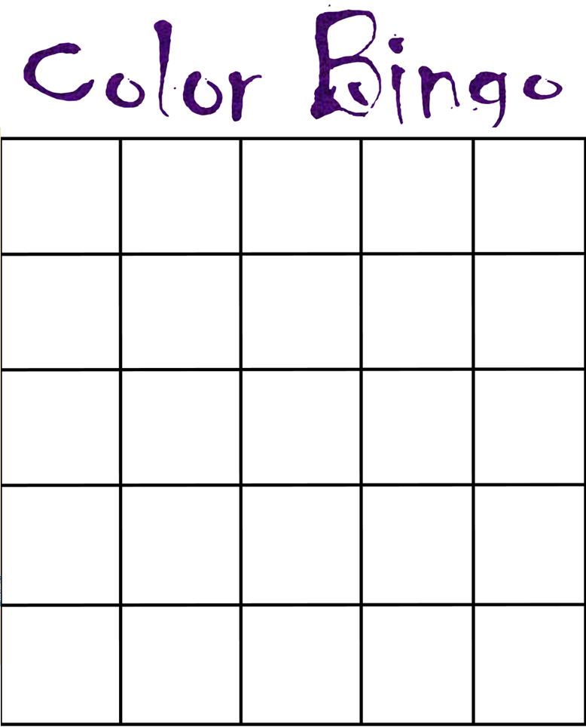
Bingo

Slide 33
Art (draw it)
Anxious
Blissful
Annoyed
Content
Disgusted
Frustrated
Indifferent
Hung over
Love-struck

Slide 34
Love-struck

Slide 35
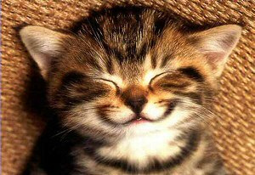
content

Slide 36
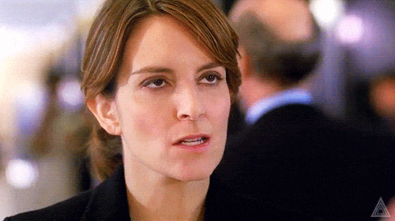
Annoyed

Slide 37
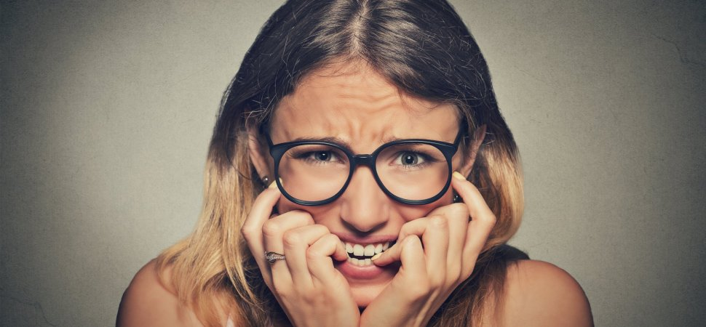
Anxious

Slide 38
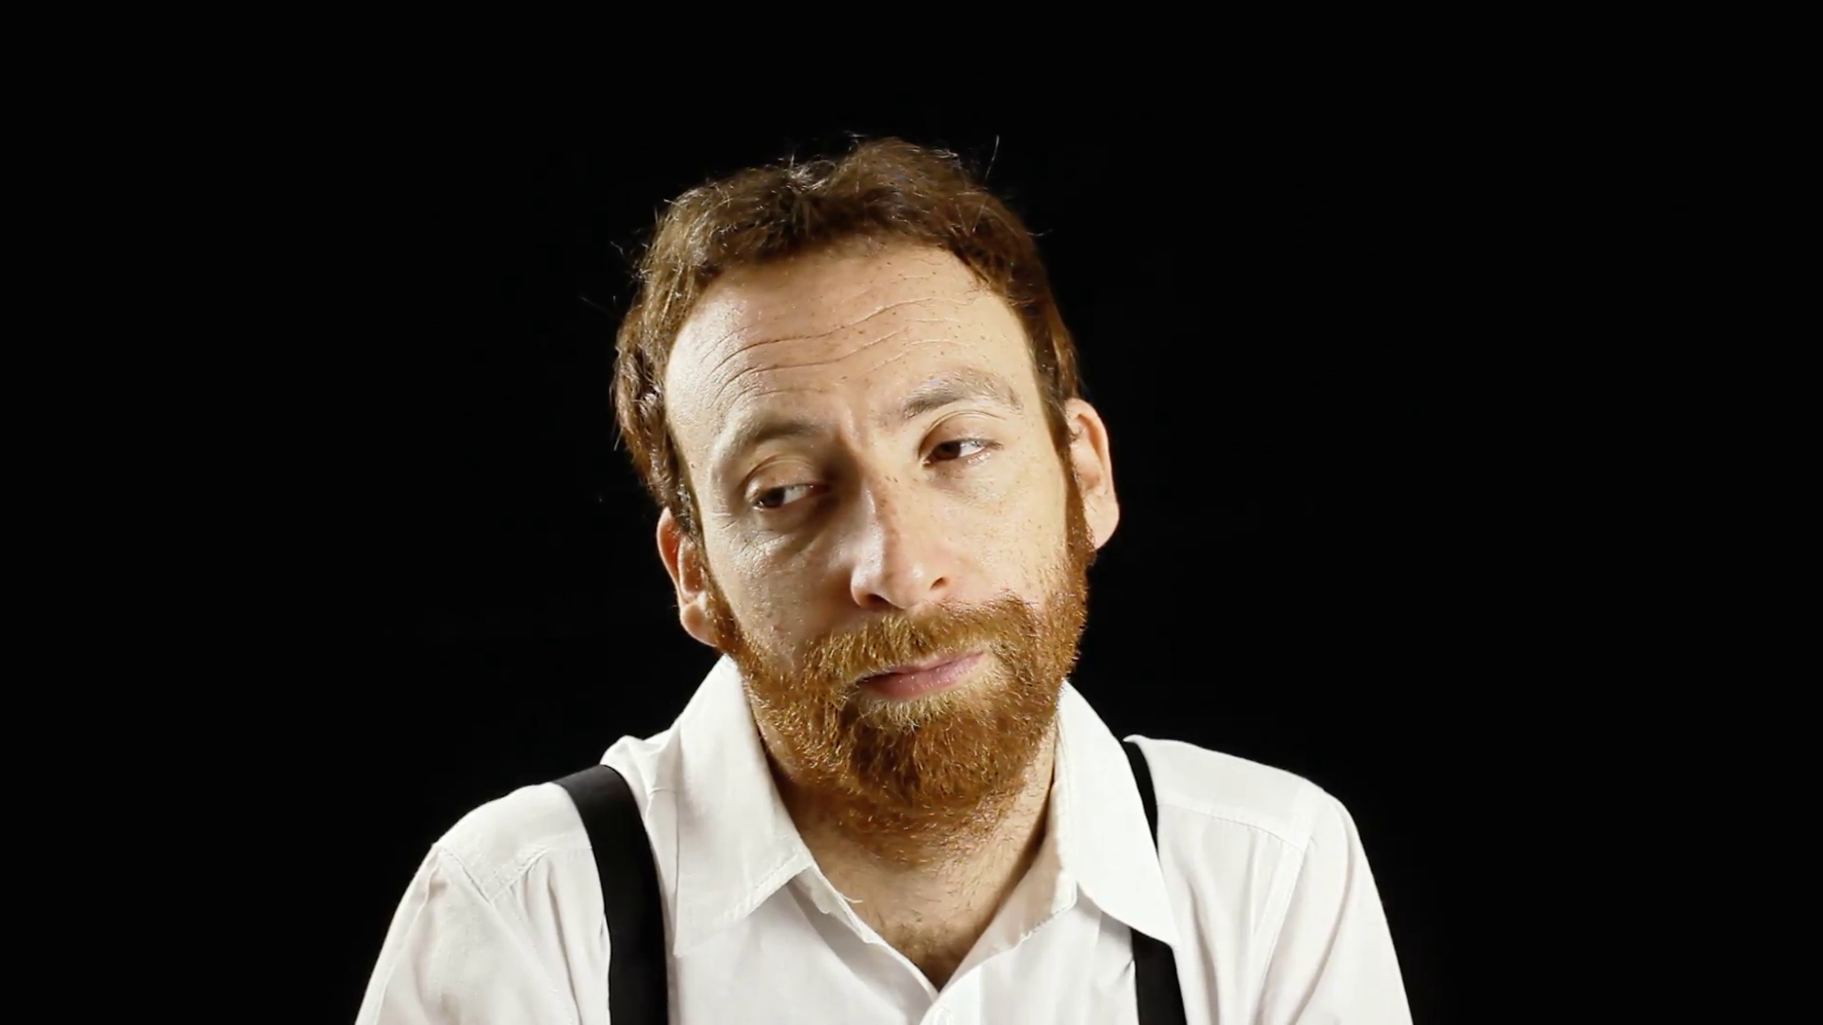
Indifferent

Slide 39
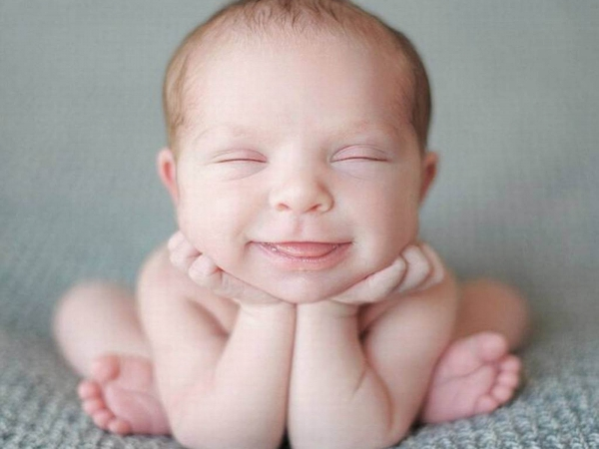
Blissful

Slide 40
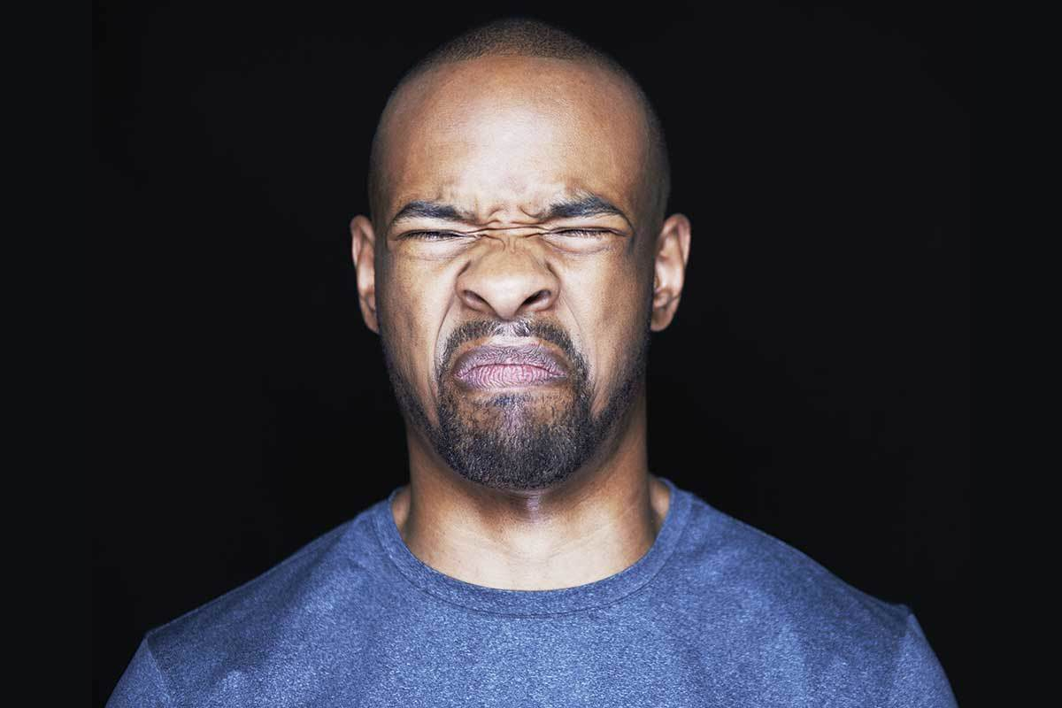
Disgusted

Slide 41
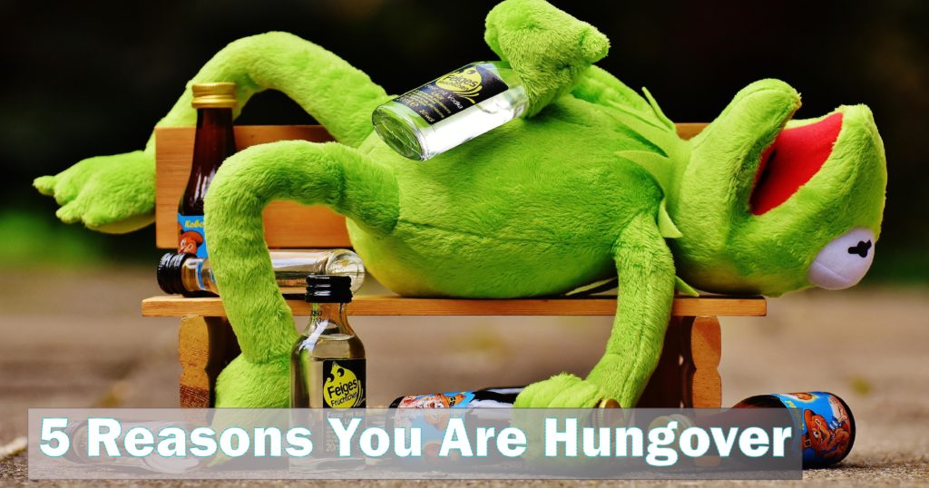
Hung over

Slide 42
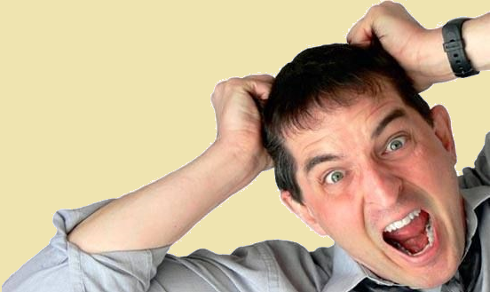
Frustrated

Slide 43
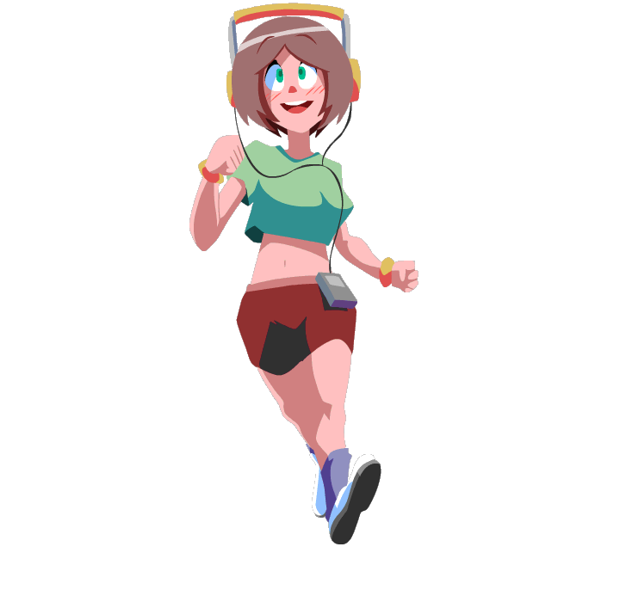
Pictures / Gifs
Jogging

Slide 44
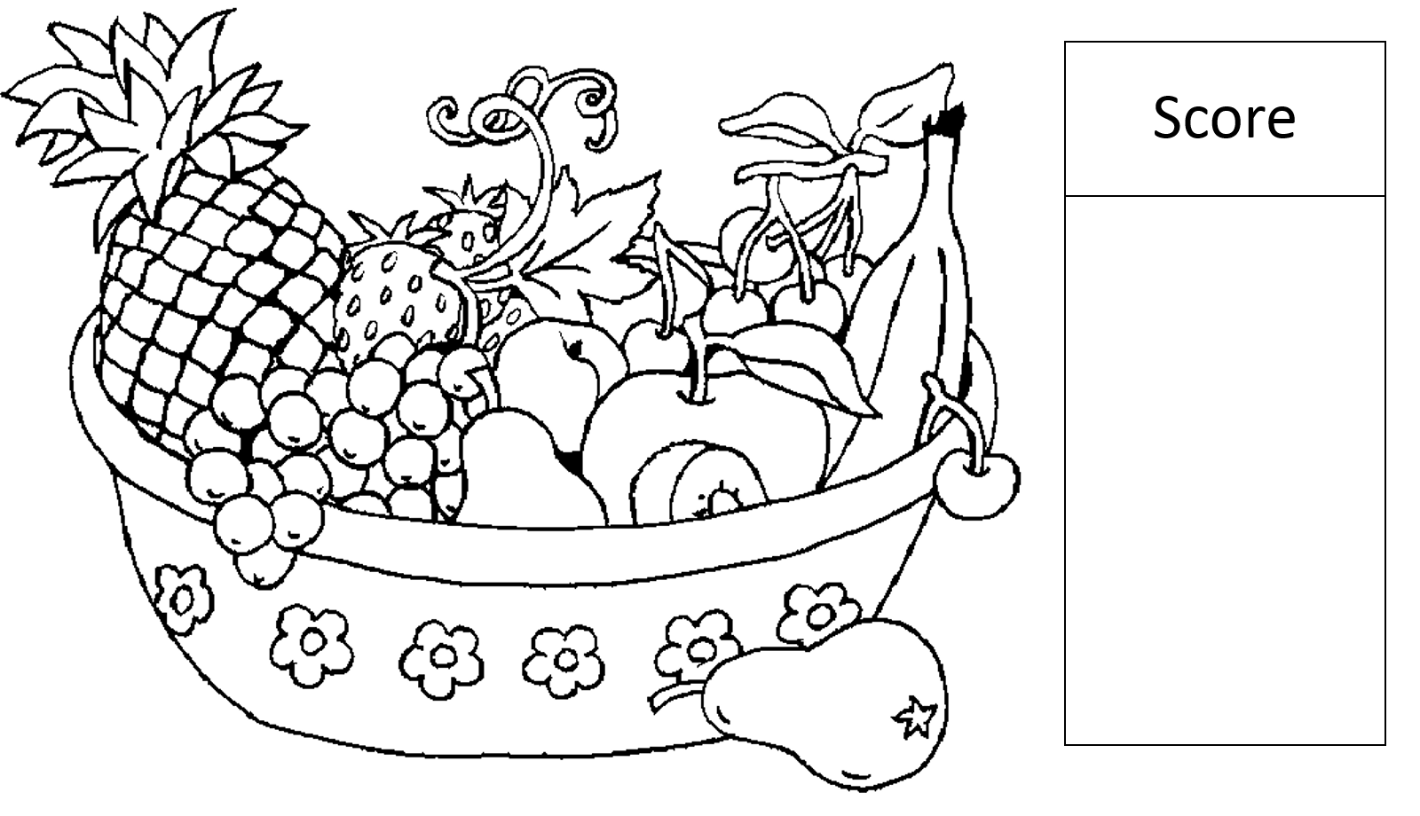
Art (Color it)
Follow Instructions: “Color the banana red.”
Color the picture. There are color cards and fruit cards. Draw two cards to see if they get a point.

Slide 45
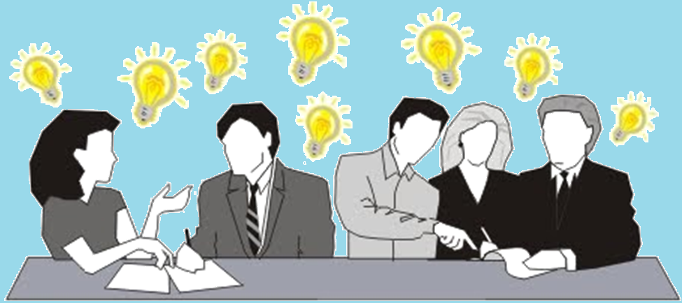
Brainstorming

Slide 46
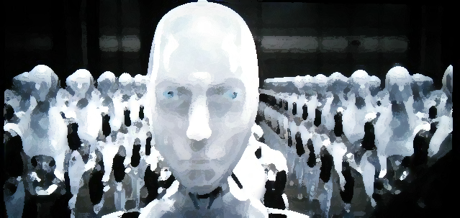
Collective vs. Individual Knowledge
Google Algorithms
Targeted advertising
Metadata
Access to information
The future of AI
Conversation by committee
Eliciting information
Sharing knowledge

Slide 47
Mind map
Fruit
Meat
Vegetables
Food
Consumers
Producers
Dairy
Grain

Slide 48
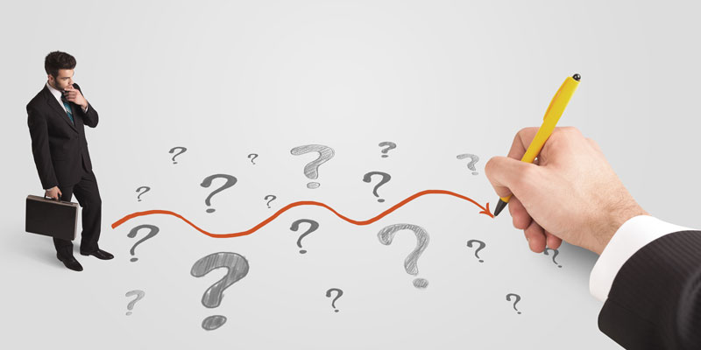
Leading Questions

Slide 49
What did you do when you woke up today?

Slide 50
What will you do after school?

Slide 51
Do you do that everyday?

Slide 52
What time do you do that?

Slide 53
“Today’s lesson is about daily routines”
I brush my teeth at 6am.

Slide 54
When to teach Vocabulary in the Classroom
Before reading
During reading
After reading

