Slide 1
Comprehension
Understanding the reading.

Slide 2
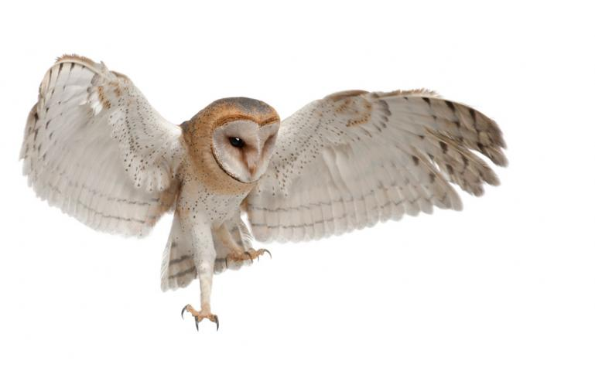
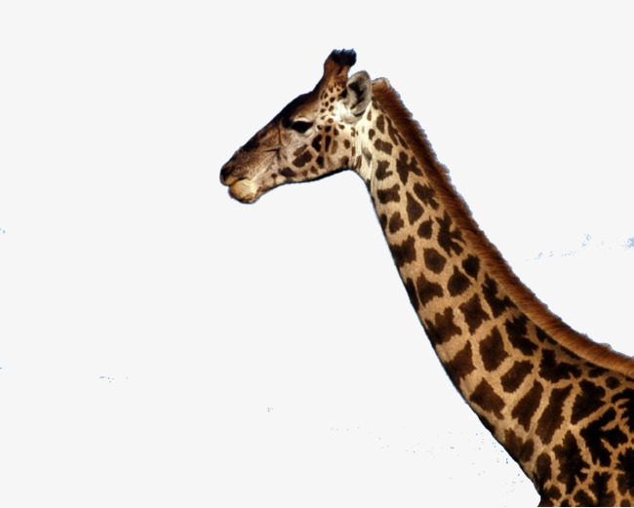
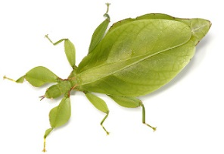
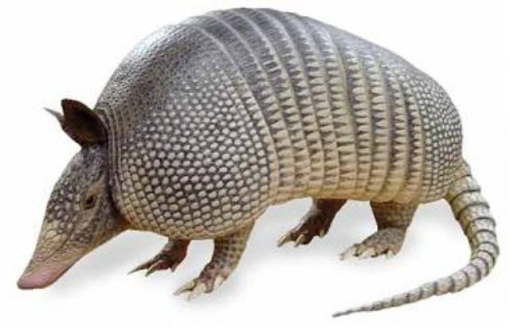
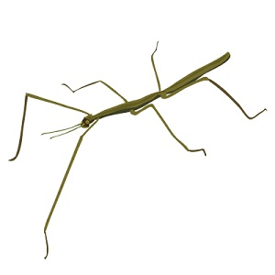
Evolution can explain many strange features in animals

Slide 3
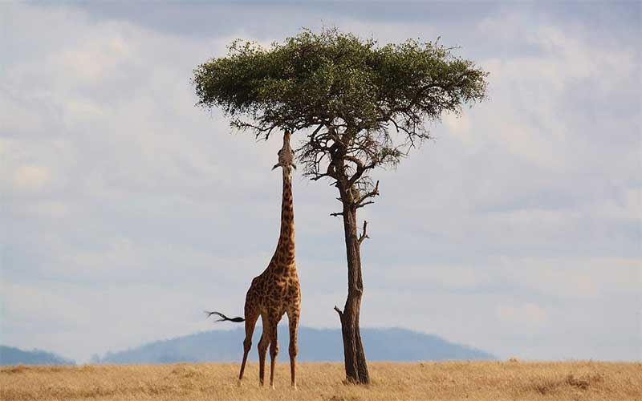
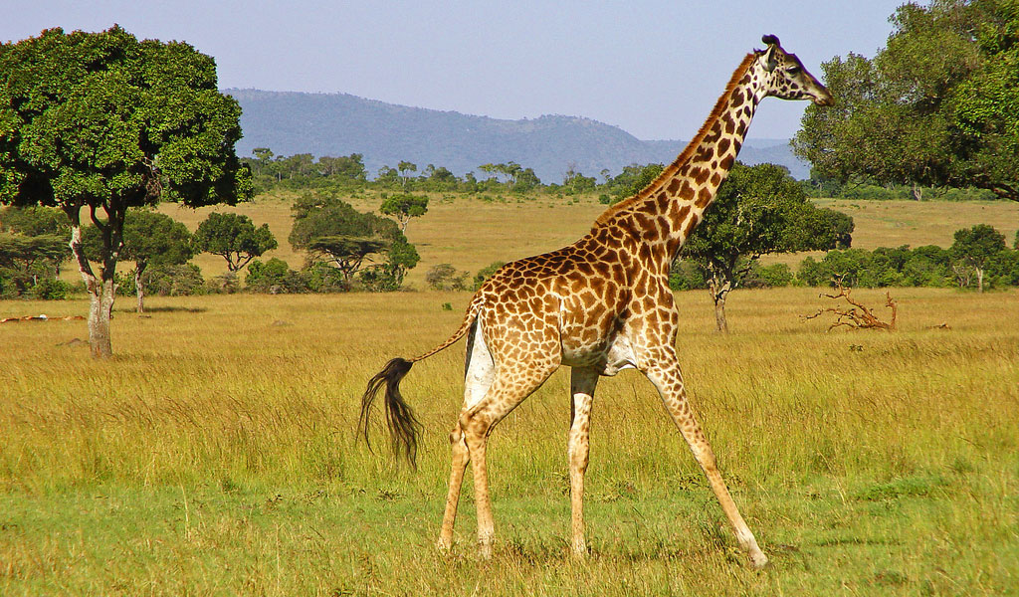
Why does the giraffe have a long neck?

Slide 4
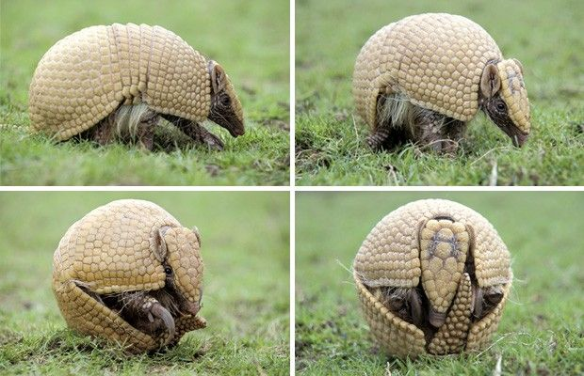
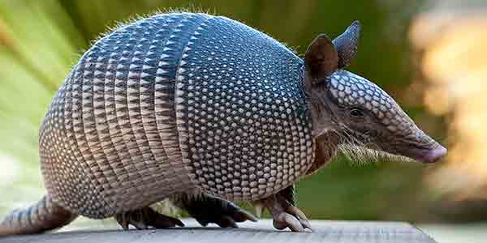
Why is armadillo skin hard?

Slide 5
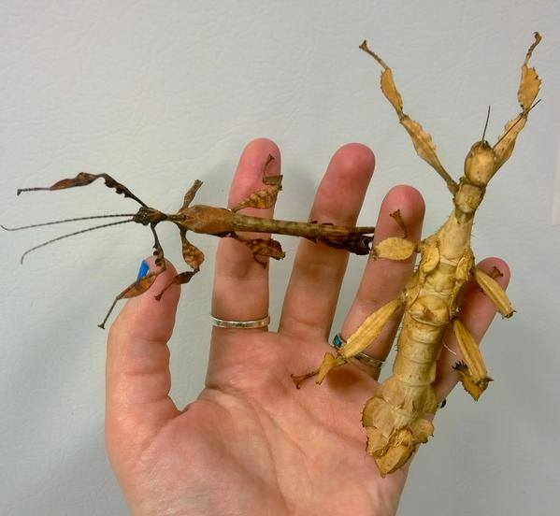
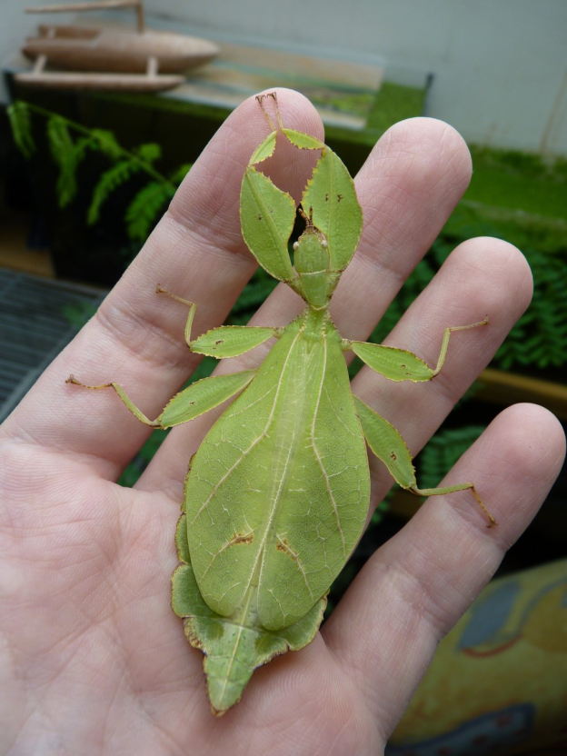
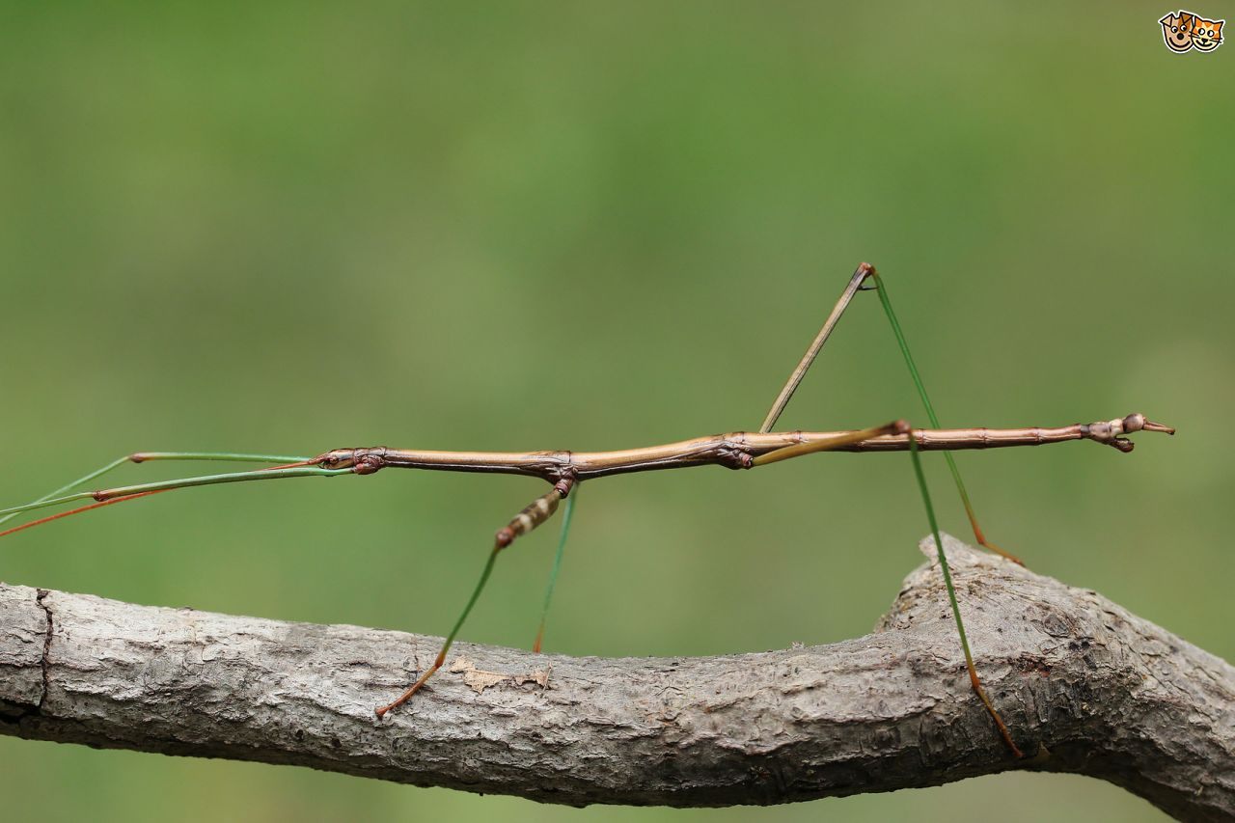
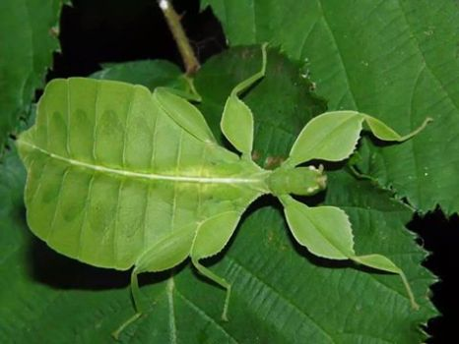
Why do these insects look like plants?

Slide 6
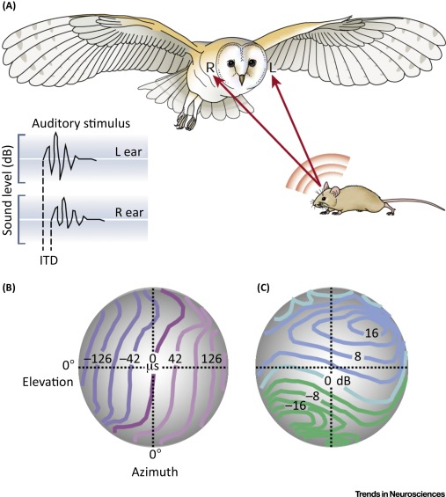
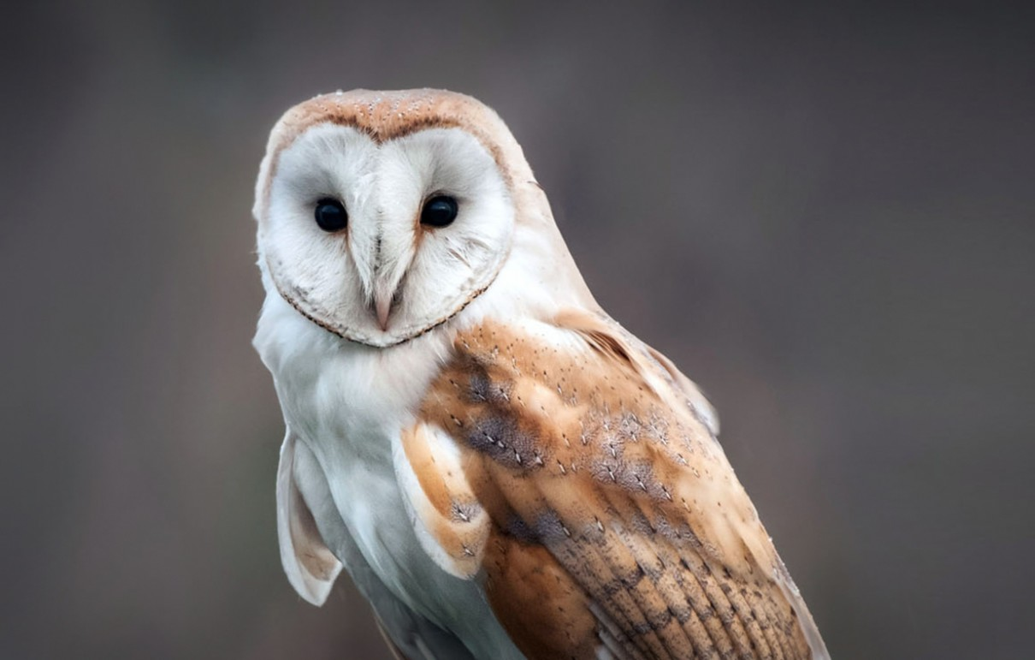
Why does a barn owl have a funny face?

Slide 7
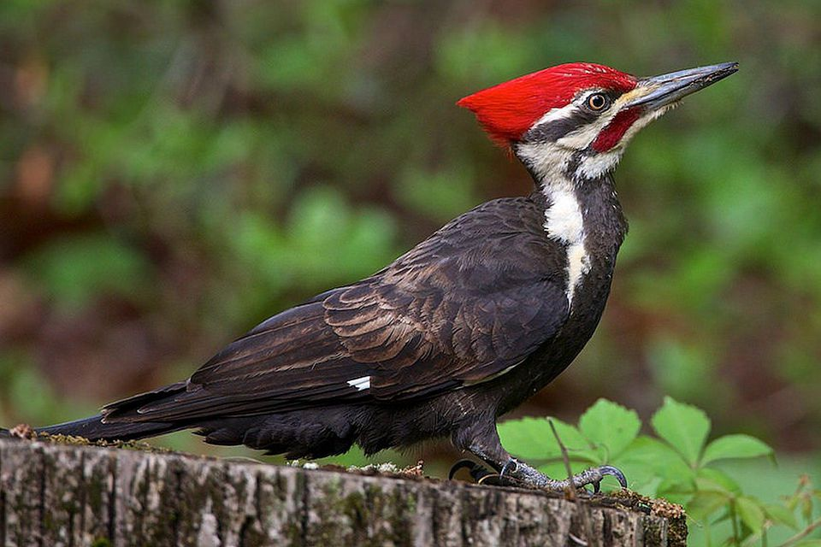
What is strange about woodpeckers?

Slide 8
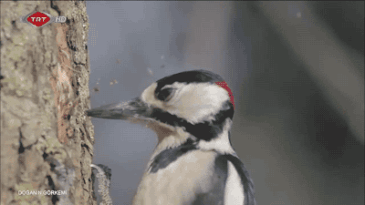

Slide 9
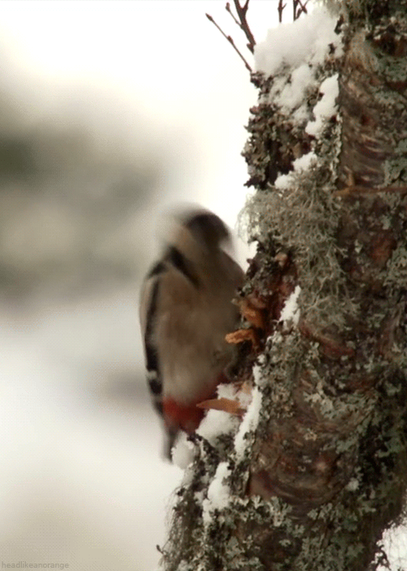
Woodpeckers spend their days banging their heads against trees. So why don’t they get headaches?

Slide 10
Woodpeckers spend their days banging their heads against trees. So why don’t they get headaches?
What they do with time.

Slide 11
Woodpeckers spend their days banging their heads against trees. So why don’t they get headaches?
hitting their heads

Slide 12
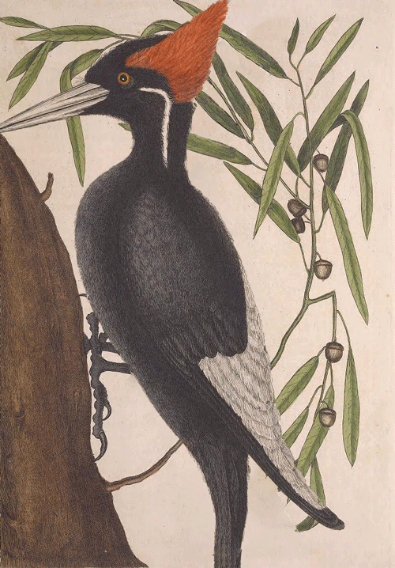
Research has shown that the impact of a woodpecker’s brain against its skull is spread over a relativity large surface area.

Slide 13
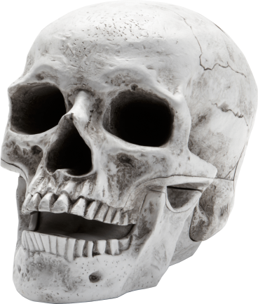
Research has shown that the impact of a woodpecker’s brain against its skull is spread over a relativity large surface area.
When it hits the skull

Slide 14
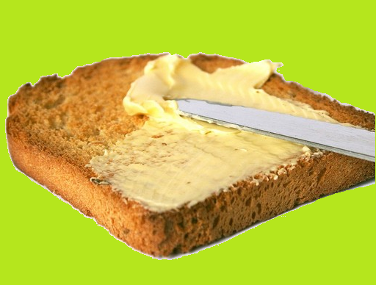
Research has shown that the impact of a woodpecker’s brain against its skull is spread over a relativity large surface area.
Apply in an even layer.

Slide 15
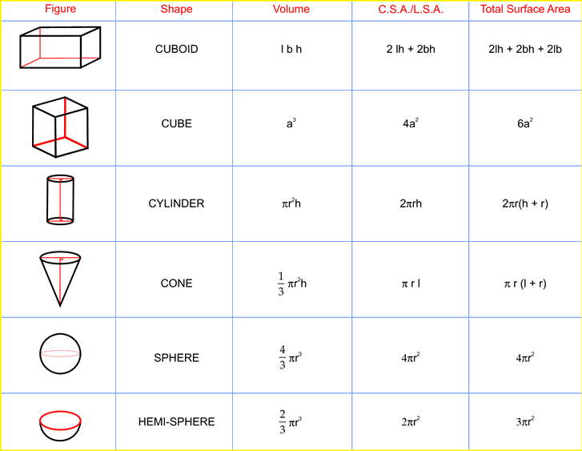
Research has shown that the impact of a woodpecker’s brain against its skull is spread over a relativity large surface area.
In relation to (compared to similar ones)

Slide 16
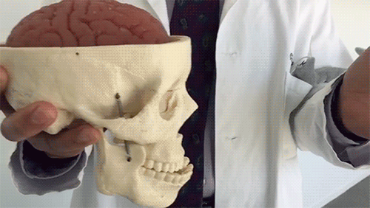
This makes the vulnerability of a woodpecker’s brain to injury very slight compared to those of a human brain.

Slide 17
This makes the vulnerability of a woodpecker’s brain to injury very slight compared to those of a human brain.
How easily harmed.

Slide 18
This makes the vulnerability of a woodpecker’s brain to injury very slight compared to those of a human brain.
Just a little

Slide 19
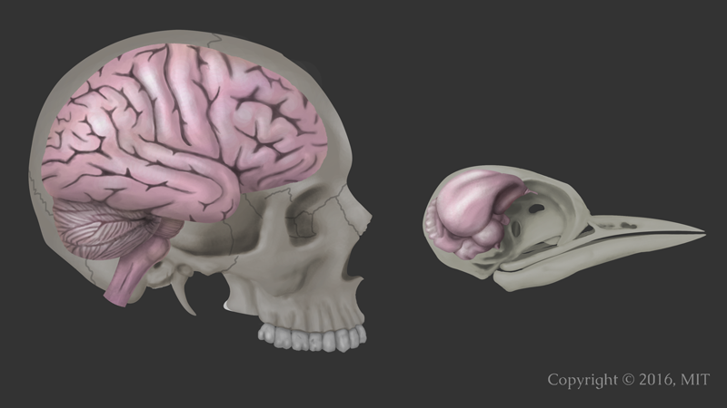
This makes the vulnerability of a woodpecker’s brain to injury very slight compared to those of a human brain.

Slide 20
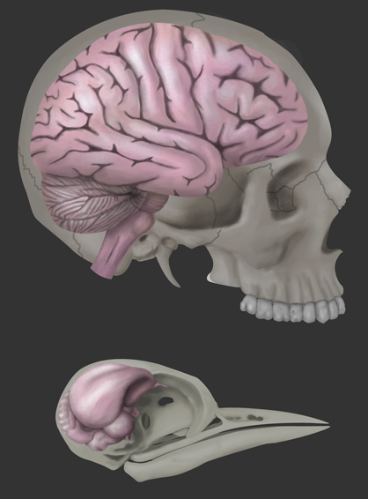
Furthermore, a woodpecker’s brain fits tightly inside it’s skull.

Slide 21
Furthermore, a woodpecker’s brain fits tightly inside it’s skull.
More information

Slide 22
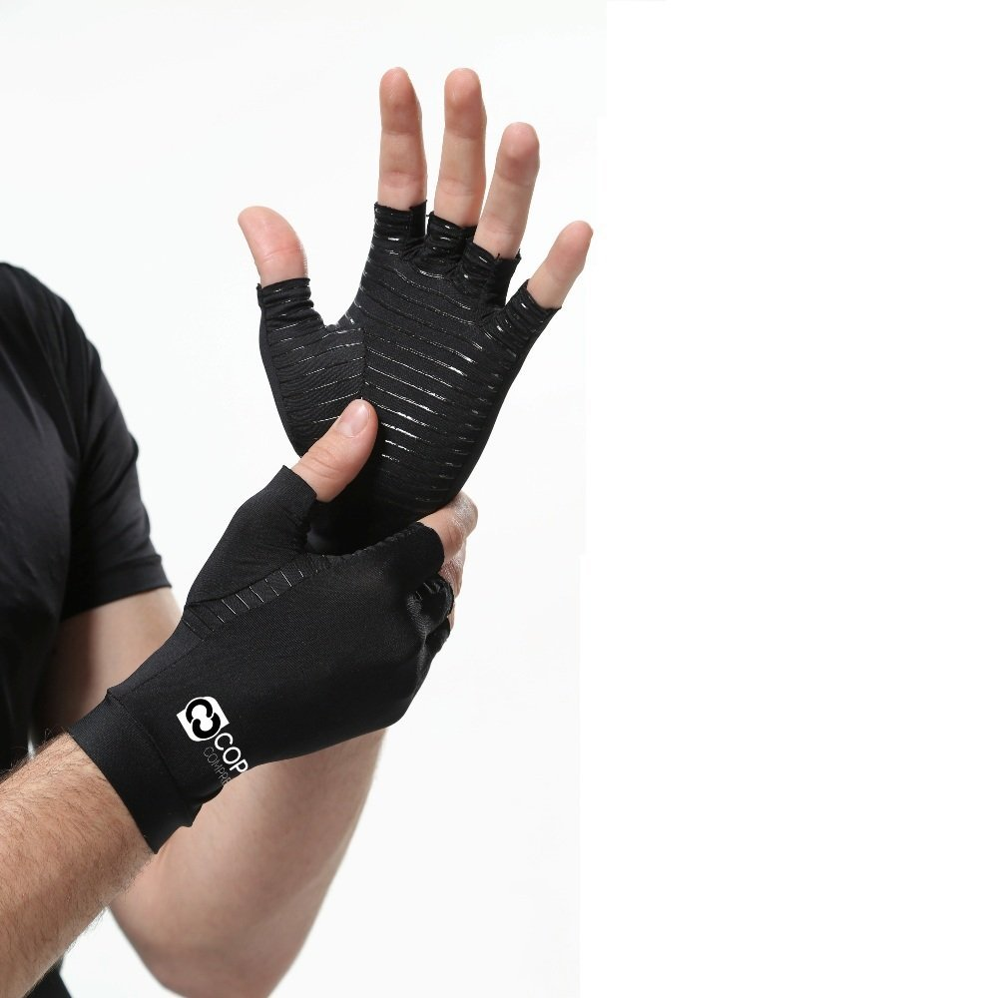
Furthermore, a woodpecker’s brain fits tightly inside it’s skull.

Slide 23
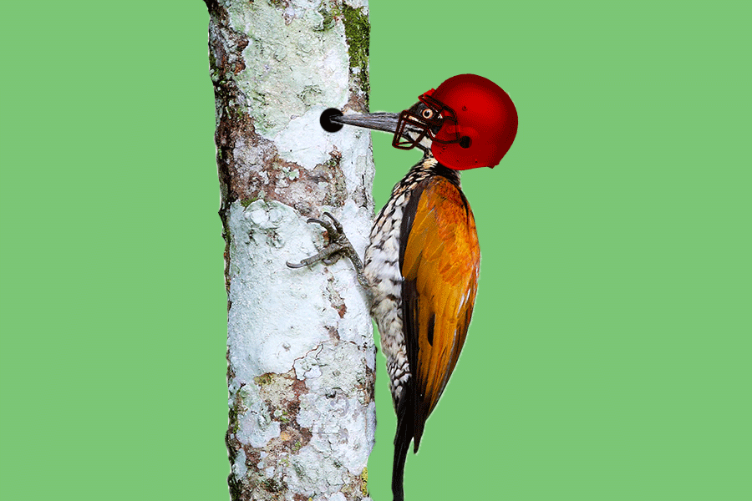
This allows for hardly any movement, and there is little risk of injury.

Slide 24
This allows for hardly any movement, and there is little risk of injury.
Result

Slide 25
This allows for hardly any movement, and there is little risk of injury.
doesn’t move

Slide 26
This allows for hardly any movement, and there is little risk of injury.
Probably wont be hurt.

Slide 27
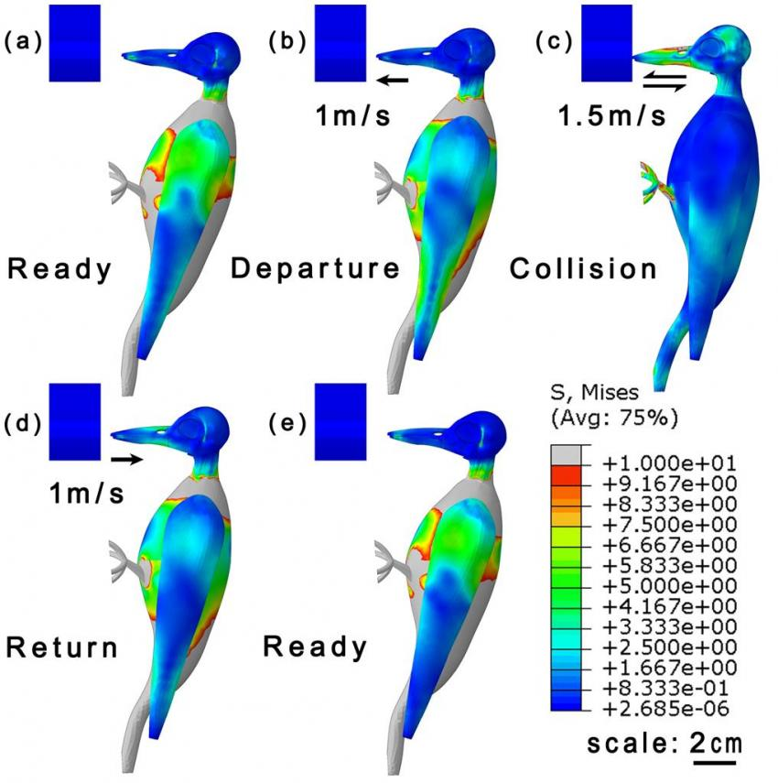
A woodpecker’s brain is also protected by the concentration of each impact on the areas of the skull that are the thickest.

Slide 28
A woodpecker’s brain is also protected by the concentration of each impact on the areas of the skull that are the thickest.
More in this area

Slide 29
A woodpecker’s brain is also protected by the concentration of each impact on the areas of the skull that are the thickest.
Stronger part

Slide 30
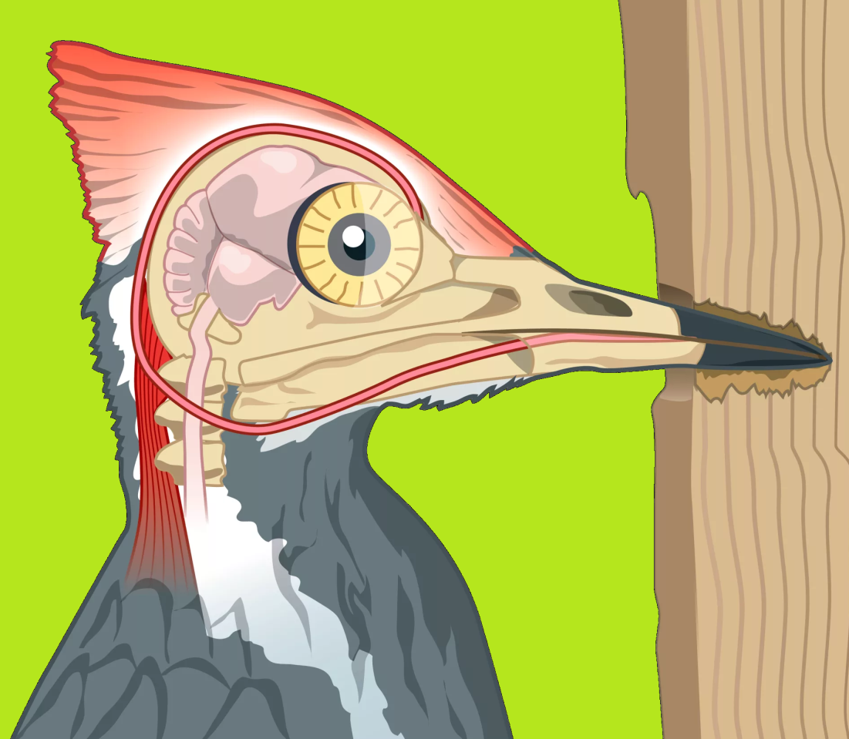
Consequently, much of the force that the woodpecker experiences is absorbed by its thick neck muscles rather than its brain.

Slide 31
Consequently, much of the force that the woodpecker experiences is absorbed by its thick neck muscles rather than its brain.
Result

Slide 32
Consequently, much of the force that the woodpecker experiences is absorbed by its thick neck muscles rather than its brain.
Pressure
Feels

Slide 33
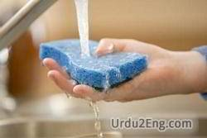
Consequently, much of the force that the woodpecker experiences is absorbed by its thick neck muscles rather than its brain.
Taken in by the neck

Slide 34
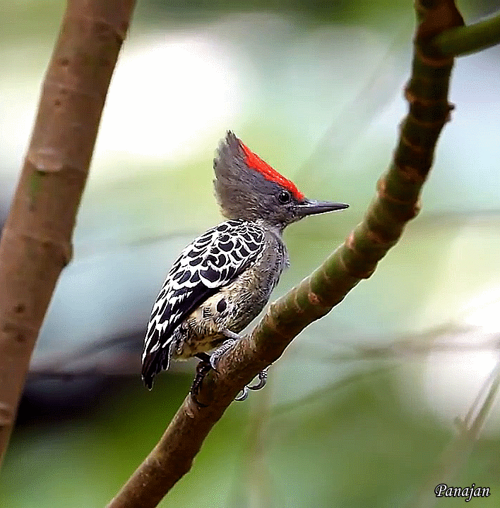

Slide 35
Headbangers
Woodpeckers spend their days banging their heads against trees. So why don’t they get headaches? Research has shown that the impact of a woodpecker’s brain against its skull is spread over a relativity large surface area. This makes the vulnerability of a woodpecker’s brain to injury very slight compared to that of a human brain. Furthermore, a woodpecker’s brain fits tightly inside its skull. This allows for hardly any movement, and there is little risk of injury. A woodpecker’s brain is also protected by the concentration of each impact on the areas of the skull that are the thickest. Consequently, much of the force that the woodpecker experiences is absorbed by its thick neck muscles rather than its brain.

Slide 36
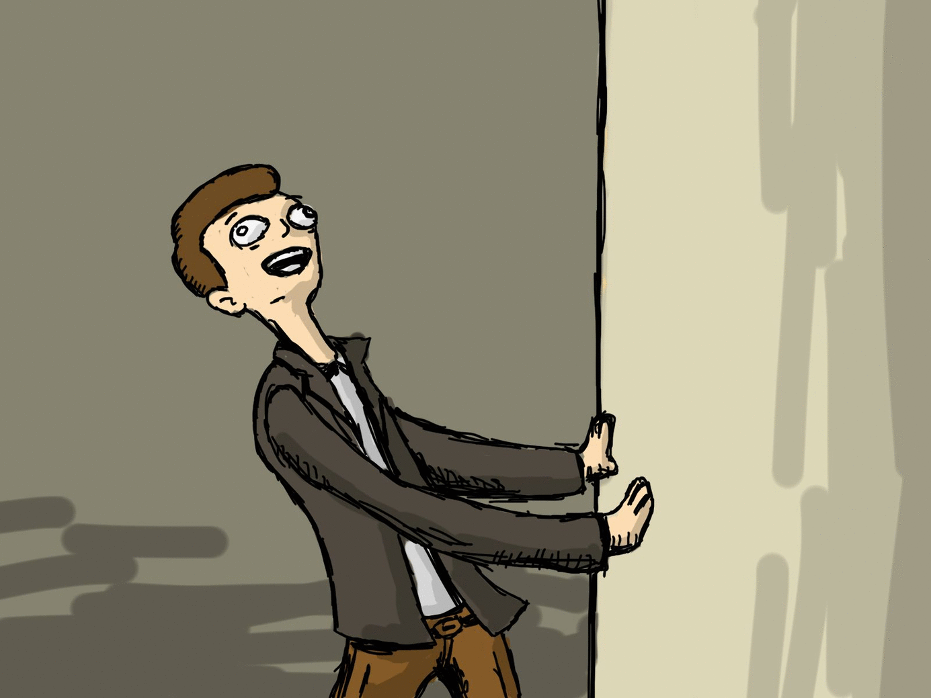
Did you understand?

Slide 37
“Do you understand”
Yes –
Maybe they understood
Embarrassed
Shy
Don’t want to lose face
Expect other students to answer
Be part of the group
Don’t want to admit that they don’t know…
No –
Which part do they not understand?

Slide 38
Comprehension Check Questions (CCQ)
Demonstrate Understanding

Slide 39
7 Types of CCQ
Questions
Easy to hard
General to specific
True or False
Identify Information
Who said it?
Finish the Sentence
Explain yourself
Agree / Disagree
Why? Why not?
Creative Responses
Information not contained in the text
http://schooloftesl.org/do-they-understand-six-ways-to-check-comprehension-in-the-language-classroom/

Slide 40
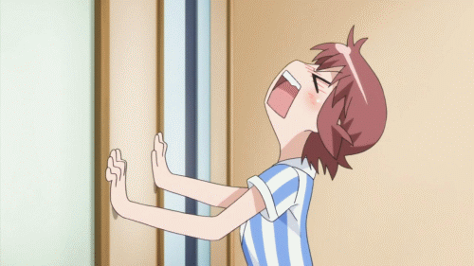

Slide 41
What animal are they talking about?

Slide 42
What do the woodpeckers do all day?

Slide 43
What body part is special on a woodpecker?

Slide 44
Why does it need a special brain?

Slide 45
What muscles absorb the impact?

Slide 46
[True or False] Its brain hits the skull.

Slide 47
[True or False] Its brain fits loosely in the skull.

Slide 48
[True or False] The force of the impact is on the thickest part of the skull.

Slide 49
Underline the adaptations of the woodpecker.

Slide 50
List the ways that the woodpecker is protected when it hits its head.

Slide 51
The woodpecker has evolved to…

Slide 52
I think the woodpecker shouldn’t hit its head against the tree. Do you agree or disagree? Why?

Slide 53
Why can’t humans hit their head against a tree?

Slide 54
Students Work
Let’s Make Questions for Students

Slide 55
Listen to the dialogue.
What are some general questions we might ask?

Slide 56
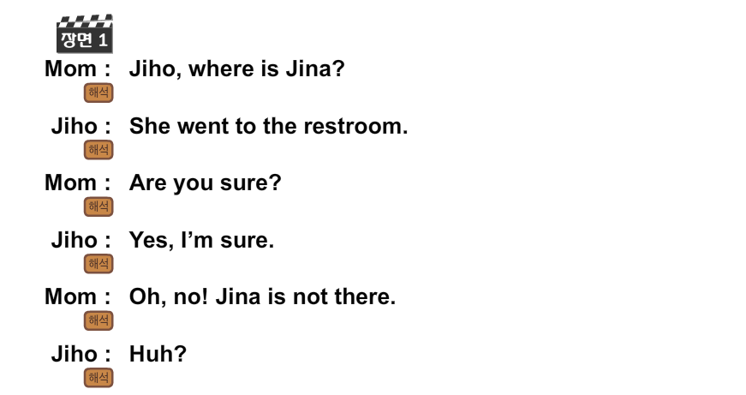

Slide 57
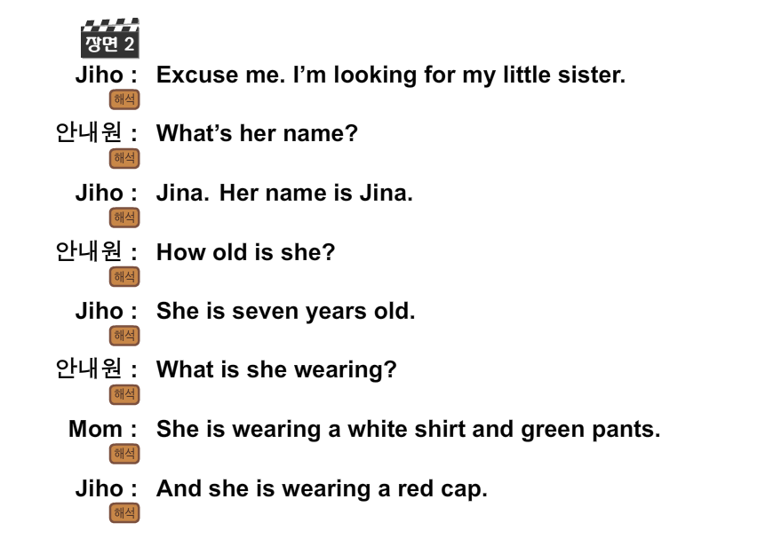

Slide 59
The Pale Blue Dot
https://www.youtube.com/watch?v=GO5FwsblpT8

Slide 61
What is the Pale Blue Dot?
Earth

Slide 62
Who lives there?
Every person who ever lived.

Slide 63
Tell me some types of people who lived there.
Kings
Peasants
Hopeful children
Young people in love
“Supreme Leader”

Slide 64
Compared to the universe, the earth is…
A very small stage

Slide 65
And yet, people kill each other. Why might they kill each other?
“Momentary master of a fraction of a dot”

Slide 66
If we look at the earth this way, is war worth it?
Why? Why not?

Slide 67
Right now, can we live anywhere else?
No

Slide 68
Can we visit other places?
Yes.

Slide 69
If something goes wrong, who will help us?
Nobody

Slide 70
What might go wrong?
Global warming
Nuclear war
Asteroid impact
Etc.

Slide 71
Who will protect our pale blue dot?
Just Us

Slide 72
What can we do?
Recycle
Reduce Carbon Footprint

Slide 73
How does this poem make you feel?
To me, it underscores our responsibility to deal more kindly with one another, and to preserve and cherish the pale blue dot, the only home we've ever known.

Slide 74
Your Turn!
Work in groups of 2 or 3.
Choose a magazine article.
Prepare 5 comprehension check questions.
Read this article to the class and ask your questions.

