Slide 1
Choosing Reading Material

Slide 2
What reading materials can you find in my classroom?

Slide 3
Why do I have so many things?

Slide 4
Keys to Reading Selection:
Access
Interest
Student + Teacher
Appropriate level

Slide 5
Factors to Consider

Slide 6
Students’ level
Acknowledge the students reading level
Too low – uninteresting and boring
Too high – can’t understand and turn off
5 fingers technique
Grading Systems
Vocabulary size + Grammatical complexity (+ Sentence Length)
Simplify the text or simplify the reading process (teach comprehension techniques)

Slide 7
Students’ Interests
Ask them
Elementary vs Secondary
Interests change
More developed
Bring your own material

Slide 8
Students’ Needs
Curriculum
The job is done for you.
Do your students need extra help?
Do they need a higher level than the textbook?
Consider what the material is used for.
Class vs SSR
Add pictures, Charts and Aids

Slide 9
Students’ Background Knowledge
What do they know?
“oral language”
Shared experiences
Use of Pre-text reading
Lack of background knowledge > language complexity
Understanding the words, but not the main ideas
Writer may assume, teachers have to compensate

Slide 10
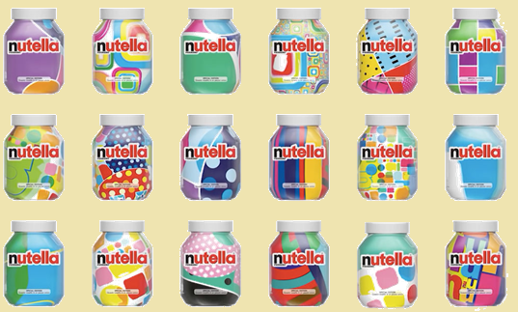
Students’ Background Knowledge
Cultural heritage
Life experiences
Interests
Areas of previous study
Personal relationships
Etc.

Slide 11
Korean Kids vs Canadian Children

Slide 12
Relevance
Real world
Newspapers, things in their life
Students interests
Increase interest
Desire to understand

Slide 13
Completeness
Beginning, Middle, End
Not using excerpts
Plot twists = confusion

Slide 14
Authenticity vs. Teacher-made
Students need to be able to comprehend real-life language
Teachers take advantage of the grammatical aspects found in the texts.
Students will be prepared to read any type of text.
The fact that language is simplified does not ensure comprehension.
It is better to simplify the reading process, rather than the text.
Adapting materials can make them accessible, interesting and informative.
Arranging materials around one theme allows the learner to build up background knowledge of the content.
Attention should be given to what the learners find easy and interesting.
If the text is poorly presented, it can always be improved.
Teacher-created materials are based on authentic texts.
They allow teachers to evaluate their students
Arias (2007)

Slide 15
Adopting Material

Slide 16
Adapting Material
Repetition
Frequency
Required Vocabulary
Shorten the Sentence
Create a purpose to the writing (vs. reading for pleasure)
Control over layout
Delete unimportant information

Slide 17
Rewriting for level and purpose
Make the following text appropriate for your students.
Try to focus on a grammatical point and repeat structure.

Slide 18
The Year 2019 Will be the Best Ever
(Level 6)
Despite all the bad and often depressing news that filled our televisions, newspapers, radios and news feeds in 2018, there are reports that the year 2019 will be the best ever. Breaking News English reporters say it will be a particularly good year for students of English. The reporters say the year will provide ample opportunities to refine and develop your listening, speaking, reading and writing skills. The New Year's resolution of all learners of English and other languages should be to exploit the myriad of websites dedicated to language learning. Dedicating just 30 minutes a day will reap great rewards in developing vocabulary, fluency and comprehension skills.
There are other reasons why 2019 will prove to be the best year ever. However, we all need to pull together and treat each other with love and respect. This year will be the year of good deeds and of helping those who are less fortunate than ourselves. It will also be a fantastic year for hobbies. Reporters say the stars in the sky are aligning to send positive vibes so that we all excel in our hobbies - both existing and new. Financially, we all need to tighten our belts so we can weather whatever monetary storms the year might throw up. And finally, we will all be more health conscious and take better care of ourselves. Reporters urge us all to exercise more and eat more nutritious food.
https://breakingnewsenglish.com/1901/190101-the-year-2019.html

Slide 19
The Year 2019 Will be the Best Ever
(Level 3)
There was a lot of depressing news on television and the radio and in news feeds in 2018. However, the year 2019 will be the best ever. It will be particularly good for English students. They will have many chances to improve listening, speaking, reading and writing skills. Everybody's New Year's resolution should be to use the many websites focusing on language learning. Just 30 minutes a day of studying will help to improve fluency and comprehension skills.
The year 2019 will be great if we work together and treat each other with respect. It will be the year of helping those who are less fortunate. It will be a great year for hobbies. The stars in the sky will line up to send positive energy for our hobbies. Financially, we will have to be careful so we don't have money problems. Finally, we will all be healthier. We will take better care of our body by exercising more and eating healthier food.
https://breakingnewsenglish.com/1901/190101-the-year-2019-4.html

Slide 20
The Year 2019 Will be the Best Ever
(Tim Teacher)
There was a lot of sad news in 2018. But, 2019 will be the best year ever! It’s great for English students. Students can study about listening, speaking, reading and writing. You can use many websites for learning English. Try studying for just 30 minutes every day.
In 2019, we should be nice to everyone. This year, let’s help everyone. We can enjoy our hobbies. We will have good energy from the universe. Don’t spend too much money. Let’s be healthy. We can exercise and eat healthy food.

Slide 21
Questions to ask when choosing a text.

Slide 22
Questions to Ask
Will this text interest my students?
Is there a meaningful purpose for reading this text?
Do you students have or can I provide them with appropriate background knowledge for understanding the content?
Is the level of abstractness appropriate?
Is the passage complete in itself or has the author assume da lot of other information and inferencing skills?
What kind of extra-textual support is available?
Is the text clearly organized with a beginning or introduction and clear sequence signals?
Is there sufficient redundancy of ideas?
Will the number of difficult vocabulary items interfere with the task which has been set?
Does the author use a lot of structures which are vague or which are difficult to process, given the students’ experience with English?
Are syntactic relationships within the sentences and between sentences clear?
Have I set an appropriate task for the type of text, the level of difficulty and the needs of my students, and have I taught them the necessary skills to cope with the task?
Hetherington (1985)

Slide 23
1. Are the students interested?
Hetherington (1985)

Slide 24
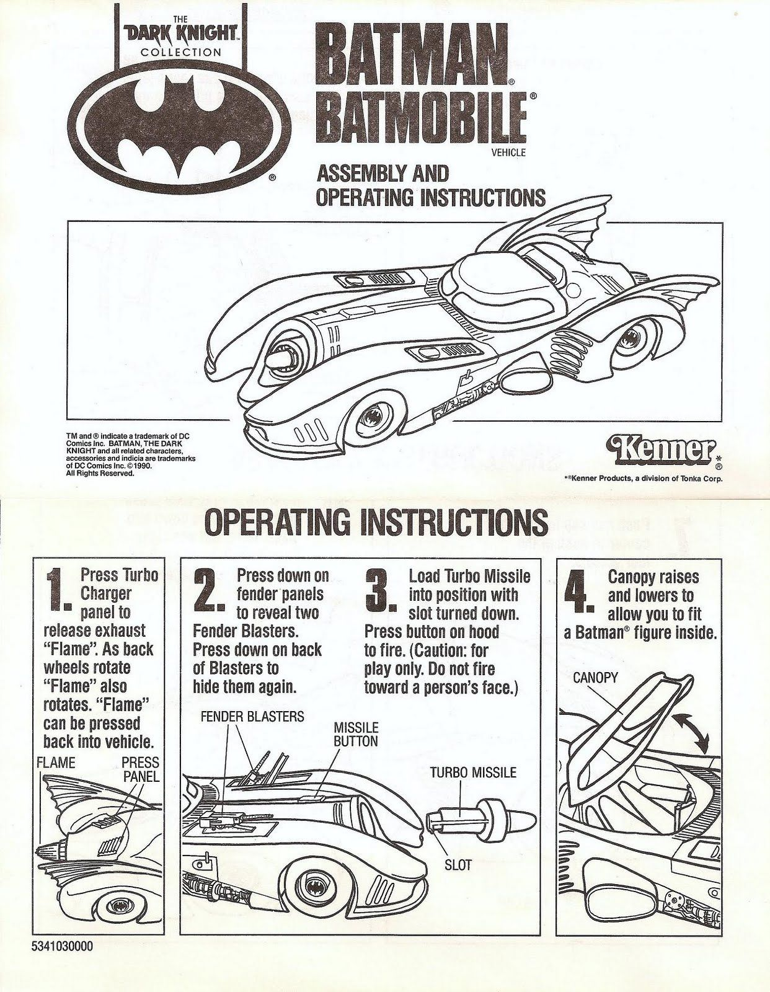
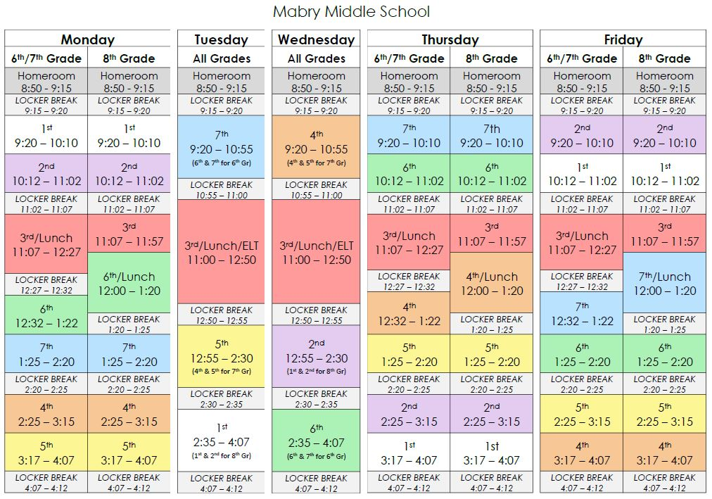
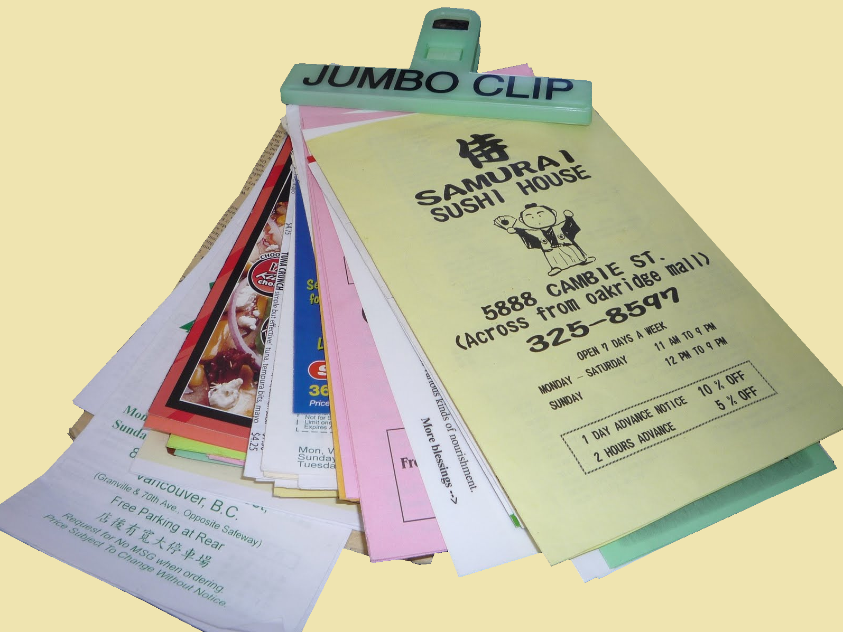
2. Is there a purpose for this text (other than language learning?
Hetherington (1985)

Slide 25
3. Do the students have / Can I give the students background knowledge?
Hetherington (1985)

Slide 26
4. Is it too abstract?
Hetherington (1985)

Slide 27
5. Is it complete?
Hetherington (1985)

Slide 28
6. Do you need extra-textual support?
Hetherington (1985)

Slide 29
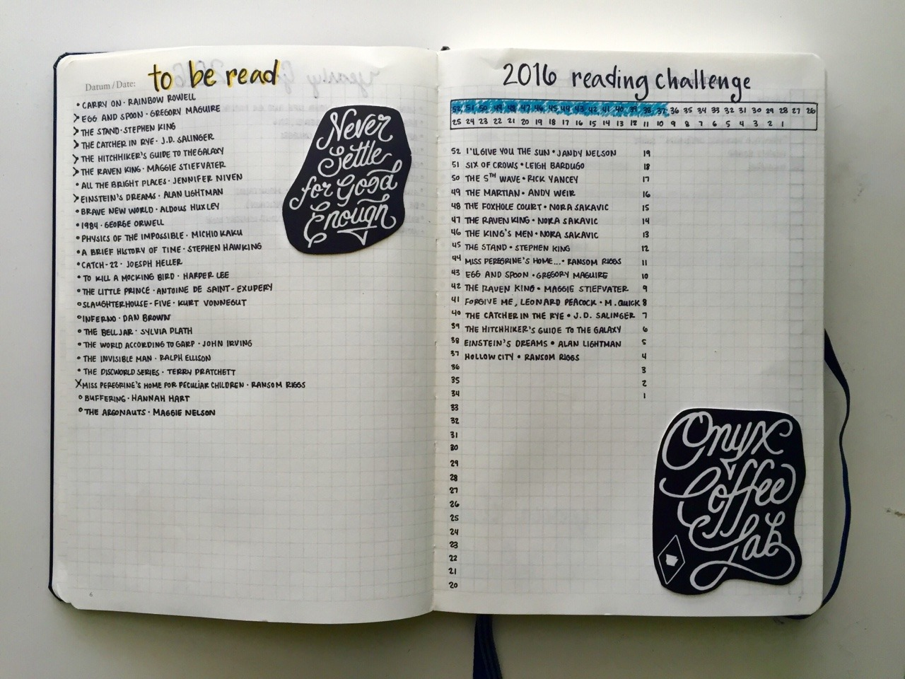
7. Is the text clearly organized?
Hetherington (1985)

Slide 30
8. Are the main ideas repeated enough?
Hetherington (1985)

Slide 31
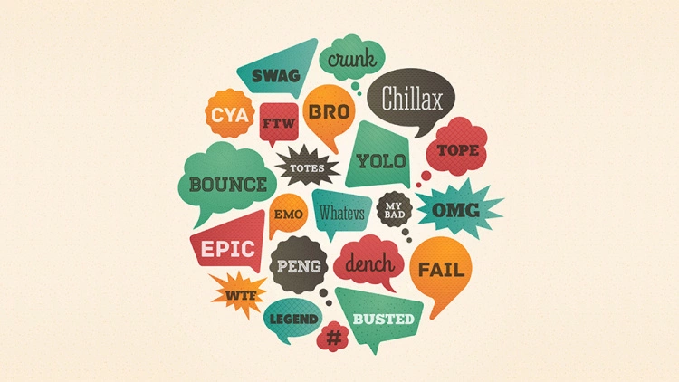
9. Are there too many new words?
Hetherington (1985)

Slide 32
10. Is it too vague for students?
Hetherington (1985)

Slide 33
11. Is the grammar clear?
Hetherington (1985)

Slide 34
12. Is the task appropriate? Do the students have the skills to read this?
Hetherington (1985)

