Slide 1
Warm up
Pre-Read
Teacher Read
Test
Students Read
Review

Slide 2
Pre-Reading Activities

Slide 3
Warm Up and Pre-Reading
Warm Up
Pre-Reading
Goal = Students should guess the topic.
Goal = Prepare the students for the reading.

Slide 4
Warm Up
Guess the topic
Indirect
Things about the topic
How are you? How is the weather?

Slide 5
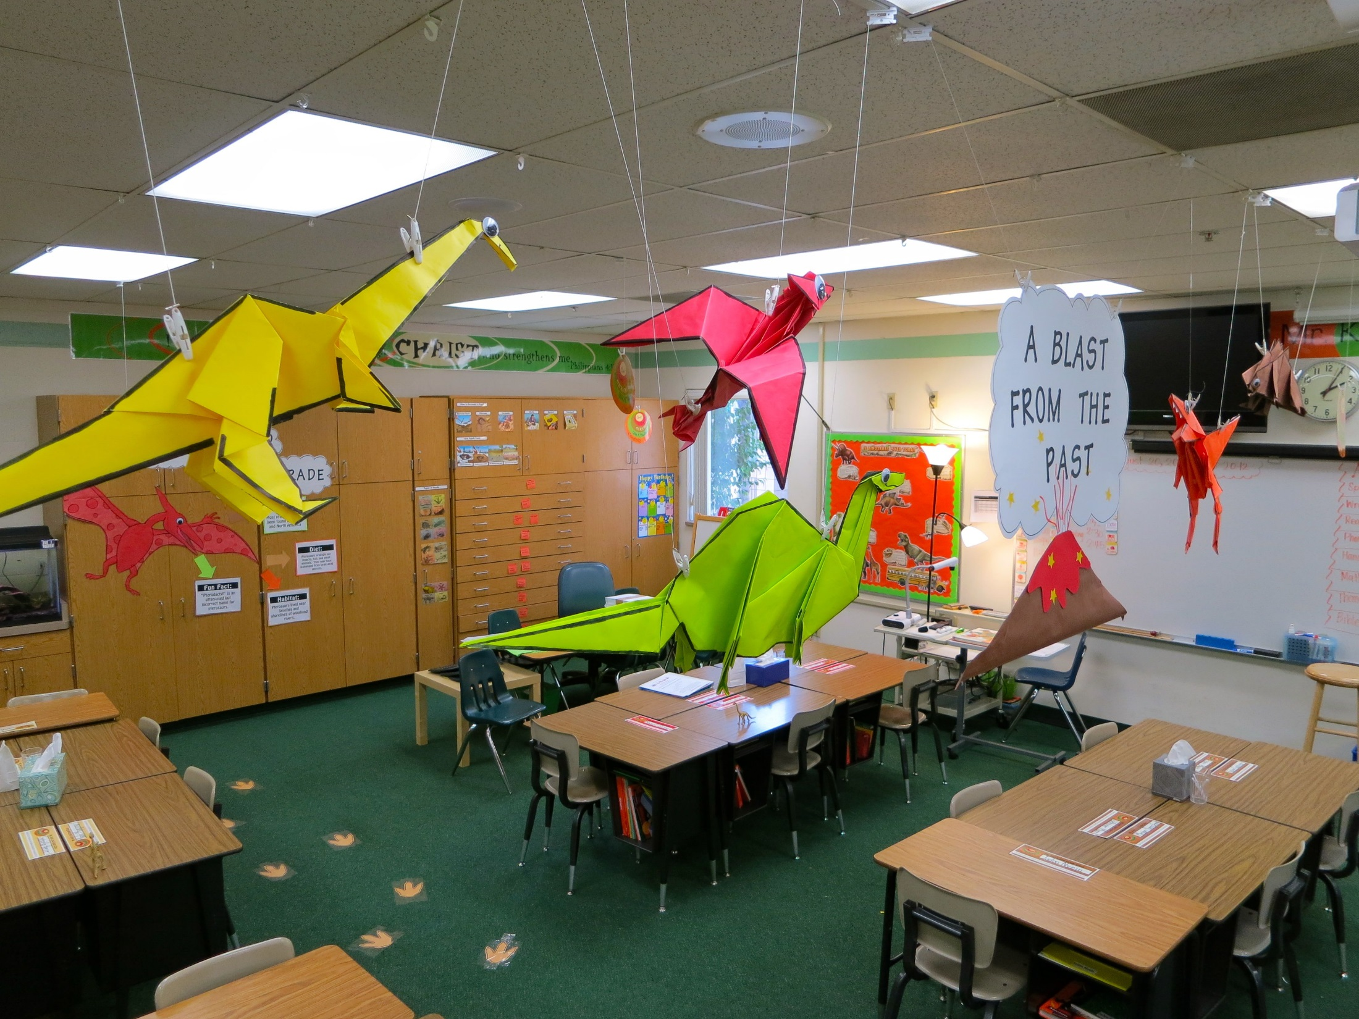
Preparing the Classroom

Slide 6
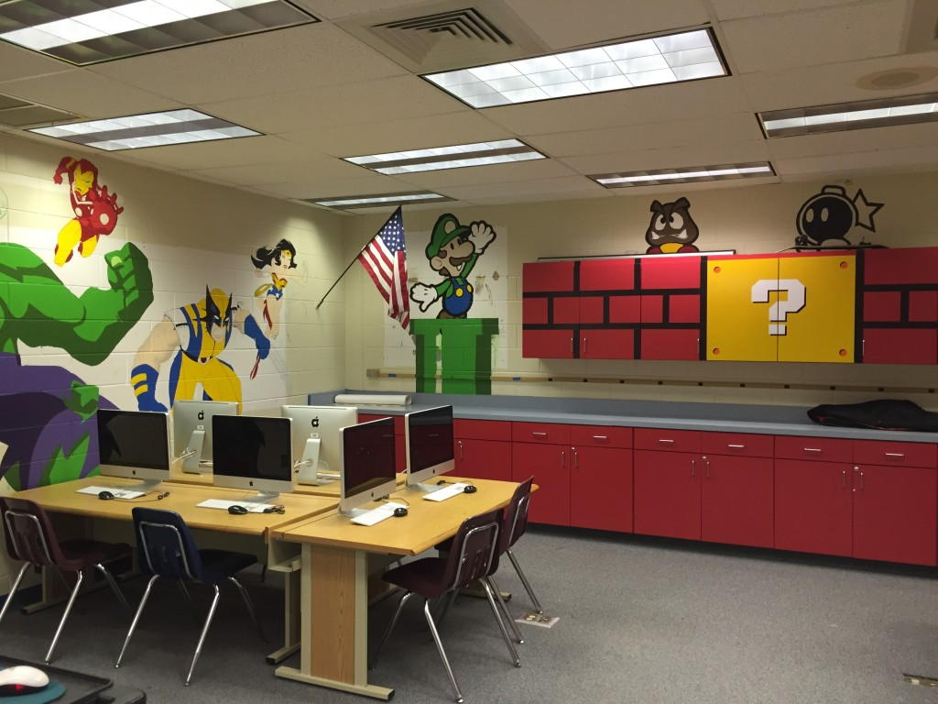

Slide 7
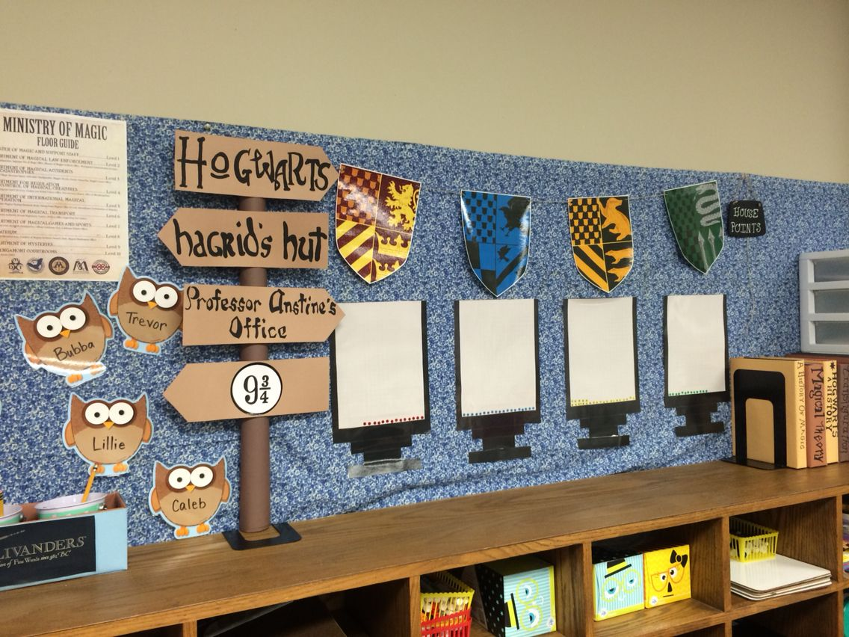

Slide 8
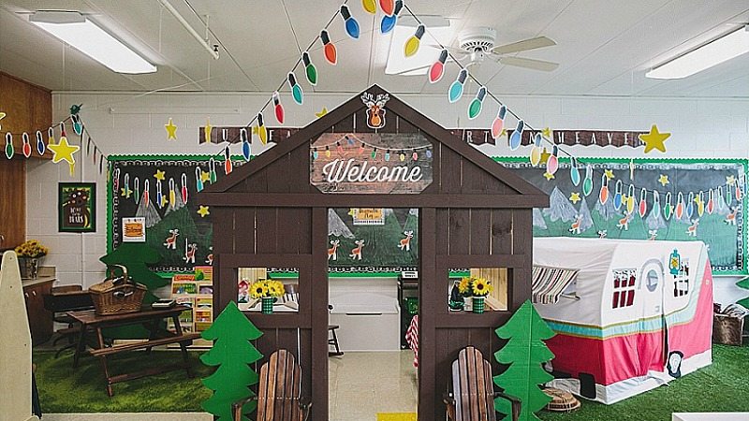

Slide 9
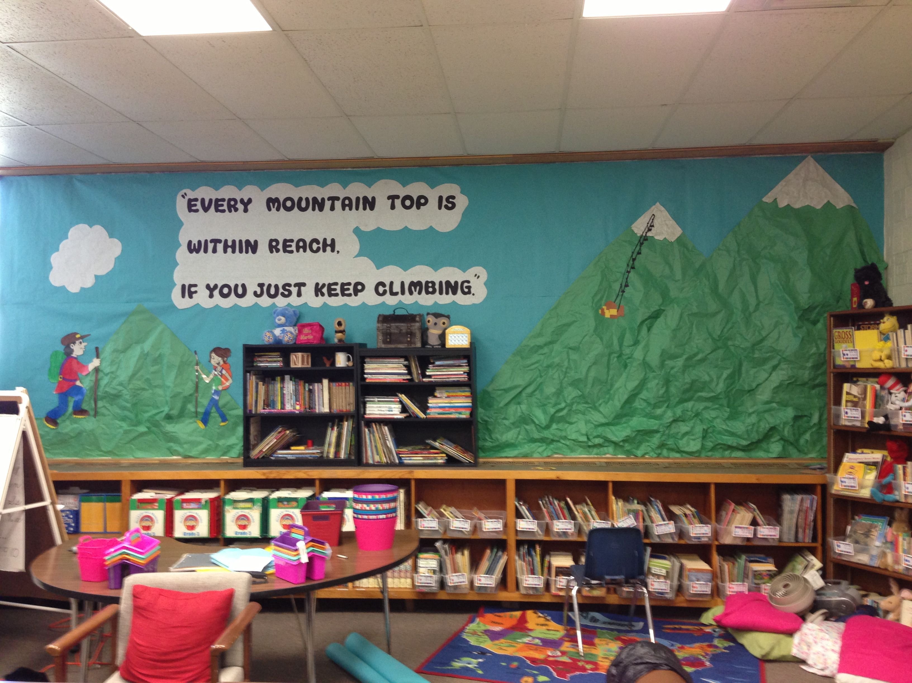

Slide 10
What do they have in common?

Slide 11
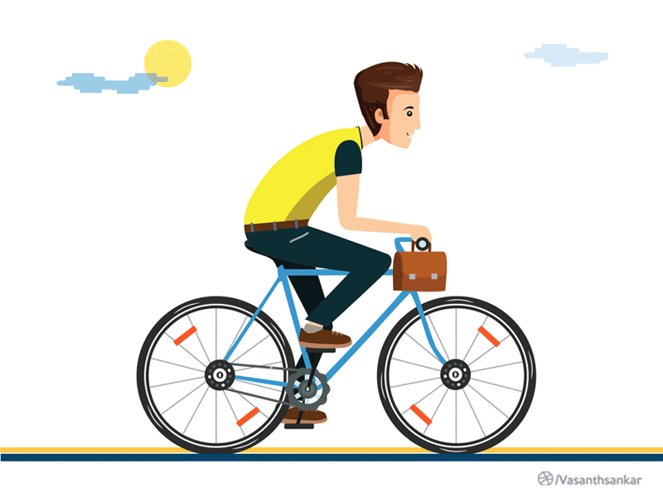
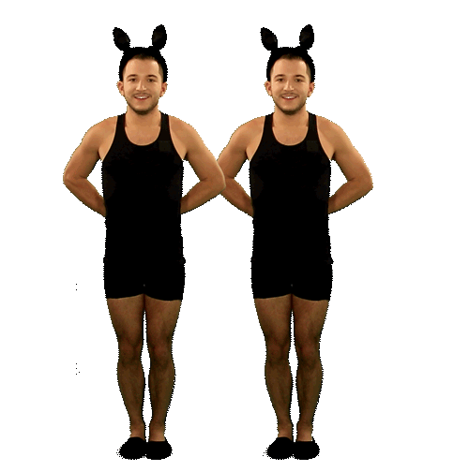
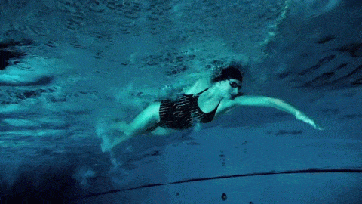
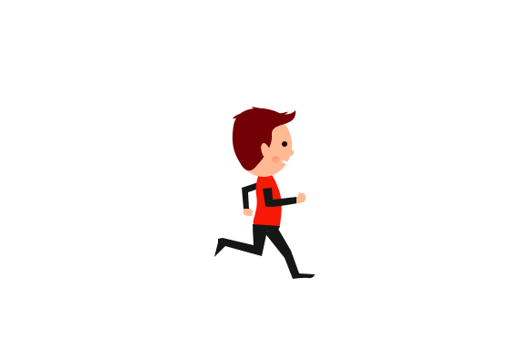
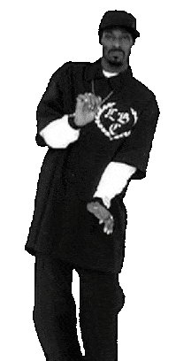
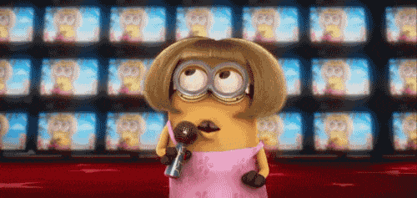
What do they have in common?

Slide 12
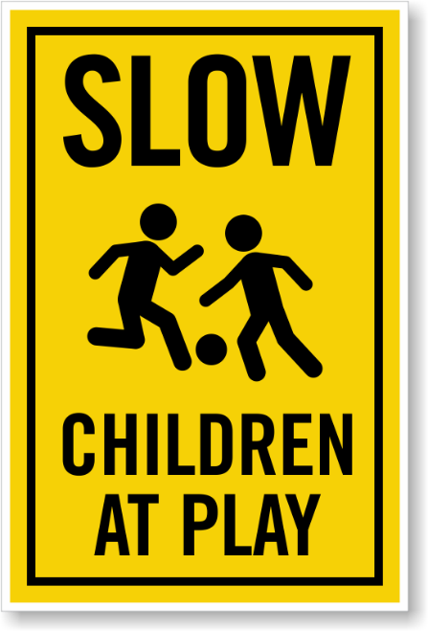
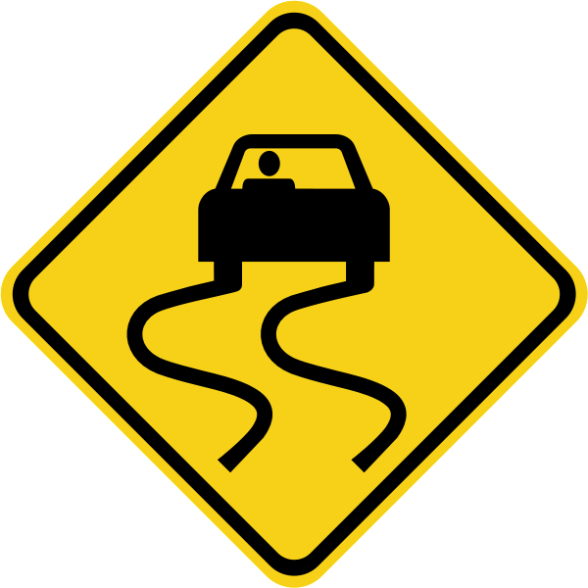
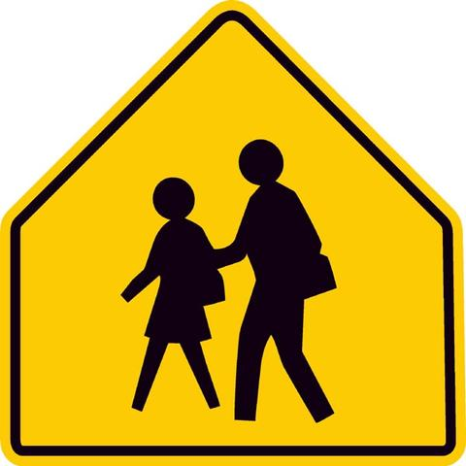
Which one doesn’t belong?

Slide 13
What do they have in common?
Today I woke up at 7:30am.
I brushed my teeth at 8:00.
I went to school at 8:30.
What did you do today?

Slide 14
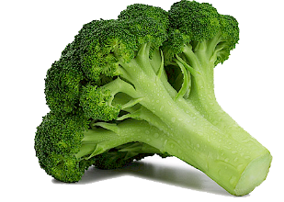
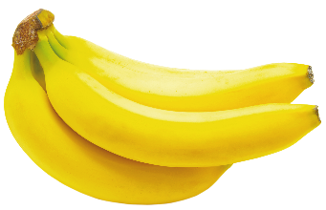
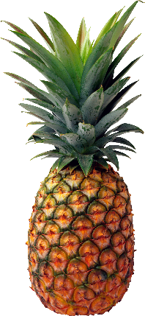
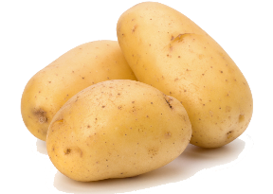
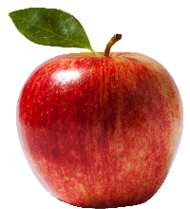
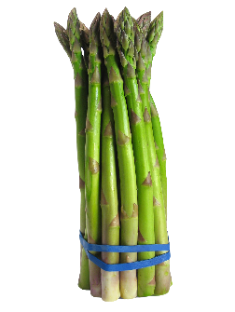
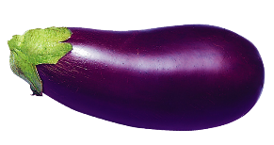
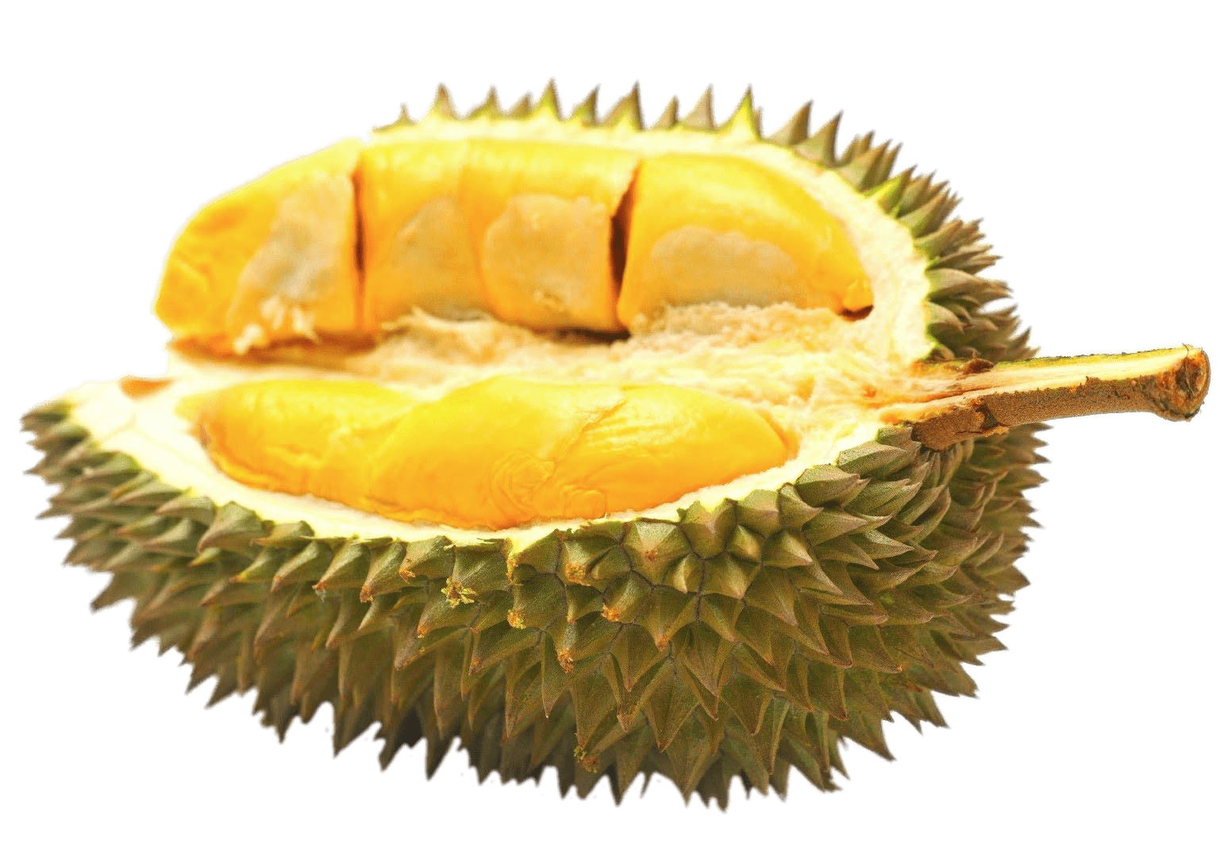
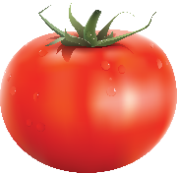
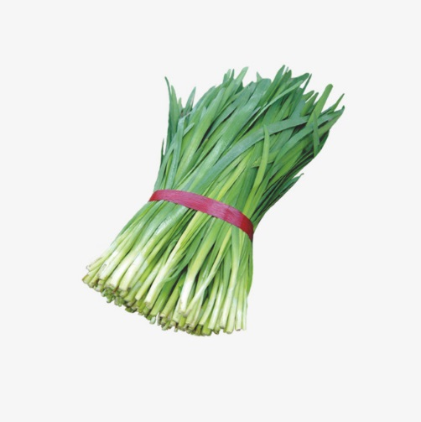
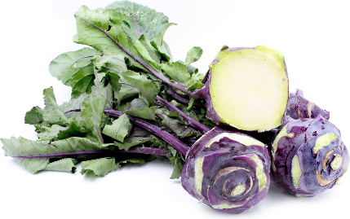
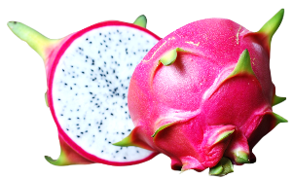
Grouping
Fruits Vegetables

Slide 15
Brainstorming

Slide 16
Capital Cities
Students write down as much as they can think of.
Have students read their answers.
If an answer is the same as another group, cross it out.

Slide 17
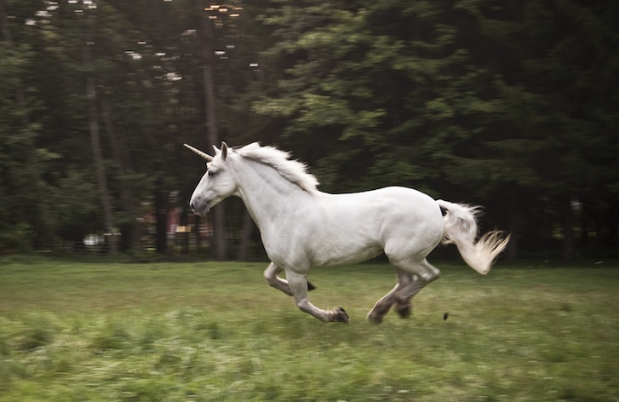
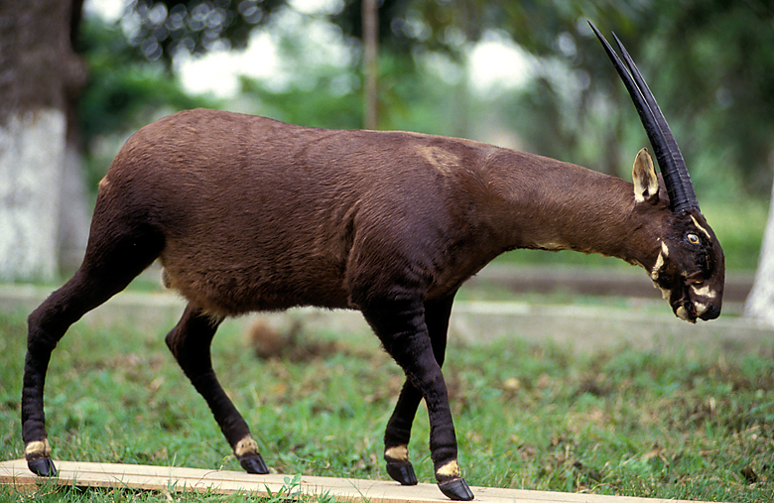
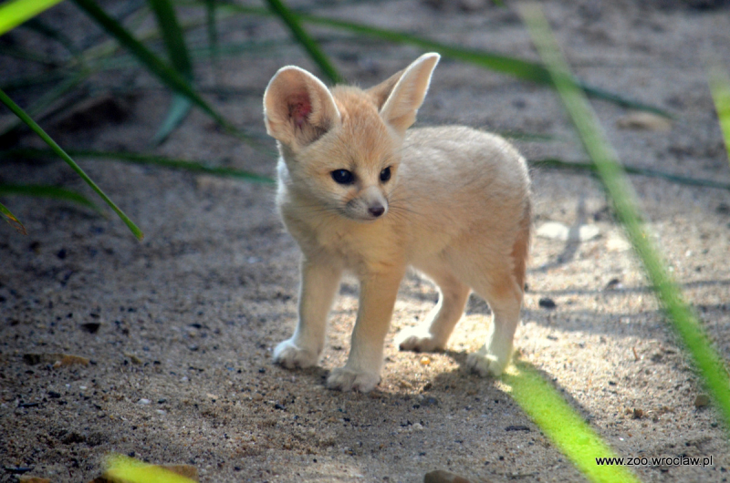
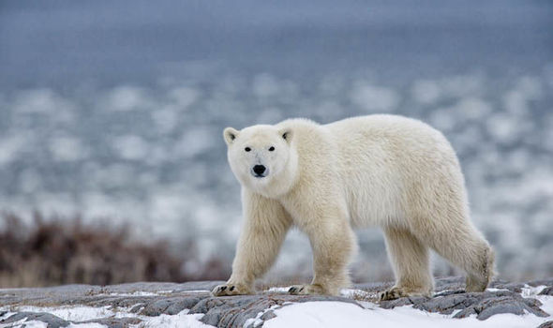
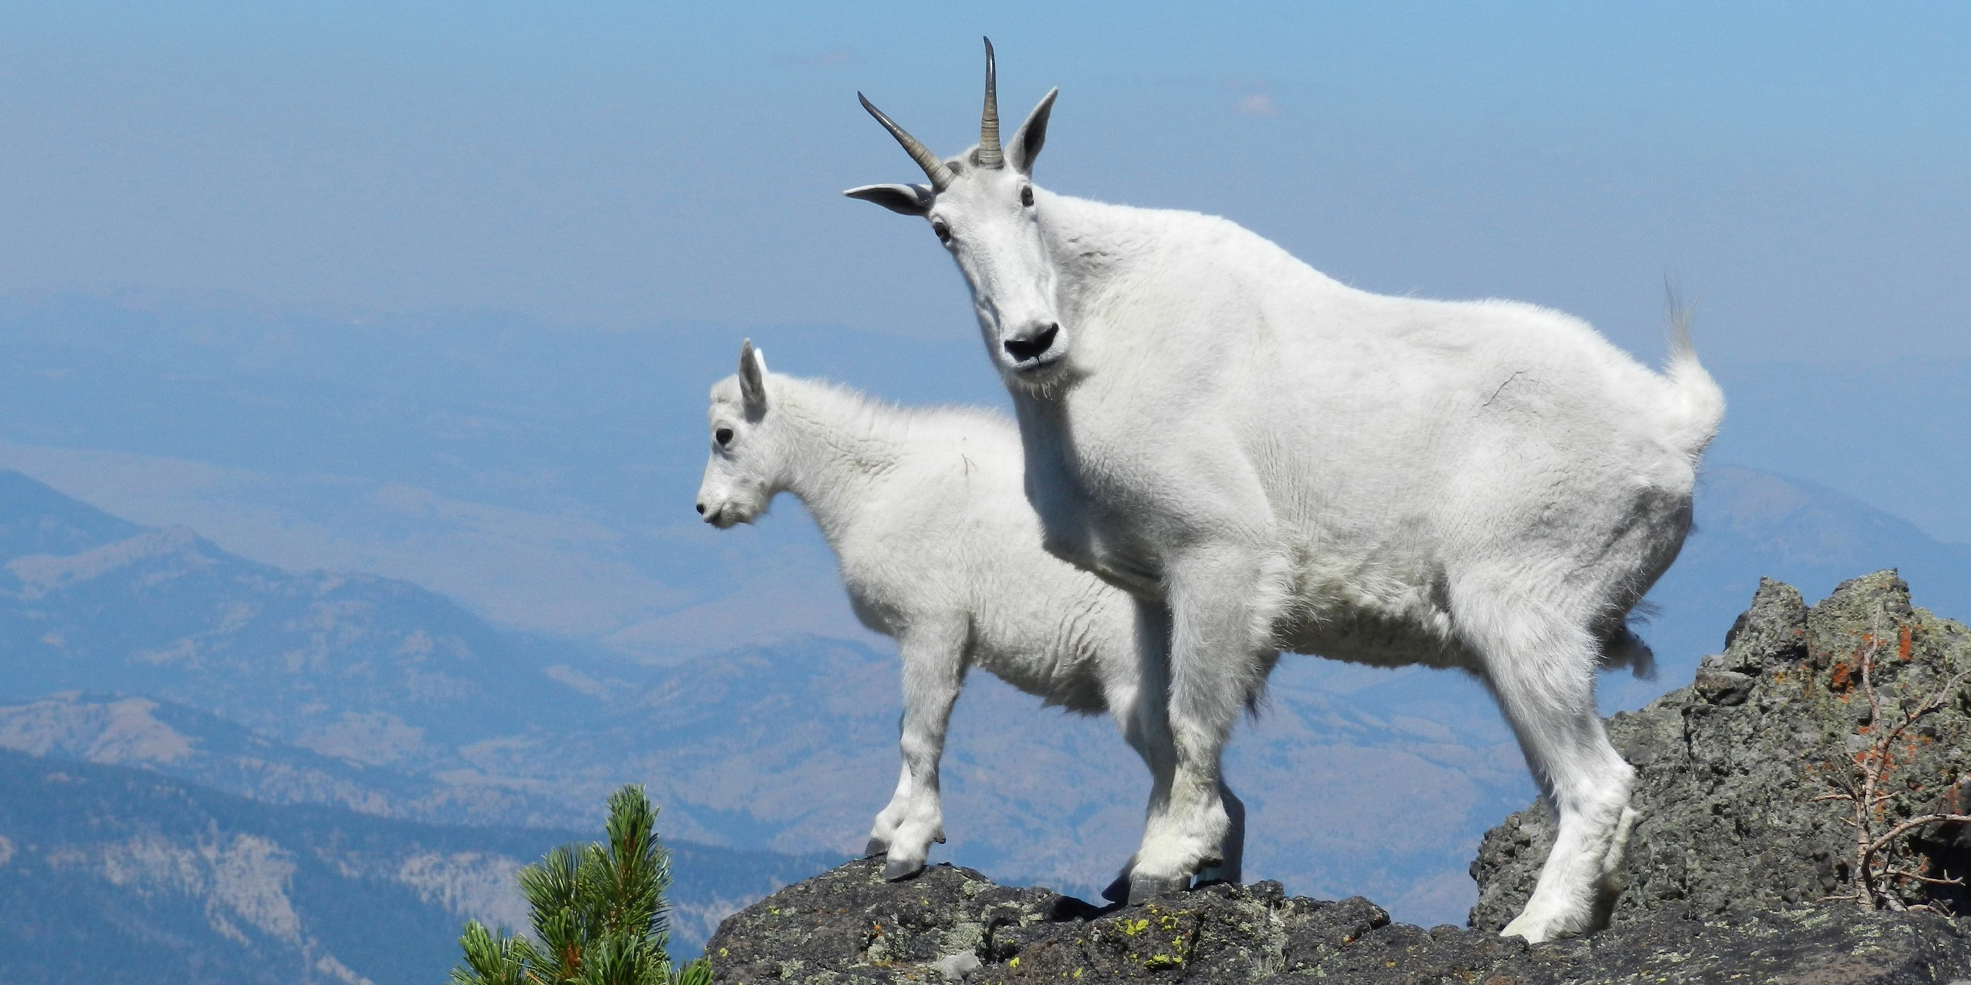
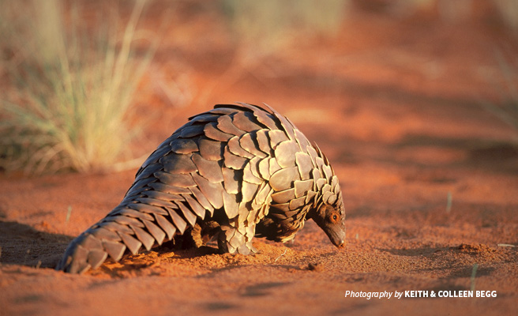
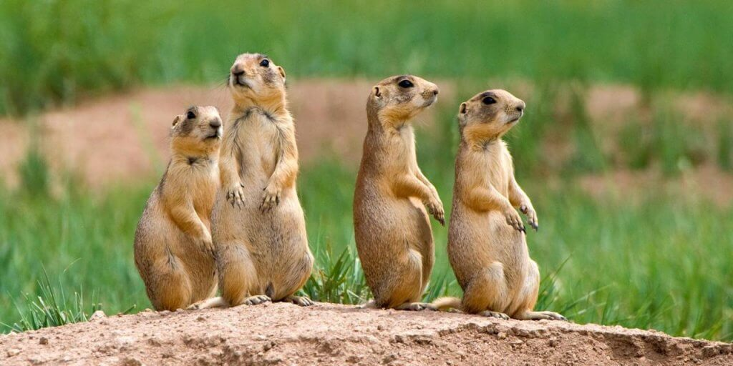
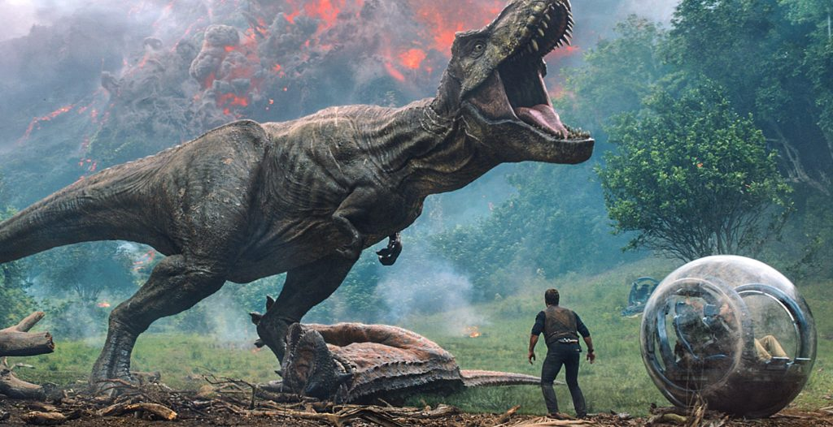
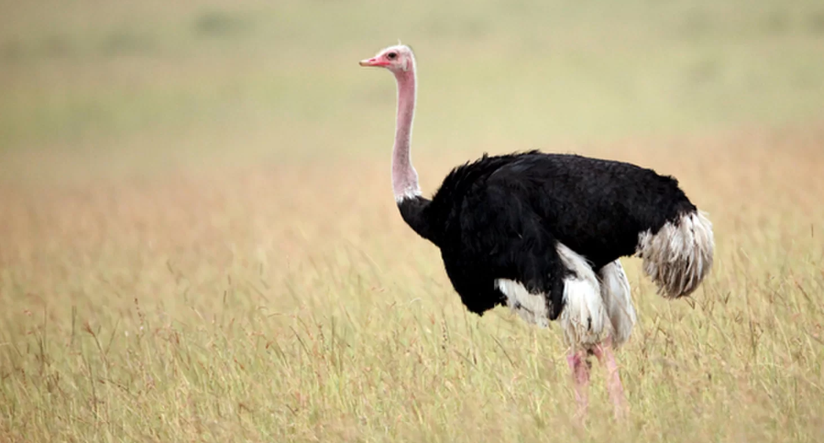
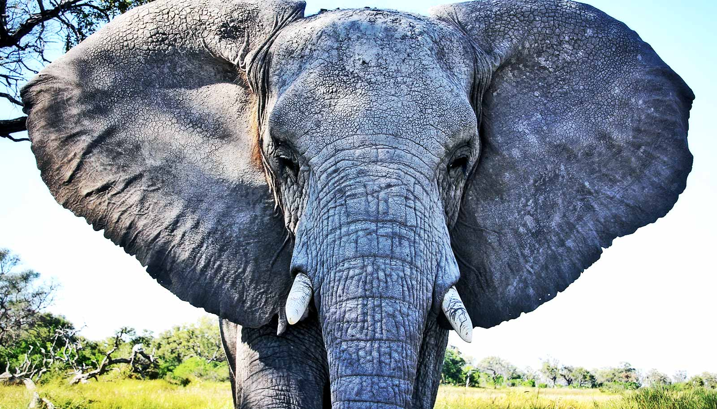
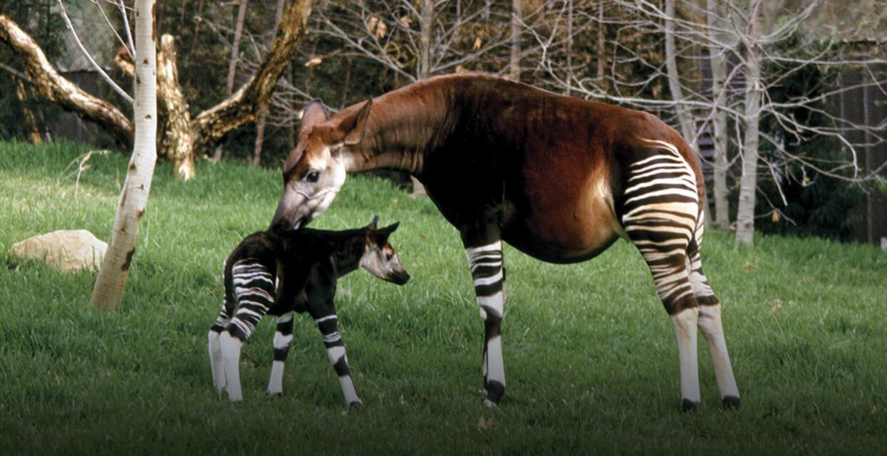
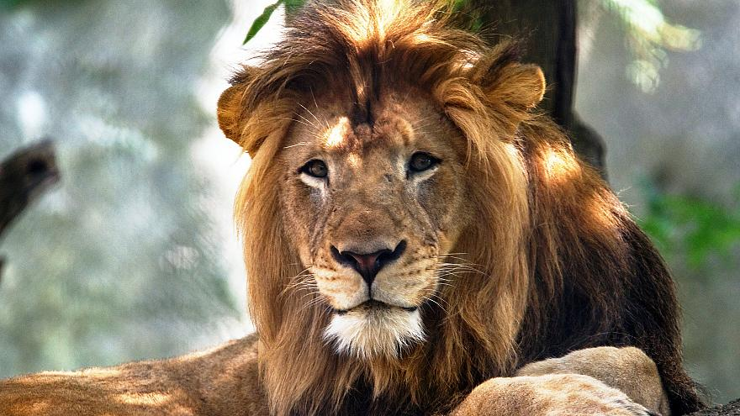
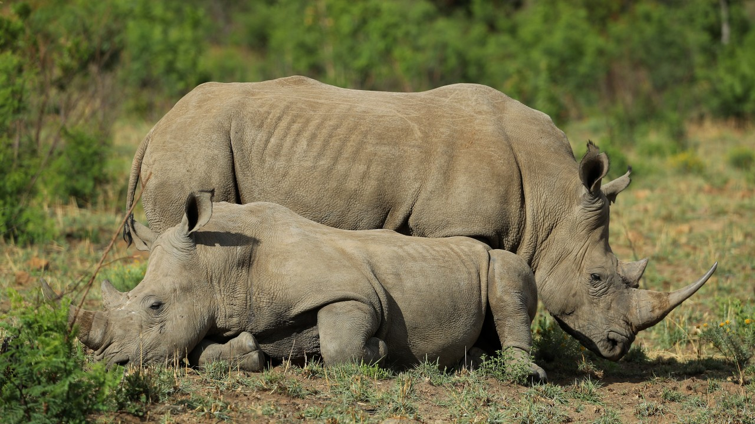
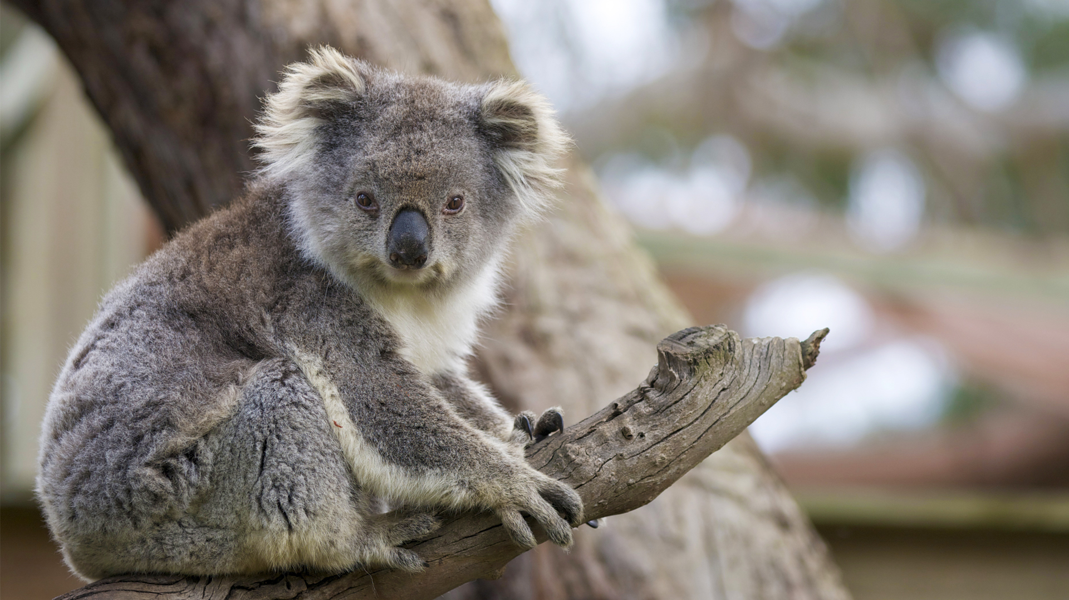
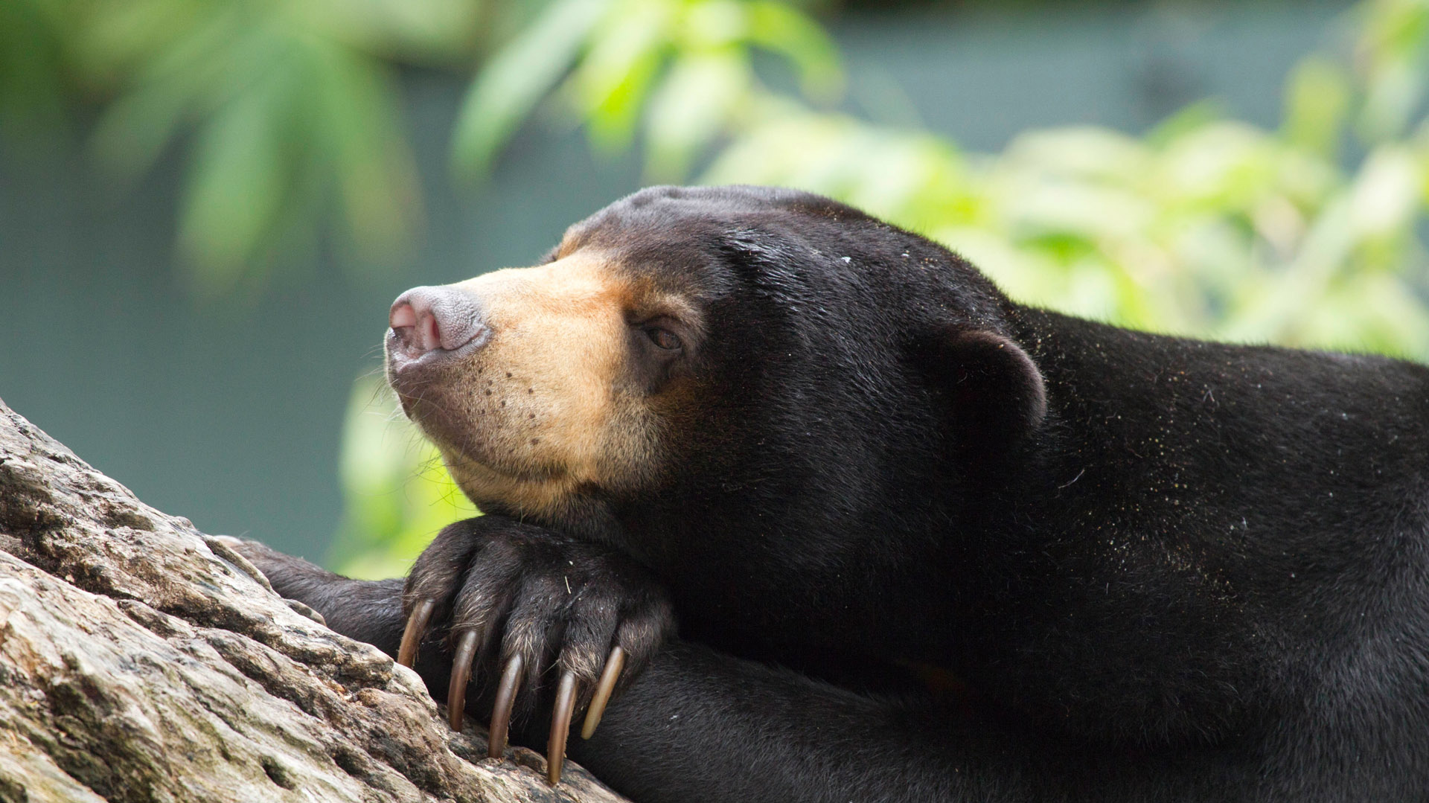
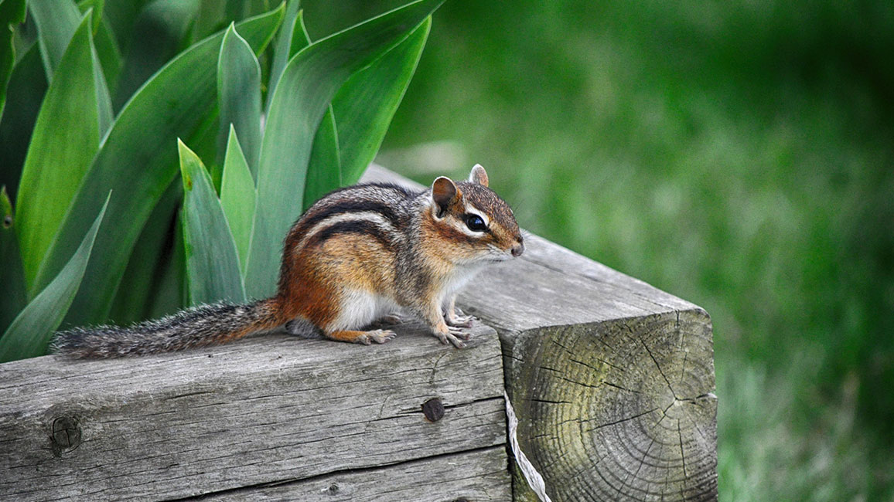
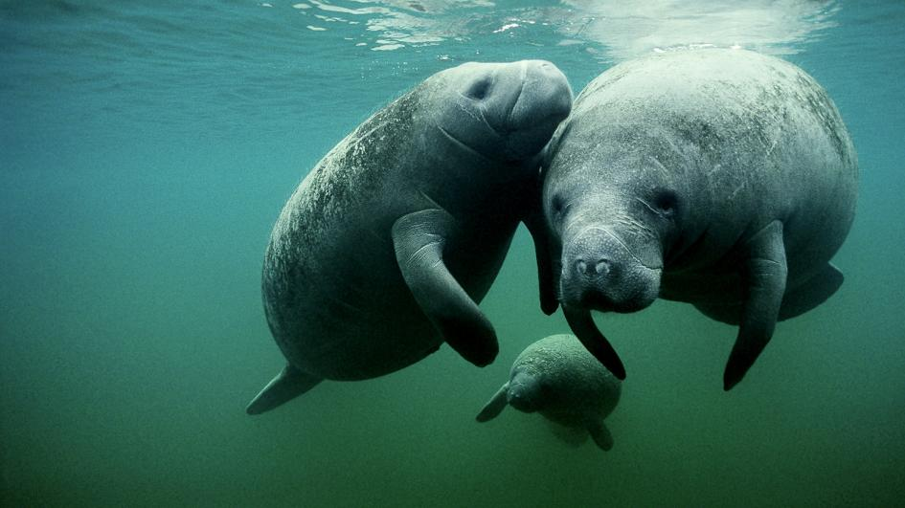
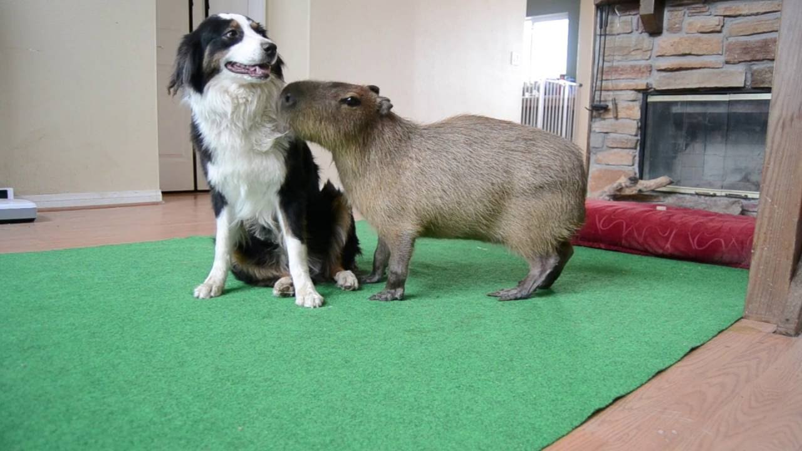
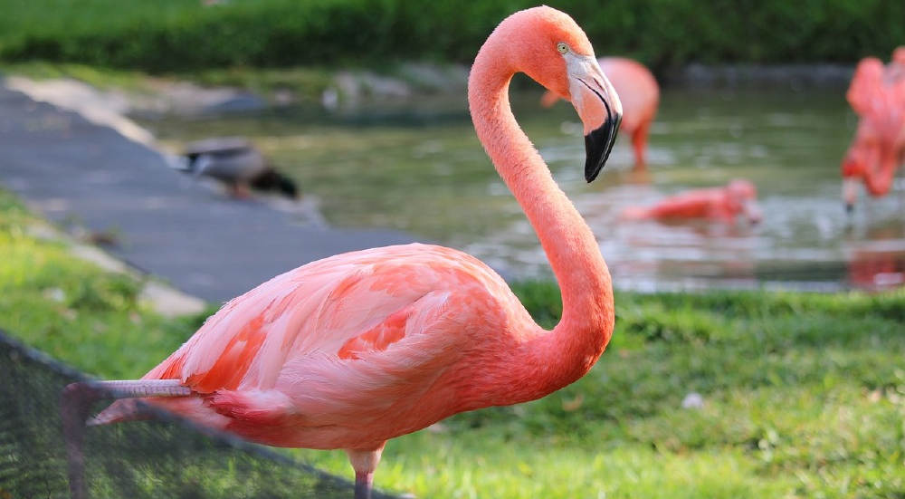
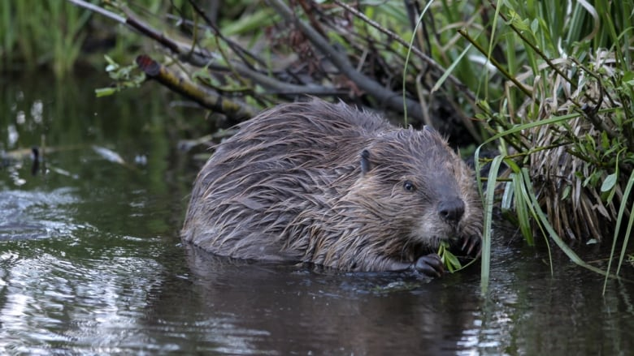
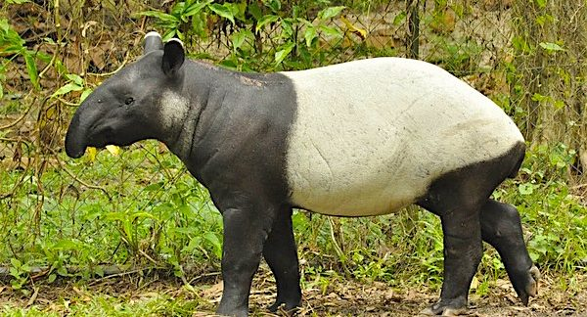
Tim’s Zoo
What animals are there in my zoo?

Slide 18
20 Questions

Slide 19
20 Questions
Guess what the topic is…
You can ask 20 questions.
The answers are Yes / No

Slide 20
Leading Questions

Slide 22
Leading Questions
Asking a series of questions to introduce students to the topic.

Slide 23
Leading Questions
How is the weather?
Is it colder or warmer outside?
Would you go outside now?
What should you wear when you go outside?
How is the weather in Australia now?
Would you wear your jacket there?
What should you wear when it is hot?

Slide 24
Pre-Reading
Elicit information about topic
Provide background knowledge
Introduce vocabulary / sentence structure

Slide 26
Scanning Skimming

Slide 27
Skimming and Scanning
Skimming
Scanning
Goal = Students have an overview of the text.
Goal = Students look for particular information in the text.

Slide 28
Skimming vs Scanning
Teaching these techniques are useful for older students.

Slide 29
Previewing

Slide 31
Previewing
Have the students guess what will happen in the reading.
From the “warm up”, they will already know the topic.
The use of “if” statements can help.

Slide 32
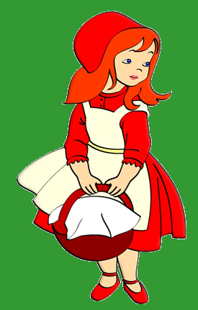
Example:
Today’s story is about a girl who gets lost in the woods.
What are some dangerous things in the forest?
If you met a wolf, what would you do?
What do you think the girl does?

Slide 33
Targeted Vocabulary

Slide 34
Targeted Vocabulary
We have already discussed some vocabulary games.
Vocabulary they will find in the story.

Slide 35
Targeted Sentence Structure

Slide 36
Targeted Sentence Structure
Similar to vocabulary.
If there is a repeated structure in the story, it may be beneficial for the students to have some experience and exposure to it before reading.
This is also true for targeted language.
Fill in the blanks and Make your own sentence activities work well.

Slide 37
May I have some ______?
water

Slide 38
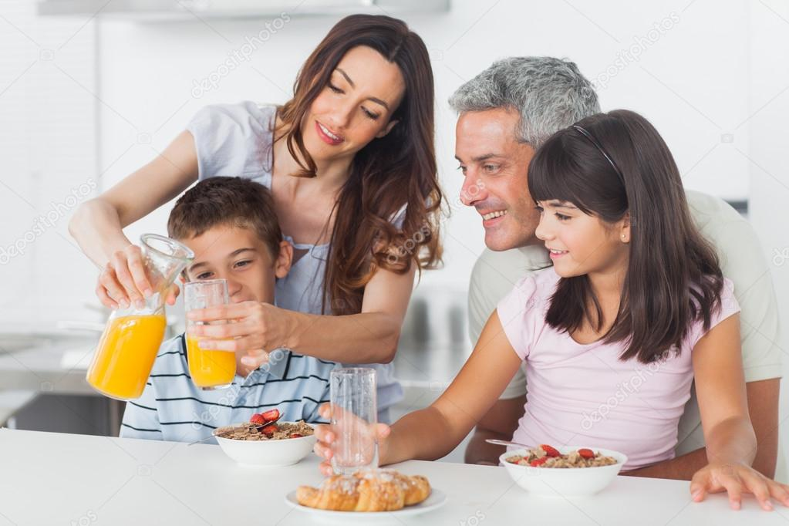
May I have some ______?
juice

Slide 39
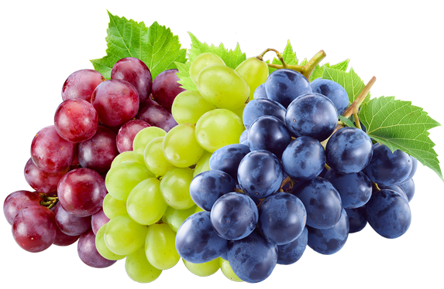
May I have some ______?
grapes

Slide 40
May I have some ______?
money

Slide 41
___________ some candies?
May I have

Slide 42
___________ the scissors?
May I have

Slide 43
______watch the movie?
May I

Slide 44
May I ______ the newspaper?
read

Slide 45
May I ______ the hamburger?
eat

Slide 46
May I ______ some water?
drink

Slide 48
Background Information

Slide 50
Background Information
A short lesson concerning the topic of the story.
It prepares the students for the text.
Without background information, the students may not understand the point of the reading.

Slide 51
Example

Slide 52
Duck Goose Swan

Slide 53
Ducks are large birds but Swans are some of the largest birds

Slide 54
Duckling Gosling Cygnet

Slide 56
Story Boards

